Slide 1



CloudMatcher: A Cloud/Crowd Service for Entity Matching
Yash Govind
University of Wisconsin-Madison
Joint work with Erik Paulson, Mukilan Ashok, Paul Suganthan G.C., Ali Hitawala, AnHai Doan, Youngchoon Park, Peggy L. Peissig, Erik LaRose, Jonathan C. Badger

Slide 2
Entity Matching
Table A
Table B
Name | Generic name | Strength
Dolorex | Acetaminophen/Phenyltolx | 500MG/ 30MG
Wart Remover | Salicylic Acid | 17%
Maki-DM | Guaifenesin/Dextromethorphan | 500MG/ 300MG
Name | Generic name | Strength
Q-Tussin DM | Guaifenesin/Dextromethorphan | 100-10MG/5
Dolorex | Acetaminophen/Phenyltolx | 500MG-30MG
Critical in numerous health informatics application
  Matching genes, proteins, patients in EHR, etc.

Slide 3
Current State of the Art
EM is well-known to be difficult
  raises both accuracy and scalability challenges
Many EM algorithms/systems have been developed
Today it is still very difficult for domain scientists to use these systems
  non-trivial and time consuming to install and learn to use
  most do not scale to large tables (e.g., 100K tuples)
  often use machine clusters, which scientists do not want to manage
  often requires scientists to have EM expertise (e.g., string matching)
  do not allow collaboration (from crowd or a team of people)

Slide 4
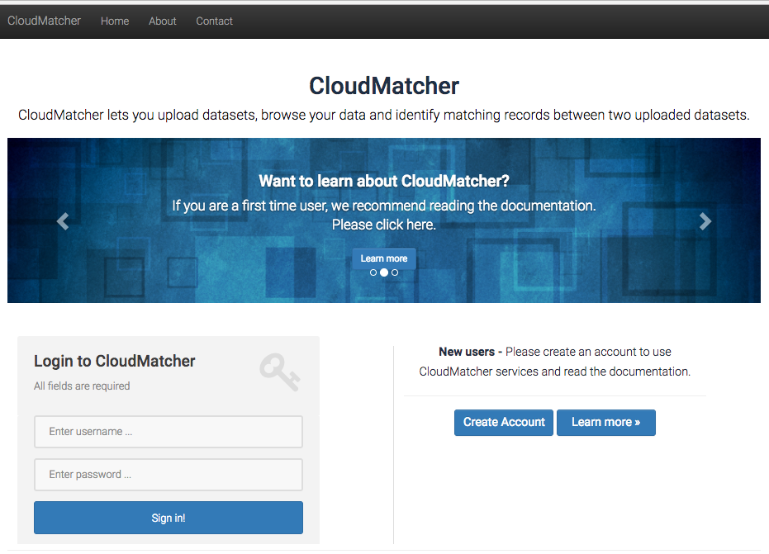
Our Solution: CloudMatcher

Slide 5
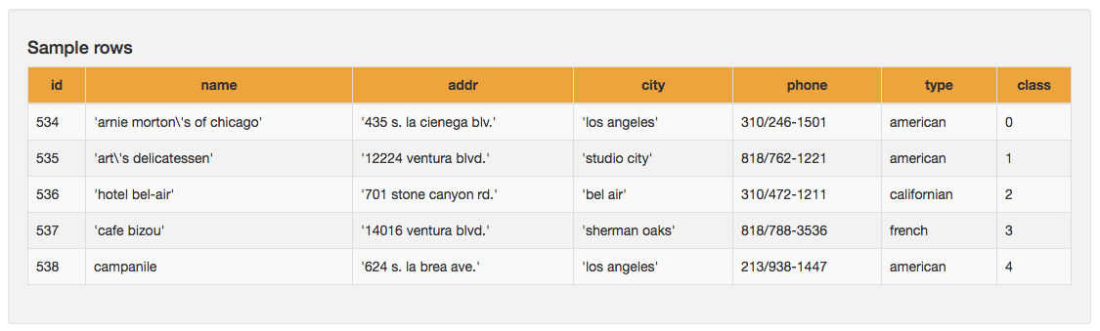
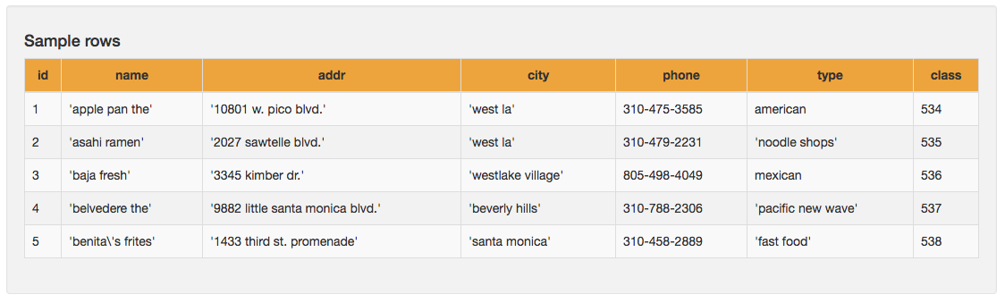
Example: Matching Tables A & B
Table A
Table B

Slide 6
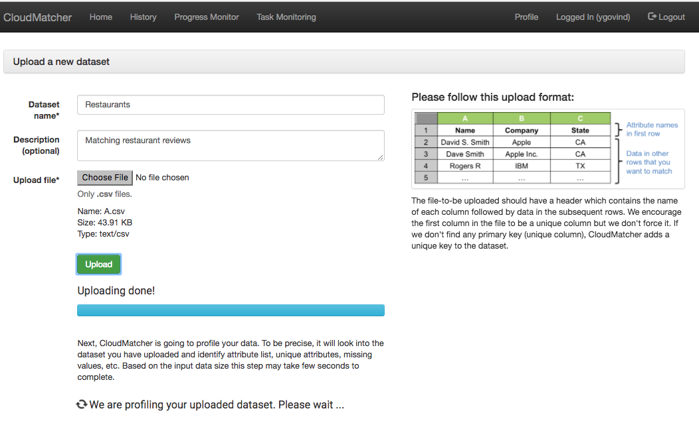
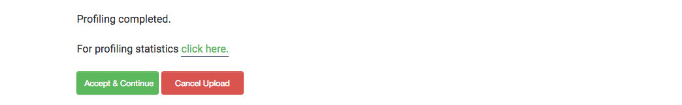
Uploading Table A

Slide 7
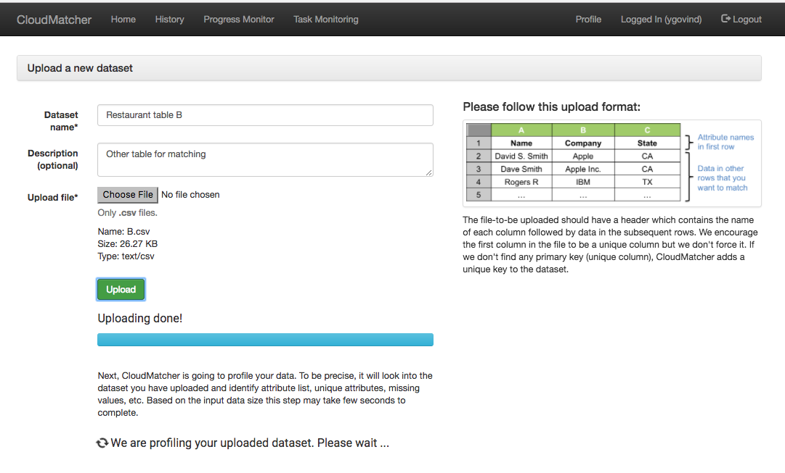
Uploading Table B

Slide 8
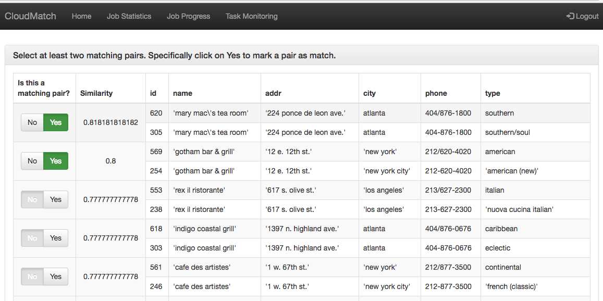
Labeling To Seed Active Learning
Label at least 2 positive pairs

Slide 9
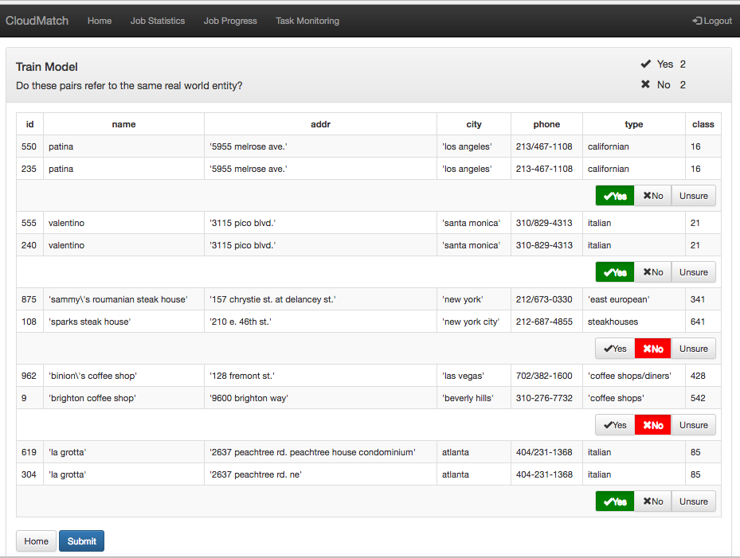
Labeling for Active Learning

Slide 10
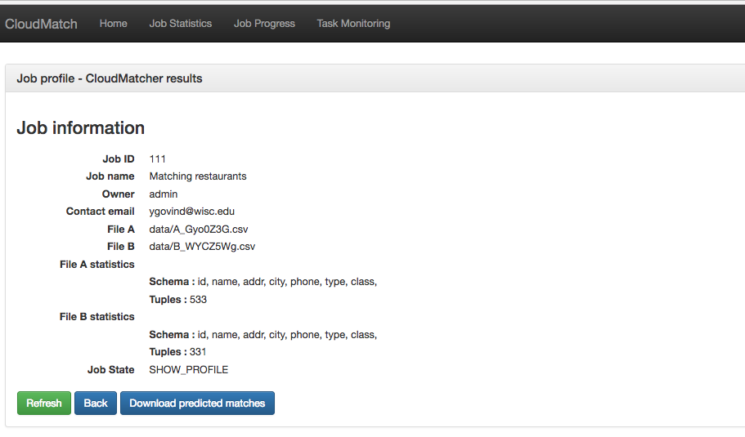
Returning Matches Between Two Tables
Sample matching pairs
Table A id | Table B id
534 | 219
535 | 220
536 | 221
537 | 222
538 | 223
539 | 224

Slide 11
Important Characteristics of CloudMatcher
Straightforward and easy to use
  No installation hassles
  No need to learn/setup complicated systems
No EM knowledge required to use
User performs simple actions
  Labeling tuple pairs as matched/no-matched
  Or, outsource labeling to crowd of workers
Scalability
  Can handle tables of millions of tuples
  Automatically add machine resources as necessary

Slide 12
Current Status
Version 1.0 has been deployed at cloudmatcher.io
Used for EM tasks at UW-Madison data science projects, and at several organizations
  e.g., applied economics, Marshfield Clinic, Johnson Controls, WalmartLabs, non-profit organizations, American Family Insurance
Version 2.0 currently under development
Will be made available for the public
Code will be open sourced soon

Slide 13

Blocking and Matching
a
b
c
A
Blocking
(a,d)
(b,e)
(c,d)
(c,e)
Matching
(a,d) Y
(b,e) N
(c,d) Y
(c,e) Y
de
B

Slide 14

The Corleone Solution
Gokhale, Chaitanya, et al. "Corleone: Hands-off crowdsourcing for entity matching." Proceedings of the 2014 ACM SIGMOD international conference on Management of data. ACM, 2014.
Tables
A
Blocker
Candidate
tuple
pairs
Matcher
Predicted
matches
User
B

Slide 15
Blocking in Corleone
Takes sample S from A X B (without materializing it)
Trains a random forest F on S (to match tuple pairs)
  using active learning, where crowd labels pairs
Example random
forest F for
matching books
isbn_match
title_match
N
Y
N
Y
No
#pages_match
No
publisher_match
N
Y
N
Y
No
Yes
No
Yes
Extracts candidate blocking rules from F
(isbn_match = N) No
(isbn_match = Y) and (#pages_match = N) No
(title_match = N) No
(title_match = Y) and (publisher_match = N) No

Slide 16
Blocking in Corleone
Use the crowd to evaluate precision of extracted rules
Select a subset of rules & execute on A & B
Need to scale using big data framework (Hadoop)
For details see
Corleone [SIGMOD-14] & Falcon [SIGMOD-17]
(isbn_match = N) No
(isbn_match = Y) and (#pages_match = N) No
(title_match = N) No
(title_match = Y) and (publisher_match = N) No
(isbn_match = N) No
(title_match = N) No

Slide 17
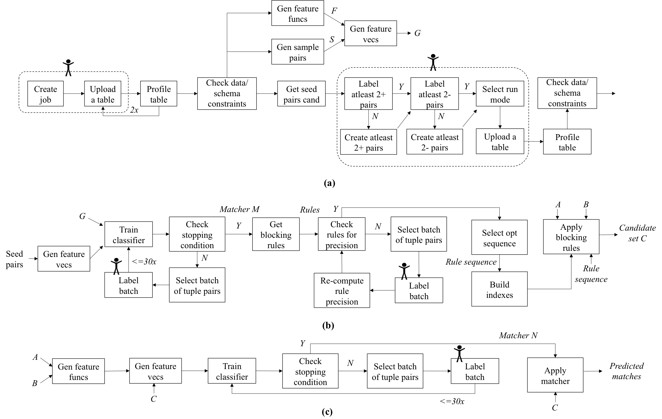
CloudMatcher: the Workflow

Slide 18
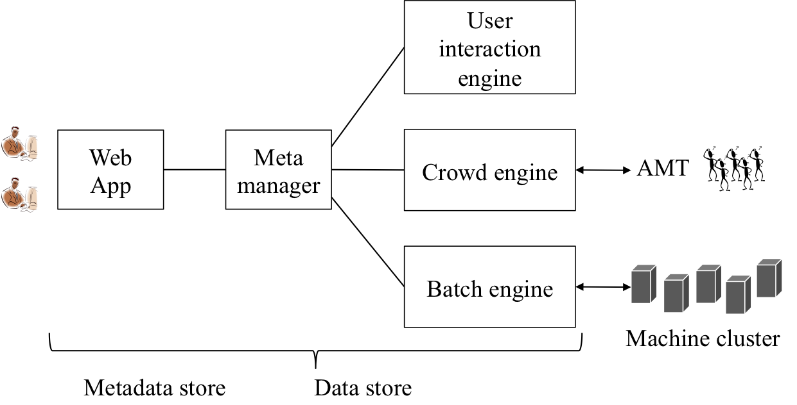
CloudMatcher: Solution Architecture
Current workflow management systems
  can’t effectively handle DAGs involving user interaction
Our solution

Slide 19
Empirical Evaluation
Data Set | Table A | Table B | Description
People | 9751 | 706,878 | Non-profit org. data to track political events of local elected officials in WI
Address | 90,673 | 231,081 | Addresses of JCI customers
Vendors | 50,295 | 50,292 | List of JCI vendors
Vendors(no Brazil) | 28,152 | 28,149 | JCI vendors (excluding Brazil vendors)
Drugs | 446,048 | 440,048 | Matching drug description for Marshfield Clinic
Ran CloudMatcher on a 4-node Amazon EC2 cluster
  Each node has 16-core Intel Xeon 2.4GHz proc. and 16GB RAM
Mechanical Turk settings
  Turker qualifications: ≥ 100 approved HITs with ≥ 95% approval rate
  payment: 2 cents per question

Slide 20
Overall Performance
Data Set | Accuracy (%) |  | Cost (# Questions) | Run Time |  |  | Candidate Set |C|
 | Precision | Recall |  | Machine Time | Crowd Time | Total Time
People | 93.75 – 96.32 | 95.50 – 97.76 | $57.6 (960) | 23m | 23h 14m | 23h 37m | 3013
Addresses | 93.22 – 95.72 | 76.93 – 81.01 | $72.0 (1200) | 38m | 36h 48m | 37h 26m | 1,095,414
Vendors | 29.95-38.04 | 91.89-98.10 | $69.6 (1160) | 58m | 30h 31m | 31h 29m | 6,754,287
Vendors (no Brazil) | 95.44 – 97.75 | 88.82 – 92.41 | $72 (1200) | 22m | 22h 19m | 22h 41m | 177,337
Drugs | 99.14 – 99.63 | 98.45 – 99.14 | User labeling (1162) | 8h 40m | 1h 10m | 9h 50m | 143,479,768

Slide 21
Conclusions
EM is critical for health informatics
Current EM systems are very difficult to use
We have developed CloudMatcher
  a cloud/crowd solution
  very easy to use
  initial results promising, but point to more work
Current system at cloudmatcher.io will be available to public, code will be open sourced

