Slide 1

Magellan: Toward Building Entity Matching Management Systems
Pradap Konda
University of Wisconsin-Madison
Joint work with Sanjib Das, Paul Suganthan G.C, AnHai Doan, Adel Ardalan, Jeffrey R. Ballard, Han Li, Fatemah Panahi, Haojun Zhang, Jeff Naughton, Shishir Prasad, Ganesh Krishnan, Rohit Deep, Vijay Raghavendra
@WalmartLabs

Slide 2
Entity Matching
Table A
Table B
Name | City | State
Dave Smith | Madison | WI
Joe Wilson | San Jose | CA
Dan Smith | Middleton | WI
Name | City | State
David D. Smith | Madison | WI
Daniel W. Smith | Middleton | WI

Slide 3
Current Work
Focuses on blocking and matching
Table A
Name | City | State
Dave Smith | Madison | WI
Joe Wilson | San Jose | CA
Dan Smith | Middleton | WI
a₁
a₂
a₃
(a₁, b₁)
(a₁, b₂)
(a₃, b₁)
(a₃, b₂)
(a₁, b₁) +
(a₁, b₂) -
(a₃, b₁) -
(a₃, b₂) +
block on
state = state
match
Table B
Name | City | State
David D. Smith | Madison | WI
Daniel W. Smith | Middleton | WI
b₁
b₂
Develops blocking and matching algorithms

Slide 4
Need More Effort on Building EM Systems
Truly critical to advance the field
EM is engineering by nature
Can’t keep developing EM algorithms in vacuum
  Akin to continuing to develop join algorithms without rest of RDBMS
Must build systems to evaluate algorithms,
integrate R&D efforts, make practical impacts
As examples, RDBMSs and Big Data systems were critical to advancing their respective fields
But what kind of systems we should build, and how?

Slide 5
Motivating Example
1M tuples
A
block
match using supervised learning
1M tuples
B
How is this done today in practice?
Development stage: find an accurate workflow,
using data samples
Production stage: execute workflow on entirety of data

Slide 6
Development Stage
select a good blocker:
blocker X, blocker Y
select a good matcher:
matcher U, matcher V
C_{x}
S
A’
(-,-)
(-,-)
(-,-)
(-,-)
(-,-)
(-,-)
(-,-)
(-,-)
blocker X
C_{x}
sample
B’
label
cross-validate
matcher U
G
A’
0.89 F₁
(-,-) +
(-,-) -
(-,-) +
blocker Y
C_{y}
B’
0.93 F₁
cross-validate
matcher V
C_{x}
A
(-,-)
(-,-)
(-,-)
(-,-)
(-,-)
(-,-) +
(-,-) +
(-,-) -
(-,-) -
(-,-) +
A’
yes
sample
blocker X
matcher V
quality
check
B
B’
no

Slide 7


Production Stage
(-,-)
(-,-)
(-,-)
(-,-)
(-,-)
(-,-)
(-,-)
(-,-)
(-,-) +
(-,-) -
(-,-) +
(-,-) +
(-,-) -
(-,-) +
(-,-) -
(-,-) +
A
blocker X
matcher V
B
Scaling, quality monitoring, exception handling, crash recovery, …

Slide 8
Limitations of Current EM Systems
We examined 33 systems
  18 non-commercial and 15 commercial ones
Systems do not cover all steps of the EM task
  Focus mostly on blocking/matching
  Ignore sampling, labeling, debugging, exploring, cleaning, etc.
Hard to exploit a wide range of techniques
  SQL querying, keyword search, learning, visualization, extraction, outlier detection, crowdsourcing, etc.
Little or no guidance for users on solving the EM task
  Suppose user wants 95% precision and 80% recall, how to start
  Which step to take next? How to do a step?
Not designed from scratch for extendability
  Very difficult to customize, extend, patch systems
  Few systems are in an interactive scripting environment

Slide 9
Our Solution: Magellan
Facilities for Lay Users
GUIs, wizards, …
Power Users
Development Stage
Production Stage
How-to guide
Supporting tools
(as Python commands)
Data samples
How-to guide
Supporting tools
(as Python commands)
Original data
EM
Workflow
Python Interactive Environment
Script Language
PyData
eco
system
Data Analysis Stack
Big Data Stack
pandas, scikit-learn, matplotlib,
numpy, scipy, pyqt, seaborn,
…
PySpark, mrjob, Pydoop,
pp, dispy,
…

Slide 10
Examples of How-to Guides
select a good blocker
select a good matcher
How to debug
a blocker?
C_{x}
S
A’
(-,-)
(-,-)
(-,-)
(-,-)
(-,-)
(-,-)
(-,-)
(-,-)
blocker X
C_{x}
sample
B’
How to sample
and label?
label
cross-validate
matcher U
G
A’
0.89 F₁
(-,-) +
(-,-) -
(-,-) +
blocker Y
C_{y}
How to debug a matcher?
B’
0.93 F₁
cross-validate
matcher V
C_{x}
A
(-,-)
(-,-)
(-,-)
(-,-)
(-,-)
(-,-) +
(-,-) +
(-,-) -
(-,-) -
(-,-) +
A’
yes
sample
blocker X
matcher V
quality
check
B
B’
no

Slide 11
Examples of Tools for How-to Guides
select a good blocker
select a good matcher
How to debug
a blocker?
C_{x}
S
A’
(-,-)
(-,-)
(-,-)
(-,-)
(-,-)
(-,-)
(-,-)
(-,-)
blocker X
C_{x}
sample
B’
How to sample
and label?
label
cross-validate
matcher U
G
A’
0.89 F₁
(-,-) +
(-,-) -
(-,-) +
blocker Y
C_{y}
How to debug a matcher?
B’
0.93 F₁
cross-validate
matcher V
C_{x}
A
(-,-)
(-,-)
(-,-)
(-,-)
(-,-)
(-,-) +
(-,-) +
(-,-) -
(-,-) -
(-,-) +
A’
yes
sample
blocker X
matcher V
quality
check
B
B’
no

Slide 12
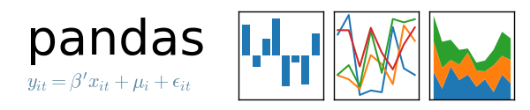












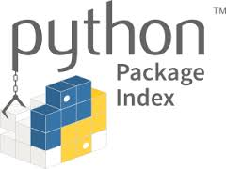




Build Tools on the PyData Ecosystem
Development stage does a lot of data analysis
  So build tools on data analysis stack in PyData
Production stage focuses on scaling
  So build tools on Big Data stack in PyData
PyData ecosystem
  Used extensively by data scientists
  86,800 packages (in PyPI)
  Data analysis stack
  Big data stack
  Tools to manage user work
  Software infrastructure to build tools
  Ways to manage/package/distribute tools
  Companies, conferences, books, etc.

Slide 13
Raises Numerous R&D Challenges
Developing good how-to guides is very difficult
  Even for very simple EM scenarios
Developing tools to support how-to guides raises many research challenges
  Accuracy, scaling
Novel challenges for designing open-world systems

Slide 14
Designing for an Open World
Closed-World Systems
Open-World Systems
RDBMS
System X
SQL queries
commands
Magellan
command x₁
command 1
command x₂
data
command 2
…
…
data
System Y
A
command y₁
A
command y₂
B
…
B
data
metadata
C
metadata
A.ssn is a key
metadata
A.ssn is a key
…
PyData ecosystem

Slide 15
Current Status of Magellan
Developed since June, 2015
7 major new tools for how-to guides
Uses 11 packages in PyData
Exposes 104 Python commands for users
Used as a teaching tool in data science classes at UW
Used extensively at
WalmartLabs, Johnson Controls, Marshfield Clinic

Slide 16
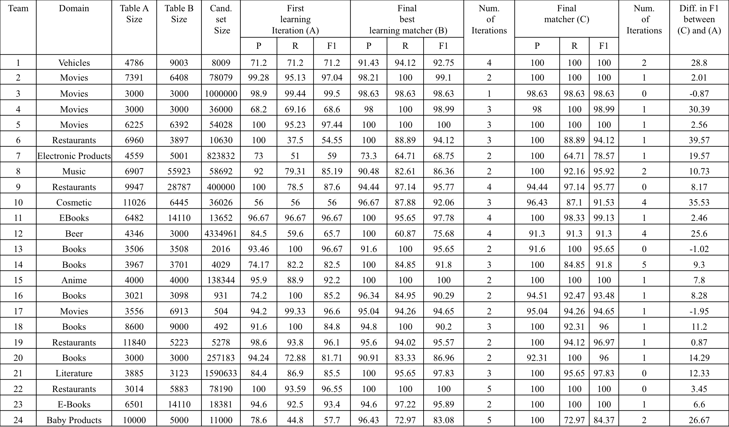
Experiments with 44 Students
Baseline: P = 56-100%, R = 37-100%, F1 = 56-99%
Magellan: P = 91-100%, R = 64-100%, F1 = 78-100%
  20 teams out of 24 achieved recall above 90%

Slide 17
Experiments with 44 Students
Tools for pain points were highly effective
Debugging blockers
  18 out of 24 teams used the debugger, for 5 iterations on average
  Debugger helps in (a) cleaning data
  (b) finding correct blocker types/attributes
  (c) tuning blocker parameters
  (d) knowing when to stop
Debugging matchers
  Teams performed 3 debugging iterations on average
  Actions performed include (a) feature selection
  (b) data cleaning
  (c) parameter tuning
Students extensively used visualization, extraction, cleaning, etc. (using PyData packages)

Slide 18
Magellan “in the Wild”
WalmartLabs
  Helped improve a system already in production
  Increased recall by 34%, while reducing precision by 0.65%
Johnson Controls
  Matched hundreds of thousands of suppliers for JCI
  Precision above 95%, recall above 92% (across many data sets)
Marshfield Clinic
  Matched 18M pairs of drugs (helped team produce a paper)
  Precision: 99.18% Recall: 95.29%
Raised additional interesting challenges
  How to collaboratively label, debug, etc?
  Data can be very dirty, need far more cleaning tools

Slide 19
Conclusions
Need far more effort on building EM systems
Proposed Magellan, a novel kind of EM systems
  Moves away from just focusing on blocking/matching
  Focuses on the entire EM pipeline
  Clearly distinguish development and production stages
  Develop detailed how-to guide for each stage
  Develop tools for pain points of the guides
  Tools are built on top of Python data ecosystem
Promising results, raises many R&D challenges
Open-source code will be released in 2016
See sites.google.com/site/anhaidgroup/projects/magellan

