Slide 1

Toward a System Building Agenda for Data Integration (and Data Science)
AnHai Doan
University of Wisconsin-Madison
Joint work with many others

Slide 2
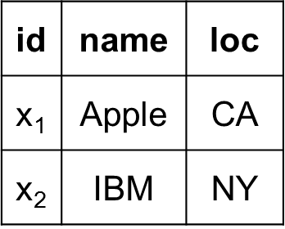
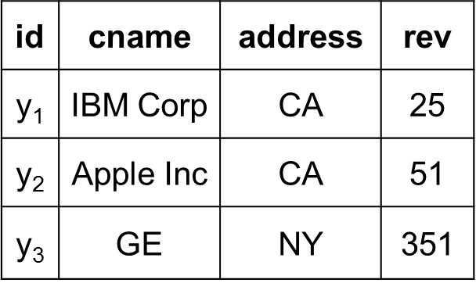
Data Integration
Combines disparate data into a clean database
Must solve many problems
  data acquisition, extraction, cleaning, schema matching/merging, entity matching/merging, etc.
RDBMS
name | loc | rev
Apple Inc | CA | 51
IBM Corp | NY | 25
news articles
GE |  | 35

Slide 3
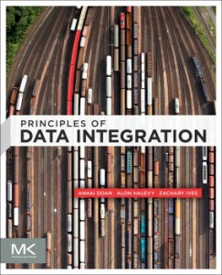

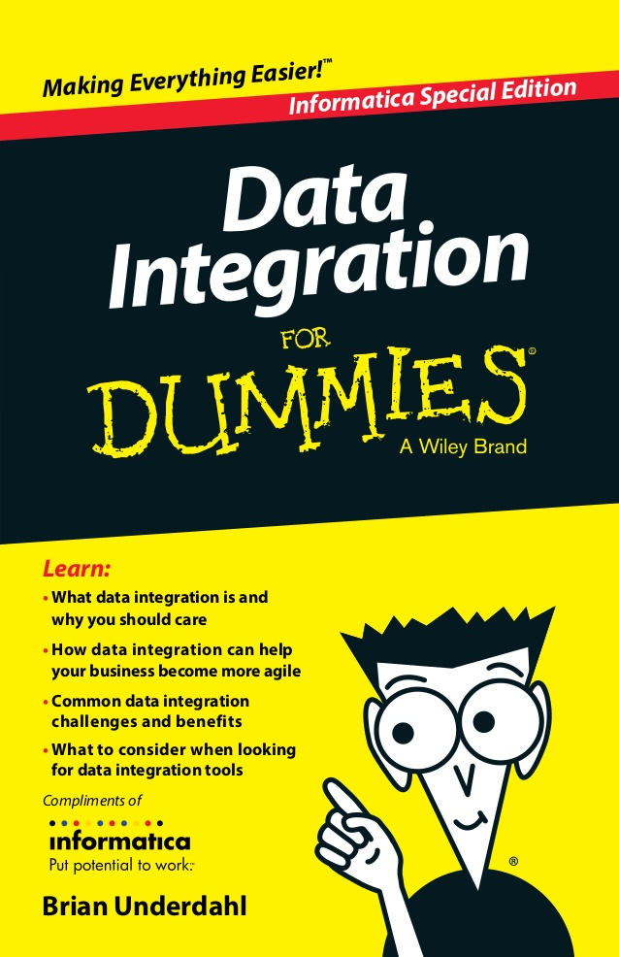
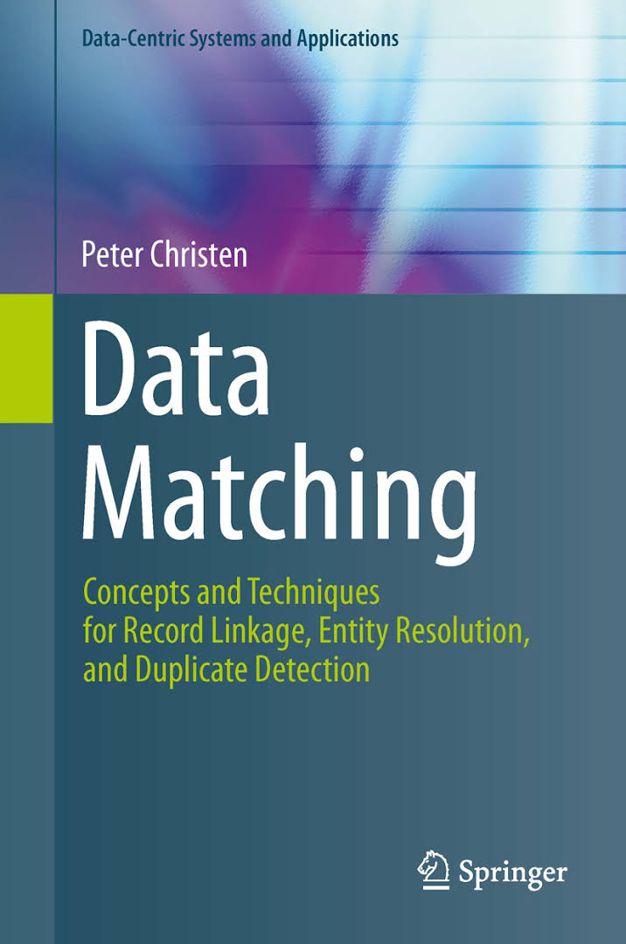
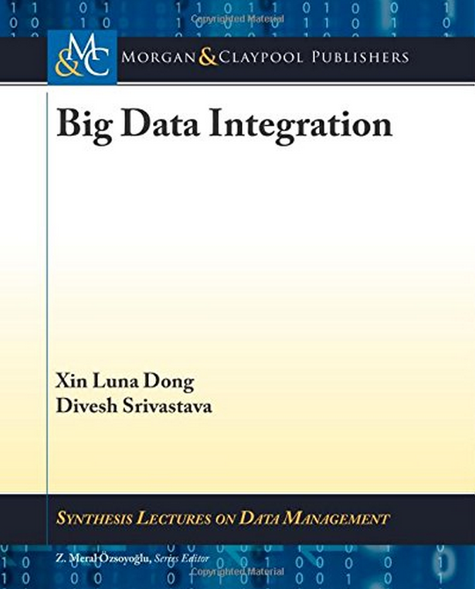
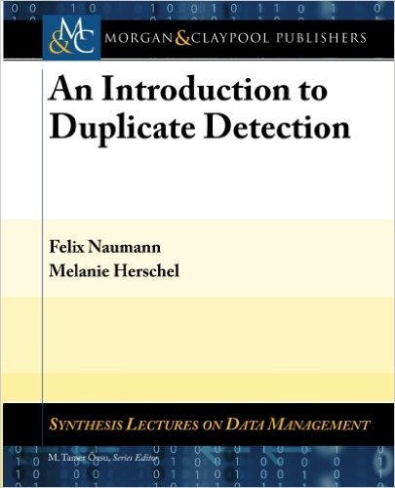
Long-Standing Challenge
Numerous works in the past 30 years
In many communities: DB, AI, KDD, Web, Semantic Web

Slide 4
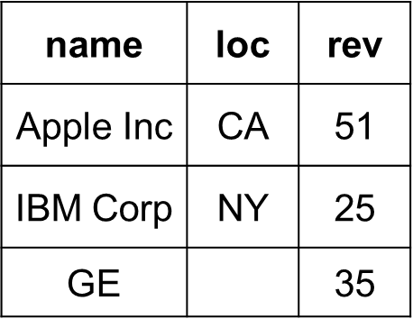
Will Become Even More Critical in the Age of Data Science
is there any
correlation
between
location and
revenue?
The data science pipeline
Data
analysis
Data integration, data wrangling, …
Major topic at the 2013 Beckman workshop

Slide 5
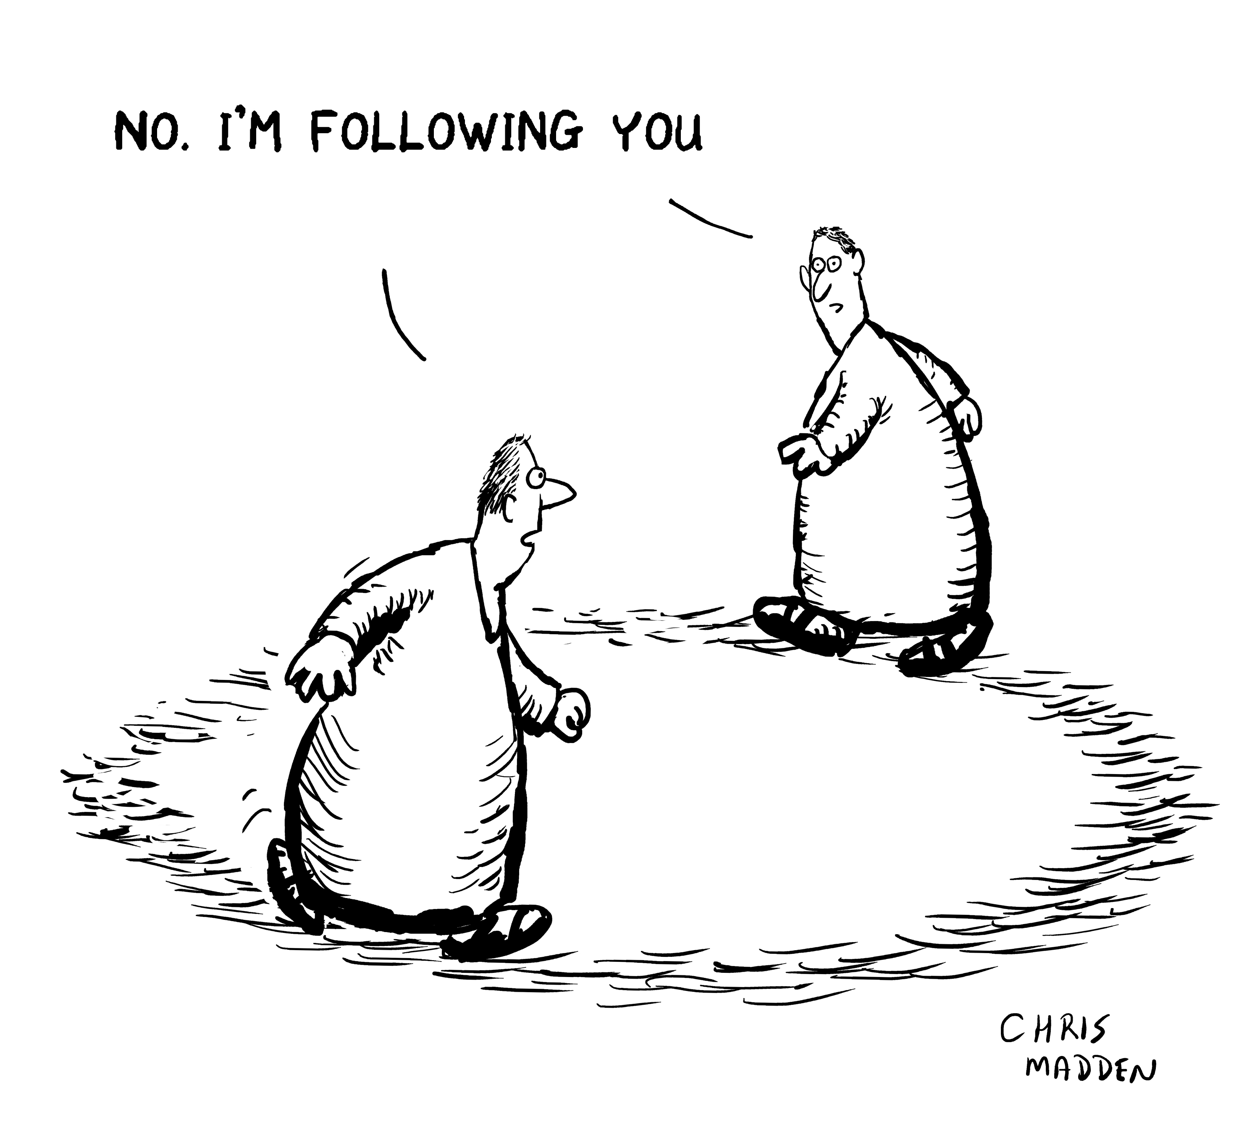
Yet the Field Appears Stagnating
Still a lot of papers
  96 papers on entity matching
  alone from 2009-2014 in
  SIGMOD, VLDB, ICDE,
  KDD, WWW
But not clear how they
advance the field
Disappointingly, still very few widely used DI tools
  many tools that we built went nowhere
What can we do to significantly advance the field?

Slide 6
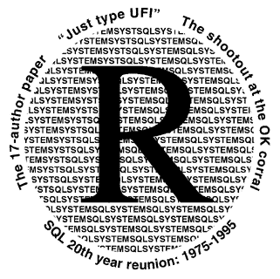


Our Proposal: Build DI Systems
Most current works develop algorithms
But DI is engineering by nature
  Can’t just develop algorithms in vacuum
  Must build systems to evaluate algorithms, integrate R&D efforts, make practical impacts
Can learn from the fields of RDBMSs and Big Data
  Where pioneering systems significantly pushed the field forward

Slide 7
Rest of the Talk
Limitations of current system building agenda
  Based on my experience in Silicon Valley
  Illustrated using entity matching
Propose a radically new system building agenda
  very different from what we researchers have done so far

Slide 8
Illustrating Example: Entity Matching
Table A
Table B
Name | City | State
Dave Smith | Madison | WI
Joe Wilson | San Jose | CA
Dan Smith | Middleton | WI
Name | City | State
David D. Smith | Madison | WI
Daniel W. Smith | Middleton | WI

Slide 9
Illustrating Example: Entity Matching
Two fundamental steps: blocking and matching
Table A
Name | City | State
Dave Smith | Madison | WI
Joe Wilson | San Jose | CA
Dan Smith | Middleton | WI
a₁
a₂
a₃
(a₁, b₁)
(a₁, b₂)
(a₃, b₁)
(a₃, b₂)
(a₁, b₁) +
(a₁, b₂) -
(a₃, b₁) -
(a₃, b₂) +
block on
state = state
match
Table B
Name | City | State
David D. Smith | Madison | WI
Daniel W. Smith | Middleton | WI
b₁
b₂

Slide 10
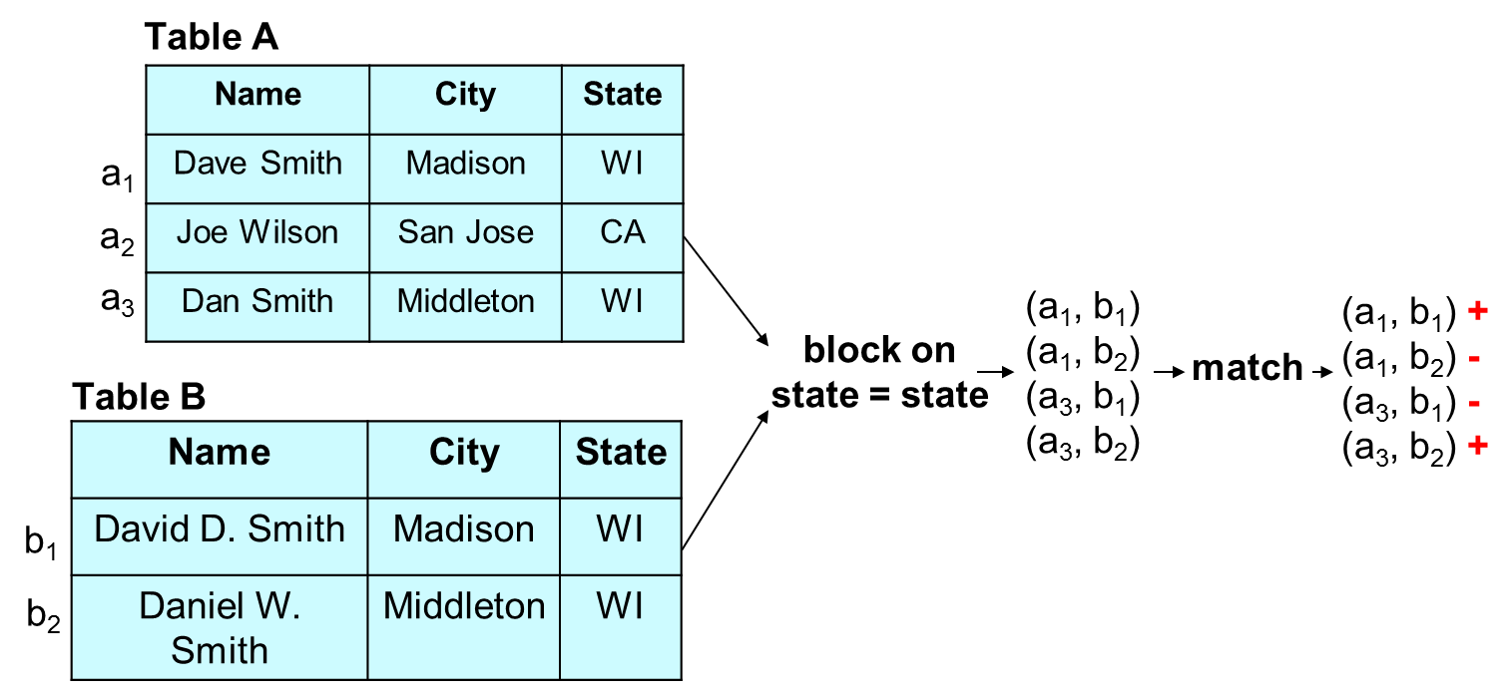
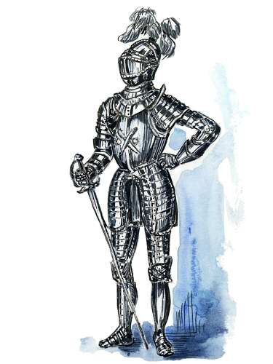
Current Research / System Building Agenda for Entity Matching
Research
Focus on these two steps
Develop algorithms
Maximize accuracy, minimize cost
Assume other steps are trivial
Build stand-alone
monolithic systems
(e.g., in Java)
Blocker 1
Blocker 2
…
Matcher 1
Matcher 2
…

Slide 11
This is Far from Enough for Handling EM in Practice
EM in practice is significantly more complex
  A messy, iterative, multiple-step process
  Many steps perceived trivial are actually quite difficult to do
Even if we let a human user be in charge of the whole EM process, he/she often doesn’t know what to do
Will illustrate in the next few slides
  Using an example of applying supervised learning to do EM

Slide 12
How Is EM Done Today in Practice?
1M tuples
A
block
match
(using supervised learning)
1M tuples
B
Development stage
  finds an accurate workflow, using data samples
Production stage
  executes workflow on entirety of data
  focuses on scalability

Slide 13
Development Stage
A
no
(-,-)
(-,-)
(-,-)
(-,-)
(-,-)
(-,-) +
(-,-) +
(-,-) -
(-,-) -
(-,-) +
A’
yes
sample
blocker X
matcher V
quality
check
B
B’
S
A’
(-,-)
(-,-)
(-,-)
blocker X
C_{x}
sample
B’
label
cross-validate
matcher U
G
A’
0.89 F₁
(-,-) +
(-,-) -
(-,-) +
blocker Y
C_{y}
B’
0.93 F₁
cross-validate
matcher V
Select the best blocker: X, Y
Select the best matcher: U, V

Slide 14
The Discovered Workflow
blocker X
matcher V

Slide 15


Production Stage
(-,-)
(-,-)
(-,-)
(-,-)
(-,-)
(-,-)
(-,-)
(-,-)
(-,-) +
(-,-) -
(-,-) +
(-,-) +
(-,-) -
(-,-) +
(-,-) -
(-,-) +
A
blocker X
matcher V
B
Must worry about scaling, quality monitoring,
exception handling, crash recovery, …

Slide 16
Given This Example of EM in Practice, We Can Now Discuss Limitations of Current EM Systems

Slide 17
Limitations of Current EM Systems
Examined 33 systems
  18 non-commercial and 15 commercial ones
1. Do not cover the entire EM workflow
2. Hard to exploit a wide range of techniques
  Visualization, learning, crowdsourcing, etc.
3. Very little guidance for users
4. Do not distinguish development vs production stages
5. Not designed from scratch for extendability

Slide 18
1. Do Not Cover the Entire EM Workflow
Focus on blocking and matching
  Develop ever more complex algorithms
  Maximize accuracy and minimize costs
Assume other steps are trivial
  In practice these steps raise serious challenges
  Example 1: sampling to obtain two smaller tables A’ and B’
  Example 2: sample a set of tuple pairs to label
  Example 3: label the set

Slide 19
Development Stage
A
no
(-,-)
(-,-)
(-,-)
(-,-)
(-,-)
(-,-) +
(-,-) +
(-,-) -
(-,-) -
(-,-) +
A’
yes
sample
blocker X
matcher V
quality
check
B
B’
S
A’
(-,-)
(-,-)
(-,-)
blocker X
C_{x}
sample
B’
label
cross-validate
matcher U
G
A’
0.89 F₁
(-,-) +
(-,-) -
(-,-) +
blocker Y
C_{y}
B’
0.93 F₁
cross-validate
matcher V
Select the best blocker
Select the best matcher

Slide 20
Example 1: Sampling Two Smaller Tables
Tables A and B each has 1M tuples
  Very difficult to experiment with them directly in development stage
  Way too big, so too time consuming
Need to sample smaller tables
  A’ from A, B’ from B, say 100K tuples for each table
How to sample?
  Random sampling from A and B may result in very few matching tuple pairs across A’ and B’
  How to resolve this?

Slide 21
Example 2: Take a Sample from the Candidate Set (for Subsequent Labeling)
Let C be the set of candidate tuple pairs produced by applying a blocker to two tables A’ and B’
We need to take a sample S from C, label S, then use the labeled set to find the best matcher and train it
How to take a sample S from C?
  Random sampling often does not work well if C contains few matches
  In such cases S contains no or very few matches

Slide 22
Example 3: Labeling the Sample
This task is often divided between two or more people
As they label their set of tuple pairs, they may follow very different notions of matching
  E.g., given two restaurants with same names, different locations
  A person may say “match”, another person may say “not matched”
At the end, it becomes very difficult to reconcile different matching notions and relabel the sample
This problem becomes even worse when we crowdsource the labeling process

Slide 23
An Illustrating Example for Distributed Labeling
Two restaurants match if they refer to the same real-world restaurant
(- , -)
(- , -)
(- , -)
…
(- , -)
([Laura’s, 23 Farewell Str], [Laura, 23 Farewell]) +
(- , -)
(- , -)
(- , -)
…
(- , -)
(- , -)
(- , -)
(- , -)
(- , -)
(- , -)
([Palmyra, 46 Main St], [Palmyra, 15 Broadway]) -
(- , -)
(- , -)
(- , -)
…
(- , -)
([KFC, 24 Main St], [KFC, 41 Johnson Ave]) +

Slide 24
2. Hard to Exploit a Wide Range of Techniques
EM steps often exploit many techniques
  SQL querying, keyword search, learning, visualization, information extraction, outlier detection, crowdsourcing, etc.
Difficult to incorporate all
into a single system
Difficult to move data
repeatedly across systems
  An EM system, a visualization system,
  an extraction system, etc.
Problem: most systems are stand-alone monoliths,
not designed to play well with other systems

Slide 25
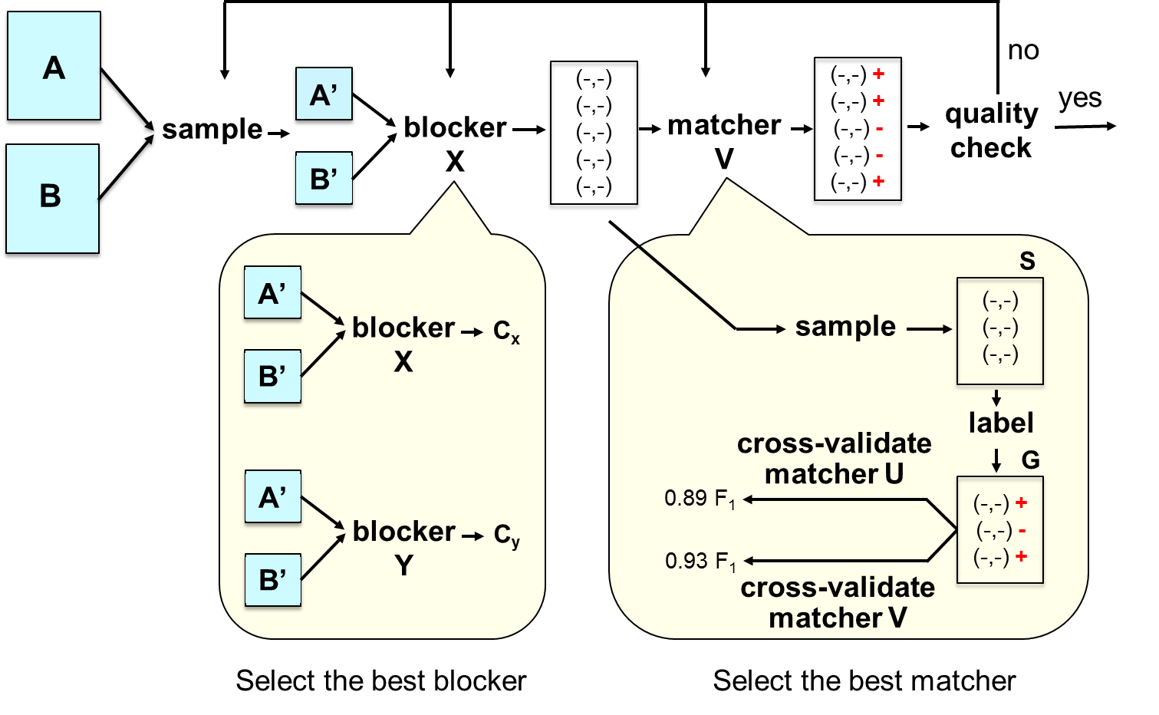
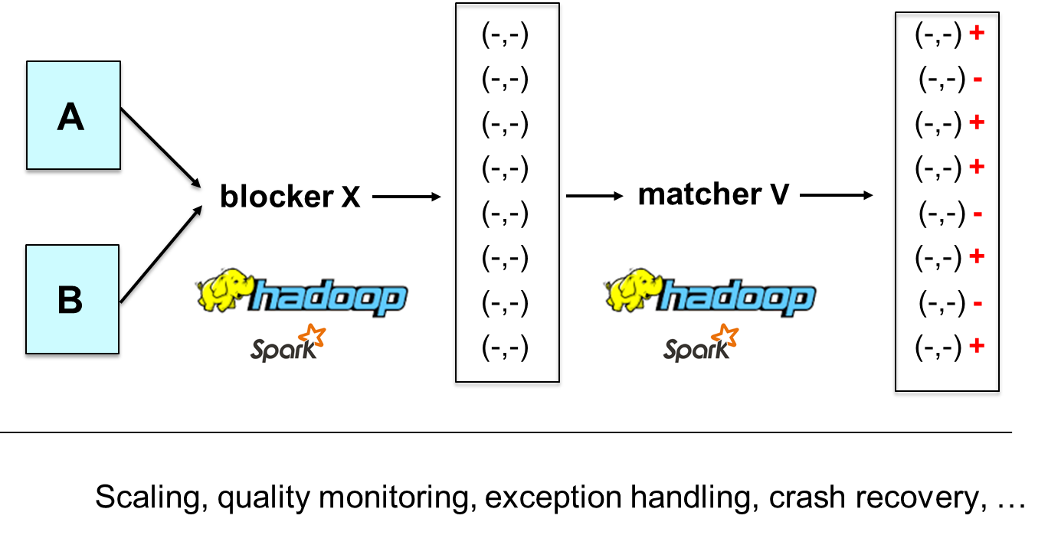
3. Do Not Distinguish Dev vs Prod Stages
Current systems
  Provide a set of blockers / matchers
  Provide a way to specify / optimize / execute workflows
  Pay very little attention to the development stage

Slide 26
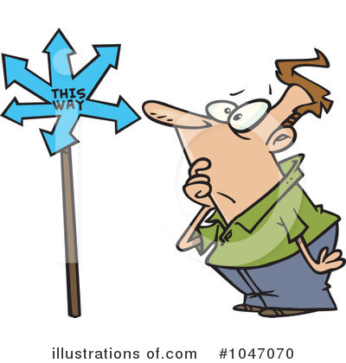
4. Little Guidance for Users
Suppose user wants at least 95% precision & 80% recall
How to start? With rule-based EM first?
Learning-based EM first?
What step to take next?
How to do a step?
  E.g., how to label a sample?
What to do if after much effort,
still hasn’t reached desired accuracy?

Slide 27
5. Not Designed from Scratch for Extendability
Can we build a single system that solves all EM problems?
  No
In practice, users often want to
  Customize, e.g., to a particular domain
  Extend, e.g., with latest technical advances
  Patch, e.g., writing code to implement
  lacking functionalities
Users also want interactive
scripting environments
  For rapid prototyping, experimentation, iteration
Most current EM systems
  are not designed so that users can easily customize, extend, patch
  are not situated in interactive scripting environments

Slide 28
Summary
Many serious limitations:
1. Do not cover the entire EM workflow
2. Hard to exploit a wide range of techniques
3. Very little guidance for users
4. Do not distinguish development vs production stages
5. Not designed from scratch for extendability

Slide 29

A New System Building Agenda
Build systems each solves a single DI problem
  Entity matching, schema matching, information extraction, etc.
  Build systems that solve multiple DI problems later
  Target power users
  As packages in Python software ecosystem (PyData)
Foster PyDI, an ecosystem
of such packages
  as part of PyData
Extend PyDI to
collaborative/cloud/crowd/
lay user settings

Slide 30
Example: Build Systems for Entity Matching
(A New Research Template)
Define a clear scope
  Each system targets a single EM scenario and power users
Solve the development stage
  Develop a how-to guide
    Helps users discover accurate workflow
    Must cover all steps
    Tells users what to do, step by step
  Develop tools for pain points in the guide
    On top of PyData ecosystem
Solve the production stage in a similar way
  But focus on scalability, crash recovery, etc.

Slide 31
How-to Guide/Tools for Development Stage
A
no
(-,-)
(-,-)
(-,-)
(-,-)
(-,-)
(-,-) +
(-,-) +
(-,-) -
(-,-) -
(-,-) +
A’
yes
sample
blocker X
matcher V
quality
check
B
B’
S
A’
(-,-)
(-,-)
(-,-)
blocker X
C_{x}
sample
B’
label
cross-validate
matcher U
G
A’
0.89 F₁
(-,-) +
(-,-) -
(-,-) +
blocker Y
C_{y}
B’
0.93 F₁
cross-validate
matcher V
Select the best blocker
Select the best matcher

Slide 32
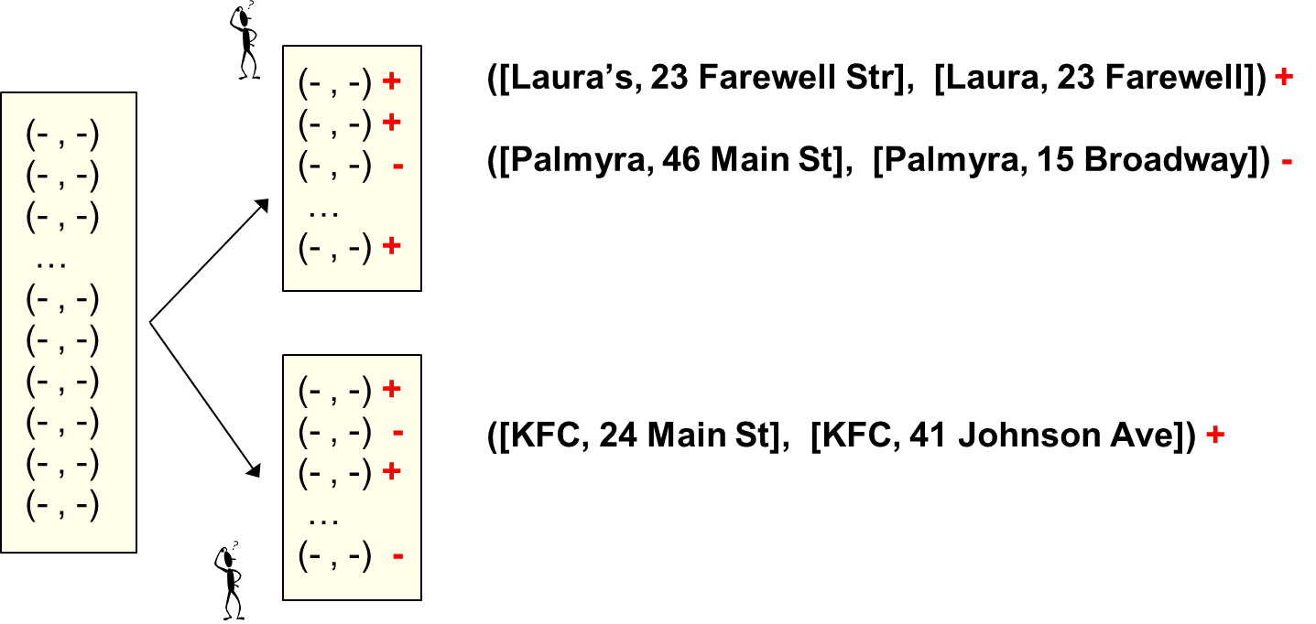
How-to Guide/Tools for Development Stage
Users want step-by-step guide on how to take a sample then label it
Tool to highlight possible matching categories
Tool to debug labels
Tool to help
revise labels

Slide 33
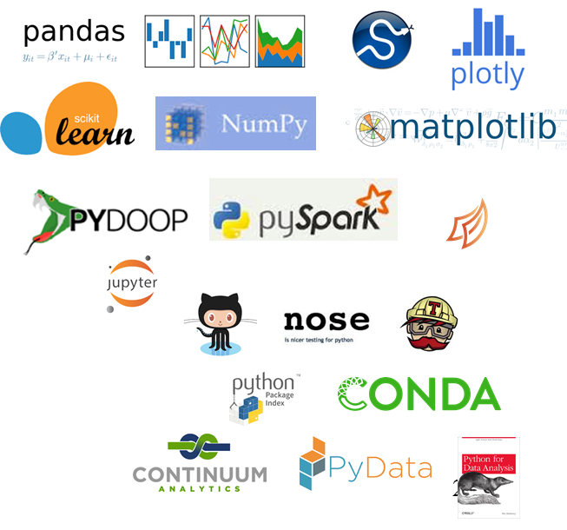
Build Tools on the PyData Ecosystem
Key observation
  Development stage does a lot of data analysis
    E.g., analyzing data to discover EM matching rules
    Often requires cleaning, visualizing, finding outliers, etc.
  Very hard to incorporate all such techniques into a single EM system
  Better to build on top of an open-source data ecosystem
Two major current ecosystems
  Python and R
PyData ecosystem
  Used extensively by data scientists
  86,800 packages (in PyPI)
  Data analysis stack / big data stack

Slide 34
An Example:
The Magellan EM Management System [VLDB-16]
Match
two tables
Power
Users
Development Stage
Production Stage
How-to guide
Tools for pain points
(as Python commands)
Data samples
How-to guide
Tools for pain points
(as Python commands)
Original data
EM
Workflow
Data Analysis Stack
Big Data Stack
PyData
eco
system
PySpark, mrjob, Pydoop,
pp, dispy,
…
pandas, scikit-learn, matplotlib,
numpy, scipy, pyqt, seaborn,
…
Python Interactive Environment
Script Language

Slide 35
Raises Numerous R&D Challenges
Developing good how-to guides is very difficult
  Even for very simple EM scenarios
Developing tools raises many research challenges
  Accuracy, scaling
Novel challenges for designing open-world systems

Slide 36
Examples of Current Research Problems
Profile the two tables to be matched,
to understand different matching definitions
Normalize attribute values using machine and humans
Verify attribute values using crowdsourcing
Debug the blocking / labeling / matching process
Scale up blocking to 100s of millions of tuples
Apply Magellan template to string similarity joins
…

Slide 37
Designing for an Open World
Closed-World Systems
Open-World Systems
RDBMS
Package X
SQL queries
commands
Magellan
command x₁
command 1
command x₂
data
command 2
…
…
data
Package Y
A
command y₁
A
command y₂
B
…
B
data
metadata
C
metadata
A.ssn is a key
metadata
A.ssn is a key
…
PyData ecosystem

Slide 38
Current Status of Magellan
Developed since June, 2015
7 major new tools for how-to guides
Uses 11 packages in PyData
Exposes 104 Python commands for users
Used as a teaching tool in data science classes at UW
Used to match entities at
WalmartLabs, Johnson Controls, Marshfield Clinic
Will be open sourced soon

Slide 39
A New System Building / Research Agenda
Build systems each solves a single DI problem
  Target power users
  As packages in Python software ecosystem (PyData)
Foster PyDI, an ecosystem
of such packages
  as part of PyData
Extend PyDI to
collaborative/cloud/crowd/
lay user settings

Slide 40
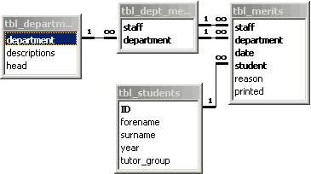
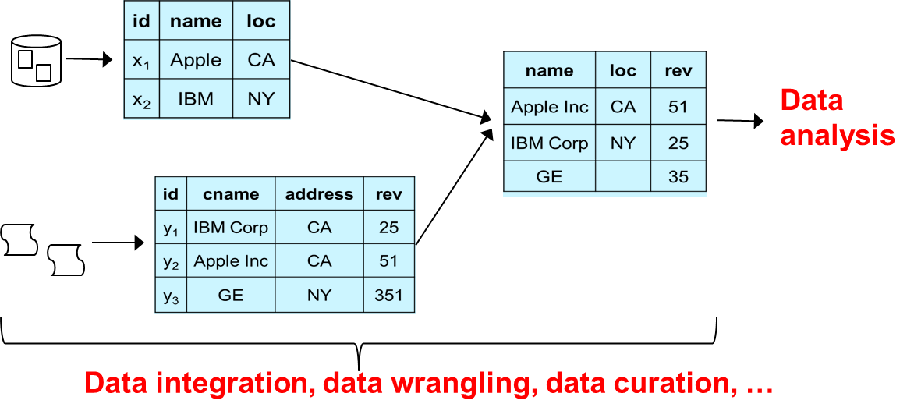

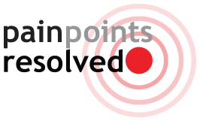
What We Believe Will Happen in Next Ten Years
relational data management
analytical data management,
data integration, data science
Ecosystem of tools + how-to guides will be
the “system of choice”
So it is critical to study how to build such ecosystems
  E.g., how to build PyDI as a part of PyData

Slide 41
How to Build PyDI as Part of PyData
Study PyData and similar ecosystems (e.g., R)
  What do they do?
  Why are they so successful?
    because they address the pain points!
    tools are designed to share
    tools are open source and free
  What are their challenges and solutions?
  Any research on how to build such ecosystems?
Apply lessons learned to foster PyDI

Slide 42
Build Collaborative/Cloud/Crowd/Lay User Versions of DI Systems
So far consider single power user in local setting
Many other settings exist, characterized by
  People: power user, lay user, team of users, etc.
  Technologies: cloud, crowdsourcing, etc.
Should study them only after we know how to build sysems for single power user in local setting
  Similar to building assembly languages before higher-level languages
We can extend PyDI to handle these settings
But they raise many additional R&D challenges

Slide 43
Suggest a Data Science Agenda
The data science pipeline
Data
analysis
Report
Data integration, data wrangling, data curation, …
The data integration community has a lot to contribute
But only if we focus on building systems!

Slide 44
Take-Home Message #1
Data integration & data science are increasingly critical
But can’t just develop algorithms, we need far more system building efforts
The way fields such as RDBMSs & Big Data have done

Slide 45
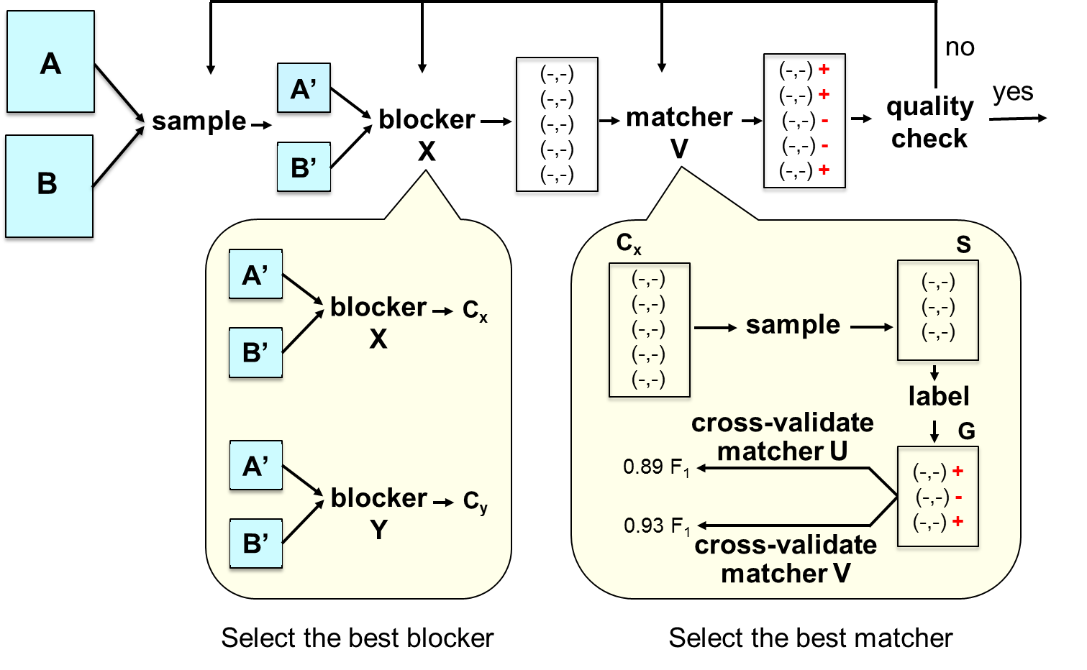
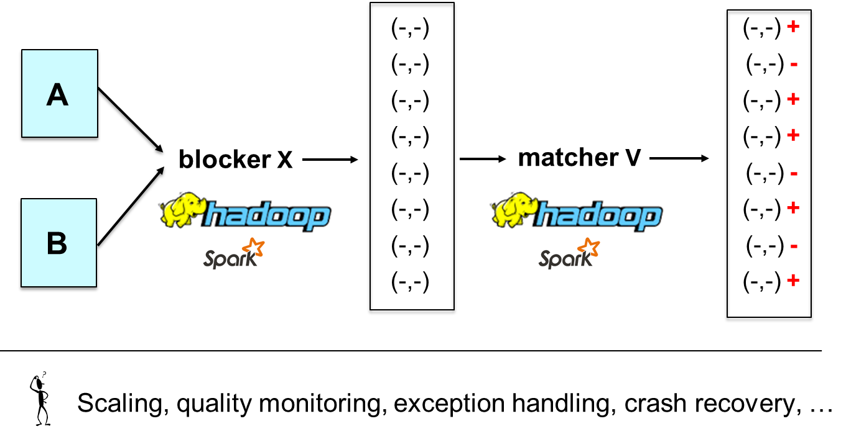

Take-Home Message #2
Current system building efforts have serious problems
But there is a promising new agenda
  single DI problem, power users
  solve development stage / production stage end to end
  develop how-to guides, then tools for pain points
  build tools on top of PyData
See Magellan VLDB-16 paper for a template.
EM is not just about blocking and matching!
Many more interesting challenges that
address paint points of real users

Slide 46
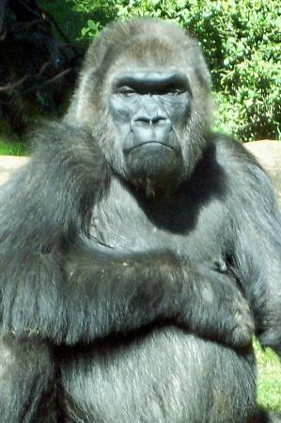
Take-Home Message #3
Tool ecosystem will be “the system” for DI & data science
Must study how to foster such ecosystems
Relational data management
Data integration,
data analytics,
data science

Slide 47
Acknowledgments
UW collaborators
  Adel Ardalan, Jeff Ballard, Sanjib Das, Yash Govind, Pradap Konda, Han Li, Paul Suganthan, Haojun Zhang
  Rashi Jalan, Rishab Kalra, Sidharth Mudgal, Varun Naik, Fatemah Panahi
  David Page
External collaborators
  Alon Halevy, Andrei Lopatenko, Wang-Chiew Tan (RIT)
  Jeff Naughton (Google)
  Youngchoon Park, Erik Paulson (JCI)
  Esteban Arcaute, Rohit Deep, Ganesh Krishnan, Shishir Prasad, Vijay Raghavendra (WalmartLabs)
  John Badger, Eric LaRose, Peggy Peissig (Marshfield Clinic)
Funding
  BD2K, WalmartLabs, NSF, JCI, UW-Madison

