Slide 1
The Teaching Dimension of Reinforcement Learning
Xuezhou Zhang
IFDS Brown-Bag
August 31th, 2020

Slide 2

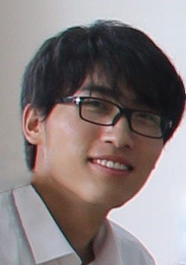
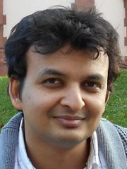

Coauthors
Shubham K. Bharti
Yuzhe Ma
Adish Singla
Jerry Zhu

Slide 3
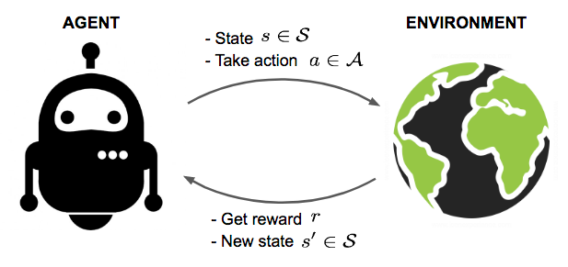
(Classic) Reinforcement Learning
Notes:
In standard reinforcement learning, the agent learns by interacting with an environment. The environment in some sense is neither benign nor adversarial to the agent. It simply doesn’t care.
Certainly, when a human learns a new task all on their own, it maps to this setting.

Slide 4

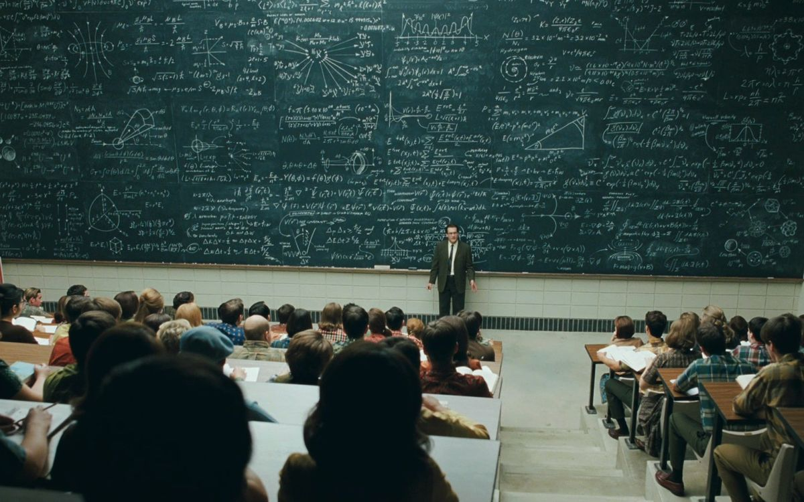
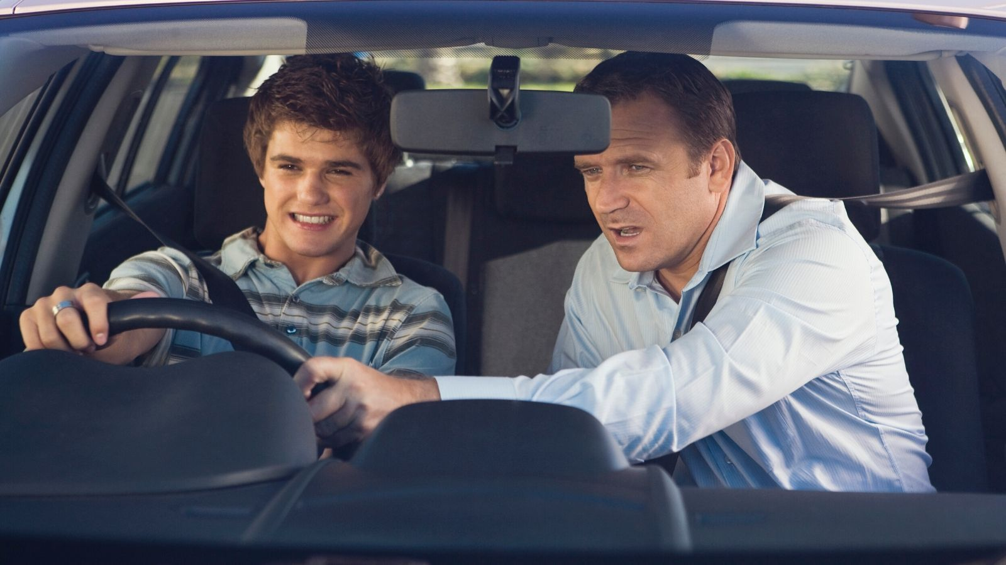
Learning from Teacher
Notes:
But perhaps more commonly, human learns with the help of a teacher. For example, when we are learning to bike as a kid, or learning to drive as a teenager, or learn calculus in college, we are all learning under the guidance of a teacher.

Slide 5

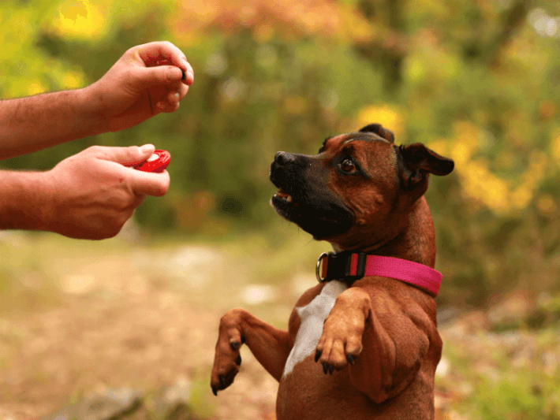

Learning from Teacher
Teacher knows (1) the MDP and (2) the optimal policy $π^{∗}$, and wants to teach the policy to the student.
Teaching by demonstration: studied extensively.
Teaching by reinforcement: studied much less.
Notes:
This motivate us to study learning in presence of a helpful teacher. In reinforcement learning context, we can assume that the teacher knows both the MDP and the optimal policy. These are reasonable assumptions, as the teacher usually knows the task well. Under this general teaching framework, two forms of teaching have been studied.
The first framework is called teaching by demonstration, also referred to as imitation learning. Here, the teacher provide demonstration of the optimal policy, and the learner aims to mimic the teacher as closely as possible. This setting has been extensively studied in the literature and people have tried to design both good learning algorithm and good teaching algorithm.
However, in real life, not all teaching are performed by demonstration. In some tasks, it’s impossible for the teacher to demonstrate. A good example is dog training, where teacher teaches via rewards and punishments. And this is the setting we study in this work.

Slide 6
Teaching by Reinforcement
Prior Work: reward shaping, very limited theoretical understanding.
We want to understand:
  What is the best teaching strategy given different teacher control?
  How much improvement can a good teacher bring compared to learning from the environment?
Notes:
Surprisingly, to the best of our knowledge, very little is known about the teaching by reinforcement problem. One related concept is reward shaping, where people find that a family of reward functions results in the same optimal policy, but some make learning converge faster. Most work on this topic are empirical, and very little theoretical understanding exist about where the speed-up come from.
In this context, we want to understand two questions:
What is the best teaching strategy given different teacher control?
How much improvement can a good teacher bring compared to standard reinforcement learning from the environment, in terms of the sample complexity?

Slide 7
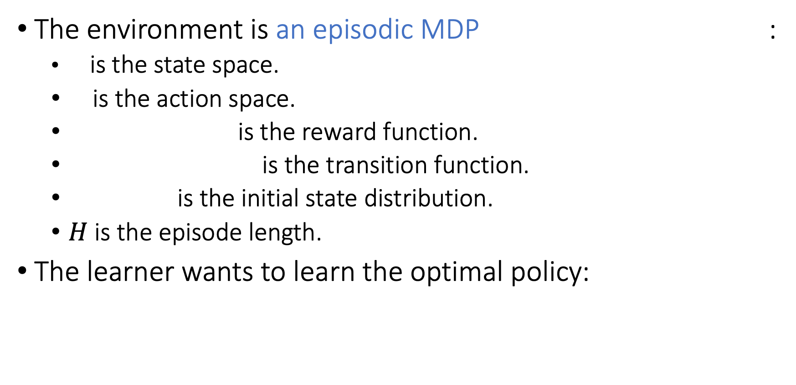
Preliminaries
The environment is an episodic MDP :
  is the state space.
  is the action space.
  is the reward function.
  is the transition function.
  is the initial state distribution.
  $H$ is the episode length.
The learner wants to learn the optimal policy:
Notes:
Let’s first make some preliminary definitions.
In this work, we assume an episodic Markov Decision Process, parametrized by the state space S, the action space A, the reward function R, the transition function P, initial state distribution mu_zero.
The goal of the agent is to learn the optimal policy in this MDP, defined as the policy that maximize the cumulative reward over H steps.

Slide 8
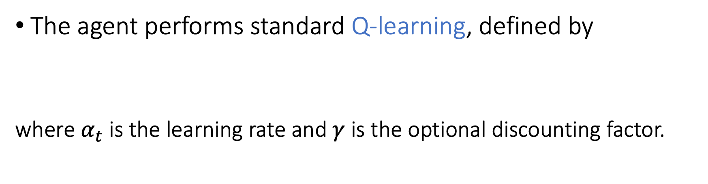
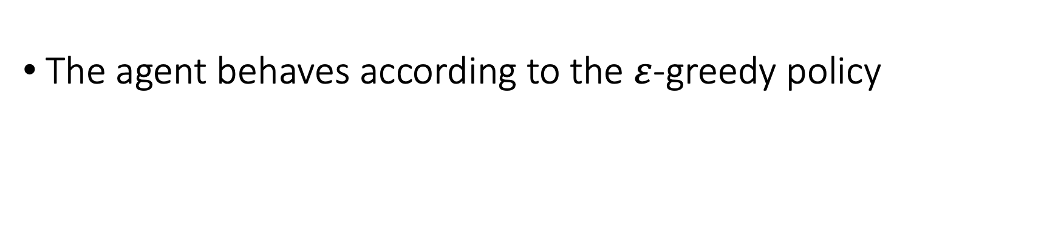
Preliminaries
The agent performs standard Q-learning, defined by
where $α_{t}$ is the learning rate and $γ$ is the optional discounting factor.
The agent behaves according to the $ε$-greedy policy
Notes:
In this work, we focus on an RL agent that performs standard Q-learning. Q-learning keeps track of a Q table. The (s,a) entry of this table aims to estimate how good it is to perform action a in state s.
We also assume that the agent uses an epsilon-greedy behavior policy.

Slide 9
Interaction Protocol

Slide 10
Sample complexity of Teaching

Slide 11
Overview of Results
We study teachers with 4 different levels of controllability.
We provide matching upper and lower bound on the teaching dimension under each teaching model.
We design efficient teaching algorithms that achieve these bounds.

Slide 12
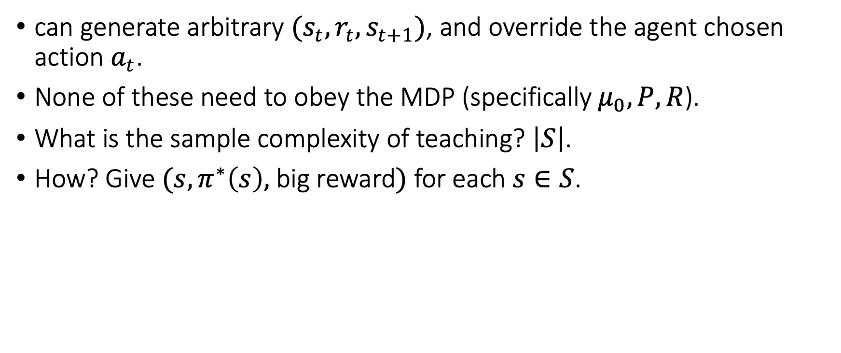
Level 1 Teacher (Strongest)
can generate arbitrary $(s_{t},r_{t},s_{t+1})$, and override the agent chosen action $a_{t}$.
None of these need to obey the MDP (specifically$μ_{0},P,R$).
What is the sample complexity of teaching? $\left|S\right|$.
How? Give $(s,π^{∗}\left(s\right),$ big reward$)$ for each $s∈S$.

Slide 14
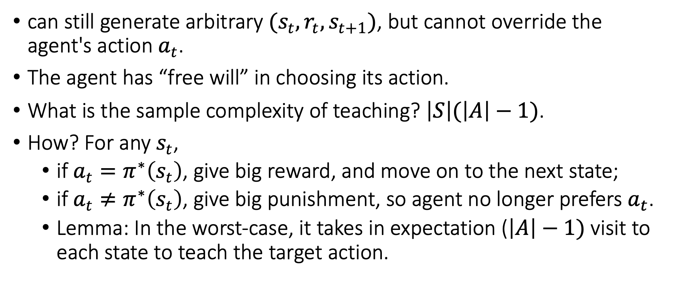
Level 2 Teacher
can still generate arbitrary $(s_{t},r_{t},s_{t+1})$, but cannot override the agent's action $a_{t}$.
The agent has “free will” in choosing its action.
What is the sample complexity of teaching? $\left|S\right|(\left|A\right|−1)$.
How? For any $s_{t}$,
  if $a_{t}=π^{∗}\left(s_{t}\right)$, give big reward, and move on to the next state;
  if $a_{t}≠π^{∗}\left(s_{t}\right)$, give big punishment, so agent no longer prefers $a_{t}$.
  Lemma: In the worst-case, it takes in expectation ($\left|A\right|−1)$ visit to each state to teach the target action.

Slide 15
“Cost of free will” = A

Slide 16

Level 3 Teacher
The teacher can still generate arbitrary reward $r_{t}$
but can only generate MDP-supported initial state and next state, i.e. $μ_{0}\left(s_{0}\right)>0$, and $P\left(s_{t+1} | s_{t},a_{t}\right)>0$.
The teacher needs to respect the real-world’s “physics”.

Slide 17
Level 3 Teacher
A deterministic learner $(ε=0)$ achieves the smallest $Tdim=Θ(SAH)$.

Slide 18
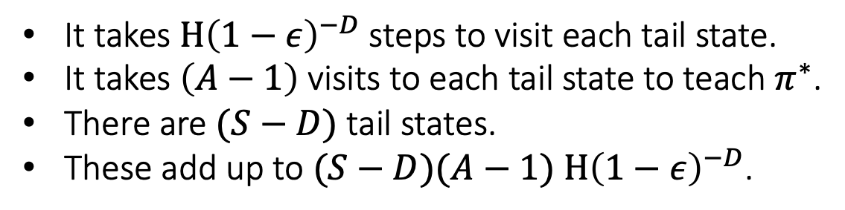
Lower-bound: construct a hard MDP
It takes $H{\left(1−ε\right)}^{−D}$ steps to visit each tail state.
It takes $\left(A−1\right)$ visits to each tail state to teach $π^{∗}$.
There are $(S−D)$ tail states.
These add up to $(S−D)(A−1)$ $H{\left(1−ε\right)}^{−D}$.

Slide 19
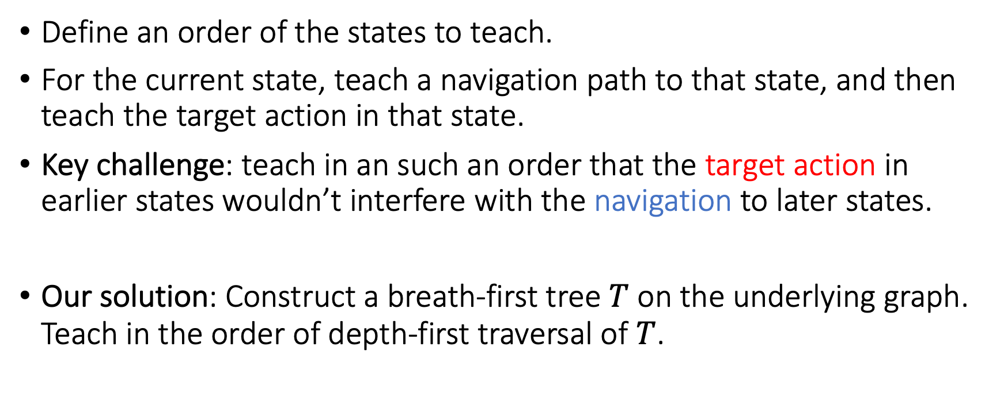
Upper-bound: NavTeach Algorithm
Define an order of the states to teach.
For the current state, teach a navigation path to that state, and then teach the target action in that state.
Key challenge: teach in an such an order that the target action in earlier states wouldn’t interfere with the navigation to later states.
Our solution: Construct a breath-first tree $T$ on the underlying graph. Teach in the order of depth-first traversal of $T$.

Slide 20
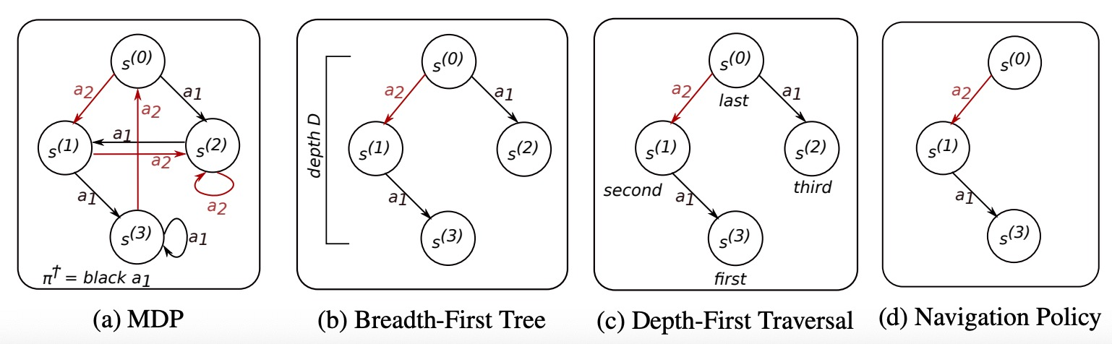
Upper-bound: NavTeach Algorithm
The advantage of depth-first traversal:
  Earlier states don’t interfere with navigation to later states.
  Maximize navigation paths sharing.

Slide 21
“Cost of navigation” = H

Slide 22

Level 4 Teacher
The teacher can only generate arbitrary reward $r_{t}$.
both initial state and next state must obey the MDP, i.e. $s_{0}∼μ_{0}\left(s_{0}\right)$, and $s_{t+1}∼P\left(⋅ | s_{t},a_{t}\right)$.
Same assumption as in reward shaping.

Slide 23
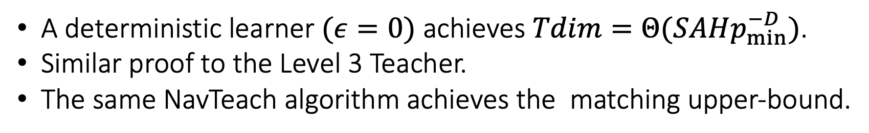
Level 4 Teacher
A deterministic learner $(ε=0)$ achieves $Tdim=Θ(SAHp_{min}^{−D})$.
Similar proof to the Level 3 Teacher.
The same NavTeach algorithm achieves the matching upper-bound.

Slide 24
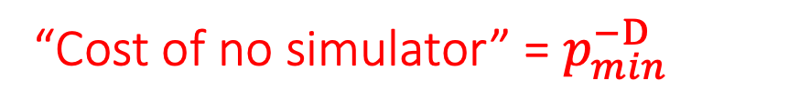
“Cost of no simulator” = $p_{min}^{−D}$
PAC-MDP bound: $O\left(\frac{H^{2}SA}{ε^{2}}\right)$ to find an $ε$-optimal policy.

Slide 25
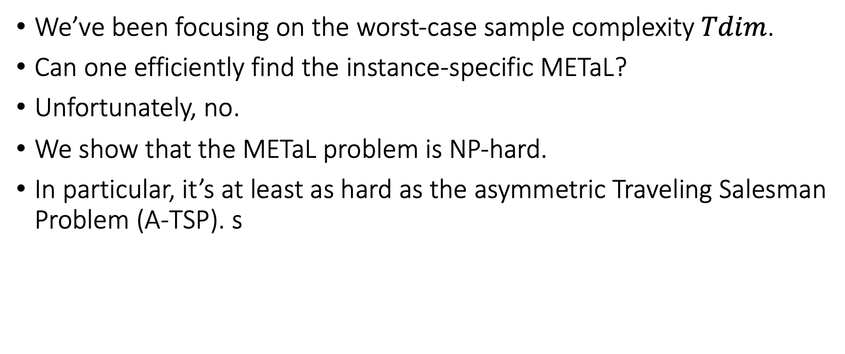
One more thing…
We’ve been focusing on the worst-case sample complexity$Tdim$.
Can one efficiently find the instance-specific METaL?
Unfortunately, no.
We show that the METaL problem is NP-hard.
In particular, it’s at least as hard as the asymmetric Traveling Salesman Problem (A-TSP). s

