Slide 1



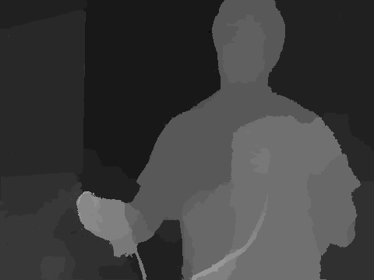


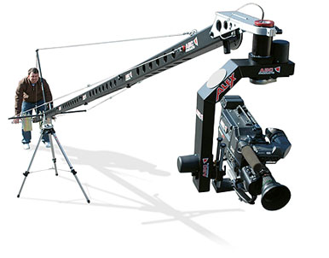
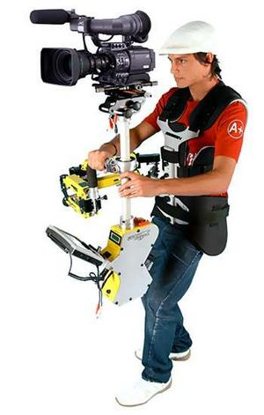
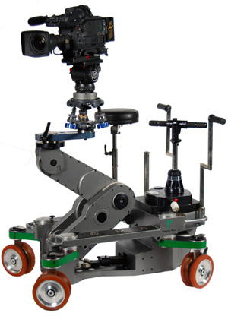
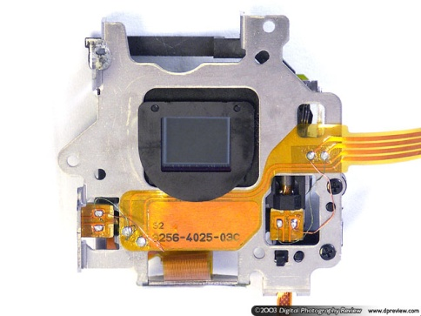
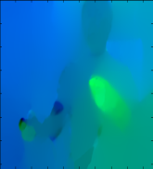

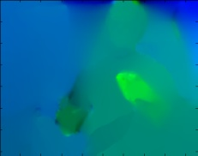
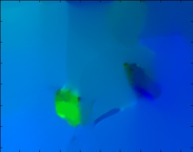
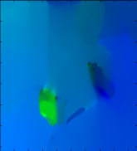



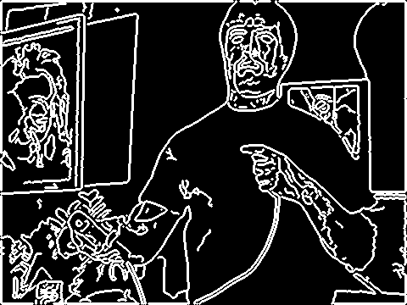
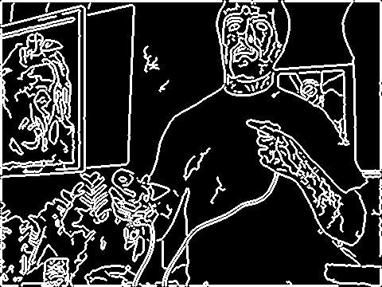
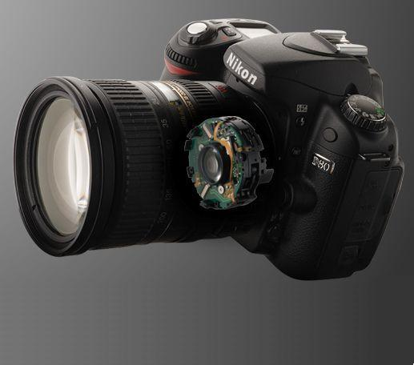

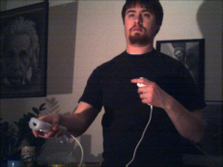
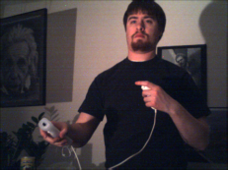
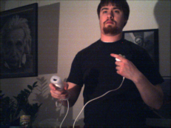
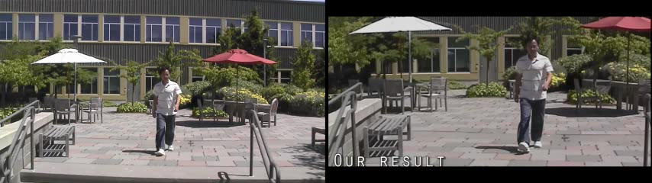
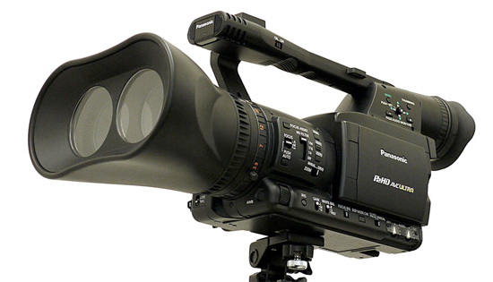
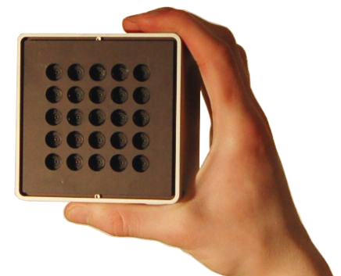
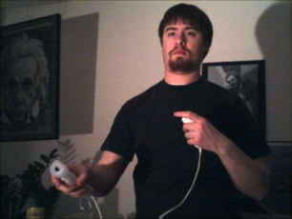
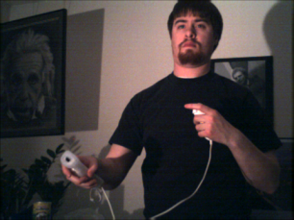

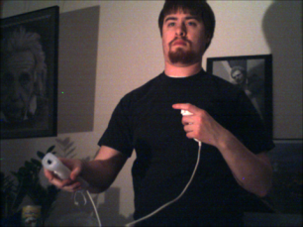

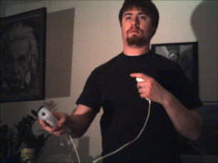
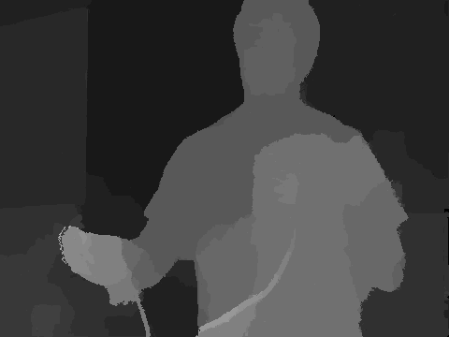
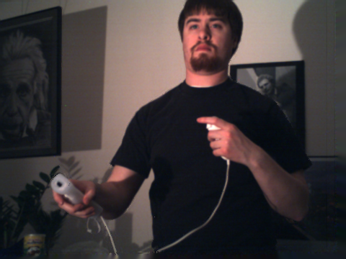
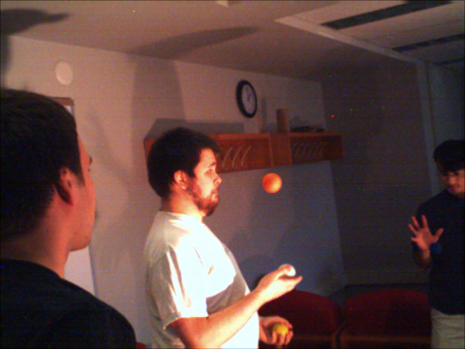
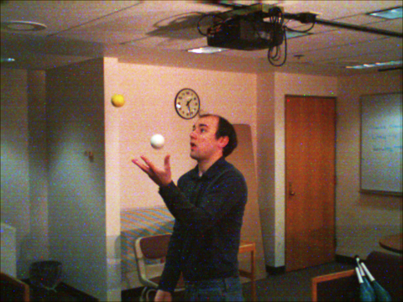
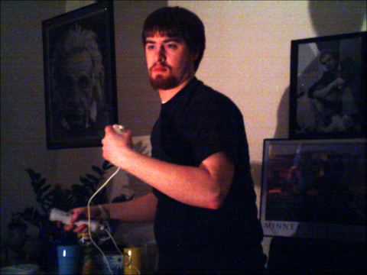
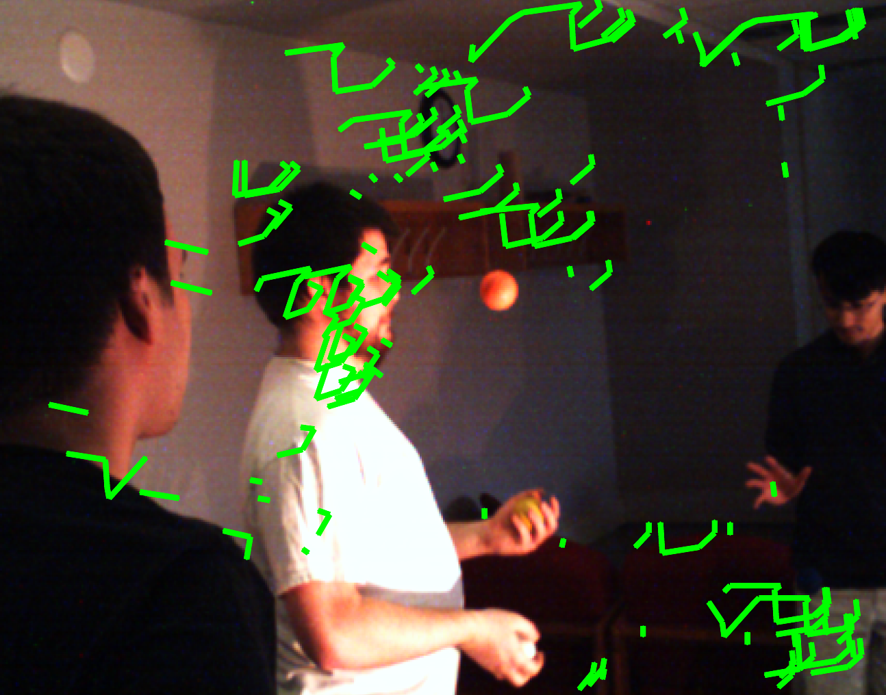
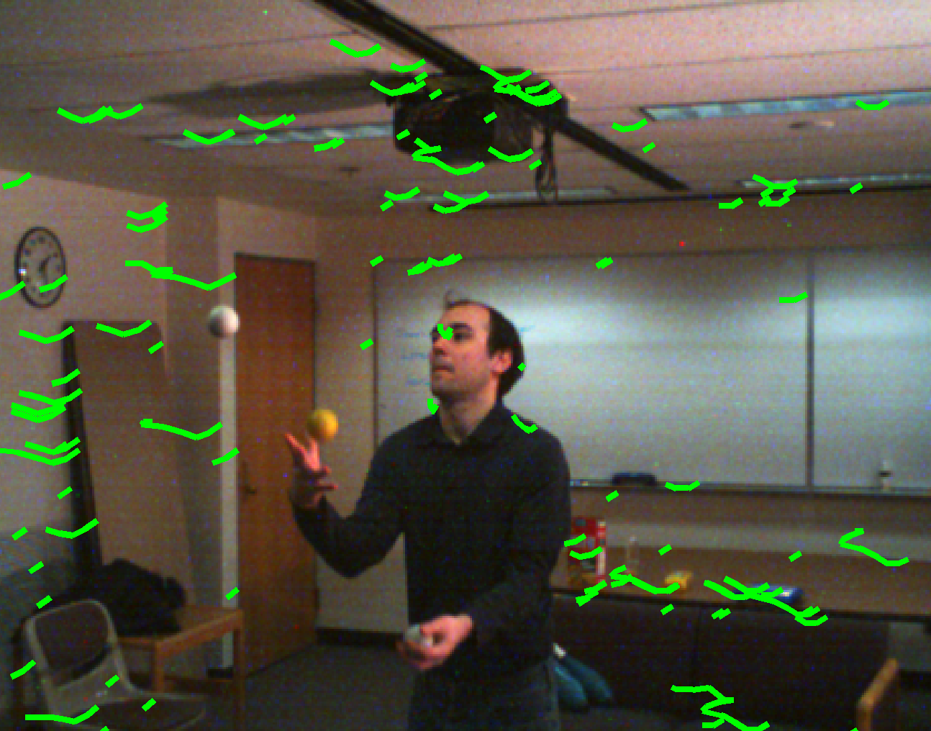
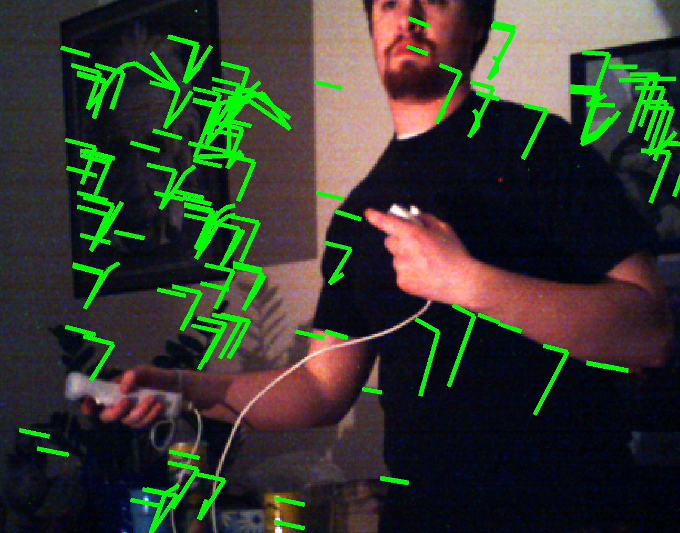
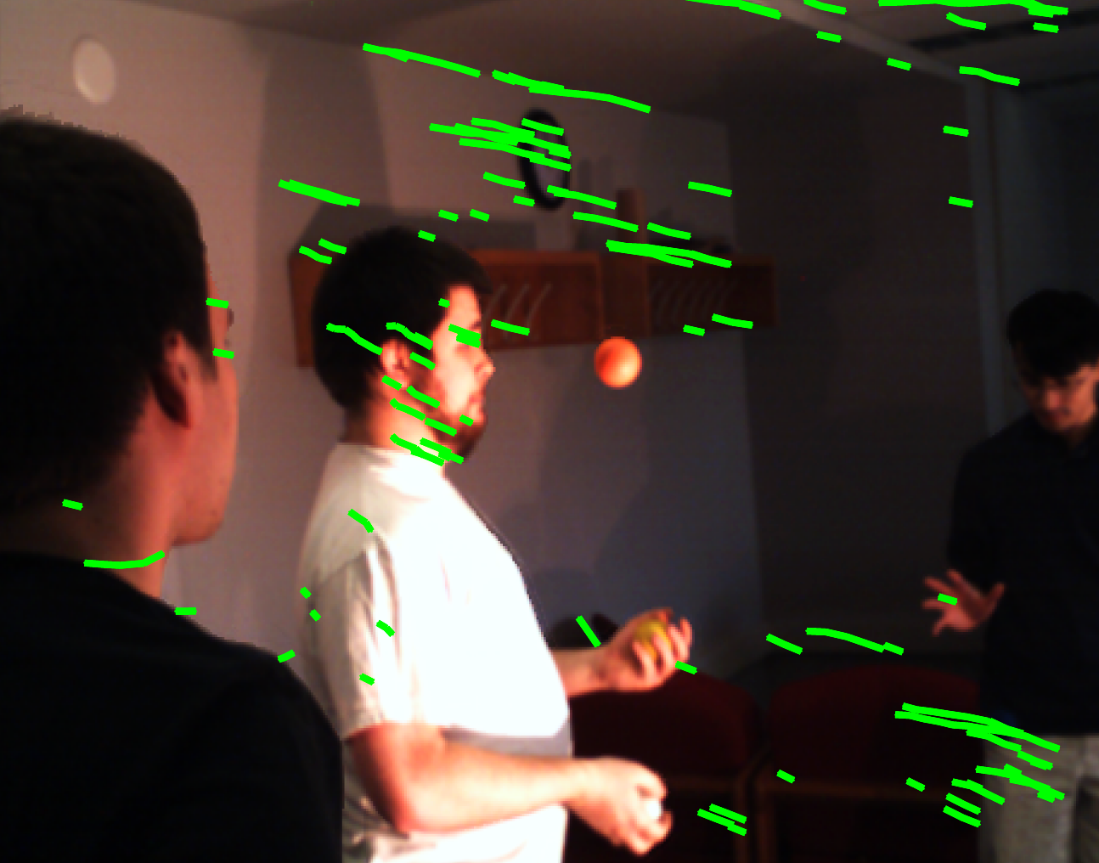
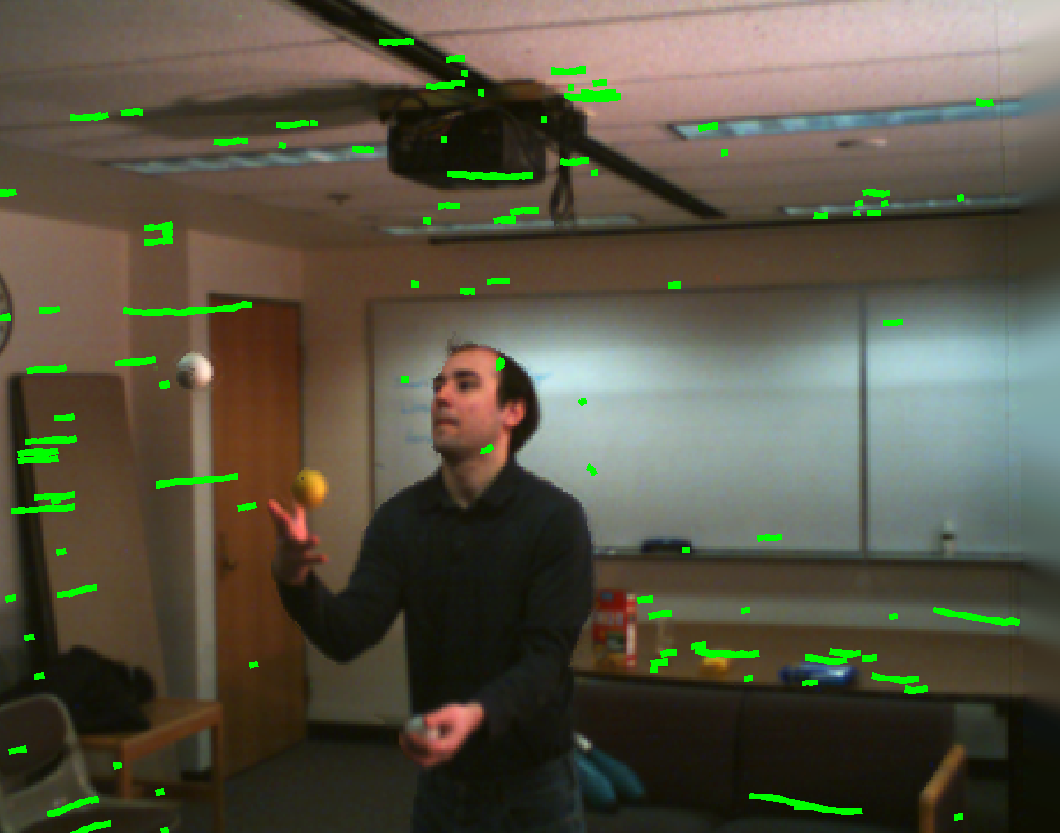
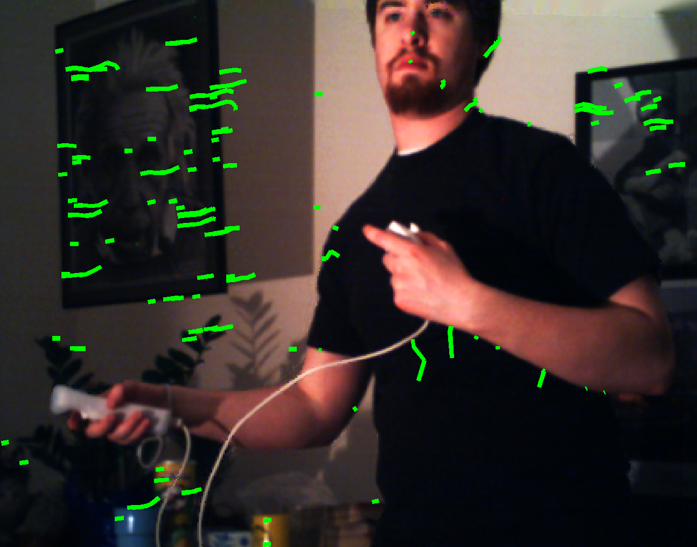
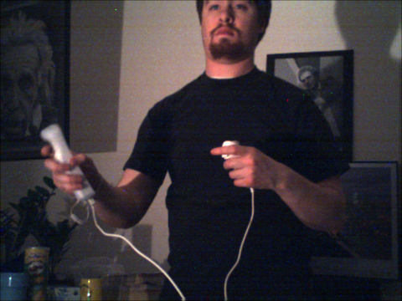



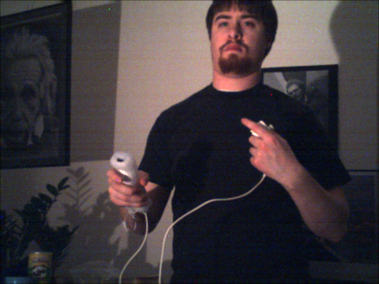
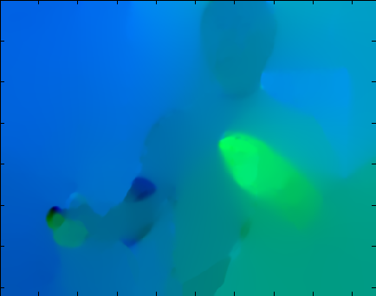


Light Field Video Stabilization
This work is sup-
ported in part by
Adobe System Inc. & NSF IIS-0845916.
Brandon M. Smith, Li Zhang
Computer Sciences, UW-Madison
Hailin Jin, Aseem Agarwala
Adobe Systems, Inc.
UW-Madison
Graphics & Vision Group
Motivation
Videos shot with a hand-held conventional video camera often appear very shaky. This shakiness is often the most distracting aspect of amateur videos that easily distinguishes them from more professional work.
Algorithm Outline
Video Stabilization
Compute depth map for each time instant [Smith et al. 2009]
Professional Solutions
Consumer Solutions
2D-transformation based methods
Burt & Anandan, Image Stabilization by Registration to a Reference Mosaic. DARPA Image Understanding Workshop, 1994
Hansen et al., Real-Time Scene Stabilization and Mosaic Construction. DARPA Image Understanding Workshop, 1994
Lee et al., Video Stabilization Using Robust Feature Trajectories. ICCV 2009
2. Compute optical flow for each time instant [Bruhn et al. 2005]
sensor stabilization
3. Detect Canny edges, use flow to match edges over time
|
|
camera crane
steadicam
camera dolly
…
4. Run spacetime optimization to find {R,t}_{f=1,…,F}
Use special hardware to avoid camera shake
_{F-1}
|
2
(
)
∑
∑
1
(
|
E
{R,t}_{f=1,…,F}
=
w_{f,j}
q_{f,j} − − q_{f-1,jprev}+ q_{f+1,jnext}
)
+ E_{reg}
Vibration Reduction (VR)
_{f=2}
_{j}
∈φ
_{f}
2
Expensive
Cumbersome
optical stabilization
5. New view synthesis
Distant scenes
Limited DOF
Rotational camera motion
Small baseline
State-of-the-art
New Approach
New View Synthesis
Relative
Transformation
R,t
Liu et al., SIGGRAPH 2009
Panasonic HD Stereo Camcorder
Viewplus Profusion 25C
Input Images
New View
Synthesis
Depth Maps
Works well if structure from motion is successful
Existing applications
Background has enough visual features
New-view synthesis [Levoy & Hanrahan SIGGRAPH ‘96, Gortler et al. SIGGRAPH ‘96]
Small dynamic targets
Synthetic aperture [Wilburn et al., SIGGRAPH 2005]
Noise Removal [Zhang et al., CVPR 2009]
Synthesized Image
New application
Why Does a Camera Array Help?
Video Stabilization
How to Avoid Structure from Motion?
Results
Stabilization as image based rendering [Buehler et al. CVPR 2001]
Insight: Only Need Relative Transformation R_{f}, t_{f}
Virtual Camera Path
Virtual Camera Path
Actual Camera Path
Actual Camera Path
Synthesize a video along a virtual smooth camera path
Spacetime optimization:
Maximize smoothness of virtual video as function of {R_{f}, t_{f}}_{f=1…F}
More input views at each time instant
Easier to work with dynamic scenes
Better handling of parallax
Advantage:
Do not need to compute 3D input camera path
How to Define the Smoothness of a Video?
Matching Salient Features
p_{f-1}
, Z_{f-1}
p_{f}
, Z_{f}
p_{f+1}
, Z_{f+1}
reproj(p_{f-1}, Z_{f-1}, R_{f-1},t_{f-1})
Original Camera
reproj(p_{f+1}, Z_{f+1}, R_{f+1},t_{f+1})
Canny Edge Maps
reproj(p_{f}, Z_{f}, R_{f},t_{f})
Summary of Contributions
Future Work
q_{f-1}
q_{f}
q_{f+1}
  Use an array for stabilization
Increase algorithm efficiency
Virtual Camera
Optical Flow [Bruhn et al. 2005]
  Stabilization without structure from motion
Use fewer cameras (two instead of five)
_{F-1}
  Can handle challenging cases
Motion deblurring with camera arrays
∑
∑
|
2
    Nearby, dynamic targets
Better handle image periphery problems
|
|
(
)
1
|
(
)
E
{R,t}_{f=1,…,F}
=
w_{f,j}
q_{f,j} − − q_{f-1,jprev}+ q_{f+1,jnext}
+ E_{reg}
    Large scene depth variation
_{f=2}
_{j}
∈φ
2
    Violent camera shake
Evaluate a range of camera baselines

