Slide 1
Mining Policies From Enterprise Network Configuration
Theophilus Benson,
Aditya Akella, David Maltz
University Of Wisconsin-Madison,
Microsoft Research

Slide 2
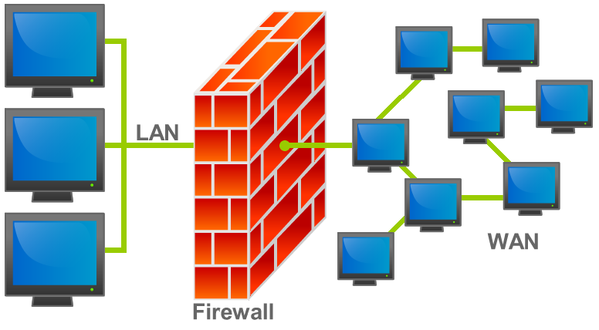
Enterprise Network Policies
Access control policies
  Restrict communication between end-hosts
    Secure network resources
Notes:
Several different policies but we focus on access control

Slide 3
Implementing Network Policies
Implementing policy
  Low level command set
  Different mechanisms
Global policy is difficult to discover
  No documentation
access-list 9 10.1.0.0 0.0.255.255
access-list 5 permit 146.151.176.0 0.0.1.255
access-list 5 permit 146.151.178.0 0.0.1.255
access-list 5 permit 146.151.180.0 0.0.3.255
route-map I1-Only permit 10
description using access-list 125
match ip address 125
set ip next-hop 128.2.33.225
ip prefix-list campus-routes seq 1 permit 72.33.0.0/16
ip prefix-list campus-routes seq 3 permit 144.92.0.0/16
ip prefix-list campus-routes seq 4 permit 146.151.0.0/16
ip prefix-list campus-routes seq 5 permit 198.51.254.0/
IT Depart.
Finance Depart.
HR Depart.
Notes:
Implementing policy
Different mechanisms; acl, route-map
Multiple devices; core, edge
Low level command set; juniper junos, cisco ios
Distributed implementation + low level comand set = difficult to extract global policy

Slide 4

Motivation: Discovering Network Policies
Why discover a network’s policy?
  Debug network problems
  Guide network redesign

Slide 5
Current Approaches for Discovering Network Policies
Manual inspection
  Time consuming
  Error prone
Extracting reachability sets
  Too fined grained
  Not human readable
Networks | Mean file size
Univ-1 | 2535
Univ-2 | 560
Univ-3 | 3060
Enet-1 | 278
Enet-3 | 600
A
B
E
R(B,C)
D
C
R(D,C)
R(C,C)

Slide 6
Example of Policies in an Enterprise
Solution: policy units
  Equivalence class on the reachability profile over the network
Host 1
Host 2
Host 3
Host 4
Host 5
Notes:
Host 1 & 2 same profile
4 policy units

Slide 7
Outline
Background
Motivation
Extracting policy units
Empirical study on 5 networks
Conclusion

Slide 8
Discovering Policy Units 1: Extracting Router Reachability Set
Simulate control plane protocols
  Discover shortest paths
Apply data plane restrictions
  R² reachability sets
F
H
I

Slide 9

Discovering Policy Units 2:
Extracting Subnet Reachability Set
Decompose each RRS into several subnet reachability set
  Apply egress and ingress filters
S² reachability sets
F
H
SF
SH
I
SI

Slide 10
Discovering Policy Units 3:
Extracting Subunit
Find largest group of addresses with identical reachability profile
Hash each subunit
SF
SH
SI
SF
SH
SI

Slide 11
Discovering Policy Units 4:
The Policy Units
Extract policy units
  Policy unit = subunit with same hash
4 policy units from 7 sub units
SF
SH
SI
SF
SH
SI

Slide 12
Policy Units in Enterprises
Name | # Subnets | # Policy Units
Univ-1 | 942 | 2
Univ-2 | 869 | 2
Univ-3 | 617 | 15
Enet-1 | 98 | 1
Enet-2 | 142 | 40
Policy units succinctly describe network
Two classes of enterprises
  Policy-lite: simple with few
  Policy-heavy: complex with many
Notes:
Policy units succinctly describe network
No correlation between size and units
Two classes of enterprises
Policy-lite: simple with few
Policy-heavy: complex with many

Slide 13
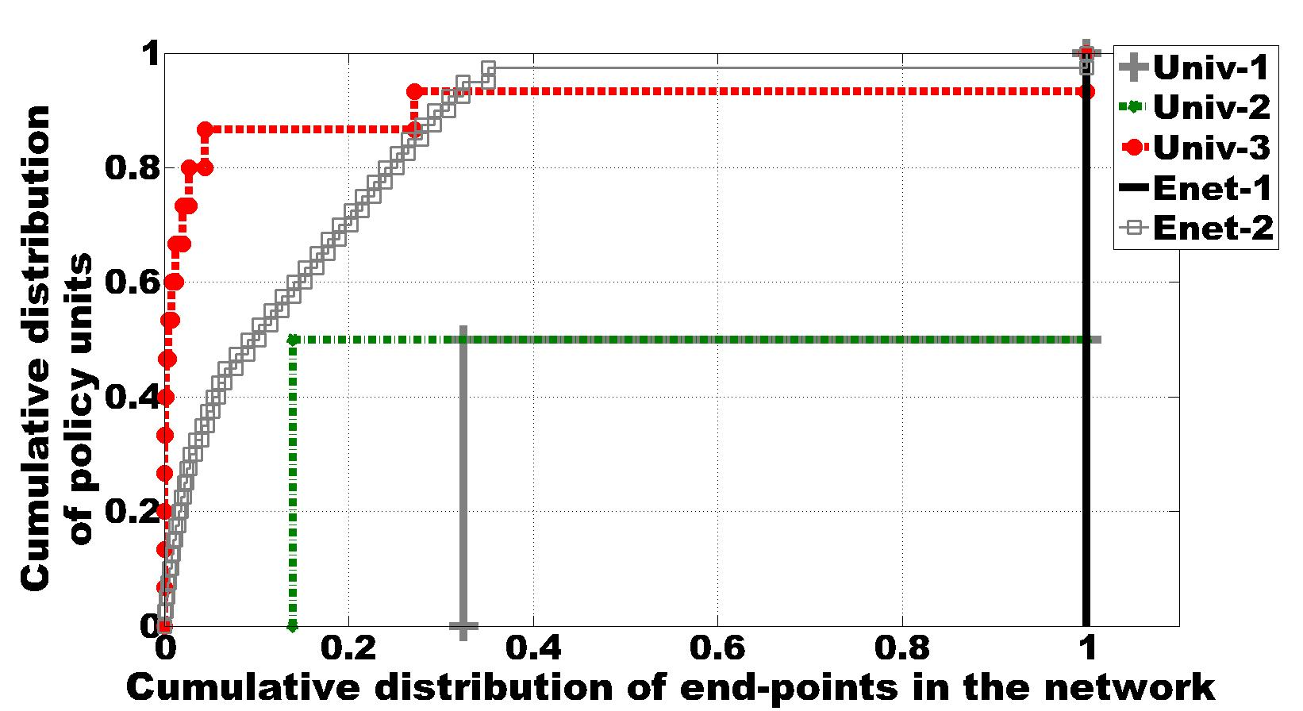
Footprint of Policy Units
Name | # Policy Units
Univ-1 | 2
Univ-2 | 2
Univ-3 | 15
Enet-1 | 1
Enet-2 | 40
4 units cover 70% of end points
Policy-Heavy: Special cases exists
  E.g admins, networked appliances

Slide 14
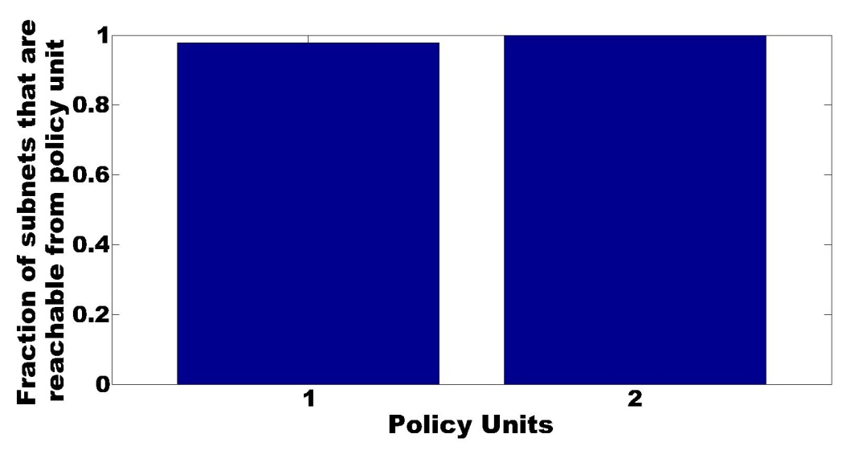
Policy Units in a Policy-lite Enterprise
“Default open”: network
  Control plane filters
Verified units with operator
Notes:
High-level:
Graph showing result from one enterprise network with 24 routers.
This is actually a Very common pattern.
This specific one caused by restriction on a handful of subnets. All host can reach most subnet but only a special group and reach the restricted subnets. The host that can talk with the restricted subnets are in PU #2 you their bar goes to 1.0, where as the host in PU#1 goes up to a little less than that. What caused that in this specific case are control plane filters Our system is able to automatically go through config files and discover the fact that the network has a default open policy as well as determine which hosts are in which group. From this example, we see the strength of the system in finding policies with subtle differences.

Slide 15
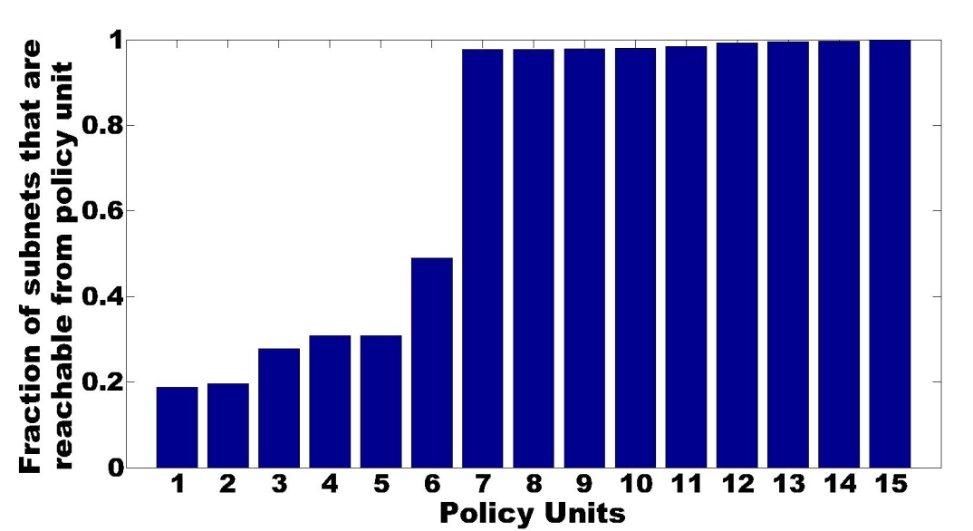
Policy Units in a Policy-heavy Enterprise
Dichotomy:
  Default-open: data plane filters
  Default-closed: data plane & control plane filters
Notes:
First half is similar to the previous example
Second half more interesting. Sets of users that can reach less than half of the network.
Able to summarize thousand of lines into 15 units

Slide 16
Conclusion
Described a framework for extracting policy units
Analyzed policies of 5 enterprises
    Most users experience the same policy
    Network implement few policies
Notes:
Elevator pitch: from our analysis we discovered that the networks implement small # of policies as indicated by the small # of policy units discovered, this highlights the strenght of the Policy un as an analysis/sumary tool

Slide 17
Thank You
Questions?

Slide 18
Related Work
Reachability sets
  Xie et al. mine policies to check for inconsistencies
Simplify policy implementation
  Inherent support for manageability [e.g., Ethane, 4D]

Slide 19
Reachability Sets As ACLs

Slide 20
Hashing ACLs

Slide 21
Reachability Profile

Slide 22
Subnet Matrix

Slide 23
IT Depart.
HR Depart.
Finance Depart.

Slide 24
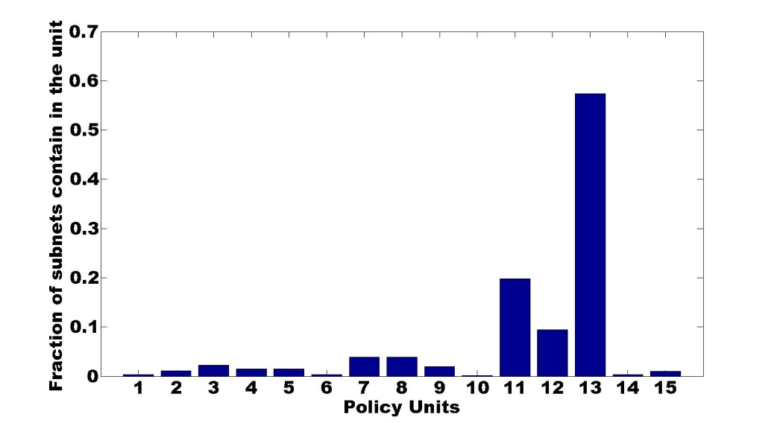

Slide 25
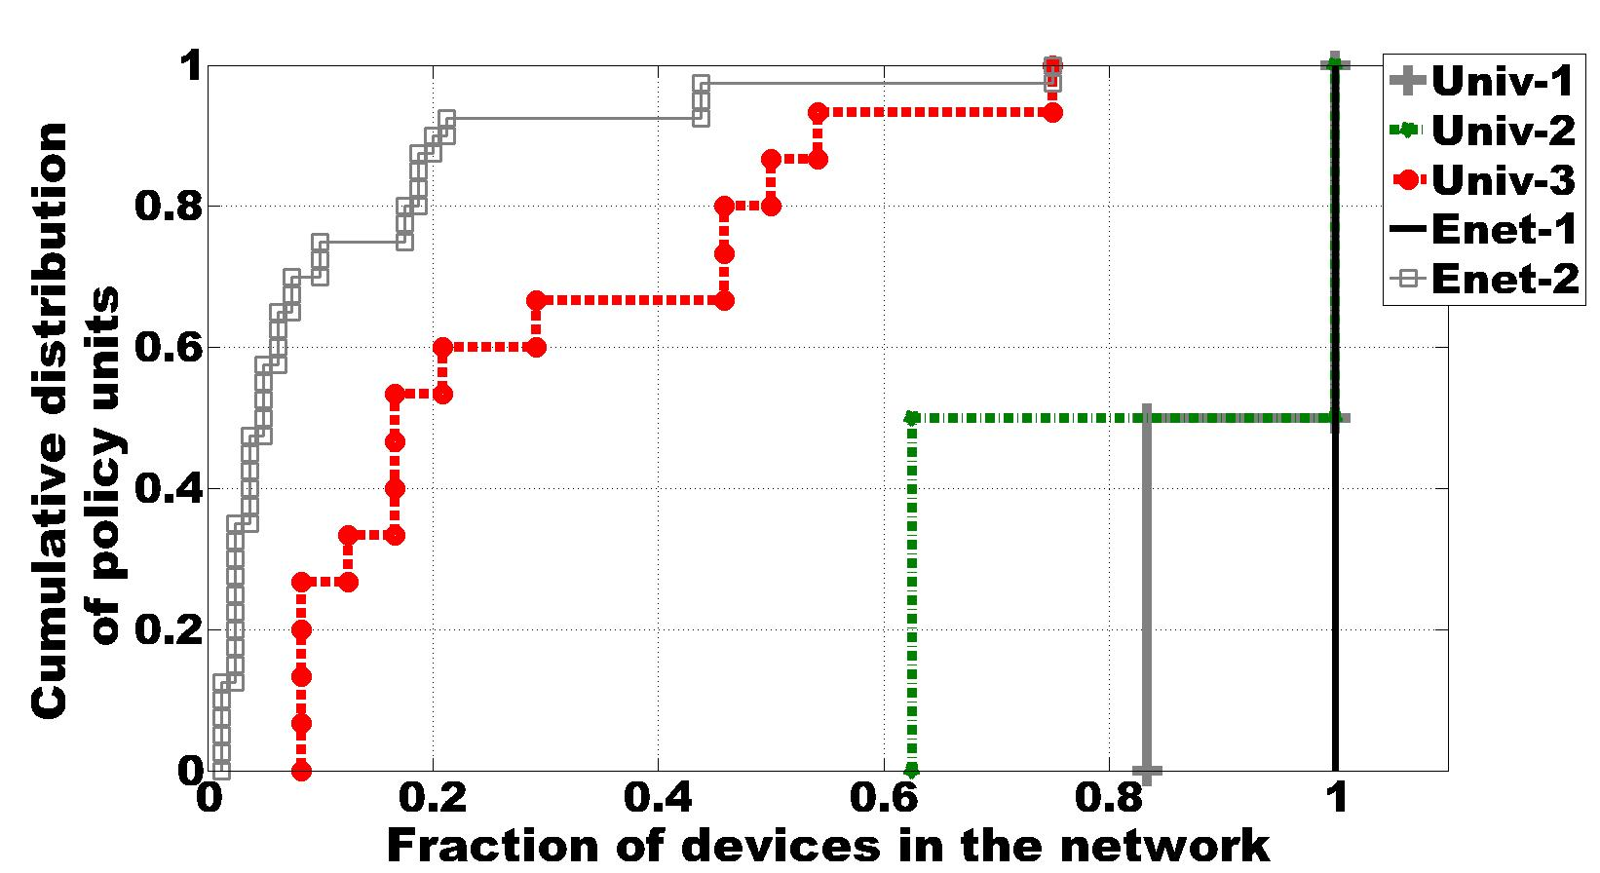
Results: Policy Units In Enterprises
Most policies in a few units
  Over 70% in 2 units
Name | # Dev | # Units
Univ-1 | 12 | 2
Univ-2 | 24 | 2
Univ-3 | 24 | 15
Enet-1 | 7 | 1
Enet-2 | 83 | 40

