Slide 1
Chimera: Large-Scale Classification using Machine Learning, Rules, and Crowdsourcing
Chong Sun, Narasimhan Rampalli, Frank Yang, AnHai Doan
@WalmartLabs & UW-Madison
Presenter: Jun Xie, @WalmartLabs
@WalmartLabs

Slide 2
Problem Definition
Classify tens of millions of products into 5000+ types
Each product: a record of attribute-value pairs
title: Gerber folding knife 0 KN-Knives
description: most versatile knife in its category ...
manufacturer, color, etc.
many products have just title attribute
Product types
laptop computers, area rugs, laptop bags & cases, dining chairs, etc.
ID | Title | SCC PT
EASW1876 | Eastern Weavers Rugs EYEBALLWH-8x10 Shag Eyeball White 8x10 Rug Shag Rugs | Area Rugs
EMLCO655 | Royce Leather 643-RED-4 Ladies Laptop Brief - Red Notebook Cases | Laptop Bags and Cases
14968347 | International Concepts Stacking Dining Arm Chair (Set of 2) | Dining Chairs
12490924 | South Carolina Gamecocks Rectangle Toothfairy Pillow | Decorative Pillows

Slide 3
Challenges
Very large # of product types (5000+)
started out having very little training data
creating training data for 5000+ is very difficult
Very limited human resources
1 developer and 1-2 analysts (who can’t write code)
Products often arrive in bursts
e.g., a batch of 300K items just come, must classify fast
makes it hard to provision for analysts and outsourcing
Need very high precision (>92%)
can tolerate lower recall, but want to increase recall over time
Current approaches can’t handle these scales/challenges

Slide 4
Manually Classifying the Items
Using analysts
can accurately classify about 100 items per day
must understand the item, navigate through a large space of possible types, decide on the most appropriate one
e.g., Misses’ Jacket, Pants and Blouse – 14 -16-18-20 Pattern ➔ sewing patterns
e.g., Gerber folding knife 0 KN-Knives ➔ utility knives? pocket knives? tactical knives? multitools?
would take 5 analysts 200 days to classify 100K items
Using outsourcing
very expensive: $770K for 1M items
outsourcing is not “elastic”
Using crowdsourcing
crowd workers can’t navigate a complex and large taxonomy of types

Slide 5
Learning-Based Solutions
Difficult to generate training data
too many prod types (5000+)
to label just 200 items per prod type, must label 1M items
Difficult to generate representative samples
random sampling would severely under-sample certain types
analysts and outsourced workers don’t know how to obtain a random sample, e.g., for handbags, computer cables
new product types appear all the time ➔ the universe of items keeps changing
Difficult to handle “corner” cases
items coming from special sources, need to be handled specially
hard to “go the last mile”, e.g., increasing precision from 90 to 95%
Concept drift and changing distribution
e.g., smart phone

Slide 6
Rule-Based Solutions
Analysts & outsourcing workers write rules to classify items
Writing rules to cover 5000+ product types is very slow
doesn’t scale
Our Chimera solution
combines the above approaches
uses learning & hand-crafted rules
uses developers, analysts, and crowsourcing
continuously improves over time
keeps precision high while trying to improve recall

Slide 7
Our Chimera Solution
Classification Rules
Crowd Evaluation
Whitelist Rules
Blacklist Rules
Sample
Items to Classify
Classified
Reports
Gatekeeper
Rules
Attribute Based
Voting Master
Result
Analysis
Unclassified
K-NN
Filter
Naïve Bayes
Perceptron
Regression
Training Data
SVM

Slide 8
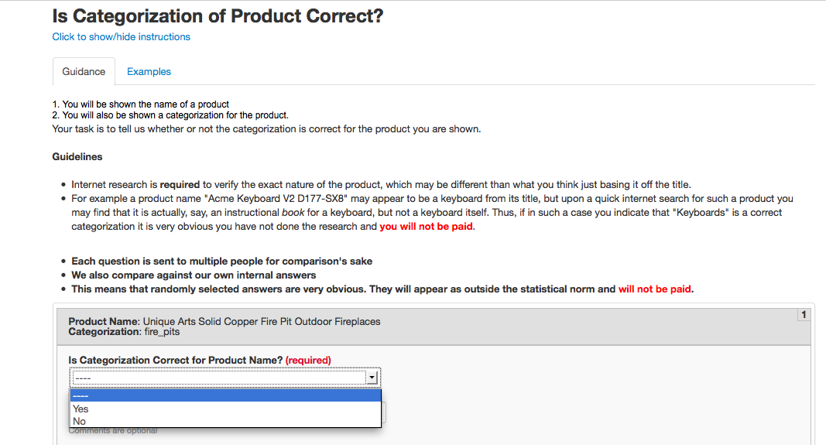
Examples
Rules
rings? ➔ rings
wedding bands? ➔ rings
diamond.*trio sets? ➔ rings
macbook ➔ ! Fruit (a blacklist rule)
Classification evaluation using crowdsourcing

Slide 9
Key Novelties of Our Solution
Use both learning and rules extensively
rules are not “nice to have”, they are critical for high accuracy
Use both crowd and analysts for evaluation/analysis
using both in-house analysts and crowdsourcing is critical at our scale to achieve an accurate, continuously improving, and cost-effective solution
Scalable in terms of human resources
taps into crowdsourcing (very elastic) and analysts
Treat human and machines as first-class citizens
solution carefully spells out what techniques are used where, who is doing what, and how to coordinate among them

Slide 10
Evaluation
Chimera has been developed and deployed for 2 years
Applied to 2.5M items from market place vendors
classified more than 90% with 92% precision
Applied to 14M items from walmart.com
classified 93% with 93% precision
As of March 2014
has 852K items in training data for 3,663 types
20,459 rules for 4,930 types
Crowdsourcing
evaluating 1,000 items takes 1 hour with 15-25 workers
Staffing
1 developer + 1 dedicated analyst + 1 more analyst when needed

Slide 11
Conclusion & Lessons Learned
Chimera: classifying millions of items into 5000+ types
At this scale, existing approaches do not work well
We have developed a highly scalable, accurate solution
using learning, rules, crowdsourcing, analysts
Lessons learned
both learning + rules are critical
crowdsourcing is critical but must be closely monitored
crowdsourcing must be coupled with in-house analysts and developers
outsourcing does not work at a very large scale
hybrid human-machine systems are here to stay
More details in our paper

