Slide 1
Building, Maintaining, and Using Knowledge Bases: A Report from the Trenches
1,2
1,2
1
Omkar Deshpande , Digvijay S. Lamba , Michel Tourn ,
Sanjib Das , Sri Subramaniam , Anand Rajaraman ,Venky Harinarayan , AnHai Doan
3
1,2
1
1
1,2,3
1
2
3
Kosmix, @WalmartLabs, University of Wisconsin-Madison
@WalmartLabs

Slide 2
Knowledge Bases (KBs)
Concept taxonomy
Instances
Relationships
all
people
lives-in
places
actors
philosophers
capitals
Concepts
Instances
Mel Gibson
Socrates
Athens

Slide 3
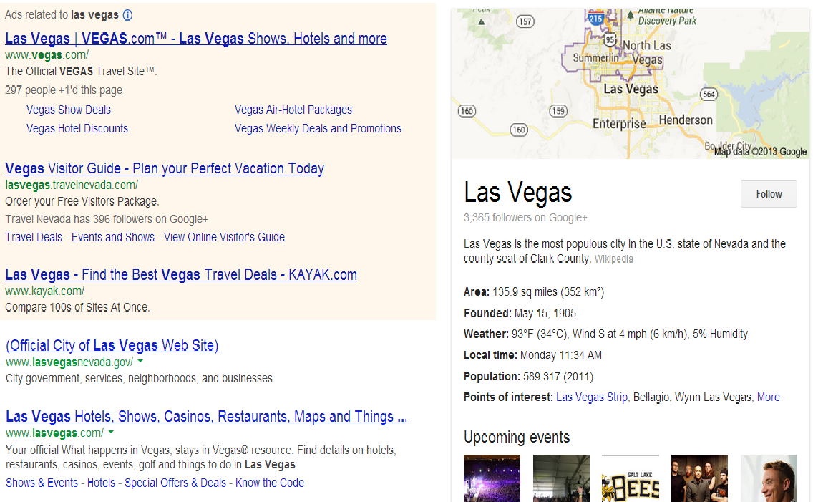
Increasingly Critical to a Wide Variety of Applications
General search
Google search using Knowledge Graph
Product search
Walmart.com, Amazon.com
Question answering
IBM Watson, Apple Siri
Advertising
Information extraction
Recommendation, playlisting, fingerprinting music (e.g., echonest.com)
Biomedical expert finding (e.g., knode.com)
Data mining in heating and cooling (e.g., Johnson Control)
Deep Web search
Social media analysis (e.g., event discovery, event monitoring)
Social commerce (e.g., social gifting), and many more ...

Slide 4
Example Knowledge Base: Kosmix KB
6.5M concepts, 6.7M concept instances, 165M relationship instances
23 verticals, 30G of disk space
First built around 2005 at Kosmix
for Deep Web search, advertising, social media analysis
Has been significantly expanded at WalmartLabs since 2011
for product search, social commerce, mining of social media, understanding Web data
Kosmix KB
Wikipedia
Adam (health)
Chrome (automobiles)
Music-Brainz (music)
City DB (cities)
Yahoo! Stocks (stocks and companies)
Yahoo! Travel (travel destinations)
….....

Slide 5
Example Application: Deep Web Search at Kosmix
all
places
people
Las Vegas
Yahoo! Travel
Whatsonwhen
.
.
.

Slide 6
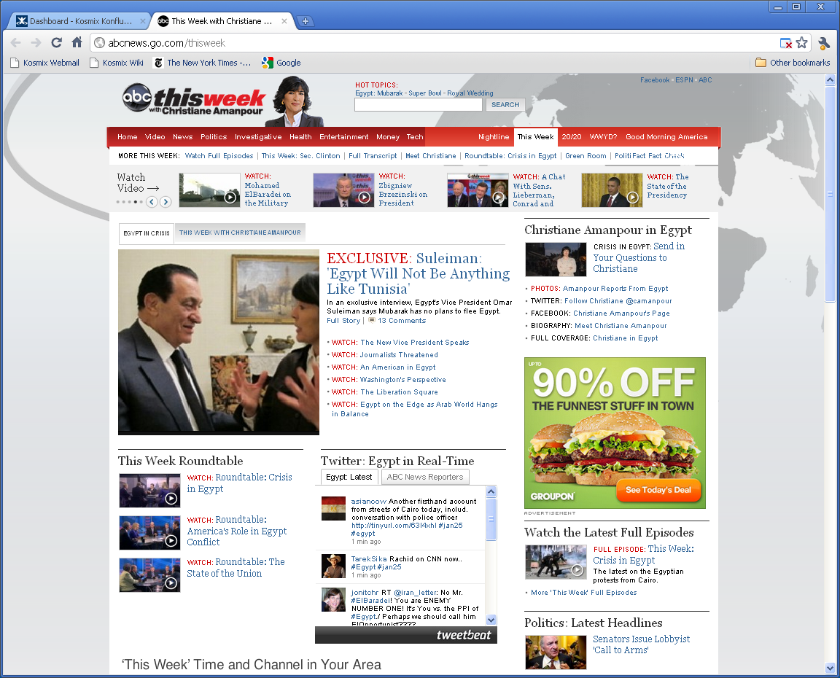
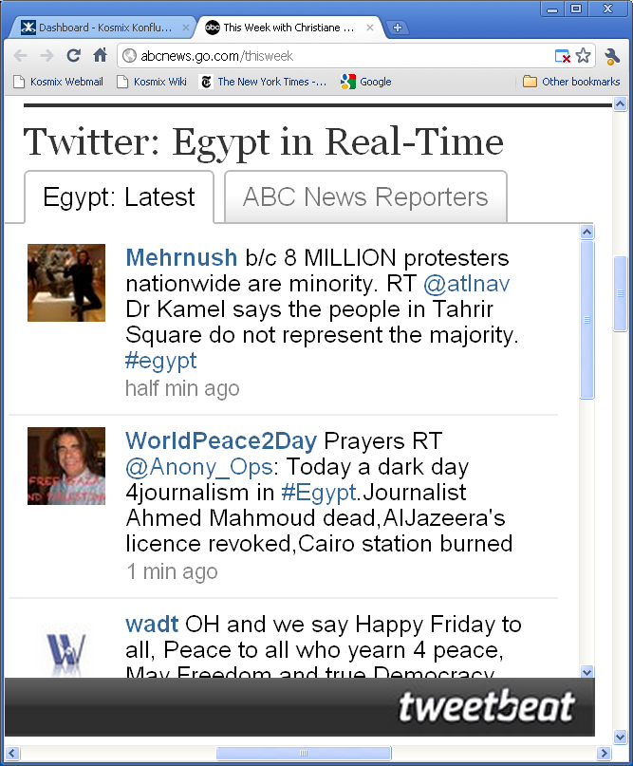
Example Application: Event Monitoring in Social Media
all
places
people
Tahrir
Las Vegas

Slide 7
Example Application: Social Gifting at WalmartLabs
Is it bad that I want a Donnie Darko tattoo?
Should ‘family guy’ end? NEVER
How can you not like Darko?! :o
all
movies
places
Donnie Darko

Slide 8
State of the Art
Increasingly critical for a wide variety of applications
Significant & growing interest in academia and industry
Important for Big Data
Big Data needs big semantics, which often come in form of large KBs
But little has been published about building, maintaining, using KBs
Current works have addressed only isolated aspects:
Initial construction, data representation, storage format, query APIs, ...
No work has addressed the end-to-end process
This work: end-to-end process of building, maintaining, using Kosmix KB
How to maintain the KB over time?
How to handle human feedback?
How to integrate various data sources?
What kinds of applications is a not-so-accurate KB good for?
How big of a team is required to build such a KB? What should the team do?

Slide 9
Key Distinguishing Aspects of Kosmix KB
Building the KB
started with Wikipedia, added many more data sources
extracting a KB from Wikipedia is non-trivial, use Web and social data / curation to guide the process
adding a lot of social/Web metadata to KB nodes
Updating the KB
rerun from scratch instead of incremental updating
must reuse human curation
Curating the KB
ongoing process, regularly evaluate the KB
add curations in form of commands ➔ enable reusing of human curation can curate multiple errors all at once

Slide 10
Building the Kosmix KB
Convert Wikipedia into a KB, then add more data sources
Why starting with Wikipedia?
must process social media
social media often mentions latest events/persons/... ➔ need them to be in our KB asap
Wikipedia is ideal for this
e.g., very soon after Susan Boyle became famous, Wikipedia had a homepage for her
Kosmix KB
Wikipedia
Adam (health)
Chrome (automobiles)
Music-Brainz (music)
City DB (cities)
Yahoo! Stocks (stocks and companies)
Yahoo! Travel (travel destinations)
….....

Slide 11
1. Convert Wikipedia into a Graph
Crawl Wikipedia, parse & construct a graph
nodes = Wikipedia pages, edges = links among Wikipedia pages
Remove irrelevant parts of graph
administration, help, discussion, ...
Glue remaining parts into a new graph with a ROOT node
ROOT
….
Kosmix
Health
Kosmix
SocialSciences
Kosmix
History
Kosmix
Arts&Ent
….
23 verticals
….
Diseases
and disorders
Philosophy
Ancient History
Disney
characters
….

Slide 12
2. Extract Taxonomy of Concepts from Graph
To obtain taxonomic tree ➔ for each node, find a single path to ROOT
But nodes can have multiple paths to ROOT; which one to pick?
Picking wrong path causes many problems
e.g., ROOT ➔ Movies ➔ Actors ➔ Ronald Reagan “Reagan left a mixed legacy”: will be classified incorrectly under “Movies”
ROOT
Philosophers
Politics
Movies
Ancient Greek
Philosophers
5th Century BC
Philosophers
US Presidents
Actors
Forced Suicide
Ronald Reagan
Socrates

Slide 13
2. Extract Taxonomy of Concepts from Graph
Intuitively, pick most popular/important/relevant path
e.g., most people know Reagan as a president, not as an actor
Solution:
assign to each edge A➔B a weight to capture its popularity/importance/relevance
run a spanning tree discovery algorithm using these weights
output a maximum spanning tree
ROOT
0.3
0.5
0.5
Philosophers
Politics
Movies
0.5
0.4
0.7
0.2
Ancient Greek
Philosophers
5th Century BC
Philosophers
US Presidents
Actors
0.9
0.5
0.9
0.7
Forced Suicide
Ronald Reagan
0.8
Socrates

Slide 14
2. Extract Taxonomy of Concepts from Graph
How to assign weights to edge A➔B?
assign multiple weights, they form a weight vector
Examples
Web signal: co-occurrence count of A and B on the Web
e.g., how many times “Ronald Reagan” and “President” co-occur in same Web page?
Social signal: same as Web signal, but measure co-occurrence in social media
List signal: how many times A and B co-occur in the same Wikipedia list?
Similarity in the names of the two nodes
e.g., “Actors” and “Actors by Nationality”
…
analyst can also assign weights to the edges

Slide 15
2. Extract Taxonomy of Concepts from Graph
ROOT
Philosophers
Politics
Movies
Ancient Greek
Philosophers
5th Century BC
Philosophers
US Presidents
Actors
Forced Suicide
Ronald Reagan
Socrates
We keep all paths for the nodes
very useful for applications
To keep all paths, must detect and break cycles (see paper)
End result: DAG of concepts + taxonomic tree imposed on the DAG

Slide 16
3. Extract Relations for the KB
ROOT
Typical solution:
Define a set of relations
livesIn, birthYear
Write extractors for them
using rules, machine learning
Apply extractors
livesIn(Reagan, DC), birthYear(Reagan, 1911)
Problems:
Wikipedia has 10,000+ interesting relations ➔ can’t manually define and extract all
difficult to obtain high accuracy
Philosophers
Politics
Movies
Locations
DC
Ancient Greek
Philosophers
5th Century BC
Philosophers
US Presidents
Actors
Forced Suicide
Ronald Reagan
Socrates

Slide 17
3. Extract Relations for the KB
Our solution: extract fuzzy relations
Extract <Barack Obama, Bo (dog), Family> as a relation
a relation exists between “Barack Obama” and “Bo (dog)”, encoded by string “Family”
but we don’t know anything more precise
Yet this is already quite useful
Example: querying “Obama family” on a search engine
search query contains “family”, above relation also contains “family”
can return “Bo (dog)” as an answer
even though word “family” never appears in the page “Bo (dog)”
Barack Obama
………………..
………………..
Family
………………..
… Bo …
……………….
Bo (dog)
………………..
………………..
………………..
………………..
………………..

Slide 18
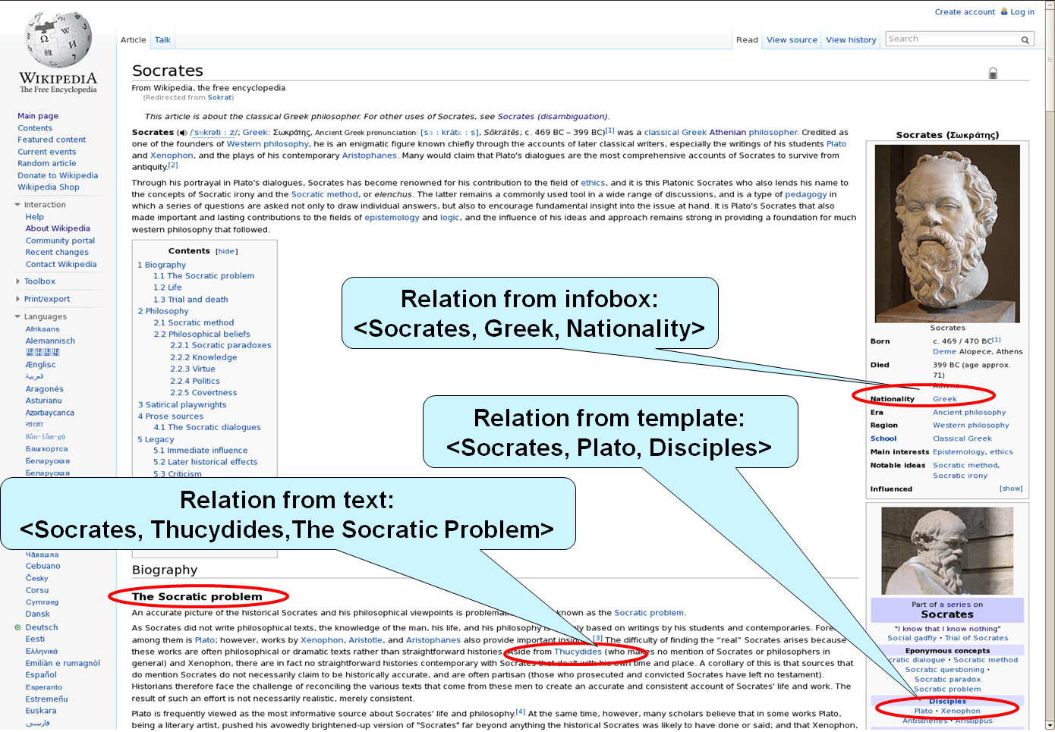

Slide 19
4. Extract Metadata for KB Instances
Web URLs
en.wikipedia.org/wiki/Mel_Gibson‎
movies.yahoo.com/person/mel-gibson/
imdb.com/name/nm0000154/
Twitter ID
@melgibson
Wikipedia page visits (last day, last week,..)
7, 33, …
Web signature
“actor”, “Hollywood”, “Oscar”, …
Social signature (last 3 hours)
“car”, “crash”, “Maserati”, …
…
ROOT
places
people
actors
Angelina Jolie
Mel Gibson

Slide 20
Example: Using Metadata in Social Media Analysis
ROOT
movies
places
people
actors
Social signature:
crash, car, Maserati
Mel (film)
Angelina Jolie
Mel Gibson
@dsmith: Mel crashed. Maserati is gone.
For more detail, see “Entity Extraction, Linking, Classification, and Tagging for Social Media: A Wikipedia-Based Approach”, VLDB-13

Slide 21
5. Add More Data Sources to the KB
Kosmix KB
Wikipedia
Adam (health)
Chrome (automobiles)
Music-Brainz (music)
City DB (cities)
Yahoo! Stocks (stocks and companies)
Yahoo! Travel (travel destinations)
….....
Challenges
Match source taxonomy (if any) to KB taxonomy
Match source instances to KB instances
Key innovations (see paper)
Interleave taxonomy matching and instance matching
Heavily use node metadata to match instances

Slide 22
Updating the KB
Kosmix KB
Wikipedia
Adam (health)
Chrome (automobiles)
Music-Brainz (music)
City DB (cities)
Yahoo! Stocks (stocks and companies)
Yahoo! Travel (travel destinations)
….....
Typical solution : Incremental updates
fast, relatively easy to preserve human curations
But difficult in our case
we use “global” algorithms (e.g., spanning tree discovery) during KB construction
Our solution
run the pipeline from the scratch daily
challenge: how to preserve human curation?

Slide 23
Human Curation
Automatically constructed KB often contains errors
automatic version of Kosmix KB is about 70% accurate
➔ need human curation
A human analyst
evaluates the quality of our KB
writes curations
Evaluate quality
samples paths and examines their accuracy
checks parent assignment for all nodes having at least 200 children
gets alerted by developers working on applications in case of quality issues
Curate by writing commands
e.g. Angelina Jolie | actors | 0.9, or even better: infobox:actors | actors | 0.9
Current KB contains several thousand commands (written over 3-4 years)
Raises the accuracy of the KB to well above 90%
all
places
people
products
Mountain View
actors
Brad Pitt
Angelina Jolie
Mel Gibson

Slide 24
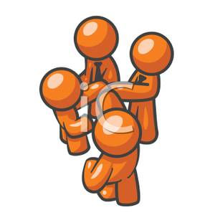
Team Organization
A core team of 4 people (in 2010-2011)
1 data analyst
performed quality evaluation and curation
1 developer
wrote code, developed new features,
added new signals on edges, etc.
0.5 systems expert
crawled data sources, maintained in-house Wikipedia mirror and Web corpus
0.5 UI specialist
worked on the look-and-feel of the tools
1 team lead
designed, supervised and coordinated the work

Slide 25
Lessons Learned
Possible to build relatively large KBs with modest hardware and team size
Human curation is important
raises the accuracy of our KB from 70% to well above 90%
possible to make a lot of curation with just 1-2 persons, using commands
An imperfect KB is still very useful for a variety of real world applications
search, advertising, social media analysis, product search, user query understanding, social gifting, social mining, …
often, these apps use KB internally and do not need to show KB data to end users
Imperfect relationships still quite useful
provide contexts for KB nodes, show how they relate to one another
Capturing contexts is critical for processing social media
especially social contexts
Important to have clear & proven methodologies to build & maintain KBs
as multiple teams try to build their own KBs

Slide 26
Conclusions
KBs are increasingly critical to wide variety of applications
Described end-to-end process of building, maintaining and using KB
Most important takeaways
even a small team can already build non-trivial KBs
even somewhat imperfect KBs can already help many applications
need end-to-end methodology to build and maintain KBs
For more information
have also added much more social data to the Kosmix KB (the social genome)
see an upcoming tech report for more details
see an upcoming VLDB-13 paper for using the KB to process social media
new project, Badger, between UW-Madison and WalmartLabs, on building KBs

