Slide 1
Parameter Passing

Slide 2
Roadmap
Last time
Discussed runtime environments
Described some conventions for assembly
Function call/return involve stack manipulations
Dynamic memory via a heap
Today
Propagating values from one function to another

Slide 3
Outline
Parameter Passing
Different styles
What they mean
How they look on the stack

Slide 4
Vocabulary
Define several terms that are needed for talking about parameters
We’ve already used some of them previously

Slide 5
L- and R- Values
L-Value
A value with a place of storage
R-Value
A value that may not have storage
b = 2;
a = 1;
a = b+b;

Slide 6
Memory references
Pointer
A variable whose value is a memory address
Aliasing
When two or more variables hold same address

Slide 7
Parameter Passing
In the procedure definition:
void v(int a, int b, bool c) { … }
Vocabulary
Formals / formal parameters / parameters
At a call site:
v(a+b, 8, true);
Vocabulary
Actuals / actual parameters / arguments

Slide 8
Types of Parameter Passing
We’ll talk about 4 different varieties
Some of these are more used than others
Each has its own advantages / uses

Slide 9
Pass by Value (aka Call by Value)
When a function is called
Values of actuals are copied into the formals
C and Java always use pass by value
void fun(int a){
a = 1;
}
void main(){
int i = 0;
fun(i);
print(i); }

Slide 10
Pass by Reference (aka Call by Reference)
When a function is called
The address of the actuals are implicitly copied
void f(int a){
a = 1;
}
void main(){
int i = 0;
f(i);
print(i); }

Slide 11
Pass by Reference (aka Call by Reference)
Low addresses
void f(int a){
a = 1;
}
void main(){
int i = 0;
f(i);
print(i); }
$$AR_{f}$$
a:
i:
/ 1
0
$$AR_{Main}$$
High addresses

Slide 12
Pass by Reference (aka Call by Reference)
Low addresses
void h(int c){
c = 1;
}
void g(int b){
h(b);
}
void f(int a){
g(a);
}
void main(){
int i = 0;
f(i);
print(i); }
$$AR_{h}$$
c:
$$AR_{g}$$
b:
$$AR_{f}$$
a:
i:
/ 1
0
$$AR_{Main}$$
High addresses

Slide 13
Language Examples
void fun(int a){
a = 1;
}
void main(){
int i = 0;
fun(i);
print(i); }
void fun(int& a){
a = 1;
}
void main(){
int i = 0;
fun(i);
print(i); }
Pass by value
C and Java
Pass by reference
Allowed in C++ and Pascal
In C, can be simulated using pointers (address-valued parameters)
void fun(int* a){
*a = 1;
}
void main(){
int i = 0;
fun(&i);
print(i); }

Slide 14
Wait, Java is Pass by Value?
All non-primitive L-values are pointers
void fun(int a, Point p){
int a = 0;
p.x = 5;
}
void main(){
int i = 0;
Point k = new Point(1, 2);
fun(i,k); }

Slide 15
Java: Pass by Value
For aDog in main, aDog.getName() equals “Max”.
∴ Execution goes down the then branch.
public static void main( String[] args ){
Dog aDog = new Dog("Max");
foo(aDog);
if (aDog.getName().equals("Max")) {
System.out.println( "Java passes by value." );
} else if (aDog.getName().equals("Fifi")) {
System.out.println( "Java passes by reference." );
}
}
public static void foo(Dog d) {
d.getName().equals("Max");
d = new Dog("Fifi");
d.getName().equals("Fifi");
}
Changes value of d in foo, but leaves aDog in main unchanged

Slide 16
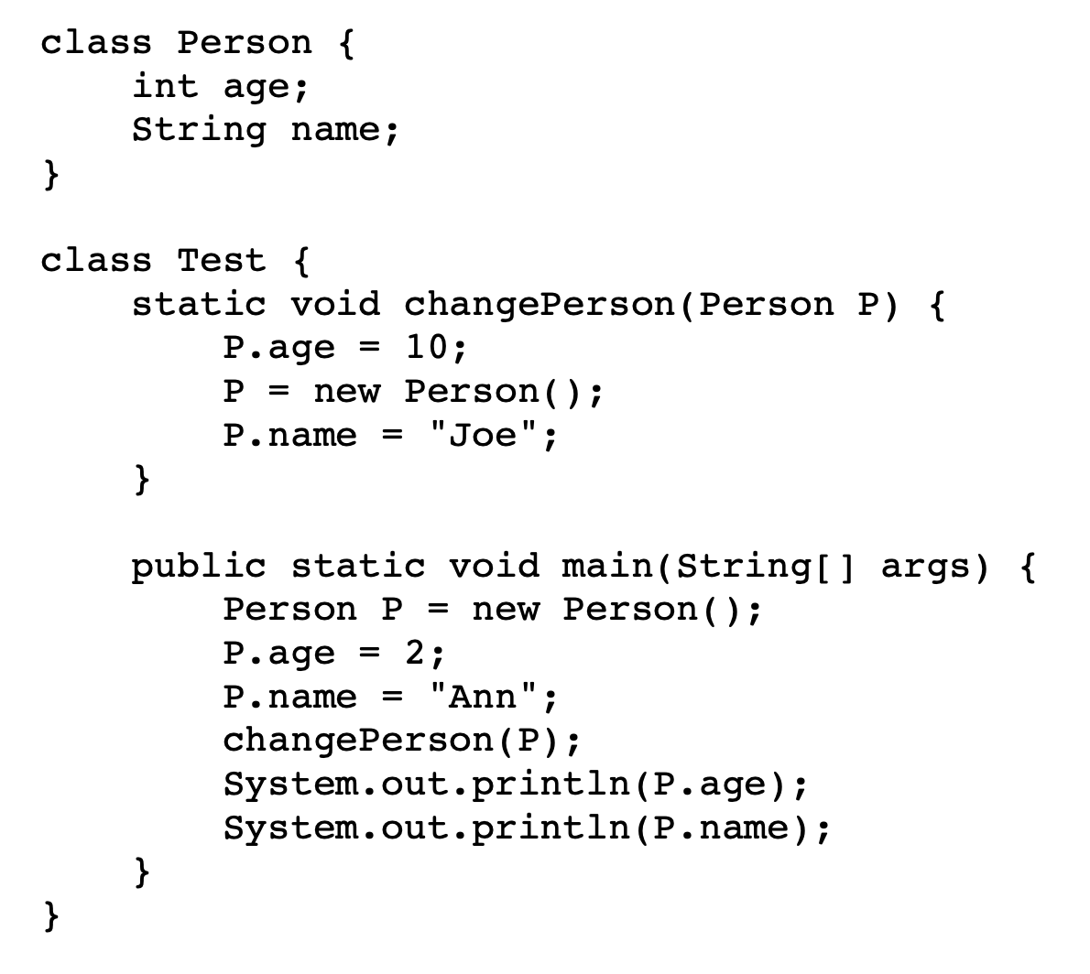
More Java

Slide 17
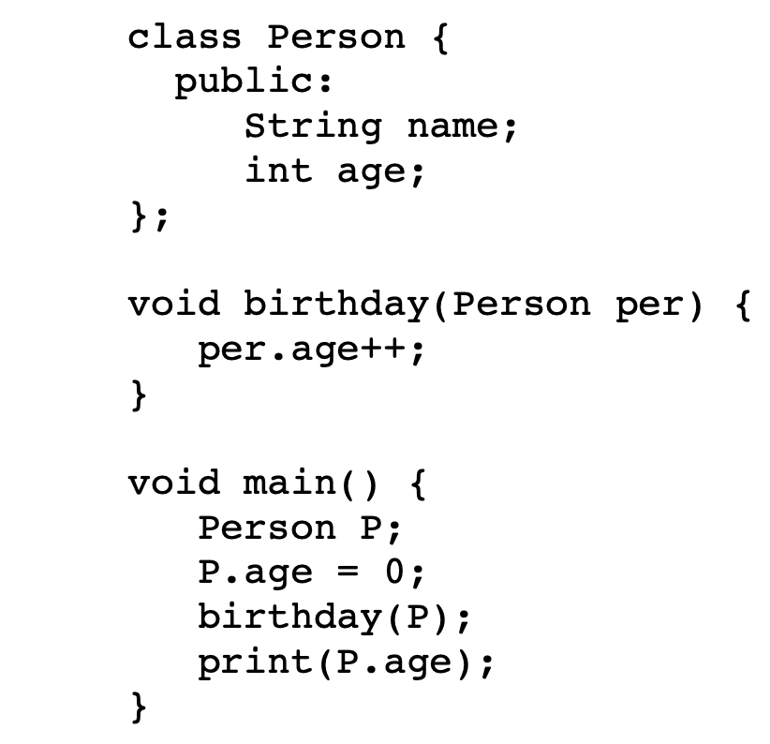

Slide 18
Pass by Value-Result
When a function is called
Value of actual is passed
When the function returns
Final values are copied back to the actuals
∴ The actual must be a variable, not an arbitrary expression
Used by Fortran IV, Ada
As the language examples show, not very modern

Slide 19
Pass by Value-Result – Example 1
int x = 1; // a global variable
void f(int & a)
{
a = 2;
// when f is called from main, a and x are aliases
x = 0;
}
main()
{
f(x);
cout << x; // 0 with call by value and call by reference
// 2 with call by value-result
}

Slide 20
Pass by Value-Result – Example 1
Low addresses
x: 1
/ 0
int x = 1; // a global variable
void f(int & a)
{
a = 2;
// when f is called from main, a and x are aliases
x = 0;
}
main()
{
f(x);
cout << x; // 0 with call by value and call by reference
// 2 with call by value-result
}
$$AR_{f}$$
1
/ 2
$$AR_{Main}$$
High addresses

Slide 21
Pass by Value-Result – Example 2
void f(int &a, int &b)
{
a = 2;
b = 4;
}
main()
{
int x;
f(x, x);
cout << x; // Undefined: different output with
// different compilers
}

Slide 22
Pass by Name (aka Call by Name)
Conceptually works as follows:
When a function is called
Body of the callee is rewritten with the text of the argument
Like macros in C/C++, but conceptually the rewriting occurs at runtime

Slide 23
Call by Need (aka Lazy Evaluation)
int f(x,y)
{ return x+y;}
main()
{
int x = f(5, 6); // x=“5+6”
cout << x; // x is now evaluated
}

Slide 24
Haskell example

Slide 25
Implementing Parameter Passing
Let’s talk about how this is actually going to work in memory

Slide 26
Let’s Draw Out the Memory
int g;
void f (int x, int y, int z){ x = 3 ; y = 4; z = y;
}
void main(){ int a = 1, b = 2, c = 3;
f(a,b,c);
f(a+b,7,8);
}
Consider pass by value and pass by reference

Slide 27
Bad Uses of R-Values
Can prevent programs that are valid in pass by value from working in pass by reference
Or when a C++ formal is changed from int to int&
void f(int a){…} $⇒$ void f(int& a){…}
f(x); // OK
f(3); // not OK
f(x + 3); // not OK
Literals and non-trivial expressions do not have locations in memory
The type checker would catch bad uses of R-values

Slide 28
Let’s Draw Out the Memory Again
int g;
void f(int x, int y, int z){ x = 3 ; y = 4; z = y;
}
void main(){ int a = 1, b = 2, c = 3;
f(a,b,g);
f(a+b,7,8);
}
Consider pass by value-result
and pass by name

Slide 29
Efficiency Considerations [Calls, Accesses by Callee, Return]
Pass by value
Copy values into AR (slow)
Access storage directly in function (fast)
Pass by reference
Copy address into AR (fast)
Access storage via indirection (slow)
Pass by value-result
Strictly slower than pass by value
Also need to know where to copy locations back

Slide 30
Object Handling
void alter(Point pt, Position pos){ pos = pt.p;
pos.x++;
pos.y++;
}
void main(){ Position loc;
Point dot;
// … initialize loc with // x=1,y=2
// … initialize dot with loc
alter(dot, loc);
}
class Point{
Position p; }
class Position{ int x, y;
}
In Java, loc and dot hold the addresses of objects (addresses in the heap)
In C++, loc and dot are objects in the stack; no (extra) indirection needed

Slide 31
Roadmap
We learned about parameter-passing conventions
Semantics of by-value, by-reference, by-value-result, by-name
How the code must traverse the stack for each of the conventions
Next time
Runtime access to variables in different scopes

