Slide 1
Code Generation

Slide 2
Roadmap
Last time, we learned about variable access
Local vs. global variables
Static vs. dynamic scopes
Today
We’ll start getting into the details of MIPS
Code generation

Slide 3
Roadmap
Scanner
Scanner
Tokens
Parser
Parser
Parse Tree
AST
Static-Semantic Analysis
Annotated AST
Symbol Table
IR Codegen
Backend
Optimizer
MC Codegen

Slide 4
The Compiler Back End
Unlike in the front end, we can skip phases without sacrificing correctness
Actually have a couple of options:
What phases do we do?
How do we order our phases?

Slide 5
Outline
Possible compiler designs
Generate IR code or machine-code code directly?
Generate during SDT or as another phase?
Frontend
or
IR
Codegen
MC
Codegen
Optimizer
MC
Codegen

Slide 6
How Many Passes Do We Want?
Fewer passes
Faster compiling
Less storage required
May increase burden on programmer
More passes
Heavyweight
Can lead to better modularity

Slide 7
To Generate IR Code or Not?
Generate Intermediate Representation:
More amenable to optimization
More flexible output options
Can reduce the complexity of code generation
Go straight to machine code:
Much faster to generate code (skip 1 pass, at least)
Less engineering in the compiler

Slide 8
What Might the IR Do?
Provide illusion of infinitely many registers
“Flatten out” expressions
Does not allow building up complex expressions
3AC (Three-Address Code)
Instruction set for a fictional machine
Every operator has at most 3 operands

Slide 9
3AC Example
tmp1 = y * z
tmp2 = x+tmp1
tmp3 = x*y
tmp4 = tmp3+z
if (tmp2 <= tmp4) goto L
a = 0
L: b = 2
if (x + y * z > x * y + z)
a = 0;
b = 2;

Slide 10
3AC Instruction Set
Assignment
x = y op z
x = op y
x = y
Jumps
if ( x op y) goto L
Indirection
x = y[z]
y[z] = x
x = &y
x = *y
*y = x
Call/Return
param x,k
retval x
call p
enter p
leave p
return
retrieve x
Type Conversion
x = AtoB y
Labeling
label L
Basic Math
times, plus, etc.

Slide 11
3AC Representation
Each instruction represented using a structure called a “quad”
Space for the operator
Space for each operand
Pointer to auxilary info
Label, succesor quad, etc.
Chain of quads sent to an architecture-specific machine-code-generation phase

Slide 12
Direct Machine-Code Generation
Option 1
Have a chain of quad-like structures where each element is a machine-code instruction
Pass the chain to a phase that writes to file
Option 2
Write code directly to the file
Greatly aided by the assembler’s capabilities
Assembler allows us to use function names, labels in output

Slide 13
b: Skip Building a Separate IR
Generate code (of a very simple kind) by traversing the AST
Add codeGen methods to the AST nodes
Directly emit corresponding code into file

Slide 14
Correctness/Efficiency Tradeoffs
Two high-level goals
Generate correct code
Generate efficient code
It can be difficult to achieve both of these at the same time
Why?

Slide 15
A Simplified Strategy
Make sure we don’t have to worry about running out of registers
For each operation (built-in, like plus, or user-defined, like a call on a user-define function), we’ll put all arguments on the stack
We’ll make liberal use of the stack for computation
We’ll make use of only two registers
Only use $t1 and $t0 for computation

Slide 16
The CodeGen Pass
We’ll now go through a high-level idea of how the topmost nodes in the program are generated

Slide 17
The Responsibility of Different Nodes
Many nodes simply “direct traffic”
ProgramNode.codeGen
call codeGen on the child
List-node types
call codeGen on each element in turn
DeclNode
StructDeclNode – no code to generate!
FnDeclNode – generate function body
VarDeclNode – varies on context! Globals vs. locals

Slide 18
Generating a Global-Variable Declaration
Source code:
int name;
struct MyStruct instance;
In varDeclNode
Generate:
.data
.align 2 #Align on word boundaries
_name: .space N #(N is the size of variable)

Slide 19
Generating a Global-Variable Declaration
.data
.align 2 #Align on word boundaries
_name: .space N #(N is the size of variable)
How do we know the size?
For scalars, well-defined: int, bool (4 bytes)
structs, 4 * size of the struct
We can calculate this during name analysis

Slide 20
Generating Function Definitions
Need to generate
Preamble
Sort of like the function signature
Prologue
Set up the function’s AR
Body
Code to perform the computation
Epilogue
Tear down the function’s AR

Slide 21
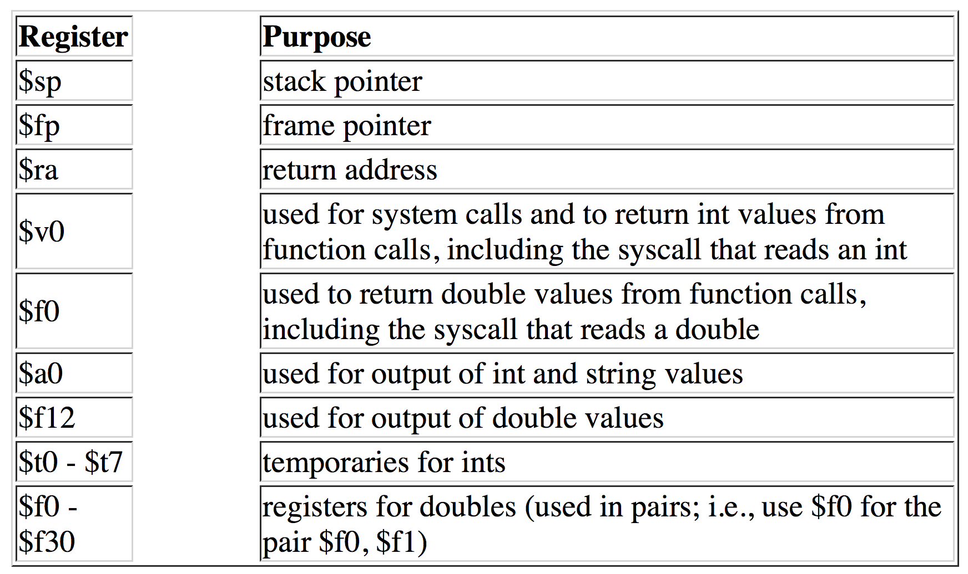
MIPS Crash Course
Also $LO and $HI, special-purpose registers used by multiplication and division instructions
Registers

Slide 22
Program Structure
For the main function, generate:
.text
.globl main
main:
For all other functions, generate:
.text
_<functionName>:
Data
Label: .data
Variable names & size; heap storage
Code
Label: .text
Program instructions
Starting location: main
Ending location

Slide 23
Data
name: type value(s)
E.g.
v1: .word 10
a1: .byte ‘a’ , ’b’
a2: .space 40
40 here is allocated space – no value is initialized

Slide 24
Memory Instructions
lw register_destination, RAM_source
copy word (4 bytes) at source RAM location to destination register.
lb register_destination, RAM_source
copy byte at source RAM location to low-order byte of destination register
li register_destination, value
load immediate value into destination register

Slide 25
Memory Instructions
sw register_source, RAM_dest
store word in source register into RAM destination
sb register_source, RAM_dest
store byte in source register into RAM destination

Slide 26
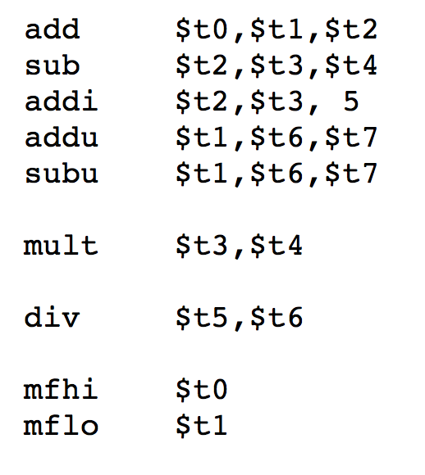
Arithmetic Instructions
Stores result in $LO
Stores result in $LO and
Remainder in $HI
Move from $HI to $t0
Move from $LO to $t1

Slide 27
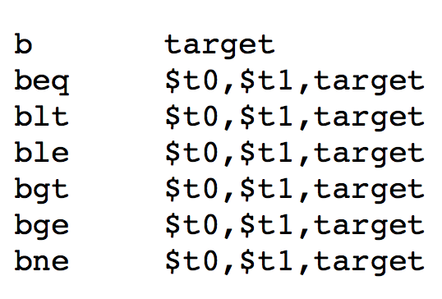
Control Instructions
Unconditional branch to target
Specified as a relative transfer of control to target (i.e., target = IP + delta)
IP implicit; delta is a 16-bit immediate operand (a signed 16-bit number)
Unconditional jump to target
Specified as an absolute transfer of control to target
Target limited to 26 bits
Indirect jump
Specified as an absolute transfer of control to address in $t3
Jump to sub_label, and store the return address in $ra

Slide 28
TODO
MIPS tutorial
https://minnie.tuhs.org/CompArch/Resources/mips_quick_tutorial.html

Slide 29
Roadmap
Today
Talked about compiler back-end design points
Decided to go directly from AST to machine code for our compiler
Next time:
Run through what the actual codegen pass looks like

