Slide 1
Syntax-Directed Translation

Slide 2
CFGs so Far
CFGs for Language Definition
The CFGs we’ve discussed can generate/define languages of valid strings
So far, we start by building a parse tree and end with some valid string
CFGs for Language Recognition
Start with a string $w$, and end with yes/no depending on whether $w∈L(G)$
CFGs in a compiler
Start with a string $w$, and end with a parse tree for $w$ if $w∈L(G)$
Generally an
abstract-syntax tree rather than a parse tree

Slide 3
CFGs for Parsing
Language Recognition isn’t enough for a parser
We also want to translate the sequence
Parsing is a special case of Syntax-Directed Translation
Translate a sequence of tokens into a sequence of actions

Slide 4
Syntax-Directed Translation (SDT)
Augment CFG rules with translation rules (at least 1 per production)
Define translation of LHS nonterminal as function of
Constants
RHS nonterminal translations
RHS terminal value
Assign rules bottom-up

Slide 5
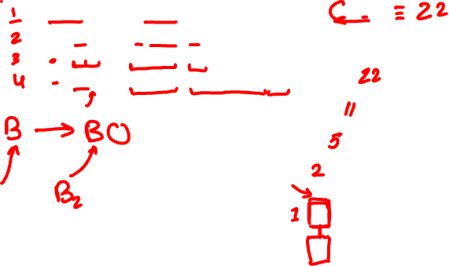
SDT Example
CFG Rules
B -> 0 B.trans = 0
| 1 B.trans = 1
| B 0 B.trans = B₂.trans * 2
| B 1 B.trans = B₂.trans * 2 + 1
Input string
10110
22
B
11
B
0
Translation is the value of the input
5
B
1
2
B
1
1
B
0
1

Slide 6
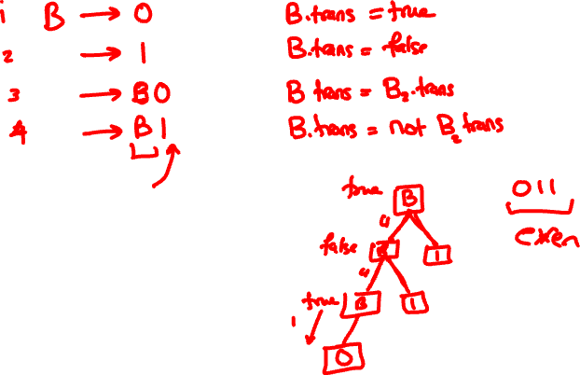

Slide 7
SDT Example 2: Declarations
Translation is a String of ids
CFG Rules
DList → ε DList.trans = “”
| DList Decl DList.trans = DList₂.trans + “ “ + Decl.trans
Decl → Type id ; Decl.trans = id.value
Type → int
| bool
“ xx yy”
DList
Input string
int xx;
bool yy;
“ xx”
DList
“yy”
Decl
Type
id
“”
DList
“xx”
Decl
Type
id
bool
ε
int

Slide 8
Exercise Time
Only add declarations of type int to the output String.
Augment the previous grammar:
CFG Rules
DList → ε DList.trans = “”
| Decl DList DList.trans = DList₂.trans + “ “ + Decl.trans
Decl → Type id ; Decl.trans = id.value
Type → int
| bool
Different nonterms can
have different types
Rules can have conditionals

Slide 9
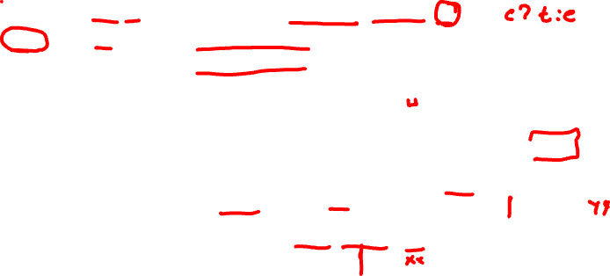
SDT Example 2b: ints only
Translation is a String of int ids
only
CFG Rules
DList → ε DList.trans = “”
| Decl DList DList.trans = DList₂.trans + “ “ + Decl.trans
Decl → Type id ; Decl.trans = (Type.trans ? id.value : “”)
Type → int Type.trans = true
| bool Type.trans = false
“ xx”
DList
Input string
int xx;
bool yy;
“ xx”
DList
“”
Decl
false
Type
id
Different nonterms can
have different types
“”
DList
“xx”
Decl
true
Type
id
bool
Rules can use conditional
expressions
ε
int

Slide 10
SDT for Parsing
In the previous examples, the SDT process assigned different types to the translation:
Example 1: tokenized stream to an integer value
Example 2: tokenized stream to a (Java) String
For parsing, we’ll go from tokens to an Abstract-Syntax Tree (AST)

Slide 11
Abstract Syntax Trees
Parse Tree
A condensed form of the parse tree
Operators at internal nodes (not leaves)
Chains of productions are collapsed
Syntactic details omitted
Expr
mult
Term
int
(8)
Term
*
Factor
Factor
intlit (8)
(
Expr
)
Example: (5+2)*8
add
Expr
+
Term
mult
add
int
(8)
Term
Factor
int
(2)
int
(5)
Factor
int
(5)
int
(2)
intlit (2)
intlit (5)

Slide 12
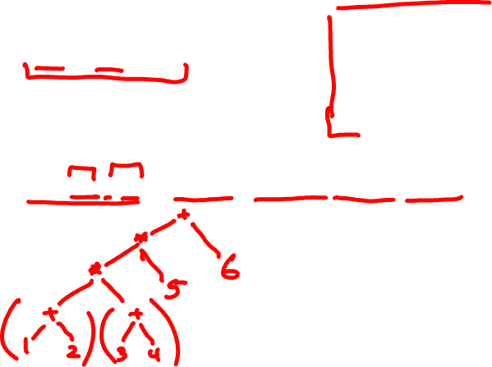
Exercise #2
Expr -> Expr + Term
| Term
Term -> Term * Factor
| Factor
Factor -> intlit
| ( Expr )
Show the AST for:
(1 + 2) * (3 + 4) * 5 + 6
Expr -> Expr + Term Expr1.trans = MkPlusNode(Expr2.trans, Term.trans)

Slide 13
AST for Parsing
In previous slides we did the translation in two steps
Structure the stream of tokens into a parse tree
Use the parse tree to build an abstract-syntax tree; then throw away the parse tree
In practice, we will combine these into one step
Question: Why do we even need an AST?
More of a “logical” view of the program: the essential structure
Generally easier to work with an AST (in the later phases of name analysis and type checking)
no cascades of exp $→$ term $→$ factor $→$ intlit, which was introduced to capture precedence and associativity

Slide 14
AST Implementation
How do we actually represent an AST in code?

Slide 15
ASTs in Code
Note that we’ve assumed a field-like structure in our SDT actions:
Expr -> Expr + Term Expr1.trans = MkPlusNode(Expr2.trans, Term.trans)
In our parser, we’ll define a class for each kind of ADT node, and create a new node object in some rules
In the above rule we would represent the Expr1.trans value via the class
For ASTs: when we execute an SDT rule
we construct a new node object, which becomes the value of LHS.trans
populate the node’s fields with the translations of the RHS nonterminals
public class PlusNode extends ExpNode {
public ExpNode left;
public ExpNode right;
}

Slide 16
How to implement ASTs
Consider the AST for a simple language of Expressions
Input
1 + 2
Tokenization
intlit plus intlit
AST
Naïve AST Implementation
+
class PlusNode
IntNode left;
IntNode right;
}
Parse Tree
1
2
Expr
Expr
plus
Term
class IntNode{
int value;
}
Term
Factor
Factor
intlit
2
intlit
1

Slide 17
How to implement ASTs
Consider AST node classes
We’d like the classes to have a common inheritance tree
AST
Naïve AST Implementation
Naïve Java AST
+
class PlusNode
{ IntNode left;
IntNode right;
}
PlusNode
IntNode left:
IntNode right:
1
2
class IntNode
{ int value;
}
IntNode
int
value:
IntNode
int
value:
1
2

Slide 18
How to implement ASTs
Consider AST node classes
We’d like the classes to have a common inheritance tree
AST
Naïve AST Implementation
Better Java AST
+
class PlusNode
{ IntNode left;
IntNode right;
}
PlusNode
ExpNode left:
ExpNode right:
1
2
class IntNode
{ int value;
}
IntNode
int
value:
IntNode
int
value:
1
2
Make these extend
ExpNode
Make these fields
be of class ExpNode

Slide 19
Implementing ASTs for Expressions
CFG
Expr -> Expr + Term
| Term
Term -> Term * Factor
| Factor
Factor -> intlit
| ( Expr )
Translation Rules
Expr1.trans = new PlusNode(Expr2.trans, Term.trans)
Expr.trans = Term.trans
Term1.trans = new TimesNode(Term2.trans, Factor.trans)
Term.trans = Factor.trans
Factor.trans = new IntNode(intlit.value)
Factor.trans = Expr.trans
Example: 1 + 2
Expr
PlusNode
ExpNode left:
ExpNode right:
Expr
plus
Term
Term
Factor
Factor
intlit
2
IntNode
value:
IntNode
value:
intlit
1
1
2

Slide 20
An AST for an code snippet
void foo(int x, int y){ if (x == y){ return;
}
while ( x < y){ cout << “hello”;
x = x + 1;
}
}
FuncBody
if
while
return
==
return
<
print
=
x
y
x
y
“hello”
x
+
x
1

Slide 21
Where are we?
Today we learned about
Syntax-Directed Translation (SDT)
Consumes a parse tree with actions
Actions yield some result
Abstract Syntax Trees (ASTs)
The result of an SDT performed during parsing in a compiler
Some practical examples of ASTs

Slide 22
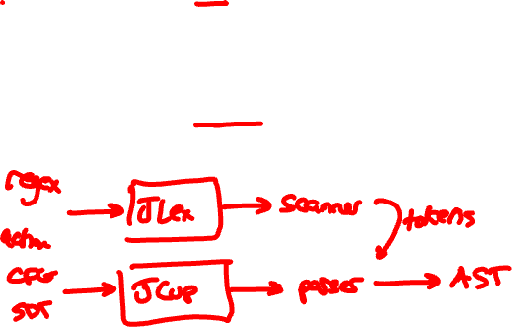
Where do we go?
Scanner
Language abstraction: RegExp
Output: Token Stream
Tool: JLex
Implementation: Interpret DFA using table (for $δ$), recording
most_recent_accepted_position and most_recent_token
Language abstraction: CFG
Output: AST by way of a syntax-directed translation
Tool: Java CUP
Implementation: ???
Parser
Next week
Next week

