Slide 1


Large-scale Deduplication using Constraints with Dedupalog
Arvind Arasu¹, Christopher Ré², and Dan Suciu²
¹Microsoft Research
²University of Washington

Slide 2
The mess of real data
Author*(x,x’)
Id | Title | Conference | Year
124 | Dedupalog | ICDE | 2009
277 | Provenance | VLDB | 2007
9123 | Dedupalog | Internat Conf on Data Engineering | 2009
88888 | Markovian Index | ICDE | 09
5858 | Correlated Indexing | VLDBJ | 2003
Id | Title | Conference | Year
124 | Dedupalog | ICDE | 2009
277 | Provenance | VLDB | 2007
9123 | Dedupalog | Internat Conf on Data Engineering | 2009
88888 | Markovian Index | ICDE | 09
5858 | Correlated Indexing | VLDBJ | 2003
Id | Title | Conference | Year
124 | Dedupalog | ICDE | 2009
277 | Provenance | VLDB | 2007
9123 | Dedupalog | Internat Conf on Data Engineering | 2009
88888 | Markovian Index | ICDE | 09
5858 | Correlated Indexing | VLDBJ | 2003
Close strings. Different Venues.
Same conference. Different Strings.
Different formats, misspellings, etc
Papers(id, title, Conference, Year)
Goal: Output distinct Papers, Conferences, etc.
If we merge two papers, can merge Confernces
Collective Deduplication

Slide 3
One slide summary
Problem: database has duplicate references to real-world entities
Goal: collective deduplication on large databases
Propose: declarative language for deduplication called Dedupalog
Experts: Correlation Clustering [Bansal 03]
New: Hard Constraints & Collective for high Precision/Recall
Practical: - Cluster ACM ~ 2 minutes
- High Precision/Recall (p/r)
Theory: O(1)-quality-apx for many dedupalog programs
Prior art can scale to < 10k references, we can scale to millions of references with high quality.
Notes:
Put the animations back in. And spend a lot of slide.
Technical challenge is the hard constraints – emphasize the challenge.

Slide 4
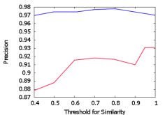
Outline
Dedupalog by Example
Semantics & Algorithms for Dedupalog
Experiments and Conclusion
Author*(x,x’)

Slide 5
Clustering with Dedupalog
Dedupalog by example
Author*(x,x’)
PaperRef(id, title, conference, publisher, year)
Wrote(id, authorName, Position)
Data to be deduplicated
TitleSimilar(title1,title2)
AuthorSimilar(author1,author2)
(Thresholded) Fuzzy-Join Output
Step (0) Create Fuzzy Matches; this is input to Dedupalog.
Step (1) Declare the entities
“Cluster Papers, Publishers, & Authors”
Paper!(id) :- PaperRef(id,-,-,-)
Publisher!(p) :- PaperRef(-,-,-,p,-)
Author!(a) :- Wrote(-,a,-)
Dedupalog is flexible:
Unique Names Assumption (UNA)
Publishers (UNA) and Papers (NOT UNA)

Slide 6
Step (2) Declare Clusters
Dedupalog by example
Author*(x,x’)
Input in the DB
PaperRef(id, title, conference, publisher, year)
Wrote(id, authorName, Position)
“Cluster papers, publishers, and authors”
TitleSimilar(title1,title2)
AuthorSimilar(author1,author2)
Paper!(id) :- PaperRef(id,-,-,-)
Publisher!(p) :- PaperRef(-,-,-,p,-)
Author!(a) :- Wrote(-,a,-)
Clusters are declared using * (like IDBs or Views): These are output
Author*(a₁,a₂) <-> AuthorSimilar(a₁,a₂)
Author1 | Author2
AA | Arvind Arasu
Arvind A | Arvind Arasu
“Cluster authors with similar names”
*IDBs are equivalence relations: Symmetric, Reflexive , & Transitively- Closed Relations: i.e., Clusters
A Dedupalog program is a set of datalog-like rules
Notes:
Show the output here earlier.

Slide 7
Simple Constraints
Dedupalog by example
Author*(x,x’)
“Papers with similar titles should likely be clustered together”
Paper*(id₁,id₂) <-> PaperRef(id₁,t₁,-), PaperRef(id₂,t₂,-),TitleSimilar(t₁,t₂)
Author*(a₁,a₂) <-> AuthorSimilar(a₁,a₂)
(<->) Soft-constraints:
Pay a cost if violated.
Paper*(id₁,id₂) <= PaperEq(id₁,id₂ )
(<=) Hard-constraints: Any clustering must satisfy these
¬ Paper*(id₁,id₂) <= PaperNeq(id₁,id₂)
“Papers in PaperEQ must be clustered together, those in PaperNEQ must not be clustered together”
Hard constraints are challenging!
PaperEQ, PaperNEQ are relations (EDBS)
¬ denotes Negation here.
Notes:
-- Note that these constraints are critical for interactive dedup.
-- Emphasize the challenges of hard constraints. And spend a little time motivating the hard constraints.

Slide 8
Advanced Constraints
Dedupalog by example
Author*(x,x’)
“Clustering two papers, then must cluster their first authors”
Author*(a₁,a₂) <= Paper*(id₁,id₂), Wrote(id₁,a₁,1), Wrote(id₂,a₂,1)
“Clustering two papers makes it likely we should cluster their publisher”
Publisher*(x,y) <- Publishes(x,p₁), Publishes(x,p₂),Paper*(p₁,p₂)
[Bhattachar, Getoor AAAI07]
“if two authors do not share coauthors, then do not cluster them”
¬ Author∗ (x, y) <- ¬ (Wrote(x, p₁,−), Wrote(y, p₂,−), Wrote(z, p₁,−),
Wrote(z, p₂,−), Author∗(x, y))
Bottomline: Dedupalog is powerful. How do we process it?
Notes:
Spend time and fix the top two queries.

Slide 9
Outline
Dedupalog by Example
Semantics & Algorithms for Dedupalog
Experiments and Conclusion
Author*(x,x’)

Slide 10
Background:
Correlation Clustering (CC)
Semantics
Input: a graph (V,E) --- Output: Clusters of nodes
An edge (u,v) says u should be clustered with v
Positive edges
Cost(J*) = 3
VLDBJ
[-]
Negative edges are implicit
VLDB
VLDB conf
Denote a clustering J*
ICDE
ICDT
International Conf. DE
Cost(J*) = |{ (i,j) | (i,j) ∈ J* xor (i,j) in E}|
Minimize Disagreement cost
Thm [Bansal et al. 03]: NP-Hard to find optimal
Thm [Ailon et al. 05] : 3-approx of optimal
Notes:
Prior Art distinction. Split the slide.

Slide 11
Dedupalog via CC
Semantics: Translate a Dedupalog Program to a set of graphs
Nodes are references (in the ! Relation)
Entity References: Conference!(c)
VLDBJ
Conference*(c₁,c₂) <-> ConfSim(c₁,c₂)
VLDB
Positive edges
VLDB conf
[-]
Negative edges are implicit
ICDE
ICDT
International Conf. DE
For a single graph w.o. hard constraints we can reuse prior art for O(1) apx.

Slide 12
Novel: Hard Constraints
Semantics
Soft
Hard
Conference*(c₁,c₂) <- ConfSim(c₁,c₂)
Positive
Equal
[-] Negative
Not Equal
Conference*(c₁,c₂) <= ConfEQ(c₁,c₂)
¬Conference*(c₁,c₂) <= ConfNEQ(c₁,c₂)
VLDBJ
VLDB
VLDB conf
Clustering MUST respect hard constraints.
These are not allowed!
ICDE
ICDT
International Conf. DE
Negative edges are implicit
Technical Challenge: How do we handle hard constraints?

Slide 13
Correlation Clustering:
Novel Hard Constraints
The algorithm
Soft
Hard
Conference*(c₁,c₂) <- ConfSim(c₁,c₂)
Positive
Equal
[-] Negative
Not Equal
Conference*(c₁,c₂) <= ConfEQ(c₁,c₂)
VLDBJ
¬Conference*(c₁,c₂) <= ConfNEQ(c₁,c₂)
VLDB
VLDB conf
ICDE
ICDT
International Conf. DE
Pick a random order of edges
While there is a soft edge do
  Pick first soft edge in order
  If turn into
  Else is [-] turn into
  Deduce labels
Return Transitively closed subsets
Simple, Combinatorial algorithm is easy to scale!
Thm: This is a 3-apx!

Slide 14
Extensions (Ads for the paper)
Extend algorithm to whole language via voting technique. Support many entities, recursive programs, etc.
  Many dedupalog programs have an O(1)-apx
  Thm: A recursive-hard constraints no O(1) apx!
  Thm: All “soft” programs O(1)
  Expert: multiway-cut hard
System properties:
(1) Streaming algorithm
(2) linear in # of matches (not n²)
(3) User interaction
Features: Support for weights, reference tables (partially), and corresponding hardness results.

Slide 15
Outline
Dedupalog by Example
Semantics & Algorithms for Dedupalog
Experiments and Conclusion
Author*(x,x’)

Slide 16

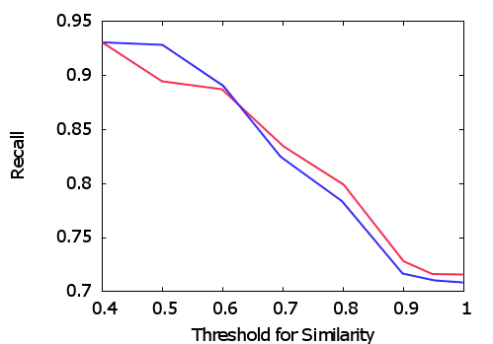
Quality on Cora
Evaluation
Precision on Cora
Recall on Cora
Hard Constraints
Hard Constraints
No Hard Constraints
No Hard Constraints
In general:
(1) good precision/recall
(2) Constraints help.
Even more important on large datasets (ACM, Citeseer) [see paper]

Slide 17
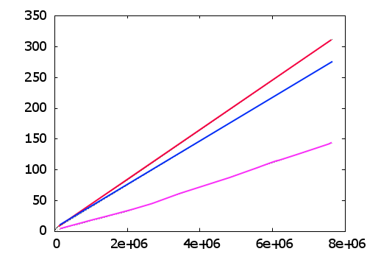
Performance
Evaluation
Experiment: Sample edges from ACM and test scale.
Complex program
Simple Hard Constraints
Seconds
Streamable Soft-only Constraints
Edges in the Graph
This is minutes, not hours
(alternate approaches can take CPU Years!)

Slide 18
Conclusion
Proposed dedupalog, a language for deduplication.
Efficiently cluster large datasets w/ high-precision recall
Novel theoretical analysis and implementation

