Slide 1
Materialized Views in Probabilistic Databases for Information Exchange and Query Optimization
Christopher Re and Dan Suciu
University of Washington

Slide 2
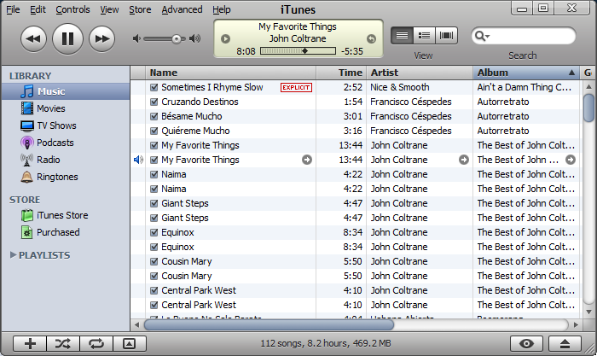
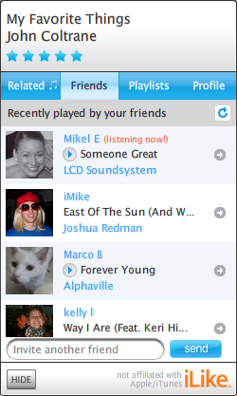
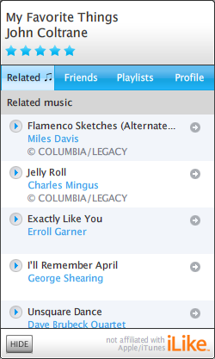
Motivating Example: Optimization
materialized – but imprecise – view
Similarity between users (8M+)
Notes:
I’m going to tell you a bit about iLike, a Seattle area startup that was kind enough to let us poke around in their internals. This is a screen shot of the iLike toolbar, a service that integrates iTunes with social networks, including facebook. iLike currently has over 8 million users registered users.
On the screen, while I am listening to music iLike tells me what other friends in my network are doing – for example I can see that Mikel E is online and currently listening to music.
If I click on the related tab, I can see recommendations for songs that are similar to the Coltrane song I’m currently playing. For example, it lists here a song by Miles Davis that I don’t have in my library, but is indeed similar.
To display related songs, I need to query a view that says if two songs are similar. Of course, for performance, this relation must be computed ahead of time. It’s not just music similarity that needs to be computed, but they also support similarity between users, between bands, etc. The data for this similarity is constantly evolving. As a result, it is a natural candidate for materialized views: My application can declare a view, and the system should be able to maintain it.
All this data is used to provide interesting features, like telling me when a band I might like is playing in my local neighborhood. So there are rich queries which must use this view to get good performance.
Of course, it’s possible to avoid using probabilistic materialized views, and instead roll custom code for each part of the application.

Slide 3
Single Slide Summary
Renewed interest in probabilistic data
  Trio, MayBMS, Maryland, Purdue, UW
  Classical : Integration, record linkage, etc.
  Emerging: iLike “Similarity Scores”
Today: Apply materialized views to pDBs
  Faster execution
  Better maintainability
The Catch: Every view using lineage, but…
  Correlations cause lineage to become large
When can we get the benefits of materialized views in prob DBs?
Notes:
The catch: The views have probs, and to compute them we need lineage, which is … ,

Slide 4
Overview
Motivation and Background
Technical Meat
Experiments
Conclusion

Slide 5
Probabilistic DBs
Restaurant Example
  Block Independent Disjoint (BID)
  Popular: Barbara92, Trio, Mystiq, Green et al.
  Query Evaluation
    Safe Queries
    Multisimulation
Chef | Dish | Rate | P
TD | Crab | High | 0.8
 |  | Med | 0.1
 |  | Low | 0.1
TD | Lamb | High | 0.3
 |  | Low | 0.7
Rating(Chef,Dish; Rating)
Possible Worlds Key
Value Attributes
Notes:
TOY: restaurant data. iLike too complicated. We’ll return to this in the evaluation.
Example of PDB, explain marginal prob.
Need to understand correlations: use BID
Blocks defined by possible worlds key, in each block only one choice
Across blocks independent.
Benefits of popularity
-------
Redo explanation – of how the tuples are correlated.

Slide 6
Restaurant Example
Chef | Restaurant | P
TD | D. Lounge | 0.9
TD | P .Kitchen | 0.7
Chef | Dish | Rate | P
TD | Crab | High | 0.8
TD | Lamb | High | 0.3
Chef | Dish | Rate | P
TD | Crab | High | 0.8
 |  | Med | 0.1
 |  | Low | 0.1
TD | Lamb | High | 0.3
 |  | Low | 0.7
p1
q1
p2
q2
Lineage could be large
W(Chef,Restaurant) WorksAt
R(Chef,Dish,Rate) Rated
Reprocessing lineage is expensive
Restaurant | Dish
D. Lounge | Crab
P. Kitchen | Crab
P. Kitchen | Lamb
“Chef and restaurant pairs where chef serves a highly rated dish”
“Chefs who serve a highly rated dish”
V(c,r) :- W(c,r),S(r,d),R(c,d,’High’)
V2(c) :- W(c,r),S(r,d),R(c,d,’High’)
S(Restaurant,Dish) Serves
Chef | Restaurant | P
TD | D. Lounge | 0.72 | p1*q1
TD | P.Kitchen | 0.602 | p2*(1 – (1-q1)(1-q2))
Understand w.o. “lineage”?
Notes:
Walk through each.
Explain tuple independent table
Deterministic table
Table from previous slide.
Show view.
Can we understand this view w.o. lineage?
-----
- Remove or shrink irr. Tuples – (med,low)
Keep english language for query. Add english for second query.
Swap english and view
Highlight boxes in different colors (make q1 dist.)

Slide 7
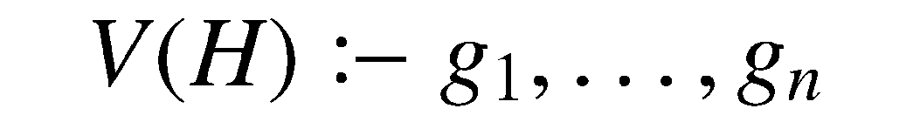
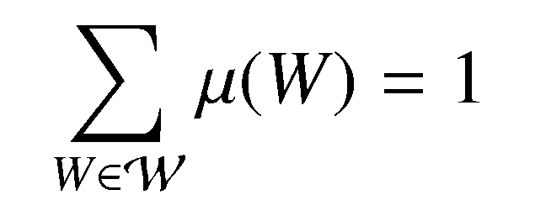
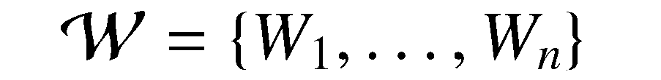
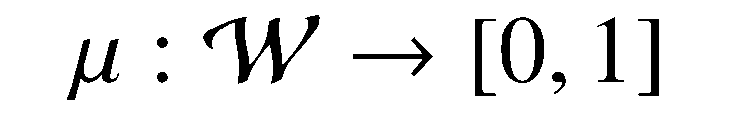
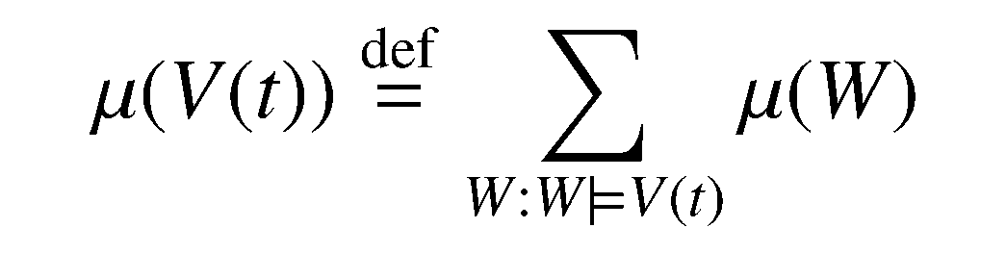
Views and Query Semantic
Views: Conjunctive, Constants
DB Semantics: Possible Worlds
View Semantics
Add worlds, if V is true
Output of V
Notes:
Go slowly though each segment/
CHANGE NOTATION TO t \in V.

Slide 8
Overview
Motivation and Background
Technical Meat
Experiments
Conclusion

Slide 9

Technical Question: Representation
Is output of V(H) on any BID database a BID table?
  Represent with Schema + marginal probs.
Yes, if there is s.t.
    V is K-“block independent”
    V is K-“disjoint in blocks”
this talk
Notes:
Outine remain – third
Fix K <= H.

Slide 10
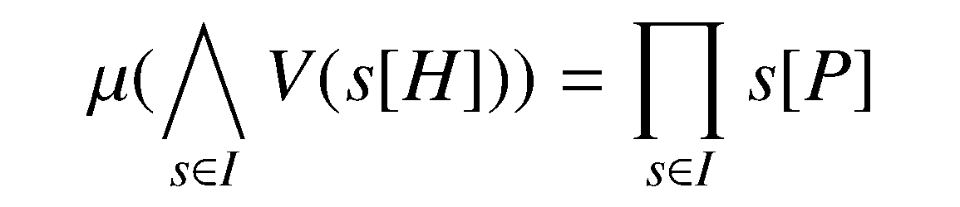
K-“block Independence”
K | A
1 | a
 | b
2 | a
 | b
All tuples from distinct “blocks”
p1
Multiply probs
p1 * q2
p2
Intuition: Fails if tuples in different blocks depend on same tuple
q1
q2
Notes:
Give a conc. Ex. Of intuition – all english.

Slide 11
Critical tuples
all tuples are disjoint critical
Preliminary notion
  Def: t is a disjoint critical tuple for a Boolean view V() if exists W
a world, W
V() :- W(‘TD’,’DL’),S(‘DL’,d),R(‘TD’,d,’High’)
Chef | Rest
TD | DL
Rest | Dish
D. L | Crab
Chef | Dish | Rate
TD | Crab | High
W(Chef, Restaurant)
S(Restaurant,Dish)
R(Chef,Dish,Rate)
Notes:
Switch schema up
Make strikeout smaller
Remind where view comes from.

Slide 12
Doubly Critical tuples
property of view V on any DB
Exists t1 critical for V(a) & t2 critical for V(b)
  t1 and t2 in same block in a prob. relation
K
a
b
K’ | A | P
k1 | a1 | p1
 | a2 | p2
k2 | … | q1
Critical
t1
t2
Tuples in V(H)
BID R(K,A)
Thm: A conjunctive view V is K-Block independent iff no K-doubly critical tuples
Notes:
Fix K and H here.
Recall the rated dish here.

Slide 13
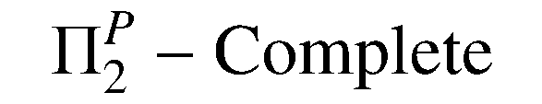
Complexity…
and a Practical test
Thm: Deciding if a view is block independent is decidable and
Good News: Simple but cautious test
  Test: “Can a prob tuple unify with different heads?”
    If so, not block independent
Thm: If view has no self-joins, test is complete.
In wild, practical test almost always works
V(c,r) :- W(c,r),S(r,d),R(c,d,’High’)
K={c,r}
V(c) :- W(c,r),S(r,d),R(c,d,’High’)
K={c}

Slide 14
Additional Results
How to pick K in the view
Dealing with disjointness
  “Disjoint in blocks”
Partial representability.
  Some views not representable,
    But a query on a view is still correct
  In general, hard, but practical test
Sets of Views

Slide 15
Overview
Motivation and Background
Technical Meat
Experiments
Conclusion

Slide 16
Experiments: Wild Queries, % rep.
Three Datasets
  iLike
  SQL Server
    Adventure works
    Northwinds
96% partially
63% representable
99.5% of iLike workload use representable views
Notes:
Switch colors and fonts.

Slide 17
Experiments
TPC-H data
Q10
Expected performance increase from materialized views
Notes:
Animate the graphs. Overlay log. And fix time.

Slide 18
Conclusion
Materialized views for probabilistic data
  Problem: Retain classical benefits of views
Contributions
  A complete theoretical solution
  Practical solutions
Verified Experimentally
  Views exist in practice
  Query processing benefits, as expected

Slide 20
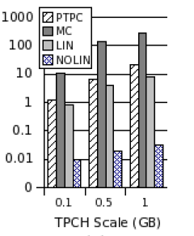
Experiments
TPC-H data
Q5 unsafe query.
Key
  PTPC: w.o prob
  MC: Monte Carlo
  LIN: w. lineage
  NOLIN: Our technique
NB: LIN not an End-to-End running time. So needs another ~ MC additional seconds!

Slide 21
Information Exchange
Chef | Restaurant | P
TD | D. Lounge | 0.9
TD | P.Kitchen | 0.7
MS | C.Bistro | 0.8
Chef | Dish | Rate | P
TD | Crab | High | 0.8
 |  | Med | 0.1
 |  | Low | 0.1
TD | Lamb | High | 0.3
 |  | Low | 0.7
MS | Fish | High | 0.6
 |  | Low | 0.3
W(Chef,Restaurant) WorksAt
Restuarant | Dish
D. Lounge | Crab
P. Kitchen | Crab
P. Kitchen | Lamb
C. Bistro | Fish
R(Chef,Dish,Rate) Rated
V(c,r) :- W(c,r),S(r,d),R(c,d,’High’)
S(Restaurant,Dish) Serves
Notes:
Introduce toy data here.

Slide 22
Technical Question 2:
Partially representable
Question 2: Given a BID database, a view V and a query Q, can we answer the result of V(D) from Q?
Show a query that is partially representable and one that correctly uses it, and one that does not.
Does not define a unique probability distribution
Notes:
May drop this, if short on time.

