Slide 1
Verilog For Computer Design
CS/ECE 552
Ramkumar Ravi
10 Feb 2012 -- Version 1.1
Based on slides from
Andy Phelps and Tony Gregerson, UW-Madison

Slide 2
How To Represent Hardware?
If you’re going to design a computer, you need to write down the design so that:
You can read it again later
Someone else can read and understand it
It can be simulated and verified
Even software people may read it!
It can be synthesized into specific gates
It can be built and shipped and make money

Slide 3
Ways to represent hardware:
Draw schematics
Hand-drawn
Machine-drawn
Write a netlist
Z52BH I1234 (N123, N234, N4567);
Write primitive Boolean equations
AAA = abc DEF + ABC def
Use a Hardware Description Language (HDL)
assign overflow = c31 ^ c32;

Slide 4
Hardware Description Languages (HDLs)
Textual representation of a digital logic design
Can represent specific gates, like a netlist, or more abstract logic
HDLs are not “programming languages”
No, really. Even if they look like it, they are not.
For many people, a difficult conceptual leap
Similar development chain
Compiler: source code ➔ assembly code ➔ binary machine code
Synthesis tool: HDL source ➔ gate-level specification ➔ hardware

Slide 5
Why use an HDL?
Easy to write and edit
Compact
Don’t have to follow a maze of lines
Easy to analyze with various tools
Why not to use an HDL
You still need to visualize the flow of logic
A schematic can be a work of art
But often isn’t!

Slide 6
HDL History
1970s: First HDLs
Late 1970s: VHDL
VHDL = VHSIC HDL = Very High Speed Integrated Circuit HDL
VHDL inspired by programming languages of the day (Ada)
1980s:
Verilog first introduced
Verilog inspired by the C programming language
VHDL standardized
1990s:
Verilog standardized (Verilog-1995 standard)
2000s:
Continued evolution (Verilog-2001 standard)
Both VHDL and Verilog evolving, still in use today

Slide 7
And the answer is…
In general, digital logic is captured in an HDL
For government / aerospace work, it’s VHDL
For all else, it’s Verilog
(This is, of course, a generalization…)
Verilog is not perfect!
But then, neither is the X86 instruction set.
And it’s nowhere near that bad.
In fact, it’s pretty good…
If you know what to watch out for.

Slide 8
Starting with an example…
module fulladd (
input A, B, Cin,
output sum, Cout );
assign sum = A ^ B ^ Cin;
assign Cout = (A & B)
| (A & Cin)
| (B & Cin);
endmodule

Slide 9
So, about Verilog…
Verilog is a (surprisingly) big language
Lots of features for synthesis and simulation of hardware
Can represent low-level features, e.g. individual transistors
Can act like a programming language, with “for” loops etc.
We’re going to learn a focused subset of Verilog
We will use it at a level appropriate for computer design
Focus on synthesizable constructs
Focus on avoiding subtle synthesis errors
Initially restrict some features just because they aren’t necessary
Rule: if you haven’t seen it approved, you can’t use it
Ask me if you have any questions

Slide 10
Why an HDL is not a Programming Language
In a program, we start at the beginning (e.g. “main”), and we proceed sequentially through the code as directed
The program represents an algorithm, a step-by-step sequence of actions to solve some problem
for (i = 0; i<10; i=i+1) {
if (newPattern == oldPattern[i]) match = i;
}
Hardware is all active at once; there is no starting point

Slide 11
Pitfalls of trying to “program” in Verilog
If you program sequentially, the synthesizer may add a lot of hardware to try to do what you say
In last example, need a priority encoder
If you program in parallel (multiple “always” blocks), you can get non-deterministic execution
Which “always” happens first?
You create lots of state that you didn’t intend
if (x == 1) out = 0;
if (y == 1) out = 1; // else out retains previous state? R-S latch!
You don’t realize how much hardware you’re specifying
x = x + 1 can be a LOT of hardware
Slight changes may suddenly make your code “blow up”
A chip that previously fit suddenly is too large or slow

Slide 12
Two Roles of HDL and Related Tools
#1: Specifying digital logic
Specify the logic that appears in final design
Either
Translated automatically (called synthesis) or
Optimized manually (automatically checked for equivalence)
#2: Simulating and testing a design
High-speed simulation is crucial for large designs
Many HDL interpreters optimized for speed
Testbench: code to test design, but not part of final design

Slide 13
Synthesis vs Simulation
HDLs have features for both synthesis and simulation
E.g., simulation-only operations for error messages, reading files
Obviously, these can be simulated, but not synthesized into circuits
Also has constructs such as for-loops, while-loops, etc.
These are either un-synthesizable or (worse) synthesize poorly
You need procedural code for testbench and only for testbench
Trends: a moving target
Good: better synthesis tools for higher-level constructs
Bad: harder than ever to know what is synthesizable or not
Important distinction: What is a “higher-level” construct and what is “procedural code”?

Slide 14
Synthesis vs Simulation
Synthesizable: A 3-input AND gate
Non-synthesizable: A 3-input AND gate that has a delay of 5 ns on Weekdays and 10 ns on Weekends
Synthesizable: A 32-bit output bus
Non-synthesizable: printf(“Hello World”)

Slide 15
HDL Design Flow
Use Synthesizable code to describe the function of something that could be built in hardware
Use Non-Synthesizable code to create a testbench that checks to see if your Synthesizable code does what you want
Simulate your testbench
Hand the Synthesizable code over to a Synthesis Tool. The tools will convert your code to a netlist of real hardware elements (gates, cells, LUTs, etc.)
Simulate this netlist with your testbench and see if it still works as intended

Slide 16
Structural vs Behavioral HDL Constructs
Structural constructs specify actual hardware structures
Low-level, direct correspondence to hardware
Primitive gates (e.g., and, or, not)
Hierarchical structures via modules
Analogous to programming software in assembly
Behavioral constructs specify an operation on bits
High-level, more abstract
Specified via equations, e.g., out = (a & b) | c
Not all behavioral constructs are synthesizable
We’ve already talked about the pitfalls of trying to “program”
But even some combinational logic won’t synthesize well
out = a % b // modulo operation – what does this synthesize to?
We will not use: + - * / % > >= < <= >> <<

Slide 17
Verilog Structural vs Behavioral Example
Structural
module mux2to1(
input S, A, B,
output Out );
wire S_, AnS_, BnS;
not (S_, S);
and (AnS_, A, S_);
and (BnS, B, S);
or (Out, AnS_, BnS);
endmodule
S
A
Out
B
Behavioral
module mux2to1(
input S, A, B,
output Out );
assign Out = (~S & A) | (S & B);
endmodule
Better:
assign Out = S? B:A;

Slide 18
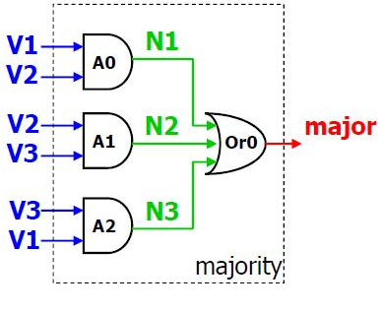
Structural vs RTL vs Behavioral
Design styles could also be categorized as
Structural – Connect primitives and modules
RTL – use continuous assignments to specify combinational logic
Behavioral - Use initial and always blocks to describe the behavior of the circuit, not its implementation
module majority (major,V1,V2,V3)
output major;
input V1,V2,V3;
wire N1,N2,N3;
and A0 (N1,V1,V2),
A1 (N2,V2,V3),
A2 (N3,V3,V1);
or OR0 (major,N1,N2,N3)
endmodule

Slide 19
Structural vs RTL vs Behavioral
RTL models use continuous assignment statements to assign Boolean expressions to signals.
If an input value changes, the value of the assignment is immediately updated. This is combinational hardware not software.

Slide 20
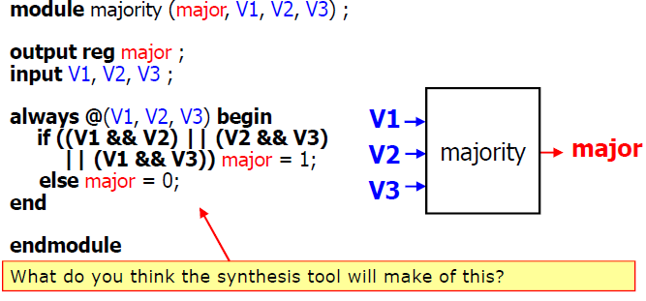
Structural vs RTL vs Behavioral
Behavior models specify what the logic does, not how to do it (simulation versus hardware)
Tools try to figure out what hardware is implied by the described behavior

Slide 21
Recall: Two Types of Digital Circuits
Combinational Logic
Logic without state variables
Examples: adders, multiplexers, decoders, encoders
No clock involved
Sequential Logic
Logic with state variables
State variables: latches, flip-flops, registers, memories
Clocked
State machines, multi-cycle arithmetic, processors

Slide 22
Verilog Structural Primitives
Gate-level
One-output boolean operators: and, or, xor, nand, nor, xnor
E.g., C = A+B
or (C, A, B);
E.g., C= A+B+D
or (C, A, B, D);
One-input operators: not
E.g., A = not Z
not (A, Z);
E.g., A = not Z, B = not Z
not (A, B, Z);
Buf is like not but just replicates signals – we don’t need
Transistor-level primitives too
We will not use

Slide 23
Three Module Components
Interface specification – new style (Verilog 2001)
module mux2to1(
input S, A, B,
output O );
Can also have inout: bidirectional wire (we will not need or use)
Declarations
Internal wires, i.e., wires that remain within this module
Wires also known as “nets” or “signals”
wire S_, AnS_, BnS;
Implementation: primitive and module instantiations
and (AnS_, A, S_);

Slide 24
Verilog Module Example
module mux2to1(
input S, A, B,
output O );
wire S_, AnS_, BnS;
not (S_, S);
and (AnS_, A, S_);
and (BnS, B, S);
or (O, AnS_, BnS);
endmodule
S
A
O
B

Slide 25
Hierarchical Verilog Example
Build up more complex modules using simpler modules
Example: 4-bit wide mux from four 1-bit muxes
Again, just “drawing” boxes and wires
module mux2to1_4(
input [3:0] A,
input [3:0] B,
input Sel,
output [3:0] O );
mux2to1 mux0 (Sel, A[0], B[0], O[0]);
mux2to1 mux1 (Sel, A[1], B[1], O[1]);
mux2to1 mux2 (Sel, A[2], B[2], O[2]);
mux2to1 mux3 (Sel, A[3], B[3], O[3]);
endmodule

Slide 26
Arrays of Instances
Need several instances with similar connections ?
Can create an array of instances
module array_of_xor(y, a, b);
input [3:0] a,b;
output [3:0] y;
xor x3 (y[3], a[3], b[3]);
xor x2 (y[2], a[2], b[2]);
xor x1 (y[1], a[1], b[1]);
xor x0 (y[0], a[0], b[0]);
//Alternate
xor X_ALL [3:0] (y[3:0], a[3:0], b[3:0]
endmodule

Slide 27
Connections by Name
Can (should) specify module connections by name
Helps keep the bugs away
Example
mux2to1 mux1 (.A (A[1])
.B (B[1]),
.O (O[1]),
.S (Sel) );
Verilog won’t complain about the order (but it is still poor practice to mix them up):

Slide 28
Wire and Vector Assignment
Wire assignment: “continuous assignment”
Connect combinational logic block or other wire to wire input
Order of statements not important to Verilog, executed totally in parallel
But order of statements can be important to clarity of thought!
When right-hand-side changes, it immediately flows through to left
Designated by the keyword assign (LHS must be a net; RHS has no restrictions)
wire c;
assign c = a | b;
wire c = a | b; // same thing

Slide 29
Vectors of Wires
Wire vectors:
wire [7:0] W1; // 8 bits, w1[7] is MSB
Also called “buses”
Operations
Bit select: W1[3]
Range select: W1[3:2]
Concatenate:
vec = {x, y, z};
{carry, sum} = vec[0:1];
e.g., swap high and low-order bytes of 16-bit vector
wire [15:0] w1, w2;
assign w2 = {w1[7:0], w1[15:8]}

Slide 30
Operators
Operators similar to C or Java
On wires:
& (and), | (or), ~ (not), ^ (xor)
On vectors:
&, |, ~, ^ (bit-wise operation on all wires in vector)
E.g., assign vec1 = vec2 & vec3;
&, |, ^ (reduction on the vector)
E.g., assign wire1 = | vec1;
Even ==, != (comparisons)
Can be arbitrarily nested: (a & ~b) | c

Slide 31
Conditional Operator
Verilog supports the ?: conditional operator
Just like in C
But much more common in Verilog
Examples:
assign out = S ? B : A;
assign mux_out = sel ? in1 : in0;
assign and2 = a ? b : 0;
assign xor2 = in1 ? ~in2 : in2;
assign triVal = sel ? in : 1’bz;
Can nest the conditionals!
assign trimux = trisel ? (muxsel ? a : b) : 1’bz;

Slide 32
Miscellaneous
Operators and expressions can be used with modules
mux2to1 mux0 (cond1 & cond2, a, b, out);
C/Java style comments
// comment until end of line
/* comment between markers */
All variable names are case sensitive
But it is a bad idea to make names that differ only in case
Constants:
assign x = 3’b011
The “3” is the number of bits
The “b” means “binary” - “h” for hex, “d” for decimal
The “011” are the digits (in binary in this case)
Another example: assign xyz = 8’hff;

Slide 33
Behavioral Verilog: Initial and Always
initial
Behavioral block operates ONCE
Starts at time 0 (beginning of operation)
Useful for testbenches
Inappropriate for combinational logic
Usually cannot be synthesized
Can sometimes provide initialization of memories/FFs
Depends on the synthesizer
always
Behavioral block operates CONTINUOUSLY
Can use a trigger list to control operation; @(a, b, c)

Slide 34
initial block example
`timescale 1ns /1ns
module t_full_adder;
reg [3:0] stim;
wire s, c;
// instantiate UUT
full_adder(sum, carry, stim[2], stim[1], stim[0]);
// monitor statement is special - only needs to be made once,
initial $monitor(“%t: s=%b c=%b stim=%b”, $time, s, c, stim[2:0]);
// tell our simulation when to stop
initial #50 $stop;
initial begin // stimulus generation
for (stim = 4’d0; stim < 4’d8; stim = stim + 1) begin
#5;
end
end
endmodule
All initial blocks start at time 0

Slide 35
always blocks
Operates continuously or on a trigger list
Can be used side-by-side with initial blocks
Cannot “nest” initial or always blocks
Useful example of continuous always block:
reg clock;
initial clock = 1’b0;
always clock = #10 ~clock;
Clock generator goes in the testbench. This doesn’t synthesize.

Slide 36
always blocks with sensitivity lists
Conditionally behave as described by always block
Always blocks are continuously operating
If sensitivity list present, continuously checking triggers
Any change on sensitivity list, triggers block
always @(a, b, c) begin
…
end
Sounds like software! It isn’t!
This is how the simulator treats it
Hardware effectively has the same resulting operation
Hardware doesn’t “wait to see” changes on trigger list
Just reacts to changes on the inputs

Slide 37
Trigger lists
Uses “event control operator” @
When net or variable in trigger list changes, always block is triggered
always @(a, b, c) begin
a1 = a & b;
a2 = b & c;
a3 = a & c;
carry = a1 | a2 | a3;
end
always @(state, input) begin
if (input == 1’b0) begin
if (state != 2’b11)
nextstate = state + 1;
else
nextstate = 2’b00;
end else
nextstate = state;
end
always @(in1, in0, sel) begin
if (sel == 1’b0) out = in0;
else out = in1;
end

Slide 38
Parameters
Allow per-instantiation module parameters
Use “parameter” statement
modname #(10, 20, 30) instname(in1, out1);
Example:
module mux2to1_N(Sel, A, B, O);
parameter N = 1
input [N-1:0] A;
input [N-1:0] B;
input Sel;
output [N-1:0] O;
mux2to1 mux0[N-1:0] (Sel, A, B, O);
endmodule
…
Mux2to1_N #(4) mux1 (S, in1, in2, out)

Slide 39
Verilog Pre-Processor
Like the C pre-processor
But uses ` (back-tick) instead of #
Constants: `define
No parameterized macros
Use ` before expanding constant macro
`define letter_A 8’h41
wire w = `letter_A;
Conditional compilation: `ifdef, `endif
File inclusion: `include
Parameter vs `define
Parameter only for “per instance” constants
`define for “global” constants

Slide 40
Common Errors
Tools are from a less gentle time
More like C, less like Java
Assume that you mean what you say
Common errors:
Not assigning a wire a value
Assigning a wire a value more than once
Avoid names such as:
clock, power, pwr, ground, gnd, vdd, vcc, init, reset
Some of these are “special” and will silently cause errors
We will use “clk” and “rst”, but only for their intended uses

Slide 41
Repeated Signals
Previously we discussed vector concatenation
assign vec = {x, y, z};
Can also repeat a signal n times
assign vec = {16{x}}; // 16 copies of x
Example uses (what does this do?):
wire [7:0] out;
wire [3:0] A;
assign out = {{4{0}}, A[3:0]};
What about this?
assign out = {{4{A[3]}}, A[3:0]};

Slide 42
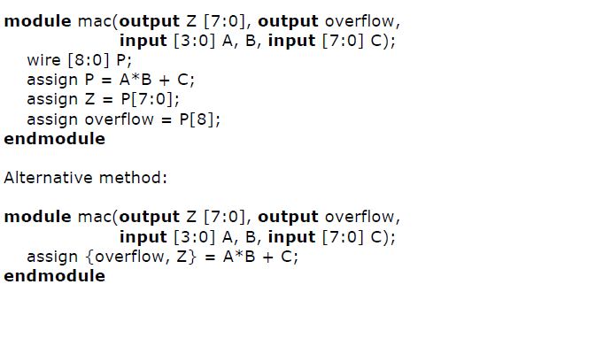
Concatenation example

Slide 43
Non-binary Hardware Values
A hardware signal can have four values
0, 1
X: don’t know, don’t care
Z: high-impedance (no current flowing)
Two meanings of “x”
Simulator indicating an unknown state
Or: You telling synthesis tool you don’t care
Synthesis tool makes the most convenient circuit (fast, small)
Use with care, leads to synthesis dependent operation
Uses for “z”
Tri-state devices drive a zero, one, or nothing (z)
Many tri-states drive the same wire, all but one must be “z”
Example: multiplexer
Why Verilog allows multiple assignments to same wire.

Slide 44
Sequential Logic in Verilog
How do we specify state-holding constructs in Verilog?
module dff (
input Clock, D, Reset,
output reg Q );
always @(posedge Clock)
begin
if (Reset)
Q = 1'b0;
else
Q = D;
end
endmodule

Slide 45
Designing Sequential Logic
CS/ECE 552 design rule: separate combinational logic from sequential state elements in lowest-level modules
Not enforced by Verilog, but a very good idea
Possible exceptions: counters, shift registers
We’ll give you a 1-bit flip-flop module (see previous slide)
Edge-triggered, not a latch
Use it to build n-bit register, registers with “load” inputs, etc.
Example use: state machine
Inputs
Clock
State
Register
Combinational Logic
Outputs
Current State
Next State

Slide 46
Clock Signals
Clock signals are not normal signals
Travel on dedicated “clock” wires
Reach all parts of the chip
Special “low-skew” routing
Ramifications:
Never do logic operations on the clocks
If you want to add a “write enable” to a flip-flop:
Use a mux to route the old value back into it
Do not just “and” the write-enable signal with the clock!
Messing with the clock can cause errors
Often can only be found using timing simulation

Slide 47
case Statements
case (<expr>)
<match-constant1>:<stmt>
<match-constant2>:<stmt>
<match-constant3>,<match-constant4>:<stmt>
default: <stmt>
endcase

Slide 48
case Statements
Useful to make big muxes
Very useful for “next-state” logic
But they are easy to abuse
If you don’t set a value, it retains its previous state
Which is a latch!
We will allow case statements, but with some severe restrictions:
Every value is set in every case
Every possible combination of select inputs must be covered
Each case lives in its own “always” block, sensitive to changes in all of its input signals
This is our only use of “always” blocks

Slide 49
case statements
Verilog has three types of case statements:
case, casex, and casez
Performs bitwise match of expression and case item
Both must have same bitwidth to match!
case
Can detect x and z! (only good for testbenches)
casez
Uses z and ? as “don’t care” bits in case items and expression
casex
Uses x, z, and ? as “don’t care” bits in case items and expression

Slide 50
Using case to detect x and z
Only use this functionality in a testbench; it won’t
synthesize!
Example taken from Verilog-2001 standard:
case (sig)
1’bz: $display(“Signal is floating.”);
1’bx: $display(“Signal is unknown.”);
default: $display(“Signal is %b.”, sig);
endcase

Slide 51
Case Statement Example
always @*
casex ({goBack, currentState, inputA, inputB})
6'b1_???_?_? : begin out = 0; newState = 3'b000; err=0; end
6'b0_000_0_? : begin out = 0; newState = 3'b000; err=0; end
6'b0_000_1_? : begin out = 0; newState = 3'b001; err=0; end
6'b0_001_1_? : begin out = 0; newState = 3'b001; err=0; end
6'b0_001_0_0 : begin out = 0; newState = 3'b010; err=0; end
6'b0_001_0_1 : begin out = 0; newState = 3'b011; err=0; end
6'b0_010_?_0 : begin out = 0; newState = 3'b010; err=0; end
6'b0_010_?_1 : begin out = 0; newState = 3'b011; err=0; end
6'b0_011_?_1 : begin out = 0; newState = 3'b011; err=0; end
6'b0_011_?_0 : begin out = 0; newState = 3'b100; err=0; end
6'b0_100_?_? : begin out = 1; newState = 3'b000; err=0; end
6'b0_101_?_? : begin out = 0; newState = 3'b000; err=1; end
6'b0_110_?_? : begin out = 0; newState = 3'b000; err=1; end
6'b0_111_?_? : begin out = 0; newState = 3'b000; err=1; end
default: begin out = 0; newState = 3’b000; err=1; end
endcase

Slide 52
What happens if it’s wrong?
Here are our rules:
A case statement should always have a default
Hitting this default is an error
Every module has an “err” output
Can be used for other checks, like illegal inputs
OR together all “err” signals -- bring “err” all the way to top
Our clock/reset module will print a message if err ==1

Slide 53
System tasks
Start with $
For output:
$display(<fmtstring><,signal>*);
$fdisplay(<fhandle>,<fmtstring><,signal>*);
Signal printf/fprintf
$monitor(<fmtstring><,signal>*);
Non-procedural printf, prints out when a signal changes
$dumpvars(1<,signal>*);
Similar to monitor
VCD format for waveform viewing (gtkwave)
Output is in dumpfile.vcd

Slide 54
More System Tasks
$time
Simulator’s internal clock (64-bit unsigned)
Can be used as both integer and auto-formatted string
$finish
Terminate simulation
$stop
Pause simulation and debug
$readmemh(<fname>,<mem>,<start>,<end>);
$writememh(<fname>,<mem>,<start>,<end>);
Load contents of ASCII file to memory array (and vice versa)
Parameters <start>,<end> are optional
Useful for loading initial images, dumping final images

Slide 55
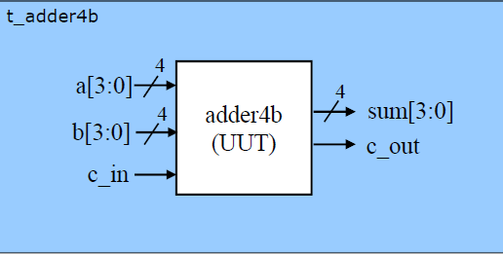
Simulation and Testbenches
Instantiate the unit being tested (UUT)
Provide input to that unit
Usually a number of different input combinations!
Watch the “results” (outputs of UUT)
Can watch ModelSim Wave window…
Can print out information to the screen or to a file

Slide 56
Printing test information
A number of system calls to output info
$monitor
Give a list of nets and variables to monitor
Output the given values every time a one of them changes
$display, $strobe
Output a value at a specific time during simulation
Can use formatting strings with these commands
Also have system calls that write to files
Only have meaning in simulation
System calls are ignored in synthesis

Slide 57
Output string formatting
Formatting string
%h, %H hex
%d, %D decimal
%o, %O octal
%b, %B binary
%t time
$monitor(“%t: %b %h %h %h %b\n”, $time, c_out, sum, a, b, c_in);
Can get more details from Verilog standard

Slide 58
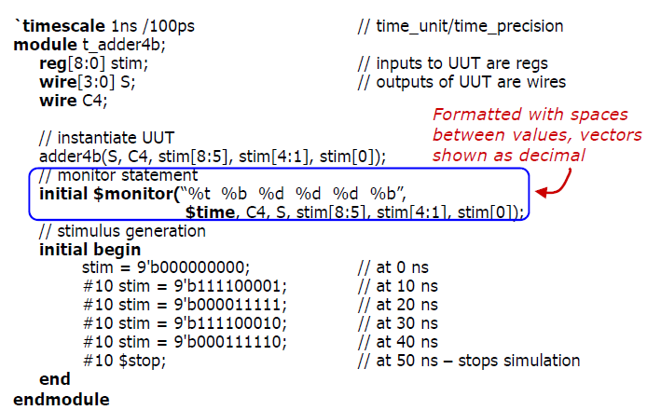
Example

Slide 59
Backup Slides:
Constructs we won’t use

Slide 60
Traditional Module Header
module mux2to1_4(A, B, Sel, O);
input [3:0] A;
input [3:0] B;
input Sel;
output [3:0] O;
mux2to1 mux0 (Sel, A[0], B[0], O[0]);
mux2to1 mux1 (Sel, A[1], B[1], O[1]);
mux2to1 mux2 (Sel, A[2], B[2], O[2]);
mux2to1 mux3 (Sel, A[3], B[3], O[3]);
endmodule

Slide 61
Behavioral Statements
Like in C, but use begin-end instead of {-} to group
if (<expr>) <stmt> else if <stmt>
for (<stmt>;<expr>;<stmt>) <stmt>
Careful: No ++ operator in Verilog

Slide 62
Behavior Invocation: Always
always @(<sensitivity><or sensitivity>*)
begin
<stmt>*
end
Defines reaction of module to changes in input
sensitivity list: signals or signal edges that trigger change
Keyword or: disjunction of multiple sensitivity elements
Multiple always sections are allowed
Careful: don’t know order in which signals arrive
Best to use one

Slide 63
Signal and Signal Edge Sensitivity
Signal sensitivity: evaluate block on any signal change
always @(CLK)
Edge sensitivity: evaluate block on particular signal change
always @(posedge CLK)
Quiz: what’s the difference?
always @(D or CLK) if (CLK) Q <= D;
always @(posedge CLK) Q <= D;

Slide 64
Auxiliary Variables
C style variables that are used procedurally
Understood to be “program helpers”, not pieces of hardware
integer i; // signed 32-bit (not int)
time t; // unsigned 64-bit
real r; // double precision FP
memory (i.e., C) like array syntax
integer iarray[63:0]; // array of 64 integers
E.g.,
integer i;
for (i = 0; i < N; i = i + 1)
memory[i] <= 0;
E.g.,
time sim_num_insn; // retired instructions

Slide 65
Behavior Modules: Tasks
module memory ();
reg [7:0] memory [1023:0];
integer i;
task clear;
begin
for (i = 0; i < 1024; i = i + 1)
memory[i] <= 8’b0;
end
endtask
endmodule
memory mem();
initial mem.clear;
Tasks: module “methods”
Can be invoked from always and initial blocks

Slide 66
An Example Test Module
`include “mux.v”
module main;
reg [3:0] A, B;
wire [3:0] O;
reg S;
mux2to1_4 mux (S, A, B, O);
initial
begin
$monitor ($time,,“S=%b,A=%d,B=%d,O=%d”, S, A, B, O);
$dumpvars(1, S, A, B, O);
#5 A=4’b1010; B=4’b0010; S=1’b0;
#5 S=1’b1;
#5 $finish;
end
endmodule

Slide 67
A Test Module With Clock
`include “fsm.v”
module main;
reg clk, in;
wire out;
fsm fsm1 (clk, in, out);
always #5 clk <= ~clk;
initial
begin
clk = 0;
$monitor ($time,,“CLK=%b”, clk, fsm1.state);
$dumpvars(1, clk, fsm1.state);
#100 $finish;
end
endmodule

Slide 68
Additional Verilog Resources
Elements of Logic Design Style by Shing Kong, 2001
Dos, do-nots, tips
http://www.cis.upenn.edu/~milom/elements-of-logic-design-style/
Verilog HDL Synthesis: A Practical Primer
By J. Bhasker, 1998
To the point (<200 pages)
Advanced Digital Design with the Verilog HDL
By Michael D. Ciletti, 2003
Verilog plus lots of digital logic design (~1000 pages)
Verilog tutorial on CD from “Computer Org. and Design”

