Slide 2
Specialized systems are
☑ Inevitable
☑ Already the norm
☑ Practical

Slide 3
Specialized systems are
☑ Inevitable
☑ Already the norm
☑ Practical

Slide 4
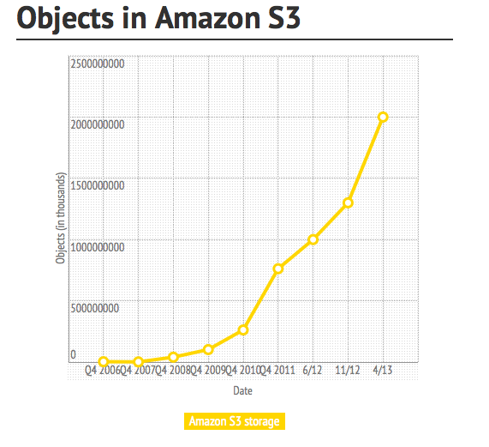
Very Big Data – 2x10^12 objects

Slide 5
When storing 2 trillion objects
Use a general-purpose solution
Standard servers with classic local layers: disks, RAID volumes, local filesystem
DHT to scale
Use a specialized solution
Conservative – 10x better price/performance
When Reed-Solomon is not good enough [Calder]
Which you would choose ?

Slide 6
Specialization is inevitable
If it’s Big, it will be specialized
Infrastructure matters
If it is small, it will run in the cloud
A.k.a. on someone else’s Big infrastructure

Slide 7
Specialized systems are
☑ Inevitable
☑ Already the norm
☑ Practical

Slide 8
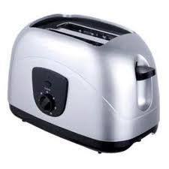
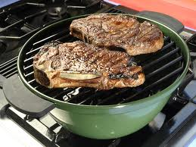
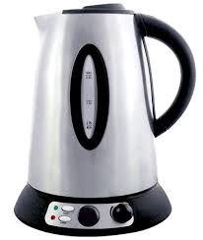
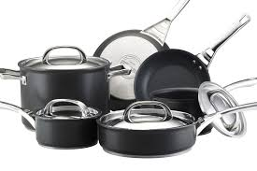
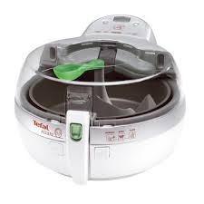
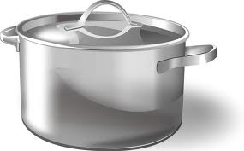
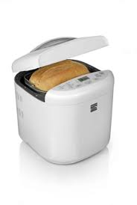
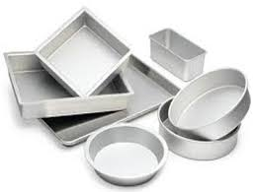
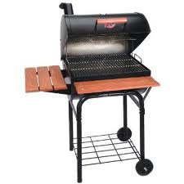
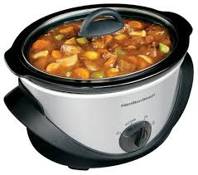
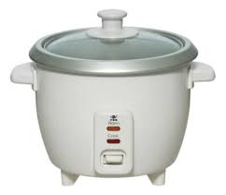
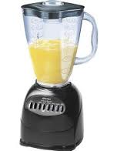
Cooking?

Slide 9
Specialization – bypass OS
Provide SLA for DMBS → manage all resources within the application (Oracle, …)
Lots of photos → build your filesystem (Facebook Haystack)
Low-latency networking → run TCP in user-space (or RDMA in HW)

Slide 10
Specialization – below OS
Hypervisor – specialized OS to run OS
Adds an operational layer
Infrastructure manages physical resources
Tenants consume virtual resources

Slide 11
Specialized systems are
☑ Inevitable
☑ Already the norm
☑ Practical

Slide 12
Virtual appliances
Virtual machines → virtual appliance
Specialized operations
Virtual appliance → customize OS
Specialized turning (e.g. for performance)
Customize OS → remove OS
Eliminate layer (e.g. run JVM in kernel)

Slide 13
Domain-specific operating system
Building a full operating system is not practical
But if your OS only runs a single application at a time ?
The return of domain-specific operating systems (remember the Exokernel)
Now leveraging hardware support designed for virtualization (e.g. Dune)

Slide 14
Using the cloud
Makes it easier to deploy and adopt new technologies
Infiniband cluster ? Would you want to buy and operate one yourself, or just run applications with low-latency
FPGA – would you rather mess with an FPGA board, or simply rent one in the cloud ?

