Slide 3
Specialized systems are
☑ Inevitable
☑ Already the norm
☑ Practical

Slide 4
Specialized systems are
☑ Inevitable
☑ Already the norm
☑ Practical

Slide 5
Infinite appetite for ever increasing capabilities
(online services, big data, internet of things,…)
No new technology is ready to save the day
We, the HW and SW systems engineers, will save the day
The good days of technology scaling
Scaling wo/ tech help:
a 30x gap per decade
Our Challenge
Chip Capability (log)
New Technology
CMOS
80s
90s
00s
10s
20s
30s
40s

Slide 6
The Potential of Specialization
Energy per operation
Instr. Fetch
Pipeline Control
Regs
Data Cache
ALU
26%
40%
7%
26%
100-1,000x by specializing everything (instructions, locality, ALUs)
2-10 x by amortizing instructions overhead (e.g., SIMD)
20-100x by also specializing locality (e.g., convolution engine)
100x would take 50 years @ 10% per year

Slide 7
Specialized systems are
☑ Inevitable
☑ Already the norm
☑ Practical

Slide 8
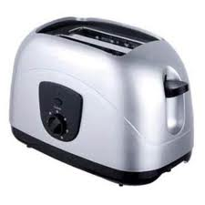
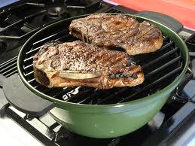
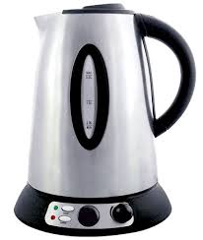
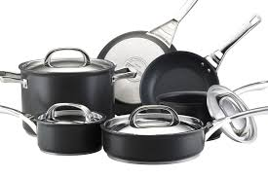
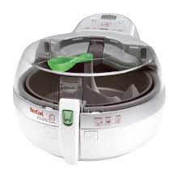
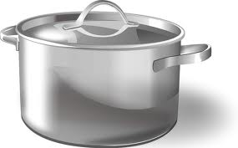
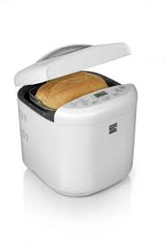
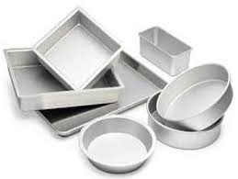
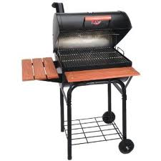
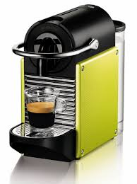
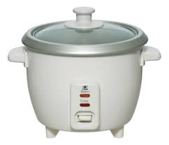
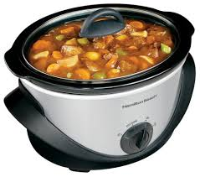
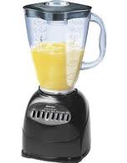
Cooking?

Slide 9
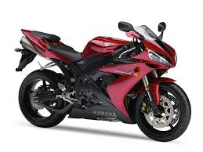
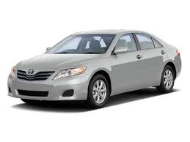
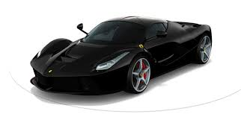
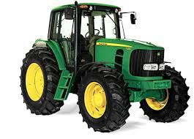
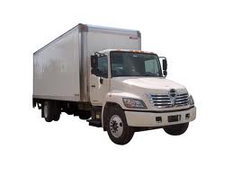
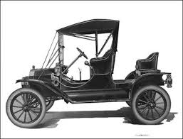
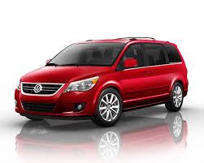
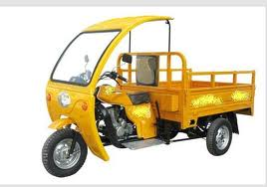
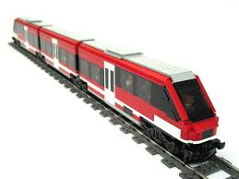
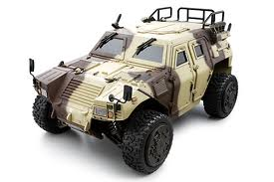
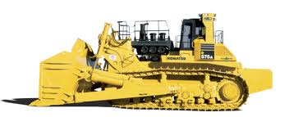
Transportation?

Slide 10
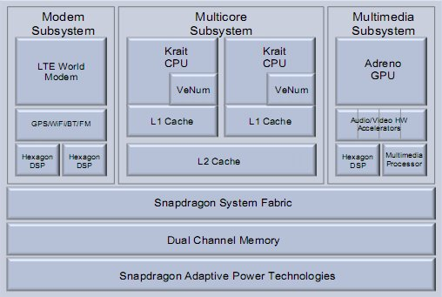
Computing?
ARM
A5, A5, A9, A15, A50
R4, R5, R7
M0, M1, M3, M4
SC100, SC300
Mai, Mai-T, Mai-V, Mai-DP
…
Intel
Xeon & Atom core
SSE for data-parallelism
AES instructions
i3, i5, i7
with/without GPU
E3, E5, E7
…
Qualcomm Snapdragon
G
G
S
S
S
S
AVR, NIOS, Blackfin, Tigersharc, AT90, CY8C2, 68HC, FCR4, Tricore, Mico8, Micro32, TMS320, TX19A, IP3022, MicroBlaze, Xcore, eZ80, …
S
S
S
S
G
S
S

Slide 11
Specialized systems are
☑ Inevitable
☑ Already the norm
☑ Practical

Slide 12
Specialization is Practical
Reusable components
Gates, ALUs, cores, GPUs, accelerators, interconnects, chips
Automated design & compilation tools
C/OpenCL/DSLs → gates, DSLs → accelerators
Domain-specific accelerators
Modems, GPUs, video/ML accelerators, NPUs, …
Flexible hardware
FPGAs & coarse-grain FPGAs, 2.5D + 3D integration, SoCs
Just make the common case efficient
Use a few programmable cores for the rest

Slide 13
Specialized systems are
☑ Inevitable
☑ Already the norm
☑ Practical

