Slide 2
Specialized systems are
☑ Inevitable
☑ Already the norm
☑ Practical

Slide 3
Heterogeneous parallelism

Slide 4
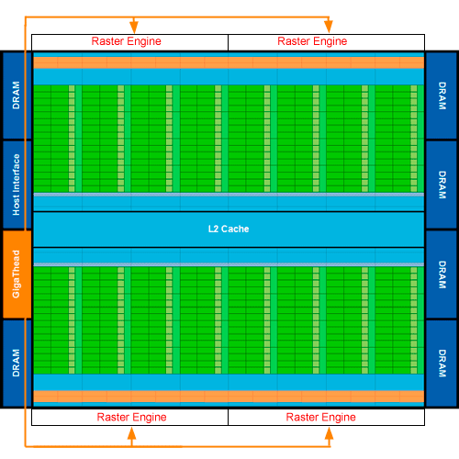
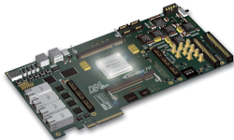
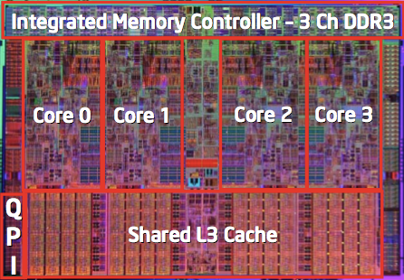
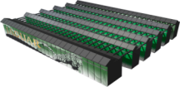
Programming Heterogeneous Parallelism
Applications
Scientific
Engineering
Virtual Worlds
Personal Robotics
Data
informatics
Heterogeneous
Hardware
New Arch.
4

Slide 5
Architecture Specific Programming Models
CUDA
OpenCL
Threads
OpenMP
MPI
Hadoop
Verilog
VHDL

Slide 6
High Performance But Low Productivity

Slide 7
General-Purpose Languages
Applications
Scientific
Engineering
Virtual Worlds
Personal Robotics
Data
informatics
Scala
Not enough semantic knowledge to compile automatically
No restrictions
Java
Python
C++
Ruby
Clojure
Heterogeneous
Hardware
New Arch.

Slide 8
Make Specialized PL Practical
☑ Inevitable
☑ Already the norm
☑ Practical

Slide 9
Domain Specific Languages
Domain Specific Languages (DSLs)
Programming language with restricted expressiveness for a particular domain
High-level, usually declarative, and deterministic
Most Science apps start with this PL
Most popular parallel PL
Enabled GPU innovation
Notes:
DSL are nothing new, they have been proposed and use for many domains, for the most part as more productive languages in the domain than using a general purpose language. But how can they help us with heterogeneous parallelism

Slide 10
High Performance Domain-Specific Languages
Applications
Scientific
Engineering
Virtual Worlds
Personal Robotics
Data
informatics
Domain- Specific
Languages
Machine Learning
(OptiML)
Statistics
(R)
Physics
(Liszt)
Data Analytics (OptiQL)
Graph Alg.
(Green Marl)
DSL
Compiler
DSL
Compiler
DSL
Compiler
DSL
Compiler
DSL
Compiler
Heterogeneous
Hardware
New Arch.

Slide 11
HP DSLs Will Be Practical
Embedded DSLs
Flexible embedding languages: Scala, F#
Metaprogramming (aka staging)
Blurring line between libraries and languages
DSL Frameworks
Support domain specific optimizations
Support parallelism and locality optimizations
Multiple backends
e.g. Spoofax, Rose, Delite, Terra/Lua

