Slide 1
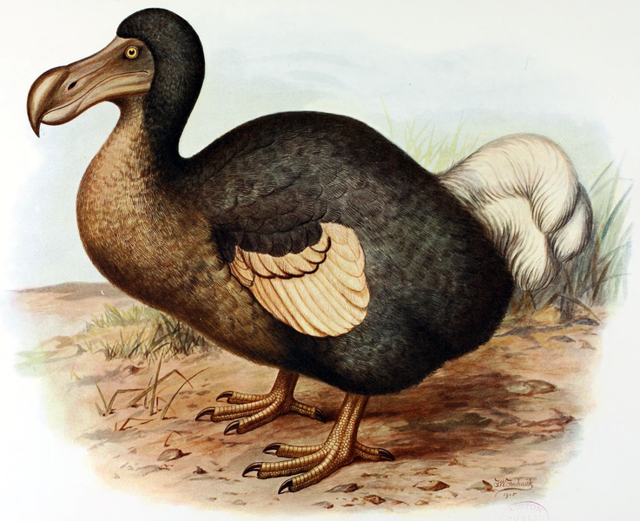
Specialization
is for
dodos
Keshav Pingali
The University of Texas at Austin

Slide 2
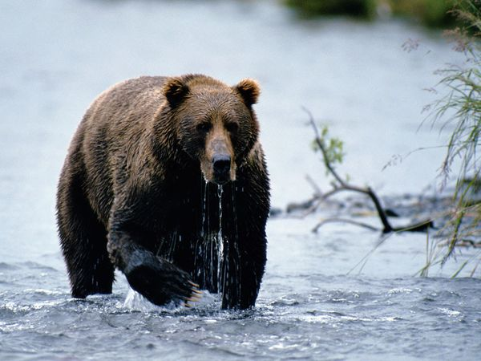
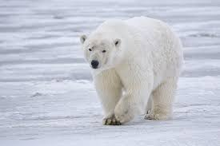
Lesson from natural world
Specialization
Brown bears
Adapted to live in temperate forests
Polar bears
Adapted to live above Arctic Circle
Polar bears evolved from brown bears
Specialization
Driven by struggle for survival

Slide 3
Lesson from Salt Lake City
1830-1978:
Mormons were mostly white
Very specialized
1978:
Church elders have divine revelation
Today:
Mormons are very diverse
Generalization:
Driven by struggle for survival
Generalization

Slide 4
Main take-away
Struggle for survival can lead to both specialization and generalization
Specialization
Useful when there are mutually exclusive alternatives
Generalization
Useful if you can adapt to diverse environments
(eg) human beings of all races now live all over the world
What are the lessons for programming languages?

Slide 5
Specialized languages = DSLs
DSLs usually evolve into general-purpose languages
To deal with diverse data types
To grow market share
MATLAB
Began with dense matrices and vectors to use EISPACK and LINPACK w/o writing FORTRAN code
Today: sparse matrices, objects, ADT’s, etc.
APL: dodo of array languages
SQL
Focus on structured data aka relations
Today: evolving to deal with unstructured data
Erlang
Began as a way to write telephony apps
Today: has evolved to a general functional language

Slide 6
Two claims for DSLs
Claim I: productivity
Programmers can code with domain abstractions
(eg) relations, groups, fields, etc.
Claim II: performance
Compilers for DSLs can use domain-specific information to optimize programs
(eg) optimization in SQL
Counter-point:
Can be implemented easily in general-purpose languages
ADTs + semantic information about methods

Slide 7
Anecdotal Evidence
Graph analytics
Many DSLs:
GraphLab, PowerGraph, Ligra, SociaLite..
Galois:
General-purpose programming model implemented in sequential C++
SOSP 2014: Nguyen et al
Galois programs run 10-10,000 times faster than GraphLab programs
Shim for GraphLab on top of Galois in about 200 lines of code

Slide 8
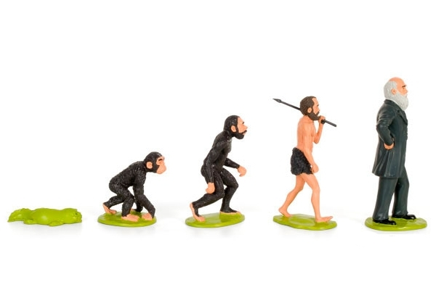
Generalization
Specialization

