Slide 1
ASPLOS 2014
First ANNUAL Debate

Slide 2
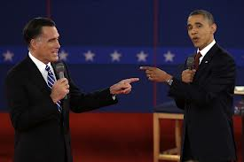
First ANNUAL ASPLOS Debate
Debate the role of specialization vs. general purpose support in architecture, programming languages, and system software.

Slide 3
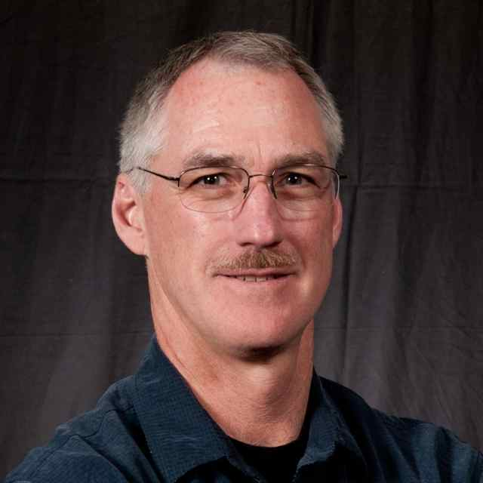
Moderator
David Wood, Wisconsin

Slide 4
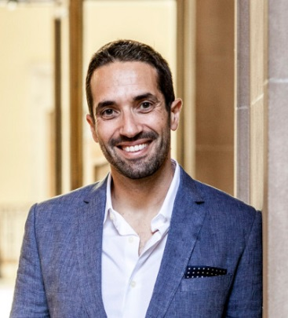
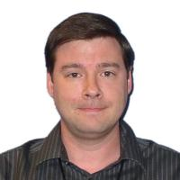
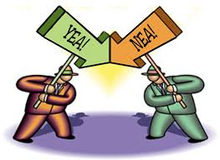
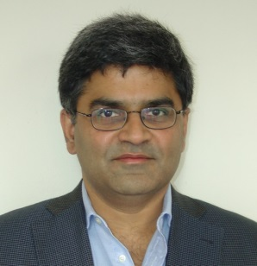
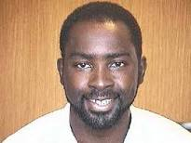
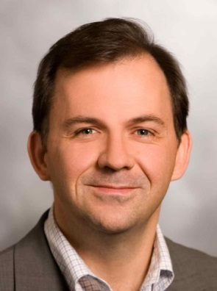
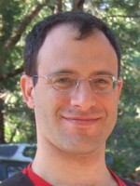
First ANNUAL ASPLOS Debate
Pro Team
Con Team
A
S
P
L
O
S
Christos Kozyrakis
Chris Hughes
Kunle Olukotun
Keshav Pingali
Ed Bougnion
Emmett Witchel

Slide 5
Debate Format
Opening Statements
7 minutes each
Slides optional
Alternate Pro and then Con positions
First Architecture, then Programming Languages & System Software
Moderated Questions
Audience participation
Closing Statements
2 minutes each
Alternate Con and then Pro positions

Slide 6
The Resolution
Resolved: Specialized architectures, languages, and system software should largely supplant general-purpose alternatives within the next decade

Slide 7
Picking the Winners
But FIRST…
Use a Google Poll to determine who wins
Preliminary (pre-debate) Poll
http://bit.ly/1hHUNG5
Final (post-debate) Poll
http://bit.ly/1ooEDSf
Please vote only ONCE!
Please share your smart phone or laptop with other audience members, as needed.
Winners drink fine wine, losers swill Ripple

Slide 8
Let’s begin!

Slide 9
Final Poll
Final (post-debate) Poll
http://bit.ly/1ooEDSf
Please vote only ONCE!
Please share your smart phone or laptop with other audience members, as needed.
Winners drink fine wine, losers swill Ripple

