Slide 1
Identifying Conditional Independencies in Bayes Nets
Lecture 4

Slide 2
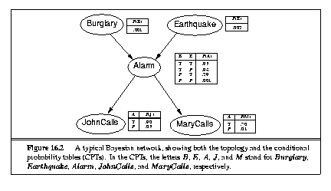

Slide 3
Getting a Full Joint Table Entry from a Bayes Net
Recall:
A table entry for X₁ = x₁,…,X_{n} = x_{n} is simply P(x₁,…,x_{n}) which can be calculated based on the Bayes Net semantics above.
Recall example:

Slide 4
Inference Example
What is probability alarm sounds, but neither a burglary nor an earthquake has occurred, and both John and Mary call?
Using j for John Calls, a for Alarm, etc.:

Slide 5
Chain Rule
Generalization of the product rule, easily proven by repeated application of the product rule
Chain Rule:

Slide 6
Chain Rule and BN Semantics

Slide 7
Markov Blanket and Conditional Independence
Recall that X is conditionally independent of its predecessors given Parents(X).
Markov Blanket of X: set consisting of the parents of X, the children of X, and the other parents of the children of X.
X is conditionally independent of all nodes in the network given its Markov Blanket.

Slide 8
d-Separation
A
B
C
Linear connection: Information can flow between A and C
if and only if we do not have evidence at B

Slide 9
d-Separation (continued)
A
B
C
Diverging connection: Information can flow between A
and C if and only if we do not have evidence at B

Slide 10
d-Separation (continued)
A
B
C
D
E
Converging connection: Information can flow between A
and C if and only if we do have evidence at B or any
descendent of B (such as D or E)

Slide 11
d-Separation
An undirected path between two nodes is “cut off” if information cannot flow across one of the nodes in the path
Two nodes are d-separated if every undirected path between them is cut off
Two sets of nodes are d-separated if every pair of nodes, one from each set, is d-separated

Slide 12
An I-Map is a Set of Conditional Independence Statements
P(X Y | Z): sets of variables X and Y are conditionally independent given Z (given a complete setting for the variables in Z)
A set of conditional independence statements K is an I-map for a probability distribution P just if the independence statements in K are a subset of the conditional independencies in P. K and P can also be graphical models instead of either sets of independence statements or distributions.

Slide 13
Note: For Some CPT Choices, More Conditional Independences May Hold
A
B
C
Suppose we have:
Then only conditional independence we have is:
P(A C | B)
Now choose CPTs such that A must be True, B must take same value as A, and C must take same value as B
In the resulting distribution P, all pairs of variables are conditionally independent given the third
The Bayes net is an I-map of P

Slide 14
Procedure for BN Construction
Choose relevant random variables.
While there are variables left:

Slide 15
Principles to Guide Choices
Goal: build a locally structured (sparse) network -- each component interacts with a bounded number of other components.
Add root causes first, then the variables that they influence.

