Slide 1
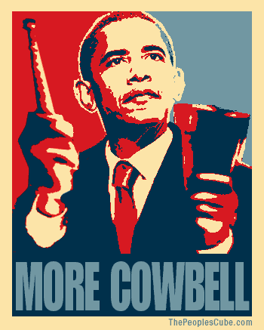
Shane Bric and Kevin Paprocki

Slide 2
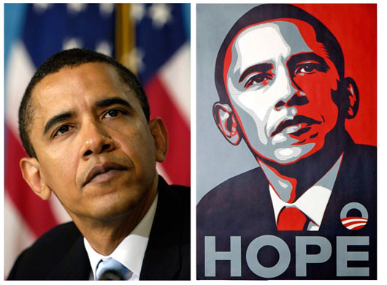
Goal:
Create an algorithm that turns an ordinary picture into an Obama campaign style poster

Slide 3
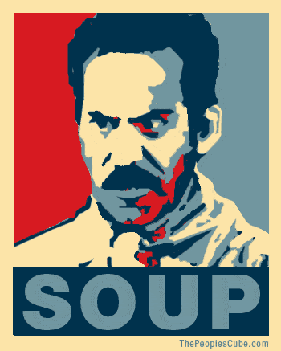
Initial Thoughts
Preserve edges and shape
Preserve relative hue differences
Map color based intensity and/or color
This lead us to..
Bi lateral filtering
Lithography

Slide 4
Bi-lateral Filtering
Preserves edges while smoothing similar colors
Pixel based on average of both:
Geometric closeness
Similarly colored pixels
Pixels that are far away in distance and color are ignored

Slide 5
Lithography
The printing process of applying successive colors of a print sequentially.
Similar in style to the Obama poster
Allows artists to separate colors
We modified this idea to apply colors individually by intensity

Slide 6
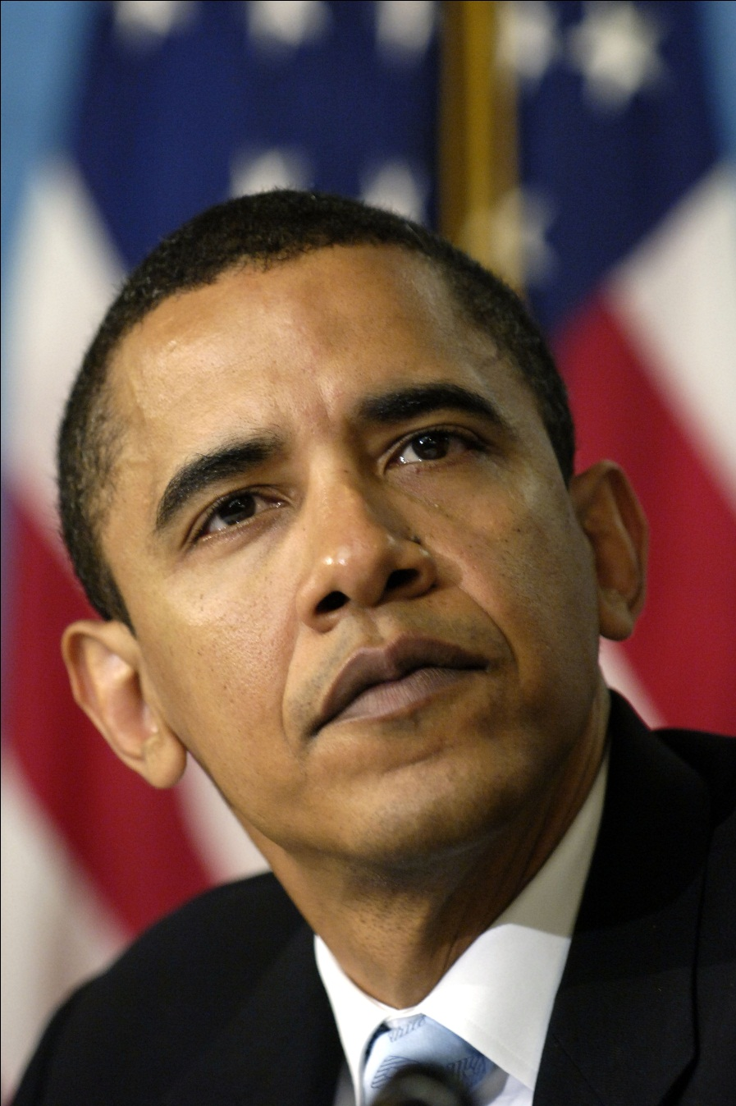
Our Algorithm
Mask the subject from the environment
Apply the bi-lateral filter
Convert the image to greyscale
Map carefully tuned intensity ranges to different colors
Output the image

Slide 7
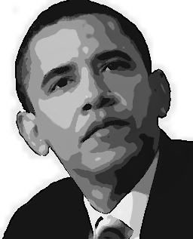
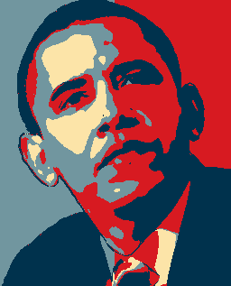
Results

Slide 8
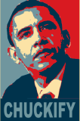
Other Implementations
Obamicon.me
Converts photo’s you upload
Must mask the background
Has similar results to our algorithm

Slide 9
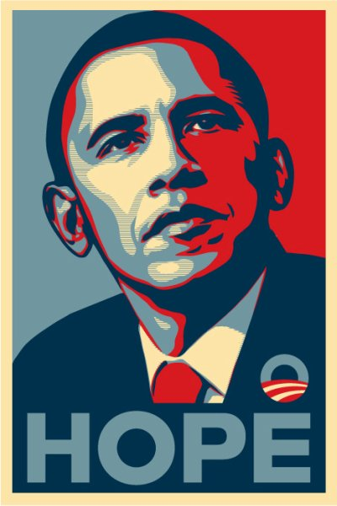
Comparison
Obamicon.me
Our Algorithm
Original

Slide 10
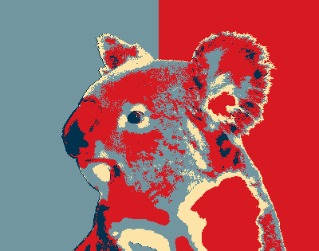
Current Problems
Manually Specify the Mask
Manually tune the color mapping for each picture
Only works with Red and Blue color scheme
The filter runs slowly on older computers or large images

Slide 11
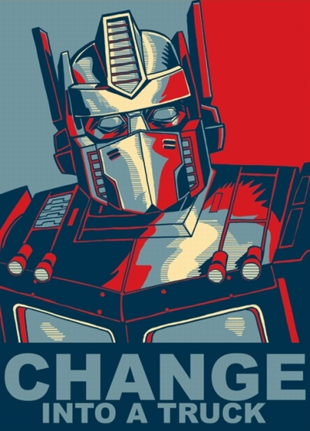
Current and Future Improvements
Choosing a color scheme
Interactive threshold adjustments
Allow users to put witty words at the bottom of the picture.
Automatic masking
Improving the background

