Slide 1
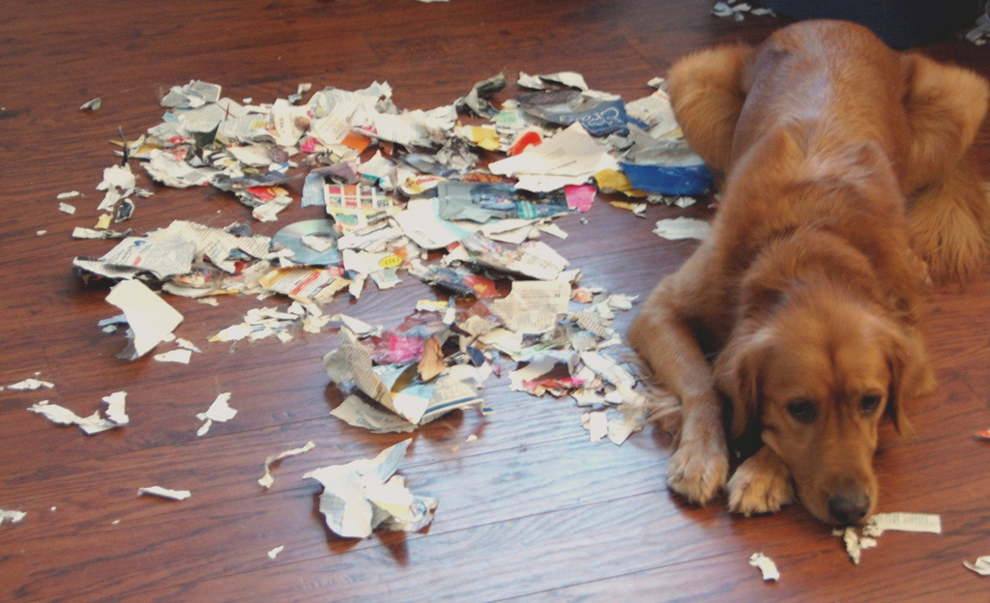
Reconstructing Shredded Documents
Nathan Figueroa

Slide 2
Example: Original

Slide 3
Example: Shredded

Slide 4
Example: Reconstructed

Slide 5
Motivation
Forensic Photography
Counter Intelligence
Security

Slide 6
Method
Isolate
Align
Match
Reassemble

Slide 7
Isolate: K-Means Segmentation
Pick K cluster means at random
Assign each pixel to the nearest mean
Compute a new mean for each cluster
Repeat 2 and 3 until convergence

Slide 8
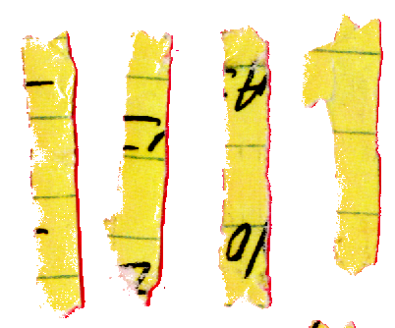
Isolate: K-Means Segmentation
Advantages
Easy to implement
Requires no user interaction
Works well on a variety of images
Challenges
Noise in certain color spaces
Artifacts along edge

Slide 9
Isolate: Connected Components
A connected component is a subgraph where every vertex is connected by a path to every other vertex in the subgraph
0 | 0 | 0 | 0 | 0 | 0 | 0 | 1 | 1 | 0
1 | 1 | 1 | 0 | 0 | 0 | 0 | 1 | 1 | 0
0 | 1 | 1 | 0 | 1 | 1 | 0 | 1 | 1 | 0
0 | 1 | 1 | 0 | 1 | 1 | 0 | 0 | 1 | 1
0 | 0 | 1 | 0 | 1 | 1 | 0 | 0 | 1 | 1
0 | 0 | 0 | 0 | 0 | 1 | 0 | 0 | 0 | 0

Slide 10
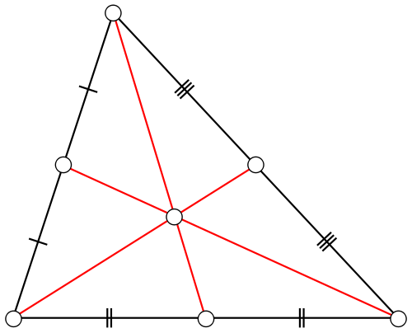
Align: Centroids
Centroid is the geometric center of mass

Slide 11
Align: Second Central Moments
The second central moments are defined by
A 2x2 covariance matrix can be constructed from the moments of each region
The eigenvectors of the covariance matrix relate to the width and length of region

Slide 12
Align: Second Central Moments
0 | 0 | 0 | 0 | 0 | 0 | 0 | 1 | 1 | 0
1 | 1 | 1 | 0 | 0 | 0 | 0 | 1 | 1 | 0
0 | 1 | 1 | 0 | 1 | 1 | 0 | 1 | 1 | 0
0 | 1 | 1 | 0 | 1 | 1 | 0 | 0 | 1 | 1
0 | 0 | 1 | 0 | 1 | 1 | 0 | 0 | 1 | 1
0 | 0 | 0 | 0 | 0 | 1 | 0 | 0 | 0 | 0

Slide 13
Align: Rotation
The dominant orientation of a chad is the orientation of the largest eigenvector
An affine rotation is applied to each chad so all chads have the same orientation

Slide 14
Match: Sum of Squared Difference
Shape of edge
Edge histograms
Optical character recognition
Simple sum of squared difference

Slide 15
Reassemble: Automatic Jigsaw
Fully automated systems perform well on small, single-page, multicolor documents
Top 5 DARPA Shredder Challenge leaders relied on human interaction for reassembly
Winning team took over 300 man hours to partially reassemble five puzzles

