Slide 1
Panoramas from Video with Occlusion Removal
Chris Hall
&
Lee Yerkes

Slide 2
Outline
Panoramas from videos
Quality Measure
Activity Synopsis Synthesis (from Discovering Panoramas in Web Videos)
Occlusion removal (Panoramas looking through cracks!)

Slide 3
Panoramas

Slide 4
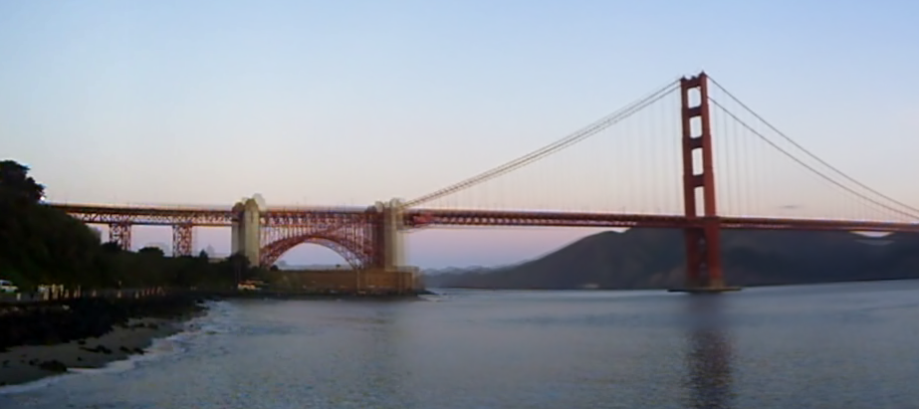
Commercial

Slide 5
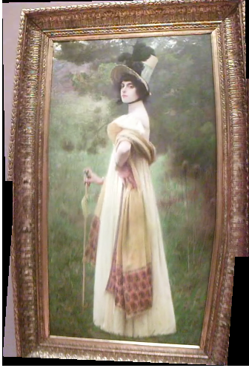
Example

Slide 6
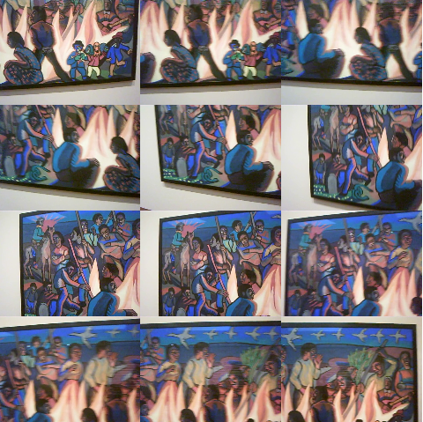
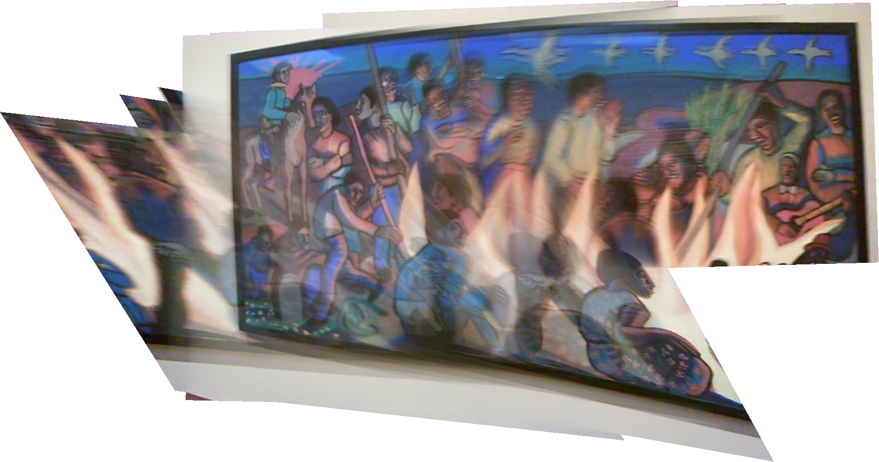
No Quality Control

Slide 7
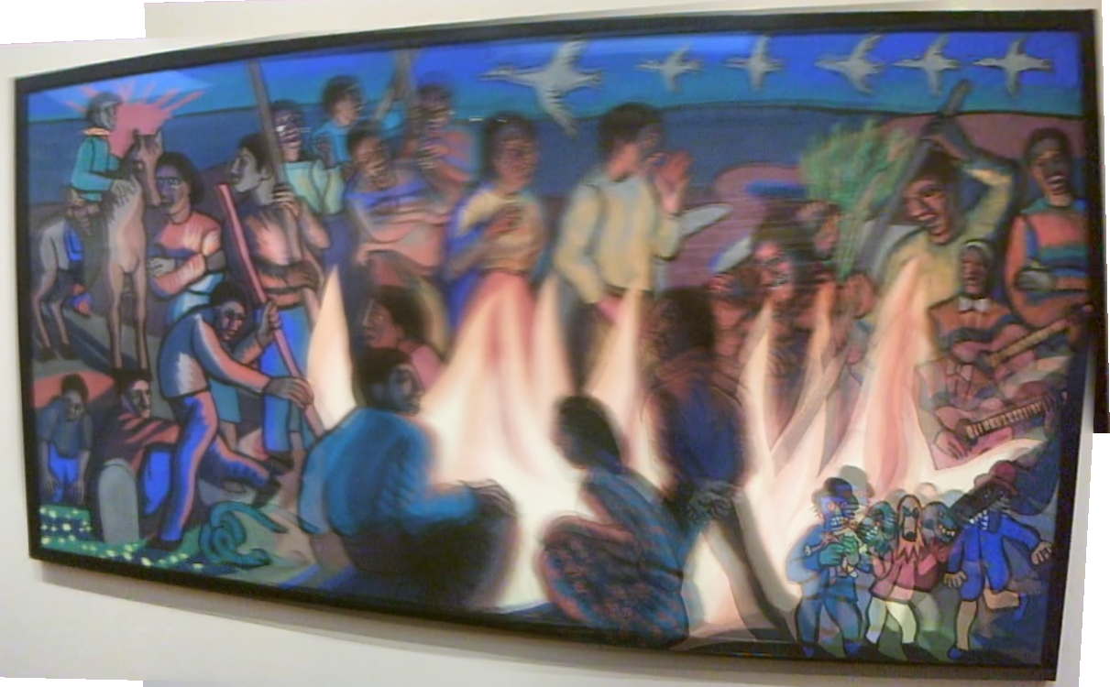
With Quality Control

Slide 8
Original

Slide 9
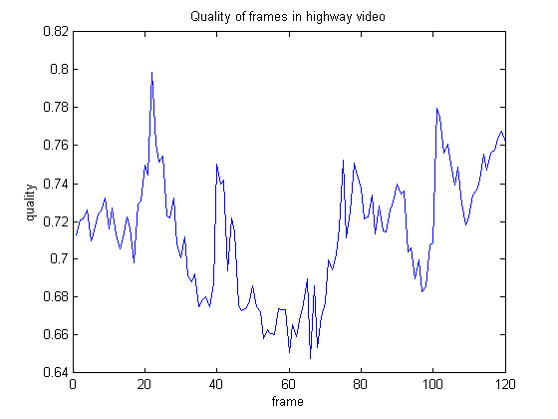
Quality Measure

Slide 10
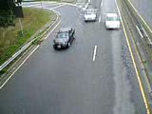
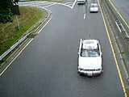
Quality Measure
Low-Quality
High-Quality

Slide 11
Optical Flow

Slide 12
Dynamic Foreground Objects

Slide 13
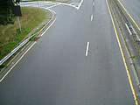
Static Background
Median of non-moving pixels

Slide 14
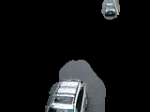
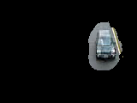
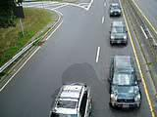
User Selected Objects

Slide 15
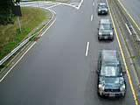
Activity Synopsis Synthesis

Slide 16
Camera Array
Focal Plane
Wall
Camera Array

Slide 17
Camera Array
Focal Plane
Occlusion
Occlusion
Occlusion
Camera Array

Slide 18
Occlusion Removal

Slide 19
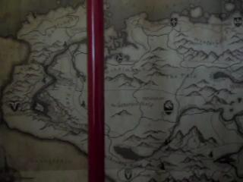
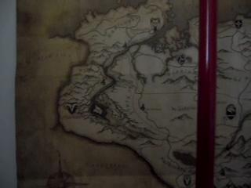
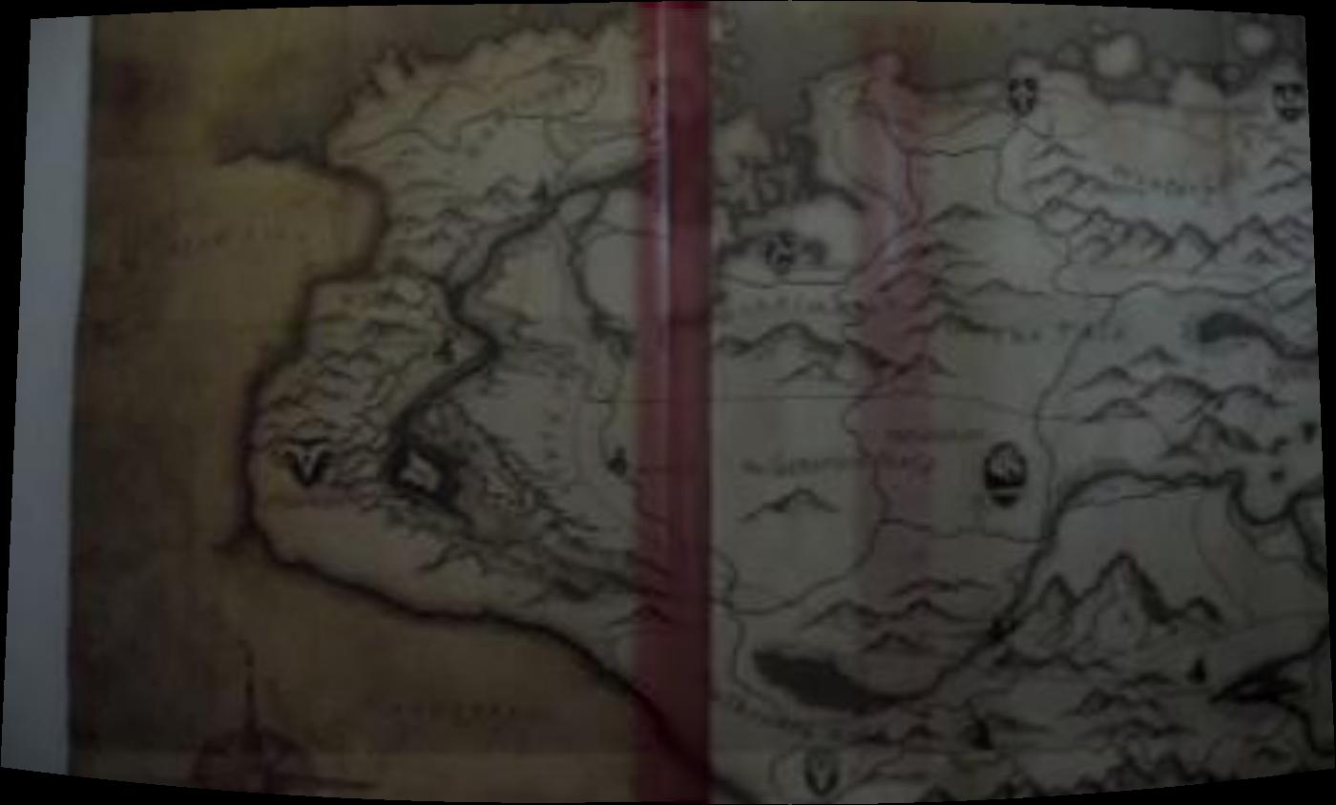
Autostitch

Slide 20
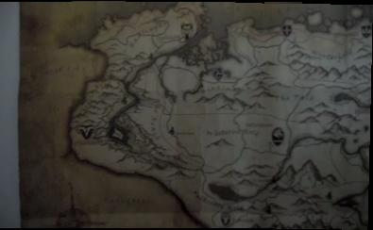
Hall and Yerkes

Slide 21
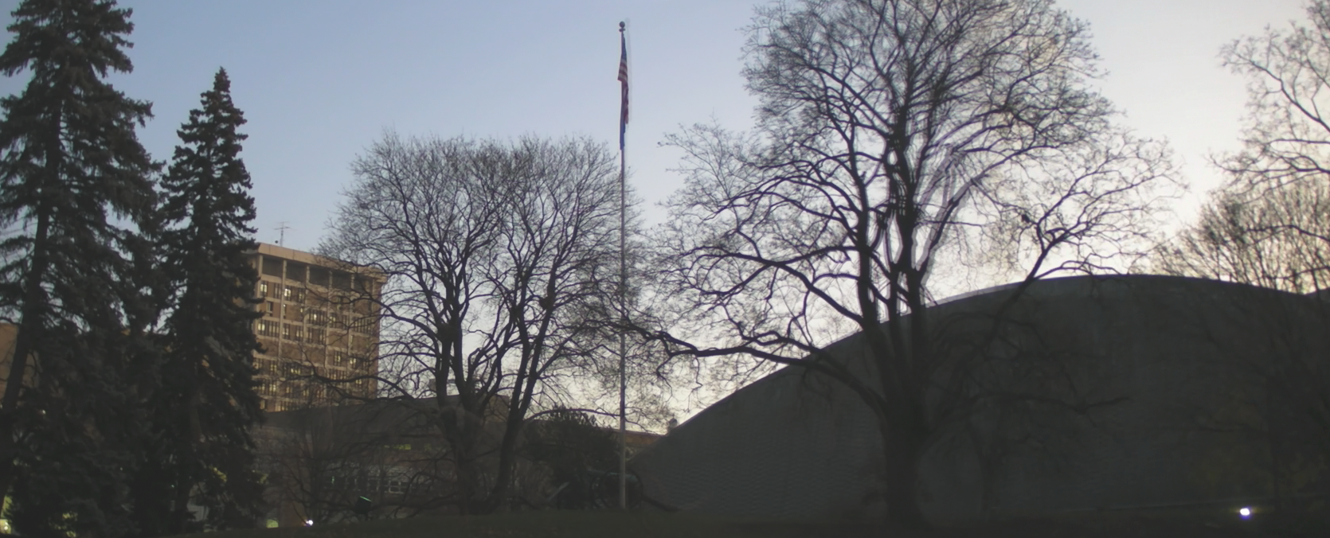
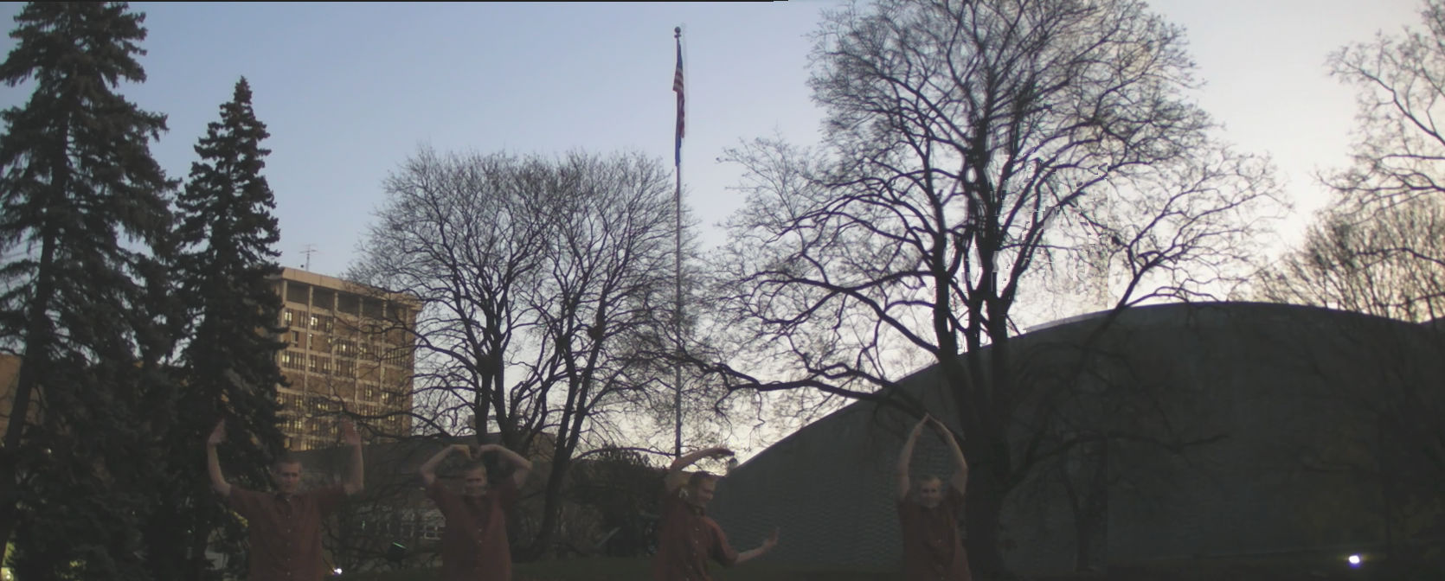
YMCA – Still/Active

Slide 22
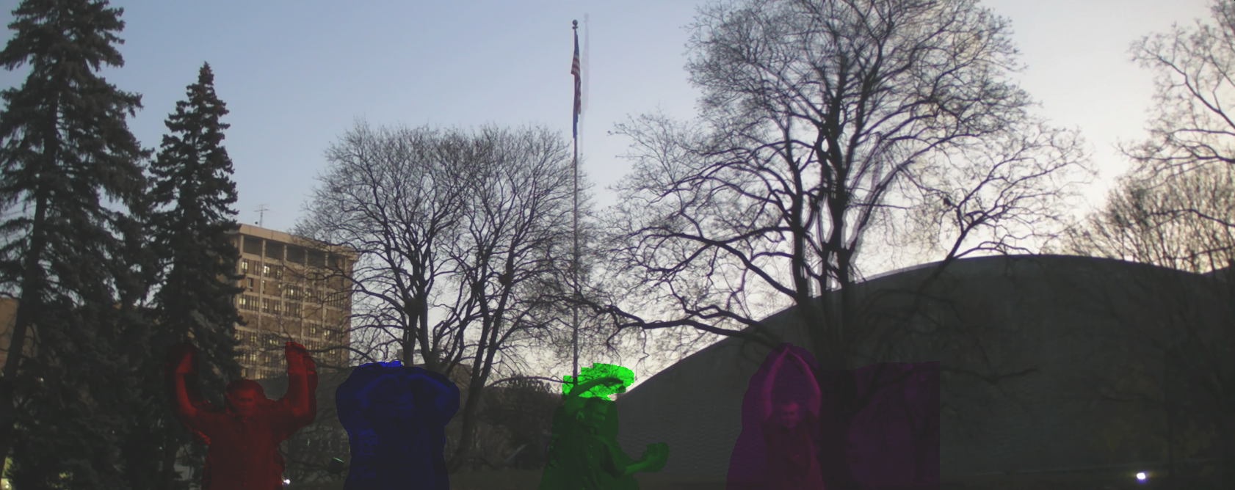
Why fixed colors?

Slide 23
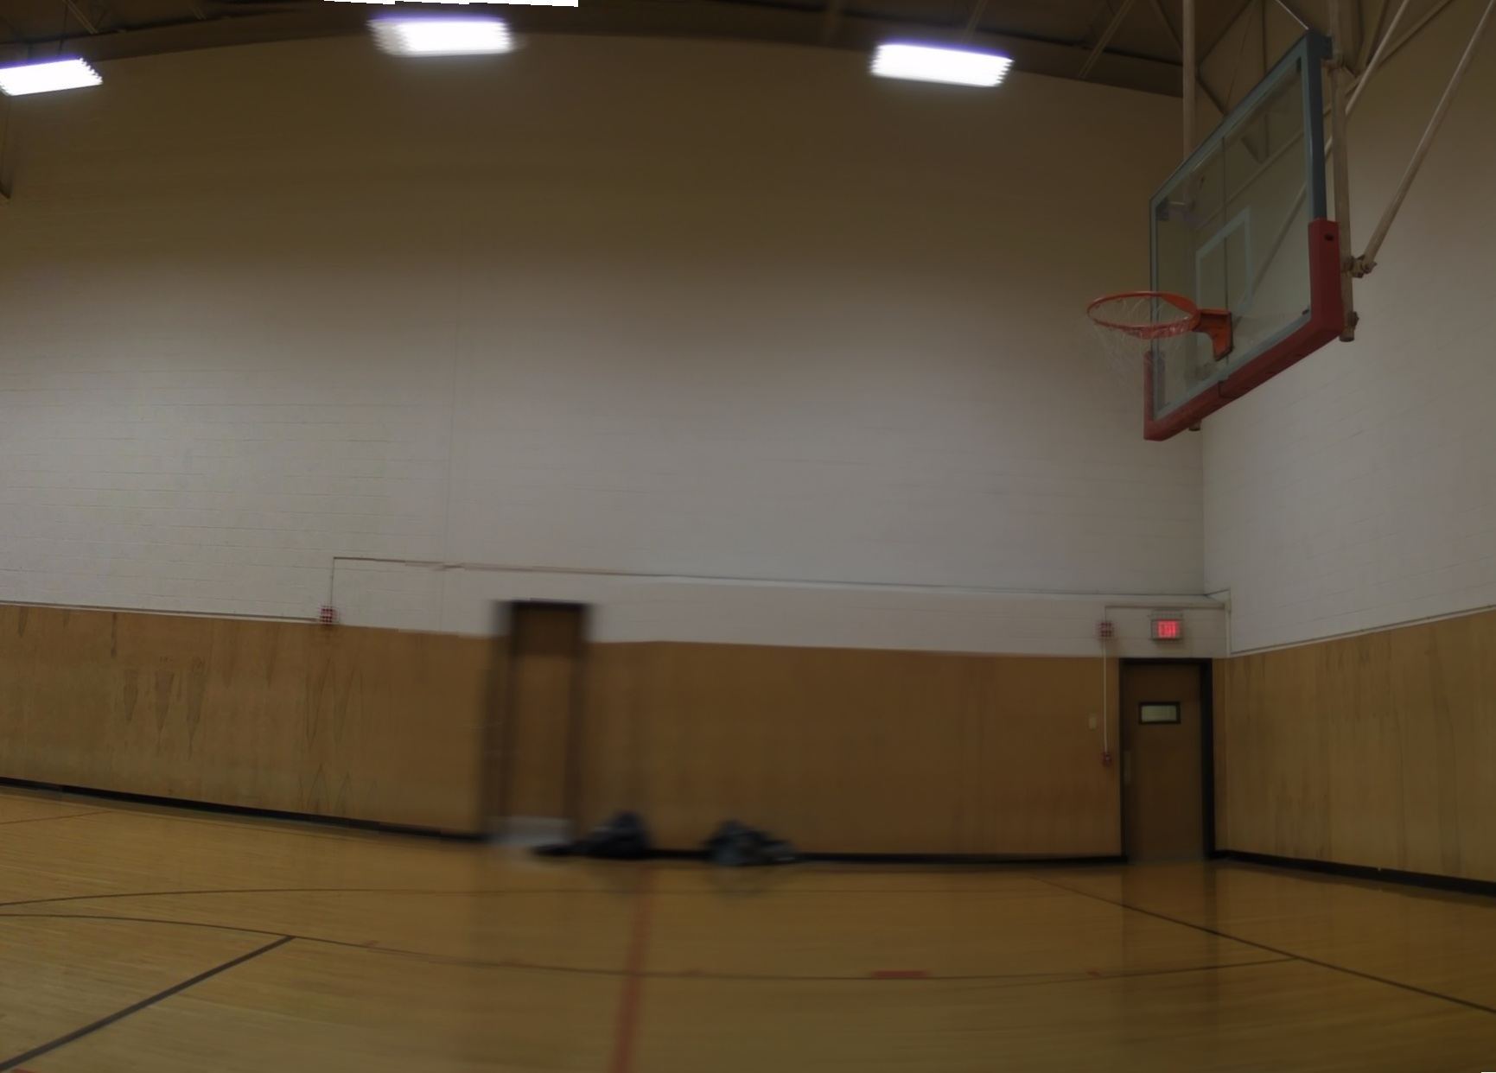
Still of Gym

Slide 24
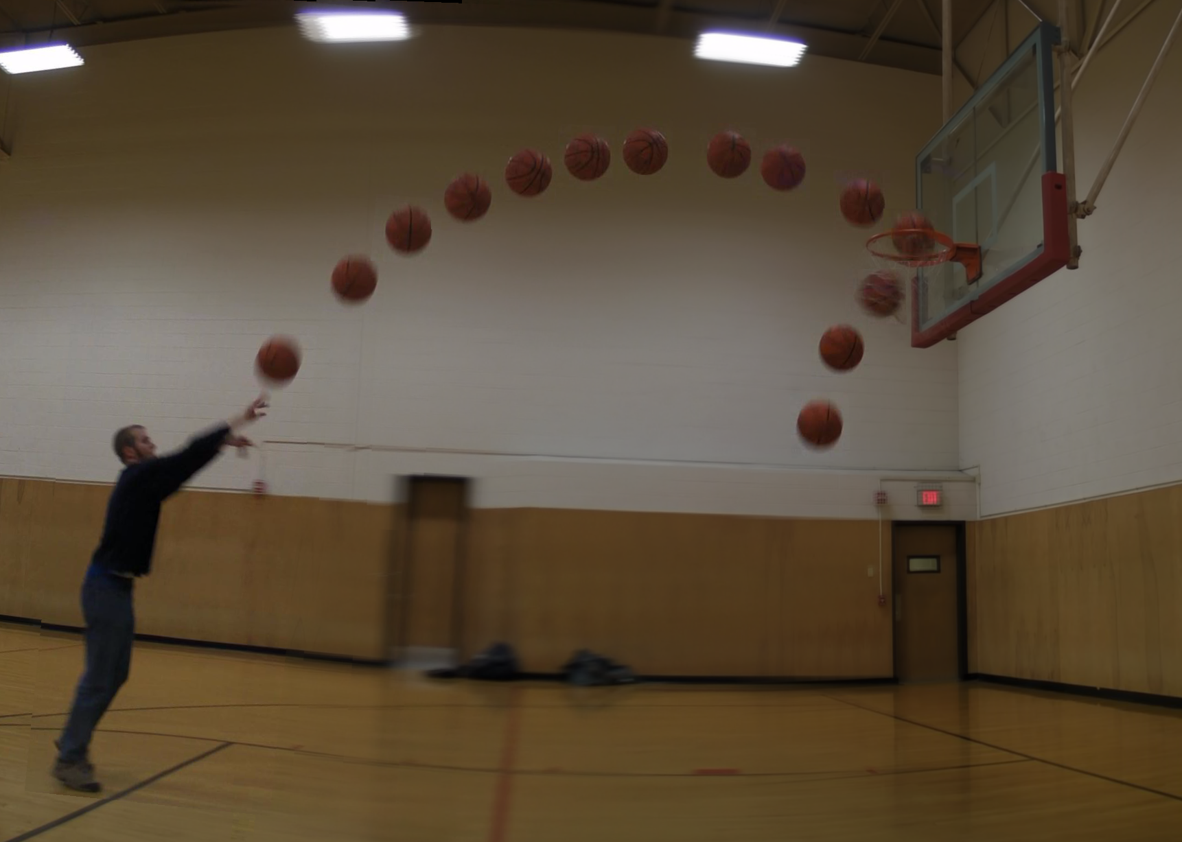
A Successful Shot

Slide 25
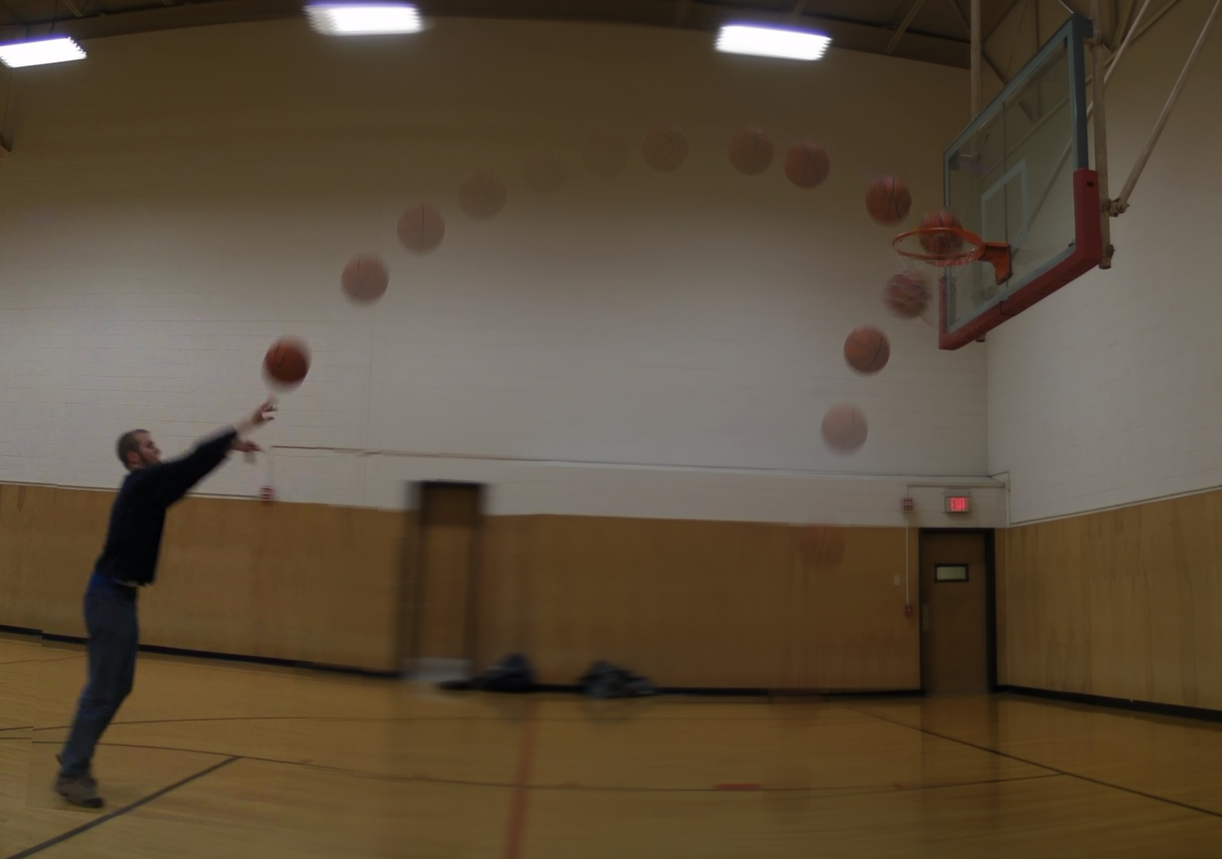
Fadeout for Emphasis

Slide 26
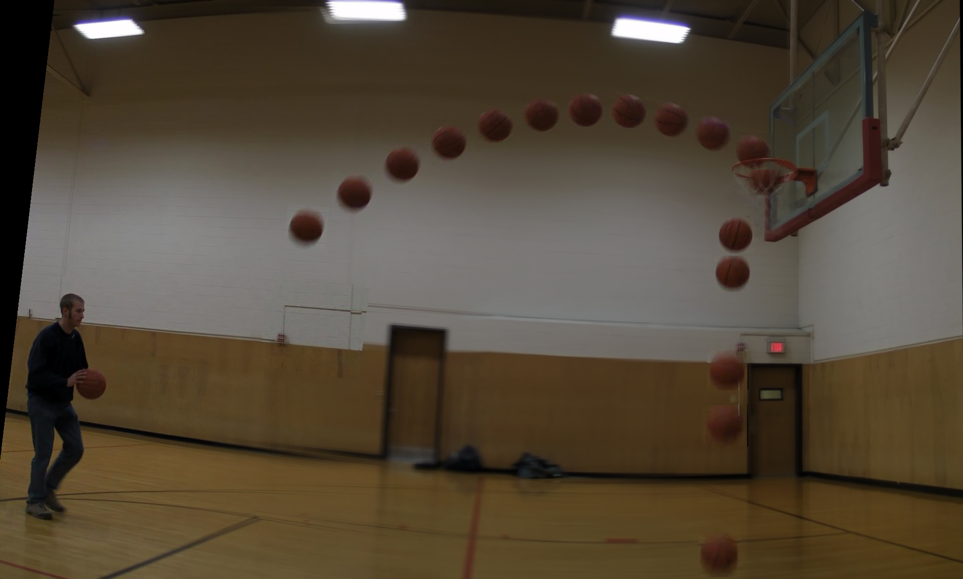
Another Shot

Slide 27
Cartwheel

Slide 28
Questions?

