Slide 1
Constraint Satisfaction Problems
Chapter 6.1 – 6.4
Derived from slides by S. Russell and P. Norvig, A. Moore, and R. Khoury

Slide 2
Constraint Satisfaction Problems (CSPs)
Standard search problem:
state is a "black box“ – any data structure that supports successor function, heuristic function, and goal test
CSP:
state is defined by variables X_{i} with values from domain D_{i}
goal test is a set of constraints specifying allowable combinations of values for subsets of variables
Use a variable-based model
Solution is not a path but an assignment of values for a set of variables that satisfy all constraints

Slide 3
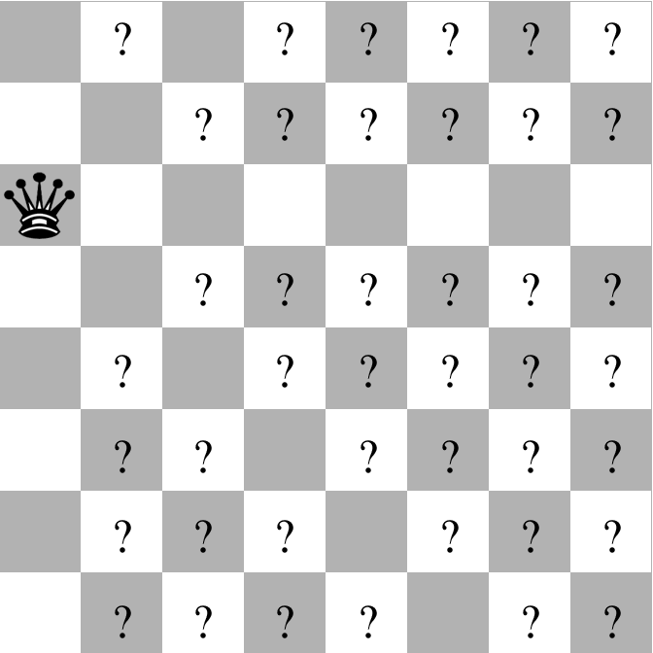
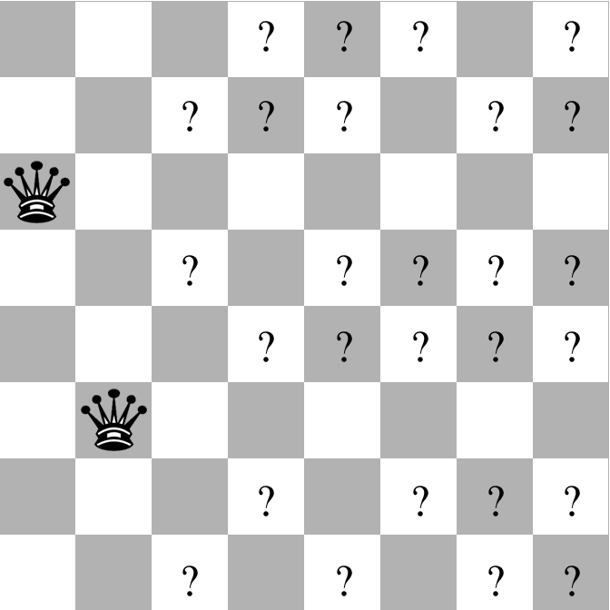
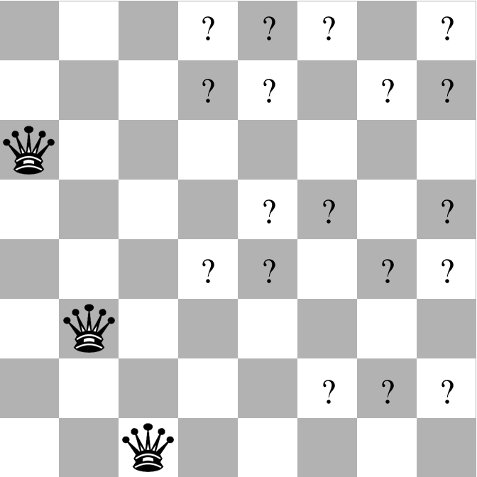
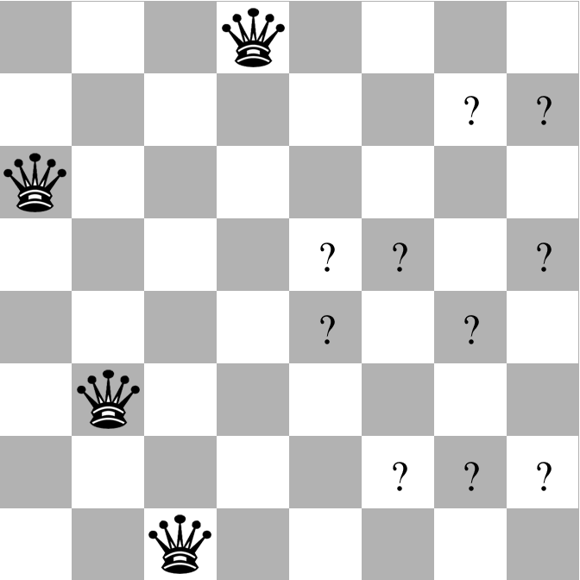
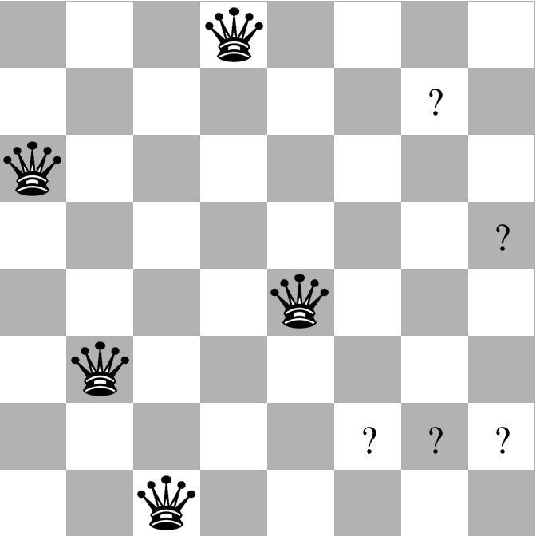
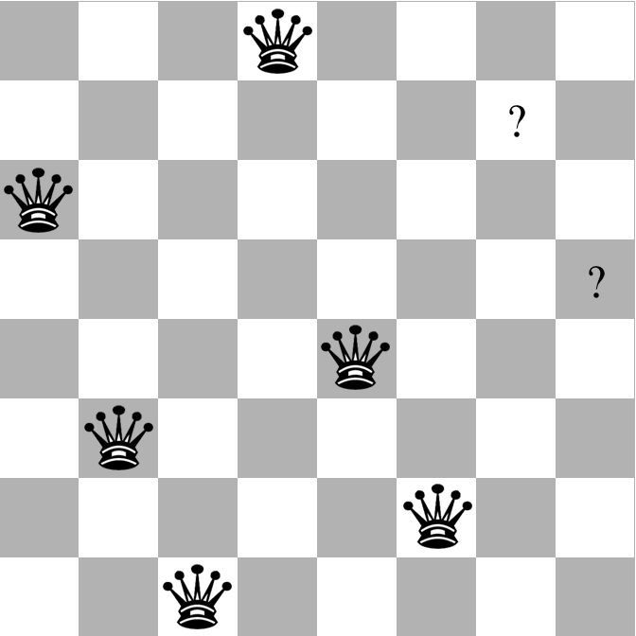
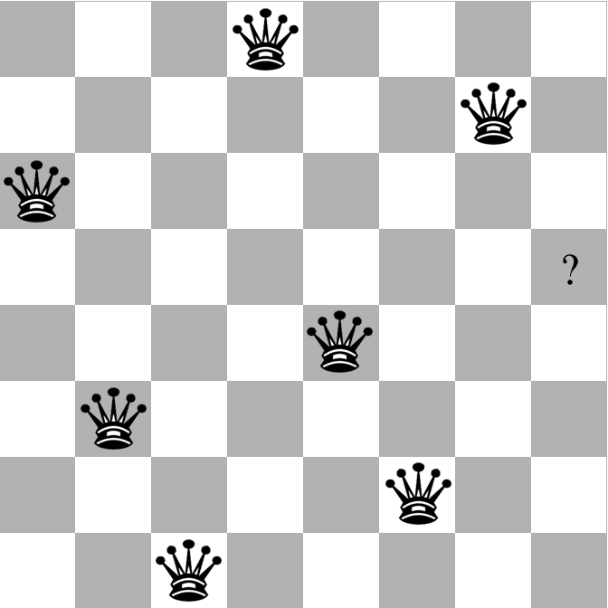
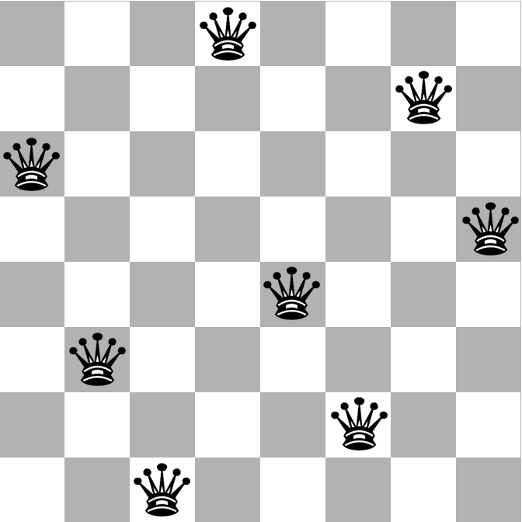
Example: 8-Queens

Slide 4
Example: 8-Queens
Variables: 64 squares, number of queens
V = {S_{1,1}, S_{1,2}, …, S_{8,8}, Number_of_queens}
Values: Queen or No-Queen
S_{i,j} is an element of D_{S} = {queen, empty}
Number_of_queens is an element of D_{N} = [0, 64]
Constraints: Attacks, queen count
{Number_of_queens = 8, S_{i,j} = queen ➔ S_{i,j+n} = empty, S_{i,j} = queen ➔ S_{i+n,j} = empty, S_{i,j} = queen ➔ S_{i+n,j+n} = empty}
States: All board configurations
2.8 x 10¹⁴ complete states
1.8 x 10¹⁴ complete states with 8 queens
92 complete and consistent states
12 unique complete and consistent states

Slide 5
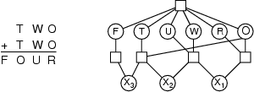
Example: Cryptarithmetic
Variables: F, T, U, W, R, O, X₁, X₂ , X₃
Domains: {0, 1, 2, 3, 4, 5, 6, 7, 8, 9}
Constraints: Alldiff (F, T, U, W, R, O)
O + O = R + 10 · X₁
X₁ + W + W = U + 10 · X₂
X₂ + T + T = O + 10 · X₃
X₃ = F, T ≠ 0, F ≠ 0

Slide 6
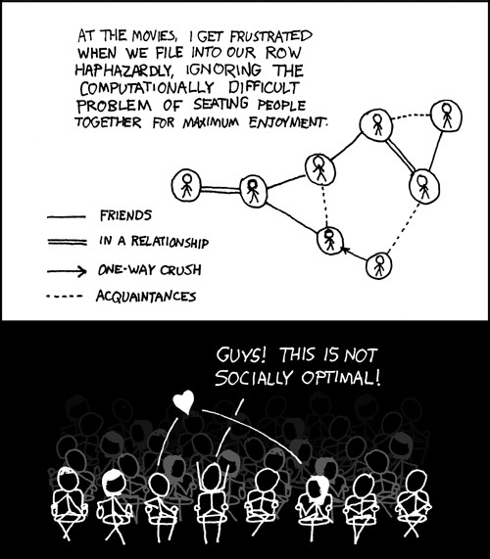
Example:
Movie Seating

Slide 7
Example: Graph Coloring
V₅
V₃
V₁
V₂
V₆
R
V₄
G
Each circle marked V₁ .. V₆ must be assigned R, G or B
No two adjacent circles may be assigned the same color
Note: 2 variables have already been assigned a color in this example

Slide 8
Other Applications of CSPs
Assignment problems
e.g., who teaches what class
Timetable problems
e.g., which class is offered when and where?
Scheduling problems
VLSI or PCB layout problems
Boolean satisfiability
N-Queens
Graph coloring
Games: Minesweeper, Magic Squares, Sudoku, Crosswords
Line-drawing labeling
Note: many problems require real-valued variables

Slide 9
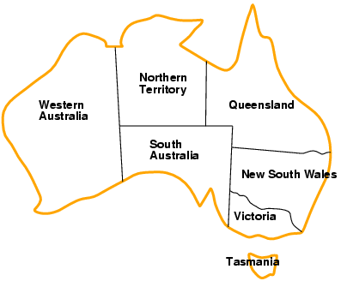
Example: Map-Coloring
Note: In general, 4 colors are necessary
Variables: WA, NT, Q, NSW, V, SA, T
Domains: D_{i} = {red,green,blue}
Constraints: adjacent regions must have different colors
e.g., WA ≠ NT, or (WA,NT) in {(red,green), (red,blue), (green,red), (green,blue), (blue,red), (blue,green)}

Slide 10
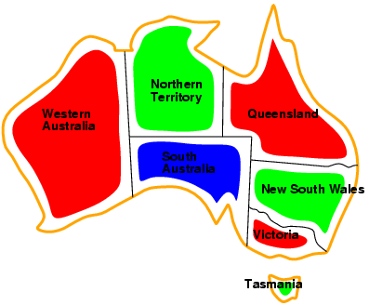
Example: Map-Coloring
Solutions are complete (i.e., all variables are assigned values) and consistent (i.e., does not violate any constraints) assignments, e.g., WA = red, NT = green, Q = red, NSW = green, V = red, SA = blue, T = green

Slide 11
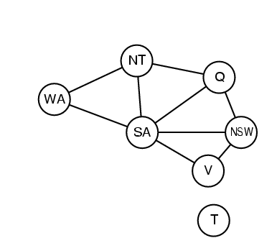
Constraint Graph
Binary CSP: each constraint relates two variables
Constraint graph: nodes are variables, arcs are constraints

Slide 12
Varieties of CSPs
Discrete variables
finite domains:
n variables, domain size d → O(d^{n}) complete assignments
e.g., Boolean CSPs, Boolean satisfiability
infinite domains:
integers, strings, etc.
e.g., job scheduling, variables are start/end times for each job
Continuous variables
e.g., start/end times for Hubble Space Telescope observations

Slide 13
Kinds of Constraints
Unary constraints involve a single variable
e.g., SA ≠ green
Binary constraints involve pairs of variables
e.g., SA ≠ WA
Higher-order constraints involve 3 or more variables
e.g., cryptarithmetic column constraints

Slide 14
Local Search for CSPs
Hill-climbing, simulated annealing, genetic algorithms typically work with "complete" states, i.e., all variables have values at every step
To apply to CSPs:
allow states with some unsatisfied constraints
operators assign a value to a variable
Variable selection: randomly select any conflicted variable
Value selection by min-conflicts heuristic:
choose value that violates the fewest constraints, i.e., hill-climb by minimizing f(n) = total number of violated constraints

Slide 15
Local Search
Min-Conflicts Algorithm:
0. Assign to each variable a random value, defining the initial state
while state not consistent do
2.1 Pick a variable, var, that has constraint(s) violated
2.2 Find value, v, for var that minimizes the total number of violated constraints (over all variables)
2.3 var = v

Slide 16
Example: 4-Queens
States: 4 queens in 4 columns (4⁴ = 256 states)
Actions: move queen to new row in its column
Goal test: no attacks
Evaluation function: f(n) = total number of attacks
f = 5
f = 2
f = 0

Slide 17
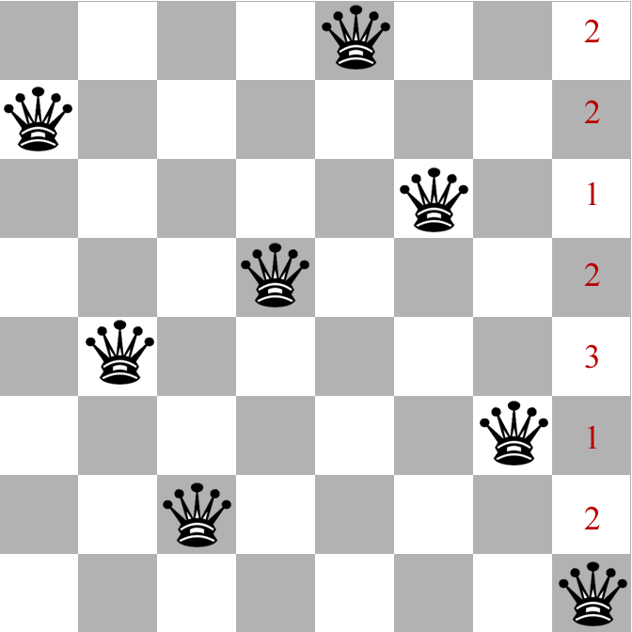
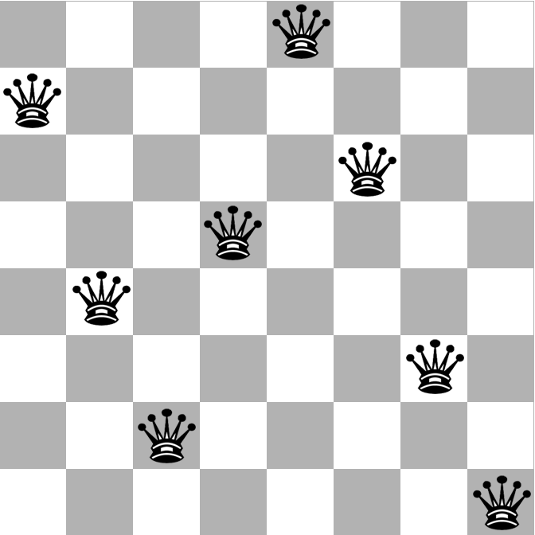
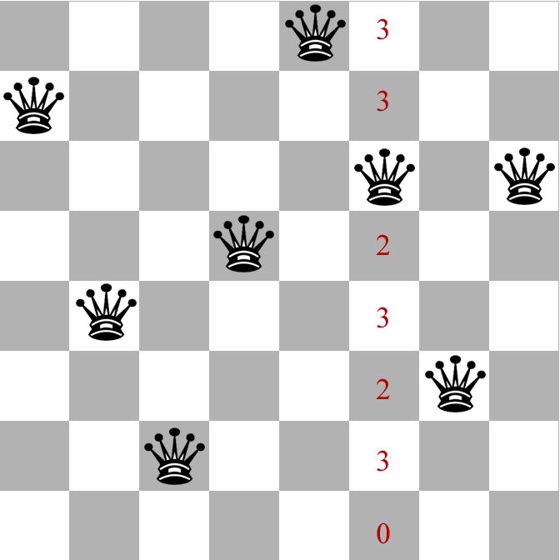
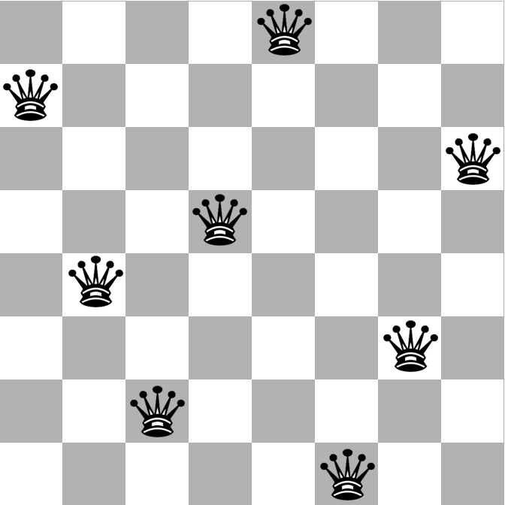
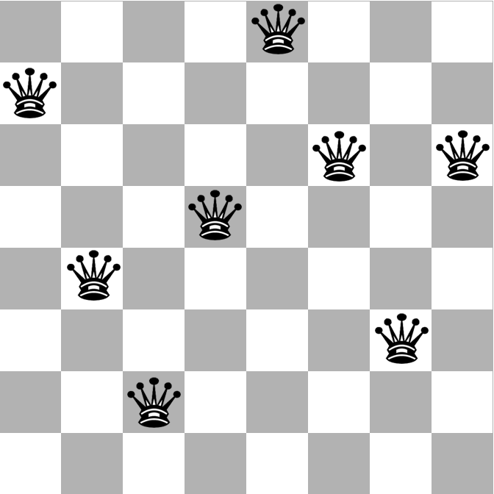
Min-Conflicts Algorithm
Notes:
In columns 4 and 8 there is 1 conflict for each queen. Randomly choose queen 8. Min-conflicts changes row for queen 8 to either row 3 or row 6, both also with 1 conflict. Randomly move queen 8 to row 3. Now there is 1 conflict in each of columns 6 and 8. Randomly choose queen in column 6. Min-conflicts for queen 6 in row 8 (0 conflicts), so move queen 6 to row 8. Now 0 conflicts for all queens. Done.

Slide 18
Min-Conflicts Algorithm
Advantages
Simple and Fast: Given random initial state, can solve n-Queens in almost constant time for arbitrary n with high probability (e.g., n = 1,000,000 can be solved on average in about 50 steps!)
Disadvantages
Only searches states that are reachable from the initial state
Might not search entire state space
Does not allow worse moves (but can move to a neighbor with the same cost)
Might get stuck in a local optimum
Not complete
Might not find a solution even if one exists

Slide 19
Standard Tree Search Formulation
States are defined by all the values assigned so far
Initial state: the empty assignment { }
Successor function: assign a value to an unassigned variable
Goal test: the current assignment is complete and consistent, i.e., all variables assigned a value and all constraints satisfied
Goal: Find any solution, so cost is not important
Every solution appears at depth n with n variables → use depth-first search

Slide 20
DFS for CSPs
V₅
V₃
V₁
V₂
V₆
R
V₄
G
Variable assignments are commutative}, i.e.,
[ WA=R then NT=G ] same as [ NT=G then WA=R ]
What happens if we do DFS with the order of assignments as B tried first, then G, then R?
Generate-and-test strategy: Generate candidate solution, then test if it satisfies all the constraints
This makes DFS look very stupid!
Example: http://www.cs.cmu.edu/~awm/animations/constraint/9d.html

Slide 22
Improved DFS: Backtracking w/ Consistency Checking
Don’t generate a successor that creates an inconsistency with any existing assignment, i.e., perform consistency checking when node is generated
Successor function assigns a value to an unassigned variable that does not conflict with all current assignments
Deadend if no legal assignments (i.e., no successors)
Backtracking (DFS) search is the basic uninformed algorithm for CSPs
Can solve n-Queens for n ≈ 25

Slide 23
Backtracking w/ Consistency Checking
Start with empty state
while not all vars in state assigned a value do
Pick a variable (randomly or with a heuristic)
if it has a value that does not violate any constraints
then Assign that value
else
Go back to previous variable and assign it another value

Slide 24
Backtracking Search with Consistency Checking
function BACKTRACKING-SEARCH(csp) returns a solution, or failure
return BACKTRACK({ }, csp)
function BACKTRACK(assignment , csp) returns a solution, or failure
if assignment is complete then return assignment
var =SELECT-UNASSIGNED-VARIABLE(csp)
foreach value in ORDER-DOMAIN-VALUES(var , assignment , csp) do
if value is consistent with assignment then
add {var = value} to assignment
result = BACKTRACK(assignment , csp)
if result != failure then
return result
else remove {var = value} and inferences from assignment
return failure

Slide 25
Backtracking w/ Consistency Checking

Slide 26
Backtracking Example

Slide 27
Australia Constraint Graph

Slide 28
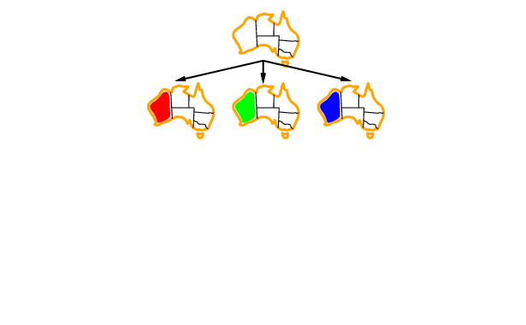
Backtracking Example

Slide 29
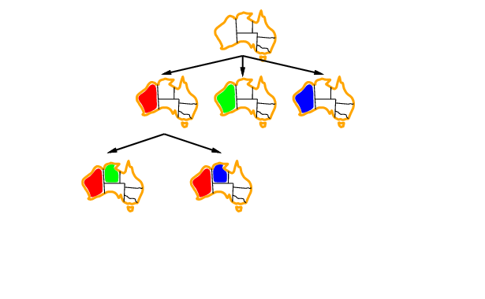
Backtracking Example

Slide 30
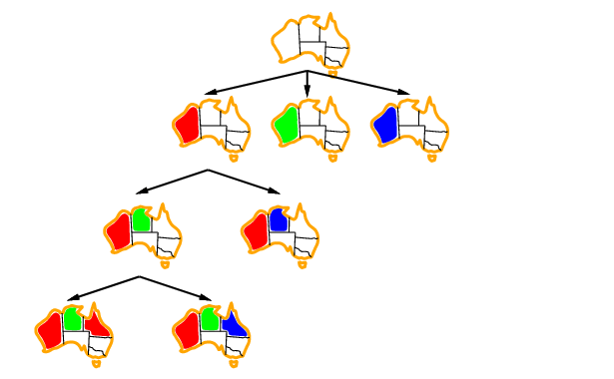
Backtracking Example

Slide 31
Backtracking Search
Depth-first search algorithm
Goes down one variable at a time
At a deadend, backs up to last variable whose value can be changed without violating any constraints, and changes it
If you back up to the root and have tried all values, then there is no solution
Algorithm is complete
Will find a solution if one exists
Will expand the entire (finite) search space if necessary
Depth-limited search with depth limit = n

Slide 33
Top-left node is hard to label!

Slide 34
Improving Backtracking Efficiency
Heuristics can give huge gains in speed
Which variable should be assigned next?
In what order should its values be tried?
Can we detect inevitable failure early?

Slide 35
Which Variable Next? Most-Constrained Variable
Most-constrained variable
Choose the variable with the fewest number of consistent values
Called the minimum remaining values (MRV) heuristic
Minimize branching factor
Try to cut off search ASAP
Notes:
MRV minimizes branching factor at the node in the search tree, producing the smallest number of subtrees to search.
NT and SA are most-constrained after WA=R.
SA is most-constrained after WA=R and NT=G

Slide 36
Which Variable Next? Most-Constraining Variable
Tie-breaker among most-constrained variables
Most-constraining variable
Choose the variable with the most constraints on the remaining variables
Called the degree heuristic
Try to cut off search ASAP
Notes:
After SA=B, all are most-constrained (except T) because each has 2 possible remaining values.
For each of these, the number of constraints on remaining vars is: WA=1, NT=2, Q=2, NSW=2, V=1. So, most-constraining are NT, Q and NSW. Say we pick NT.
After SA=B and NT=G, most-constrained are WA and Q with 1 possible remaining value. For each of these the number of constraints on remaining values is WA=0, Q=1.
So, most-constraining is Q because it is adjacent to NSW.

Slide 37
Which Value Next? Least-Constraining Value
Given a variable, choose the least-constraining value
Pick the value that rules out the fewest values in the remaining variables
Try to pick values best first
Combining these heuristics makes 1000-Queens feasible
Notes:
Choose value that is most likely to lead to a solution.
Q=R is least-constraining value because SA has 1 possible value whereas if Q=B, SA has 0 possible values.

Slide 38
Example: 8-Queens
After Q1=3, most-constrained vars are Q2 and Q3 because there are 3 constraints on their possible rows. Both Q2 and Q3 are most-constraining (=6)
Say we pick Q2. What is its least-constraining val? Q2=1 rules out 10 vals, Q2=5 rules out 11 vals, etc.
Notes:
After Q1=3, most-constrained vars are Queens 2 and 3 because there are 3 constraints on their possible rows. Of these, which is the most constraining var? Both have constraints on all remaining 6 vars, so they are equally good. Say we pick Queen 2. Then find least-constraining val for Queen 2.
Q2=1 will rule out 1 row (6-1=5 more) and 1 diagonal (6-1 vals) for each remaining var, i.e., 10 new vals ruled out.
Q2=5 will rule out 1 row (6-1=5 vals), part of diag1 (3 vals) and part of diag2 (3 vals), i.e., 11 new vals ruled out.
Q2=6 will rule out 1 row (6-1=5 vals), part of diag1 (3 vals), and part of diag2 (2 vals), i.e., 10 new vals ruled out.
Q2=7 will rule out 1 row (6-1=5 vals), part of diag1 (5 vals), and part of diag2 (1 val), i.e., 11 vals ruled out.
Q2=8 will rule out 1 row (6-1=5 vals), part of diag1 (4 vals), i.e., 9 vals ruled out.
So pick Q2=8 (wrong choice made on board shown)

Slide 39
Example: 8-Queens
After Q1=3 and Q2=6, most-constrained var is Q3 because only 3 possible remaining vals
Then find least-constraining val for Q3. Q3=2 will rule out 8 more vals for remaining vars. Q3=4 will rule out 9 more vals for remaining vars. Q3=8 will rule out 6 more vals for remaining vars. So pick Q3=8.
Notes:
After Q1=3 and Q2=6, most-constrained var is Q3 because only 3 possible remaining vals.
Then find least-constraining val for Q3.
Q3=2 will rule out 8 more vals for remaining vars, Q4, …, Q8
Q3=4 will rule out 9 more vals for remaining vars
Q3=8 will rule out 6 more vals for remaining vars.
So pick Q3=8.

Slide 40
Quiz: Name the AI Virtual Assistants Created by these Companies
Apple
Siri
Amazon
Alexa (Echo)
Google
Assistant (Home)
Microsoft
Cortana
Samsung
Bixby
Facebook
M (discontinued January 2018)
Baidu
Raven H
Notes:
Google also has NOW and Allo

Slide 41
Warm-up Quiz
Where did the word robot first appear?
Answer: Karel Capek’s 1920 science fiction play “R.U.R.” which stands for “Rossum’s Universal Robots” in Czech

Slide 42
Name these Robots in Star Trek
The Doctor
Data
Lore
Borg Queen
Notes:
Answer: Data, The Doctor, Lore, Borg Queen

Slide 43
Course Planning
HW #2 regrades must be done before Spring Break
HW #3 written problem solutions will be posted this Thursday morning; scores not done until after Spring Break
Midterm scores will be posted early next week
HW #4: out ~4/4; due 4/15
HW #5: out ~4/18; due 4/29
Final Exam: 5/9, 12:25 – 2:25 p.m.

Slide 44
Local Search
Min-Conflicts Algorithm:
Assign to each variable a random value, defining the initial state
while state not consistent do
Pick a variable, var, that has constraint(s) violated
Find value, v, for var that minimizes the total number of violated constraints (over all variables)
var = v

Slide 45
Improved DFS: Backtracking w/ Consistency Checking
Don’t generate a successor that creates an inconsistency with any existing assignment, i.e., perform consistency checking when node is generated
Successor function assigns a value to an unassigned variable that does not conflict with all current assignments
“backward checking”
Deadend if no legal assignments (i.e., no successors)

Slide 46
Forward Checking Algorithm
V₅
V₃
V₁
V₂
V₆
R
V₄
G
Initially, for each variable, record the set of all possible legal values for it
When you assign a value to a variable in the search, update the set of legal values for all unassigned variables. Backtrack immediately if you empty a variable’s set of possible values.

Slide 47
Improvement: Forward Checking
V₅
V₃
V₁
V₂
V₆
R
V₄
G
Initially, for each variable, record the set of all possible legal values for it
When you assign a value to a variable in the search, update the set of legal values for all unassigned variables. Backtrack immediately if you empty a variable’s set of possible values.
What happens if we do DFS with the order of assignments as B tried first, then G, then R?
Example: http://www.cs.cmu.edu/~awm/animations/constraint/27f.html

Slide 48
Forward Checking Algorithm
Keep track of remaining legal values for all variables
Deadend when any variable has no legal values

Slide 49
Example: Map-Coloring
Variables: WA, NT, Q, NSW, V, SA, T
Domains: D_{i} = {red,green,blue}
Constraints: adjacent regions must have different colors
e.g., WA ≠ NT, or (WA,NT) in {(red,green), (red,blue), (green,red), (green,blue), (blue,red), (blue,green)}

Slide 50
Constraint Graph
Binary CSP: each constraint relates two variables
Constraint graph: nodes are variables, arcs are constraints

Slide 51
Forward Checking
Keep track of remaining legal values for all unassigned variables
Deadend when any variable has no legal values
Note: WA is not the
most constraining var

Slide 52
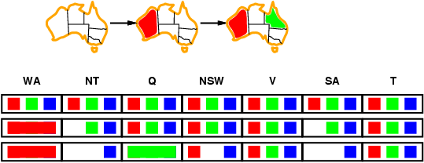
Forward Checking
Keep track of remaining legal values for all unassigned variables
Deadend when any variable has no legal values
Note: Q is not
most constrained variable

Slide 53
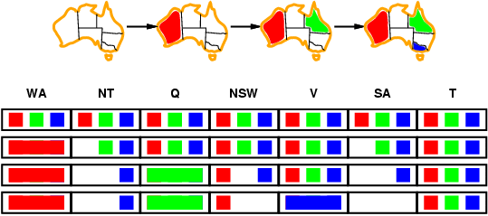
Forward Checking
Keep track of remaining legal values for all unassigned variables
Deadend when any variable has no legal values
Note: V is not most constrained variable

Slide 55
Constraint Propagation
Forward checking propagates information from assigned to unassigned variables, but doesn't provide early detection for all failures:
NT and SA cannot both be blue!
Constraint propagation repeatedly (recursively) enforces constraints for all variables

Slide 56
Constraint Propagation
V₅
V₃
V₁
V₂
V₆
R
V₄
G
Main idea: When you delete a value from a variable’s domain, check all variables connected to it. If any of them change, delete all inconsistent values connected to them, etc.
Note: In the above example, nothing changes

Slide 57
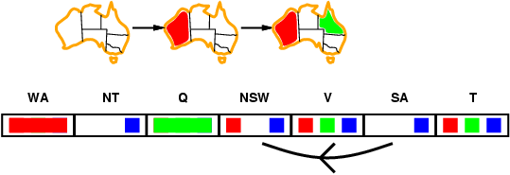
Arc Consistency
Simplest form of propagation makes each arc (i.e., each binary constraint) consistent
X →Y is consistent if
for every value x at var X there is some allowed y, i.e., there is at least 1 value of Y that is consistent with x at X
X = SA
Y = NSW
Notes:
SA → NSW is consistent if SA=B means there is at least one remaining value at NSW that is consistent with SA=B -- here there is because NSW can be R.

Slide 58
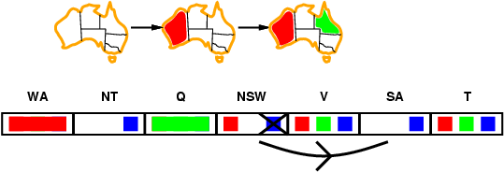
Arc Consistency
Simplest form of propagation makes each arc consistent
X →Y is consistent if
for every value x at X there is some allowed y; if not, delete x
X = NSW
Y = SA
Notes:
NSW → SA is consistent for NSW=R because B at SA is consistent with NSW=R. But B at NSW is NOT consistent with SA because there is no remaining value at SA that is consistent with B at NSW; so delete B at NSW.

Slide 59
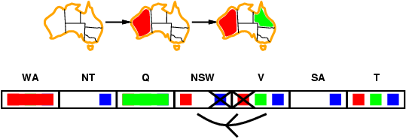
Arc Consistency
Simplest form of propagation makes each arc consistent
X →Y is consistent if
for every value x at X there is some allowed y; if not, delete x
If X loses a value, all neighbors of X must be rechecked
X = V
Y = NSW
Notes:
V is adjacent to NSW, so V → NSW is checked after B is deleted from NSW.

Slide 60
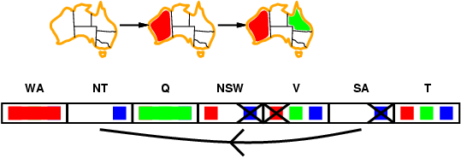
Arc Consistency
Simplest form of propagation makes each arc consistent
X →Y is consistent if
for every value x at X there is some allowed y; if not, delete x
If X loses a value, all neighbors of X must be rechecked
Arc consistency detects failure earlier than forward checking
Use as a preprocessor and after each assignment during search
X = SA
Y = NT
Notes:
SA is adjacent to V, so SA → NT needs to be checked after V updated. Etc.

Slide 61
Australia Constraint Graph

Slide 62
Row 6, col 4 node must not be red because node to upper-right (row 5, col 5) must not be black

Slide 63
Arc Consistency Algorithm AC-3
Check if
X_{i} ➔ X_{j}
consistent
Time complexity: O(n²d³)

Slide 64
Arc Consistency Algorithm “AC-3”
function AC-3(csp) // returns false if inconsistency is found and true otherwise
// input: csp, a binary CSP with components (X, D, C)
// local variables: queue, a queue of arcs; initially all arcs in csp
while queue not empty do {
(X_{i} , X_{j} ) = Remove-First(queue);
if Revise(csp, X_{i} , X_{j} ) then { // make arc consistent
if size of D_{i} = 0 then return false
foreach X_{k} in X_{i}.Neighbors – { X_{j} } do // propagate changes to neighbors
add (X_{k} , X_{i} ) to queue
}
}
return true
// check if X_{i} ➔ X_{j} consistent

Slide 65
Arc Consistency Algorithm “AC-3”
function Revise(csp, X_{i} , X_{j} ) // returns true if we revise the domain of X_{i}
revised = false;
foreach x in D_{i} do {
if no value y in D_{j} allows (x, y) to satisfy the constraints between X_{i} and X_{j} then {
delete x from D_{i} ;
revised = true;
}
}
return revised
// check if X_{i} ➔ X_{j} consistent

Slide 66
Constraint Propagation
V₅
V₃
V₁
V₂
V₆
R
V₄
G
In this example, constraint propagation solves the problem without search … But not always that lucky!
Constraint propagation can be done as a preprocessing step
And it can be performed during search
Note: when you backtrack, you must undo some of your additional constraints

Slide 67
Combining Search with CSP
Idea: Interleave search and CSP inference
Perform DFS
At each node assign a selected value to a selected variable
Run CSP to reduce variables’ domains and check if any inconsistencies arise as a result of this assignment

Slide 68
Combining Backtracking Search with CSP: MAC Algorithm
function BACKTRACKING-SEARCH(csp) returns a solution or failure
return BACKTRACK({ }, csp)
function BACKTRACK(assignment, csp) returns a solution or failure
if assignment is complete then return assignment;
var = SELECT-UNASSIGNED-VARIABLE(csp);
foreach value in ORDER-DOMAIN-VALUES(var, assignment, csp) do {
if value is consistent with assignment then {
add {var = value} to assignment;
inferences = AC-3(csp, var, value);
if inferences != failure then {
add inferences to assignment;
result = BACKTRACK(assignment, csp);
if result != failure then return result; }
}
remove {var = value} and inferences from assignment;
}
return failure

Slide 69
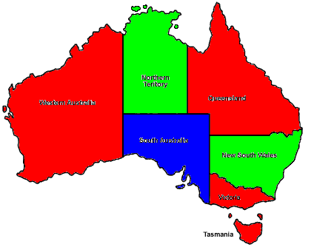
Backtracking Search Revisited
WA = R
WA = G
WA = B
NT = G
NT = B
Q = B
Q = R
NSW = G
NSW = G
NSW = R
NSW = B
SA = B
SA = ?
SA = ?
V = R
T = R
T = G
T = B
Slide credit: R. Khoury

Slide 70
Conflict-Directed Backjumping
Suppose we color Australia in this order:
WA = R
NSW = R
T = B
NT = B
Q = G
SA = ?
Deadend at SA
No possible solution with WA = NSW
Backtracking will try to change T on the way, even though it has nothing to do with the problem, before going to NSW
Slide credit: R. Khoury

Slide 71
Conflict-Directed Backjumping
Backtracking goes back one level in the search tree at a time
Called Chronological backtracking
Not good in cases where the previous step is not a cause of the conflict
Conflict-Directed Backjumping
Go back to a variable involved in the conflict
Skip several levels if needed to get there
Non-chronological backtracking
Nothing on this topic on exam
Slide credit: R. Khoury

Slide 72
Conflict-Directed Backjumping
Maintain a Conflict Set (CS) for each variable
List of previously-assigned variables that are related by constraints
CS(WA) = {}
CS(NSW) = {}
CS(T) = {}
CS(NT) = {WA}
CS(Q) = {NSW, NT}
CS(SA) = {WA, NSW, NT, Q}
When we hit a deadend, backjump to the most recent variable in the Conflict Set
Slide credit: R. Khoury

Slide 73
Conflict-Directed Backjumping
Learn from a conflict by updating the Conflict Set of the variable we jumped to
Example: Conflict at X_{j} and backjump to X_{i}
CS(X_{i}) = {X₁, X₂, X₃}
CS(X_{j}) = {X₃, X₄, X₅, X_{i}}
CS(X_{i}) = CS(X_{i}) ∪ CS(X_{j}) – {X_{i}}
= {X₁, X₂, X₃, X₄, X₅}
X_{i} absorbs the Conflict Set of X_{j}
Slide credit: R. Khoury

Slide 74
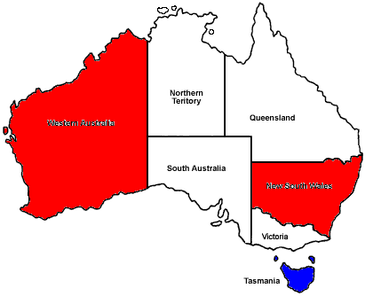
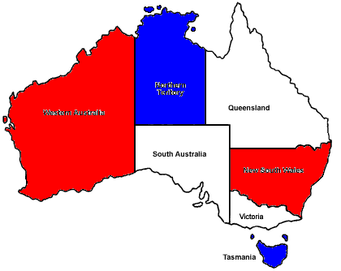
Conflict-Directed Backjumping
CS(WA) = {}
conf(NSW) = {}
conf(T) = {}
conf(NT) = {WA}
conf(Q) = {NSW,NT}
conf(SA) = {WA,NSW,NT,Q}
CS(NSW) = {WA}
CS(NT) = {WA,NSW}
CS(Q) = {WA,NSW,NT}
SA’s domain empty ➔ deadend
SA backjumps to most recent var in CS(SA): Q
Update CS(Q) = {WA, NSW, NT}
Meaning: “There is no consistent solution from Q=G onwards, given preceding assignments WA=R, NSW=R and NT=B”
Slide credit: R. Khoury

Slide 75
Conflict-Directed Backjumping
CS(WA) = {}
conf(NSW) = {}
conf(T) = {}
conf(NT) = {WA}
conf(Q) = {NSW,NT}
conf(SA) = {WA,NSW,NT,Q}
CS(NSW) = {WA}
CS(NT) = {WA,NSW}
CS(Q) = {WA,NSW,NT}
Q’s domain empty ➔ deadend
Q backjumps to NT (i.e., most recent var in CS(Q))
Update CS(NT) = {WA, NSW}
There is no consistent solution from NT=B onwards, given preceding assignments WA=R and NSW=R
Slide credit: R. Khoury

Slide 76
Conflict-Directed Backjumping
CS(WA) = {}
conf(NSW) = {}
conf(T) = {}
conf(NT) = {WA}
conf(Q) = {NSW,NT}
conf(SA) = {WA,NSW,NT,Q}
CS(NSW) = {WA}
CS(NT) = {WA,NSW}
CS(Q) = {WA,NSW,NT}
Try NT=G (which is consistent with WA=R, NSW=R)
Retrying Q and SA fails again
So, there is no consistent solution from NT=G onwards, given preceding assignments WA=R and NSW=R
NT’s domain now empty ➔ deadend
Slide credit: R. Khoury

Slide 77
Conflict-Directed Backjumping
CS(WA) = {}
conf(NSW) = {}
conf(T) = {}
conf(NT) = {WA}
conf(Q) = {NSW,NT}
conf(SA) = {WA,NSW,NT,Q}
CS(NSW) = {WA}
CS(NT) = {WA,NSW}
CS(Q) = {WA,NSW,NT}
NT backjumps to NSW
Update CS(NSW) = {WA}
Skips T, which is irrelevant in this conflict
Discovers the relationship between NSW and WA, which is not present in our constraints, so try NSW=G …
Slide credit: R. Khoury

Slide 78
Conflict-Directed Backjumping
CS(WA) = {}
conf(NSW) = {}
conf(T) = {}
conf(NT) = {WA}
conf(Q) = {NSW,NT}
conf(SA) = {WA,NSW,NT,Q}
CS(NSW) = {WA}
CS(NT) = {WA,NSW}
CS(Q) = {WA,NSW,NT}
Q backjump to NT
conf(NT) = {WA,NSW}
Meaning: “There is no consistent solution from NT onwards, given the preceding assignments of WA and NSW together”
NT backjump to NSW
CS(NSW) = {WA}
Skips T, which is irrelevant in this conflict
Discovers the relationship between NSW and WA, which is not present in our constraints
SA backjump to Q
conf(Q) = {WA,NSW,NT}
Meaning: “There is no consistent solution from Q onwards, given the preceding assignments of WA, NSW and NT together”
Slide credit: R. Khoury
Notes:
Q’s domain empty so deadend; Q backjumps to NT (i.e., most recent var in CS(Q)).
Try NT=G (which is consistent with WA=R, NSW=R)
Retrying Q and SA fails again
So, there is no consistent solution from NT=G onwards, given preceding assignments WA=R and NSW=R
NT’s domain now empty ➔ deadend.
NT backjumps to NSW
Update CS(NSW) = {WA}
Skips T, which is irrelevant in this conflict
Discovers the relationship between NSW and WA, which is not present in our constraints, so try NSW=G …

Slide 79
Constraint Learning
When a contradiction occurs, remember the minimum set of variables from the conflict set that was responsible for the problem
Save these “no-goods” as new constraints so that they are never attempted again somewhere else in search
For example, {WA=R, NSW=R, NT=B}

Slide 80
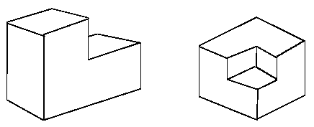
Application: Labeling Blocks World Scenes “The Waltz Algorithm”
The Waltz algorithm is used for interpreting line drawings of solid polyhedra
Look at all intersections.
What kind of intersection could this be? A concave intersection of three faces? Or an external convex intersection?
Adjacent intersections impose constraints on each other. Use CSP to find a unique set of labelings. Important step to “understanding” the image.

Slide 81
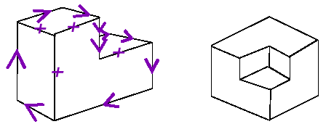
Waltz Algorithm on “Blocks World” Scenes
Assume all objects:
Have no shadows or cracks
Three-faced vertices
“General position”: no junctions change with small movements of the eye.
Then each line in image is one of the following 3 types:
Boundary line (edge of an object) (<) with right hand of arrow denoting “solid” and left hand denoting “space”
Interior convex edge (+)
Interior concave edge (−)

Slide 82
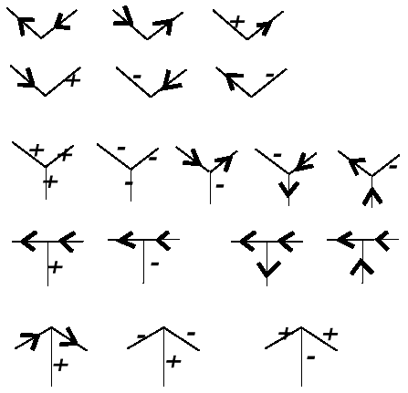
18 Legal Kinds of Junctions
Label each junction in one of the above ways
Junctions must be labeled so that lines are labeled consistently at both ends
Can you formulate this as a CSP?

Slide 83
Junction
Dictionary

Slide 84
Waltz Examples

Slide 85
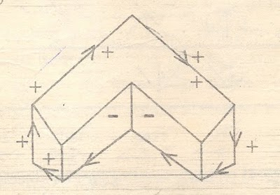
Example Labeling

Slide 86
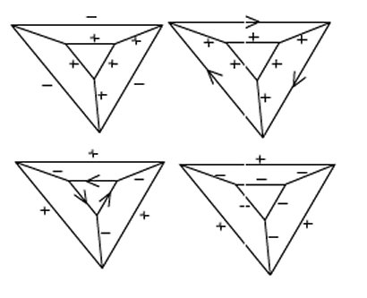
Ambiguous Example

Slide 87
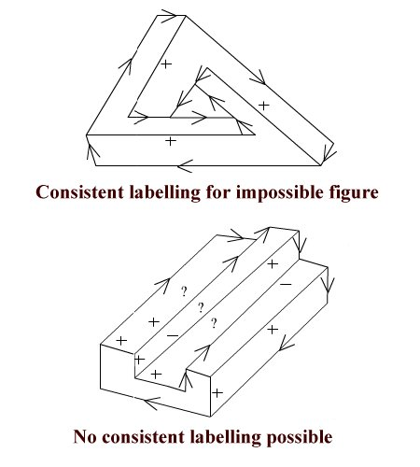
Impossible Object Example

Slide 88
Summary
CSPs are a special kind of problem:
states defined by values of a fixed set of variables
goal test defined by constraints on variable values
Backtracking = depth-first search with one variable assigned per node plus consistency checking
Variable ordering and value selection heuristics help significantly
Forward checking prevents assignments that guarantee later failure
Constraint propagation (e.g., arc consistency) does additional work to constrain values and detect inconsistencies earlier

