Slide 1
Representing Uncertainty for Probabilistic Inference
Chapter 13

Slide 2
Uncertainty in the World
An agent can often be uncertain about the state of the domain since there is often ambiguity and uncertainty
Plausible/probabilistic inference
  I’ve got this evidence; what’s the chance that this conclusion is true?
    I’ve got a sore neck; how likely am I to have meningitis?
    A mammogram test is positive; what’s the probability that the patient has breast cancer?
Notes:
CLICK EACH SUB

Slide 3
Probabilistic Inference
How do we use probabilities in AI?
You wake up with a headache
Do you have the flu?
H = headache, F = flu
Logical Inference: if H then F
(but the world is usually not this simple)
Statistical Inference: compute the probability of a query/diagnosis/decision given (i.e., conditioned on) evidence/symptom/observation, i.e., P(F | H)
[Example from Andrew Moore]

Slide 4
Uncertainty
Say we have a rule:
if toothache then problem is cavity
But not all patients have toothaches due to cavities, so we could set up rules like:
if toothache and ¬gum-disease and ¬filling and ...
then problem = cavity
This gets complicated; better method:
if toothache then problem is cavity with 0.8 probability
or P(cavity | toothache) = 0.8
the probability of cavity is 0.8 given toothache is observed
Notes:
CLICK EACH SUB

Slide 5
Example of Uncertainty
Assume a camera and vision system is used
to estimate the curvature of the road ahead
There's uncertainty about which way it curves
  limited pixel resolution, noise in image
  algorithm for “road detection” is not perfect
This uncertainty can be represented with a simple probability model:
  P(road curves to left | E) = 0.6
  P(road goes straight | E) = 0.3
  P(road curves to right | E) = 0.1
  the probability of an event is a measure of agent’s belief in the event given the evidence E
Notes:
CLICK EACH SUB

Slide 6
Uncertainty in the World and our Models
True uncertainty: rules are probabilistic in nature
  quantum mechanics
  rolling dice, flipping a coin
Laziness: too hard to determine exception-less rules
  takes too much work to determine all of the relevant factors
  too hard to use the enormous rules that result
Theoretical ignorance: don't know all the rules
  problem domain has no complete, consistent theory (e.g., medical diagnosis)
Practical ignorance: do know all the rules BUT
  haven't collected all relevant information for a particular case
Notes:
CLICK EACH

Slide 7
Logics
Logics are characterized by what they use as "primitives"
Logic | What Exists in World | Knowledge States
Propositional | facts | true/false/unknown
First-Order | facts, objects, relations | true/false/unknown
Temporal | facts, objects, relations, times | true/false/unknown
Probability Theory | facts | degree of belief 0..1
Fuzzy | degree of truth | degree of belief 0..1
Notes:
CLICK EACH SUB

Slide 8
Probability Theory
Probability theory serves as a formal means for
  Representing and reasoning with uncertain knowledge
  Modeling degrees of belief in a proposition (event, conclusion, diagnosis, etc.)
Probability is the “language” of uncertainty
  A key modeling tool in modern AI
Notes:
CLICK EACH SUB

Slide 9
Probability Notation
A representation that is similar to Propositional Logic but is more expressive
in being able to represent degrees of belief as probabilities
A proposition (aka event) is:
  A = a which means variable A takes value a
  e.g., RoadCurvature = left
  either true or false in the world
  agent has a degree of belief in the proposition
Notes:
CLICK EACH SUB

Slide 10
Sample Space
A space of events in which we assign probabilities
Events can be binary, multi-valued, or continuous
Events are mutually exclusive
Examples
  Coin flip: {head, tail}
  Die roll: {1, 2, 3, 4, 5, 6}
  English words: a dictionary
  High temperature tomorrow: {-100, …, 100}

Slide 11
Random Variable
A variable, X, whose domain is a sample space, and whose value is (somewhat) uncertain
Examples:
  X = coin flip outcome
  X = tomorrow’s high temperature
For a given task, the user defines a set of random variables for describing the world
Each variable has a set of mutually exclusive and exhaustive possible values

Slide 12
Random Variable
Random Variables (RV):
  are capitalized (usually) e.g., Sky, Weather, Temperature
  refer to attributes of the world whose "status" is unknown
  have one and only one value at a time
  have a domain of values that are possible states of the world:
    Boolean: domain = <true, false>
    Cavity = true (often abbreviated as cavity ) Cavity = false (often abbreviated as ¬cavity )
    Discrete: domain is countable (includes Boolean)
    values are mutually exclusive and exhaustive
    e.g. Sky domain = <clear, partly_cloudy, overcast>
    Sky = clear abbreviated as clear
    Sky ≠ clear also abbreviated as ¬clear
    Continuous: domain is real numbers (beyond scope of CS 540)
Notes:
CLICK EACH SUB

Slide 13
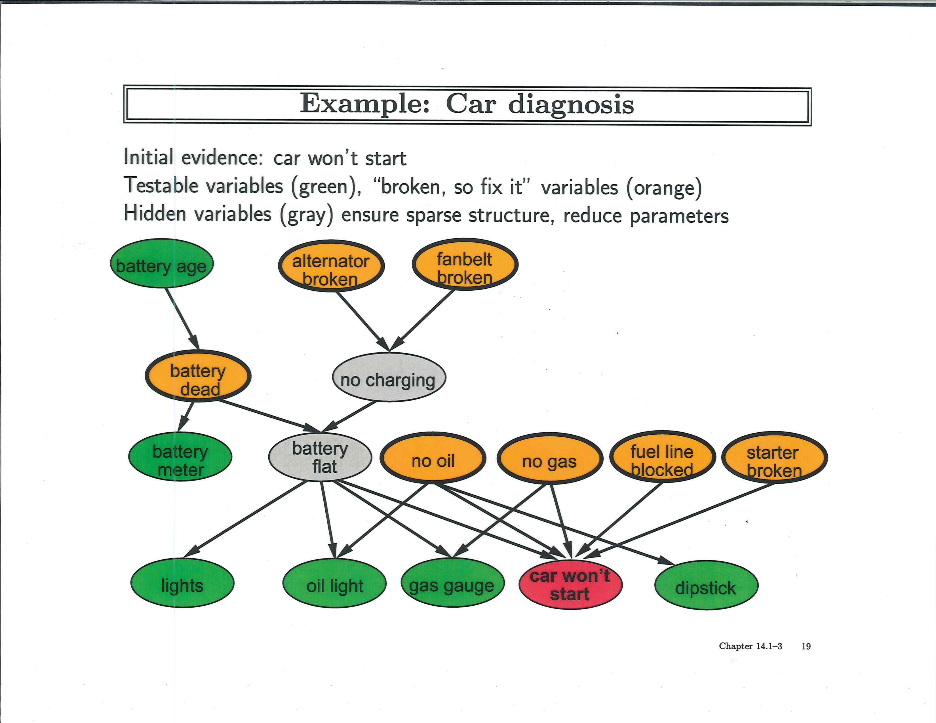

Slide 14
Probability for Discrete Events
An agent’s uncertainty is represented by
P(A=a) or simply P(a)
  the agent’s degree of belief that variable A takes on value a given no other information related to A
  a single probability called an unconditional or prior probability
Notes:
CLICK EACH SUB

Slide 15

Probability for Discrete Events
Examples
  P(head) = P(tail) = 0.5 fair coin
  P(head) = 0.51, P(tail) = 0.49 slightly biased coin
  P(first word = “the” when flipping to a random page in R&N) = ?
Book: The Book of Odds

Slide 16
Probability for Discrete Events
Probability for more complex events, A
  P(A = “head or tail”) = ? fair coin
  P(A = “even number”) = ? fair 6-sided die
  P(A = “two dice rolls sum to 2”) = ?

Slide 17
Probability for Discrete Events
Probability for more complex events, A
  P(A = “head or tail”) = 0.5 + 0.5 = 1 fair coin
  P(A = “even number”) = 1/6 + 1/6 + 1/6 = 0.5 fair 6-sided die
  P(A = “two dice rolls sum to 2”) = 1/6 * 1/6 = 1/36

Slide 18
Source of Probabilities
Frequentists
  probabilities come from data
  if 10 of 100 people tested have a cavity, P(cavity) = 0.1
  probability means the fraction that would be observed
  in the limit of infinitely many samples
Objectivists
  probabilities are real aspects of the world
  objects have a propensity to behave in certain ways
  coin has propensity to come up heads with probability 0.5
Subjectivists
  probabilities characterize an agent's belief
  have no external physical significance

Slide 19
Probability Distributions
Given A is a RV taking values in 〈a₁, a₂, … , a_{k}〉
  e.g., if A is Sky, then value is one of <clear, partly_cloudy, overcast>
P(a) represents a single probability where A=a
  e.g., if A is Sky, then P(a) means any one of
  P(clear), P(partly_cloudy), P(overcast)
P(A) represents a probability distribution
  the set of values: 〈P(a₁), P(a₂), …, P(a_{k})〉
  If A takes n values, then P(A) is a set of n probabilities
  e.g., if A is Sky, then P(Sky) is the set of probabilities:
  〈P(clear), P(partly_cloudy), P(overcast)〉
  Property: ∑ P(a_{i}) = P(a₁) + P(a₂) + ... + P(a_{k}) = 1
    sum over all values in the domain of variable A is 1 because the domain is mutually exclusive and exhaustive
Notes:
CLICK EACH SUB

Slide 20
Probability Table
Weather
P(Weather = sunny) = P(sunny) = 200/365
P(Weather) = 〈200/365, 100/365, 65/365〉
We’ll obtain the probabilities by counting frequencies from data
sunny
cloudy
rainy
200/365
100/365
65/365

Slide 21
The Axioms of Probability
  0 ≤ P(A) ≤ 1
  P(true) = 1, P(false) = 0
  P(A ∨ B) = P(A) + P(B) – P(A ∧ B)
Note: Here P(A) means P(A=a) for some value a and P(A ∨ B) means P(A=a ∨ B=b)

Slide 22
The Axioms of Probability
  0 ≤ P(A) ≤ 1
  P(true) = 1, P(false) = 0
  P(A ∨ B) = P(A) + P(B) – P(A ∧ B)
Sample
space
The fraction of A can’t
be smaller than 0

Slide 23
The Axioms of Probability
  0 ≤ P(A) ≤ 1
  P(true) = 1, P(false) = 0
  P(A ∨ B) = P(A) + P(B) – P(A ∧ B)
The fraction of A can’t
be bigger than 1
Sample
space

Slide 24
The Axioms of Probability
  0 ≤ P(A) ≤ 1
  P(true) = 1, P(false) = 0
  P(A ∨ B) = P(A) + P(B) – P(A ∧ B)
Sample
space
Valid sentence: e.g., “X=head or X=tail”

Slide 25
The Axioms of Probability
  0 ≤ P(A) ≤ 1
  P(true) = 1, P(false) = 0
  P(A ∨ B) = P(A) + P(B) – P(A ∧ B)
Sample
space
Invalid sentence:
e.g., “X=head AND X=tail”

Slide 26
The Axioms of Probability
  0 ≤ P(A) ≤ 1
  P(true) = 1, P(false) = 0
  P(A ∨ B) = P(A) + P(B) – P(A ∧ B)
A
Sample
space
B

Slide 27
Some Theorems
Derived from the Axioms
P(¬A) = 1 – P(A)
If A can take k different values a₁, …, a_{k}:
P(A=a₁) + … + P(A=a_{k}) = 1
P(B) = P(B ∧ ¬A) + P(B ∧ A), if A is a binary event
P(B) = ∑_{i=1…k}P(B ∧ A=a_{i}), if A can take k values
Called Addition or Conditioning rule

Slide 28
Joint Probability
The joint probability P(A=a, B=b) is shorthand for P(A=a ∧ B=b), i.e., the probability of both A=a and B=b happening
P(A=a), e.g., P(1st word on a random page = “San”) = 0.001
(possibly: San Francisco, San Diego, …)
A
P(B=b), e.g., P(2nd word = “Francisco”) = 0.0008
(possibly: San Francisco, Don Francisco, Pablo Francisco …)
P(A=a,B=b), e.g., P(1st =“San”, 2nd =“Francisco”) = 0.0007

Slide 29
Full Joint Probability Distribution (FJPD)
P(Temp=hot, Weather=rainy) = P(hot, rainy) = 5/365 = 0.014
The full joint probability distribution table for n random variables, each taking k values, has k^{n} entries
Weather
sunny
cloudy
rainy
hot
150/365
40/365
5/365
Temp
cold
50/365
60/365
60/365

Slide 30
Full Joint Probability Distribution (FJPD)
Bird | Flier | Young | Probability
T | T | T | 0.0
T | T | F | 0.2
T | F | T | 0.04
T | F | F | 0.01
F | T | T | 0.01
F | T | F | 0.01
F | F | T | 0.23
F | F | F | 0.5
3 Boolean random variables ⇒ 2³ – 1 = 7 “degrees of freedom” (DOF) or “independent values”
Sums to 1

Slide 31
Computing from the FJPD
Marginal Probabilities
  P(Bird=T) = P(bird) = 0.0 + 0.2 + 0.04 + 0.01 = 0.25
  P(bird, ¬flier) = 0.04 + 0.01 = 0.05
  P(bird ∨ flier) = 0.0 + 0.2 + 0.04 + 0.01 + 0.01 + 0.01 = 0.27
Sum over all other variables
“Summing Out”
“Marginalization”

Slide 32
Unconditional / Prior Probability
One’s uncertainty or original assumption about an event prior to having any data about it or anything else in the domain
P(Coin = heads) = 0.5
P(Bird = T) = 0.0 + 0.2 + 0.04 + 0.01 = 0.22
Compute from the FJPD by marginalization

Slide 33
Marginal Probability
The name comes from the old days when the sums were written in the margin of a page
Weather
sunny
cloudy
rainy
hot
150/365
40/365
5/365
Temp
cold
50/365
60/365
60/365
∑ 200/365 100/365 65/365
P(Weather) = 〈200/365, 100/365, 65/365〉
Probability distribution for r.v. Weather

Slide 34
Marginal Probability
This is nothing but P(B) = ∑_{i=1…k}P(B ∧ A=a_{i}), where A can take k values
Weather
sunny
cloudy
rainy
∑
195/365 170/365
hot
150/365
40/365
5/365
Temp
cold
50/365
60/365
60/365
P(Temp) = 〈195/365, 170/365〉

Slide 35
Conditional Probability
Conditional probabilities
  formalizes the process of accumulating evidence
  and updating probabilities based on new evidence
  specifies the belief in a proposition (event, conclusion, diagnosis, etc.) that is conditioned on a proposition (evidence, feature, symptom, etc.) being true
P(a | e): conditional probability of A=a
given E=e evidence is all that is known true
  P(a | e) = P(a ∧ e) / P(e) = P(a, e) / P(e)
  conditional probability can viewed as the joint probability P(a, e) normalized by the prior probability, P(e)
Notes:
CLICK EACH SUB

Slide 36
Conditional Probability
The conditional probability P(A=a | B=b) is the fraction of time A=a, within the region where B=b
P(A=a), e.g. P(1st word on a random page = “San”) = 0.001
A
P(B=b), e.g. P(2nd word = “Francisco”) = 0.0008
P(A=a | B=b), e.g. P(1st=“San” | 2nd =“Francisco”) = ?
(possibly: San, Don, Pablo …)

Slide 37
Conditional Probability
P(san | francisco)
= #(1st=s and 2nd=f) / #(2nd=f)
= P(san ∧ francisco) / P(francisco)
= 0.0007 / 0.0008
= 0.875
P(s)=0.001
P(f)=0.0008
P(s,f)=0.0007
A
P(B=b), e.g. P(2nd word = “Francisco”) = 0.0008
P(A=a | B=b), e.g. P(1st=“San” | 2nd =“Francisco”) = 0.875
(possibly: San, Don, Pablo …)‏
Although “San” is rare and “Francisco” is rare,
given “Francisco” then “San” is quite likely!

Slide 38
Conditional Probability
Conditional probabilities behave exactly like standard probabilities; for example:
0 ≤ P(a | e) ≤ 1
conditional probabilities are between 0 and 1 inclusive
P(a₁ | e) + P(a₂ | e) + ... + P(a_{k} | e) = 1
conditional probabilities sum to 1 where a₁, …, a_{k} are all values in the domain of random variable A
P(¬a | e) = 1 − P(a | e)
negation for Boolean random variable A
Notes:
CLICK EACH

Slide 39
Conditional Probability
P(conjunction of events | e)
  P(a ∧ b ∧ c | e) or as P(a, b, c | e)
  is the agent’s belief in the sentence a ∧ b ∧ c conditioned on e being true
P(a | conjunction of evidence)
  P(a | e ∧ f ∧ g) or as P(a | e, f, g)
  is the agent’s belief in the sentence a conditioned on e ∧ f ∧ g being true
Notes:
CLICK EACH

Slide 40
Computing Conditional Probability
P(¬B|F) = ?
P(F) = ?
Note: P(¬B|F) means P(B=false | F=true)
and P(F) means P(F=true)

Slide 41
Full Joint Probability Distribution
Bird (B) | Flier (F) | Young (Y) | Probability
T | T | T | 0.0
T | T | F | 0.2
T | F | T | 0.04
T | F | F | 0.01
F | T | T | 0.01
F | T | F | 0.01
F | F | T | 0.23
F | F | F | 0.5
3 Boolean random variables ⇒ 2³ – 1 = 7 “degrees of freedom” or “independent values”
Sums to 1

Slide 42
Computing Conditional Probability
P(¬B|F) = P(¬B, F)/P(F)
= (P(¬B, F, Y) + P(¬B, F, ¬Y))/P(F)
= (0.01 + 0.01)/P(F)
P(F) = P(F, B, Y) + P(F, B, ¬Y) + P(F, ¬B, Y) + P(F, ¬B, ¬Y)
= 0.0 + 0.2 + 0.01 + 0.01
= 0.22
Marginalization

Slide 43
Computing Conditional Probability
Instead of using Marginalization to compute P(F), can alternatively use Normalization:
P(¬B|F) = .02/P(F) from previous slide
P(¬B|F) + P(B|F) = 1 by definition
P(B|F) = P(B,F)/P(F) = (0.0 + 0.2)/P(F)
So, 0.02/P(F) + 0.2/P(F) = 1
Hence, P(F) = 0.22

Slide 44
Normalization
Addition rule
In general, P(A | B) = ⍺ P(A, B)
where ⍺ = 1/P(B) = 1/(P(A, B) + P(¬A, B))
P(Q | E₁, …, E_{k}) = ⍺ P(Q, E₁, …, E_{k})
= ⍺ ∑_{Y} P(Q, E₁, …, E_{k}, Y)

Slide 45
Conditional Probability with Multiple Evidence
P(¬B | F, ¬Y) = P(¬B, F, ¬Y) / P(F, ¬Y)
= P(¬B, F, ¬Y) / (P(¬B, F, ¬Y) + P(B, F, ¬Y))
= .01 /(.01 + .2)
= 0.048

Slide 46
Conditional Probability
P(X₁=x₁, …, X_{k}=x_{k} | X_{k+1}=x_{k+1}, …, X_{n}=x_{n}) =
sum of all entries in FJPD where X₁=x₁, …, X_{n}=x_{n} divided by sum of all entries where X_{k+1}=x_{k+1} , …, X_{n}=x_{n}
But this means in general we need the entire FJPD table, requiring an exponential number of values to do probabilistic inference (i.e., compute conditional probabilities)

Slide 47
Conditional Probability
In general, the conditional probability is
We can have everything conditioned on some other event(s), C, to get a conditionalized version of conditional probability:
‘|’ has low precedence.
This means: P(A | (B,C))

Slide 48
The Chain Rule
From the definition of conditional probability we have
P(A, B) = P(B) * P(A | B) = P(A | B) * P(B)
It also works the other way around:
P(A, B) = P(A) * P(B | A) = P(B | A) P(A)
It works with more than 2 events too:
P(A₁, A₂, …, A_{n}) =
P(A₁) * P(A₂ | A₁) * P(A₃| A₁, A₂) * …
* P(A_{n} | A₁, A₂, …, A_{n-1})
Called “Product Rule”
Called “Chain Rule”

Slide 49
Warmup QUIZ
Who is credited with providing the voice of 'Puter, the talking computer, in The Lego Batman Movie (2017) ?
Siri

Slide 50





QUIZ: Name These Robots
C-3PO (Star Wars)
Wall-E (Wall-E)
Marvin (Hitchhiker’s Guide to the Galaxy)
Gort (The Day the Earth Stood Still)
Dot Matrix (Spaceballs)
Notes:
C-3PO (Star Wars), Wall-E (Wall-E), Marvin (Hitchhiker’s Guide to the Galaxy), Gort (The Day the Earth Stood Still), Dot Matrix (Spaceballs)
In the 1951 film, “The Day the Earth Stood Still” Klaatu tells Helen Benson that if any harm comes to Klaatu, she must say to Gort the phrase “Klaatu barada niko”

Slide 51
QUIZ
Who are the “robots” appearing in fiction by Mary Shelley, Rabbi Judah Loew, and Marvel Comics?
Frankenstein, Golem, and Ultron

Slide 52
Probabilistic Reasoning
How do we use probabilities in AI?
You wake up with a headache
Do you have the flu?
H = headache, F = flu
Logical Inference: if H then F
(but the world is usually not this simple)
Statistical Inference: compute the probability of a query/diagnosis/decision given (i.e., conditioned on) evidence/symptom/observation, i.e., P(F | H)
[Example from Andrew Moore]

Slide 53
Example
Statistical Inference: Compute the probability of a diagnosis, F, given symptom, H, where H = “has a headache” and F = “has flu”
That is, compute P(F | H)
You know that
P(H) = 0.1 “one in ten people has a headache”
P(F) = 0.01 “one in 100 people has flu”
P(H | F) = 0.9 “90% of people who have flu have a headache”
[Example from Andrew Moore]

Slide 54
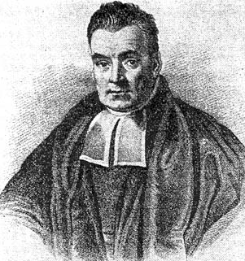
Inference with Bayes’s Rule
Thomas Bayes, “Essay Towards Solving a Problem in the Doctrine of Chances,” 1764
P(H) = 0.1 “one in ten people has a headache”
P(F) = 0.01 “one in 100 people has flu”
P(H|F) = 0.9 “90% of people who have flu have a headache”
P(F|H) = (0.9 * 0.01) / 0.1 = 0.09
So, there’s a 9% chance you have flu – much less than 90%
But it’s higher than P(F) = 1% since you have a headache
Def of cond. prob.
Product rule

Slide 55
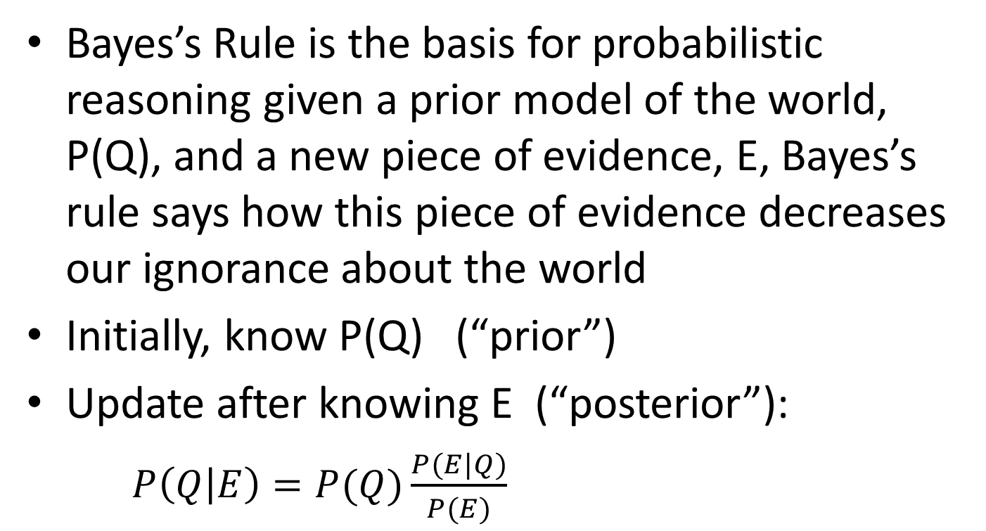
Bayes’s Rule

Slide 56
Inference with Bayes’s Rule
P(A|B) = P(B | A)P(A) / P(B) Bayes’s rule
Why do we make things this complicated?
  Often P(B|A), P(A), P(B) are easier to get
Some terms:
    Prior: P(A): probability of A before any evidence
    Likelihood: P(B|A): assuming A, how likely is the evidence B
    Posterior: P(A|B): probability of A after knowing evidence B
    (Deductive) Inference: deriving an unknown probability from known ones

Slide 57
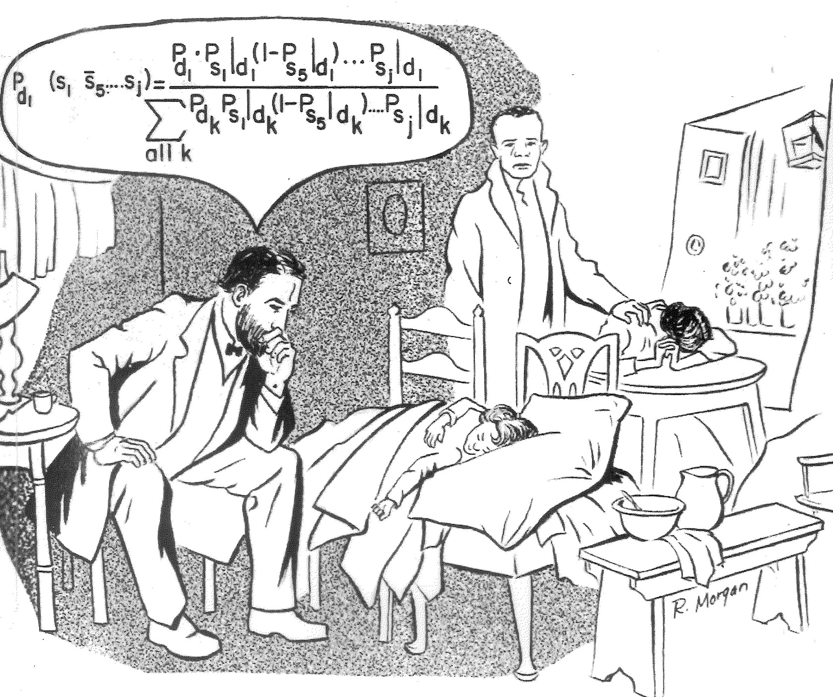
Bayes’s Rule in Practice

Slide 58
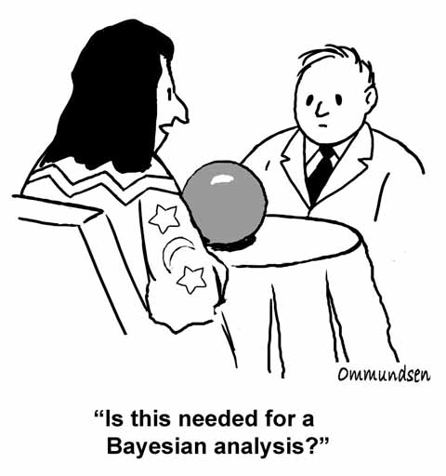

Slide 59
Summary of Important Rules
Conditional Probability: P(A|B) = P(A,B)/P(B)
Product rule: P(A,B) = P(A|B)P(B)
Chain rule: P(A,B,C,D) = P(A|B,C,D)P(B|C,D)P(C|D)P(D)
Conditionalized version of Chain rule:
P(A,B|C) = P(A|B,C)P(B|C)
Bayes’s rule: P(A|B) = P(B|A)P(A)/P(B)
Conditionalized version of Bayes’s rule:
P(A|B,C) = P(B|A,C)P(A|C)/P(B|C)
  Addition / Conditioning rule: P(A) = P(A,B) + P(A,¬B)
  P(A) = P(A|B)P(B) + P(A|¬B)P(¬B)

Slide 60
Common Mistake
P(A) = 0.3 so P(¬A) = 1 – P(A) = 0.7
P(A|B) = 0.4 so P(¬A|B) = 1 – P(A|B) = 0.6
  because P(A|B) + P(¬A|B) = 1
but P(A|¬B) ≠ 0.6 (in general)
because P(A|B) + P(A|¬B) ≠ 1 in general

Slide 61
Quiz
A doctor performs a test that has 99% reliability, i.e., 99% of people who are sick test positive, and 99% of people who are healthy test negative. The doctor estimates that 1% of the population is sick.
Question: A patient tests positive. What is the chance that the patient is sick?
0-25%, 25-75%, 75-95%, or 95-100%?

Slide 62
Quiz
A doctor performs a test that has 99% reliability, i.e., 99% of people who are sick test positive, and 99% of people who are healthy test negative. The doctor estimates that 1% of the population is sick.
Question: A patient tests positive. What is the chance that the patient is sick?
0-25%, 25-75%, 75-95%, or 95-100%?
Common answer: 99%; Correct answer: 50%
Notes:
P(TP | S) = 0.99
P(~TP | ~S) = 0.99
P(S) = 0.01
P(S | TP) =

Slide 63
Given:
P(TP | S) = 0.99
  P(¬TP | ¬S) = 0.99
  P(S) = 0.01
Query:
P(S | TP) = ?
TP = “tests positive”
S = “is sick”

Slide 64
P(TP | S) = 0.99
P(¬TP | ¬S) = 0.99
P(S) = 0.01
P(S | TP) =
P(TP | S) P(S) / P(TP)
= (0.99)(0.01) / P(TP) = 0.0099/P(TP)
P(¬S | TP) = P(TP | ¬S)P(¬S) / P(TP)
  = (1 – 0.99)(1 – 0.01) / P(TP) = 0.0099/P(TP)
0.0099/P(TP) + 0.0099/P(TP) = 1, so P(TP) = 0.0198
So, P(S | TP) = 0.0099 / 0.0198 = 0.5

Slide 65
Inference with Bayes’s Rule
In a bag there are two envelopes
  one has a red ball (worth $100) and a black ball
  one has two black balls. Black balls are worth nothing
You randomly grab an envelope, and randomly take out one ball – it’s black
At this point you’re given the option to switch envelopes. Should you switch or not?
Similar to the “Monty Hall Problem”

Slide 66
Inference with Bayes’s Rule
E: envelope, 1 = (R,B), 2 = (B,B)
B: the event of drawing a black ball
Given: P(B|E=1) = 0.5, P(B|E=2) = 1, P(E=1) = P(E=2) = 0.5
Query: Is P(E=1 | B) > P(E=2 | B)?
Use Bayes’s rule: P(E|B) = P(B|E)*P(E) / P(B)
P(B) = P(B|E=1)P(E=1) + P(B|E=2)P(E=2) = (.5)(.5) + (1)(.5) = .75
P(E=1|B) = P(B|E=1)P(E=1)/P(B) = (.5)(.5)/(.75) = 0.33
P(E=2|B) = P(B|E=2)P(E=2)/P(B) = (1)(.5)/(.75) = 0.67
After seeing a black ball, the posterior probability of this envelope being #1 (thus worth $100) is smaller than it being #2
Thus you should switch!
Conditioning rule

Slide 67
Summary of Important Rules
Conditional Probability: P(A|B) = P(A,B)/P(B)
Product rule: P(A,B) = P(A|B)P(B)
Chain rule: P(A,B,C,D) = P(A|B,C,D)P(B|C,D)P(C|D)P(D)
Conditionalized version of Chain rule:
P(A,B|C) = P(A|B,C)P(B|C)
Bayes’s rule: P(A|B) = P(B|A)P(A)/P(B)
Conditionalized version of Bayes’s rule:
P(A|B,C) = P(B|A,C)P(A|C)/P(B|C)
  Addition / Conditioning rule: P(A) = P(A,B) + P(A,¬B)
  P(A) = P(A|B)P(B) + P(A|¬B)P(¬B)

Slide 68
Another Example
1% of women over 40 who are tested have breast cancer. 85% of women who really do have breast cancer have a positive mammography test (true positive rate). 8% who do not have cancer will have a positive mammography (false positive rate).
Question: A patient gets a positive mammography test. What is the chance she has breast cancer?

Slide 69
Let Boolean random variable M mean “positive mammography test”
Let Boolean random variable C mean “has breast cancer”
Given:
  P(C) = 0.01
  P(M|C) = 0.85
  P(M|¬C) = 0.08

Slide 70
Compute the posterior probability: P(C|M)

Slide 71
P(C|M) = P(M|C)P(C)/P(M) by Bayes’s rule
= (.85)(.01)/P(M)
P(M) = P(M|C)P(C) + P(M|¬C)P(¬C) by the Conditioning rule
So, P(C|M) = .0085/[(.85)(.01) + (.08)(1-.01)]
= 0.097
So, there is only a 9.7% chance that if you have a positive test you really have cancer!

Slide 72
Bayes’s Rule with Multiple Evidence
Say the same patient goes back and gets a second mammography and it too is positive. Now, what is the chance she has cancer?
Let M1, M2 be the 2 positive tests
Compute posterior: P(C|M1, M2)

Slide 73
Bayes’s Rule with Multiple Evidence
P(C|M1, M2) = P(M1, M2|C)P(C)/P(M1, M2) by Bayes’s rule
= P(M1|M2, C)P(M2|C)P(C)/P(M1, M2)
Assuming M1 and M2 are independent means P(M1, M2) = P(M1)P(M2)
From before, P(M1) = P(M2) = 0.0877
So, P(C|M1, M2) = (.85)(.85)(.01)/ (.0877)(.0877) = 0.9395 or 93.95%
Conditionalized Chain rule

Slide 74
Independence
Two events A, B are independent if the following hold:
  P(A, B) = P(A) * P(B)
  P(A, ¬B) = P(A) * P(¬B)
  …
  P(A | B) = P(A)
  P(B | A) = P(B)
  P(A | ¬B) = P(A)
  …

Slide 75
Independence
Independence is a kind of domain knowledge
  Needs an understanding of causation
  Very strong assumption
Example: P(burglary) = 0.001 and P(earthquake) = 0.002
  Let’s say they are independent
  The full joint probability table = ?

Slide 76
Independence
Given: P(B) = 0.001, P(E) = 0.002, P(B|E) = P(B)
The full joint probability distribution table (FJPD) is:
Need only 2 numbers to fill in entire table
Now we can do anything, since we have the FJPD
Burglary | Earthquake | Prob.
B | E | = P(B)P(E)
B | ¬E
¬B | E
¬B | ¬E
Notes:
P(B, E) = P(B | E) P(E) by Product rule. = P(B)P(E) by independence of B and E. = 0.001 * 0.002 = 0.000002
Similarly for the other rows.

Slide 77
Independence
Given n independent, Boolean random variables, the FJPD has 2^{n} entries, but we only need n numbers (degrees of freedom) to fill in entire table
Given n independent random variables, where each can take k values, the FJPD table has:
  k^{n} entries
  Only n(k-1) numbers needed (DOFs)

Slide 78
Independence Misused
A famous statistician would never travel by airplane, because he had studied air travel and estimated that the probability of there being a bomb on any given flight was one in a million, and he was not prepared to accept these odds.
One day, a colleague met him at a conference far from home. "How did you get here, by train?"
"No, I flew"
"What about the possibility of a bomb?"
"Well, I began thinking that if the odds of one bomb are 1:million, then the odds of two bombs are (1/1,000,000) x (1/1,000,000). This is a very, very small probability, which I can accept. So now I bring my own bomb along!"
An innocent old math joke

Slide 79
Conditional Independence
Random variables can be dependent, but conditionally independent
Example: Your house has an alarm
  Neighbor John calls when he hears the alarm
  Neighbor Mary calls when she hears the alarm
  Assume John and Mary don’t talk to each other
Is JohnCall independent of MaryCall?
  No – If John called, it is likely the alarm went off, which increases the probability of Mary calling
  P(MaryCall | JohnCall) ≠ P(MaryCall)

Slide 80
Conditional Independence
But, if we know the status of the Alarm, JohnCall will not affect whether or not Mary calls
P(MaryCall | Alarm, JohnCall) = P(MaryCall | Alarm)
We say JohnCall and MaryCall are conditionally independent given Alarm
In general, “A and B are conditionally independent given C” means:
  P(A | B, C) = P(A | C)
  P(B | A, C) = P(B | C)
  P(A, B | C) = P(A | C) P(B | C)

Slide 81
Independence vs. Conditional Independence
Say Alice and Bob each toss separate coins. A represents “Alice’s coin toss is heads” and B represents “Bob’s coin toss is heads”
A and B are independent
Now suppose Alice and Bob toss the same coin. Are A and B independent?
  No. Say the coin may be biased towards heads. If A is heads, it will lead us to increase our belief in B beings heads. That is, P(B|A) > P(A)

Slide 82
Say we add a new variable, C: “the coin is biased towards heads”
The values of A and B are dependent on C
But if we know for certain the value of C (true or false), then any evidence about A cannot change our belief about B
That is, P(B|C) = P(B|A, C)
A and B are conditionally independent given C

Slide 83
Another Example of
Conditional Independence
C: patient has a cavity
T: patient has a toothache
R: dentist’s probe catches on patient’s tooth
Domain knowledge: Cavity directly causes toothache and probe-catches. Once we know a patient has a cavity, then whether or not the patient has a toothache does NOT affect whether or not the probe catches
T and R are conditionally independent given C
Given knowledge of C, knowing anything else won’t help knowing about T
P(R|C, T) = P(R|C)

Slide 84
Conditional Independence
If A is conditionally independent of B given C, is it also true that B is conditionally independent of A given C?
That is, if P(A|B, C) = P(A|C),
does P(B|A, C) = P(B|C)? Answer: Yes
But A and B are not necessarily independent, i.e., P(A|B) ≠ P(A) and P(B|A) ≠ P(B) in general
  If we don’t know C, then A and B may influence each other
C can still depend on both A and B:
  P(C|A) ≠ P(C) and P(C|B) ≠ P(C) in general

Slide 85
Revisiting Earlier Example
Let Boolean random variable M mean “positive mammography test”
Let Boolean random variable C mean “has breast cancer”
Given:
  P(C) = 0.01
  P(M|C) = 0.85
  P(M|¬C) = 0.08

Slide 86
Bayes’s Rule with Multiple Evidence
Say the same patient goes back and gets a second mammography and it too is positive. Now, what is the chance she has Cancer?
Let M1, M2 be the 2 positive tests
M1 and M2 are not independent
Compute posterior: P(C|M1, M2)

Slide 87
Bayes’s Rule with Multiple Evidence
P(C|M1, M2) = P(M1, M2|C)P(C)/P(M1, M2) by Bayes’s rule
= P(M1|M2, C)P(M2|C)P(C)/P(M1, M2)
P(M1, M2) = P(M1, M2|C)P(C) + P(M1, M2|¬C)P(¬C) by Conditioning rule
= P(M1|M2, C)P(M2|C)P(C) + P(M1|M2, ¬C)P(M2|¬C)P(¬C) by Conditionalized Chain rule
Conditionalized Chain rule

Slide 88
Cancer “causes” a positive test, so M1 and M2 are conditionally independent given C, so
P(M1|M2, C) = P(M1 | C) = 0.85
P(M1, M2) = P(M1|M2, C)P(M2|C)P(C) + P(M1|M2, ¬C)P(M2|¬C)P(¬C)
= P(M1|C)P(M2|C)P(C) + P(M1|¬C)P(M2|¬C)P(¬C) by cond. indep.
= (.85)(.85)(.01) + (.08)(.08)(1-.01)
= 0.01356
So, P(C|M1, M2) = (.85)(.85)(.01)/ .01356
= 0.533 or 53.3%

Slide 89
Example
Prior probability of having breast cancer:
  P(C) = 0.01
Posterior probability of having breast cancer after 1 positive mammography:
  P(C|M1) = 0.097
Posterior probability of having breast cancer after 2 positive mammographies (and cond. independence assumption):
  P(C|M1, M2) = 0.533

Slide 90
Bayes’s Rule with Multiple Evidence
Say the same patient goes back and gets a second mammography and it is negative. Now, what is the chance she has cancer?
Let M1 be the positive test and ¬M2 be the negative test
Compute posterior: P(C|M1, ¬M2)

Slide 91
Bayes’s Rule with Multiple Evidence
P(C|M1, ¬M2) = P(M1, ¬M2|C)P(C)/ P(M1, ¬M2) by Bayes’s rule
= P(M1|C)P(¬M2|C)P(C)/P(M1, ¬M2)
= (.85)(1-.85)(.01)/P(M1, ¬M2)
P(M1, ¬M2) = P(M1, ¬M2|C)P(C) + P(M1, ¬M2|¬C)P(¬C) by Conditioning rule
= P(M1|¬M2, C)P(¬M2|C)P(C) + P(M1|¬M2, ¬C)P(¬M2|¬C)P(¬C) by Conditionalized Chain rule

Slide 92
Cancer “causes” a positive test, so M1 and ¬M2 are conditionally independent given C, so
P(M1|¬M2, C)P(¬M2|C)P(C) + P(M1|¬M2, ¬C)P(¬M2|¬C)P(¬C)
= P(M1|C)P(¬M2|C)P(C) + P(M1|¬C)P(¬M2|¬C)P(¬C) by cond. indep.
= (.85)(1 - .85)(.01) + (1 - .08)(.08)(1 - .01)
= 0.074139 (= P(M1, ¬M2))
So, P(C|M1, ¬M2) = (.85)(1 - .85)(.01)/ .074139
= 0.017 or 1.7%

Slide 93
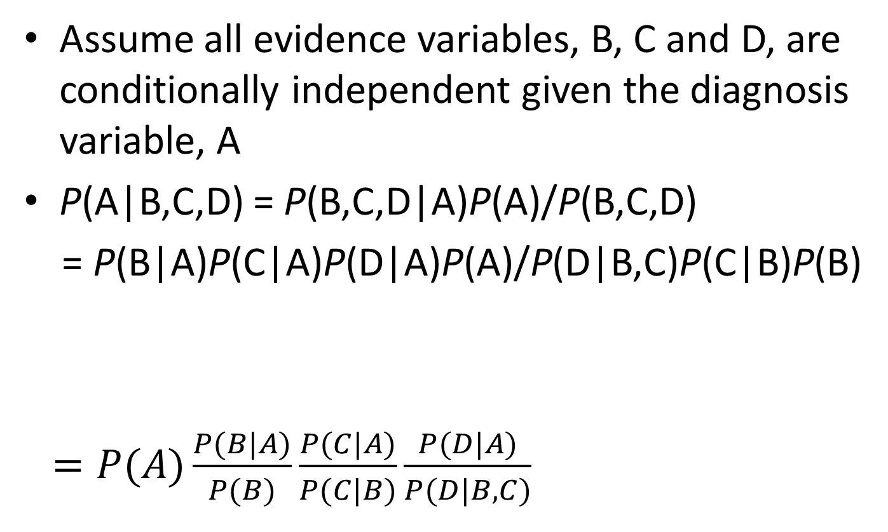
Bayes’s Rule with Multiple Evidence and Conditional Independence
Conditionalized Chain rule + conditional independence
Chain rule

Slide 94
Inference Ignorance
“Inferences about Testosterone Abuse Among Athletes,” 2004
  Mary Decker Slaney doping case
“Justice Flunks Math,” 2013
  Amanda Knox trial in Italy

Slide 95
Summary of Important Rules
Conditional Probability: P(A|B) = P(A,B)/P(B)
Product rule: P(A,B) = P(A|B)P(B)
Chain rule: P(A,B,C,D) = P(A|B,C,D)P(B|C,D)P(C|D)P(D)
Conditionalized version of Chain rule:
P(A,B|C) = P(A|B,C)P(B|C)
Bayes’s rule: P(A|B) = P(B|A)P(A)/P(B)
Conditionalized version of Bayes’s rule:
P(A|B,C) = P(B|A,C)P(A|C)/P(B|C)
  Addition / Conditioning rule: P(A) = P(A,B) + P(A, ¬B)
  P(A) = P(A|B)P(B) + P(A|¬B)P(¬B)

Slide 96
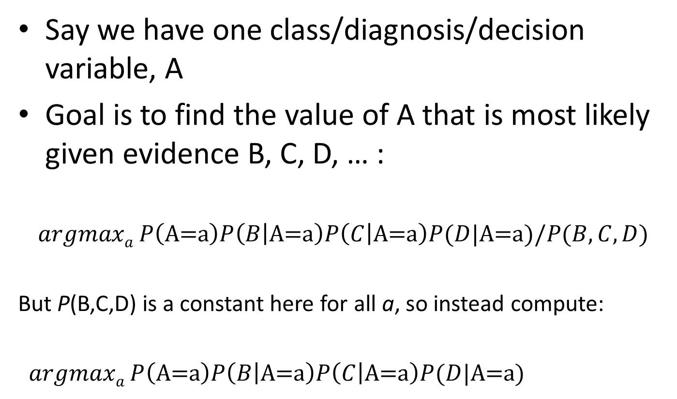
Naïve Bayes Classifier

Slide 97
Naïve Bayes Classifier
Classification problem: Find the value of class/decision/diagnosis variable Y that is most likely given evidence/measurements/attributes X_{i} = v_{i}
Use Bayes’s rule and conditional independence:
Try all possible values of Y and pick the value that gives the maximum probability
But denominator, P(X₁=v₁, …, X_{n}=v_{n}), is a constant for all values of Y, so it won’t affect which value of Y is best

Slide 98
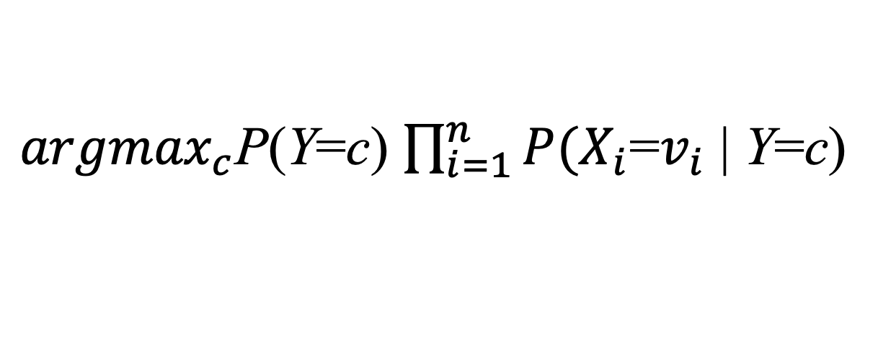
Naive Bayes Classifier Testing Phase
For a given test instance defined by X₁=v₁, …, X_{n}=v_{n}, compute
Assumes all evidence variables are conditionally independent of each other given the class variable
Robust because it gives the right answer as long as the correct class is more likely than all others
${argmax}_{c}$P(Y=c) $\prod_{i=1}^{n}{P(X_{i}}$=$v_{i}$ | Y=c)
Class variable
Evidence variable

Slide 99
Naïve Bayes Classifier
A special Bayesian Network structure:
  a ‘class’ variable Y at root, compute P(Y | X₁, …, X_{n})
  evidence nodes X_{i} (observed features) are all leaves
  conditional independence between all evidence assumed. Usually not valid, but often empirically OK
Y
…
X₁
X₂
X_{n}

Slide 100
Naïve Bayes Classifier
What’s stored in the CPTs?
J
J | Person is Junior
C | Brought coat to class
Z | Lives in zipcode 53706
H | Saw “Hunger Games 1” more than once
C
Z
H

Slide 101
Naïve Bayes Classifier Training Phase
P(J) =
J
J | Person is Junior
C | Brought coat to class
Z | Lives in zipcode 53706
H | Saw “Hunger Games 1” more than once
Compute from the Training set all the necessary Prior and Conditional probabilities
C
Z
H
P(C|J) =
P(C|¬J) =
P(Z|J) =
P(Z|¬J) =
P(H|J) =
P(H|¬J) =

Slide 102
Naïve Bayes Classifier
P(J) =
J
J | Person is Junior
C | Brought coat to class
Z | Lives in zipcode 53706
H | Saw “Hunger Games 1” more than once
C
Z
H
P(C|J) =
P(C|¬J) =
P(Z|J) =
P(Z|¬J) =
P(H|J) =
P(H|¬J) =
# Juniors who saw H>1
---------------------------------
# Juniors
# Juniors
----------------------------
# people in database
# non-juniors who saw H>1
---------------------------------------
# non-juniors

Slide 103
Naïve Bayes Classifier
Assume k classes and n evidence (i.e., attribute) variables, each with m possible values
k-1 values needed for computing P(Y=c)
(m-1)k values needed for computing P(X_{i}=v_{i} |Y=c) for each evidence variable X_{i}
So, (k-1) + n(m-1)k values needed instead of exponential size FJPD table

Slide 104
Naïve Bayes Classifier
A new person shows up in class wearing an “I live in Union South where I saw the ‘Hunger Games 1’ every night” coat.
What’s the probability that the person is a Junior?
P(J) =
J
J | Person is Junior
C | Brought coat to class
Z | Lives in zipcode 53706
H | Saw “Hunger Games 1” more than once
C
Z
H
P(C|J) =
P(C|¬J) =
P(Z|J) =
P(Z|¬J) =
P(H|J) =
P(H|¬J) =

Slide 105
Is the Person a Junior?
Input (evidence): C, Z, H
Output (query): J
P(J|C,Z,H)
= P(J,C,Z,H) / P(C,Z,H) by def. of cond. prob.
= P(J,C,Z,H) / [P(J,C,Z,H) + P(¬J,C,Z,H)] by marginalization
where
P(J,C,Z,H) = P(J)P(C|J)P(Z|J)P(H|J) by chain rule and conditional independence associated with Bayes Net
P(¬J,C,Z,H) = P(¬J)P(C|¬J)P(Z|¬J)P(H|¬J)

Slide 106
Naïve Bayes Classifier
Conditional probabilities can be very, very small, so instead use logarithms to avoid underflow:

Slide 107
Add-1 Smoothing
Unseen event problem: Training data may not include some cases
  flip a coin 3 times, all heads → one-sided coin?
  Conditional probability = 0
  Just because a value doesn’t occur in the training set doesn’t mean it will never occur
“Add-1 Smoothing” ensures that every conditional probability > 0 by pretending that you’ve seen each attribute’s value 1 extra time

Slide 108
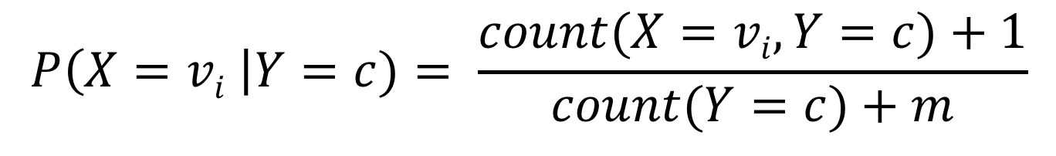
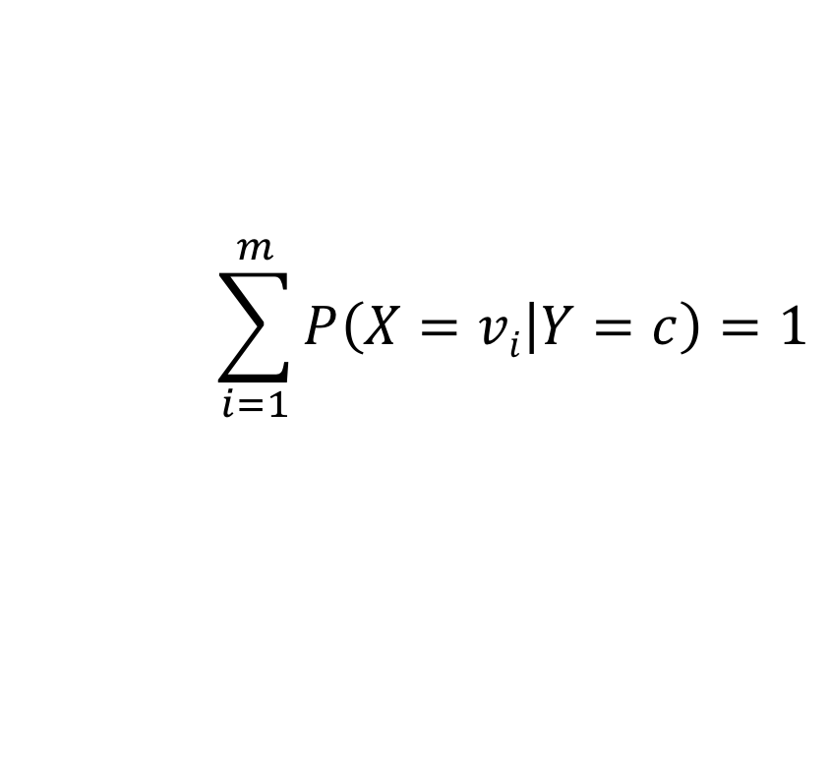
Add-1 Smoothing
number of times attribute X has value v_{i} in all training instances with class c
Compute Conditional probabilities as
Note:
$$P\left(X=vi \right|Y=c)= \frac{count(X=vi, Y=c)+1}{count(Y=c)+m}$$
number of training instances with class c
$$\sum_{i=1}^{m}{P\left(X=vi | Y=c\right)=1}$$
where m = number of possible values for attribute X

Slide 109
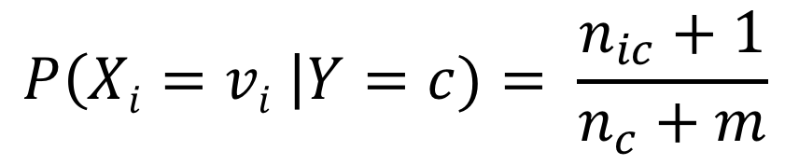
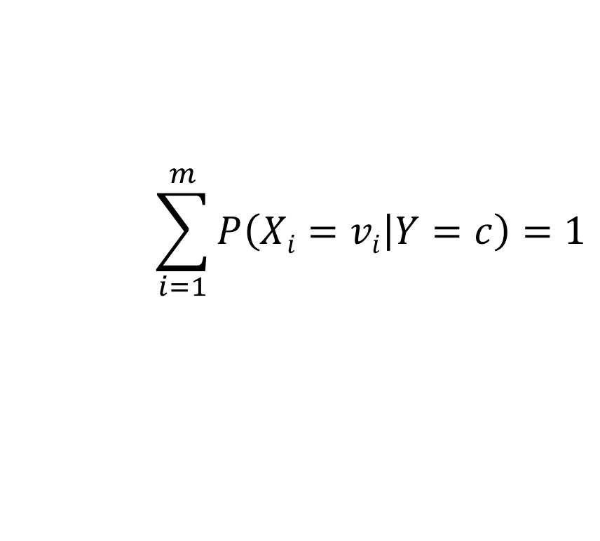
Add-1 Smoothing
Let n_{ic} = number of times attribute X_{i} has value v_{i} in all training instances with class c
Let n_{c} = number of training instances with class c
Compute Conditional probabilities as
Note:
$$P\left(Xi=vi \right|Y=c)= \frac{n_{ic}+1}{n_{c}+m}$$
$$\sum_{i=1}^{m}{P\left(Xi=vi | Y=c\right)=1}$$

Slide 110
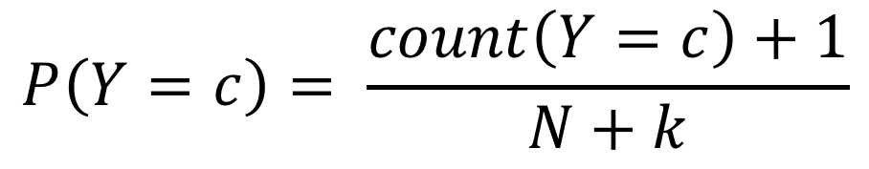
Add-1 Smoothing
Compute Prior probabilities as
where N = size of the training set, k = number of classes
$$P\left(Y=c\right)= \frac{count\left(Y=c\right)+1}{N+k}$$

Slide 111
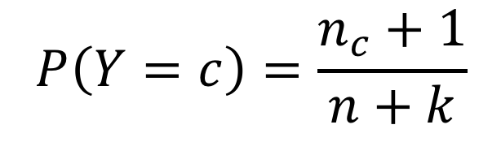
Add-1 Smoothing
Compute Prior probabilities as
where n = size of the training set
$$P\left(Y=c\right)=\frac{n_{c}+1}{n+k}$$

Slide 112
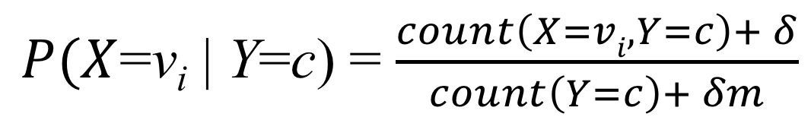
Laplace Smoothing
aka Add-δ Smoothing
Instead of adding 1, add δ (a positive real number)
Compute conditional probabilities as
$P(X$=v_{i} | Y=c) = $\frac{count\left(X=vi, Y=c\right)+ δ}{count\left(Y=c\right)+ δm}$
where m = number of possible values for attribute X

Slide 113
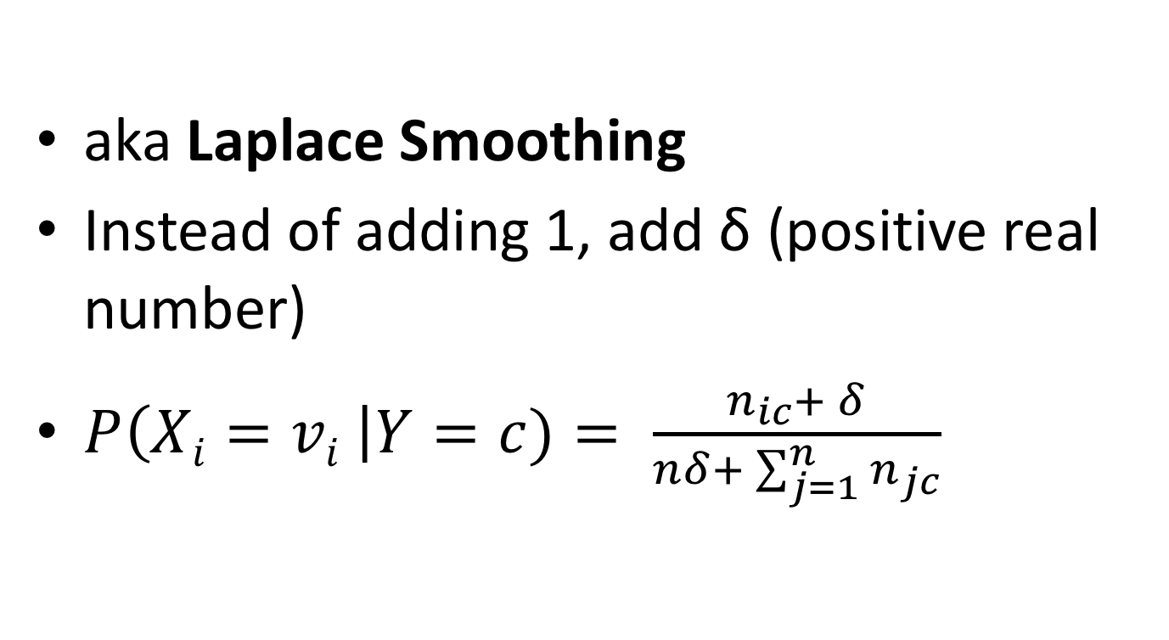
Add-δ Smoothing
aka Laplace Smoothing
Instead of adding 1, add δ (positive real number)
$P\left(Xi=vi \right|Y=c)= \frac{n_{ic}+ δ}{nδ+ \sum_{j=1}^{n}{n_{jc}}}$

