Slide 1
Speech Recognition
Chapter 15.1 – 15.3, 23.5
“Markov models and hidden Markov models: A brief tutorial,” E. Fosler-Lussier, 1998

Slide 2
Introduction
Speech is a dominant form of communication between humans and is becoming one for humans and machines
Speech recognition: mapping an acoustic signal
into a string of words
Speech understanding: mapping what is said
to its meaning
Notes:
CLICK EACH

Slide 3
Applications
Medical transcription
Vehicle control (e.g., fighter aircraft, helicopters)
Game control
Intelligent personal assistants (e.g., Siri)
Smartphone apps
HCI
Automatic translation
Telephony for the hearing impaired

Slide 4
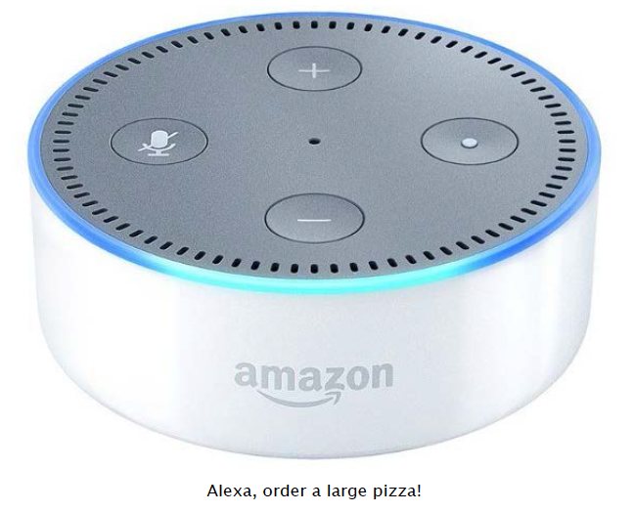
Alexa, order a large pizza!

Slide 5

Commercial Software
Nuance Dragon NaturallySpeaking
Google Cloud Speech API
Microsoft Bing Speech API
IBM Speech to Text
wit.ai
api.ai
CMU Sphinx
and many more

Slide 6
Sphinx-4 Performance
Test | WER (%) | RT | Vocabulary Size | Language Model
TI46 | 0.168 | .02 | 11 | isolated digits recognition
TIDIGITS | 0.549 | 0.05 | 11 | continuous digits
AN4 | 1.192 | 0.20 | 79 | trigram
RM1 | 2.88 | 0.41 | 1,000 | trigram
WSJ5K | 6.97 | 0.96 | 5,000 | trigram
HUB4 | 18.756 | 3.95 | 60,000 | trigram
WER - Word error rate (%) (lower is better)
RT - Real Time - Ratio of processing time to audio time - (lower is better)

Slide 7
Introduction
Human languages are limited to a set of about 40 to 50 distinct sounds called phones, e.g.,
  [ey] bet
  [ah] but
  [oy] boy
  [em] bottom
  [en] button
Phonemes are equivalence classes of phones that can’t be distinguished from each other in a given language
These phones are characterized in terms of acoustic features, e.g., frequency and amplitude, that can be extracted from the sound waves
Notes:
CLICK EACH

Slide 8
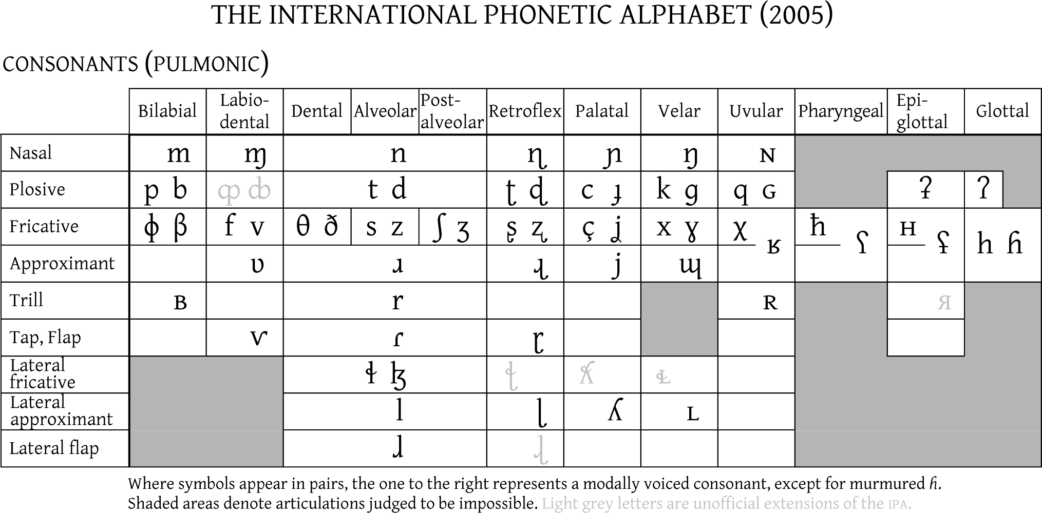
International Phonetic Alphabet
http://www.yorku.ca/earmstro/ipa/consonants.html
http://www.youtube.com/watch?v=Nz44WiTVJww&feature=fvw

Slide 9
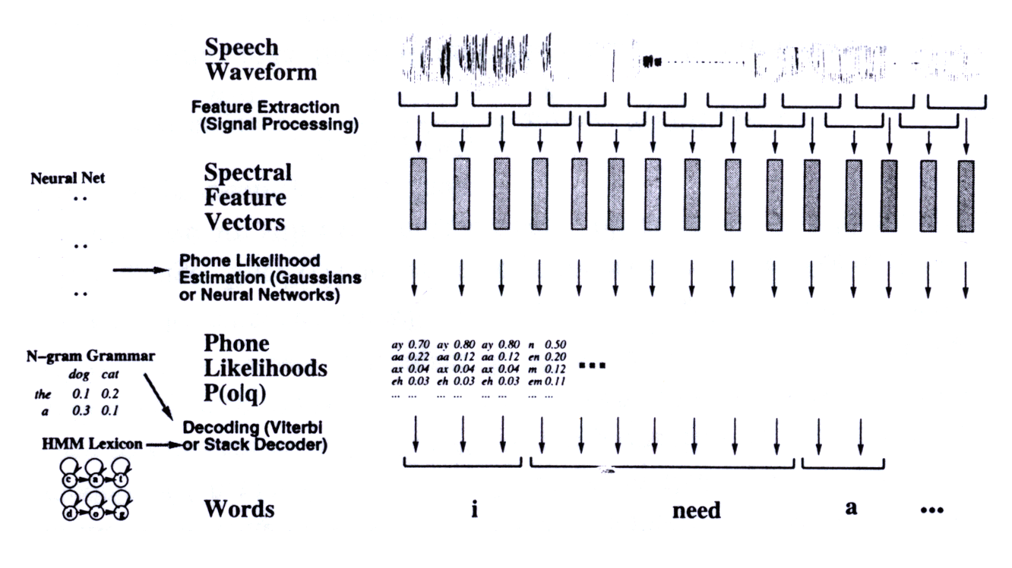
Speech Recognition Architecture
Goal: Large vocabulary, continuous speech (words not separated), speaker-independent
Speech
Waveform
Feature Extraction
(Signal Processing)
Spectral
Feature
Vectors
Neural Net
Phone Likelihood
Estimation (Gaussians
or Neural Networks)
Phone
Likelihoods
P(o|q)
N-gram Grammar
Decoding (Viterbi
or Stack Decoder)
HMM Lexicon
Words

Slide 10
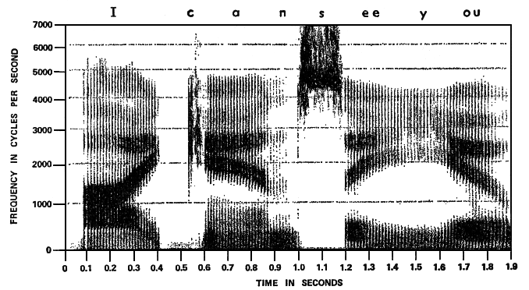
Spectrograph
“I can see you”
frequency
time
Created using Fourier Transform

Slide 11
Speech Recognition Task
Signal
Processor
o₁, o₂, …
Match
Search
w₁, w₂, …
Analog
Speech
Discrete
Observations
Word
Sequence

Slide 12
Introduction
Why isn't this easy?
  just develop a dictionary of pronunciation
  e.g., coat = [k] + [ow] + [t] = [kowt]
  but “recognize speech” ≈ “wreck a nice beach”
Problems:
  Homophones: different fragments sound the same
    e.g., “rec” and “wreck”
  Segmentation: determining breaks between words
    e.g., “nize speech” and “nice beach”
  Speed of speech, accents, dialects
  Signal processing problems
    Background noise, poor quality microphone, echo
Notes:
CLICK EACH SUB

Slide 13

Hearing Speech with your Eyes
McGurk Effect: An audio-visual illusion – what you see affects what you hear
Is he saying “BA BA” or “DA DA”?

Slide 14
Hearing Speech with your Eyes
McGurk Effect: An audio-visual illusion – what you see affects what you hear
Is he saying “BA BA” or “DA DA”?
Most adults (98%) think they are hearing "DA" – a so called "fused response" – where the "D" is a result of an audio-visual illusion. In reality you are hearing the sound “BA,” while you are seeing the lip movements “GA.”

Slide 15
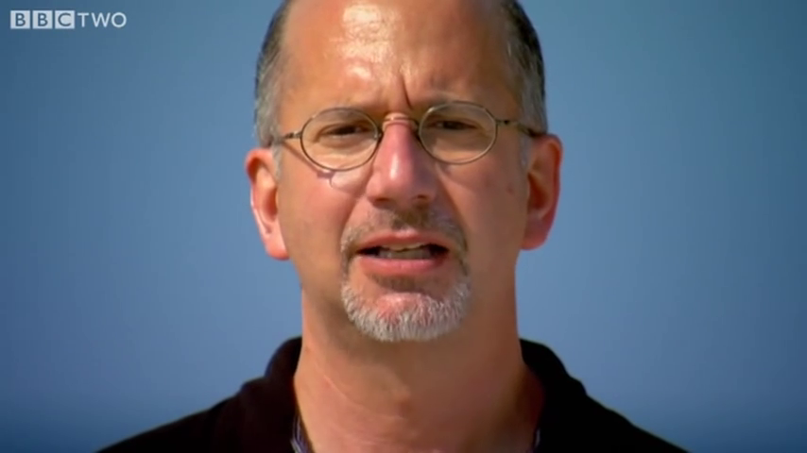
McGurk Effect: Hearing with your Eyes

Slide 16
Signal Processing
Sound is an analog energy source resulting from pressure waves striking an eardrum or microphone
An analog-to-digital converter is used to capture the speech sounds
  Sampling: the number of times per second that the sound level is measured
  Quantization: the number of bits of precision for the sound level measurements
    Telephone: 3 KHz (3000 times per second)
    Speech recognizer: 8 KHz with 8 bits/sample
    so that 1 minute takes about 500K bytes
Notes:
CLICK EACH SUB

Slide 17
Signal Processing
Wave encoding
  group into ~10 msec frames (blocks) that
  are analyzed individually
  frames overlap to ensure important acoustical events at frame boundaries aren't lost
  frames are represented by a set of features
    amount of energy at various frequencies
    total energy in a frame
    differences from prior frame
  vector quantization encodes signal by mapping frames into n-dimensional feature space
Notes:
CLICK EACH SUB

Slide 18
Input Sequence
Vector Quantization encodes each frame as one of, say, 256 possible observation values (aka labels): C1, C2, …, C256
For example, use k-Means Clustering for unsupervised learning of k = 256 clusters in feature space
Input is a sequence such as
  C82, C44, C63, C44, C25, …
  = o₁, o₂, o₃, o₄, o₅, …

Slide 19
Signal Processing
Goal is speaker independence so that representation of sound is independent of a speaker's specific pitch, volume, speed, and other aspects such as dialect
Speaker identification does the opposite, i.e., the specific details are needed to decide who is speaking
A significant problem is dealing with background noise that is often other speakers
Notes:
CLICK EACH

Slide 20
Speech Recognition Model
Bayes’s Rule is used break up the problem into manageable parts:
  P (Words | Signal ) = P (Signal | Words ) P (Words )
  P (Signal )
  P (Words ): Language model
    likelihood of words being heard
    e.g., “recognize speech” more likely than “wreck a nice beach”
  P (Signal |Words ): Acoustic model
    likelihood of a signal given word sequence
    accounts for differences in pronunciation of words
    e.g., given “nice,” likelihood that it is pronounced [nuys]
Notes:
CLICK EACH SUB

Slide 21
Signal = observation sequence
Words = sequence of words
Best match metric:
Bayes’s rule:
observation likelihood prior
(acoustic model) (language model)

Slide 22
Language Model
P(Words) is the joint probability that a sequence
of Words = w₁ w₂ ... w_{n} is likely for a specified natural language
This joint probability can be expressed using the chain rule (order reversed):
P (w₁ w₂ … w_{n} ) = P (w₁ ) P (w₂ |w₁ ) P (w₃ |w₁ w₂ ) ... P (w_{n} |w₁ ... w_{n-1} )
Collecting all these probabilities is too complex; it requires probabilities for m^{n-1} starting sequences for a sequence of n words in a language of m words
  Simplification is necessary!
Notes:
CLICK EACH SUB

Slide 23
Language Model
First-order Markov Assumption
  Probability of a word depends only on the previous word:
P(w_{i} | w₁ ... w_{i-1} ) ≈ P(w_{i} | w_{i-1})
The Language Model simplifies to
P (w₁ w₂ … w_{n}) = P (w₁ ) P (w₂ |w₁ ) P (w₃ |w₂ ) ... P (w_{n} |w_{n-1} )
  called the bigram model
  relates consecutive pairs of words
Notes:
CLICK EACH SUB

Slide 24
Language Model
More context could be used, such as the two words before, called the trigram model:
P(w_{i} | w₁ ... w_{i-1} ) ≈ P(w_{i} | w_{i-1} w_{i-2})
A weighted sum of unigram, bigram, trigram models could also be used in combination:
P (w₁ w₂ … w_{n} ) = ∏ (c₁ P (w_{i} ) + c₂ P (w_{i} | w_{i-1} ) + c₃ P (w_{i} | w_{i-1} w_{i-2} ))
Bigram and trigram models account for
  local context-sensitive effects
    e.g., "bag of tricks" vs. "bottle of tricks"
  some local grammar
    e.g., "we was" vs. "we were"
Notes:
CLICK EACH SUB

Slide 25
Language Model
Probabilities are obtained by computing the frequency of all possible pairs of words in a large training set (i.e., corpus) of word strings:
  if "the" appears in training data 10,000 times
  and it's followed by "clock" 11 times then
  P (clock | the) = 11/10000 = .0011
These probabilities are stored in
  a probability table
  a probabilistic finite state machine
Notes:
CLICK EACH SUB

Slide 26
Language Model
Probabilistic finite state
machine: an almost fully connected directed graph:
attack
tomato
the
nodes: all possible words and
a START state
arcs: labeled with a probability
  from START to a word is the prior probability
  of the destination word being the first word
  from one word to another is the conditional probability of the destination word following a given source word
START
of
killer
Notes:
CLICK EACH SUB, CLICK ANIM

Slide 27
Language Model
Probabilistic finite state
machine: an almost fully connected directed graph:
attack
tomato
the
joint probability is estimated for the
bigram model by starting at START
and multiplying the probabilities of the
arcs that are traversed for a given
sentence:
P (“attack of the killer tomato” )
= P (attack ) P (of | attack ) P (the | of ) P (killer | the ) P (tomato | killer )
START
of
killer
Notes:
CLICK EACH SUB

Slide 28
Acoustic Model
P(Signal | Words ) is the conditional probability that
a signal is likely given a sequence of spoken words for a particular natural language
This is divided into two probabilities:
  P (Phones | Word ): probability of a sequence of phones given Word
  P (Signal | Phones ): probability of a sequence of vector quantization values from the acoustic signal given Phones
Notes:
CLICK EACH SUB

Slide 29
Acoustic Model
P(Phones | Word ) can be specified and computed using a Markov Model (MM)
P(Signal | Phones) can be specified and computed using a Hidden Markov Model (HMM)

Slide 30
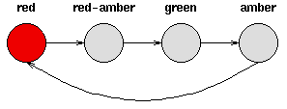
Finding Patterns
Speech is an example of a more general problem of finding patterns over time (or any discrete sequence)
Deterministic patterns have a fixed sequence of states, where the next state is dependent solely on the previous state
European
Stop light

Slide 31

Modeling a Sequence of States
Bayesian Network structure for a sequence of states from {Red (R), Red-Amber (RA), Green (G), Amber (A)}. Each q_{i} is a random variable indicating the state of the stoplight at time i.
q₁=R
q₂=RA
q₃=G
q₄=A
…
q₅=R

Slide 32
Markov Property
The 1st order Markov assumption:
State q_{t+1} is conditionally independent of {q_{t-1}, q_{t-2}, … q₁} given q_{t}. In other words:
P(q_{t+1}=s_{j} | q_{t}=s_{i} , q_{t-1}=s_{k} , …, q₁=s_{l} ) = P(q_{t+1}=s_{j} | q_{t}=s_{i} )

Slide 33
Non-Deterministic Patterns
Assume a discrete set of states, but we can’t model the sequence deterministically
Example: Predicting the weather
  States: Sunny, Cloudy, Rainy
  Arcs: Probability, called the state transition probability, of moving from one state to another
Nth-order Markov assumption: Today’s weather can be predicted solely given knowledge of the last N days’ weather
1st-order Markov assumption: Today’s weather can be predicted solely given knowledge of yesterday’s weather

Slide 34
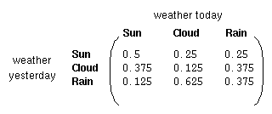

1st-Order Markov Model
Markov process is a process that moves from state to state probabilistically based on a state transition matrix, A, associated with a graph of the possible states
1st-order Markov model for weather prediction:
0.5 | 0.375 | 0.125
0.25 | 0.125 | 0.625
0.25 | 0.375 | 0.375
A
0.25

Slide 35
Matrix Properties
Sum of values in row = 1 because these are the probabilities of all outgoing arcs from a state
Sum of values in a column does NOT necessarily equal 1 because this is the sum of probabilities on all incoming arcs to a state
.075
.8
.9
.15
.025
.05
.25
.25
.5

Slide 36

1st-Order Markov Model
To initialize the process, also need the prior probabilities of the initial state at time t = 0, called π. For example, if we know the first day was sunny, then π is a vector =
For simplicity, we will often assume a single, given state is the start state

Slide 37
1st-Order Markov Model
Markov Model M = (A, π) consists of
  Discrete set of states, s₁, s₂, …, s_{N}
  π vector, where π_{i} = P(q₁=s_{i})
  State transition matrix, A = {a_{ij}}
    where a_{ij} = P(q_{t+1}=s_{j} | q_{t}=s_{i} )
The state transition matrix is fixed a priori and describes probabilities associated with a (completely-connected) graph of the states

Slide 38
Our Language Model is a Markov Model
attack
tomato
the
START
of
killer

Slide 39
Example: Using a Markov Model for Weather Prediction
A =
0.5 | 0.375 | 0.125
0.25 | 0.125 | 0.625
0.25 | 0.375 | 0.375
π =
Given that today is sunny, what is the probability of the next two days being sunny and rainy, respectively?

Slide 40
Weather Prediction Example (cont.)
P(q₂= Sun, q₃=Rain | q₁=Sun) = ?
P(q₃=Rain | q₁=Cloudy) = ?

Slide 41
Weather Prediction Example (cont.)
conditionalized chain rule
P(q₂= Sun, q₃=Rain | q₁=Sun)
  = P(q₃=Rain | q₂= Sun, q₁=Sun) P(q₂= Sun | q₁=Sun)
  = P(q₃=Rain | q₂= Sun) P(q₂= Sun | q₁=Sun)
  = (.125)(.5)
  = 0.0625
P(q₃=Rain | q₁=Cloudy)
  = P(q₂= Sun, q₃=Rain | q₁=Cloudy)
  + P(q₂= Cloudy, q₃=Rain | q₁=Cloudy)
  + P(q₂= Rain, q₃=Rain | q₁=Cloudy)
1st order Markov assumption
(conditional independence)
addition rule

Slide 42
Markov Property
P(q_{t+1}=s₁|q_{t}=s₂) = 1/2
P(q_{t+1}=s₂|q_{t}=s₂) = 1/2
P(q_{t+1}=s₃|q_{t}=s₂) = 0
P(q_{t+1}=s₁|q_{t}=s₁) = 0
P(q_{t+1}=s₂|q_{t}=s₁) = 0
P(q_{t+1}=s₃|q_{t}=s₁) = 1
s₂
1/2
q_{t+1} is conditionally independent of { q_{t-1}, q_{t-2}, … q₁, q₀ } given q_{t}.
In other words:
P(q_{t+1} = s_{j} |q_{t} = s_{i} ) =
P(q_{t+1} = s_{j} |q_{t} = s_{i} , all earlier history)
Question: what would be the best Bayes Net to represent the Joint Distribution of (q₀, q₁, … q₃,q₄ )?
1/2
2/3
s₁
s₃
1/3
N = 3
t =1
q_{t}=q₁=s₂
1
P(q_{t+1}=s₁|q_{t}=s₃) = 1/3
P(q_{t+1}=s₂|q_{t}=s₃) = 2/3
P(q_{t+1}=s₃|q_{t}=s₃) = 0

Slide 43
Markov Property
P(q_{t+1}=s₁|q_{t}=s₂) = 1/2
P(q_{t+1}=s₂|q_{t}=s₂) = 1/2
P(q_{t+1}=s₃|q_{t}=s₂) = 0
Answer:
q₀
P(q_{t+1}=s₁|q_{t}=s₁) = 0
P(q_{t+1}=s₂|q_{t}=s₁) = 0
P(q_{t+1}=s₃|q_{t}=s₁) = 1
s₂
q₁
1/2
q_{t+1} is conditionally independent of { q_{t-1}, q_{t-2}, … q₁, q₀ } given q_{t}.
In other words:
P(q_{t+1} = s_{j} |q_{t} = s_{i} ) =
P(q_{t+1} = s_{j} |q_{t} = s_{i} , all earlier history)
Question: what would be the best Bayes Net to represent the Joint Distribution of (q₀, q₁, q₂,q₃,q₄ )?
1/2
2/3
q₂
s₁
s₃
1/3
N = 3
t=1
q_{t}=q₁=s₂
1
q₃
P(q_{t+1}=s₁|q_{t}=s₃) = 1/3
P(q_{t+1}=s₂|q_{t}=s₃) = 2/3
P(q_{t+1}=s₃|q_{t}=s₃) = 0
q₄

Slide 44
Markov Property
P(q_{t+1}=s₁|q_{t}=s₂) = 1/2
P(q_{t+1}=s₂|q_{t}=s₂) = 1/2
P(q_{t+1}=s₃|q_{t}=s₂) = 0
Answer:
q₀
q_{t+1} is conditionally independent of { q_{t-1}, q_{t-2}, … q₁, q₀ } given q_{t}.
In other words:
P(q_{t+1} = s_{j} |q_{t} = s_{i} ) =
P(q_{t+1} = s_{j} |q_{t} = s_{i} ,any earlier history)
Question: what would be the best Bayes Net structure to represent the Joint Distribution of ( q₀, q₁, q₂,q₃,q₄ )?
i | P(q_{t+1}=s₁|q_{t}=s_{i}) | P(q_{t+1}=s₂|q_{t}=s_{i}) | … | P(q_{t+1}=s_{j}|q_{t}=s_{i}) | … | P(q_{t+1}=s_{N}|q_{t}=s_{i})
1 | a₁₁ | a₁₂ | … | a_{1j} | … | a_{1N}
2 | a₂₁ | a₂₂ | … | a_{2j} | … | a_{2N}
3 | a₃₁ | a₃₂ | … | a_{3j} | … | a_{3N}
: | : | : | : | : | : | :
i | a_{i1} | a_{i2} | … | a_{ij} | … | a_{iN}
N | a_{N1} | a_{N2} | … | a_{Nj} | … | a_{NN}
P(q_{t+1}=s₁|q_{t}=s₁) = 0
P(q_{t+1}=s₂|q_{t}=s₁) = 0
P(q_{t+1}=s₃|q_{t}=s₁) = 1
s₂
q₁
1/2
1/2
2/3
q₂
s₁
s₃
1/3
Each of these probability tables is identical
N = 3
t=1
q_{t}=q₁=s₂
1
q₃
P(q_{t+1}=s₁|q_{t}=s₃) = 1/3
P(q_{t+1}=s₂|q_{t}=s₃) = 2/3
P(q_{t+1}=s₃|q_{t}=s₃) = 0
Notation:
q₄

Slide 45
Acoustic Model
P(Phones |Word ) can be specified as a Markov model, describing the possible phone sequences for pronouncing a given word, e.g., “tomato:”
.2
[ow]
1
.6
[ey]
1
START
[t]
[m]
[t]
1
[ow]
[ah]
[aa]
.8
1
.4
1
Nodes: correspond to the production of a phone
  sound slurring (coarticulation), e,g., due to quickly pronouncing a word
  variation in pronunciation of words, e.g., due to dialects
Arcs: probability of transitioning from current state to another
Notes:
CLICK EACH SUB

Slide 46
Acoustic Model
P(Phones |Word ) can be specified as a Markov model, describing the possible phone sequences for pronouncing a given word, e.g., “tomato:”
.2
[ow]
1
.6
[ey]
1
START
[t]
[m]
[t]
1
[ow]
[ah]
[aa]
.8
1
.4
1
P(Phones | Word) is a path through the graph, e.g.,
  P ([towmeytow] | tomato ) = 0.2 * 1 * 0.6 * 1 * 1 = 0.12
  P ([towmaatow] | tomato ) = 0.2 * 1 * 0.4 * 1 * 1 = 0.08
  P ([tahmeytow] | tomato ) = 0.8 * 1 * 0.6 * 1 * 1 = 0.48
  P ([tahmaatow] | tomato ) = 0.8 * 1 * 0.4 * 1 * 1 = 0.32
Notes:
CLICK EACH SUB

Slide 47
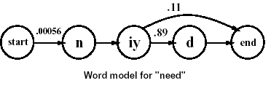
Acoustic Model for “Need”
Look at probabilities of various phones as we listen:
  In corpus “need” always starts with "n" sound
  What are the possibilities for the next sound? With probability 1, we know that next sound will be "iy"
  What are possibilities for next sound? 11% of the time, “d” sound will be omitted
  Probability of transitioning from "iy" to the "d" sound is 0.89
Circles represent two things—states and observations
In real world, state is hidden: For sound [iy], we don't know whether we are at second phone of the word “knee” or the second phone of the word “need”

Slide 48
Problem
The Acoustic Model also needs to compute P(Signal | Phones) but we don’t know the sequence of phones, we only have the observation sequence o₁, o₂, o₃, …
How do we relate the given input observation sequence to the “hidden” phone sequences associated with a word sequence?

Slide 49
Hidden Markov Models (HMMs)
Sometimes the states we want to predict are not directly observable; the only observations available are indirect evidence
Example: A CS major does not have direct access to the weather (sunny, cloudy, rainy) each day, but can only observe the condition of each day’s Badger Herald newspaper (dry, dryish, damp, soggy)
Example: In speech recognition we can observe acoustic features, i.e., o₁, o₂, …, but there is no direct evidence of the words or phones being spoken

Slide 50
HMMs
Hidden States: The states of real interest, e.g., the true weather or the sequence of words or phones spoken; represented as a 1st-order Markov model
Observable States: A discrete set of observable values; the number of observable values is not, in general, equal to the number of hidden states. The observable values are related somehow to the hidden states (i.e., not 1-to-1 correspondence)

Slide 51
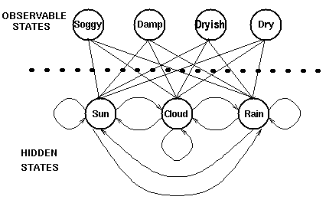
Hidden Markov Model
Start

Slide 52
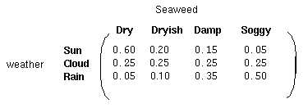
Arcs and Probabilities in HMMs
Arcs connecting hidden states and observable states represent the probability of generating an observed state given that the Markov process is in a hidden state
Observation Likelihood matrix, B, (aka output probability distribution) stores probabilities associated with arcs from hidden states to observable states, i.e., P(Observed | Hidden)
newspaper
Encodes semantic
variations, sensor
noise, etc.

Slide 53
HMM Summary
An HMM contains 2 types of information:
  Hidden states: s₁, s₂, s₃, …
  Observable states
    In speech recognition, the vector quantization values in the input sequence, O = o₁, o₂, o₃, …
An HMM, λ = (A, B, π), contains 3 sets of probabilities:
  π vector, π = (π_{i})
  State transition matrix, A = (a_{ij})
    where a_{ij} = P(q_{t} = s_{i} | q_{t-1} = s_{j})
  Observation likelihood matrix, B = b_{j}(o_{k}) = P(y_{t} = o_{k} | q_{t} = s_{j})

Slide 54
HMM Summary
1st order Markov property says observation o_{i} is conditionally independent of hidden states q_{i-1} , q_{i-2} , …, q₀ given q_{i}
In other words,
P(o_{t} = x | q_{t} = s_{i}, q_{t-1} = s_{j(t-1)}, …, q₀ = s_{j(0)})
= P(o_{t} = x | q_{t} = s_{i} )

Slide 55
Example: An HMM

Slide 56
Noisy Hidden State
Example: Noisy Proximity sensors. (unreliably tell us the contents of the 8 adjacent squares)
 |  |  | R₀ |  | 2
 |  | H
W | W | W
 | ®
H
W denotes “WALL”
True state q_{t}
Uncorrupted Observation
O_{t} is noisily determined depending on the current state.
Assume that O_{t} is conditionally independent of {q_{t-1}, q_{t-2}, … q₁, q_{0 ,}O_{t-1}, O_{t-2}, … O₁, O₀ } given q_{t}.
In other words:
P(O_{t} = X |q_{t} = s_{i} ) =
P(O_{t} = X |q_{t} = s_{i} ,any earlier history)
W |  | W
 | ® | W
H | H
What the robot sees: Observation O_{t}

Slide 57
HMMs
Example: Noisy Proximity sensors. (unreliably tell us the contents of the 8 adjacent squares)
 |  |  | R₀ |  | 2
 |  | H
W | W | W
 | ®
H
W denotes “WALL”
True state q_{t}
Uncorrupted Observation
O_{t} is noisily determined depending on the current state.
Assume that O_{t} is conditionally independent of {q_{t-1}, q_{t-2}, … q₁, q_{0 ,}O_{t-1}, O_{t-2}, … O₁, O₀ } given q_{t}.
In other words:
P(O_{t} = X |q_{t} = s_{i} ) =
P(O_{t} = X |q_{t} = s_{i} ,any earlier history)
W |  | W
 | ® | W
H | H
What the robot sees: Observation O_{t}
Question: what’d be the best Bayes Net structure to represent the Joint Distribution of (q₀, q₁, q₂,q₃,q_{4 ,}O₀, O₁, O₂,O₃,O₄ )?

Slide 58
HMMs
Answer:
q₀
Example: Noisy Proximity sensors. (unreliably tell us the contents of the 8 adjacent squares)
O₀
q₁
 |  |  | R₀ |  | 2
 |  | H
O₁
W | W | W
 | ®
H
W denotes “WALL”
q₂
True state q_{t}
Uncorrupted Observation
O₂
O_{t} is noisily determined depending on the current state.
Assume that O_{t} is conditionally independent of {q_{t-1}, q_{t-2}, … q₁, q_{0 ,}O_{t-1}, O_{t-2}, … O₁, O₀ } given q_{t}.
In other words:
P(O_{t} = X |q_{t} = s_{i} ) =
P(O_{t} = X |q_{t} = s_{i} ,any earlier history)
W |  | W
 | ® | W
H | H
q₃
O₃
What the robot sees: Observation O_{t}
q₄
Question: what’d be the best Bayes Net structure to represent the Joint Distribution of (q₀, q₁, q₂,q₃,q_{4 ,}O₀, O₁, O₂,O₃,O₄ )?
O₄

Slide 59
HMMs
Answer:
q₀
Notation:
Example: Noisy Proximity sensors. (unreliably tell us the contents of the 8 adjacent squares)
O₀
i | P(O_{t}=1|q_{t}=s_{i}) | P(O_{t}=2|q_{t}=s_{i}) | … | P(O_{t}=k|q_{t}=s_{i}) | … | P(O_{t}=M|q_{t}=s_{i})
1 | b₁(1) | b₁ (2) | … | b₁ (k) | … | b₁(M)
2 | b₂ (1) | b₂ (2) | … | b₂(k) | … | b₂ (M)
3 | b₃ (1) | b₃ (2) | … | b₃(k) | … | b₃ (M)
: | : | : | : | : | : | :
i | b_{i}(1) | b_{i} (2) | … | b_{i}(k) | … | b_{i} (M)
: | : | : | : | : | : | :
N | b_{N} (1) | b_{N} (2) | … | b_{N}(k) | … | b_{N} (M)
q₁
 |  |  | R₀ |  | 2
 |  | H
O₁
W | W | W
 | ®
H
W denotes “WALL”
q₂
True state q_{t}
Uncorrupted Observation
O₂
O_{t} is noisily determined depending on the current state.
Assume that O_{t} is conditionally independent of {q_{t-1}, q_{t-2}, … q₁, q_{0 ,}O_{t-1}, O_{t-2}, … O₁, O₀ } given q_{t}.
In other words:
P(O_{t} = X |q_{t} = s_{i} ) =
P(O_{t} = X |q_{t} = s_{i} ,any earlier history)
W |  | W
 | ® | W
H | H
q₃
O₃
What the robot sees: Observation O_{t}
q₄
Question: what’d be the best Bayes Net structure to represent the Joint Distribution of (q₀, q₁, q₂,q₃,q_{4 ,}O₀, O₁, O₂,O₃,O₄ )?
O₄

Slide 60
Example: HMM Acoustic Model
for the Word “Need”
a₂₄
a₁₁
a₂₂
a₃₃
Hidden states: Phones
start₀
a₀₁
[n]₁
a₁₂
[iy]₂
a₂₃
[d]₃
a₃₄
end₄
b₂(o₃)
b₂(o₅)
b₁(o₁)
b₁(o₂)
b₂(o₄)
b₃(o₆)
Observation
sequence:
…
…
o₁
o₂
o₃
o₄
o₅
o₆

Slide 61
Acoustic Model
P(Signal | Phone) can be specified as an HMM, e.g., phone model for [m]:
0.3
0.9
0.4
Onset
0.7
Mid
0.1
End
0.6
FINAL
Possible
outputs:
o1: 0.5
o2: 0.2
o3: 0.3
o3: 0.2
o4: 0.7
o5: 0.1
o4: 0.1
o6: 0.5
o7: 0.4
  nodes: probability distribution over a set of possible output values
  arcs: probability of transitioning from current hidden state to next hidden state
Notes:
CLICK EACH SUB

Slide 62
Signal = observation sequence
Words = sequence of words
Best match metric:
Bayes’s rule:
observation likelihood prior
(acoustic model) (language model)

Slide 63
Our Language Model is a Markov Model
attack
tomato
the
START
of
killer

Slide 64
Acoustic Model
P(Phones | Word ) can be specified and computed using a Markov Model (MM)
P(Signal | Phones) can be specified and computed using a Hidden Markov Model (HMM)

Slide 65
HMM Summary
An HMM contains 2 types of information:
  Hidden states: s₁, s₂, s₃, …
  Observable states
    In speech recognition, the vector quantization values in the input sequence, O = o₁, o₂, o₃, …
An HMM, λ = (A, B, π), contains 3 sets of probabilities:
  π vector, π = (π_{i})
  State transition matrix, A = (a_{ij})
    where a_{ij} = P(q_{t} = s_{i} | q_{t-1} = s_{j})
  Observation likelihood matrix, B = b_{j}(o_{k}) = P(y_{t} = o_{k} | q_{t} = s_{j})

Slide 66
Acoustic Model
P(Signal | Phone) can be specified as an HMM, e.g., phone model for [m]:
0.3
0.9
0.4
Onset
0.7
Mid
0.1
End
0.6
FINAL
Possible
outputs:
o1: 0.5
o2: 0.2
o3: 0.3
o3: 0.2
o4: 0.7
o5: 0.1
o4: 0.1
o6: 0.5
o7: 0.4
  nodes: probability distribution over a set of possible output values
  arcs: probability of transitioning from current hidden state to next hidden state
Notes:
CLICK EACH SUB

Slide 67
Acoustic Model
P(Signal | Phone) can be specified as an HMM, e.g., phone model for [m]:
0.3
0.9
0.4
Onset
0.7
Mid
0.1
End
0.6
FINAL
1
o1: 0.5
o2: 0.2
o3: 0.3
o3: 0.2
o4: 0.7
o5: 0.1
o4: 0.1
o6: 0.5
o7: 0.4
P(Signal | Phone) is a path through the states, i.e.,
  P([o1,o4,o6] | [m]) = (1)(.5)(.7)(.7)(.1)(.5)(.6) = 0.00735
  P([o1,o4,o4,o6] | [m]) = (1)(.5)(.7)(.7)(.9)(.7)(.1)(.5)(.6)
  + (1)(.5)(.7)(.7)(.1)(.1)(.4)(.5)(.6) = 0.0049245
Notes:
CLICK EACH SUB

Slide 68
Generating HMM Observations
Choose an initial hidden state, q₁ = s_{i} , based on π
For t = 1 to T do
  Choose output/observation state z_{t} = o_{k} according to the symbol probability distribution in hidden state s_{i}, b_{i}(k)
  Transition to a new hidden state q_{t+1} = s_{j} according to the state transition probability distribution for state s_{i}, a_{ij}
So, transition to new state using A matrix, and then output value at the new state using B matrix

Slide 69
Modeling a Sequence of States
Bayesian Network structure for a sequence of hidden states from {R, S, C}. Each q_{i} is a hidden/“latent” random variable indicating the state of the weather on day i. Each o_{i} is the observed state of the newspaper on day i.
Each horizontal arc has A matrix probs.
q1=R
q2=S
q3=S
q4=C
…
q5=R
o1=Damp
o2=Damp
o3=Dry
o4=Dryish
o5=Soggy
Each vertical arc
has B matrix probs.

Slide 70
Combining Models: Create One Large HMM
P(Phones | Word )
tomato
P (Words )
attack
.2
[ow]
1
.5
[ey]
1
[t]
[m]
[t]
1
[ow]
tomato
the
[ah]
[m]
[aa]
.8
1
.5
1
START
of
0.3
0.9
0.4
killer
Onset
0.7
Mid
0.1
End
0.6
FINAL
o1: 0.5
o2: 0.2
o3: 0.3
o3: 0.2
o4: 0.7
o5: 0.1
o4: 0.1
o6: 0.5
o7: 0.4
P(Signal | Phone)
Notes:
CLICK ANIM

Slide 71
Start here

Slide 72
HMM Summary
An HMM contains 2 types of information:
  Hidden states: s₁, s₂, s₃, …
  Observable states
    In speech recognition, the vector quantization values in the input sequence, O = o₁, o₂, o₃, …
An HMM, λ = (A, B, π), contains 3 sets of probabilities:
  π vector, π = (π_{i})
  State transition matrix, A = (a_{ij})
    where a_{ij} = P(q_{t} = s_{i} | q_{t-1} = s_{j})
  Observation likelihood matrix, B = b_{j}(o_{k}) = P(y_{t} = o_{k} | q_{t} = s_{j})

Slide 73
3 Common Tasks using HMMs
Evaluation problem
Decoding problem
Learning problem

Slide 74
Evaluation Problem: P(O | λ)
Find the probability of an observed sequence given an HMM. For example, given several HMMs such as a “summer HMM” and a “winter HMM” and a sequence of newspaper observations, which HMM most likely generated the given sequence?
In speech recognition, use one HMM for each word, and an observation sequence from a spoken word. Compute P(O | λ). Recognize the word by identifying the most probable HMM.
Use Forward algorithm

Slide 75
Decoding Problem
Find the most probable sequence (i.e., path) of hidden states given an observation sequence
Compute Q* = argmax_{Q} P(Q | O)
Use Viterbi algorithm

Slide 76
Learning Problem
Generate an HMM given a sequence of observations and a set of known hidden states
Learn the most probable HMM
Compute λ* = argmax_{λ} P(O | λ)
Use Forward-Backward algorithm or Expectation-Maximization (EM) algorithm

Slide 77
Evaluation Problem
Compute P(O | λ) where O = o₁, o₂, …, o_{T} is the observation sequence and λ is an HMM model defined by (π, A, B)
Let Q = q₁, q₂, …, q_{T} be a specific hidden state sequence
P(O | λ) = Σ P(O | Q) P(Q) by Conditioning rule
P(O | Q) = Π P(o_{t} | q_{t}) = b_{q1}(o₁ ) b_{q2}(o₂ ) … b_{qT}(o_{T} )
P(Q) = P(q₁) Π P(q_{t} | q_{t-1}) = π_{q1} a_{q1q2} … a_{qT-1qT}
So, P(O | λ) = Σ π_{q1} b_{q1}(o₁) a_{qoq1} b_{q2}(o₂) a_{q1q2} b_{q3}(o₃) ··· a_{qT-1qT} b_{qT}(o_{T})
Q
T
t=1
T
t=2
Q
Notes:
P(O|Q) computed using the conditionalized version of the chain rule plus 1st order Markov assumption (i.e., conditional independence)
P(Q) computed using chain rule plus 1st order Markov assumption

Slide 78
Computation of P(O | λ)
Use Addition rule:
Given fixed state sequence Q = q₁, q₂, …, q_{T}

Slide 79
Example: An HMM

Slide 80
P(q₁=Happy, q₂=Sad | HMM) = ?

Slide 81
P(q₁=H, q₂=S | HMM) = ?
by Chain rule

Slide 82
P(q₂=Happy | HMM) = ?
by Conditioning rule

Slide 83
P(q₃=Happy | HMM) = ?

Slide 84
P(o₁=Laugh, o₂=Frown | q₁=H, q₂=S) = ?

Slide 85
P(o₁=Laugh, o₂=Frown | HMM) = ?
(Evaluation Problem)

Slide 86
Evaluation Problem
Compute P(O | λ) where O = o₁, o₂, …, o_{T} is the observation sequence and λ is an HMM model defined by (π, A, B)
Let Q = q₁, q₂, …, q_{T} be a specific hidden state sequence
P(O | λ) = Σ P(O | Q) P(Q) by Conditioning rule
P(O | Q) = Π P(o_{t} | q_{t}) = b_{q1}(o₁ ) b_{q2}(o₂ ) … b_{qT}(o_{T} )
P(Q) = P(q₁) Π P(q_{t} | q_{t-1}) = π_{q1} a_{q1q2} … a_{qT-1qT}
So, P(O | λ) = Σ π_{q1} b_{q1}(o₁) a_{qoq1} b_{q2}(o₂) a_{q1q2} b_{q3}(o₃) ··· a_{qT-1qT} b_{qT}(o_{T})
Q
T
t=1
T
t=2
Q

Slide 87
P(o₁=Laugh, o₂=Frown | HMM) = ?

Slide 89
P(o₁=L, o₂=F, q₁=H, q₂=S) = ?
by Chain rule plus Markov property
In general:

Slide 90
P(q₁=H, q₂=S | o₁=L, o₂=F ) = ?
(State Estimation Problem)

Slide 91
P(q₁=S | o₁=F) = ?
(State Estimation Problem)
Needed as part of solving the “Decoding Problem”
Most Probable Path Problem: Find q₁, q₂ such that
P(q₁ = x, q₂ = y | o₁ = L, o₂ = F) is a maximum over all possible values of x and y, and give the values of x and y

Slide 92
P(q₁=S | o₁=F) = ?
Conditioning rule

Slide 93
P(q₃=H | o₁=F, o₂=L, o₃=Y) = ?
(Decoding Problem)

Slide 94
P(q₃=H | o₁=F, o₂=L, o₃=Y) = ?
Addition rule
where

Slide 95
P(q₂ = H | q₁ = S, o₂=F) = ?
by cond. chain rule
by independence of q₁ and o₂
Bayes rule
Markov assump.
Product rule

Slide 96
How to Solve HMM Problems Efficiently?

Slide 97
Nothing on the Final Exam in the remaining speech recognition slides

Slide 98
Computation of P(O | λ)
Since there are N^{T} sequences (N hidden states and T observations), O(T N^{T} ) calculations required!
For N = 5, T = 100 ⇒ 10⁷² computations!

Slide 99
Forward Algorithm for Solving Evaluation Problem
Compute Bayesian likelihood P(O | λ)
incrementally by following the state transitions for the HMM λ
  Let O_{t} = o₁ o₂ … o_{t-1} o_{t}
  P(O_{t}, j | λ) = P(O_{t-1}, i | λ) a_{i,j} b_{jt}
    in state j at o_{t}, previously state i at o_{t-1}
    a_{i,j} is the transition probability between state i and state j
    b_{i,t} is the observation likelihood that the state j label matches o_{t}
a_{i,j}
i
j
o_{t-1}
o_{t}

Slide 100
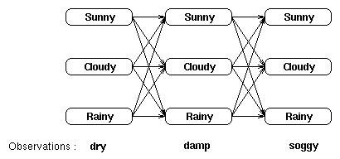
Evaluation using Exhaustive Search
Given observation sequence (dry, damp, soggy), “unroll” the hidden state sequence as a “trellis” (matrix):

Slide 101
Evaluation using Exhaustive Search
Each column in the trellis (matrix) shows a possible state of the weather on a given day
Each state in a column is connected to each state in the adjacent columns
Sum the probabilities of each possible sequence of the hidden states; here, 3³ = 27 possible weather sequences
P(dry,damp,soggy | HMM λ) =
P(dry,damp,soggy | sunny,sunny,sunny)
+ P(dry,damp,soggy | sunny,sunny,cloudy)
+ ··· + P(dry,damp,soggy | rainy,rainy,rainy)
Not practical since the number of paths is O(N^{T}) where N is the number of hidden states and T is number of observations

Slide 102
Forward Algorithm Intuition
Idea: compute and cache values α_{t}(i) representing probability of being in state i after seeing first t observations, o₁, o₂, ..., o_{t}
Each cell expresses the probability
α_{t}(i) = P(q_{t}=i | o₁, o₂, ..., o_{t})
q_{t} = i means "the probability that the t ^{th} state in the sequence of hidden states is state i
Compute α by summing over extensions of all paths leading to current cell
An extension of a path from state i at time t-1 to state j at t is computed by multiplying together:
i. previous path probability from the previous cell α_{t-1}(i)
ii. transition probability a_{ij} from previous state i to current state j
iii. observation likelihood b_{jt} that current state j matches observation symbol t
Notes:
Similar to the caching idea used in variable elimination algorithm for Bayes Nets

Slide 103
Forward Algorithm
α_{t-1}(i)
If there are multiple states leading to state j ⇒
  P(O_{t}, j | λ) = Σ_{all i} P(O_{t-1}, i | λ) a_{i,j} b_{jt}
  i.e., sum the probabilities
a_{1,j}
1
j
a_{2,j}
2
o_{t-1}
o_{t}

Slide 104
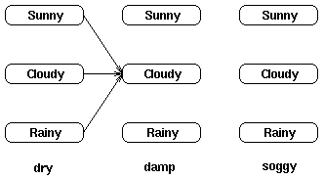
Evaluation using Forward Algorithm
Compute probability of reaching each intermediate hidden state in the trellis given observation sequence O = o₁, o₂, …, o_{T} That is, P(q_{t} = s_{i} | O)
Example: Given O = (dry, damp, soggy), compute P(O, q₂=cloudy | HMM λ)
α₂(cloudy) =
P(O | q₂=cloudy) ×
∑P(all paths to q₂=cloudy)

Slide 105
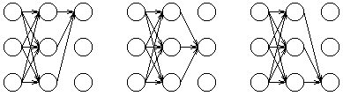
Forward Algorithm
P(O, q_{T}=s_{j} | λ) = sum of all possible paths through the trellis
O(N²T) computation time (i.e., linear in T, the length of the sequence)

Slide 106
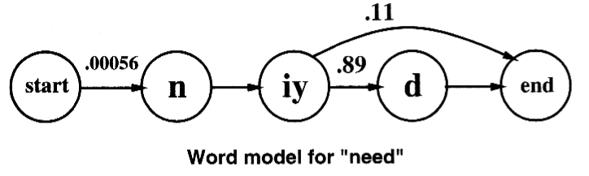
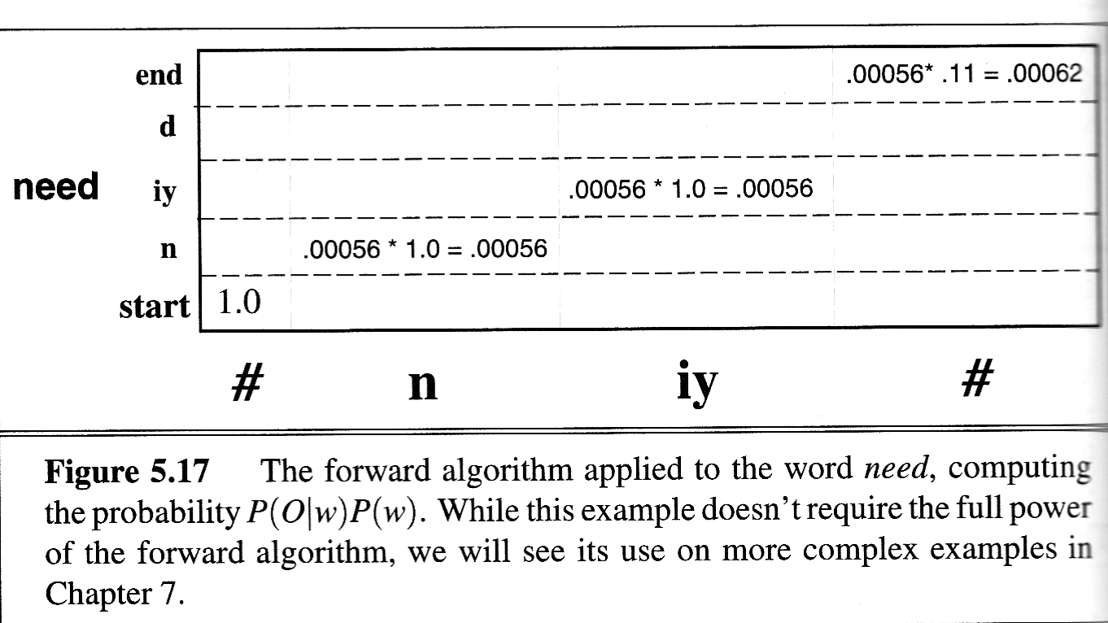
Forward Algorithm

Slide 107
Forward Algorithm (cont.)
Compute α recursively:
  α₁(j) = π_{j} b_{j}(o₁) for all states j
  α_{t}(j) = P(O, q_{t}= s_{j} | λ)
  = [Σ α_{t-1}(i)a_{ij}] b_{j}(o_{t}) for t > 0
P(O | λ) = Σ α_{T}(s_{j})
O(N²T) computation time (i.e., linear in T, the length of the sequence)
N
i=0
N
j=1

Slide 108
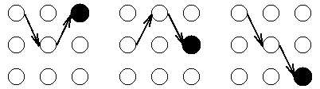
Decoding Problem
Most probable sequence of hidden states is the state sequence Q that maximizes P(O,Q | λ)
Similar to the Forward Algorithm except uses MAX instead of SUM, thereby computing the probability of the most probable path to each state in the trellis

Slide 109
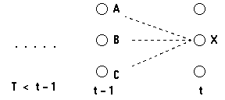
Decoding using Viterbi Algorithm
For each state q_{i} and time t, compute recursively δ_{t}(i) = maximum probability of all sequences ending at state q_{i} and time t, and the best path to that state
Exploits the Dynamic Programming invariant:
  If the ultimate best path for O includes state q_{i}
  then it includes the best path up to and including q_{i-1}

Slide 110
Viterbi Algorithm
Variant of forward algorithm that considers all words simultaneously and computes most likely path
A type of dynamic programming algorithm
Input is sequence of observations, and an HMM
Output is most probable state sequence Q = q₁, q₂, q₃, q₄, ..., q_{T} together with its probability
Works by computing max of previous paths instead of sum
Looks at the whole sequence before deciding on the best final state and then follows back pointers to recover the best path
Linear time and linear space algorithm in T

Slide 111
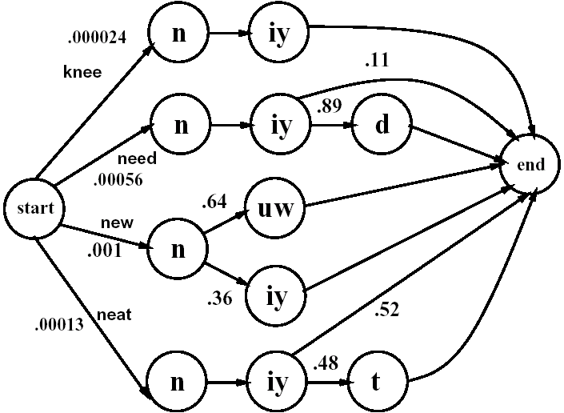
Combined Pronunciation Networks

Slide 112
Viterbi Algorithm Intuition
Idea: Compute probability by taking the max over extensions of all paths leading to current cell in the trellis
An extension of a path from a state i at time t-1 to state j at t is computed by multiplying together:
  previous path probability from the previous cell, δ_{t-1}(i)
  transition probability a_{ij} from previous state i to current state j
  observation likelihood b_{jt} that current state j matches observation symbol t

Slide 113
Viterbi Algorithm
By the 1st-order Markov assumption:
P(X, t) = max { P(i, t-1) × P(X | i) × P(o_{t} | X) }
Hence, δ_{t}(i) = max { δ_{t-1}(j) a_{ji} b_{j}(o_{t}) }
Record back pointer to best previous state; use this to obtain best path by tracing back from final state
Linear time and linear space in t
i=A,B,C
j

Slide 114
Summary of Viterbi Algorithm
Given an HMM, the Viterbi algorithm finds the most probable sequence of hidden states given a sequence of observed values
Exploits time invariance of the probabilities to avoid examining every possible path through the trellis
Looks at the whole sequence before deciding on the best final state and then follows back pointers to recover the best path
Uses entire context to make its decision and is therefore robust with respect to noise (e.g., a bad observation value in the middle of the sequence)

Slide 115
Viterbi Algorithm
Word boundaries unknown ⇒ segmentation needed
[ay d ih s hh er d s ah m th ih ng ax b aw …]
”I just heard something about …”
Assumption: Dynamic Programming invariant
  If ultimate best path for O includes state q_{i} ,
  then it includes the best path up to and including q_{i}
  Not valid for all grammars

Slide 116
Viterbi Algorithm
function VITERBI(observations of len T, state-graph) returns best-path
num_states ← NUM-OF-STATES(state-graph)
Create a path probability matrix viterbi[num-states+2,T+2]
viterbi[0,0]←1.0
for each time step t from 0 to T do
for each state s from 0 to num-states do
for each transition s’ from s specified by state-graph
new-score←viterbi[s,t]*a[s,s’]*b_{s’}(o_{t})
if ((viterbi[s’,t+1] = 0) || (new-score > viterbi[s’,t+1]))
then
viterbi[s’,t+1]←new-score
back-pointer[s’,t+1]←s
Backtrace from highest probability state in the final column of viterbi[] and return path.
single automaton → combine single-word networks
→ add word transition probabilities
= bigram probabilities
states correspond
to subphones & context
Beam search
b(ax,aw)
left
b(ax,aw)
middle
b(ax,aw)
right

Slide 117
Summary
Speech recognition systems work best if
  high SNR (low noise and background sounds)
  small vocabulary
  good language model
  pauses between words
  trained to a specific speaker
Current systems
  vocabulary of ~200,000 words for single speaker
  vocabulary of ~5,000 words for multiple speakers
  accuracy depends on the task
  “Deep learning” methods now state-of-the-art
Notes:
CLICK EACH SUB

Slide 118
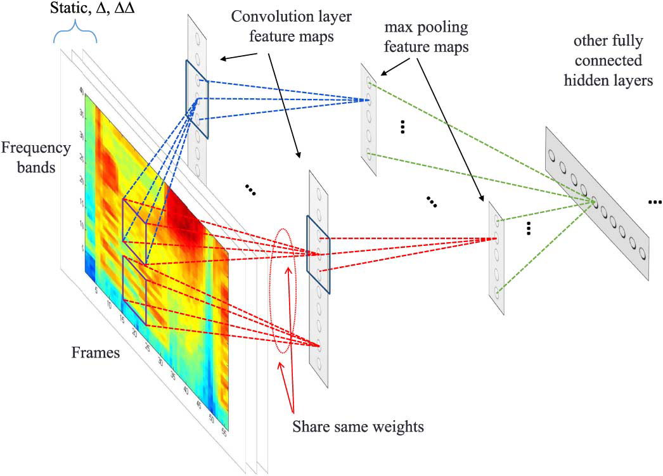
An Alternative Approach:
Deep Learning CNN for Speech Recognition
spectrogram

Slide 119
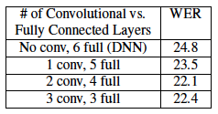
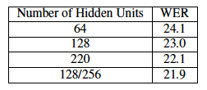
CNN Results
T. Sainath et al., Deep convolutional neural networks for LVCSR, Proc. ICASSP, 2013
Word Error Rate
Notes:
LVCSR = Large vocabulary speech recognition

Slide 120
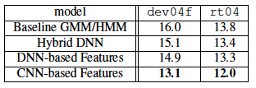
HMMs vs CNNs
Training set
Test set
WER (word error rate) on 400 hours of English broadcast news
DNN = feedforward NN with 5 hidden layers, each with 1024 units
CNN with 2 convolutional layers and 4 fully connected layers

Slide 121
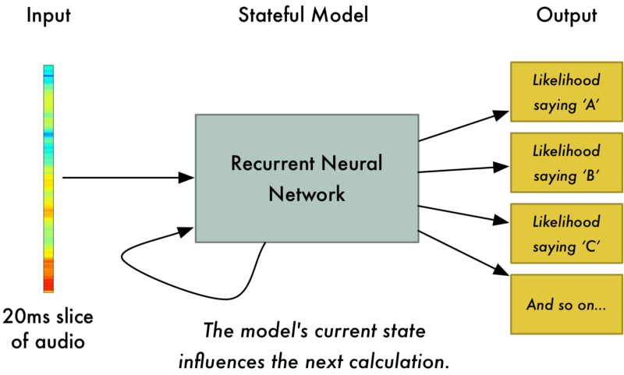
Deep Learning using a Recurrent Net

Slide 122
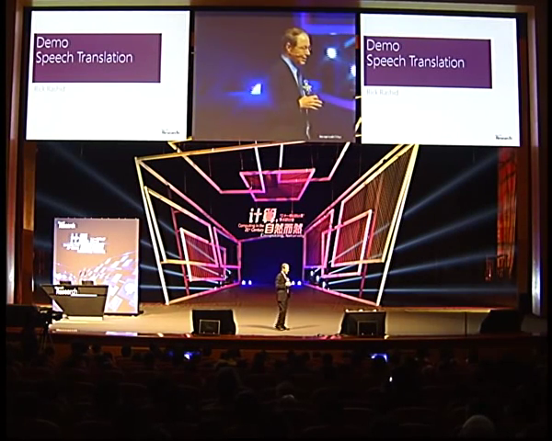
Microsoft on Deep Learning for Speech Recognition (now used in Skype)
Rick Rashid, Microsoft, 2012
Notes:
Presentation by Rick Rashid, Chief Research Officer, Microsoft Research, November 2012
Technology now used in Skype
Goto 3:00-5:10

Slide 123
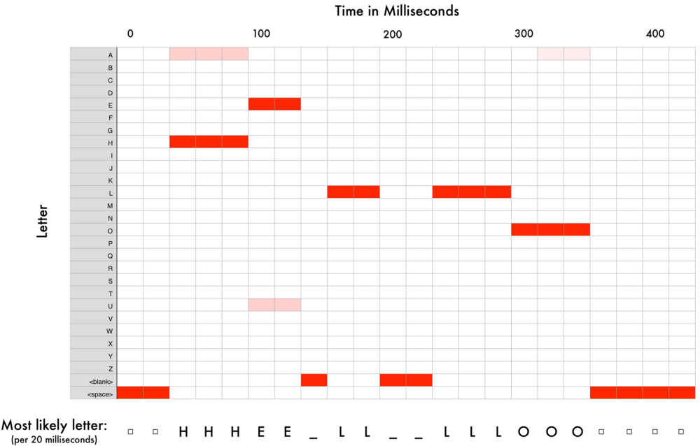

Slide 124
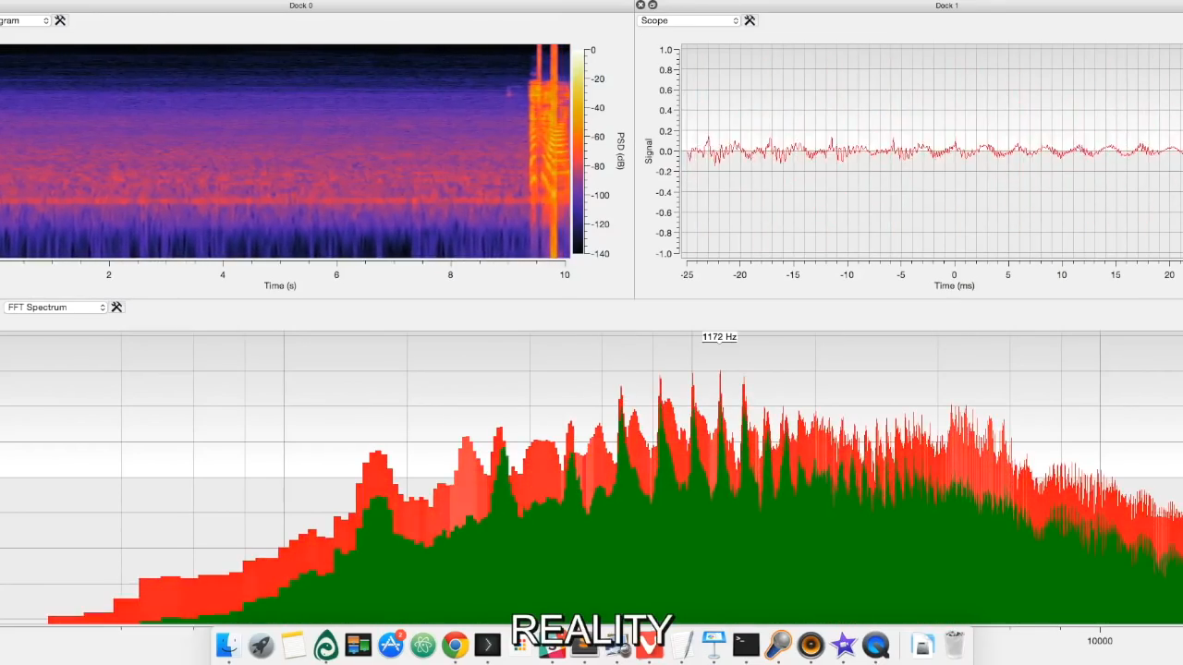
Speech Recognition using Deep Learning

Slide 125
Error Rates: Machine vs. Human*
Task
Machine
Human
Digits (10) | 0.72% | 0.009%
Letters (26) | 5.0% | 1.6%
Transactional speech (1,000) | 3.6% | 0.1%
Sentences read from WSJ (5,000) | 12.8 - 7.2% | 1.1 - 0.9%
Telephone speech (14,000) | 43.0% (19.3% in 2000) | 4.0%
* R. Lippmann, Speech Comm. 22(1), 1997

Slide 126
How Siri Works
Apple’s Siri Personal Assistant consists of:
  Speech recognition
    Limited vocabulary
  Grammar analysis
    Search for key phrases and use them to build a simple model of what user wants to do; integrated with other info on phone such as address book, nicknames, birthdays, GPS
  Web service providers
    Tools for mapping to external APIs for Yelp, Zagat, Wikipedia
Limited domains: restaurants, sports, movies, travel, weather, …

Slide 127
Siri Topics for Limited Domains
Ask for a reminder
Send a text message
Ask about the weather
Make a dinner reservation
Ask for information (e.g., from Wikipedia)
Set a meeting
Send e-mail
Get directions
Get a telephone number or make a call
Etc.

Slide 128
Limited Set of “Active Ontologies”
Restaurant/Dining Ontology includes restaurant databases and review services (e.g., Yelp and Zagat)
Dining-related vocabulary database
Model of actions that people usually perform when they decide on dining choices
Domain-specific dialog for interaction with user
Access to online reservation services, e.g., Open Table, and rules for making reservation through it, and entering result into user’s calendar

Slide 129
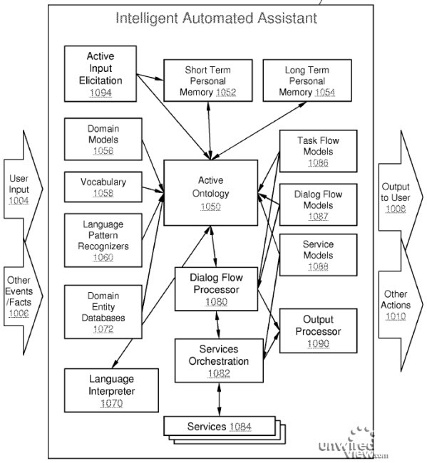
from patent application

Slide 130
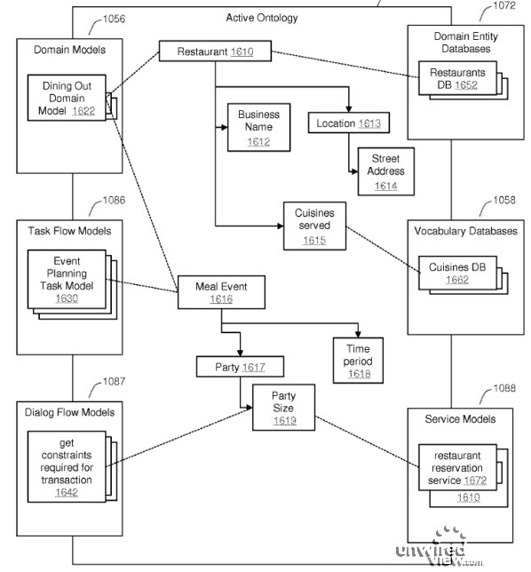
Restaurant Ontology

Slide 131
Other Applications of HMMs
Probabilistic robotics
  SLAM: Simultaneous Localization And Mapping
  Robot control learning
Tracking objects in video
Spam deobfuscation (mis-spelling words)
Bioinformatics
Consumer decision modeling
Economics & Finance
And many more …

Slide 132
Application: Tracking Objects in Video
Track the (hidden) state, X_{t}, of a system as it changes over time, t
Given: A sequence of noisy observations (i.e., features), Z_{t}
Goal: Compute best estimate of the hidden variables specifying the state, X_{t}, of the system at each time step, t. That is, compute
argmax P(X_{t} | Z_{t})
X_{t}
The Decoding Problem!

Slide 133
P(z_{k} | x_{k})
hidden
P(x_{k} | x_{k-1})
1st order Markov assumption: z_{k} is conditionally independent of z₁, ..., z_{k-1} given x_{k}

Slide 134
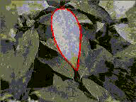
Application: Tracking Objects in Video

Slide 135
Stochastic Approach: Monte Carlo Samples (Particles)
P(X | Z) is often difficult or impossible to compute in closed form because of noise or complexity
An alternative is to approximate P(X | Z) using many discrete samples (aka “particles”):
  Each particle is a hidden state and a weight
  Next hidden state is particle with largest weight
weighted according to the likelihood of the particle
X
X
[ http://www.fulton.asu.edu/~morrell/581/ ]

Slide 136
Approximate Inference by Sampling
Inference can be done approximately by sampling
General sampling approach:
  Generate many, many samples (each sample is a hidden state, X)
  Count the fraction of samples matching the observed evidence, Z
  As the number of samples approaches ∞, the fraction converges to the posterior:
  P(X | Z)

Slide 137
Simple Sampling
Sample B: x=rand(0,1). If (x<0.001) B=true else B=false
Sample E: x=rand(0,1). If (x<0.002) E=true else E=false
If (B==true and E==true) sample A ~ {0.95, 0.05}
elseif (B==true and E==false) sample A ~ {0.94, 0.06}
elseif (B==false and E==false) sample A ~ {0.29, 0.71}
else sample A ~ {0.001, 0.999}
Similarly sample J
Similarly sample M
This generates
one sample.
Repeat to generate
more samples
P(B)=0.001
B
E
P(E)=0.002
P(A | B, E)=0.95
P(A | B, ~E)=0.94
P(A | ~B, E)=0.29
P(A | ~B, ~E)=0.001
A
J
M
P(J|A)=0.9
P(J|~A)=0.05
P(M|A)=0.7
P(M|~A)=0.01

Slide 138
Inference with Simple Sampling
Say we want to infer B, given E and M, i.e., P(B | E, M)
We generate tons of samples
Keep those samples with E=true and M=true, and throw away the others
For the ones we keep (n of them), count the ones with B=true, i.e., those that fit our query (n₁)
We return an estimate of
P(B | E, M) ≈ n₁ / n
The quality of this estimate improves
as we sample more and more
B
E
A
J
M

Slide 139
Particle Filters
Also known as:
Sequential Monte Carlo filter
Bootstrap filter
Condensation
Survival of the fittest
Sampling-based approach rather than trying to calculate the exact posterior
Represent belief by a set of random samples, which approximates the posterior distribution
Approximate solution to an exact model (rather than an optimal solution to an approximate model)

Slide 140
Monte Carlo Methods
A class of numerical methods involving statistical sampling processes for finding approximate solutions to quantitative problems
In 1864 O. Fox estimated π by dropping a needle onto a ruled board
S. Ulam used computers in 1940s to automate the statistical sampling process for developing nuclear weapons at Los Alamos
S. Ulam, J. von Neuman, and N. Metropolis developed algorithms to convert non-random problems into random forms so that statistical sampling can be used for their solution; they named them “Monte Carlo” methods after the casino

Slide 141
Tracking using Particle Filters:
CONDENSATION (Conditional Density Propagation)
M. Isard and A. Blake, CONDENSATION – Conditional density propagation for visual tracking, Int. J. Computer Vision 29(1), 1998, pp. 4-28

Slide 142
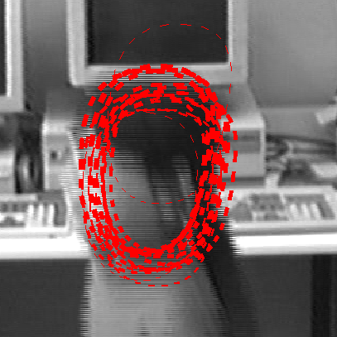
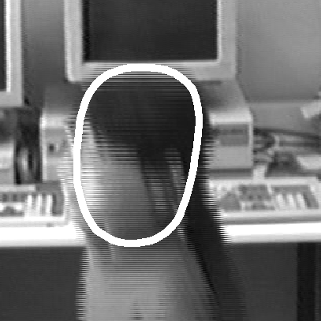
Tracking in Video using a Particle Filter Algorithm to Estimate Object’s State
From Isard & Blake, 1998
Mean of weighted
state samples
Hidden state samples

Slide 143
Bayes’s Rule
This is what you can predict
This is what you can
evaluate
This is what you want at each time step. Knowing P(X|Z) will tell us the most likely state X
This is a constant for a given image

Slide 144
Algorithm
Select: Randomly select N particles from {s_{t-1}^{(n)}} based on weights π_{t-1}^{(n)}; same particle may be picked multiple times (factored sampling)
Predict: Move particles (i.e., update states) according to a deterministic motion model (drift), then perturb them individually (diffuse)
Measure: Get a likelihood for each new sample by comparing it with the image’s local appearance, i.e., based on P(z_{t} | x_{t}); then update weight accordingly to obtain {(s_{t}^{(n)}, π_{t}^{(n)})}

Slide 145
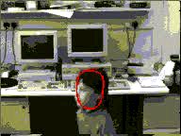
Dancing Example

Slide 146
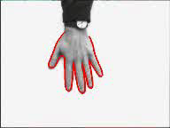

Hand Example

Slide 147

Pointing Hand Example

Slide 148
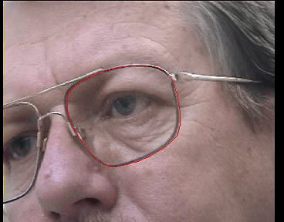
Glasses Example
6D state space of affine transformations of a spline curve
Edge detector applied along normals to the spline
Autoregressive motion model

Slide 149
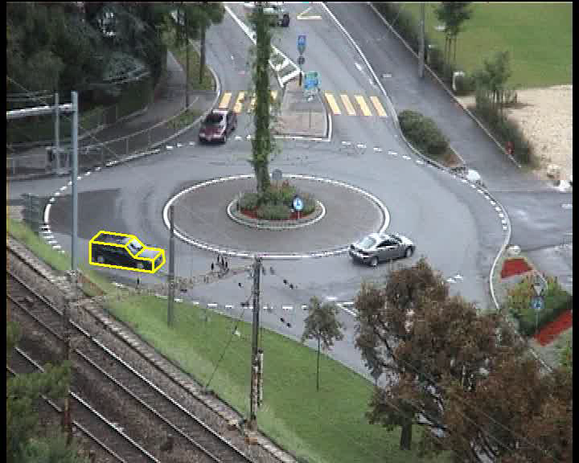
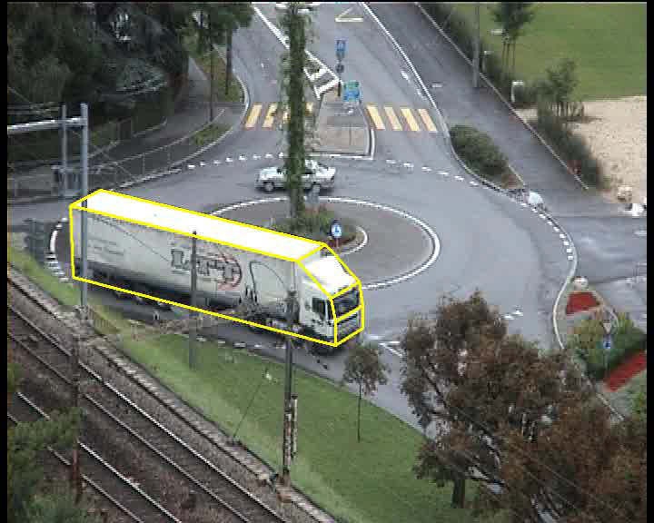
3D Model-based Example
3D state space: image position + angle
Polyhedral model of object

Slide 150
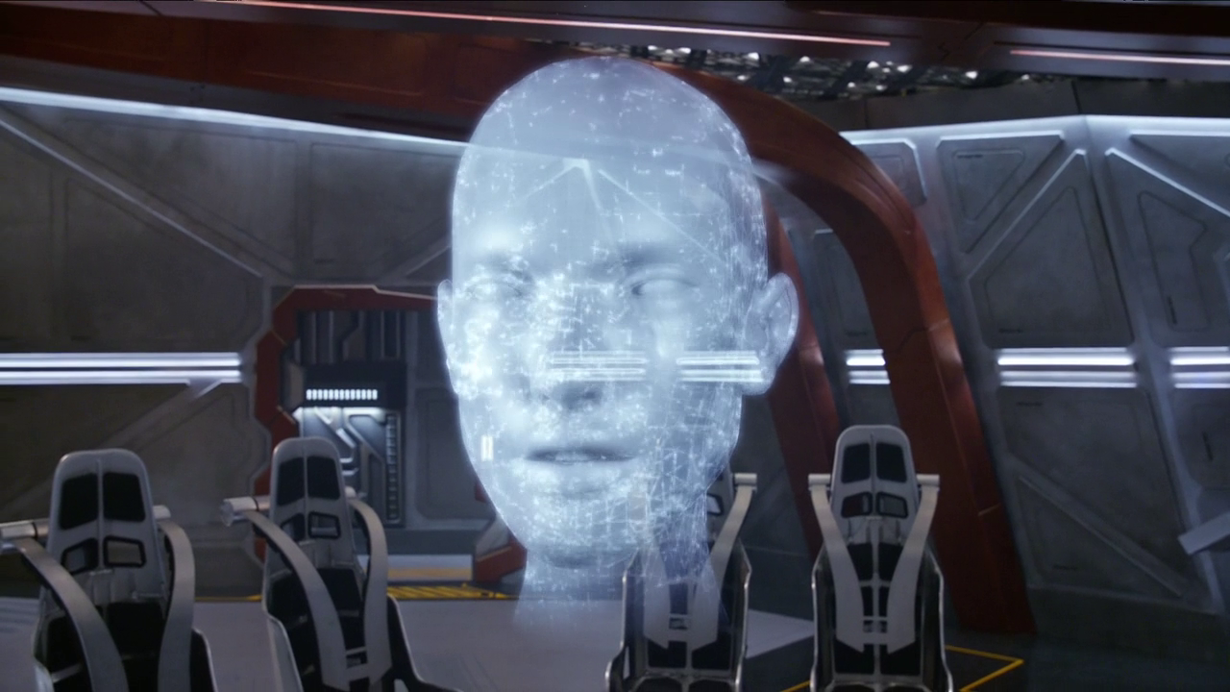
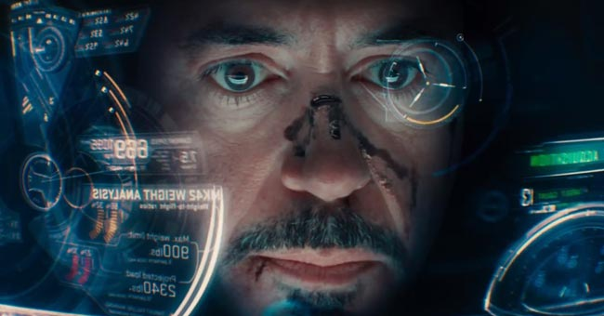

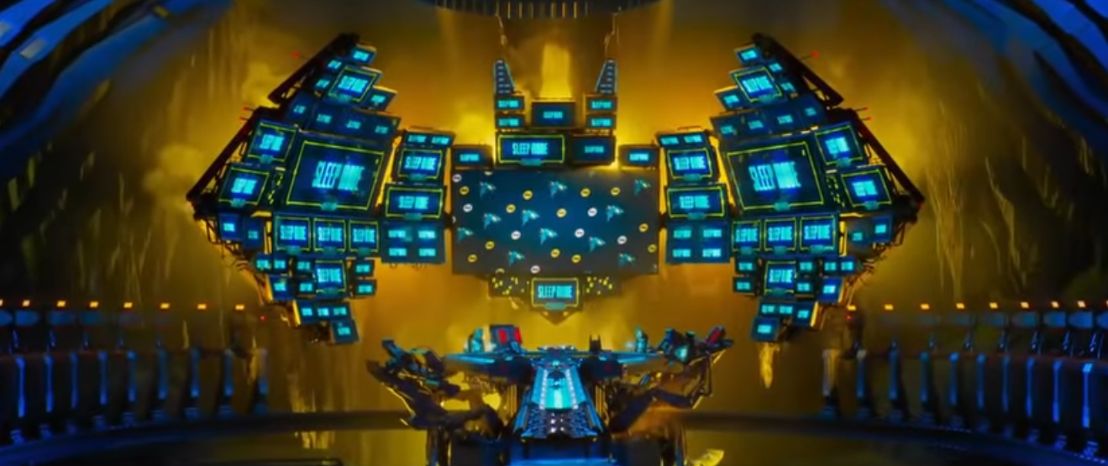
QUIZ: Name these AIs
Gideon (Legends of Tomorrow)
Jarvis (Iron Man)
Aida (Agents of S.H.I.E.L.D)
‘Puter (Lego Batman)
Notes:
Gideon (from Legends of Tomorrow - although this character started on the Flash show first), Jarvis (from Iron Man), Aida (from Agents of S.H.I.E.L.D), 'Puter (from the Lego Batman movie)

Slide 151
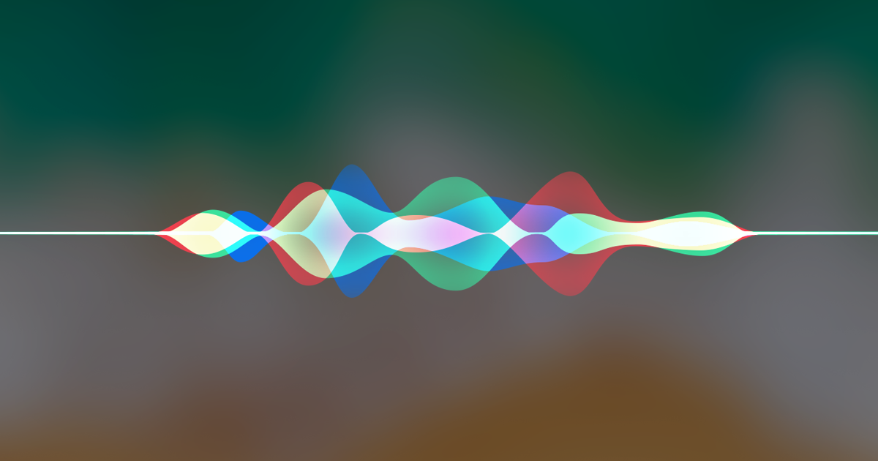
Extra Credit QUIZ
Who is credited with providing the voice of 'Puter, the talking computer, in the Lego Batman movie?
Siri

Slide 152
QUIZ: In What Movie Did a Robot Say
"I can't do that Dave”
HAL 9000 in 2001: A Space Odyssey (1968)
“Beep bop boop beep beep beep”
R2-D2 in Star Wars (1977)
“I need your clothes, your boots and your motorcycle”
The Terminator in Terminator 2 (1991)
“Klaatu borada nikto”
  said to Gort in The Day the Earth Stood Still (1951)

Slide 153
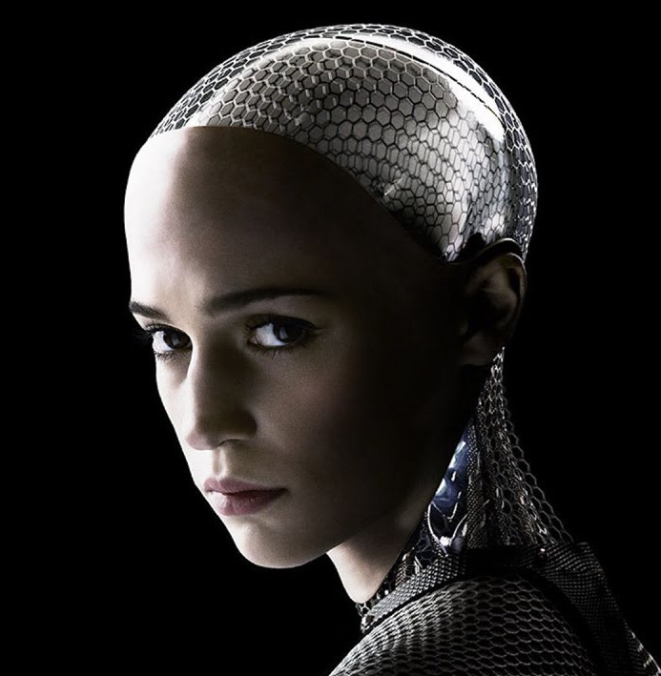
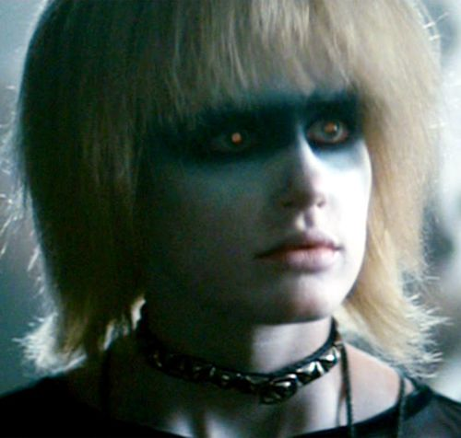


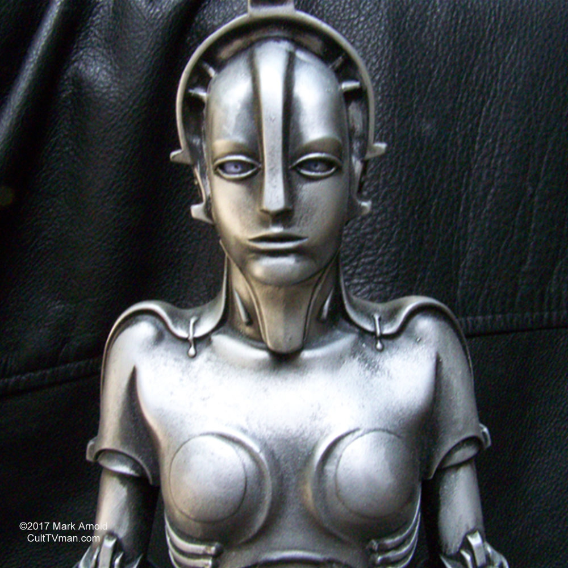
QUIZ: Name these Female Robots (aka Gynoids)
Ex Machina
Blade Runner
Her
Ava
Pris
Samantha
Metropolis
Agents of S.H.I.E.L.D
Jetsons
Aida
Rosie
Maria
Notes:
Maria in Metropolis (1927) is considered the first robot depicted in cinema

Slide 154
QUIZ: In What Movie Did a Robot Say
"I can't do that Dave”
HAL 9000 in 2001: A Space Odyssey (1968)
“Beep bop boop beep beep beep”
R2-D2 in Star Wars (1977)
“I need your clothes, your boots and your motorcycle”
The Terminator in Terminator 2 (1991)
“Klaatu borada nikto”
  said to Gort in The Day the Earth Stood Still (1951)

