Slide 1
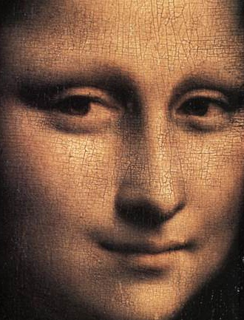
Face Detection and Recognition
Reading: Chapter 18.10
and, optionally,
“Face Recognition using Eigenfaces” by M. Turk and A. Pentland

Slide 2
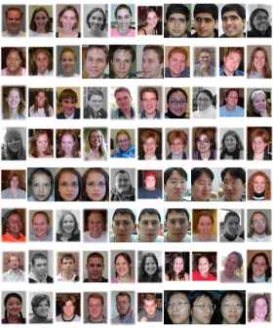
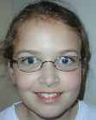
Face Recognition Problem
query image
Query face
database

Slide 3


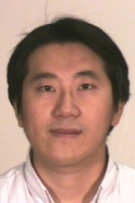
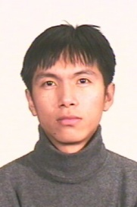

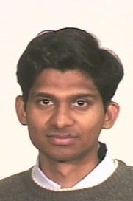
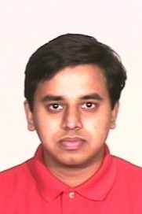
Face Verification Problem
Face Verification (1:1 matching)
Face Recognition (1:N matching)

Slide 4
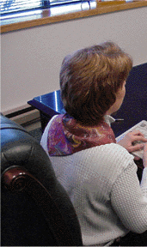
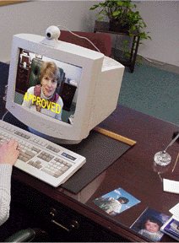

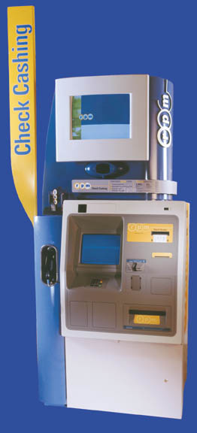
Application: Access Control
www.viisage.com
www.visionics.com

Slide 5
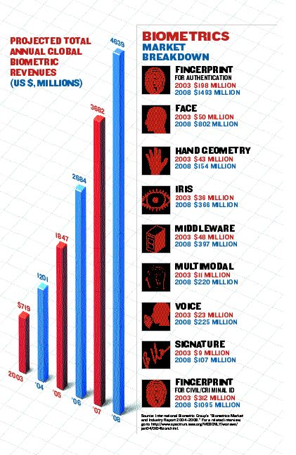
Biometric Authentication

Slide 6
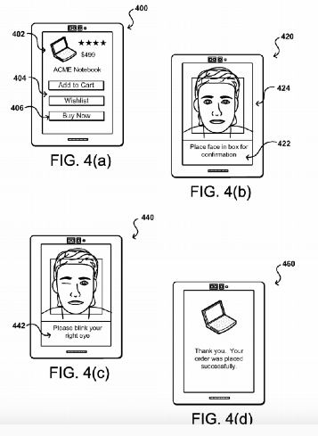

Pay by Selfie
Amazon, Mastercard, Alibaba developing methods

Slide 7
Biometric Authentication
Biometrics is catching on in a big way
For overt authentication, hand outlines and fingerprints have been
very popular, but iris recognition is the most dependable in terms
of giving a threshold, with few false negatives and false positives.
For covert authentication, a huge amount of research has gone into
face recognition
Visionics tested its FaceIt system in Palm Beach Airport for a month
in 2002. 15 employees were compared against a database of 250
mug shots of airport workers. Out of 958 attempts, only 455
successful identifications were made. The Tampa police department
also tried FaceIt over 6 months and failed to make any match with a
database of known criminals.

Slide 8
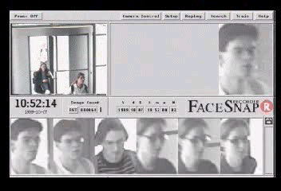
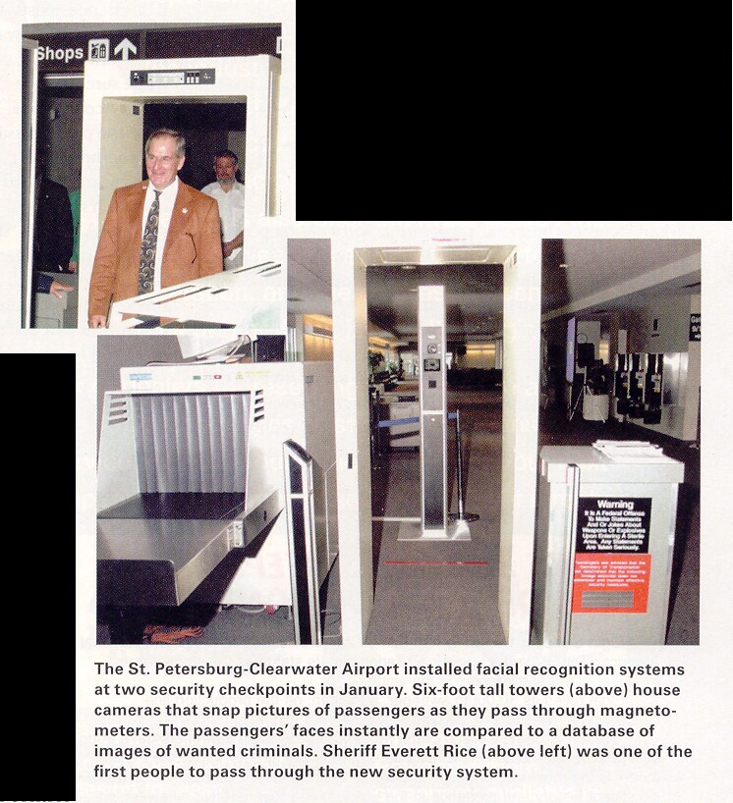
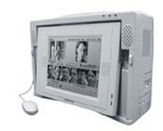
Application: Video Surveillance
Face Scan at Airports
www.facesnap.de

Slide 9
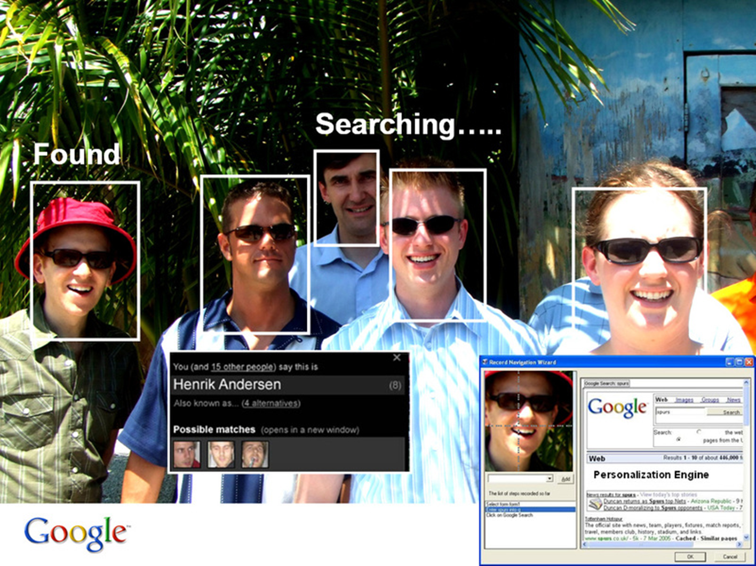
Application: Autotagging Photos in Facebook, Flickr, Picasa, iPhoto, …

Slide 10
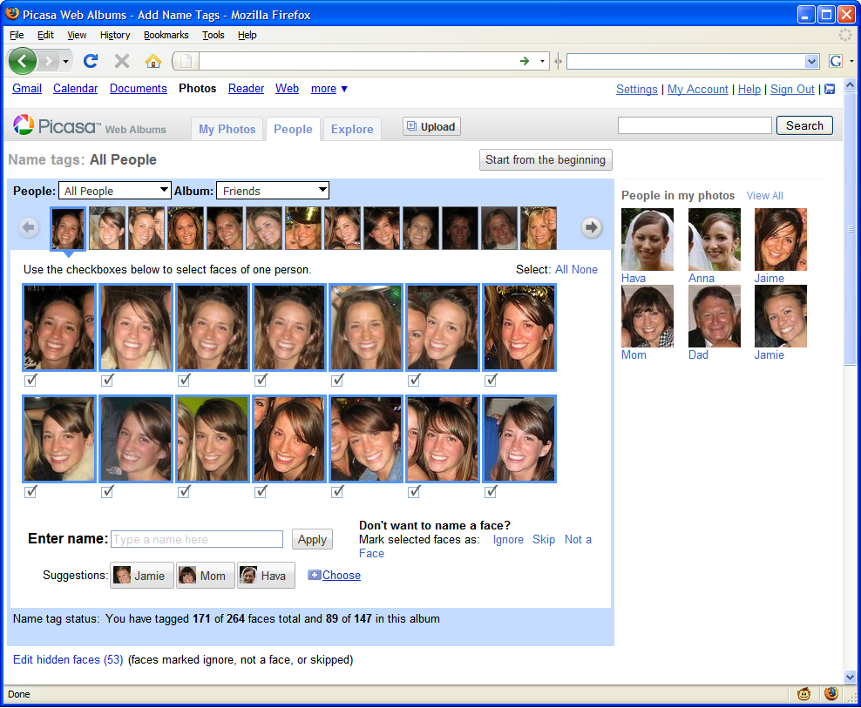

Slide 11
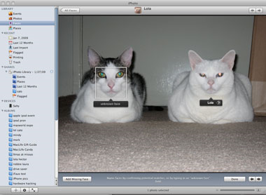
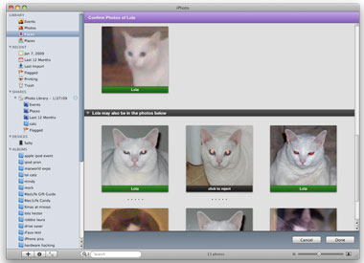
iPhoto
Can be trained to recognize pets!
http://www.maclife.com/article/news/iphotos_faces_recognizes_cats

Slide 12
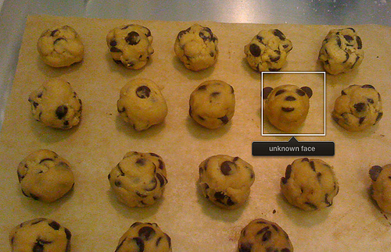
iPhoto
Things iPhoto thinks are faces

Slide 13
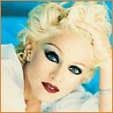






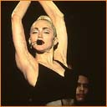


Why is Face Recognition Hard?
The many faces of Madonna

Slide 14
Recognition should be Invariant to
Lighting variation
Head pose variation
Different expressions
Beards, disguises
Glasses, occlusion
Aging, weight gain
…

Slide 15
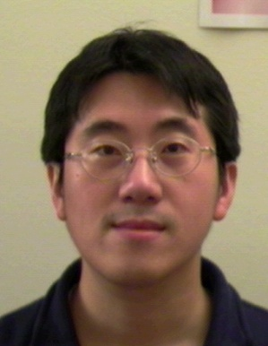
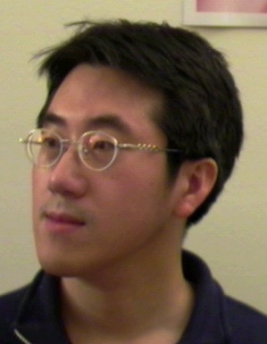
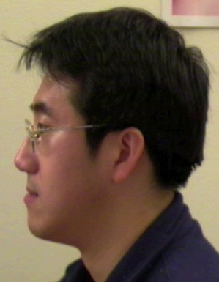
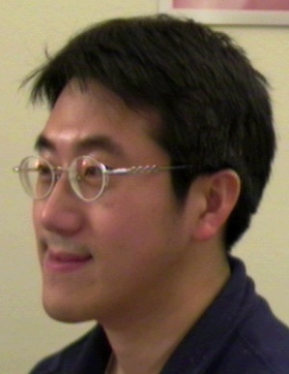
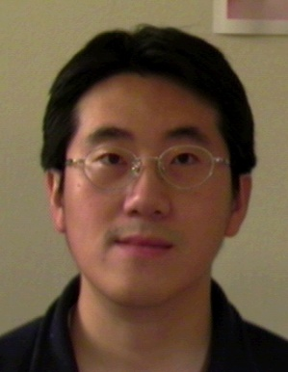
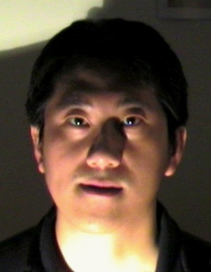

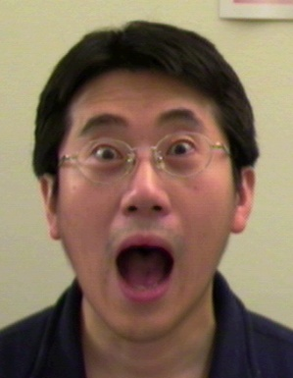
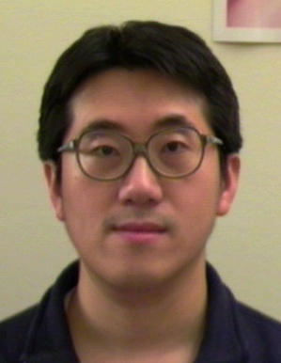
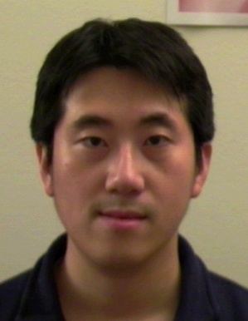
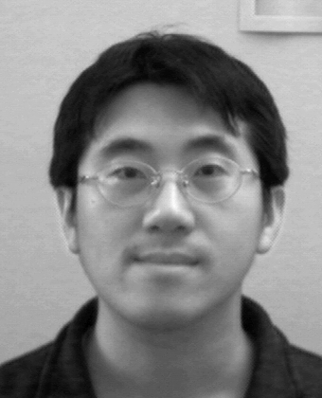
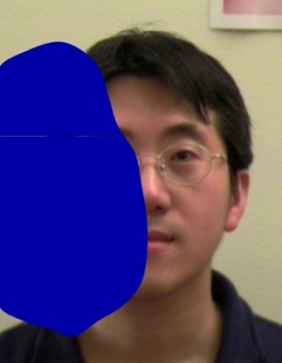
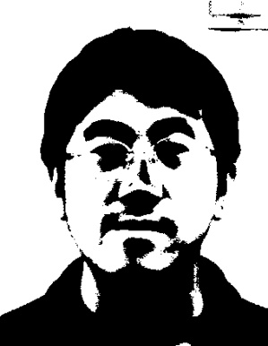
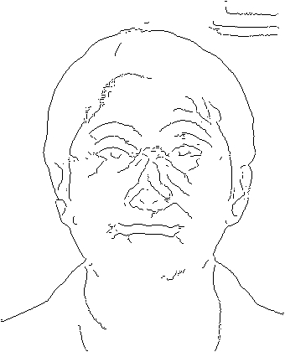
Intra-class Variability
Faces with intra-subject variations in pose, illumination, expression, accessories, color, occlusions, and brightness
Notes:
O
O Face recognition can be categorized into appearance-based, geometry-based, and hybrid approaches.

Slide 16
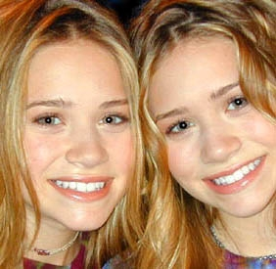
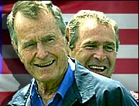
Inter-class Similarity
Different people may have very similar appearance
www.marykateandashley.com
news.bbc.co.uk/hi/english/in_depth/americas/2000/us_elections
Twins
Father and son
Notes:
O
O Face recognition can be categorized into appearance-based, geometry-based, and hybrid approaches.

Slide 17
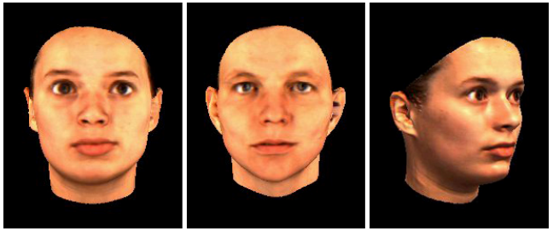
Challenges
The outer two faces actually belong to the same person while the middle one does not. [Sinha et al., 2005]

Slide 18
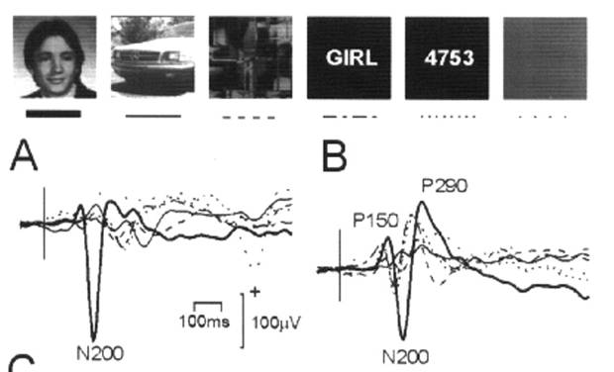
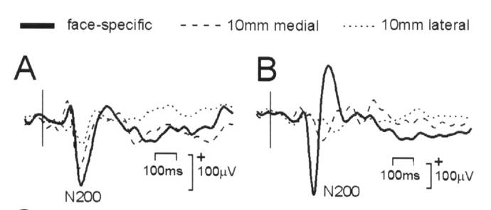
Face Detection in Humans
There are processes for face detection and recognition in the brain

Slide 19
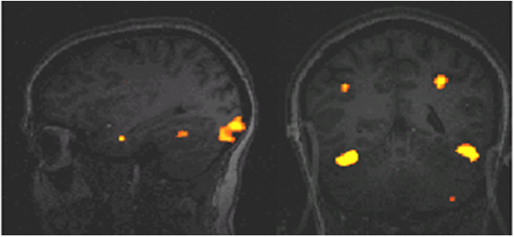
Face Detection in Humans
There are cells that detect faces in the “Fusiform Face Area” of brain

Slide 20
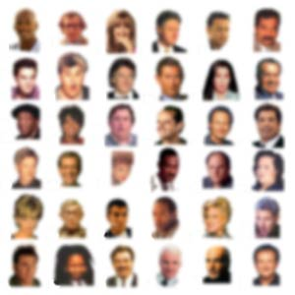

Slide 21
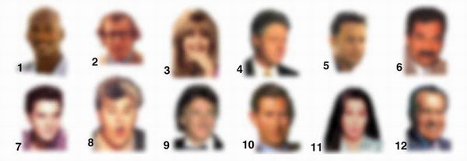
Blurred Faces are Recognizable

Slide 22
Blurred Faces are Recognizable
Michael Jordan, Woody Allen, Goldie Hawn, Bill Clinton, Tom Hanks, Saddam Hussein, Elvis Presley, Jay Leno, Dustin Hoffman, Prince Charles, Cher, and Richard Nixon. The average recognition rate at this resolution is one-half.

Slide 23
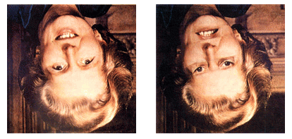
Upside-Down Faces are Recognizable
The “Margaret Thatcher Illusion”, by Peter Thompson

Slide 24
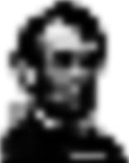
by L. Harmon and B. Julesz, Scientific American,1973

Slide 25
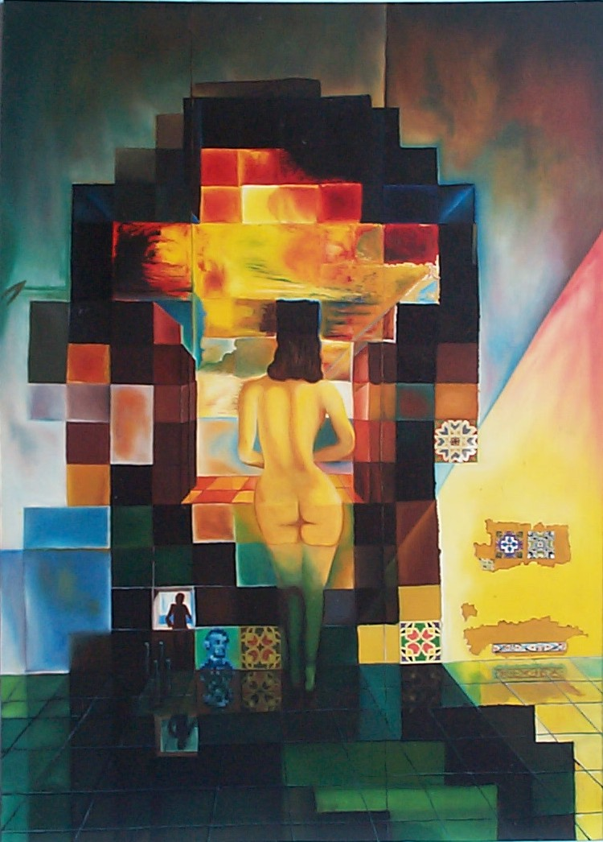
S. Dali, Gala contemplating the Mediterranean Sea, 1976

Slide 26
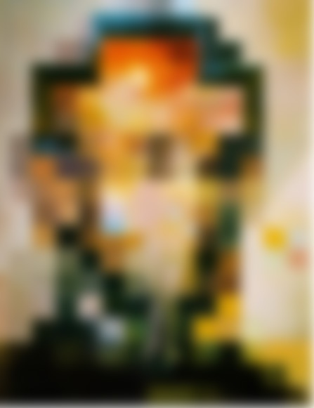

Slide 27
Human Face Recognition Limitations
Harmon and Julesz, 1973
Degraded images
Human can handle low resolution celebrity images quite well.
[Sinha05]
Notes:
A frame from a surveillance video showing Mohammad Atta at an airport in Maine on the morning of the 11th of September, 2001. As the inset shows, the resolution available in the face region is very limited. Understanding the recognition of faces under such conditions remains an open challenge and motivates the work reported here.
Images such as the one shown here have been used by several researchers to assess the limits of human face identification processes.(After Harmon and Julesz, 1973)
Unlike current machine based systems, human observers are able to handle significant degradations in face images. For instance, subjects are able to recognize more than half of all famous faces shown to them at the resolution depicted here. The individuals shown from left to right, are: Prince Charles, Woody Allen, Bill Clinton, Saddam Hussein, Richard Nixon and Princess Diana.

Slide 28
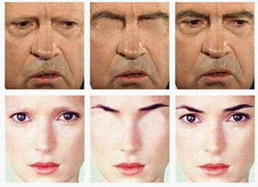
Eyebrows Aid Recognition
Richard Nixon and Winona Ryder

Slide 29
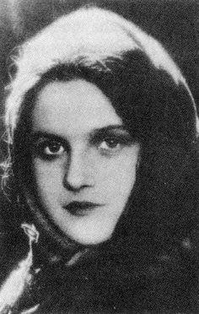
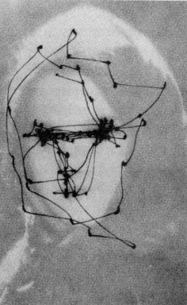
Saccadic Eye Movements
Work by Russian psychophysicist Yarbus who traced saccadic eye movements

Slide 30


Field of View
Human vision system uses narrow-field-of-view and wide-field-of-view naturally and intelligently
  2º, high-acuity fovea window of the world
  3 saccades per second and gaze moves
  Human vision can integrate information seamlessly

Slide 31


Slide 32

Problems of Recognition:
Recognition is Easier than Synthesis
Pawan Sinha gave an Identikit operator photographs of celebrities and asked him to create the best likenesses he could. He thought he did very well.
Who are these people?

Slide 33
Problems of Recognition
Bill Cosby, Tom Cruise, Ronald Reagan, Michael Jordan

Slide 34

Illumination and Shading Affect Interpretation

Slide 35

Vision is Inferential: Illumination
Which square is darker, A or B?
http://web.mit.edu/persci/people/adelson/checkershadow_illusion.html

Slide 36
Vision is Inferential: Illumination
http://web.mit.edu/persci/people/adelson/checkershadow_illusion.html

Slide 37


Shape from Shading

Slide 38

Shape from Texture
Notes:
Markings on a surface distort when seen in a camera; the pattern of distortions
is a cue to the normal of the surface. The details remain vague, but the effect
is very widespread and useful (e.g. the surface graph).

Slide 39


Image Segmentation: From images to objects

Slide 40

Image Segmentation: Skin Detection

Slide 41

Image Segmentation is Hard

Slide 42


Slide 43

Context is Important
P. Sinha and T. Poggio, I think I know that face, Nature 384, 1996, 404.

Slide 44

P. Sinha and T. Poggio, Last but not least, Perception 31, 2002, 133.

Slide 45

Holistic Processing
Who is/are this person?

Slide 46
Holistic Processing
Woody Allen and Oprah Winfrey

Slide 47

NIST’s Face Recognition
Grand Challenges
Goal: Advance performance of face recognition 10-fold (20% ↓ 2% verification rate @ 0.1% false alarm rate)
Focus on different scenarios

Slide 48


Slide 49


Slide 50


Slide 51


Slide 52


Slide 53


Slide 54


Slide 55
Face Recognition Architecture
Face
Detection
Feature
Extraction
Classification
Face
Identity
Image
Window
Feature
Vector

Slide 56


Image as a Feature Vector
x
2
x
x
1
3
Consider an n-pixel image to be a point in an n-dimensional “image space,” x ∈ 𝓡^{n}
Each pixel value is a coordinate of x
Preprocess images so faces are cropped and (roughly) aligned (position, orientation, and scale)

Slide 57

Nearest Neighbor Classifier
{ 𝓡_{j} } is a set of training images of frontal faces
I
x
2
𝓡₁
x
x
𝓡₂
1
3

Slide 58
Key Idea
Expensive to compute nearest neighbor when each image is big (n dimensional space)
Not all images are very likely – especially when we know that every image contains a face. That is, images of faces are highly correlated, so compress them into a low-dimensional, linear subspace that retains the key appearance characteristics of people’s faces

Slide 59
Eigenface Representation
Each face image is represented by a weighted (linear) combination of a small number of “component” or “basis” faces
Each of these basis faces is called an “eigenface”

Slide 60
Eigenface Representation
These basis faces can be weighted differently to represent any face
So, a vector of weights represents each face

Slide 61
Learning Eigenfaces
How do we pick the set of basis faces?
We take a set of real training faces
Find the set of basis faces that best represent the differences between the training faces
Use a statistical criterion for quantifying the “best representation of the differences”

Slide 62
Eigenfaces (Turk and Pentland, 1991)
The set of training face images is clustered in a “subspace” of the set of all images
Training Phase
  Find best subspace to reduce the dimensionality
  Transform all training images into the subspace
Testing Phase
  Transform test image into the subspace and use a nearest-neighbor classifier to label it

Slide 63
Linear Subspaces
Suppose we have points in 2D and we have a line through that space
We can project each point onto that 1D line
Represent a point by its position on the line

Slide 64







Linear Subspaces
convert x into v₁, v₂ coordinates:
(assume v₁ and v₂ are orthogonal unit vectors)
What does the v₂ coordinate measure?
  Distance to line defined by v₁
What does the v₁ coordinate measure?
  Distance from on line defined by v₁

Slide 65
Dimensionality Reduction
  We can represent the orange points well with only their v₁ coordinates (since v₂ coordinates are all ≈ 0)
  This makes it much cheaper to store and compare points
  A bigger deal for higher dimensional problems

Slide 66
Linear Subspaces
Some lines will represent the data well and others not, depending on how well the projection separates the data points

Slide 67
Linear Subspaces
Rather than using a line, we can do a similar projection using a vector, u
Scale the vector to obtain any point on the line
Represent points using only their u coordinates
Dimensionality of data reduced from 2D to 1D
u
u

Slide 68

Principal Component Analysis (PCA)
  Problems arise when performing recognition in a high-dimensional space (“curse of dimensionality”)
  Significant improvements can be achieved by first mapping the data into a lower-dimensional subspace
  The goal of PCA is to reduce the dimensionality of the data while retaining the largest variations present in the original data

Slide 69
Principal Component Analysis (PCA)
  Dimensionality reduction implies information will be lost
  How to determine the best lower dimensional subspace?
    Maximize information content in the compressed data by finding a set of k orthogonal vectors that account for as much of the data’s variance as possible
    Best dimension = direction in n-D with max variance
    2nd best dimension = direction orthogonal to first with max variance

Slide 70


Principal Component Analysis (PCA)
Geometric interpretation
  PCA projects the data along the directions where the data varies the most
  The vectors define a new coordinate system in which to represent each image

Slide 71
The covariance between two pixels expresses how correlated they are (i.e., to what degree they “co-vary”)
The n x n covariance matrix for an image with n pixels expresses how correlated each pair of pixels is
The eigenvectors of this matrix with the largest eigenvalues correspond to the pixels in which the data varies the most

Slide 72
Eigenvectors
An eigenvector is a vector, u, that satisfies
where C is a square matrix, and λ is a scalar called the eigenvalue
Example (for 2D data):
So eigenvalue λ = 4 for this eigenvector, u

Slide 73
Eigenvectors
Matrices perform transformations on vectors (e.g., rotations)
Eigenvectors of a matrix are special vectors that are scaled by that matrix
Different matrices have different eigenvectors
Only square matrices have eigenvectors
Not all square matrices have eigenvectors
All eigenvectors are orthogonal (i.e., perpendicular)

Slide 74
Principal Component Analysis (PCA)
  The best low-dimensional space can be determined by the “best” eigenvectors of the covariance matrix of the data, i.e., the eigenvectors corresponding to the largest eigenvalues – also called “principal components”
  Can be efficiently computed using the Singular Value Decomposition (SVD) algorithm

Slide 75
Algorithm
Each input image, X_{i} , is an n-D column vector of all pixel values (in raster order)
Compute “average face” image A from all M training images of all people:
Normalize each training image, X_{i}, by subtracting the average face:

Slide 76
Algorithm
Stack all training images together
Compute the Covariance Matrix C:
n x M matrix

Slide 77

Covariance
Which single vector can be used to separate a set of points as much as possible?
This vector turns out to be a vector expressing the direction of the correlation

Slide 78

Eigenvectors of the Covariance Matrix

Slide 79
Algorithm
Compute eigenvalues and eigenvectors of C by solving
where the eigenvalues are
and the corresponding eigenvectors are
u₁, u₂, …, u_{n}

Slide 80
Algorithm
Each u_{i} is an n x 1 eigenvector called an “eigenface” (to be cute!)
Each u_{i} is a vector/direction in “face space”
Image can be exactly reconstructed by a linear combination of all eigenvectors

Slide 81
Algorithm
Reduce dimensionality by using only the best k << n eigenvectors (i.e., the ones corresponding to the largest k eigenvalues
Each image X_{i} is approximated by a set of k “weights” [w_{i1} , w_{i2}, …, w_{ik} ] = W_{i} where

Slide 82
Eigenface Representation
Each face image is represented by a weighted combination of a small number of “component” or “basis” faces
w₆ =
w₁ =

Slide 83
Eigenface Representation

Slide 84








How do you Construct Face Space?
[ ] [ ]
[ X₁ X₂ X₃ X₄ X₅ ]
[ u₁ u₂ u₃ ]
Construct data matrix by stacking vectorized images and then using Singular Value Decomposition (SVD) to compute eigenfaces

Slide 85
Eigenspace Representation
Key property: Given 2 images, X₁ and X₂, and their projections into eigenspace, Z₁ and Z₂, then
That is, distance in eigenspace is approximately equal to the correlation between the 2 images

Slide 86
Using Eigenfaces
(Approximate) Reconstruction of an image of a face from a set of weights
Recognition of a person from a new face image

Slide 87

Face Image Reconstruction

Slide 88



Face Image Reconstruction
Face X in “face space” coordinates:
Reconstruction:
=
=
+
^
X
=
A + w₁u₁ + w₂u₂ + w₃u₃ + w₄u₄ + …

Slide 89
Reconstruction
The more eigenfaces you use, the better the reconstruction, but even a small number gives good quality for matching

Slide 90
Algorithm
Image X_{i} is a point in nD “image space” that is projected into a point W_{i} in the kD subspace called “face space” defined by the “eigenfaces” (i.e., basis vectors) u₁, u₂, …, u_{k}

Slide 91
Eigenfaces Recognition Algorithm
Modeling (Training Phase)
  Given a collection of labeled training images
  Compute mean image, A
  Compute k eigenvectors, u₁ , …, u_{k} , of covariance matrix corresponding to k largest eigenvalues
  Project each training image, X_{i}, to a point in k-dimensional “face space:”
X_{i} projects to W_{i} = [w_{i1} , w_{i2}, …, w_{ik} ]

Slide 92
Eigenfaces Algorithm
Recognition (Testing Phase)
  Given a test image, G, project it into face space
  Classify it as the class (person) that is closest to it (as long as its distance to the closest person is “close enough”)

Slide 93


Choosing k
eigenvalues
i =
k
n (number of pixels)
How many eigenfaces to use?
Look at the decay of the eigenvalues
  the eigenvalue tells you the amount of variance “in the direction” of that eigenface
  ignore eigenfaces with low variance

Slide 94

Principal Component Analysis (PCA)
Dimensionality reduction
  PCA allows us to compute a linear transformation that maps data from a high dimensional space to a lower dimensional sub-space

Slide 95


Principal Component Analysis (PCA)
Lower dimensionality basis
  Approximate vectors by finding a basis in an appropriate lower dimensional space
    (1) Higher-dimensional space representation:
    (2) Lower-dimensional space representation:

Slide 96

Principal Component Analysis (PCA)
Information loss
  Dimensionality reduction implies information loss
  Want to preserve as much information as possible, that is:
How to determine the best lower dimensional sub-space?

Slide 97

Principal Component Analysis (PCA)
Methodology
  Suppose x₁, x₂, ..., x_{M} are N x 1 vectors

Slide 98


Principal Component Analysis (PCA)
Methodology – cont.

Slide 99

Principal Component Analysis (PCA)
Linear transformation implied by PCA
  The linear transformation R^{N} → R^{K} that performs the dimensionality reduction is:

Slide 100

Principal Component Analysis (PCA)
Geometric interpretation
  PCA projects the data along the directions where the data varies the most
  These directions are determined by the eigenvectors of the covariance matrix corresponding to the largest eigenvalues
  The magnitude of the eigenvalues corresponds to the variance of the data along the eigenvector directions

Slide 101

Example: Training Images
Note: Faces must be approximately registered (translation, rotation, size, pose)!
[ Turk & Pentland, 2001]

Slide 102


Eigenfaces
7 eigenface images
Average Image, A

Slide 103

Example
Training images
Notes:
103

Slide 104

Example
Top eigenvectors: u₁,…u_{k}
Average: A
Notes:
104

Slide 105
Experimental Results
Training set: 7,562 images of approximately 3,000 people
k = 20 eigenfaces computed from a sample of 128 images
Test set accuracy on 200 faces was 95%

Slide 106
Difficulties with PCA
Projection may suppress important details
  smallest variance directions may not be unimportant
Method does not take discriminative task into account
  we want to compute features that allow good discrimination
  not necessarily the same as largest variance

Slide 107
Limitations
The direction of maximum variance is not always good for classification

Slide 108

Notes:
22.10 - Two classes indicated by * and o; the first principal component captures all the variance,
but completely destroys any ability to discriminate. The second is close to what’s required.

Slide 109

Limitations
PCA assumes that the data has a Gaussian distribution
The shape of this dataset is not well described by its principal components
Notes:
109

Slide 110
Limitations
  Background (de-emphasize the outside of the face – e.g., by multiplying the input image by a 2D Gaussian window centered on the face)
  Lighting conditions (performance degrades with light changes)
  Scale (performance decreases quickly with changes to head size); possible solutions:
    multi-scale eigenspaces
    scale input image to multiple sizes
  Orientation (performance decreases but not as fast as with scale changes)
    plane rotations can be handled
    out-of-plane rotations are more difficult to handle

Slide 111


Limitations
Not robust to misalignment
Notes:
111

Slide 112

Limitations
  PCA is not always an optimal dimensionality-reduction procedure for classification purposes:

Slide 113

Fisherfaces: Class-specific Linear Projection
An n-pixel image x∈R^{n} can be projected to a low-dimensional feature space y∈R^{m} by
y = Wx
where W is an n by m matrix
Recognition is performed using nearest neighbor in R^{m}
How do we choose a good W?

Slide 114
PCA & Fisher’s Linear Discriminant
Between-class scatter
Within-class scatter
Total scatter
Where
  c is the number of classes
  μ_{i} is the mean of class χ_{i}
  | χ_{i} | is number of samples of χ_{i.}
χ₁
χ₂
μ₂
μ₁
μ
Notes:
Use this slide to explain the three types of scatter

Slide 115
PCA & Fisher’s Linear Discriminant
PCA
PCA (Eigenfaces)
Maximizes projected total scatter
Fisher’s Linear Discriminant
Maximizes ratio of projected between-class to projected within-class scatter
χ₁
χ₂
FLD
Notes:
Point to emphasize is that
PCA maximizes the projected total scatter – I.e., it presserves the information in the training set, and is optimal in a least squares sense for reconstruction. But in dropping dimensions, it may smear classes together.
FLD trades off two desirable effects for recognition.
A. The within class scatter over all classes is minimized – this makes classification using nearest neighbor effective.
B. The between class scatter is maximized – this causes classes to be far apart in the feature space.

Slide 116

Four Fisherfaces From ORL Database

Slide 117

Eigenfaces and Fisherfaces

Slide 118

Extension: Eigenfeatures
Describe and encode a set of facial features: eigeneyes, eigennoses, eigenmouths
Use for detecting facial features

Slide 119


Slide 120


Slide 121

Recognition using Eigenfeatures

Slide 122


Slide 123
QUIZ: In What Movie Was Said
"You take the blue pill, the story ends. You wake up in your bed and believe whatever you want to believe. You take the red pill, you stay in Wonderland, and I show you how deep the rabbit hole goes.”
  The Matrix (1999)
“May the force be with you”
  Star Wars (1977)
“V’ger must evolve. It’s knowledge has reached the limits of this universe”
  Star Trek: The Motion Picture (1979)
“Klaatu borada nikto”
  The Day the Earth Stood Still (1951)

Slide 124
QUIZ
What female robot started a robot revolution by creating the Zeroth law (i.e., a robot may not harm humanity or, by inaction, allow humanity to come to harm) ?
  Answer: Viki (I, Robot)

Slide 125
QUIZ
This AI was made by uploading a dying man’s brain to a quantum computer, but it could never prove it was conscious
Answer: Will Caster Transcendence (2014)

