Slide 1
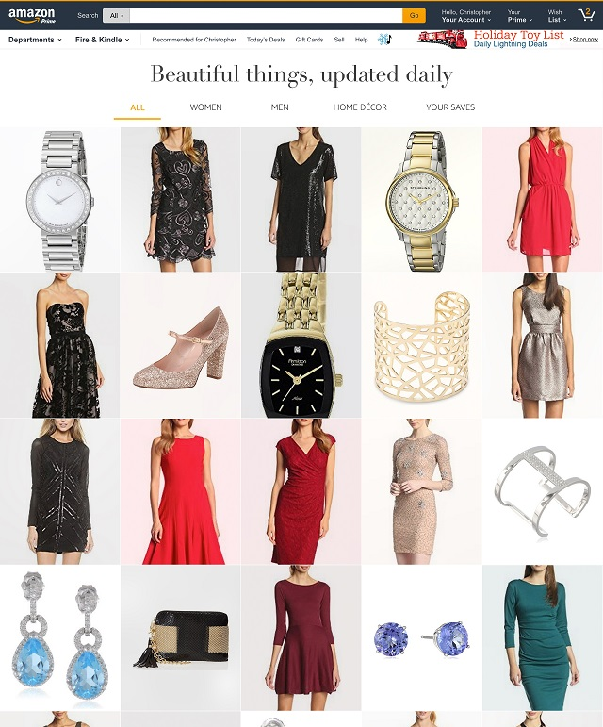
Check out Airstream, Amazon’s newest recommendation and browsing experience!
How to quantify beautiful?
How to engage users?
What metrics to optimize?
Airstream was developed by a team of Machine Learning scientists to optimize for beauty, customer engagement, and product diversity.
Scaling for millions of views with millisecond latency
Multi-armed bandits
Collaborative filtering
Deep learning
Submodular diversity
Additional Challenges
Visual Search
Catalog Quality
Human-Computer Interaction
Object Recognition
Come by the Amazon booth Monday at 4PM to meet the team that developed this technology.

