Slide 1
Industrial Data Science Content Recommendation Examples
Houssam Nassif
houssamn@amazon.com

Slide 2
Background
Me in one word: Curious
Career path: A biologist turned Artificial Intelligence scientist
Biomedical research hospital, Department of Natural Resources, Cisco, Google
Currently Senior ML Scientist at Amazon

Slide 3
Industrial data science
Applied research
Software Engineers and Scientists working together on ALL aspects
More on my research:
http://pages.cs.wisc.edu/~hous21/
Remainder of talk: Examples of data science in practice

Slide 4
Start with a real-world problem

Slide 5
Biking competition
Stop biking pointlessly, join team Circle!
Year-round carousel rides!
Unlimited laps!
All you can eat Pi!
No corners to hide!
Hurry, don’t linger around!
Join now!
Check other teams
Notes:
Terrible mistake of hiring a lousy designer.

Slide 6
Multiple-slot template
Stop biking pointlessly, join team Circle!
Slot
Year-round carousel rides!
Unlimited laps!
All you can eat Pi!
No corners to hide!
Hurry, don’t linger around!
Join now!
Check other teams
Notes:
The page has multiple component slots: heading, image, textual description, and two buttons

Slide 7
Each slot has multiple variations
Alternative
variants
Image
slot
Notes:
each with possible variations

Slide 8
Template combinatorics: 48 layouts
Stop biking pointlessly, join team Circle!
x2
x3
Best way to bicycle!
We cycle and re-cycle!
No point in not joining!
x2
Join now!
Check other teams
x2
x2
Notes:
Exponential explosion. Total of 48 possible combinations

Slide 9
A/B testing?
A/B testing with 48 treatments would take months!
5 different A/B testing experiments, each varying one slot
Doesn’t take slot dependencies in account
Solution?
Multi-Variate Testing Bandit

Slide 10
Divide and conquer
KDD’17

Slide 11
Challenges
Capture interactions between content
Learn fast
Choose fast

Slide 12
Model pairwise interactions
Stop biking pointlessly, join team Circle!
Year-round carousel rides!
Unlimited laps!
All you can eat Pi!
No corners to hide!
Hurry, don’t linger around!
Join now!
Check other teams

Slide 13
Challenges
Capture interactions between content
Model pairwise interactions
Learn fast
Choose fast

Slide 14
Challenges
Capture interactions between content
Model pairwise interactions
Learn fast
Choose fast

Slide 15
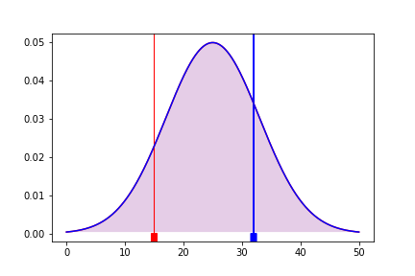
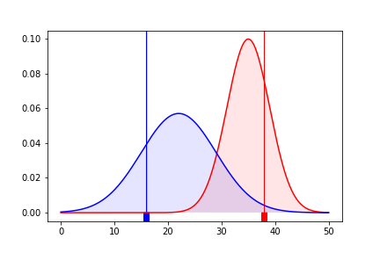
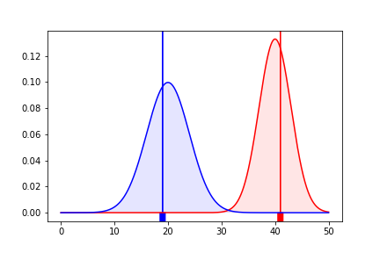
Thompson Sampling bandit
Pr(r < b) = 50%
Pr(r < b) = 20%
Pr(r < b) = 0.01%
Explore more!
Exploit more!
Simulation

Slide 16
Challenges
Capture interactions between content
Model pairwise interactions
Learn fast
Thompson sampling bandit
Choose fast

Slide 17
Challenges
Capture interactions between content
Model pairwise interactions
Learn fast
Thompson sampling bandit
Choose fast
Notes:
This is all good. Achieved by contextual bandit.

Slide 19
Greedy Hill Climbing Search complexity
D: nb of slots, N: nb of variations per slot
Number of possible layout combinations: O(N^{D})
Sequential evaluation of a layout: O(D)
Exhaustive evaluations: O(DN^{D})
Repeat Hill Climbing loop K times.
S random restarts
Hill Climbing evaluations: O(DSKN)

Slide 20
Challenges
Capture interactions between content
Model pairwise interactions
Learn fast
Thompson sampling bandit
Choose fast
Hill Climbing greedy optimization

Slide 21
Experimental results
1 week (MVT bandit)
vs.
2 months (A/B testing)
Winning layout:
21% lift vs median layout
44% lift vs worse layout
Faster convergence and better messages

Slide 22
Repeat in different domain
ICML’16

Slide 23
Music considerations
Explicit clusters: album, artist
Same album: same meta-data (album cover graphic, title)
User behavior: play album songs back-to-back
Similar scores to same-album songs
Notes:
Unlike other digital and physical products, music content tends to have explicit clusters.
album contains multiple songs. Share same album cover graphic, title and description.
In addition to overlapping content features, album songs also share behavioral features as users play them back to back.
As a result, Recommender systems tend to score same-album songs similarly.

Slide 24
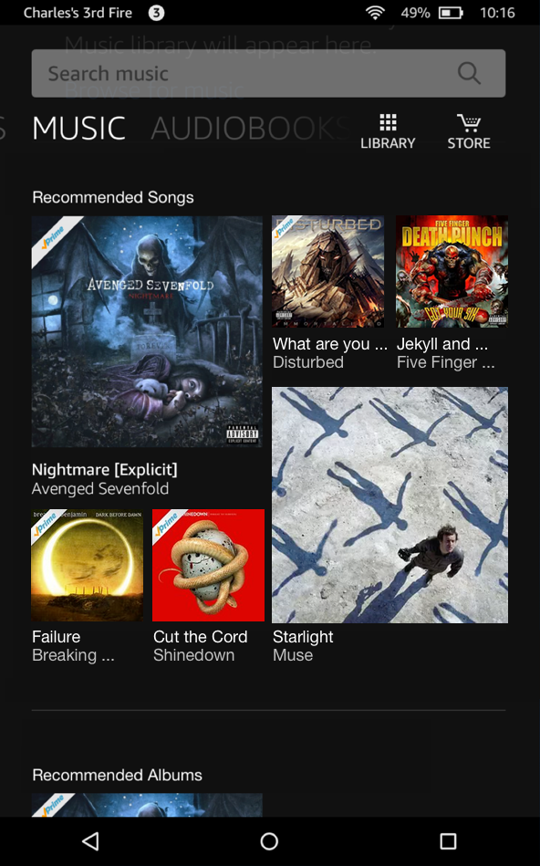
Why diversify music stream?
Notes:
Simply scoring by relevance, a musical stream may look like this. Not an enticing visual appearance.
Diverse & visually pleasing, yet relevant.
Thus the need to establish balance between relevance and diversity. this paper: move from to

Slide 25
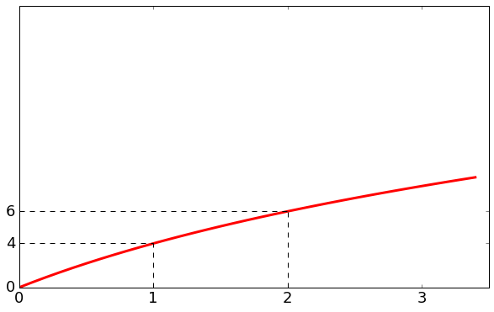
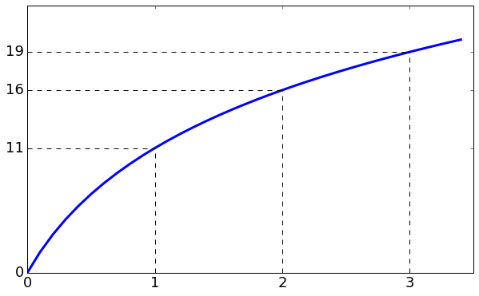
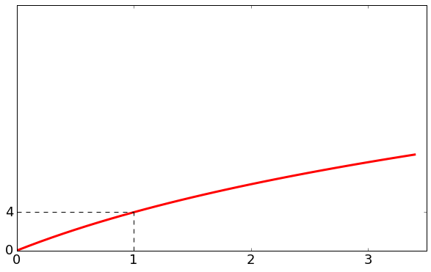
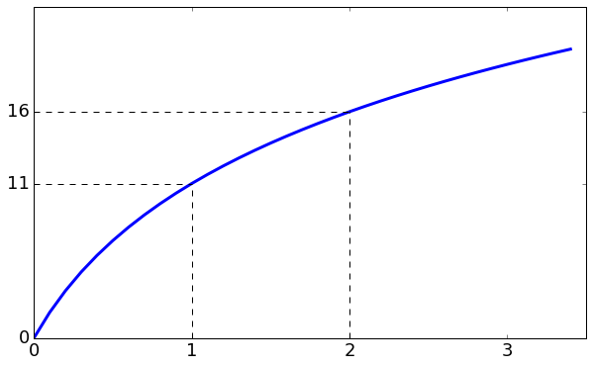
Submodular diversity mix
+3
+5
+11
+2
+4
Diversified list:

Slide 26
Results
0.64% (p=0.03) increase in minutes streamed
Diversity affects recommendation quality
Submodularity produces uniformly diverse set. All contiguous subsets are also diverse.
Submodularity ensures most relevant item is first, followed by mix of most relevant items within each category.
Notes:
Our submodular solution fares better. One reason is that Submodularity produces uniformly diverse stream. Diminishing returns property holds for any contiguous part of the recommended list.
Another is that swap may not retain most relevant content, like we saw in our toy example. Submod ensures most relevant item is first, followed by mix of most relevant items within categories

Slide 27
Combine solutions
RecSys’16

Slide 28
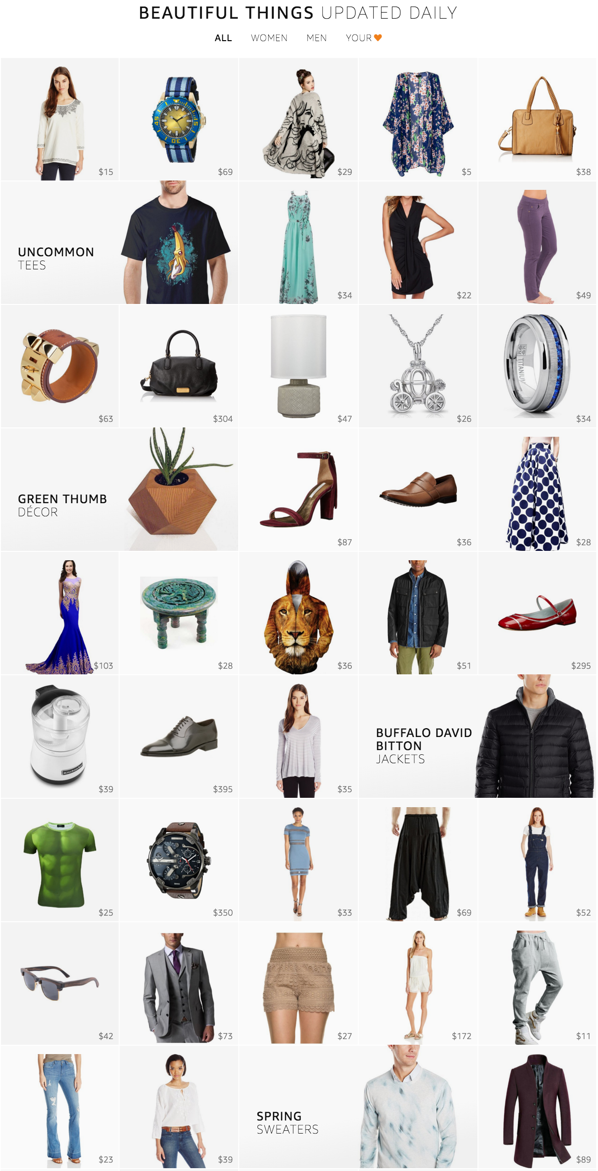
Amazon Stream: www.amazon.com/stream
Notes:
Stream is a new product discovery experience designed to show customer a large collection of products in an endless beautiful imagery.
No customer intent. Window shopping.
This paper describes our solutions for overcoming the challenges we faced

Slide 29
Challenges
Contextual bandits!
Need for product scoring function
Explore new products and exploit popular ones
Need for diverse stream
Hedge against the uncertainty in customer intent
Need for season-aware stream
Customers can engage with relevant products all year round
Need for personalized stream
Customers can focus more on products that they like
Notes:
We used Thompson sampling bandits

Slide 30
Challenges
Need for product scoring function
Explore new products and exploit popular ones
Need for diverse stream
Hedge against the uncertainty in customer intent
Need for season-aware stream
Customers can engage with relevant products all year round
Need for personalized stream
Customers can focus more on products that they like
Submodularity, 9.82% lift in clicks
Notes:
We used Thompson sampling bandits

Slide 31
Challenges
Need for product scoring function
Explore new products and exploit popular ones
Need for diverse stream
Hedge against the uncertainty in customer intent
Need for season-aware stream
Customers can engage with relevant products all year round
Need for personalized stream
Customers can focus more on products that they like
Notes:
We used Thompson sampling bandits

Slide 32
Adaptive category weights
Fashion trends are seasonal
Learn about seasonal trends from customer behavior
Estimate category weight by smoothed CTR over rolling-window
w_{k} = (clicks_{k} + α_{k}) / (views_{k} + α_{k} + β_{k})
8.29% lift in clicks
Notes:
estimate adaptive or seasonal category weights by smoothed per-category CTR over a rolling-window.
More concretely, the adaptive weight for a category is the total clicks plus some alpha prior, divided by the sum of total views of the same category, alpha, and beta priors.
[We also tried click over expected clicks and logistic regression with position-bias correction. The three models are qualitatively comparable but we adopted CTR as it is much simpler to implement and allow easy incorporation of signals from external sources.]

Slide 33
Challenges
Need for product scoring function
Explore new products and exploit popular ones
Need for diverse stream
Hedge against the uncertainty in customer intent
Need for season-aware stream
Customers can engage with relevant products all year round
Need for personalized stream
Customers can focus more on products that they like
Notes:
We used Thompson sampling bandits

Slide 34
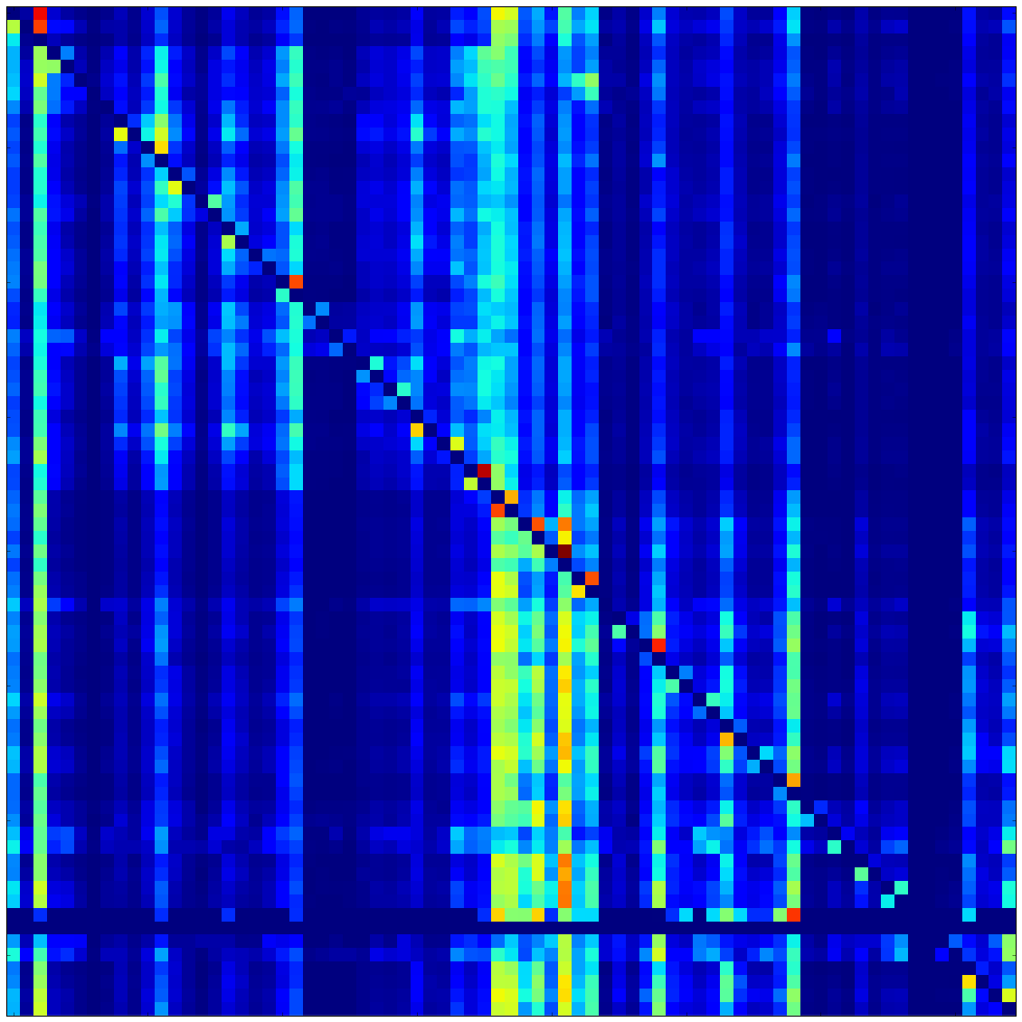
Personalized weights
12.58% lift in clicks
×
Customer preference vector
Category-category correlations
⬇
Smoothed customer preference vector
Notes:
The diffusion of preferences is simply a multiplication of the category-category correlation matrix and the customer’s preference vector.
The resulting customer preference vector is smoother and exposes more categories for the purpose of discovery.

Slide 35
Extrapolate to new challenges
ICML’18

Slide 36
Standard advertising workflow
Predictive Model
Features $X_{i }$
(user history,
device, time)
Reward $Y_{i,k}$
(clicks, revenue)
Recommendation
$$W_{k}$$
Environment
$$i$$

Slide 37
Model incremental outcomes

Slide 38
What-if estimates
$Y\left(W=k\right):$ observed outcome of user $x$seeing campaign $k$
$Y\left(W≠k\right)$: what-if estimate (counterfactual) of user $x$ NOT seeing campaign $k$
Incremental effect: $τ_{k}\left(x\right)=E\left[Y\left(W=k\right)−Y\left(W≠k\right)\right| X=x]$

Slide 39
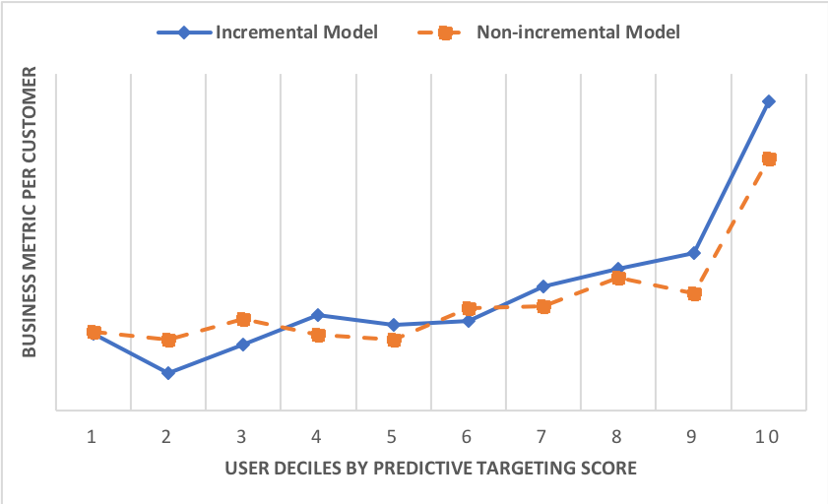
Comparison with conventional marketing

Slide 40
Scale your solution
KDD’19

Slide 41
Adaptive real time search
User has a mental picture of desired item
User can answer questions like: “Is this item similar to what you have in mind?”
Very large catalogue of items
Challenge: allow users to adaptively refine search rankings in real time, through feedbacks in the form of likes and dislikes.
Notes:
Scale: large catalogue, real time

Slide 42
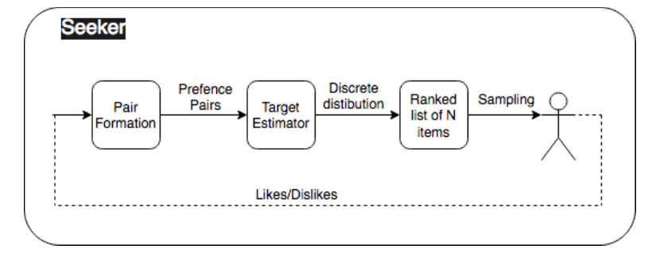
Trade-offs for speed
Move computationally expensive context from bandit sampling to a fast point-wise target estimation

Slide 43
Without affecting results

Slide 44
Collaborate

Slide 45
Engineers are crucial
Seeker: Real-Time Interactive Search. Biswas A, Pham TT, Vogelsong M, Snyder B, and Nassif H. KDD'19, Anchorage, Alaska, pp. 2867-2875, 2019.
Contextual Multi-Armed Bandits for Causal Marketing. Sawant N, Namballa CB, Sadagopan N, and Nassif H. ICML'18 Workshops, Stockholm, Sweden, 2018.
An efficient bandit algorithm for realtime multivariate optimization. Hill D, Nassif H, Liu Y, Iyer A, and Vishwanathan SVN. KDD'17, Halifax, Canada, pp. 1813-1821, 2017.
Adaptive, Personalized Diversity for Visual Discovery. Teo CH, Nassif H, Hill D, Srinavasan S, Goodman M, Mohan V, and Vishwanathan SVN. RecSys'16, Boston, pp. 35-38, 2016.
Diversifying Music Recommendations. Nassif H, Cansizlar KO, Goodman M, and Vishwanathan SVN. ICML'16 Workshops, New York, 2016.

Slide 46
Want to help?
We are hiring engineers and scientists!
Questions? Comments?
houssamn@amazon.com
http://pages.cs.wisc.edu/~hous21/

