Slide 1
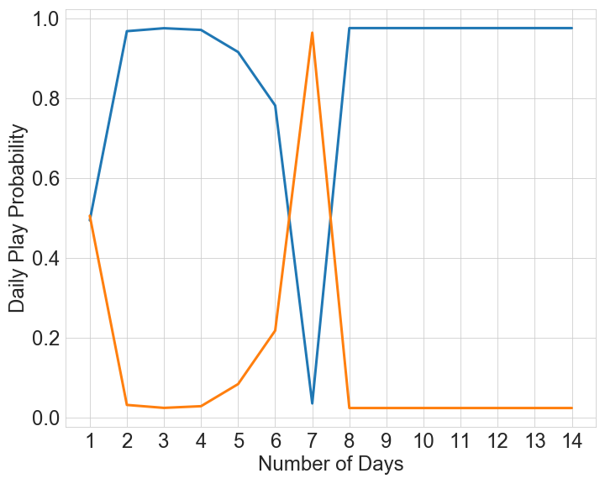
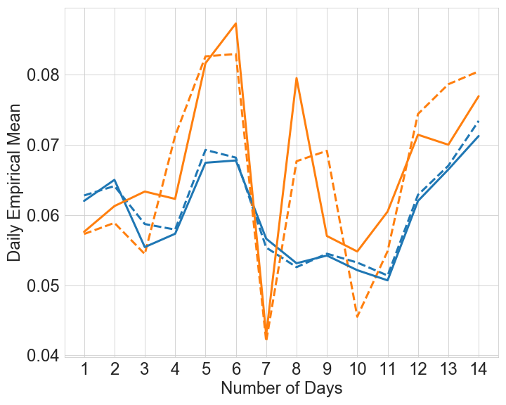
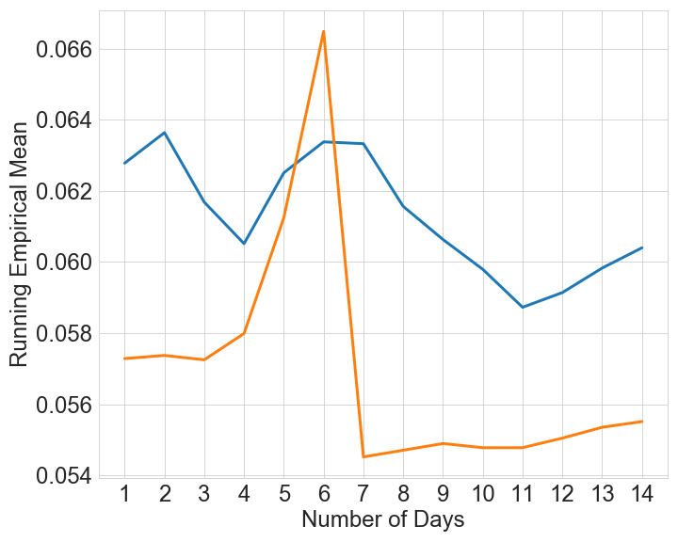
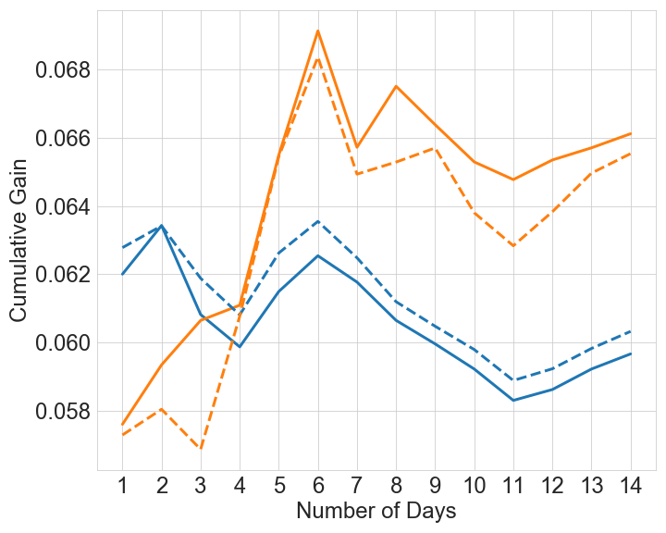
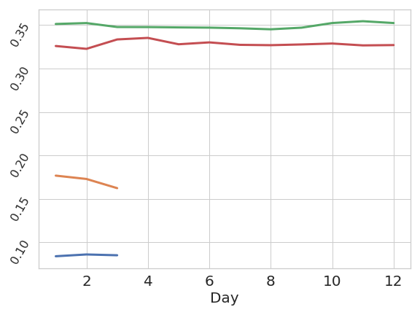
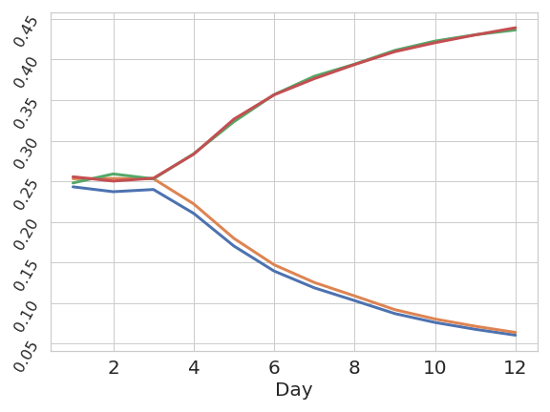
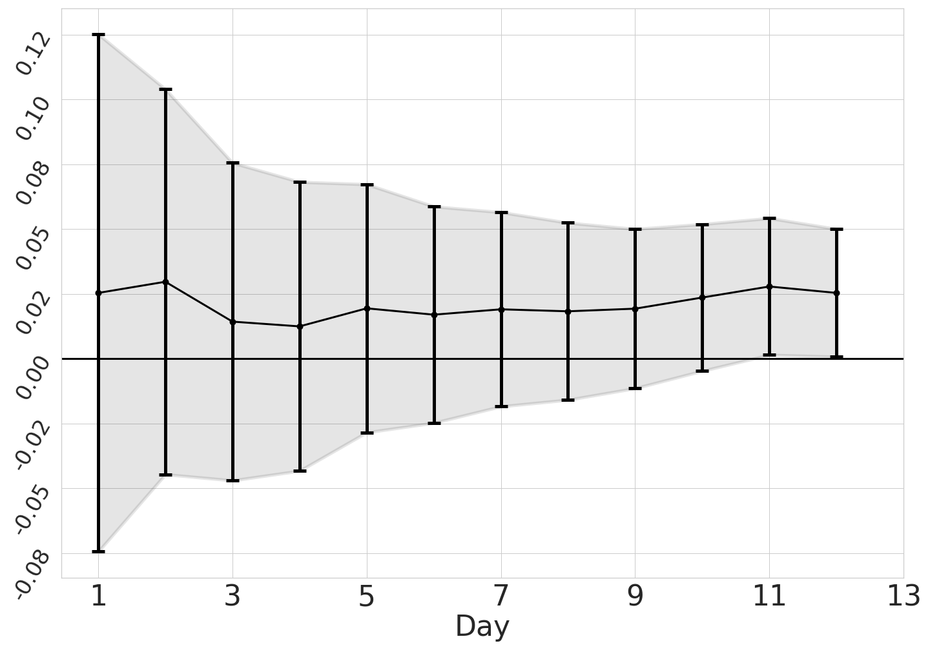
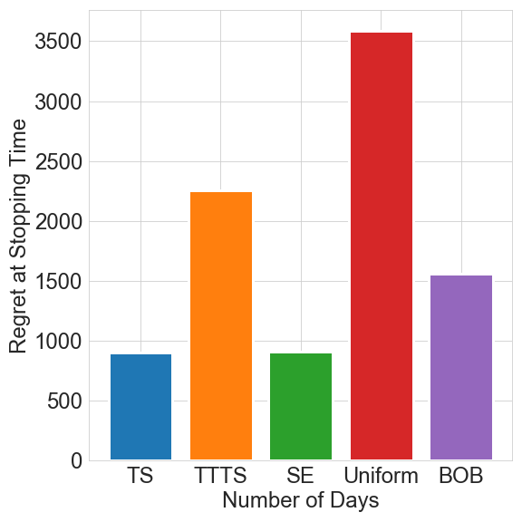
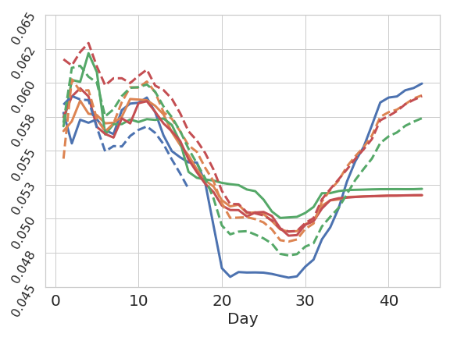
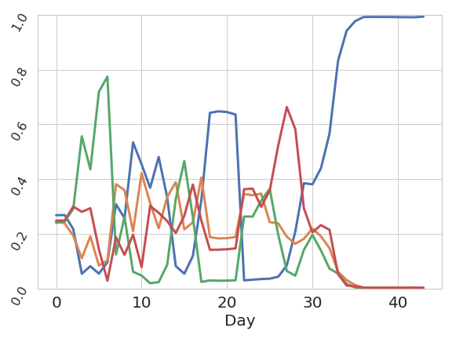
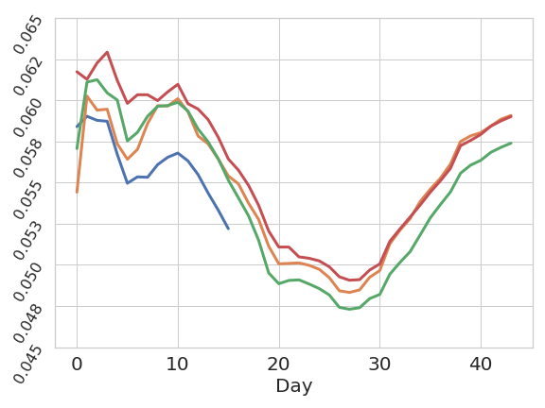
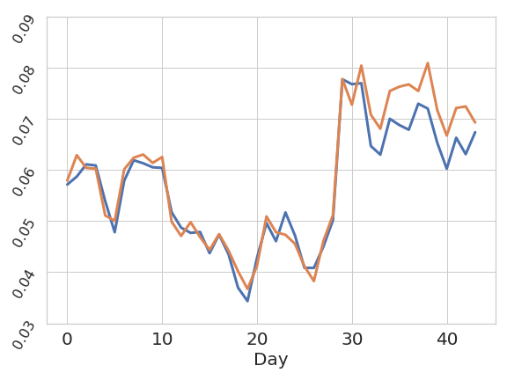
Best of three worlds:
Adaptive experimentation for digital marketing in practice
Tanner Fiez¹, Houssam Nassif² , Lalit Jain^{1,3}
¹Amazon, Meta ², University of Washington³
Motivating Case Study
Method: Successive Elimination on Cumulative Gain
Daily Traffic Split
Daily Message Means
Assume mean is constant over a day
$k$-arms, Arm $i$ on day $t:$ $Ber\left(μ_{i,t}\right)$
$n_{t}$ total samples on day $t$
Algorithm selects allocation $\left(p_{1,t}, p_{2,t},⋯, p_{k,t}\right)∈Δ^{k}$
Total observed reward of arm $i$ on day $t$is $r_{i,t}$
Cumulative Gain
IPS Estimate
Anytime-Valid CI
$$CG_{i}=\sum_{s=1}^{T}{n_{s}μ_{i,s}}$$
$${\hat{CG}}_{i}=\sum_{s=1}^{T}{\frac{r_{i,s}}{p_{i,s}}}$$
$|CG_{i}$ -${\hat{CG}}_{i}$|$≤C_{i,t}\left(δ\right)$
for all time w.p. $≥1−δ$
Running Empirical Means
Normalized Cumulative Gain
Cumulative Gain Rate
Percentage Traffic
Empirical Gap
Marketer runs 2 week experiment using Thompson Sampling
Fails to have a significant t-test
Simpson’s Paradox: Empirical means, and posterior probability are misleading for decision making.
What they should have measured:
Cumulative Gain: how much reward it would gain if it received all the traffic
Lessons Learned
Experiments
Regret Minimization Isn’t Enough
Inference is important
Goal of experimentation is not just informing the current decision, but more importantly the next decision!
Daily Means
Stopping Times
Regret at Stopping
Be Wary of the Batch
Batch updates can lead to early decisions that mislead adaptive algorithms
Be robust to biases that occur due to infrequent batch updating
Identify the Counterfactual Best
Empirical mean is poorly behaved, hard to understand and prone to Simpson’s Paradox
Cumulative Gain: Identify the counterfactual best, i.e. the arm with the highest total reward over experimentation period
Elimination obtains significance quickly, is robust to time-variation, and has low experiment cost
TS Running Empirical Mean
TS Allocation
Provide Always Valid Inference
If it’s on a dashboard, people will look at it. Show daily empirical means so people can debug.
Always valid confidence intervals provide for safe sequential monitoring for any adaptive procedure.
Objective: Best of Three Worlds
Cumulative Gain Rate
Daily Algorithmic Performance
Mostly Model Agnostic
Identify Counterfactual Best
Minimize Opportunity Cost
Excellent real world performance compared to existing regret-minimizing approaches

