Slide 1
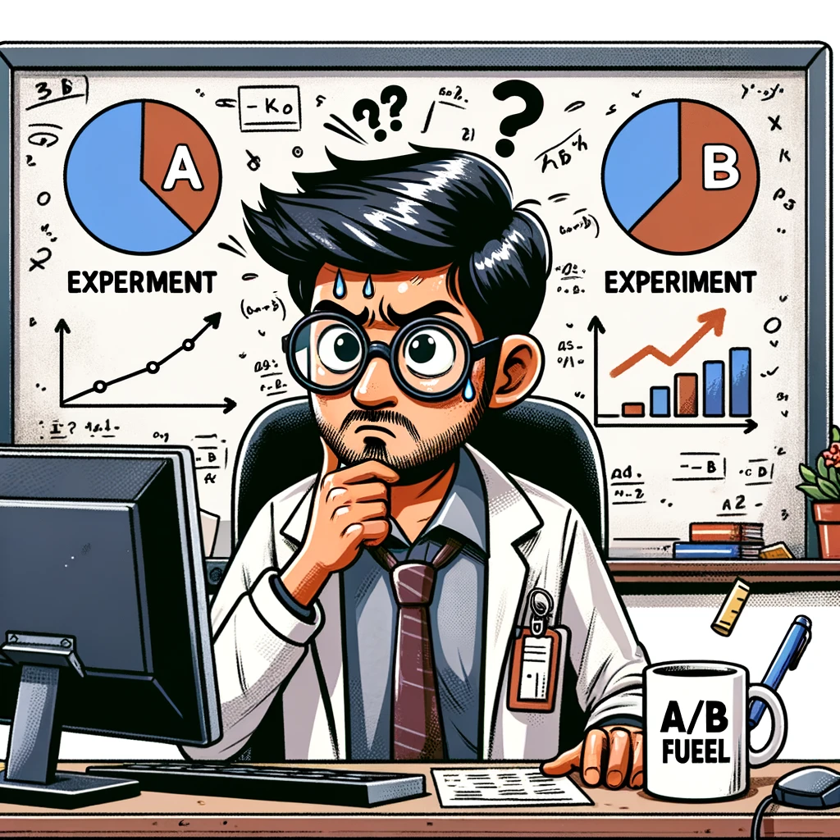
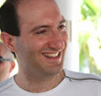
Best of Three Worlds: Adaptive Experimentation for Digital Marketing!
Do you sometimes feel that your bandit is biased…against you??
Dreading the regret of bad decisions?
Restless due to Non-stationarity?
Tanner Fiez* (Amazon)
Houssam Nassif (Meta)
Lalit Jain
(Amazon/UW)
Notes:
Hoping to save potentially lost conversions, they run a Thompson sampling algorithm based experiment. After two weeks they look at the dashboard and see something like this plot on the LHS.
From looking at the traffic allocation, they are fairl convinced that message A is the best, indeed Thompson sampling is giving it all the traffic.
As you can see, the Thompson sampling algorithm is rather aggressive – but by day 8 seems to have moved into a world where it believes that message 1 is where to place its full traffic allocation.

Slide 2
Best of Three Worlds: Adaptive Experimentation for Digital Marketing!
Wave goodbye to weak experiments and power up with us!
Regret is for bad fashion choices, not experiments.
We don’t predict the future, but we sure are robust to it’s changes.
"Dodge the pitfalls of traditional testing; leap into the future with us!” ™️
Tanner Fiez* (Amazon)
Houssam Nassif (Meta)
Lalit Jain
(Amazon/UW)
Notes:
Hoping to save potentially lost conversions, they run a Thompson sampling algorithm based experiment. After two weeks they look at the dashboard and see something like this plot on the LHS.
From looking at the traffic allocation, they are fairl convinced that message A is the best, indeed Thompson sampling is giving it all the traffic.
As you can see, the Thompson sampling algorithm is rather aggressive – but by day 8 seems to have moved into a world where it believes that message 1 is where to place its full traffic allocation.

