Slide 1
Innovating in the content space: creation, targeting and measurement
HOUSSAM NASSIF
Amazon Research
Notes:
Presenting part of my vision and record in the content space. This is only the tip of the iceberg, the part that is published with me as co-author

Slide 2
Personal Background
Me in one word: Curious
Career path: biologist, software engineer, bioinformatics, ML scientist
Biomedical informatics: Proteins’09, ICDM’09, IHI’10, AMIA’11, BIBM’12, BMC Bioinformatics’12, JAMIA’12, HealthCom’13, AMIA’13, BMC Cancer’14, ACS Chemical Biology’15.
Logic and relational learning: ILP’09, AMIA’12, ECML’12, ILP’13, ECML’13, ECML’14
Recommender systems: ICML’16, RecSys’16, KDD’17, ICML’18, KDD’19, ICML’20, ICML’21, Management Science’22.
Notes:
Mostly journals. Concurrent algorithmic innovations

Slide 3
Submodular diversity
ICML’16, RecSys’16
With Cansizlar KO, Goodman M, Teo CH, Hill D, Srinavasan S, Mohan V, Vishwanathan SVN

Slide 4


Why diversify music stream?
Notes:
Simply scoring by relevance, a musical stream may look like this. Not an enticing visual appearance.
Diverse & visually pleasing, yet relevant.
Thus the need to establish balance between relevance and diversity. this paper: move from to

Slide 5
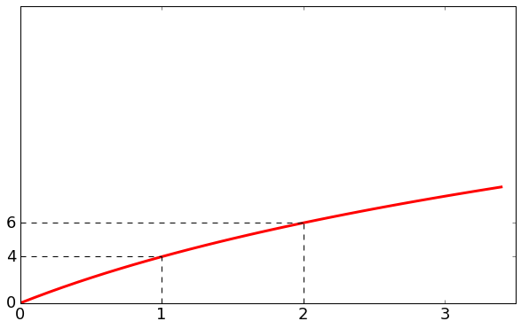
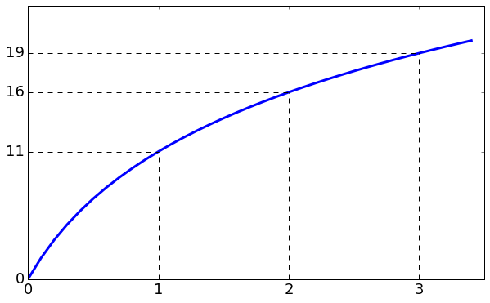
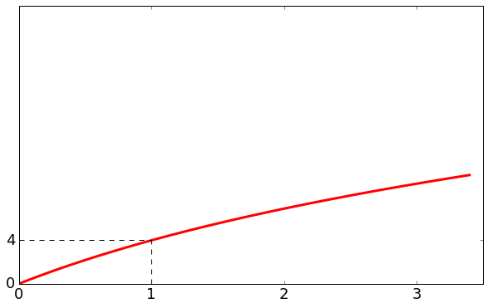
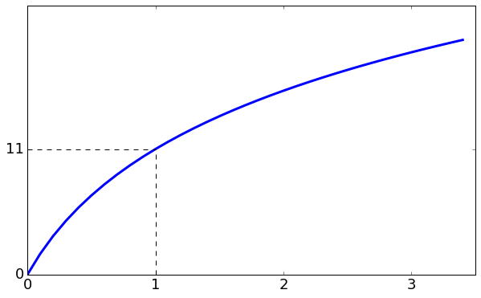
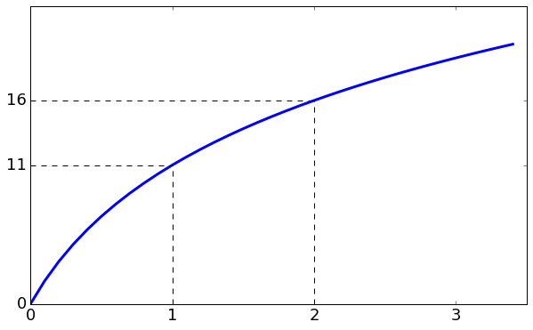
Submodular diversity mix
+3
+5
+11
+2
+4
Diversified list:
Notes:
Diminishing returns

Slide 6

Results
Uniformly diverse set: All contiguous subsets are also diverse.
Submodularity ensures most relevant item is first, followed by mix of most relevant items within each category.
Curve slope is parametrized, mixing diversity with relevance, and giving business a knob $α$to tune.
$$\text{s}\text{lope}= \frac{1}{1+ \frac{α}{w}\sum_{i}{\text{value}(i) }}$$
Knob to tune
Category prior, personalization
Notes:
Our submodular solution fares better. One reason is that Submodularity produces uniformly diverse stream. Diminishing returns property holds for any contiguous part of the recommended list.
Another is that swap may not retain most relevant content, like we saw in our toy example. Submod ensures most relevant item is first, followed by mix of most relevant items within categories

Slide 7
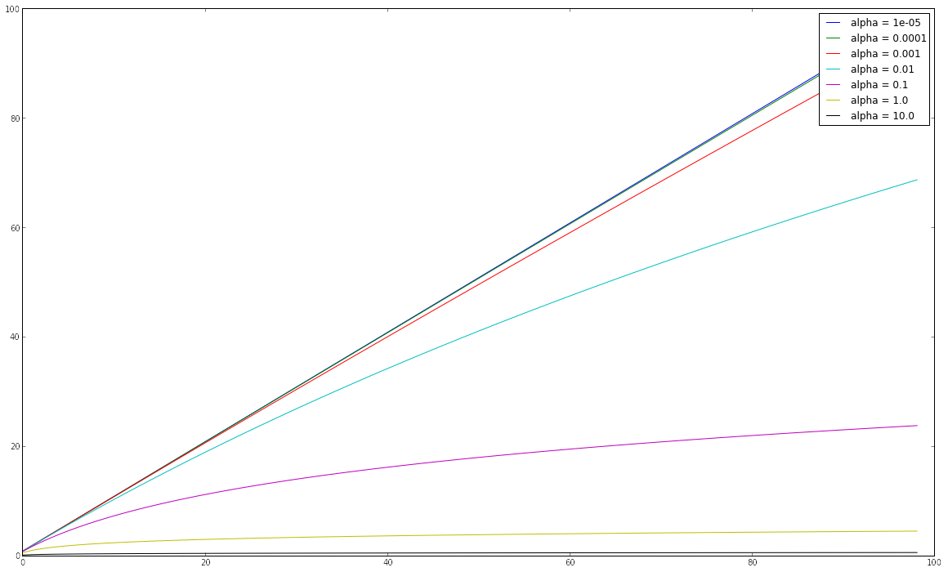
Tuning submodular slope
Low α, order by item value
Cumulative category value
Medium α, mix
value and diversity
High α, strictly abide by diversity
Sum of item values in category
Notes:
Controls slope. Straight line is modular gain.

Slide 8

Window shopping
Notes:
Stream is a new product discovery experience designed to show customer a large collection of products in an endless beautiful imagery.
No customer intent. Window shopping.
This paper describes our solutions for overcoming the challenges we faced

Slide 9
Challenges
Contextual bandits
Need for product scoring function
  Explore new products and exploit popular ones
Need for diverse stream
  Hedge against the uncertainty in customer intent
Need for season-aware stream
  Customers can engage with relevant products all year round
Need for personalized stream
  Customers can focus more on products that they like
Notes:
We used Thompson sampling bandits

Slide 10
Challenges
Need for product scoring function
  Explore new products and exploit popular ones
Need for diverse stream
  Hedge against the uncertainty in customer intent
Need for season-aware stream
  Customers can engage with relevant products all year round
Need for personalized stream
  Customers can focus more on products that they like
Submodularity, 9.82% lift

Slide 11
Challenges
Need for product scoring function
  Explore new products and exploit popular ones
Need for diverse stream
  Hedge against the uncertainty in customer intent
Need for season-aware stream
  Customers can engage with relevant products all year round
Need for personalized stream
  Customers can focus more on products that they like

Slide 12
Adaptive category weights
Fashion trends are seasonal
Learn about seasonal trends from customer behavior
Estimate category weight by smoothed CTR over rolling-window
w_{k} = (clicks_{k} + α_{k}) / (views_{k} + α_{k} + β_{k})
8.29% lift
Notes:
estimate adaptive or seasonal category weights by smoothed per-category CTR over a rolling-window.
More concretely, the adaptive weight for a category is the total clicks plus some alpha prior, divided by the sum of total views of the same category, alpha, and beta priors.
[We also tried click over expected clicks and logistic regression with position-bias correction. The three models are qualitatively comparable but we adopted CTR as it is much simpler to implement and allow easy incorporation of signals from external sources.]

Slide 13
Challenges
Need for product scoring function
  Explore new products and exploit popular ones
Need for diverse stream
  Hedge against the uncertainty in customer intent
Need for season-aware stream
  Customers can engage with relevant products all year round
Need for personalized stream
  Customers can focus more on products that they like

Slide 14
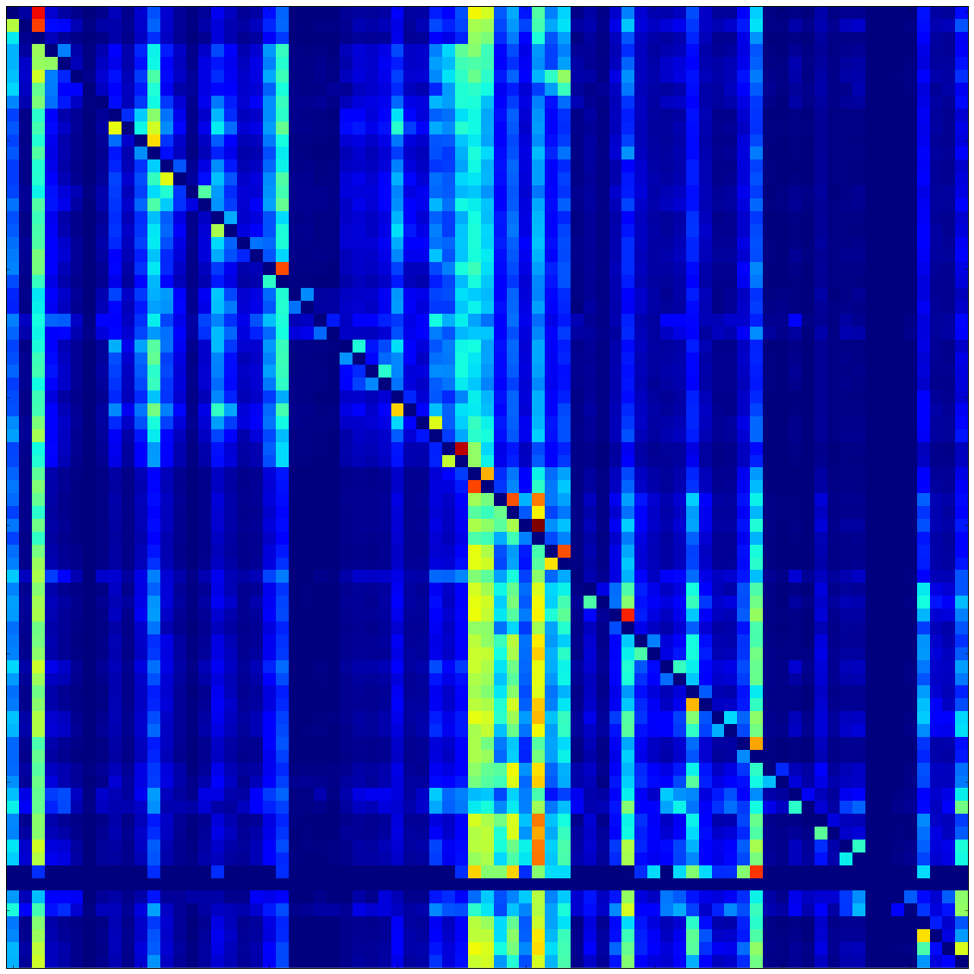
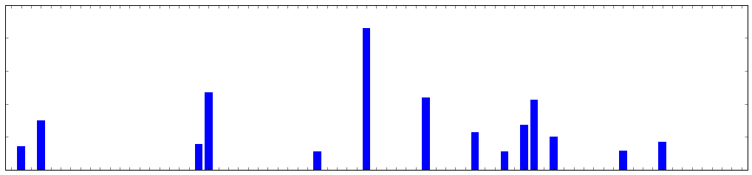
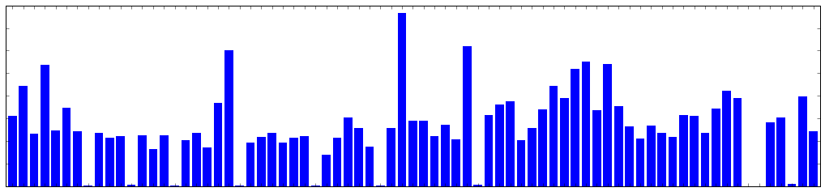
Personalized weights
12.58% lift
×
Customer preference vector
Category-category correlations
⬇
Smoothed customer preference vector
Notes:
The diffusion of preferences is simply a multiplication of the category-category correlation matrix and the customer’s preference vector.
The resulting customer preference vector is smoother and exposes more categories for the purpose of discovery.

Slide 15
Combinatorial bandits
KDD’17
With Hill D, Liu Y, Iyer A, Vishwanathan SVN

Slide 16
Multiple-slot template
Stop biking pointlessly, join team Circle!
Slots
Best way to bicycle!
We cycle and re-cycle!
No point in not joining!
Join now!
Check other teams
Notes:
Say you have an ad with multiple slots

Slide 17
Each slot has multiple variations
Alternative
variants
Image
slot
Notes:
each with alternative variants

Slide 18
Combinatorial explosion
2-3 variants per slot would give hundreds of distinct layouts
A/B testing with a 100 treatments would take months!
5 different A/B testing experiments, each varying one slot
Doesn’t take slot dependencies in account

Slide 19
Challenges
Capture interactions between content
Learn fast
Choose fast

Slide 20
Model pairwise interactions
Stop biking pointlessly, join team Circle!
Year-round carousel rides!
Unlimited laps!
All you can eat Pi!
No corners to hide!
Hurry, don’t linger around!
Join now!
Check other teams
Notes:
Our representation captures all pairwise interactions as 2nd order features

Slide 21
Challenges
Capture interactions between content
Model pairwise interactions (GLM or Neural Network)
Learn fast
Choose fast

Slide 22
Challenges
Capture interactions between content
Model pairwise interactions
Learn fast
Choose fast

Slide 23
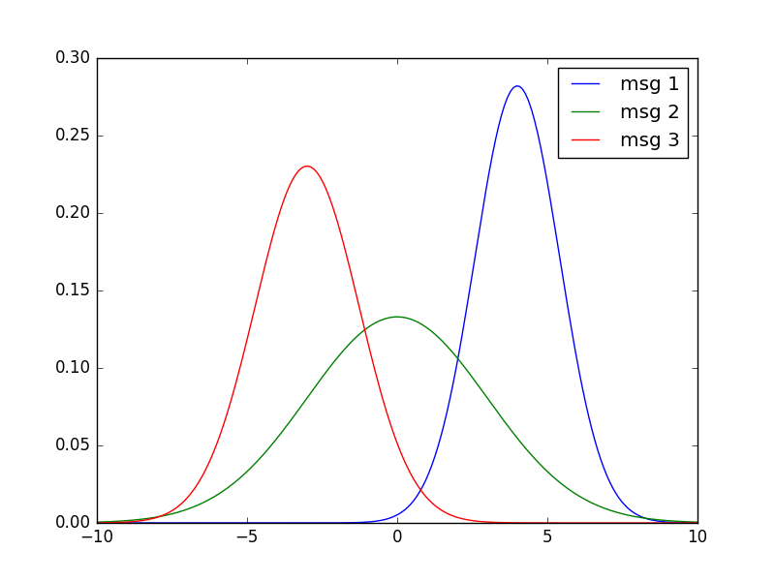
Weights as distributions
Weight distributions of features
B1
H1
I1
Weights:
-4.2
-2.8
5.4
Total score: -1.6
Notes:
instead of a point estimate, you have a distribution

Slide 24
Weights as distributions
Weight distributions of features
B1
H1
I1
Weights:
-3.2
1.0
3.9
Total score: 1.7

Slide 25
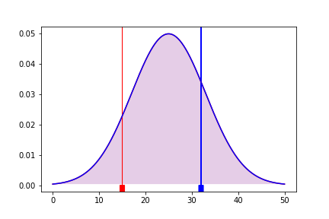
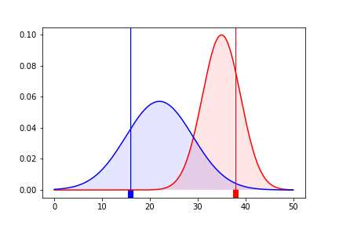
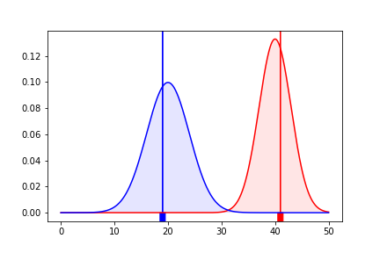
Thompson Sampling bandit
P(B < R) = 50%
P(B > R) = 20%
P(B > R) = 0.01%
Explore more!
Exploit more!
Simulation

Slide 26
Challenges
Capture interactions between content
Model pairwise interactions
Learn fast
Thompson sampling bandit
Choose fast

Slide 27
Challenges
Capture interactions between content
Model pairwise interactions
Learn fast
Thompson sampling bandit
Choose fast

Slide 28
One bandit per slot
One Thompson Sampling bandit per slot
Stop biking pointlessly, join team Circle!
Year-round carousel rides!
Unlimited laps!
All you can eat Pi!
No corners to hide!
Hurry, don’t linger around!
Join now!
Check other teams
Takes as contextual input the values of all the other slots
Notes:
Takes as input the values of all the other slots

Slide 29
Hill Climbing greedy optimization
Too expensive at run-time to
consider N^{D} exponential layouts
Stop biking pointlessly, join team Circle!
Year-round carousel rides!
Unlimited laps!
All you can eat Pi!
No corners to hide!
Hurry, don’t linger around!
Join now!
Check other teams
1. Perform Thompson Sampling once on all bandits, and fix parameters.
Notes:
Sample once over all bandits, fix parameters. Only dealing with point estimates.

Slide 30
Hill Climbing greedy optimization
Stop biking pointlessly, join team Circle!
Year-round carousel rides!
Unlimited laps!
All you can eat Pi!
No corners to hide!
Hurry, don’t linger around!
Join now!
Check other teams
2. Start with random layout.

Slide 31
Hill Climbing greedy optimization
Stop biking pointlessly, join team Circle!
Year-round carousel rides!
Unlimited laps!
All you can eat Pi!
No corners to hide!
Hurry, don’t linger around!
Join now!
Check other teams
3. Choose slot to optimize.

Slide 32
Hill Climbing greedy optimization
Stop biking pointlessly, join team Circle!
Year-round carousel rides!
Unlimited laps!
All you can eat Pi!
No corners to hide!
Hurry, don’t linger around!
?
Join now!
Check other teams
4. Bandit optimizes slot content, given all other slots contents.

Slide 33
Hill Climbing greedy optimization
Stop biking pointlessly, join team Circle!
Year-round carousel rides!
Unlimited laps!
All you can eat Pi!
No corners to hide!
Hurry, don’t linger around!
Join now!
Check other teams
5. Update the slot using the best content.

Slide 34
Hill Climbing greedy optimization
Stop biking pointlessly, join team Circle!
Year-round carousel rides!
Unlimited laps!
All you can eat Pi!
No corners to hide!
Hurry, don’t linger around!
Rotate teams
?
Join now!
Check other teams
6. Choose a new slot to optimize, until convergence

Slide 35
Search complexity
D: nb of slots, N: nb of variations per slot
Number of possible layout combinations: O(N^{D})
Sequential evaluation of a layout: O(D)
Exhaustive evaluations: O(DN^{D})
Repeat Hill Climbing loop K times.
S random restarts
Hill Climbing evaluations: O(DSKN)

Slide 36
Challenges
Capture interactions between content
Model pairwise interactions
Learn fast
Thompson sampling bandit
Choose fast
Hill Climbing greedy optimization

Slide 37
Simulation results
MVT2: Proposed model (interaction, Thompson sampling, Hill Climbing)
MVT1: MVT2 without interaction features
N^{D}MAB: Bandit with distinct N^{D} arms
MVT1 converges fastest, but MVT2 has lowest regret

Slide 38
Simulation results
MVT2: Proposed model (interaction, Thompson sampling, Hill Climbing)
MVT1: MVT2 without interaction features
N^{D}MAB: Bandit with distinct N^{D} arms
MVT2 and N^{D}MAB capture interactions

Slide 39
Simulation results
MVT2: Proposed model (interaction, Thompson sampling, Hill Climbing)
MVT1: MVT2 without interaction features
N^{D}MAB: Bandit with distinct N^{D} arms
MVT2 and MVT1 can handle 1,000s of combinations (12^{D} = 1,728)

Slide 40
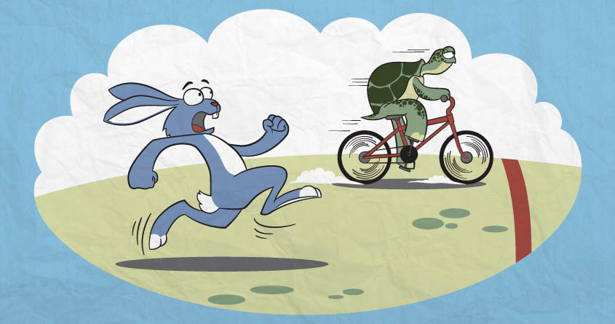
Experimental results
1 week (MVT bandit)
vs.
2 months (A/B testing)
Winning layout:
21% lift vs median layout
44% lift vs worse layout
Faster convergence and better messages

Slide 41
Bootstrapping bandits
Management Science’22
With Nabi S, Hong J, Mamani H, Imbens G
Notes:
Going into the tail

Slide 42
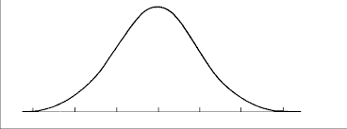

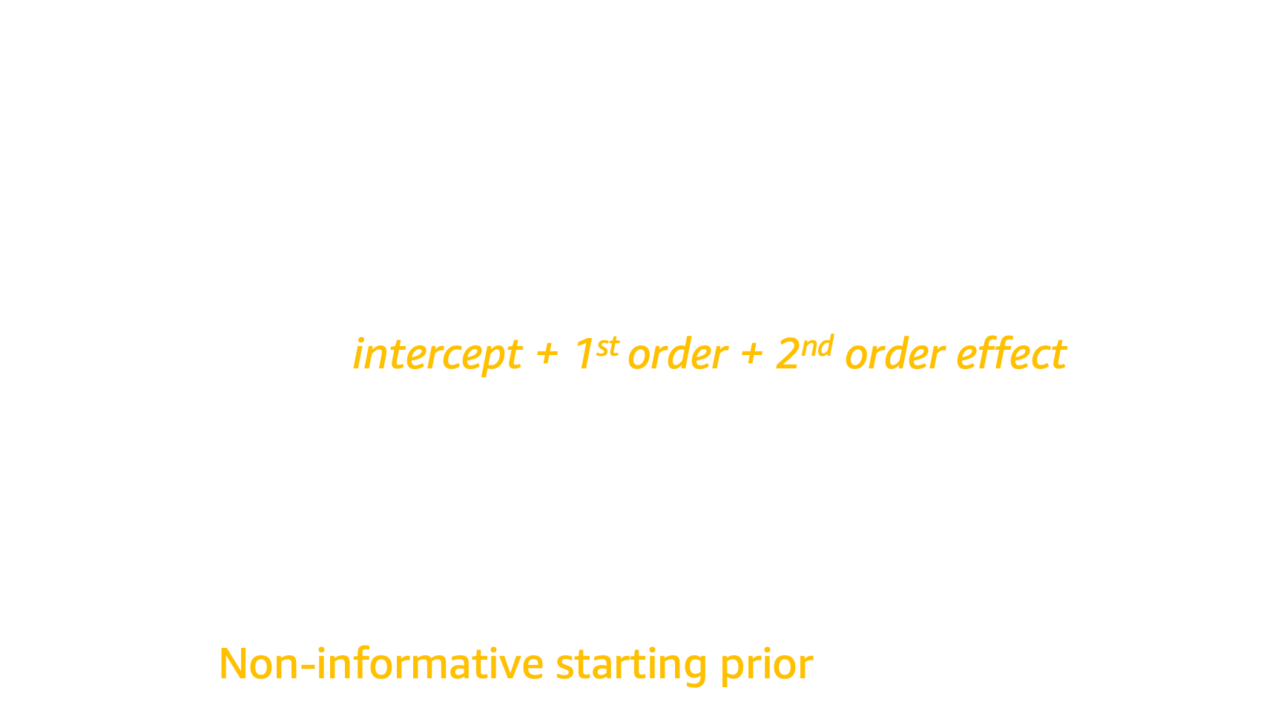




Bayesian generalized linear models
$$X^{⊤}W=w^{0}+\sum_{i}{w_{i}^{1}x_{i}^{1}+\sum_{i}{\sum_{j}{w_{ij}^{2} x_{ij}^{2}}}}$$
intercept + 1st order + 2nd order effect
$X^{⊤}W=$
Non-informative starting prior: $w_{i}∼N(0,1)$
${∗x}_{1}$+
${∗x}_{2}+⋯$ =
$$w_{1}∼N({\tilde{μ}}_{1}, {\tilde{σ}}_{1}^{2})$$
$$w_{2}∼N({\tilde{μ}}_{2}, {\tilde{σ}}_{2 }^{2})$$
$$∑w_{i}x_{i}$$
Notes:
And we feed them into a Bayesian GLM, (c) where each feature is associated with a distribution. (c) These weight distributions generally start with a non-informative prior

Slide 43



Impose Bayesian hierarchy
Compute empirically from data
Impose meta-prior:
$$N\left(ν_{Cat1}, τ_{Cat1}^{2}\right)$$
$$N\left(ν_{Cat2}, τ_{Cat2}^{2}\right)$$
$$X^{⊤}W=w^{0}+\sum_{i}{w_{i}^{1}x_{i}^{1}+\sum_{i}{\sum_{j}{w_{ij}^{2} x_{ij}^{2}}}}$$
Category 1
Category 2
Notes:
Our question is, can we leverage the data to start from informative priors instead?
(c) Our features can be divided into 2 categories. But our method applies to any feature grouping.
(c) We impose a hierarchical meta-prior, (c) that we compute from the observed data itself

Slide 44


Empirical Bayes algorithm
Start with non-informative priors:
$$N\left(0, 1\right)$$
$$N\left(0, 1\right)$$
$$X^{⊤}W=w^{0}+\sum_{i}{w_{i}^{1}x_{i}^{1}+\sum_{i}{\sum_{j}{w_{ij}^{2} x_{ij}^{2}}}}$$
Initial data
Run
Category 1
Category 2
Notes:
Here is how our EB algorithm works. read slide

Slide 45

Empirical Bayes algorithm
Compute empirically from data
$$N\left(ν_{Cat1}, τ_{Cat1}^{2}\right)$$
$$N\left(ν_{Cat2}, τ_{Cat2}^{2}\right)$$
$$X^{⊤}W=w^{0}+\sum_{i}{w_{i}^{1}x_{i}^{1}+\sum_{i}{\sum_{j}{w_{ij}^{2} x_{ij}^{2}}}}$$
Initial data
Run
Category 1
Category 2

Slide 46
Empirical Bayes algorithm
Restart model with empirical priors:
$$N\left(ν_{Cat1}, τ_{Cat1}^{2}\right)$$
$$N\left(ν_{Cat2}, τ_{Cat2}^{2}\right)$$
$$X^{⊤}W=w^{0}+\sum_{i}{w_{i}^{1}x_{i}^{1}+\sum_{i}{\sum_{j}{w_{ij}^{2} x_{ij}^{2}}}}$$
Initial data
Run
Category 1
Category 2

Slide 47
Empirical Bayes algorithm
Run as usual
$$N\left(ν_{Cat1}, τ_{Cat1}^{2}\right)$$
$$N\left(ν_{Cat2}, τ_{Cat2}^{2}\right)$$
$$X^{⊤}W=w^{0}+\sum_{i}{w_{i}^{1}x_{i}^{1}+\sum_{i}{\sum_{j}{w_{ij}^{2} x_{ij}^{2}}}}$$
Run
Category 1
Category 2

Slide 48
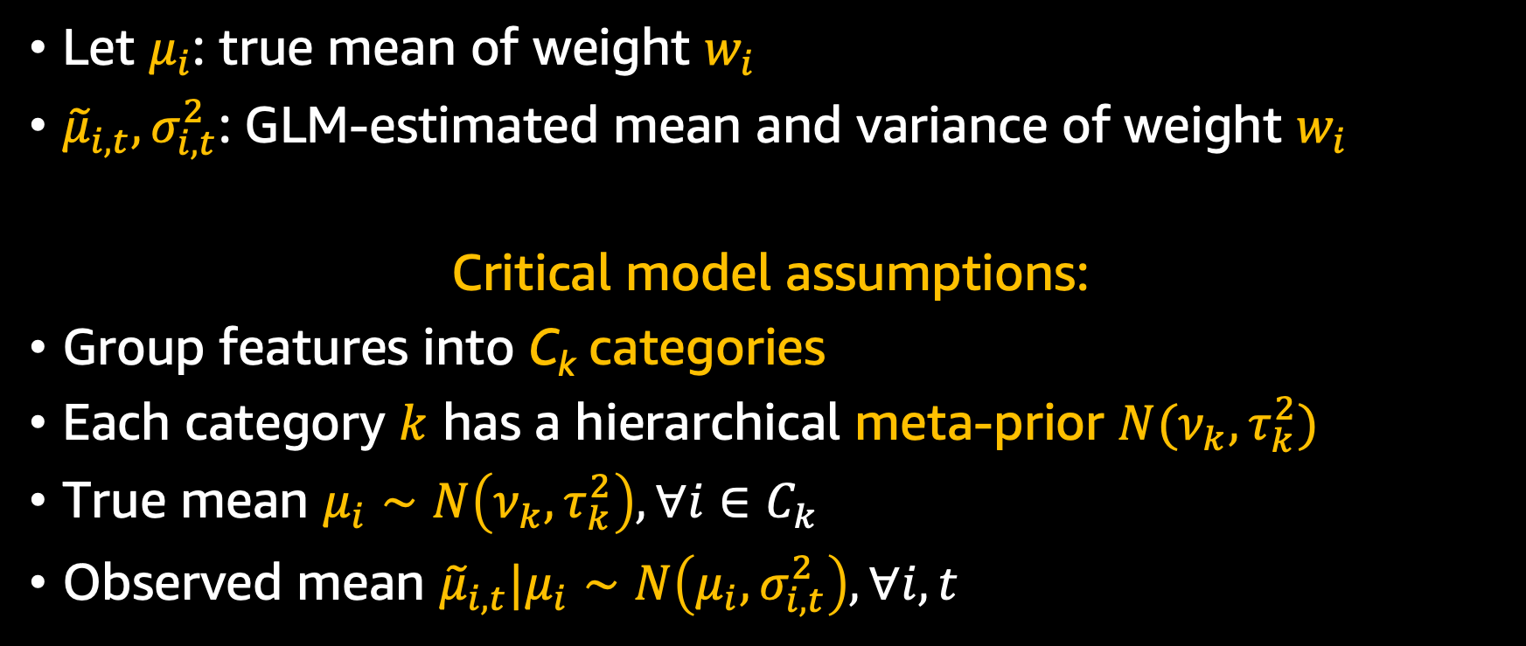
Modelin assumptions
Let $μ_{i}$: true mean of weight $w_{i}$
${\tilde{μ}}_{i,t}, σ_{i,t}^{2}$: GLM-estimated mean and variance of weight $w_{i}$
Critical model assumptions:
Group features into C_{k} categories
Each category $k$ has a hierarchical meta-prior $N(ν_{k}, τ_{k}^{2})$
True mean $μ_{i}∼N\left(ν_{k}, τ_{k}^{2}\right), ∀i∈C_{k}$
Observed mean ${\tilde{μ}}_{i,t}|μ_{i}∼N\left(μ_{i}, σ_{i,t}^{2}\right), ∀i,t$
Notes:
Define: mu, mu, sigma
First, we group our features into two categories.
Impose on each grouping a meta-prior. hierarchy.
Each feature’s true mean μi is drawn from that feature’s category meta-prior
observed mean μ ̃i,t is drawn from Gaussian with true mean and observed variance

Slide 49
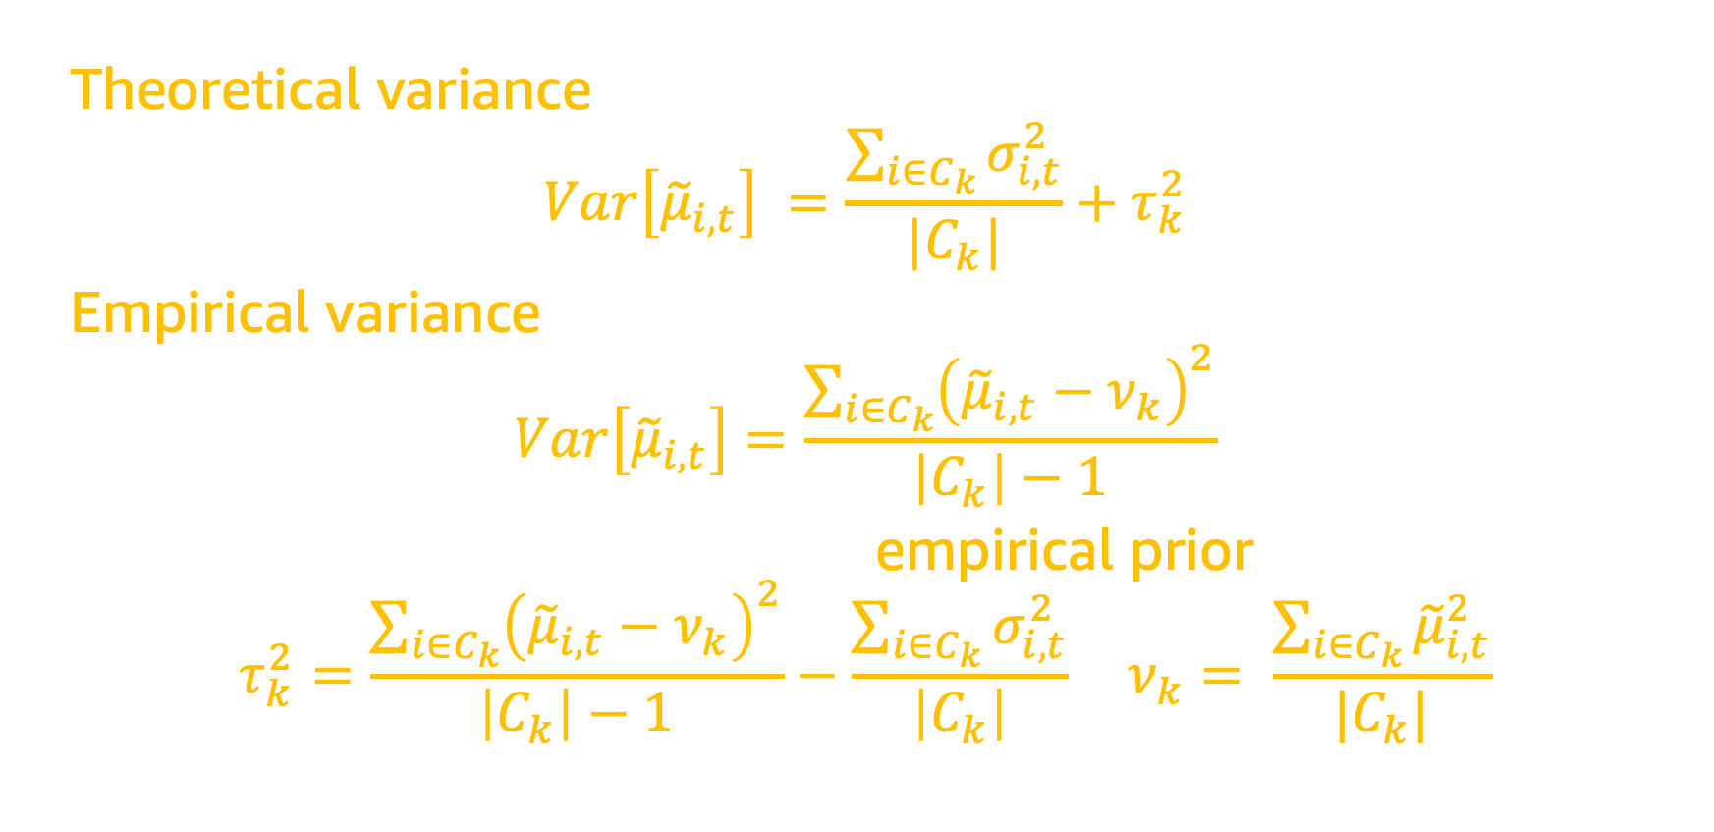
Empirical prior estimation
Theoretical variance, per variance decomposition:
$$Var\left[{\tilde{μ}}_{i,t}\right] =\frac{\sum_{i∈C_{k}}{σ_{i,t}^{2}}}{|C_{k}|}+τ_{k}^{2}$$
Empirical variance, using variance formula on GLM estimates:
$$Var\left[{\tilde{μ}}_{i,t}\right]=\frac{\sum_{i∈C_{k}}{{\left({\tilde{μ}}_{i,t}−ν_{k}\right)}^{2}}}{\left|C_{k}\right|−1}$$
Combine both and recover the empirical prior:
$$τ_{k}^{2}=\frac{\sum_{i∈C_{k}}{{\left({\tilde{μ}}_{i,t}−ν_{k}\right)}^{2}}}{\left|C_{k}\right|−1}−\frac{\sum_{i∈C_{k}}{σ_{i,t}^{2}}}{\left|C_{k}\right|}; ν_{k}= \frac{\sum_{i∈C_{k}}{{\tilde{μ}}_{i,t}^{2}}}{|C_{k}|}$$
Notes:
with some math, variance of estimated mean.
Important result: I can recover my meta-prior from the data.
This is why it is called Empirical Bayes

Slide 50
When to compute empirical prior
Longer reset time helps more
Empirical prior helps, even with one day
Notes:
Compute EB prior after 0, 1, 3 days. Lower is better.

Slide 51
Lasting effect on small batches

Slide 52
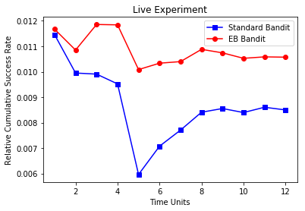
Live experiment
Notes:
Live experiment. Y-axis is success rate, higher is better. (c) EB converges faster (time unit 5 vs 8), and is more stable.

Slide 53
Causal bandits
ICML’18
With Sawant N, Namballa CB, Sadagopan N

Slide 54
Model incremental outcomes

Slide 55
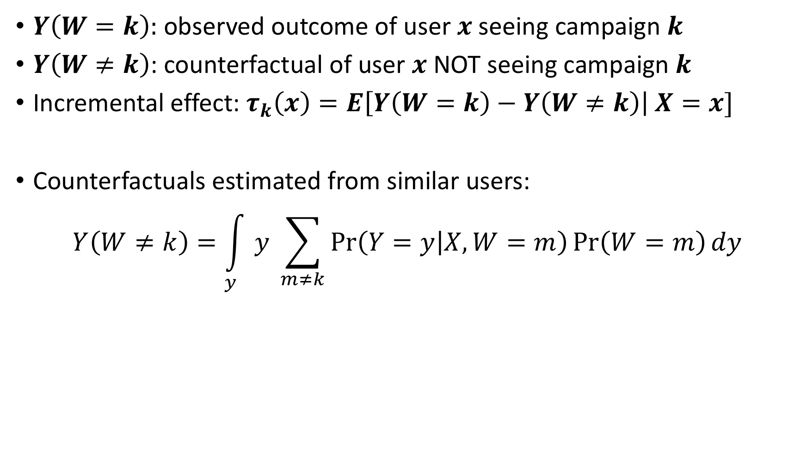
Generation of Local Counterfactuals
$Y\left(W=k\right):$ observed outcome of user $x$seeing campaign $k$
$Y\left(W≠k\right)$: counterfactual of user $x$ NOT seeing campaign $k$
Incremental effect: $τ_{k}\left(x\right)=E\left[Y\left(W=k\right)−Y\left(W≠k\right)\right| X=x]$
Counterfactuals estimated from similar users:
$$Y\left(W≠k\right)=\int_{y}{y \sum_{m≠k}{\operatorname{Pr}\left(Y=y | X, W=m\right)\operatorname{Pr}\left(W=m\right)dy}}$$

Slide 56

Generation of Local Counterfactuals
Probabilistic nature ensures similar customers view different campaigns
Counterfactuals estimated from similar users (KNN, propensity matching)
Measurement: $Y_{i,k}^{∗}$ = $Y_{i}\left(W_{k}=1\right)−Y_{i}\left(W_{k}=0\right)$
Prediction: ${\hat{τ}}_{k}\left(x\right)=𝔼\left[Y_{i,k}^{∗}\right|X_{i}=x]$
Inverse propensity weighting unbiases stochastic exploration

Slide 57
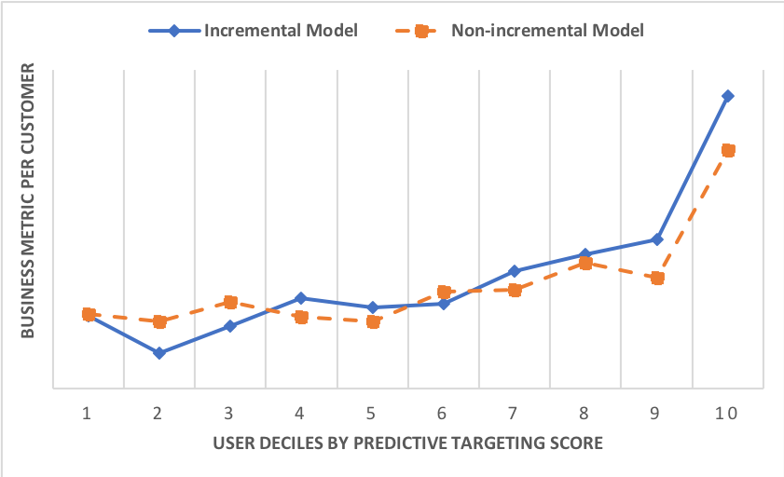
Comparison with conventional marketing

Slide 58
Realtime interactive bandits
KDD’19
With Biswas A, Pham TT, Vogelsong M, Snyder B

Slide 59

I have no idea how to describe this item!
Notes:
Suppose you want to search for an item, but have no idea (Jackie Chan) how to describe it.

Slide 60

Able to give ordinal information
?
?
?
|| ● – ★ ||² < || ○ – ★ ||²
$$P(\text{●}\text{ > }\text{○ | ★})= \frac{1}{1+e^{\text{\{|}\text{|● – ★}\text{|}\text{|}\text{2} \text{−}\text{ ||○ – ★||}\text{2}\text{\}}}}$$
Likelihood of ★
Notes:
But if I give you two choices, you can tell me which one is closer to your target item. (c, explain)
(c) In your feature space, distance between star and White ball is smaller than star and Black ball.
(c) We can even mathematically represent the P of a user picking item A over B, given target.
(c) If I observe a bunch of preference pairs, I can compute likelihood of an item being the target. Can then sample from it.

Slide 61
Adaptive real time search
Pointiness
Color gradient
Notes:
Here is a toy adaptive real time search application. Say our feature space has two dimensions. We need to interactively find the target in the user's mind.

Slide 62
Notes:
And here are our items. Target item is at top right with red arrow. System presents two options. User pick the closest. System recomputes likelihoods and shows two options. Shadowed items are not eliminated, they have reduced likelihood mass.

Slide 63
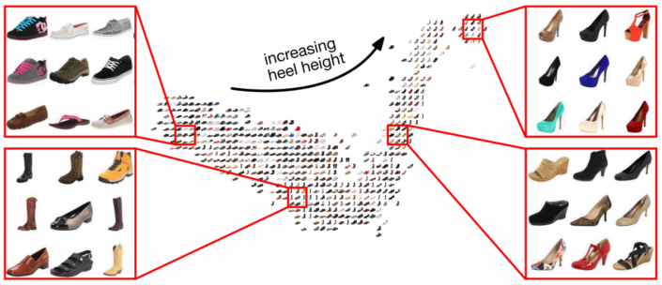
Apply in embedding space
Source: Belongie et al.
Notes:
In reality, we show a slate of recommendation, and apply algorithm in embedding space

Slide 64
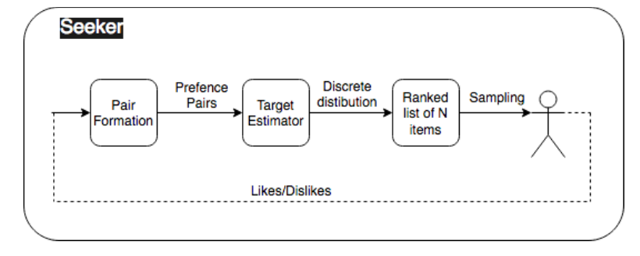
Trade-offs for speed
Fast point-wise target estimation
Very large catalog of items
Need fast real-time contextual bandits
Notes:
Our representation allows for a fast point-wise target estimation. But how do we choose the items to present to user in REAL TIME? We have a very large catalogue, and proper contextual bandits are slow

Slide 65

Sample from point estimates
Generate discrete distribution using softmax equation
Fast sampling using Gumbel-softmax trick
Add uncertainty estimates thru annealing
$$argmax_{j}\left\{g_{j}+\sqrt{\frac{C^{2}}{n_{j}}} Gumbel\left(0,1\right)\right\}∼\frac{e^{g_{j}\sqrt{n_{j}/C^{2}}}}{\sum_{i}{e^{g_{i}\sqrt{n_{i}/C^{2}}}}}=p_{j}$$
Likelihood of ★, pointwise estimate
Sample once
# of interactions with item j
Recover softmax distribution
Notes:
[READ] We get contextual TS bandit behavior, using fast non-contextual techniques

Slide 66
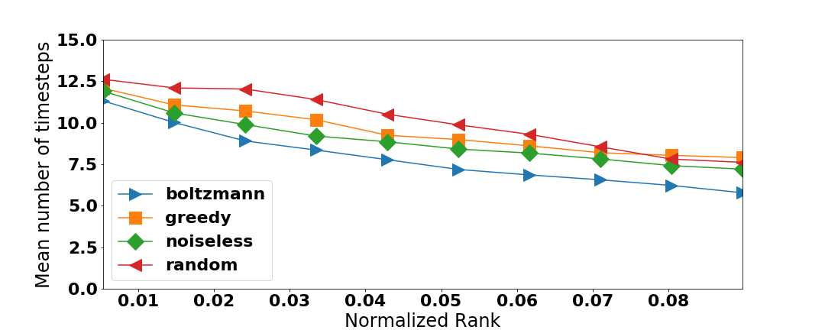
Boltzmann (softmax) bandit

Slide 67
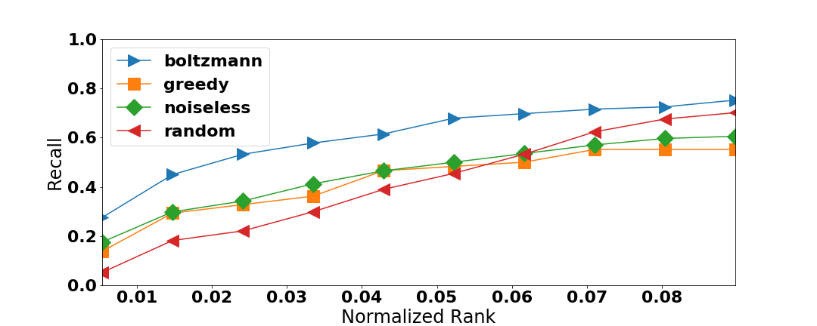
Boltzmann (softmax) bandit

Slide 68
Finding the user’s reward function
ICML’20
With Geng S, Manzanares C, Reppen M, Sircar R

Slide 69
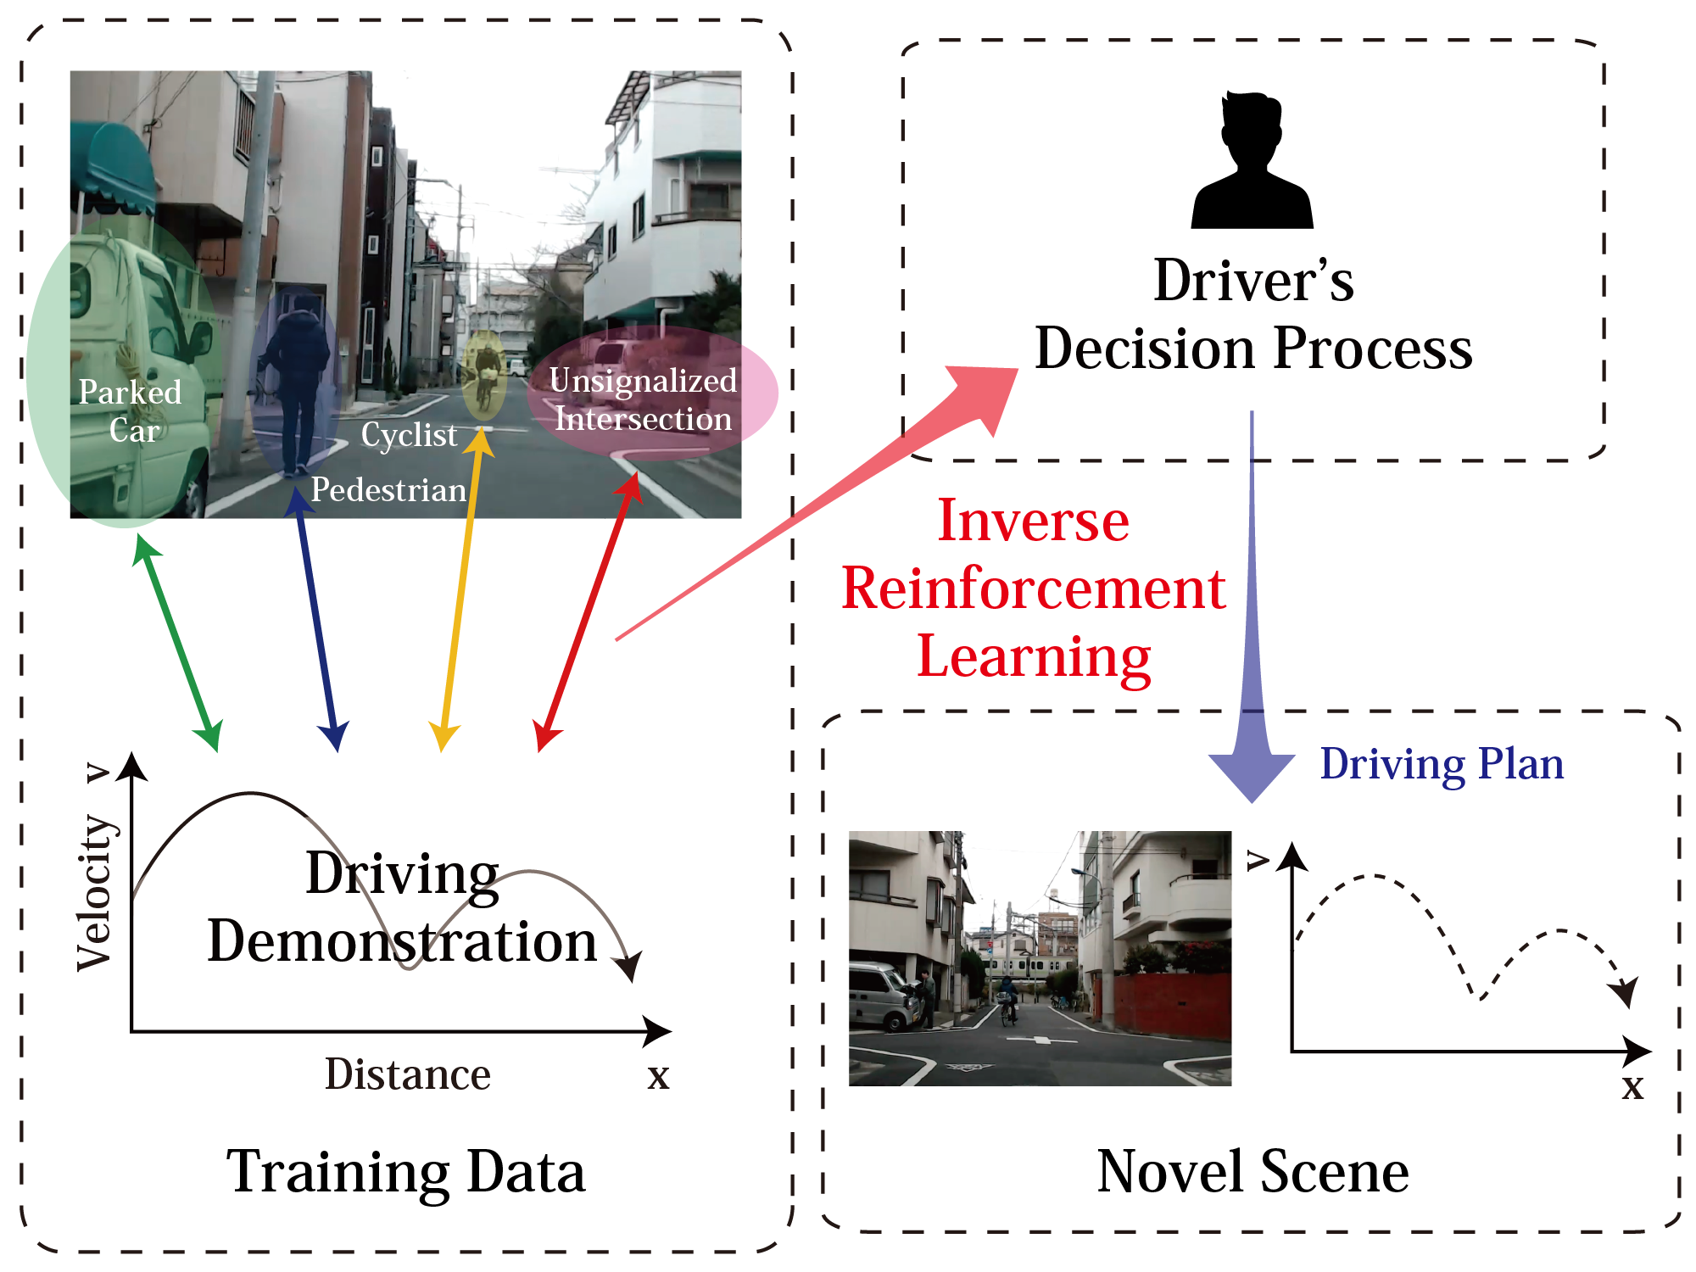
Inverse RL
Goal: Estimate the reward function of an agent given its decision-making history
Source: Shimosaka et al.
Notes:
Reminder of Inverse RL. The aim is to recover a hidden reward function from observed agent demonstrations. Common example is autonomous driving. U record a driver, apply IRL to uncover the driver’s decision process, and then apply it on novel scenes.

Slide 70
Identification issue
Unknown reward function reward(state, action)
Observed demonstrations
Optimal policy
r
IRL
Set of reward functions that explain demonstrations
Notes:
Recovering the reward is not as easy as it seems. Given a reward function, an agent follows a policy and generates demonstrations. Based on demonstrations, IRL attempts to reverse engineer reward. different reward functions could explain the observed demonstrations, making it impossible to identify the true underlying reward function.
Identification issue

Slide 71

Anchor action
Key assumption!
Observed demonstrations
Known reward value for reward(state, action)
Optimal policy
r
PQR method
Naturally satisfied assumption: Do-nothing action, with 0 reward.
Notes:
We add the concept of an anchor action for each state: it is an action whose reward is known a priori
This is key. U may object: it is a restrictive assumption!
It turns out it is often naturally satisfied: the action of doing nothing, with 0 reward.
This assumption, coupled with our method allows exact identification.
IMP: to notice that we allow the Reward to depend on both s & a, not only on state, as other restrictive IRL methods assume
IRL assumes demonstrations result from an optimal policy. But it is impractical to assume agents always make the best choice.

Slide 72
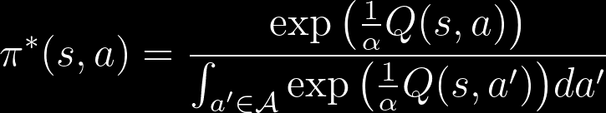

Energy based modeling
Assume agents maximize entropy-augmented long-term expected reward
Assume agents follow stochastic energy-based policy
Optimal policy:
Realistic behavior, agent likely (not guaranteed) to select better actions
Deterministic if $α→0^{+}$
Notes:
We remedy that by assuming agents maximize and follow energy based modeling. Under this paradigm, the optimal policy itself is stochastic (softmax).
Energy based modeling allows for randomness in agent behavior, and is more realistic. Note that other IRL methods require deterministic optimal policy.
U can recover the deterministic case by setting alpha = 0

Slide 73
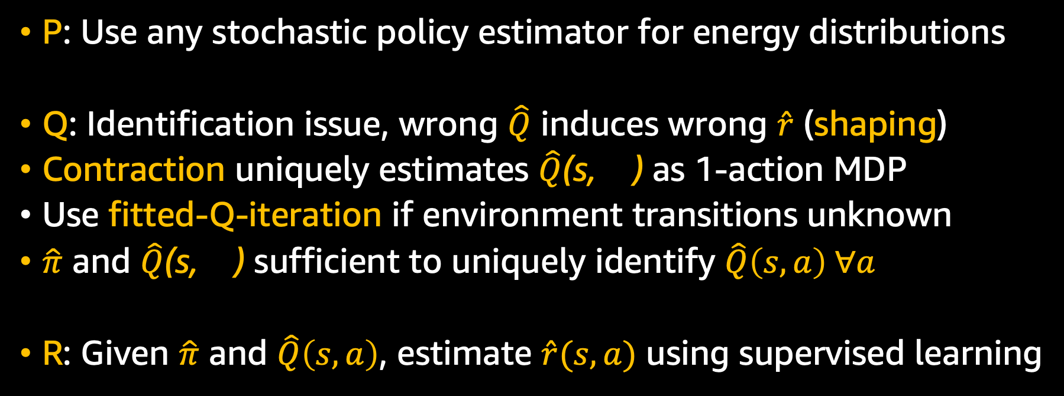
PQR: Policy, Q-function, Reward
P: Use any stochastic policy estimator for energy distributions
Q: Identification issue, wrong $\hat{Q}$ induces wrong $\hat{r}$ (shaping)
Contraction uniquely estimates $\hat{Q}$(s, ) as 1-action MDP
Use fitted-Q-iteration if environment transitions unknown
$\hat{π}$ and $\hat{Q}$(s, ) sufficient to uniquely identify $\hat{Q}\left(s,a\right) ∀a$
R: Given $\hat{π}$ and $\hat{Q}\left(s,a\right)$, estimate $\hat{r}(s,a)$ using supervised learning
Notes:
We call our method PQR, as we sequentially estimate Policy, Q-func, Reward. First step is to estimate policy using any stochastic policy estimator for energy distributions.
2nd step is Q-estimation. Here, we run into identification issue, as wrong Q induces wrong R (shaping)
We leverage anchor action to solve a fixed point contraction to uniquely estimate Q for anchor actions.
As transitions are usually unknown, we use a deep Q-network strategy, on which we apply the contraction repeatedly over demonstrations.
Now we have estimates of policy and Q-anchor, which are sufficient to identify Q for all state-action pairs.
Final step, using policy & Q-func estimates, we can recover reward using supervised learning
FQI algorithm uses a deep function for QA(s), and implements the operator T by repeatedly leveraging the observed demonstrations. Because contraction expectation is over unknown transitions.
Solves it using Q-network strategy. Q is deep net. Apply expectation contraction operator repeatedly on Q-network. For expectation, get it from observed samples (run thru observed samples)
Same idea as auto-encoder (with X & Y changing)

Slide 74
Reward estimation
Theoretical guarantee: Estimation error is non-asymptotically upper bounded (under some assumptions)
Reward recovery MSE, for (5, 10, 20, 40) state feature dimensions
Notes:
We also provide non-asymptotic upper bounds on estimation error for PQR. Results show that it performs very well, as compared to other IRL methods.

Slide 75
Thank you!
Questions? Comments?
houssam.nassif@gmail.com
Full papers at:
http://pages.cs.wisc.edu/~hous21/

Slide 76

Appendix

Slide 77

Submodular diversity
$c$: category, $i$: item, $S$: diversified set, score($i$): $i$’s recommender score
Category utility:
$$fc(S) = log\left(1 + \sum_{i∈S∩c}{\text{score}(i)}\right)$$
Maximize sum of all category utilities:
$${argmax}_{S}\left(ρ\left(S\right)=\sum_{c}{fc\left(S\right)}\right)$$
Greedy near-optimal solution: $S_{t+1}=S_{t}∪\{{argmax}_{i\backslash S_{t}}ρ\left(S_{t}∪\{i\}\right)\}$
Notes:
category utility: log of sum of item scores.
Incorporate recommender score into diversity measure
Maximize sum of all category utilities: submodular.
Near optimal solution achieved iteratively, greedily adding item with highest incremental utility.

Slide 78

Theoretical Results
Unbiasedness property of meta-prior variance estimator:
$E\left[{\hat{τ}}_{k}^{2}\right]=$ $τ_{k}^{2}$- $\frac{1}{N_{k} (N_{k}−1)}$ $\sum_{\begin{aligned}i,j∈C_{k} \\ i≠j\end{aligned}}{Cov({\tilde{μ}}_{i},{\tilde{μ}}_{j})}$
Our meta-prior variance estimator is strongly consistent when:
  Feature estimates ${\tilde{μ}}_{i}$ and their observed variances ${\tilde{σ}}_{i}^{2}$ are independent
  Expectation and variance exist for ${\tilde{μ}}_{i}$,${ \tilde{μ}}_{i}^{2}$, and ${\tilde{σ}}_{i}^{2}$.
Cumulative regret of our EB TS bandit is of order $\tilde{O}(d^{\frac{3}{2}} \sqrt{T})$

