Slide 1
Diversifying Music Recommendations
Houssam Nassif, Kemal Oral Cansizlar,
Mitchell Goodman, S.V.N. Vishwanathan
houssamn@amazon.com
Notes:
Thank you all for coming. I will be presenting today an experiment of diversifying music recommendation that my colleagues Oral, Mitchell, Vishy and I did at amazon

Slide 2
Outline
Motivation
Jaccard Swap diversity method
Submodular diversity method
Experiment
Notes:
So why do we care about diversity in music recommendations?

Slide 3
Why diversify music stream?
Notes:
Simply scoring by relevance, a musical stream may look like this. Not an enticing visual appearance. balance between product scores and variety.
Research: user likely to interact with this recom-mendation. Diverse & visually pleasing, yet relevant.
Thus the need to establish balance between relevance and diversity. this talk: move from to

Slide 4
Music considerations
Explicit clusters: album, artist
Same album: same meta-data (album cover graphic, title)
User behavior: play album songs back-to-back
Similar scores to same-album songs
Notes:
Unlike other digital and physical products, music content tends to have explicit clusters.
album contains multiple songs. Share same album cover graphic, title and description.
In addition to overlapping content features, album songs also share behavioral features as users play them back to back.
As a result, Recommender systems tend to score same-album songs similarly.

Slide 5
About Amazon Prime Music
Free benefit for prime members
Millions of songs
Thousands of expert-programmed playlists
Upload your own music
Create personal playlists
Notes:
In amazon prime music, this may result in customer perceived duplication.
Prime music: “browse by”, various carousels

Slide 6
Amazon Prime Music mobile app
Access your music from anywhere
List-form recommendation
Devices with limited interaction capability
Notes:
This work presents experiments to diversify Amazon Music mobile app recommendations.
Existing recommender engine. Display recommended content in list form.
Duplication problem amplified due to limited screen, and being more onerous to navigate

Slide 7
Outline
Motivation
Jaccard Swap diversity method
Submodular diversity method
Experiment
Notes:
We experiment with two diversification methods. The first, Jaccard Swap, is

Slide 8
Explanation-based diversity
C. Yu, L. Lakshmanan, S. Amer-Yahia. It takes variety to make a world: Diversification in recommender systems. EDBT 2009.
$u$: user, $i$: item
$\text{ItemSim}\left(i, i^{′}\right)$: similarity measure between two items
$\text{Items}(u)$: Set of items user $u$ interacted with
$\text{E}\text{xpl}\left(u,i\right)=\left\{i^{′} \right| \text{ItemSim}\left(i, i^{′}\right)>ε \text{\& }i’∈\text{Items}(u)\}$
Notes:
An explanation based method by yahoo research.
U, I, Some similarity measure.
Interacted with: listened, rated
The explanation of recommending item (i) to user (u) is the set of items similar to item (i) that user (u) has interacted with. Obtained by content-based, or filtering and latent methods.

Slide 9
Jaccard diversity distance
$$Du(i,j) =1 − \frac{\left|\text{Expl}\left(u,i\right) ∩ \text{Expl}\left(u,j\right)\right|}{\left|\text{Expl}\left(u,i\right) ∪ \text{Expl}\left(u,j\right)\right|}$$
$Du\left(i,j\right)=1$ if explanation sets completely separate
$Du\left(i,j\right)=0$ if explanation sets are identical
Notes:
Jaccard diversity distance between items (i,j) for user (u) :
1- ratio of the intersection over the union of their explanation sets
Similarity measure. Ranges between 1 if sets completely separate, to 0 for identical sets

Slide 10
Algorithm Swap
$$Di=\sum_{j}{Du\left(i,j\right)}$$
Recommender score
Explanatory set
$$Du(i,j)$$
7
1.17
2/3
6.2
1/2
1.66
And if $Δ\text{score}< τ$
If diversity increases
1
6
1.5
5
1.5
1
Notes:
Heuristic. Sort items by recommender score, pick top K
Compute pairwise Jaccard diversity distance
Compute diversity sum for each item, pick min
Swap if diversity increases
And if score doesn’t drop below threshold

Slide 11
Outline
Motivation
Jaccard Swap diversity method
Submodular diversity method
Experiment
Notes:
Now we turn our attention to the submodular method, which is more principled

Slide 12
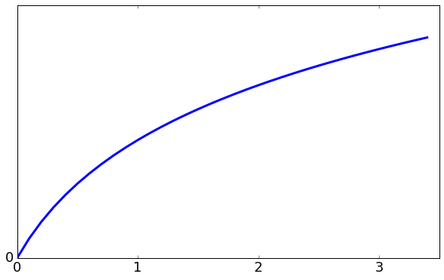
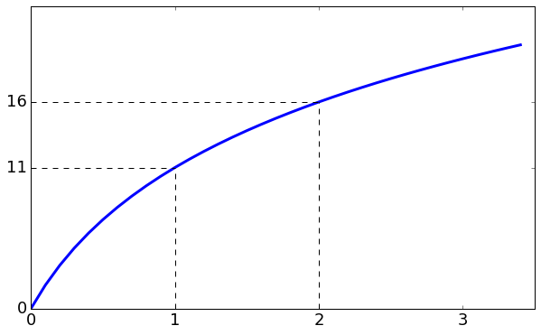
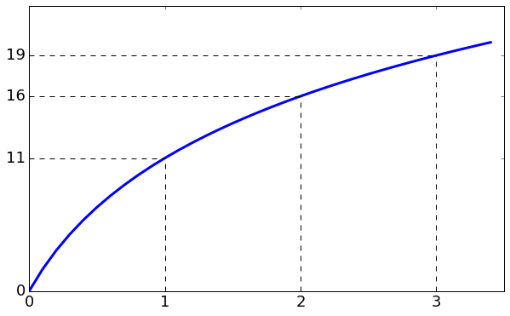
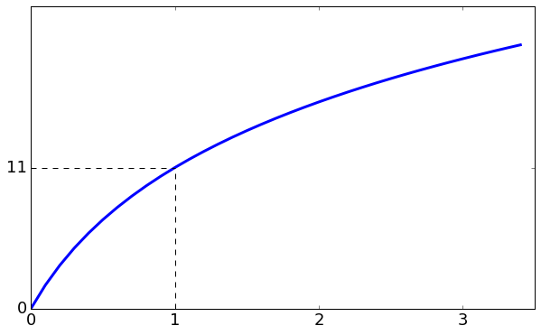
Diminishing returns
Set utility
+3
Incremental utility
tapers off
+5
+11
Cumulative number of explanation items in set
Notes:
Submodular function nicely models diminishing returns.
http://choonhui.aka.amazon.com:8888/notebooks/research/airstream/notebooks/airstream%20talk%20slides.ipynb

Slide 13
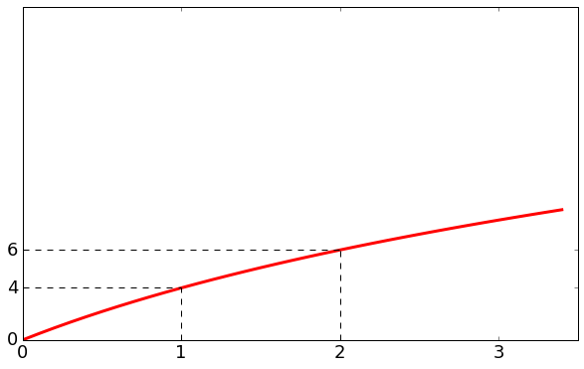
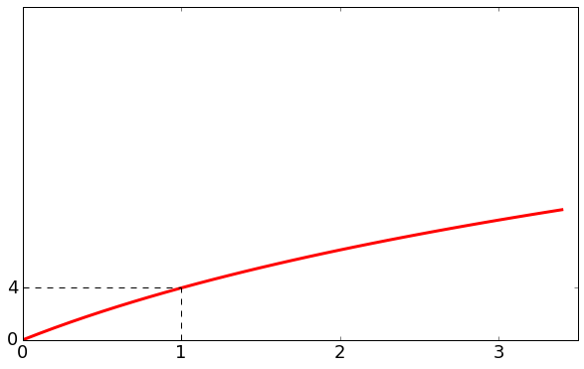
Submodular diversity mix
+3
+5
+11
+2
+4
Diversified list:
Notes:
Two submodular functions with different utilities. Create a mix.
At some point the incremental utility of adding a circle is higher.
Let us formalize

Slide 14
Submodular diversity
$c$: category, $i$: item, $S$: diversified set, score($i$): $i$’s recommender score
Category utility:
$$fc(S) = log\left(1 + \sum_{i∈S∩c}{\text{score}(i)}\right)$$
Maximize sum of all category utilities:
$${argmax}_{S}\left(ρ\left(S\right)=\sum_{c}{fc\left(S\right)}\right)$$
Greedy near-optimal solution: $S_{t+1}=S_{t}∪\{{argmax}_{i\backslash S_{t}}ρ\left(S_{t}∪\{i\}\right)\}$
Notes:
category utility: log of sum of item scores
Jaccard swap sorted by recommender score and had independent diversity measure. Incorporate recommender score into diversity measure
Log1p: contribute no more than recommender score.
$Maximize sum of all category utilities: submodular.
Near optimal solution achieved iteratively, greedily adding to set S item with highest incremental utility.

Slide 15
Outline
Motivation
Jaccard Swap diversity method
Submodular diversity method
Experiment

Slide 16
Experimental setup
Baseline: Rank by recommender score
Item-to-item collaborative filtering recommender provides item score and explanation set
Artist and album as Jaccard explanation set features and submodular categories ( , , , …)
Randomized controlled trial with equal customer allocation

Slide 17
Results
Treatment comparison | Increase in minutes streamed
Submodularity vs Baseline | 0.64% (p=0.03)
Jaccard Swap vs Baseline | 0.40% (p=0.18)
Submodularity vs Jaccard Swap | 0.24% (p=0.41)
Diversity affects recommendation quality
Submodularity method improvement is significant
Notes:
We measure minutes streamed, which is the number of minutes customers listen to recommended songs.
Indicator metric, whether a customer consumed music or not, was up and significant for T2 & T3. how many more customers we are able to engage.

Slide 18
Baseline vs Submodular

Slide 19
Submodular approach benefits
Smoothness:
Submodularity produces uniformly diverse set. All contiguous subsets are also diverse.
Jaccard Swap doesn’t.
Relevance:
Swap may not retain most relevant content.
Submodularity ensures most relevant item is first, followed by mix of most relevant items within each category.
Notes:
Our submodular solution fares better. One reason is that Submodularity produces uniformly diverse stream. Diminishing returns property holds for any contiguous part of the recommended list.
$Another is that swap may not retain most relevant content, like we saw in our toy example. Submod ensures most relevant item is first, followed by mix of most relevant items within categories

Slide 20
Takeaways
Diversifying music recommendations improves recommendation quality and user engagement.
Incorporate recommender score into diversity measure.
Submodular approach produces relevant and uniformly diverse mix.

Slide 21
Thank you!
Questions?
houssamn@amazon.com
We are hiring!

