Slide 1
Industrial Data Science: Amazonian Perspective
Houssam Nassif
houssamn@amazon.com

Slide 2
Background
Me in one word: Curious
Career path: A biologist turned Artificial Intelligence scientist
Biomedical research hospital, Department of Natural Resources, Cisco, Google
Currently Senior ML Scientist at Amazon

Slide 3
Research
Modeling protein binding
Breast cancer prediction
Information Retrieval
Uplift modeling
Submodular diversity
Multi-armed bandit
http://pages.cs.wisc.edu/~hous21/

Slide 4
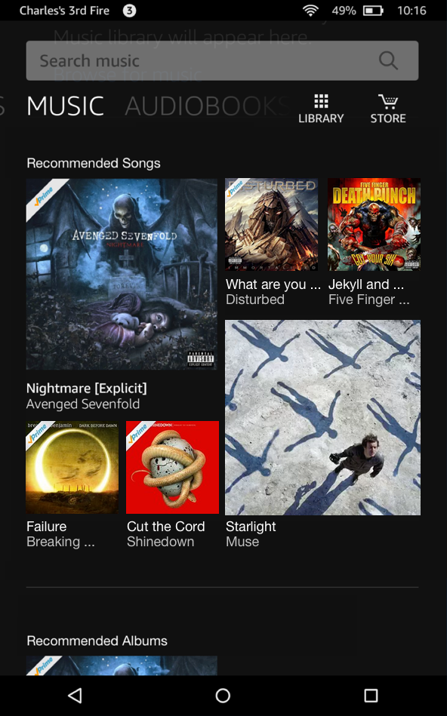
Music diversity
Notes:
Simply scoring by relevance, a musical stream may look like this. User behavior and metadata
Not an enticing visual appearance.
Diverse & visually pleasing, yet relevant.

Slide 5
Relevant and diverse stream
Notes:
Stream is a new product discovery experience designed to show customer a large collection of products in an endless beautiful imagery.
No customer intent. Window shopping.
This paper describes our solutions for overcoming the challenges we faced

Slide 6
Notes:
We also do algorithm innovations

Slide 7
Model incremental outcomes

Slide 8
Empirical Bayes bootstrapping
Bandit
Empirical Bayes
Data duplication
Notes:
Empirical Bayes.

Slide 9
Want to know more?
Stop by our talk, today at 11:10 AM, CC-Room 306
Session TB18, Empirical Studies in Operations Management
Want to help? We are hiring engineers and scientists!
Questions? Comments?
houssamn@amazon.com
http://pages.cs.wisc.edu/~hous21/

