Slide 1
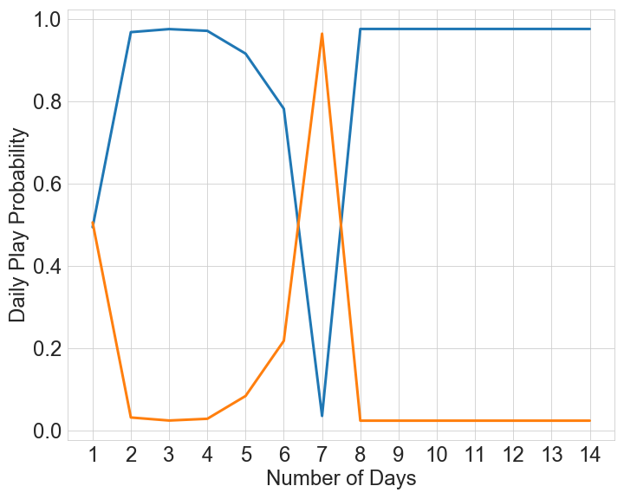
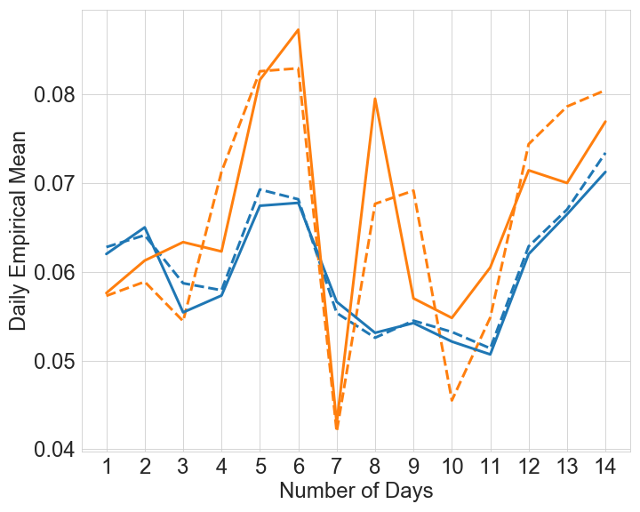
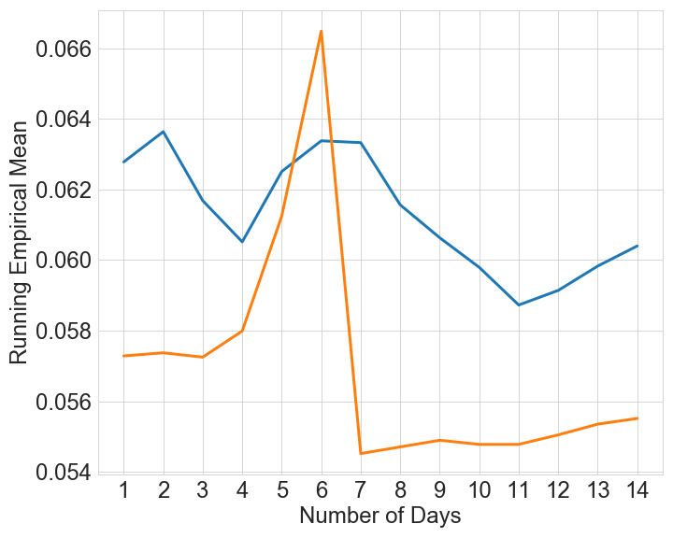
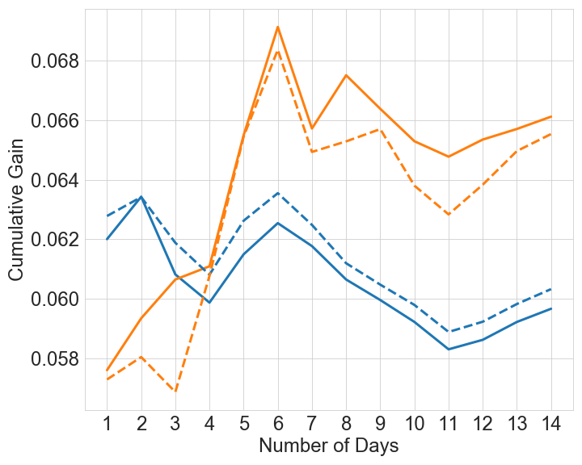
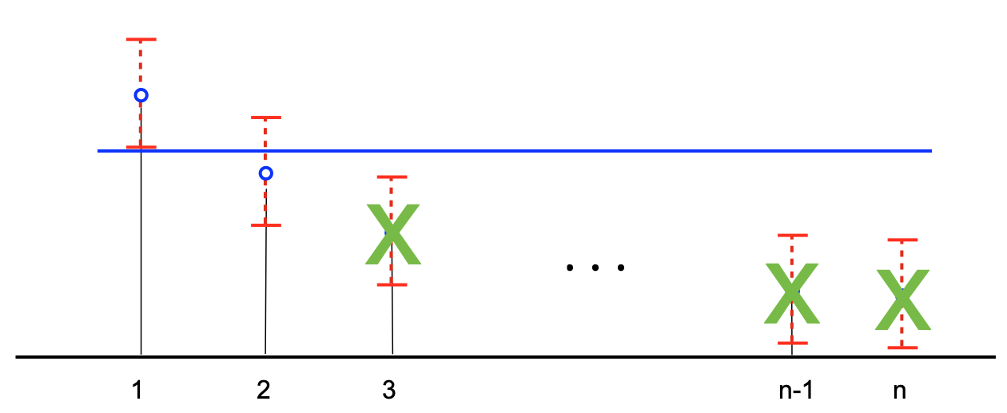
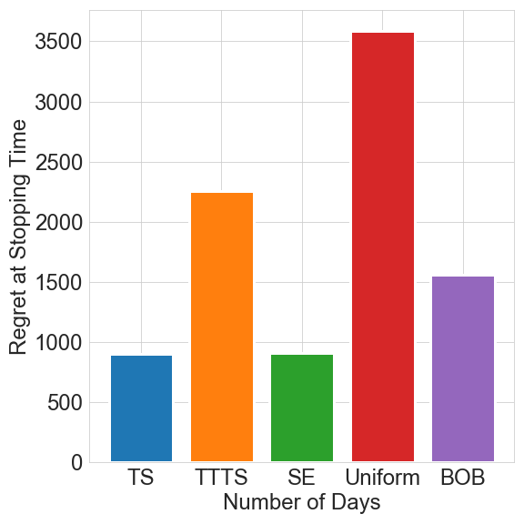
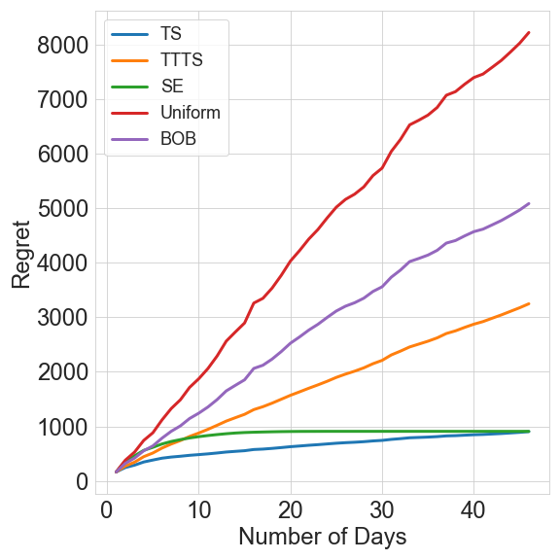
Adaptive Experimental Design and Counterfactual Inference
Tanner Fiez¹, Sergio Gamez¹ , Arick Chen¹ , Houssam Nassif¹ , Lalit Jain^{1,2}
¹Amazon, ²University of Washington
Motivating Case Study
Objective: Best of Three Worlds
Daily Traffic Split
Daily Message Means
Identify Counterfactual Best
Minimize Opportunity Cost
Marketer runs 2 week experiment using Thompson Sampling
Fails to have a significant t-test
Empirical means, and posterior probability are misleading for decision making. Simpson’s Paradox
Cumulative Gain: how much reward it would gain if it received all the traffic is robust
Mostly Model Agnostic
Method: Successive Elimination on Cumulative Gain
Normalized Cumulative Gain
Assume that mean is constant over a day
We have $k$-arms, the distribution of arm $i$ on day $t$ is $Ber\left(μ_{i,t}\right)$
Algorithm selects allocation $\left(p_{1,t}, p_{2,t},⋯, p_{k,t}\right)∈Δ^{k}$
$n_{t}$ total samples on day $t$
Total observed reward of arm $i$ on day $t$is $r_{it}$
Running Empirical Means
$$CG_{i}=\sum_{s=1}^{T}{n_{s}μ_{s,i}}$$
$${\hat{CG}}_{i}=\sum_{s=1}^{T}{\frac{r_{is}}{p_{i}}}$$
Cumulative Gain
IPS Estimate
Lessons Learned
1
2
3
n-1
n
Regret Minimization Isn’t Enough
Inference is important
Goal of experimentation is not just informing the current decision, but more importantly the next decision!
Be Wary of the Batch
Batch updates can lead to early decisions that mislead adaptive algorithms
Be robust to biases that occur due to infrequent batch updating
Experiments
Identify the Counterfactual Best
Empirical mean is poorly behaved, hard to understand and prone to Simpson’s Paradox
Cumulative Gain: Identify the counterfactual best, i.e. the arm with the highest total reward over experimentation period
Provide Always Valid Inference
If it’s on a dashboard, people will look at it. Show daily empirical means so people can debug.
Always valid confidence intervals provide for safe sequential monitoring for any adaptive procedure.
Stopping Times
Regret at Stopping
Regret
Elimination obtains significance quickly, is robust to time-variation, and has low experiment cost

