Slide 1
Solving Inverse Reinforcement Learning, Bootstrapping Bandits, and Adaptive Recommendation
HOUSSAM NASSIF
Amazon Research
Notes:
Today I will be presenting three distinct RL/bandit projects that have two qualities in common. First, they all leverage reward signals to inform recommendation, second, they all were led by interns.

Slide 2
Solving Inverse Reinforcement Learning
Geng S, Nassif H, Manzanares C, Reppen M, and Sircar R
ICML’20
Notes:
The first project is about solving IRL. Led by sinong, published at ICML

Slide 3
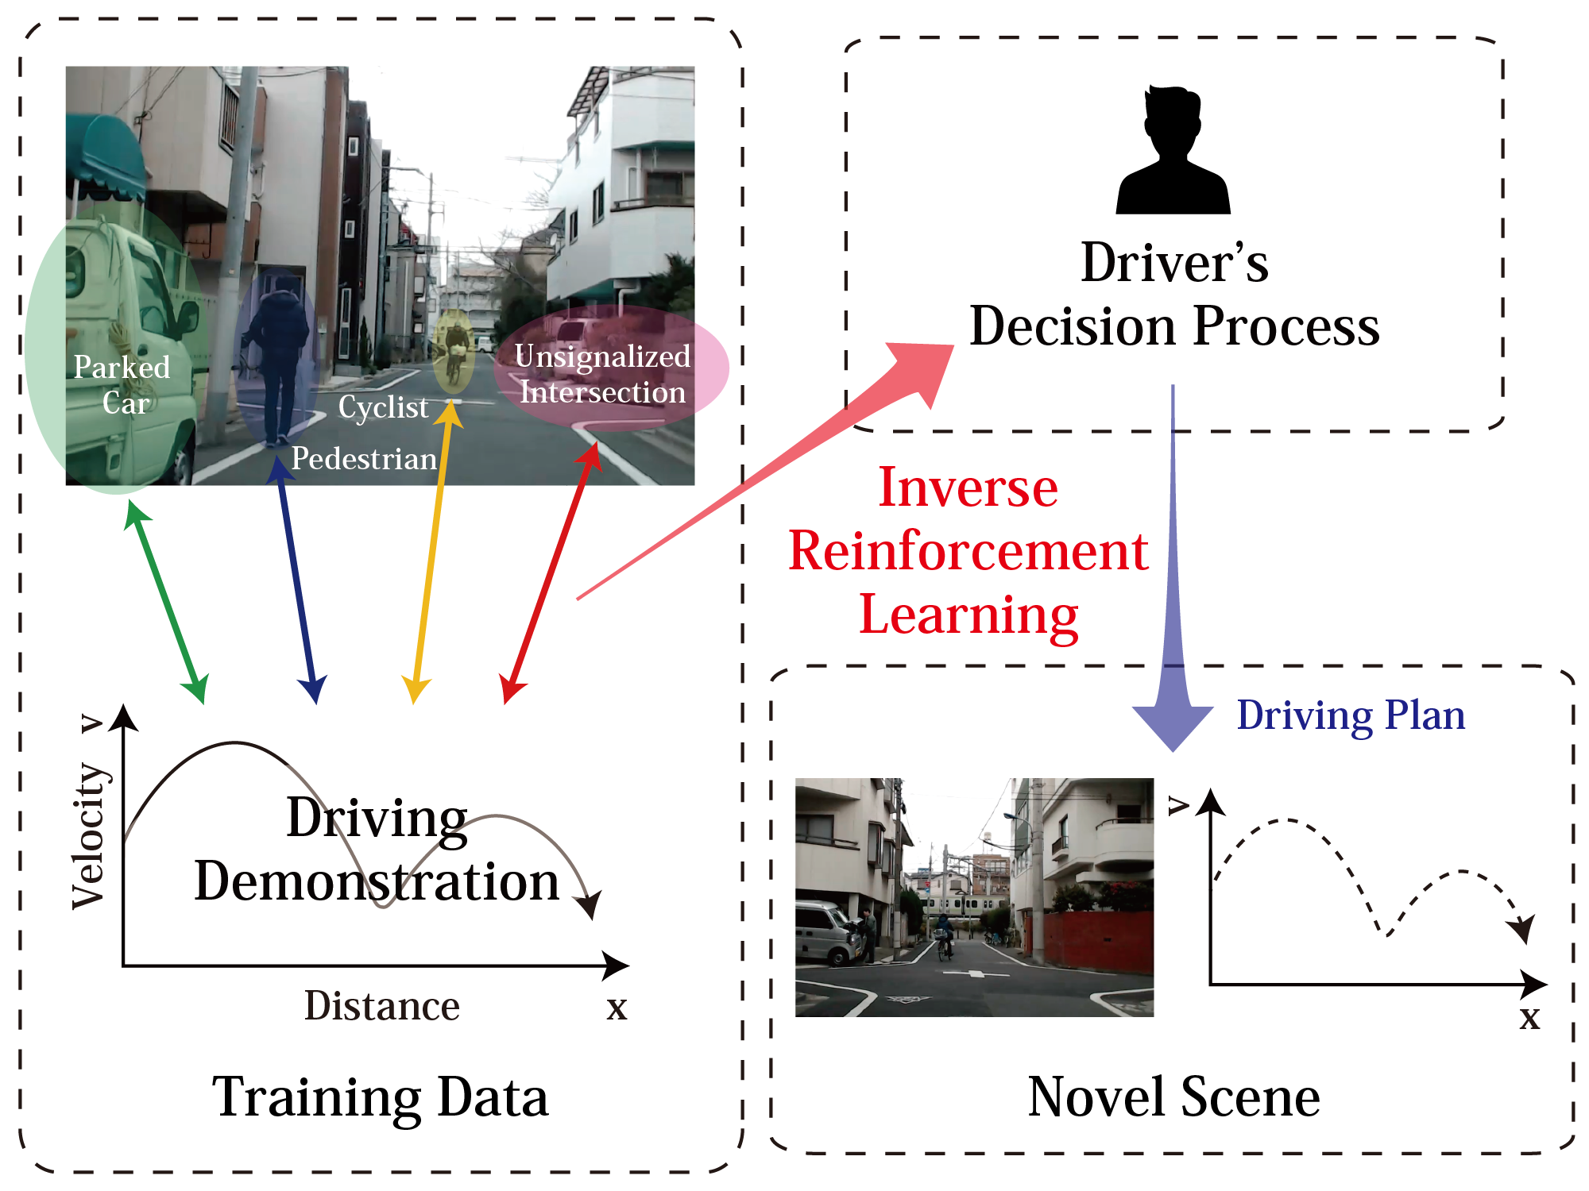
Inverse RL
Goal: Estimate the reward function of an agent given its decision-making history
Source: Shimosaka et al.
Notes:
Reminder of Inverse RL. The aim is to recover a hidden reward function from observed agent demonstrations. Common example is autonomous driving. U record a driver, apply IRL to uncover the driver’s decision process, and then apply it on novel scenes.

Slide 4
Identification issue
Unknown reward function reward(state, action)
Observed demonstrations
Optimal policy
r
IRL
Set of reward functions that explain demonstrations
Notes:
Recovering the reward is not as easy as it seems. Given a reward function, an agent follows a policy and generates demonstrations. Based on demonstrations, IRL attempts to reverse engineer reward. different reward functions could explain the observed demonstrations, making it impossible to identify the true underlying reward function.
Identification issue

Slide 5

Anchor action
Key assumption!
Observed demonstrations
Known reward value for reward(state, action)
Optimal policy
r
PQR method
Naturally satisfied assumption: Do-nothing action, with 0 reward.
Notes:
We add the concept of an anchor action for each state: it is an action whose reward is known a priori
This is key. U may object: it is a restrictive assumption!
It turns out it is often naturally satisfied: the action of doing nothing, with 0 reward.
This assumption, coupled with our method allows exact identification.
IMP: to notice that we allow the Reward to depend on both s & a, not only on state, as other restrictive IRL methods assume
IRL assumes demonstrations result from an optimal policy. But it is impractical to assume agents always make the best choice.

Slide 6
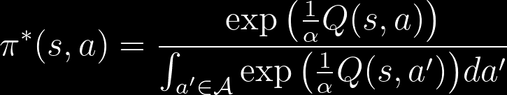

Energy based modeling
Assume agents maximize entropy-augmented long-term expected reward
Assume agents follow stochastic energy-based policy
Optimal policy:
Realistic behavior, agent likely (not guaranteed) to select better actions
Deterministic if $α→0^{+}$
Notes:
We remedy that by assuming agents maximize and follow energy based modeling. Under this paradigm, the optimal policy itself is stochastic (softmax).
Energy based modeling allows for randomness in agent behavior, and is more realistic. Note that other IRL methods require deterministic optimal policy.
U can recover the deterministic case by setting alpha = 0

Slide 7
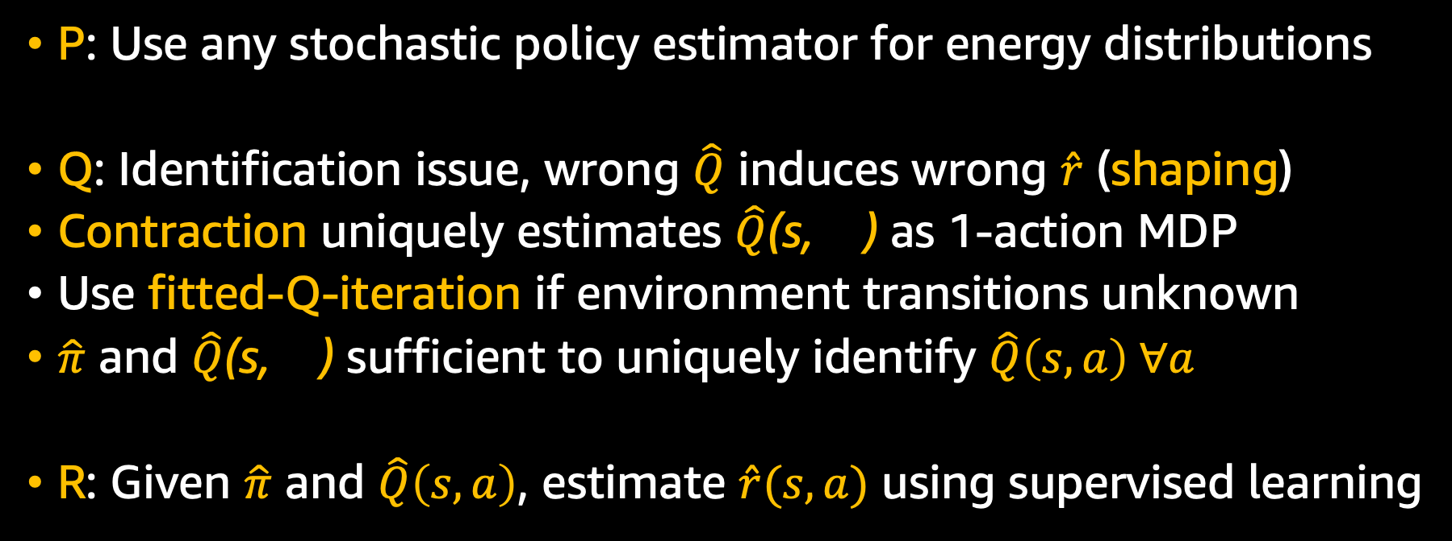
PQR: Policy, Q-function, Reward
P: Use any stochastic policy estimator for energy distributions
Q: Identification issue, wrong $\hat{Q}$ induces wrong $\hat{r}$ (shaping)
Contraction uniquely estimates $\hat{Q}$(s, ) as 1-action MDP
Use fitted-Q-iteration if environment transitions unknown
$\hat{π}$ and $\hat{Q}$(s, ) sufficient to uniquely identify $\hat{Q}\left(s,a\right) ∀a$
R: Given $\hat{π}$ and $\hat{Q}\left(s,a\right)$, estimate $\hat{r}(s,a)$ using supervised learning
Notes:
We call our method PQR, as we sequentially estimate Policy, Q-func, Reward. First step is to estimate policy using any stochastic policy estimator for energy distributions.
2nd step is Q-estimation. Here, we run into identification issue, as wrong Q induces wrong R (shaping)
We leverage anchor action to solve a fixed point contraction to uniquely estimate Q for anchor actions.
As transitions are usually unknown, we use a deep Q-network strategy, on which we apply the contraction repeatedly over demonstrations.
Now we have estimates of policy and Q-anchor, which are sufficient to identify Q for all state-action pairs.
Final step, using policy & Q-func estimates, we can recover reward using supervised learning
FQI algorithm uses a deep function for QA(s), and implements the operator T by repeatedly leveraging the observed demonstrations. Because contraction expectation is over unknown transitions.
Solves it using Q-network strategy. Q is deep net. Apply expectation contraction operator repeatedly on Q-network. For expectation, get it from observed samples (run thru observed samples)
Same idea as auto-encoder (with X & Y changing)

Slide 8
Reward estimation
Theoretical guarantee: Estimation error is non-asymptotically upper bounded (under some assumptions)
Reward recovery MSE, for (5, 10, 20, 40) state feature dimensions
Notes:
We also provide non-asymptotic upper bounds on estimation error for PQR. Results show that it performs very well, as compared to other IRL methods.

Slide 9
Bootstrapping Bandits
Nabi S, Nassif H, Hong J, Mamani H, and Imbens G
Management Science
Notes:
Second project, led by Sareh. Forthcoming at Management Science

Slide 10
Multiple-slot template
Stop biking pointlessly, join team Circle!
Slots
Best way to bicycle!
We cycle and re-cycle!
No point in not joining!
Join now!
Check other teams
Notes:
Say you have an ad with multiple slots

Slide 11
Each slot has multiple variations
Alternative
variants
Image
slot
Notes:
each with alternative variants

Slide 12
Second-order features
Stop biking pointlessly, join team Circle!
Year-round carousel rides!
Unlimited laps!
All you can eat Pi!
No corners to hide!
Hurry, don’t linger around!
Join now!
Check other teams
Notes:
Our representation captures all pairwise interactions as 2nd order features

Slide 13
Featurization
First-order features, X¹: variant values
E.g. “image1”, “title2”, “button1”
Second-order features, X²: variant combinations/interactions
E.g. “image1 AND title2”, “image1 AND button1”
Concatenate for final feature vector representation:
X = [X¹, X²]
Notes:
In this simple example, we have two categories of features, 1st order, and 2nd order. We concatenate them for final feature vector

Slide 14
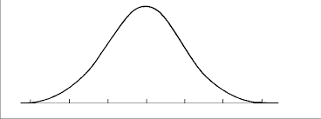

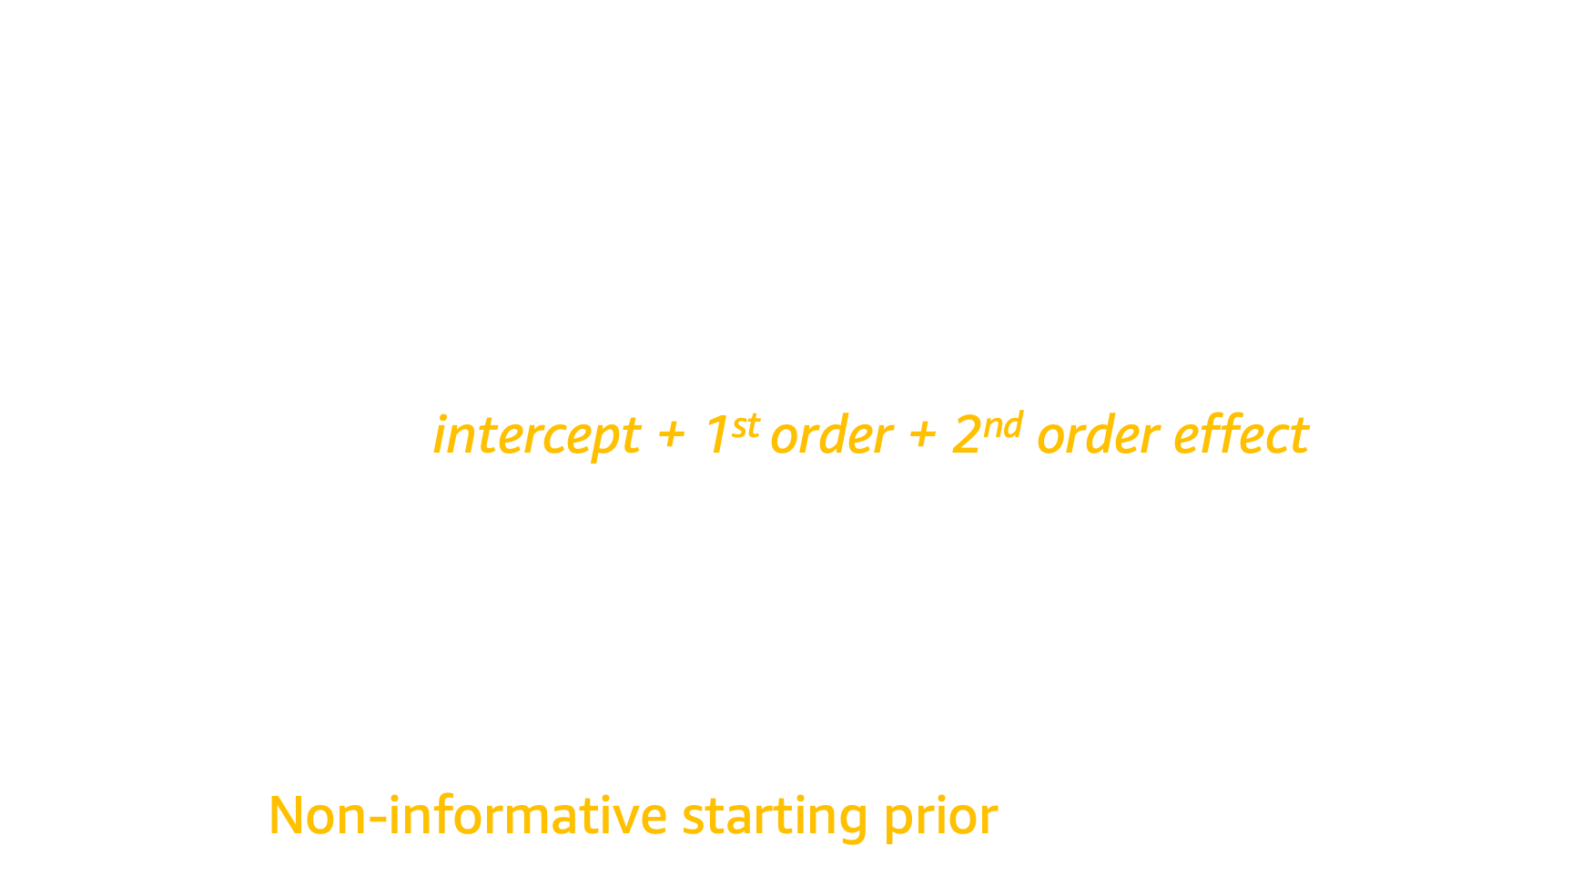




Bayesian generalized linear models
$$X^{⊤}W=w^{0}+\sum_{i}{w_{i}^{1}x_{i}^{1}+\sum_{i}{\sum_{j}{w_{ij}^{2} x_{ij}^{2}}}}$$
intercept + 1st order + 2nd order effect
$X^{⊤}W=$
Non-informative starting prior: $w_{i}∼N(0,1)$
${∗x}_{1}$+
${∗x}_{2}+⋯$ =
$$w_{1}∼N({\tilde{μ}}_{1}, {\tilde{σ}}_{1}^{2})$$
$$w_{2}∼N({\tilde{μ}}_{2}, {\tilde{σ}}_{2 }^{2})$$
$$∑w_{i}x_{i}$$
Notes:
And we feed them into a Bayesian GLM, (c) where each feature is associated with a distribution. (c) These weight distributions generally start with a non-informative prior

Slide 15



Impose Bayesian hierarchy
Compute empirically from data
Impose meta-prior:
$$N\left(ν_{Cat1}, τ_{Cat1}^{2}\right)$$
$$N\left(ν_{Cat2}, τ_{Cat2}^{2}\right)$$
$$X^{⊤}W=w^{0}+\sum_{i}{w_{i}^{1}x_{i}^{1}+\sum_{i}{\sum_{j}{w_{ij}^{2} x_{ij}^{2}}}}$$
Category 1
Category 2
Notes:
Our question is, can we leverage the data to start from informative priors instead?
(c) Our features can be divided into 2 categories. But our method applies to any feature grouping.
(c) We impose a hierarchical meta-prior, (c) that we compute from the observed data itself

Slide 16


Empirical Bayes algorithm
Start with non-informative priors:
$$N\left(0, 1\right)$$
$$N\left(0, 1\right)$$
$$X^{⊤}W=w^{0}+\sum_{i}{w_{i}^{1}x_{i}^{1}+\sum_{i}{\sum_{j}{w_{ij}^{2} x_{ij}^{2}}}}$$
Initial data
Run
Category 1
Category 2
Notes:
Here is how our EB algorithm works. read slide

Slide 17

Empirical Bayes algorithm
Compute empirically from data
$$N\left(ν_{Cat1}, τ_{Cat1}^{2}\right)$$
$$N\left(ν_{Cat2}, τ_{Cat2}^{2}\right)$$
$$X^{⊤}W=w^{0}+\sum_{i}{w_{i}^{1}x_{i}^{1}+\sum_{i}{\sum_{j}{w_{ij}^{2} x_{ij}^{2}}}}$$
Initial data
Run
Category 1
Category 2

Slide 18
Empirical Bayes algorithm
Restart model with empirical priors:
$$N\left(ν_{Cat1}, τ_{Cat1}^{2}\right)$$
$$N\left(ν_{Cat2}, τ_{Cat2}^{2}\right)$$
$$X^{⊤}W=w^{0}+\sum_{i}{w_{i}^{1}x_{i}^{1}+\sum_{i}{\sum_{j}{w_{ij}^{2} x_{ij}^{2}}}}$$
Initial data
Run
Category 1
Category 2

Slide 19
Empirical Bayes algorithm
Run as usual
$$N\left(ν_{Cat1}, τ_{Cat1}^{2}\right)$$
$$N\left(ν_{Cat2}, τ_{Cat2}^{2}\right)$$
$$X^{⊤}W=w^{0}+\sum_{i}{w_{i}^{1}x_{i}^{1}+\sum_{i}{\sum_{j}{w_{ij}^{2} x_{ij}^{2}}}}$$
Run
Category 1
Category 2

Slide 20
When to compute empirical prior
Longer reset time helps more
Empirical prior helps, even with one day
Notes:
Compute EB prior after 0, 1, 3 days. Lower is better.

Slide 21
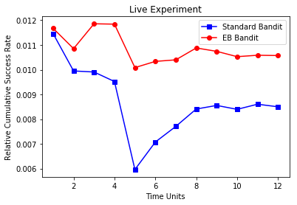
Live experiment
Notes:
Live experiment. Y-axis is success rate, higher is better. (c) EB converges faster (time unit 5 vs 8), and is more stable.

Slide 22
Adaptive Recommendation
Biswas A, Pham TT, Vogelsong M, Snyder B, and Nassif H
KDD’19
Notes:
Final project was led by Ari, and published at KDD’19

Slide 23

I have no idea how to describe this item!
Notes:
Suppose you want to search for an item, but have no idea how to describe it.

Slide 24

Able to give ordinal information
?
?
?
|| ● – ★ ||² < || ○ – ★ ||²
$$P(\text{●}\text{ > }\text{○ | ★})= \frac{1}{1+e^{\text{\{|}\text{|● – ★}\text{|}\text{|}\text{2} \text{−}\text{ ||○ – ★||}\text{2}\text{\}}}}$$
Likelihood of ★
Notes:
But if I give you two choices, you can tell me which one is closer to your target item. (c, explain)
(c) In your feature space, distance between star and White ball is smaller than star and Black ball.
(c) We can even mathematically represent the P of a user picking item A over B, given target.
(c) If I observe a bunch of preference pairs, I can compute likelihood of an item being the target. Can then sample from it.

Slide 25
Adaptive real time search
Pointiness
Color gradient
Notes:
Here is a toy adaptive real time search application. Say our feature space has two dimensions. We need to interactively find the target in the user's mind.

Slide 26
Notes:
And here are our items. Target item is at top right with red arrow. System presents two options. User pick the closest. System recomputes likelihoods and shows two options. Shadowed items are not eliminated, they have reduced likelihood mass.

Slide 27
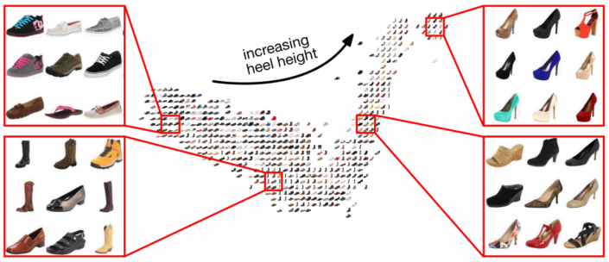
Apply in embedding space
Source: Belongie et al.
Notes:
In reality, we show a slate of recommendation, and apply algorithm in embedding space

Slide 28
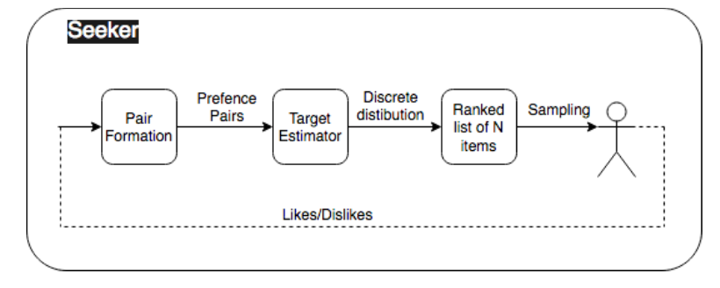
Trade-offs for speed
Fast point-wise target estimation
Very large catalog of items
Need fast real-time contextual bandits
Notes:
Our representation allows for a fast point-wise target estimation. But how do we choose the items to present to user in REAL TIME? We have a very large catalogue, and proper contextual bandits are slow

Slide 29

Sample from point estimates
Generate discrete distribution using softmax equation
Fast sampling using Gumbel-softmax trick
Add uncertainty estimates thru annealing
$$argmax_{j}\left\{g_{j}+\sqrt{\frac{C^{2}}{n_{j}}} Gumbel\left(0,1\right)\right\}∼\frac{e^{g_{j}\sqrt{n_{j}/C^{2}}}}{\sum_{i}{e^{g_{i}\sqrt{n_{i}/C^{2}}}}}=p_{j}$$
Likelihood of ★, pointwise estimate
Sample once
# of interactions with item j
Recover softmax distribution
Notes:
[READ] We get contextual TS bandit behavior, using fast non-Bayesian non-contextual techniques

Slide 30
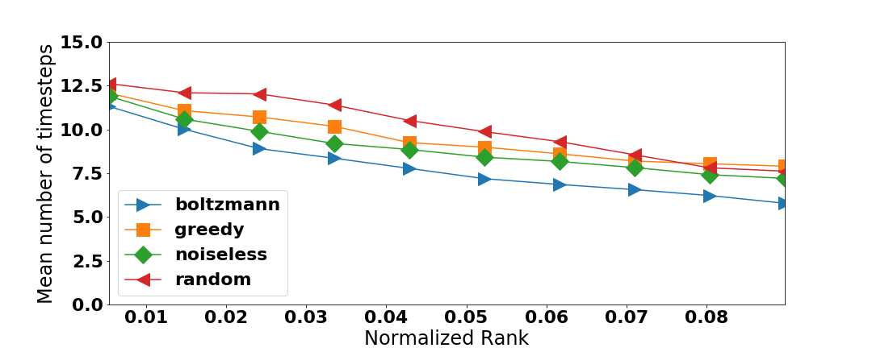
Boltzmann (softmax) bandit

Slide 31
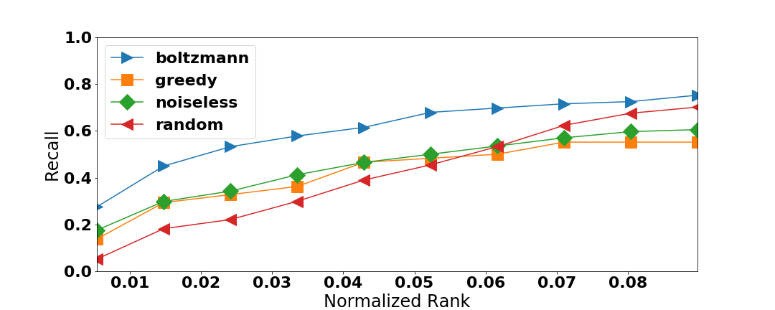
Boltzmann (softmax) bandit

Slide 32
Thank you!
Questions? Comments?
houssamn@amazon.com
http://pages.cs.wisc.edu/~hous21/

