Slide 1
A practitioner’s perspective on Artificial Intelligence
UK Lebanon Tech Hub
Houssam Nassif
Houssam.nassif@gmail.com

Slide 2
Background
Me in one word: Curious
Career path: A biologist turned Artificial Intelligence scientist
Biomedical research hospital, Department of Natural Resources, Cisco, Google, Amazon
http://pages.cs.wisc.edu/~hous21/

Slide 3
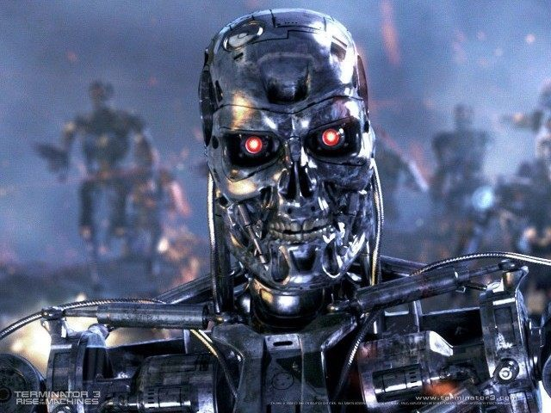
Artificial Intelligence is…

Slide 4
…ubiquitous and mundane
Spam filter
Routing (network, cellular, transportation)
Text/Speech/Image recognition
Self-driving cars
Recommender systems
Personalized and curated content
Ad targeting, market segmentation…
Computers learn and function without being explicitly programmed

Slide 5
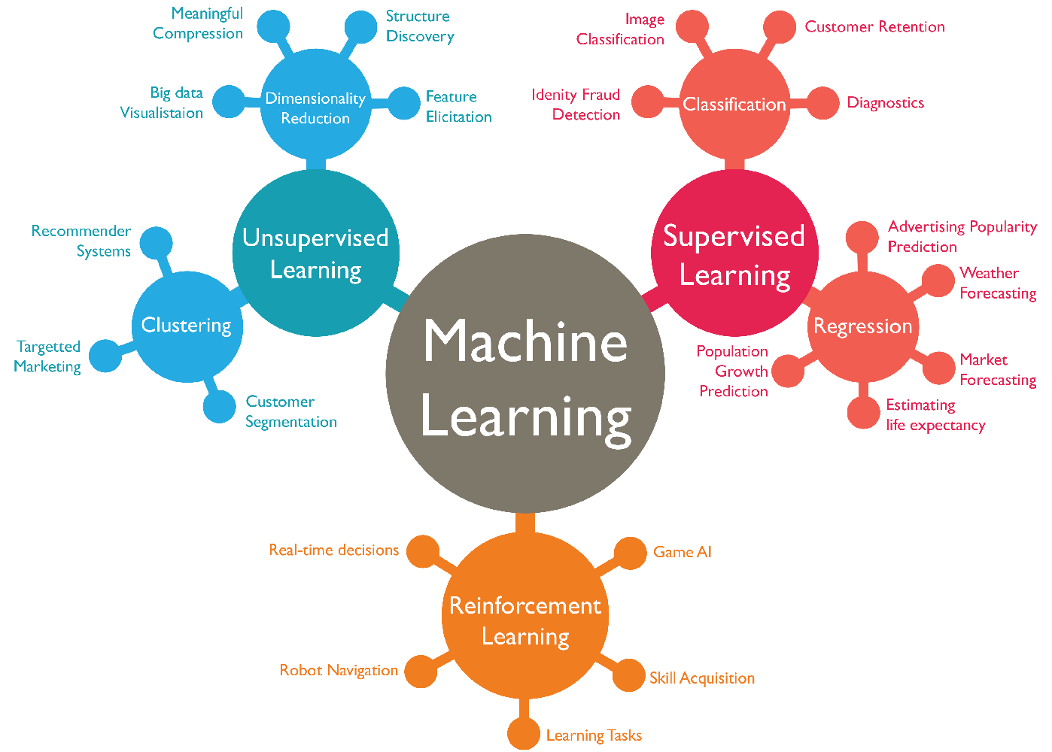
Image credit: Abdul Rahid
Notes:
ML == AI. As opposed to Knowledge representation, NLP

Slide 6
Do I need AI/ML?
Simple algorithms take you a long way
AI needs lots of data and/or good data
Plenty of black box and out of the box tools
Democratizing playing field: deep nets
No Free Lunch Theorem
Notes:
“Hacky” SDE solution very hard to beat
Humbling experience
Data wrangler is crucial. MLE and Data scientists.
Respect what came before

Slide 7
ML projects in production

Slide 8
Timelines
Microsoft examples, Ralf Herbrich
Halo 2 Beta Test
Research
Code
Devel
Work with Game Devs
Research
Develop
Work with Game Devs
Simulation work and Tool Development for Halo 3
Research
Work with Bungie
Tool Develop
(Halo 3)
TrueSkill (41 months)
Jul 2004
Mar 2005
Dec 2005
Mar 2006
Jun 2006
Mar 2007
Jul 2007
Sep 2004
Dec 2004
Nov 2005
May 2007
Nov 2007
Ad predictor (28 months)
Problem Identify
AdCenter Compete
Offline Evaluation
Working with Development Team on scalable Training
Research Analysis
Development of Tools
Beta Test
Jan 2007
Mar 2007
May 2007
Aug 2007
Mar 2008
Jun 2008
Dec 2008
Mar 2009
Notes:
3-18 months per project.

