Slide 1
Recent Developments of Logistic Linear Bandits
Kwang-Sung Jun (전광성)
Assistant Professor

Slide 2


Interactive machine learning
Examples: Product recommendation, online advertising, interactive search
Goal: (1) present interesting items or (2) perform A/B/$⋯$/K testing
The challenge: feedback loop
present an item
click or
How to best collect data in order to improve the performance in the long run?
Research Goal: Develop interactive ML algorithms with small sample complexity and computational efficiency and study their fundamental limits.
Notes:
예를 들어주죠.
(1) 상품추천 (2) A/B 테스팅 – 웹페이지 레이아웃..

Slide 3
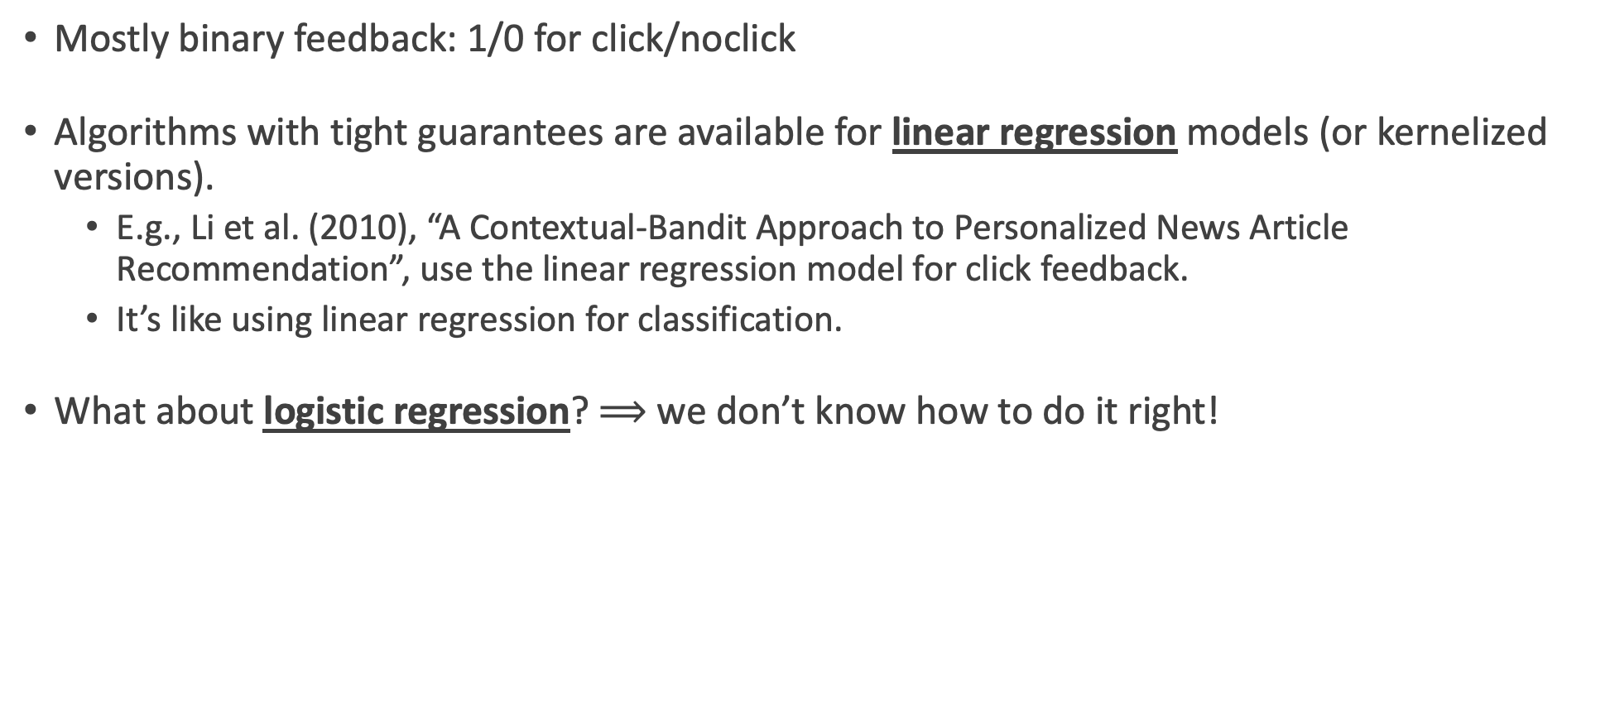
Interactive machine learning: Where are we?
Mostly binary feedback: 1/0 for click/noclick
Algorithms with tight guarantees are available for linear regression models (or kernelized versions).
  E.g., Li et al. (2010), “A Contextual-Bandit Approach to Personalized News Article Recommendation”, use the linear regression model for click feedback.
  It’s like using linear regression for classification.
What about logistic regression? $⟹$ we don’t know how to do it right!
The challenge: Finite-time uncertainty estimation with nonlinear feedback models
(and without the i.i.d. assumption)

Slide 4

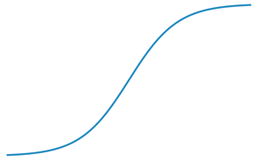
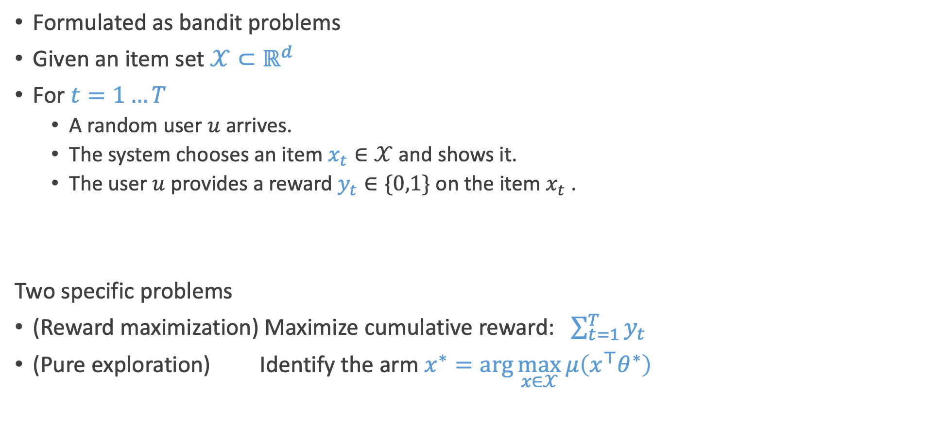
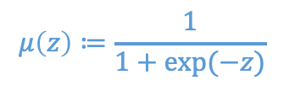

TL;DR
Formulated as bandit problems
Given an item set $𝒳⊂ℝ^{d}$
For $t=1…T$
  A random user $u$ arrives.
  The system chooses an item $x_{t}∈𝒳$ and shows it.
  The user $u$ provides a reward $y_{t}∈\{0,1\}$ on the item $x_{t}$ .
Two specific problems
(Reward maximization) Maximize cumulative reward: $\sum_{t=1}^{T}{y_{t}}$
(Pure exploration) Identify the arm $x^{∗}=\arg{\max_{x∈𝒳}{μ\left(x^{⊤}θ^{∗}\right)}}$
$$μ\left(z\right)≔\frac{1}{1+exp⁡(−z)}$$
1
[Assumption] $y_{t} \sim Bernoulli\left( μ\left(x_{t}^{⊤}θ^{∗}\right) \right)$
unknown parameter
0
0
-4
4
Jun, Jain, Mason, and Nassif, "Improved Confidence Bounds for the Linear Logistic Model and Applications to Linear Bandits”, ICML’21
Notes:
Reward maximization: population level recommendation for the best news slot.
Pure exploration: content layout => perhaps there are many parameters to adjust…

Slide 5
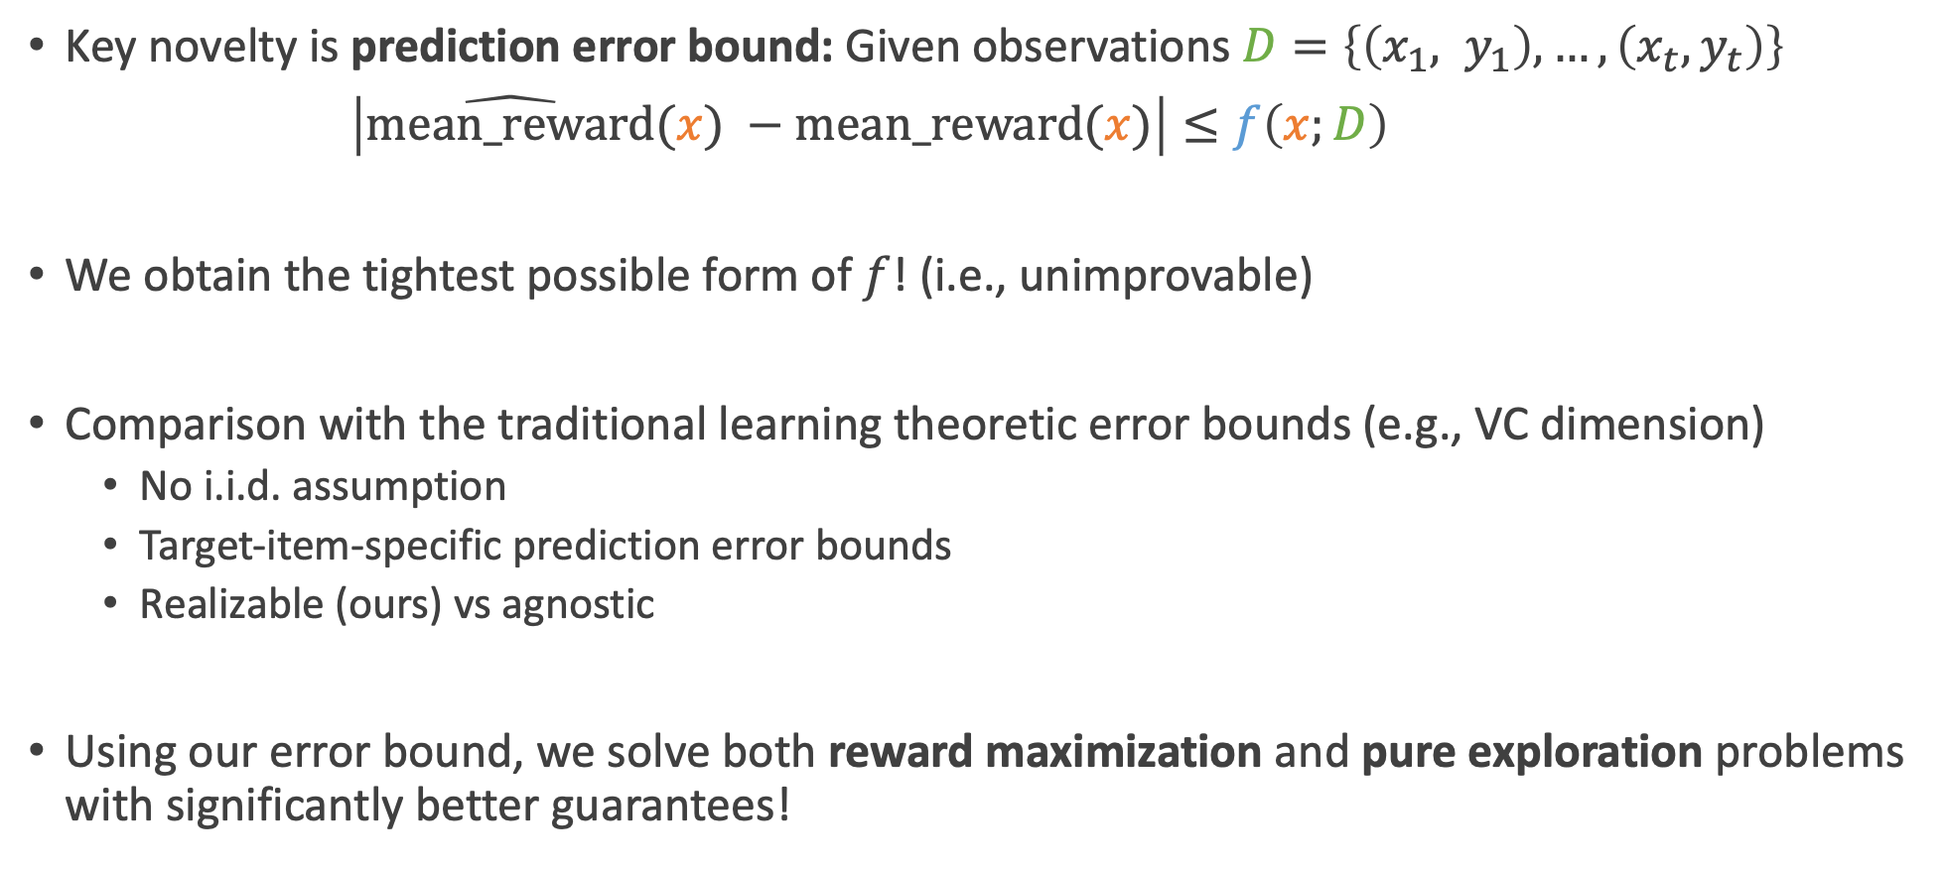

TL;DR
Key novelty is prediction error bound: Given observations $D=\left\{\left(x_{1}, y_{1}\right), …, \left(x_{t}, y_{t}\right)\right\}$
$\left|\hat{mean_reward}(x) −mean_reward(x)\right|≤f\left(x;D\right)$
We obtain the tightest possible form of $f$! (i.e., unimprovable)
Comparison with the traditional learning theoretic error bounds (e.g., VC dimension)
  No i.i.d. assumption
  Target-item-specific prediction error bounds
  Realizable (ours) vs agnostic
Using our error bound, we solve both reward maximization and pure exploration problems with significantly better guarantees!
target item (arbitrary)
some $f$ (explained later)
Jun, Jain, Mason, and Nassif, "Improved Confidence Bounds for the Linear Logistic Model and Applications to Linear Bandits”, ICML’21

Slide 6
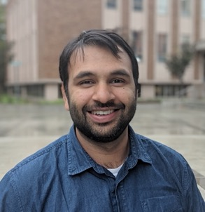
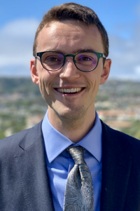

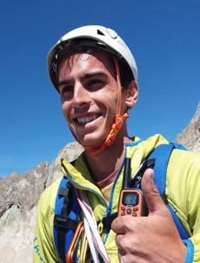

Collaborators
Lalit Jain
Assistant Professor
UW
Blake Mason
Postdoc
UW-Madison
Houssam Nassif
Amazon
Louis Faury
Criteo AI Lab
Marc Abeille
Criteo AI Lab

Slide 7
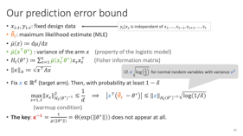
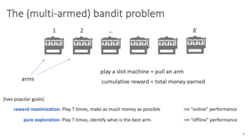
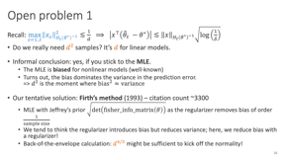
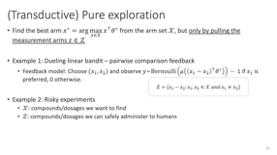
Summary
1. background on bandits
2. prediction error bounds
3. bandit algorithms
4. open problems

Slide 8



The (multi-armed) bandit problem
1
2
…
$$K$$
play a slot machine = pull an arm
arms
cumulative reward = total money earned
[two popular goals]
reward maximization: play T times, make as much money as possible
$⟹$“online” performance
pure exploration: play T times, identify what is the best arm.
$⟹$ “offline” performance
Q: What determines the problem difficulty?
Notes:
Explain the expected behavior to achieve these goals

Slide 9

The (multi-armed) bandit problem
1
2
…
$$K$$
side information is available ⟹ less exploration!
the difficulty is determined by the richness of the ‘side info’, not the number of arms!

Slide 10
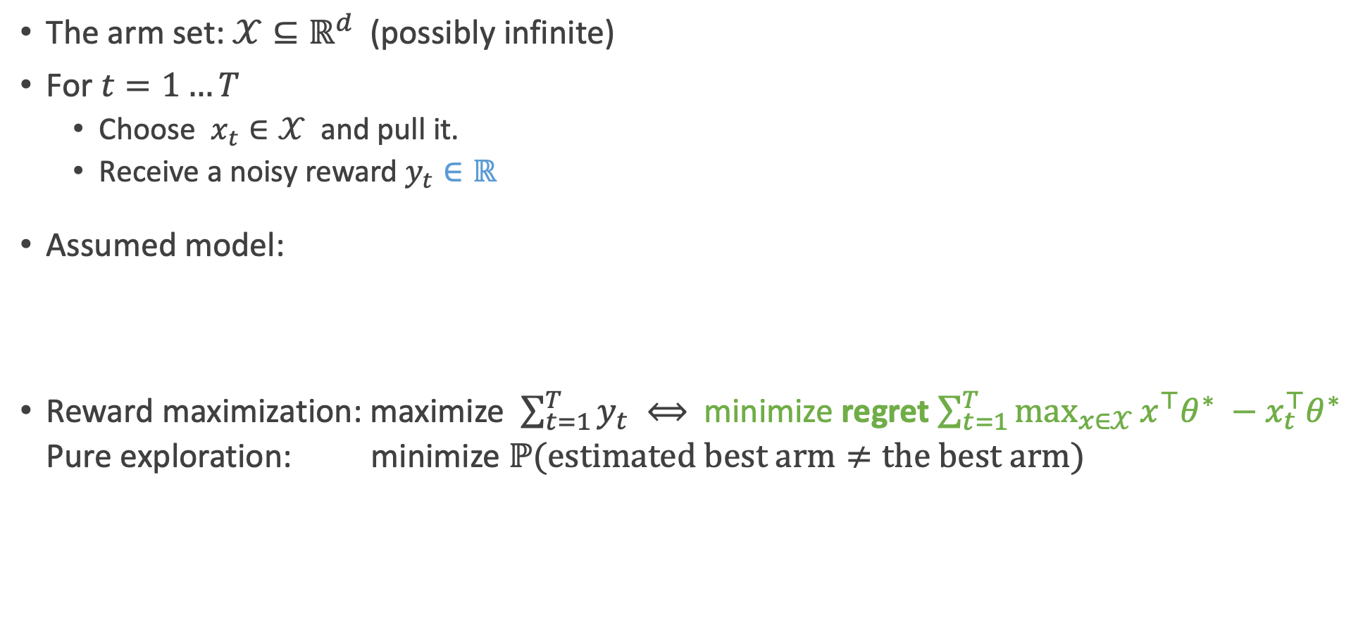


Linear bandits ($=$bandits with features)
The arm set: $𝒳⊆ℝ^{d}$ (possibly infinite)
For $t=1…T$
  Choose $x_{t}∈𝒳$ and pull it.
  Receive a noisy reward $y_{t}∈ℝ$
Assumed model:
Reward maximization: maximize $\sum_{t=1}^{T}{y_{t}} ⟺$ minimize regret $\sum_{t=1}^{T}{\max_{x∈𝒳}{x^{⊤}θ^{∗}} −x_{t}^{⊤}θ^{∗}}$
Pure exploration: minimize $ℙ(estimated best arm≠the best arm)$
$$y_{t}=x_{t}^{⊤}θ^{∗}+η_{t}$$
zero-mean noise (e.g., Gaussian)
unknown parameter
* can leverage user information in each time $⟹$ contextual bandits.
E.g., an arm = $vec\left(u_{t}z^{⊤}\right)$
user vector
item vector
Auer, Using Confidence Bounds for Exploitation-Exploration Trade-offs, 2002.

Slide 11
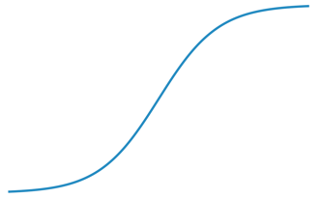

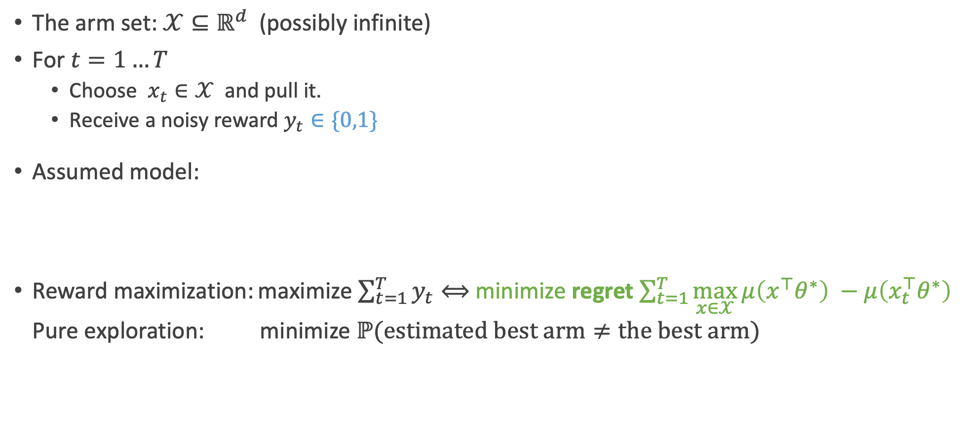
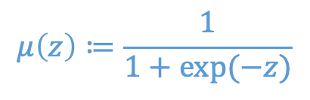
Logistic linear bandits
$$μ\left(z\right)≔\frac{1}{1+exp⁡(−z)}$$
The arm set: $𝒳⊆ℝ^{d}$ (possibly infinite)
For $t=1…T$
  Choose $x_{t}∈𝒳$ and pull it.
  Receive a noisy reward $y_{t}∈\{0,1\}$
Assumed model:
Reward maximization: maximize $\sum_{t=1}^{T}{y_{t}}⟺$ minimize regret$\sum_{t=1}^{T}{\max_{x∈𝒳}{μ\left(x^{⊤}θ^{∗}\right)} −μ\left(x_{t}^{⊤}θ^{∗}\right)}$
Pure exploration: minimize $ℙ(estimated best arm≠the best arm)$
mean
parameter
1
0
$$y_{t} \sim Bernoulli\left( μ\left(x_{t}^{⊤}θ^{∗}\right) \right)$$
-4
0
4
natural parameter
link function
Filippi, Cappe, Garivier, and Szepesvari, “Parametric Bandits: The Generalized Linear Case”, 2010.

Slide 12

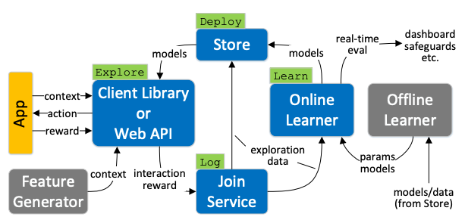
Applications: Reward maximization
online new recommendation
online advertisements
product recommendation
Multiworld testing Decision Service (MWT)
by Microsoft

Slide 13

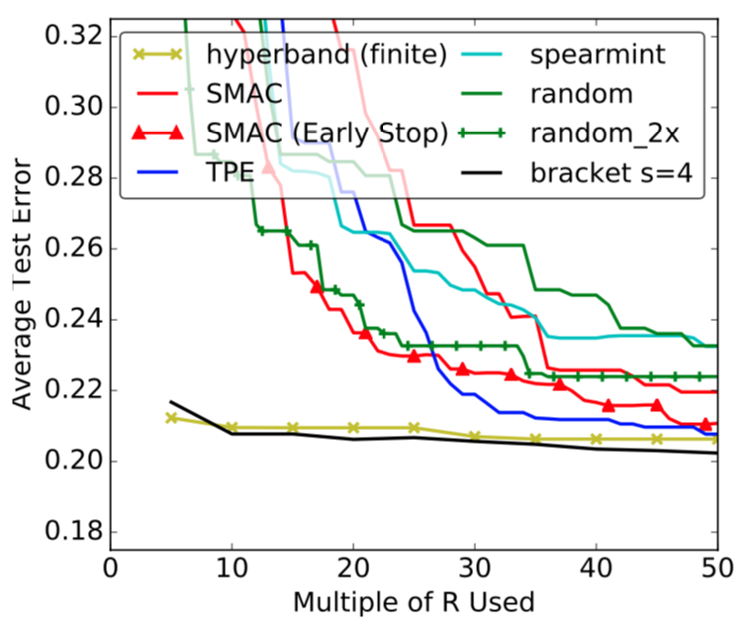
Applications: Pure exploration
  Monte-Carlo tree search
Hyperparameter optimization
arm = possible move
reward = results of random playout
arm = hyperparameter configuration
reward = holdout set accuracy improvement

Slide 14
Applications: Pure exploration
crowdsourcing (cartoon caption contest)
arm = submitted caption
reward = 0 (unfunny), 1 (somewhat funny), 2 (funny)

Slide 15
Value of studying bandit problems
Newly developed techniques are being transferred to reinforcement learning
E.g., tight instance-dependent regret guarantee for bandits (Combes et al. (2017))
=> tight instance-dependent regret guarantee for RL (Ok et al. (2018))
Extremely simple mathematical problem
Relatively new
  Numerous open problems
  Still at a stage where theory can provide a heavylifting in practice (I believe).

Slide 16

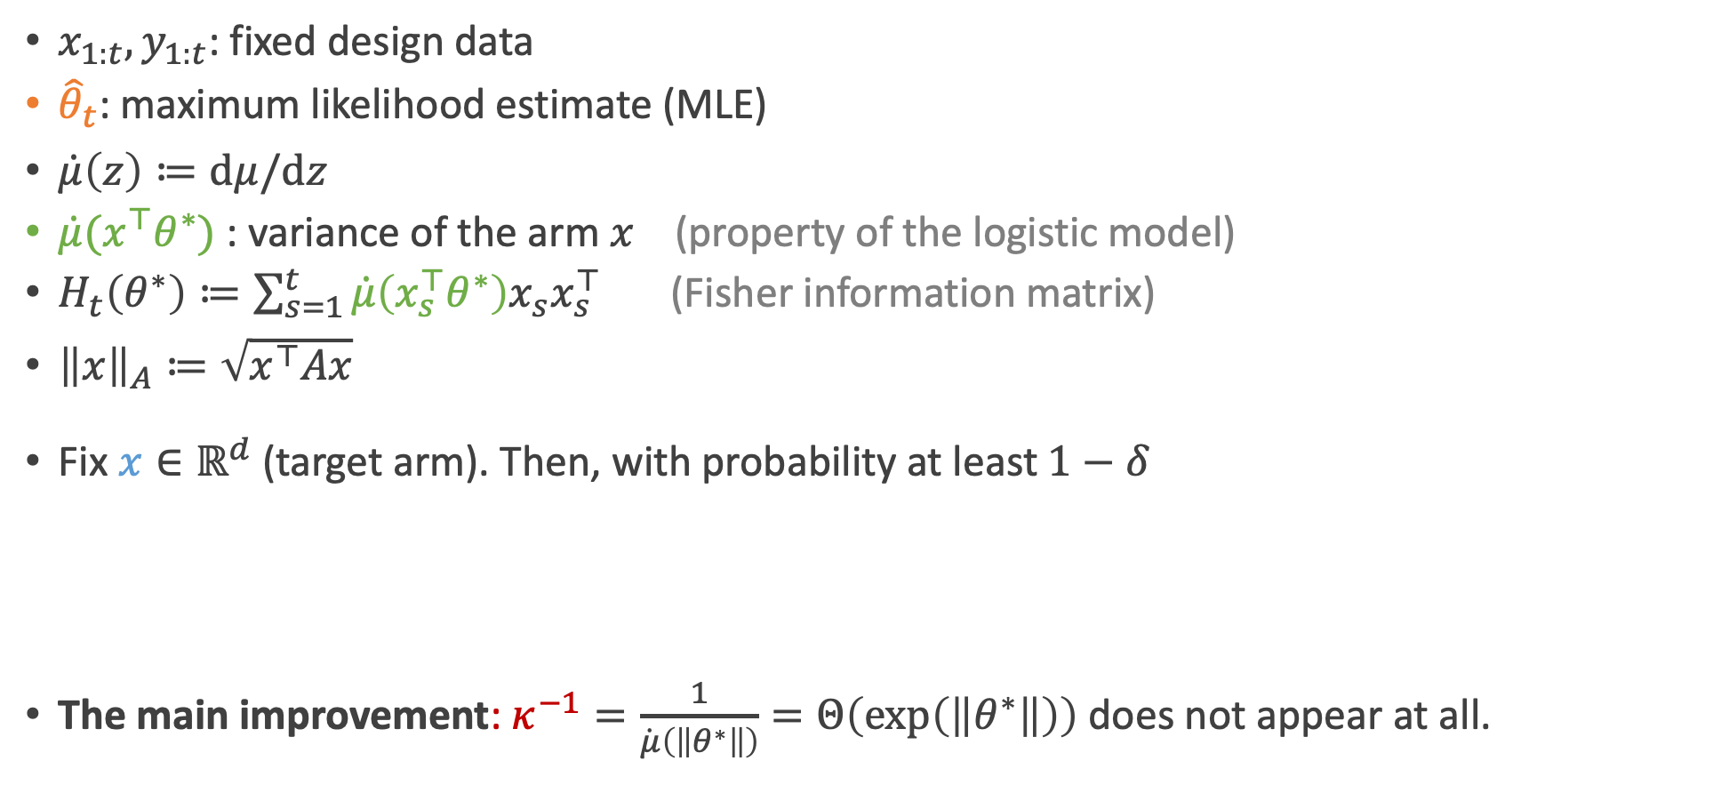
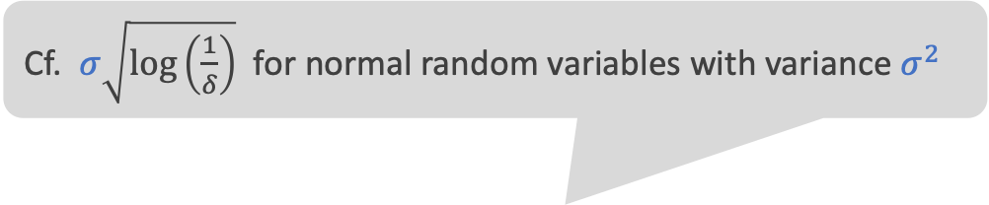
Our prediction error bound
$y_{s}|x_{s}$ is independent of $x_{1},…,x_{s−1}, x_{s+1}, …, x_{t}$
$x_{1:t}, y_{1:t}$: fixed design data
${\hat{θ}}_{t}$: maximum likelihood estimate (MLE)
$\dot{μ}\left(z\right)≔dμ/dz$
$\dot{μ}(x^{⊤}θ^{∗})$ : variance of the arm $x$ (property of the logistic model)
$H_{t}\left(θ^{∗}\right)≔\sum_{s=1}^{t}{\dot{μ}\left(x_{s}^{⊤}θ^{∗}\right)x_{s}x_{s}^{⊤}}$ (Fisher information matrix)
${\left\|x\right\|}_{A}≔\sqrt{x^{⊤}Ax}$
Fix $x∈ℝ^{d}$ (target arm). Then, with probability at least $1−δ$
The main improvement: $κ^{−1}=\frac{1}{\dot{μ}\left(\left\|θ^{∗}\right\|\right)}=Θ\left(\exp\left(\left\|θ^{∗}\right\|\right)\right)$ does not appear at all.
Cf. $σ\sqrt{\log\left(\frac{1}{δ}\right)}$ for normal random variables with variance $σ^{2}$
$$\max_{s=1..t}{\left\|x_{s}\right\|}_{H_{t}{\left(θ^{∗}\right)}^{−1}}^{2}≲\frac{1}{d} ⟹ \left|x^{⊤}\left({\hat{θ}}_{t} −θ^{∗}\right)\right|≲{\left\|x\right\|}_{H_{t}{\left(θ^{∗}\right)}^{−1}}\sqrt{\log\left(1/δ\right)}$$
(warmup condition)

Slide 17

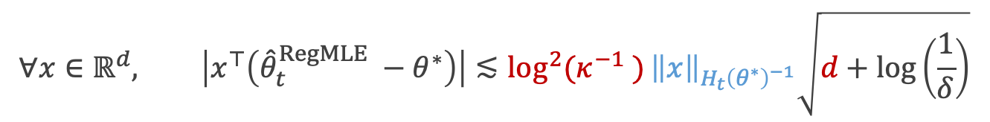
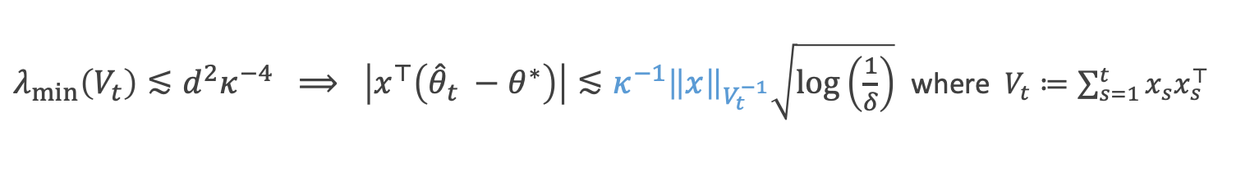
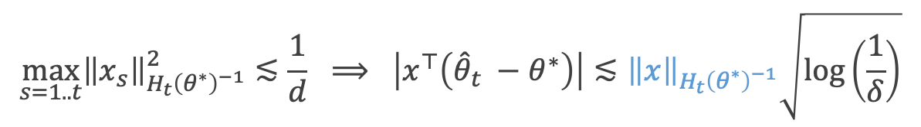


Comparison
$$\max_{s=1..t}{\left\|x_{s}\right\|}_{H_{t}{\left(θ^{∗}\right)}^{−1}}^{2}≲\frac{1}{d} ⟹ \left|x^{⊤}\left({\hat{θ}}_{t} −θ^{∗}\right)\right|≲{\left\|x\right\|}_{H_{t}{\left(θ^{∗}\right)}^{−1}}\sqrt{\log\left(\frac{1}{δ}\right)}$$
Ours:
Li et al. (2017)
Faury et al. (2020)
required sample size: between $d^{2}\log^{2}{(κ^{−1} )}$ and $d^{2}κ^{−1}$
$$≤κ^{−1}{\left\|x\right\|}_{V_{t}^{−1}}$$
$λ_{min}\left(V_{t}\right)≲d^{2}κ^{−4} ⟹ \left|x^{⊤}\left({\hat{θ}}_{t} −θ^{∗}\right)\right|≲{κ^{−1}\left\|x\right\|}_{V_{t}^{−1}}\sqrt{\log\left(\frac{1}{δ}\right)}$ where $V_{t}≔\sum_{s=1}^{t}{x_{s}x_{s}^{⊤}}$
requires $d^{3}κ^{−4}$ samples at all time
$$∀x∈ℝ^{d}, \left|x^{⊤}\left({\hat{θ}}_{t}^{RegMLE} −θ^{∗}\right)\right|≲\log^{2}{(κ^{−1} )}{\left\|x\right\|}_{H_{t}{\left(θ^{∗}\right)}^{−1}}\sqrt{d+\log\left(\frac{1}{δ}\right)}$$
extra factors in the width
works for all x simultaneously.
no condition needed
adaptive design
Q: is ours tight? I think so, as long as the MLE is used (will be discussed later)

Slide 18
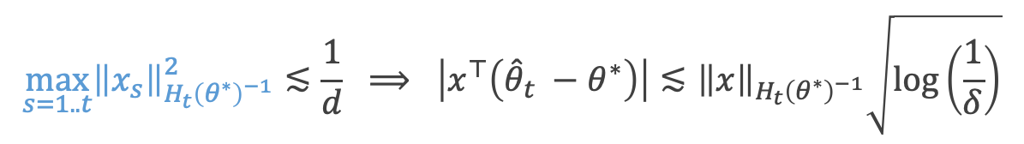

Proof sketch
$$\max_{s=1..t}{\left\|x_{s}\right\|}_{H_{t}{\left(θ^{∗}\right)}^{−1}}^{2}≲\frac{1}{d} ⟹ \left|x^{⊤}\left({\hat{θ}}_{t} −θ^{∗}\right)\right|≲{\left\|x\right\|}_{H_{t}{\left(θ^{∗}\right)}^{−1}}\sqrt{\log\left(\frac{1}{δ}\right)}$$
Key technique 1: (generalized) self-concordance: $|\ddot{μ}\left(z\right)|≤\dot{μ}(z)$
  Simple and tight ways to control higher order terms from Taylor expansion.
  Bach (2010) & Faury et al. (2020).

Slide 19
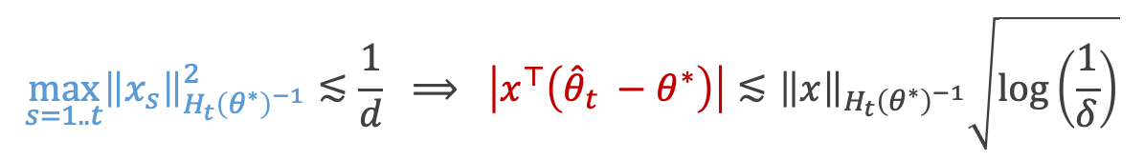
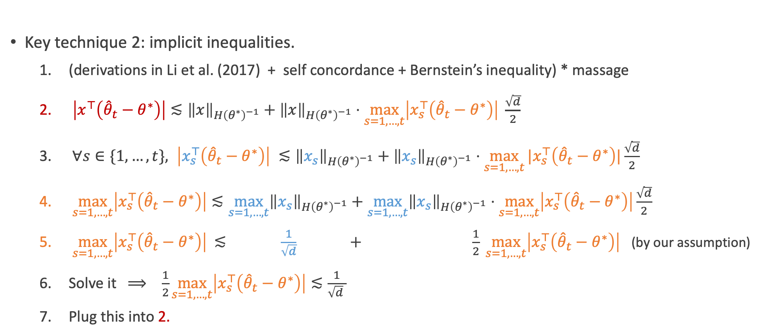
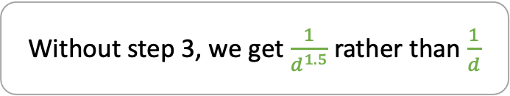
Proof sketch
$$\max_{s=1..t}{\left\|x_{s}\right\|}_{H_{t}{\left(θ^{∗}\right)}^{−1}}^{2}≲\frac{1}{d} ⟹ \left|x^{⊤}\left({\hat{θ}}_{t} −θ^{∗}\right)\right|≲{\left\|x\right\|}_{H_{t}{\left(θ^{∗}\right)}^{−1}}\sqrt{\log\left(\frac{1}{δ}\right)}$$
Key technique 2: implicit inequalities.
  (derivations in Li et al. (2017) + self concordance + Bernstein’s inequality) * massage
  $\left|x^{⊤}\left({\hat{θ}}_{t}−θ^{∗}\right)\right|≲{\left\|x\right\|}_{H{\left(θ^{∗}\right)}^{−1}}+{\left\|x\right\|}_{H{\left(θ^{∗}\right)}^{−1}}⋅\max_{s=1,…,t}\left|x_{s}^{⊤}\left({\hat{θ}}_{t}−θ^{∗}\right)\right| \frac{\sqrt{d}}{2}$
  $∀s∈\{1,…,t\}, \left|x_{s}^{⊤}\left({\hat{θ}}_{t}−θ^{∗}\right)\right| ≲{\left\|x_{s}\right\|}_{H{\left(θ^{∗}\right)}^{−1}}+{\left\|x_{s}\right\|}_{H{\left(θ^{∗}\right)}^{−1}}⋅\max_{s=1,…,t}{|x_{s}^{⊤}\left({\hat{θ}}_{t}−θ^{∗}\right)|}\frac{\sqrt{d}}{2}$
  $\max_{s=1,…,t}\left|x_{s}^{⊤}\left({\hat{θ}}_{t}−θ^{∗}\right)\right|≲\max_{s=1,…,t}{\left\|x_{s}\right\|}_{H{\left(θ^{∗}\right)}^{−1}}+\max_{s=1,…,t}{\left\|x_{s}\right\|}_{H{\left(θ^{∗}\right)}^{−1}}⋅\max_{s=1,…,t}\left|x_{s}^{⊤}\left({\hat{θ}}_{t}−θ^{∗}\right)\right|\frac{\sqrt{d}}{2}$
  $\max_{s=1,…,t}\left|x_{s}^{⊤}\left({\hat{θ}}_{t}−θ^{∗}\right)\right|$ $≲ \frac{1}{\sqrt{d}} + \frac{1}{2} \max_{s=1,…,t}\left|x_{s}^{⊤}\left({\hat{θ}}_{t}−θ^{∗}\right)\right|$ (by our assumption)
  Solve it $⟹ \frac{1}{2}\max_{s=1,…,t}\left|x_{s}^{⊤}\left({\hat{θ}}_{t}−θ^{∗}\right)\right|≲\frac{1}{\sqrt{d} }$
  Plug this into 2.
Without step 3, we get $\frac{1}{d^{1.5}}$ rather than $\frac{1}{d}$

Slide 20
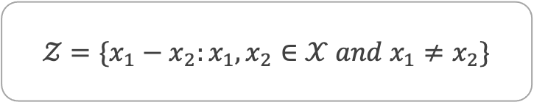
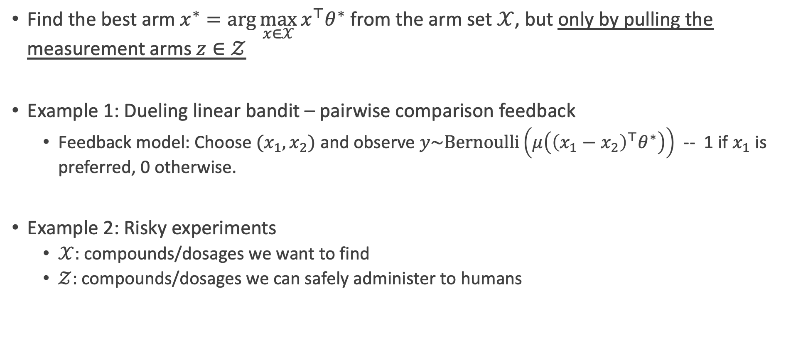
(Transductive) Pure exploration
Find the best arm $x^{∗}=\arg{\max_{x∈𝒳}{x^{⊤}θ^{∗}}}$ from the arm set $𝒳$, but only by pulling the measurement arms $z∈𝒵$
Example 1: Dueling linear bandit – pairwise comparison feedback
  Feedback model: Choose $(x_{1},x_{2})$ and observe $y\sim Bernoulli\left(μ\left({\left(x_{1}−x_{2}\right)}^{⊤}θ^{∗}\right)\right)$ -- 1 if $x_{1}$ is preferred, 0 otherwise.
Example 2: Risky experiments
  $𝒳:$ compounds/dosages we want to find
  $𝒵$: compounds/dosages we can safely administer to humans
$$𝒵=\{x_{1}−x_{2}:x_{1},x_{2}∈𝒳 and x_{1}≠x_{2}\}$$

Slide 21


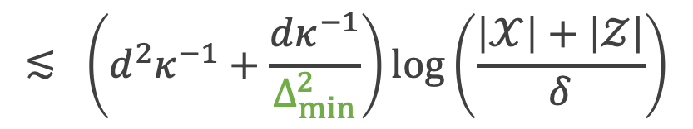

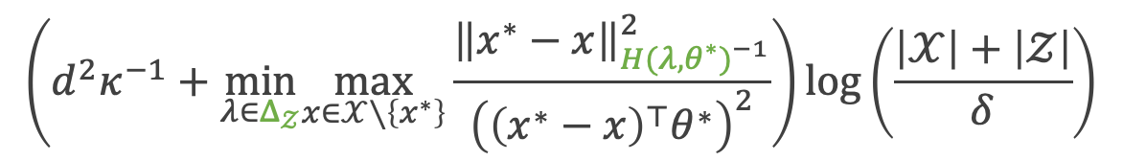
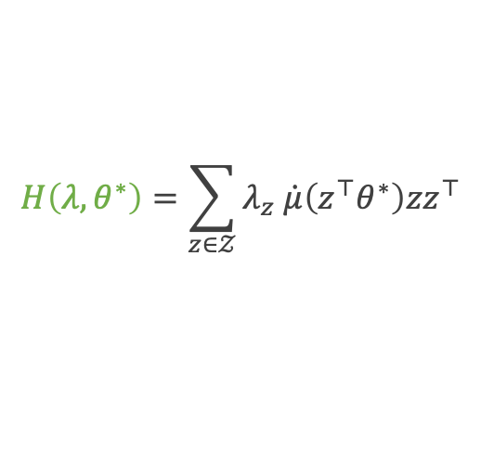
Pure exploration: Our bound
Sample complexity guarantee:
How many samples do we need until identifying the best arm w.p. at least $1−δ$?
Kazerouni et al. (2019) when $𝒳=𝒵$: $\frac{dκ^{−2}|𝒳|}{Δ_{min}^{2}}\log\left(\frac{1}{δ}\right)$
Is it tight? $⟹$ not exactly, but close (Taylor approximation to the lower bound)
Can we be completely independent of $κ^{−1}?$ $⟹$ not in general (proof in our paper).
$Δ_{𝒵} ≔$ distributions over the arm set $𝒵$
$$H\left(λ,θ^{∗}\right)=\sum_{z∈𝒵}{λ_{z} \dot{μ}\left(z^{⊤}θ^{∗}\right)zz^{⊤}}$$
$$\left(d^{2}κ^{−1}+\min_{λ∈Δ_{𝒵}}\max_{x∈𝒳∖\left\{x^{∗}\right\}}\frac{{\left\|x^{∗}−x\right\|}_{{H(λ, θ^{∗})}^{−1}}^{2}}{{\left({\left(x^{∗}−x\right)}^{⊤}θ^{∗}\right)}^{2}}\right)\log\left(\frac{\left|𝒳\right|+\left|𝒵\right|}{δ}\right)$$
$$≲ \left(d^{2}κ^{−1}+\frac{dκ^{−1}}{Δ_{min}^{2}}\right)\log\left(\frac{\left|𝒳\right|+\left|𝒵\right|}{δ}\right)$$
$$Δ_{min}≔\min_{x∈𝒳∖\{x^{∗}\} }{{\left(x^{∗}−x\right)}^{⊤}θ^{∗}}$$
warmup
the main instance-dependent term
(smallest gap)
Notes:
best arm과 non-best arm 들을 구분해내는데 가장 효율적인 샘플링 전략이 소모할 양

Slide 22
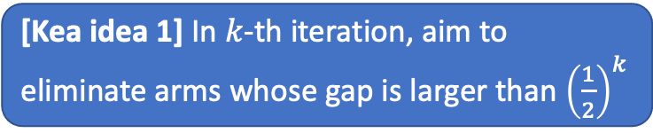
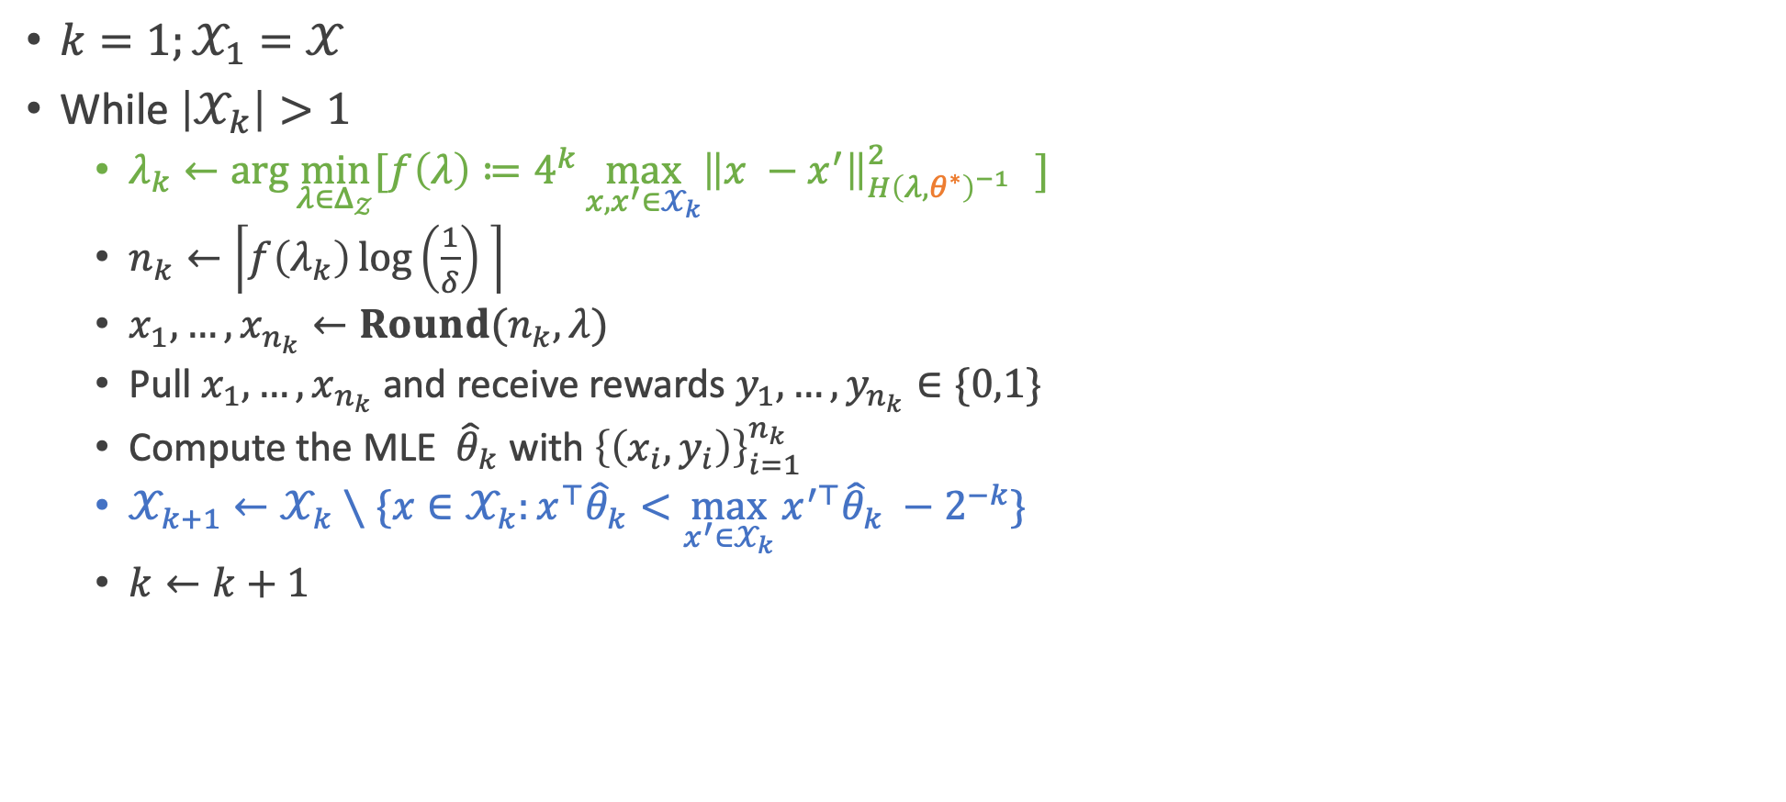
Algorithm (sketch)
$k=1;𝒳_{1}=𝒳$
While $\left|𝒳_{k}\right|>1$
  $λ_{k}←\arg{\min_{λ∈Δ_{𝒵}}{[f\left(λ\right)≔4^{k}\max_{x,x^{′}∈𝒳_{k}}{{\left\|x −x^{′}\right\|}_{H{\left(λ, θ^{∗}\right)}^{−1} }^{2}} ]}}$
  $n_{k}←\left\lceil f\left(λ_{k}\right)\log\left(\frac{1}{δ}\right) \right\rceil$
  $x_{1},…,x_{n_{k}}←Round(n_{k},λ)$
  Pull $x_{1},…,x_{n_{k}}$ and receive rewards $y_{1},…, y_{n_{k}}∈\{0,1\}$
  Compute the MLE ${\hat{θ}}_{k}$ with ${\left\{\left(x_{i},y_{i}\right)\right\}}_{i=1}^{n_{k}}$
  $𝒳_{k+1}←𝒳_{k}∖\{x∈𝒳_{k}:{x^{⊤}\hat{θ}}_{k}<\max_{x^{′}∈𝒳_{k}}{{x^{′⊤}\hat{θ}}_{k}} −2^{−k}\}$
  $k←k+1$
[Kea idea 1] In $k$-th iteration, aim to eliminate arms whose gap is larger than ${\left(\frac{1}{2}\right)}^{k}$
[Kea idea 2] Find the most efficient sampling strategy that is provably capable of doing that!

Slide 23
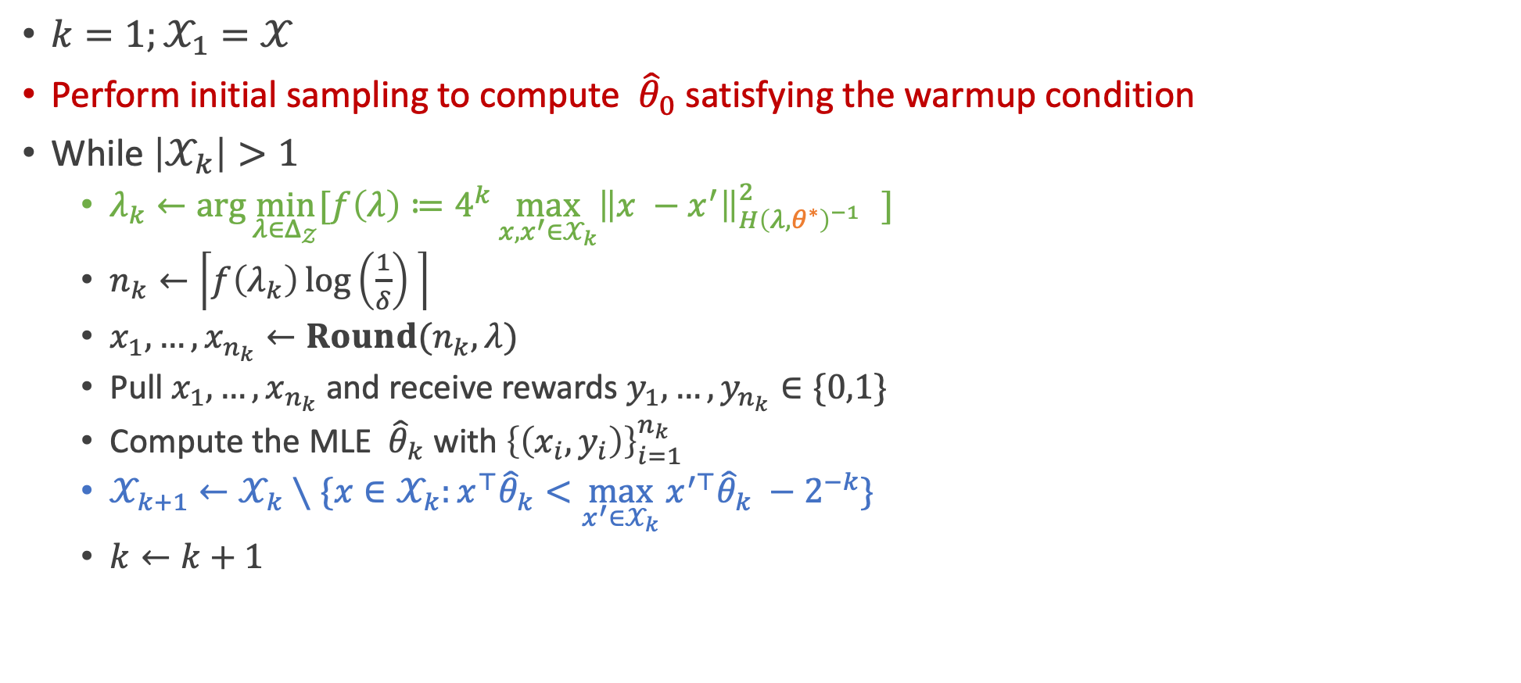

Algorithm (sketch)
$k=1;𝒳_{1}=𝒳$
Perform initial sampling to compute ${\hat{θ}}_{0}$ satisfying the warmup condition
While $\left|𝒳_{k}\right|>1$
  $λ_{k}←\arg{\min_{λ∈Δ_{𝒵}}{[f\left(λ\right)≔4^{k}\max_{x,x^{′}∈𝒳_{k}}{{\left\|x −x^{′}\right\|}_{H{\left(λ, θ^{∗}\right)}^{−1} }^{2}} ]}}$
  $n_{k}←\left\lceil f\left(λ_{k}\right)\log\left(\frac{1}{δ}\right) \right\rceil$
  $x_{1},…,x_{n_{k}}←Round(n_{k},λ)$
  Pull $x_{1},…,x_{n_{k}}$ and receive rewards $y_{1},…, y_{n_{k}}∈\{0,1\}$
  Compute the MLE ${\hat{θ}}_{k}$ with ${\left\{\left(x_{i},y_{i}\right)\right\}}_{i=1}^{n_{k}}$
  $𝒳_{k+1}←𝒳_{k}∖\{x∈𝒳_{k}:{x^{⊤}\hat{θ}}_{k}<\max_{x^{′}∈𝒳_{k}}{{x^{′⊤}\hat{θ}}_{k}} −2^{−k}\}$
  $k←k+1$
[Modification 1] replace $θ^{∗}$ with ${\hat{θ}}_{k−1}$
$$f\left(λ\right)≔\max\left\{4^{k}\max_{x,x^{′}∈𝒳_{k}}{{\left\|x −x^{′}\right\|}_{H{\left(λ, {\hat{θ}}_{k−1}\right)}^{−1} }^{2}}, d⋅\max_{z∈𝒵}{\left\|z\right\|}_{H{\left(λ,{\hat{θ}}_{k−1}\right)}^{−1}}^{2}\right\}$$
Warmup condition
[Modification 2] ensure the warmup condition will be satisfied

Slide 24
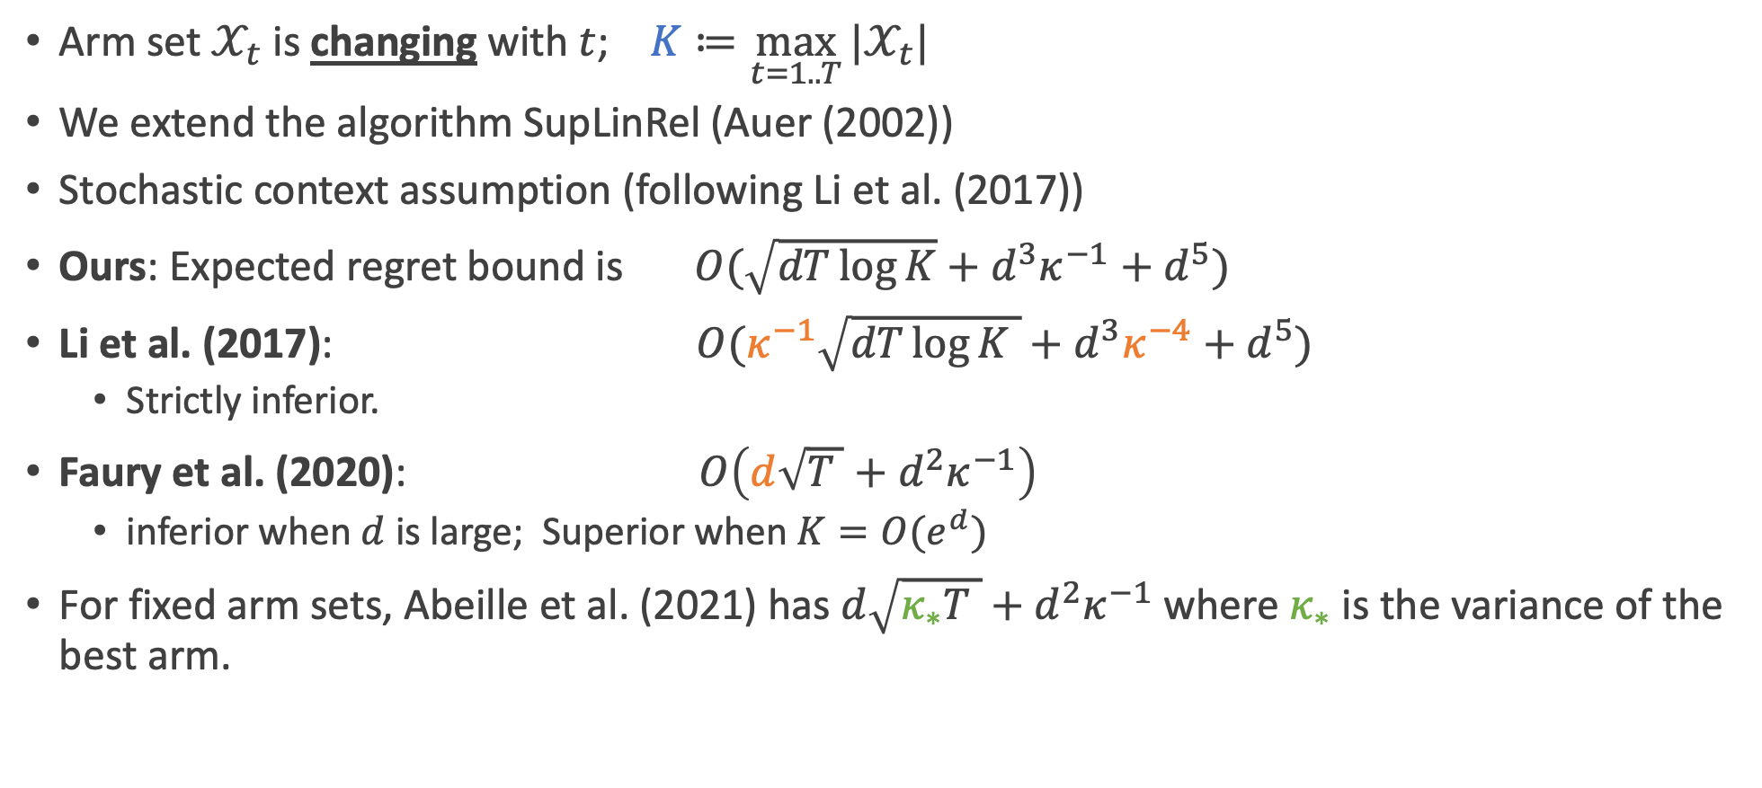
Reward maximization (sketch)
Arm set $𝒳_{t}$ is changing with $t$; $K≔\max_{t=1..T}{|𝒳_{t}|}$
We extend the algorithm SupLinRel (Auer (2002))
Stochastic context assumption (following Li et al. (2017))
Ours: Expected regret bound is $O(\sqrt{dT\log{K}}+d^{3}κ^{−1}+d^{5})$
Li et al. (2017): $O(κ^{−1}\sqrt{dT\log{K} }+d^{3}κ^{−4}+d^{5})$
  Strictly inferior.
Faury et al. (2020): $O\left(d\sqrt{T }+d^{2}κ^{−1}\right)$
  inferior when $d$ is large; Superior when $K=O(e^{d})$
For fixed arm sets, Abeille et al. (2021) has $d\sqrt{κ_{∗}T }+d^{2}κ^{−1}$ where $κ_{∗}$ is the variance of the best arm.
suboptimal factors in orange

Slide 25
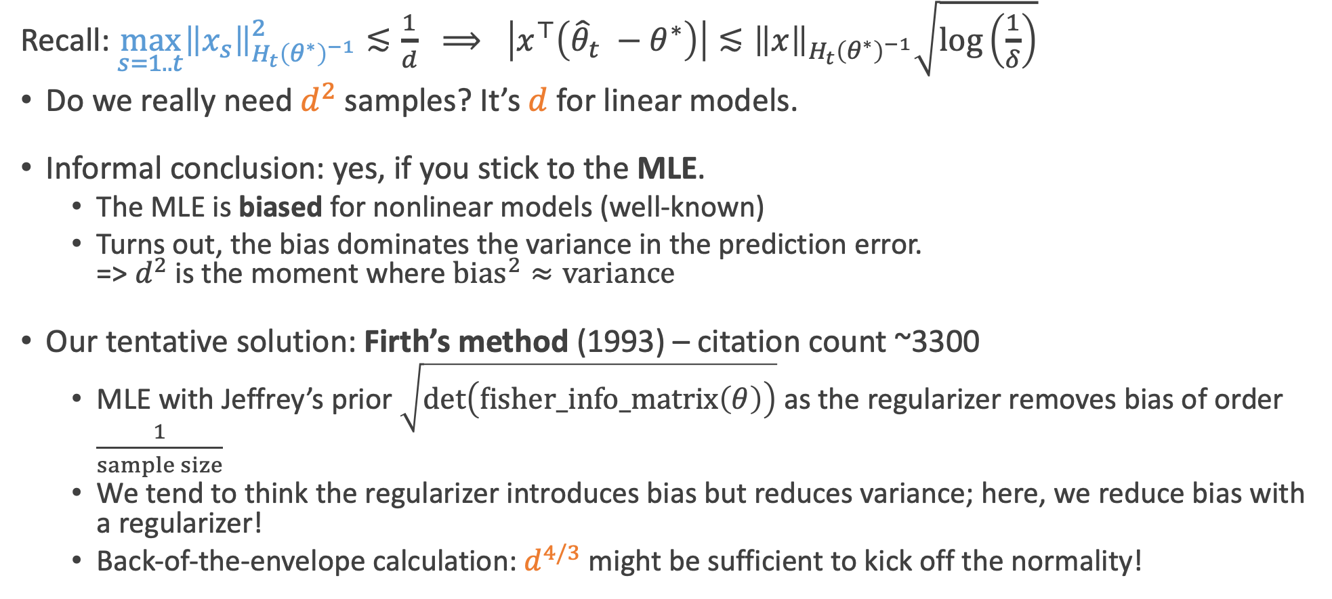
Open problem 1
Recall: $\max_{s=1..t}{\left\|x_{s}\right\|}_{H_{t}{\left(θ^{∗}\right)}^{−1}}^{2}≲\frac{1}{d} ⟹ \left|x^{⊤}\left({\hat{θ}}_{t} −θ^{∗}\right)\right|≲{\left\|x\right\|}_{H_{t}{\left(θ^{∗}\right)}^{−1}}\sqrt{\log\left(\frac{1}{δ}\right)}$
Do we really need $d^{2}$ samples? It’s $d$ for linear models.
Informal conclusion: yes, if you stick to the MLE.
  The MLE is biased for nonlinear models (well-known)
  Turns out, the bias dominates the variance in the prediction error.
  => $d^{2}$ is the moment where $bias^{2}≈variance$
Our tentative solution: Firth’s method (1993) – citation count ~3300
  MLE with Jeffrey’s prior $\sqrt{\det\left(fisher_info_matrix\left(θ\right)\right)}$ as the regularizer removes bias of order $\frac{1}{sample size}$
  We tend to think the regularizer introduces bias but reduces variance; here, we reduce bias with a regularizer!
  Back-of-the-envelope calculation: $d^{4/3}$ might be sufficient to kick off the normality!

Slide 26
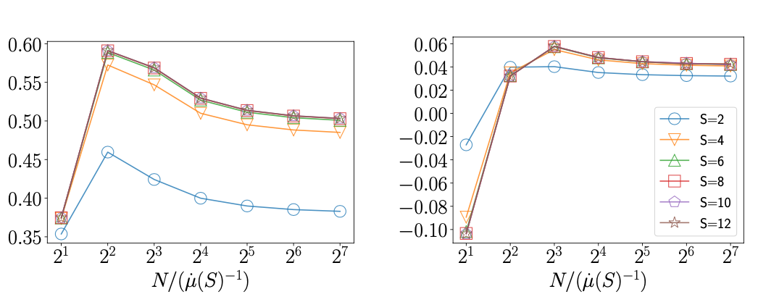
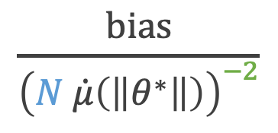

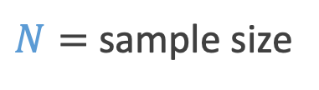

Open problem 1
$N=$ sample size
$$\frac{bias}{{\left(N \dot{μ}\left(\left\|θ^{∗}\right\|\right)\right)}^{−2}}$$
$$\frac{bias}{{\left(N \dot{μ}\left(\left\|θ^{∗}\right\|\right)\right)}^{−1}}$$
$\dot{μ}\left(z\right)≔$ $dμ/dz$
MLE
Firth
*When the MLE does not exist, we apply a reasonable makeshift.

Slide 27

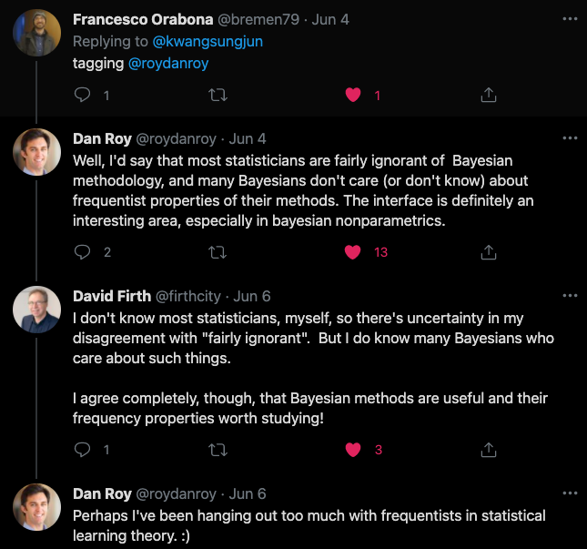
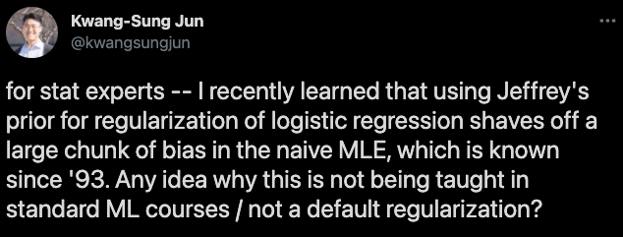

Open problem 1
Having fun with tweets
반성하겠습니다..

Slide 28
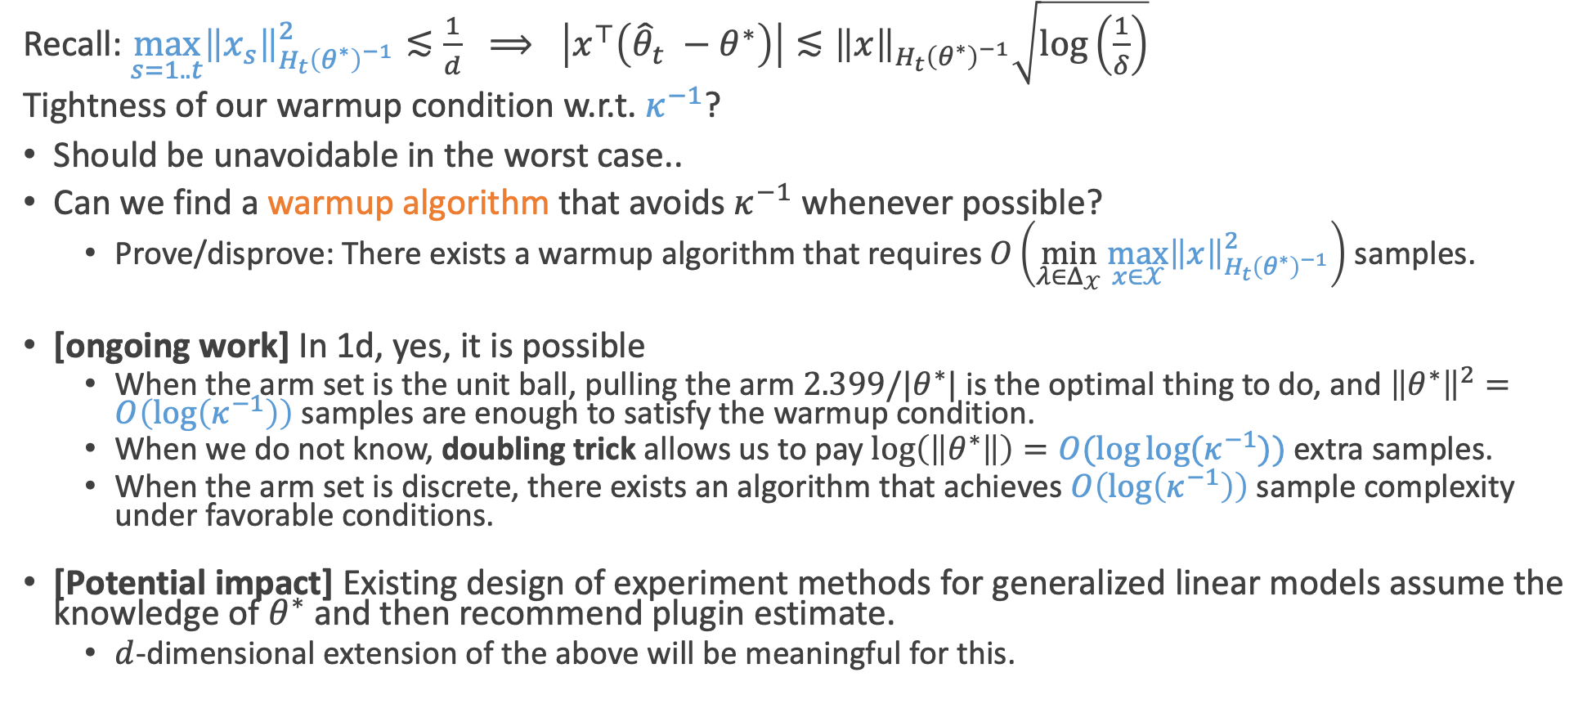
Open problem 2
Recall: $\max_{s=1..t}{\left\|x_{s}\right\|}_{H_{t}{\left(θ^{∗}\right)}^{−1}}^{2}≲\frac{1}{d} ⟹ \left|x^{⊤}\left({\hat{θ}}_{t} −θ^{∗}\right)\right|≲{\left\|x\right\|}_{H_{t}{\left(θ^{∗}\right)}^{−1}}\sqrt{\log\left(\frac{1}{δ}\right)}$
Tightness of our warmup condition w.r.t. $κ^{−1}$?
Should be unavoidable in the worst case..
Can we find a warmup algorithm that avoids $κ^{−1}$ whenever possible?
  Prove/disprove: There exists a warmup algorithm that requires $O\left(\min_{λ∈Δ_{𝒳}}{\max_{x∈𝒳}{{\left\|x\right\|}_{H_{t}{\left(θ^{∗}\right)}^{−1}}^{2}}}\right)$ samples.
[ongoing work] In 1d, yes, it is possible
  When the arm set is the unit ball, pulling the arm $2.399/|θ^{∗}|$ is the optimal thing to do, and ${\left\|θ^{∗}\right\|}^{2}=O\left(\log\left(κ^{−1}\right)\right)$ samples are enough to satisfy the warmup condition.
  When we do not know, doubling trick allows us to pay $\log\left(\left\|θ^{∗}\right\|\right)=O(\log{\log{(κ^{−1})}})$ extra samples.
  When the arm set is discrete, there exists an algorithm that achieves $O\left(\log\left(κ^{−1}\right)\right)$ sample complexity under favorable conditions.
[Potential impact] Existing design of experiment methods for generalized linear models assume the knowledge of $θ^{∗}$ and then recommend plugin estimate.
  $d$-dimensional extension of the above will be meaningful for this.

Slide 29
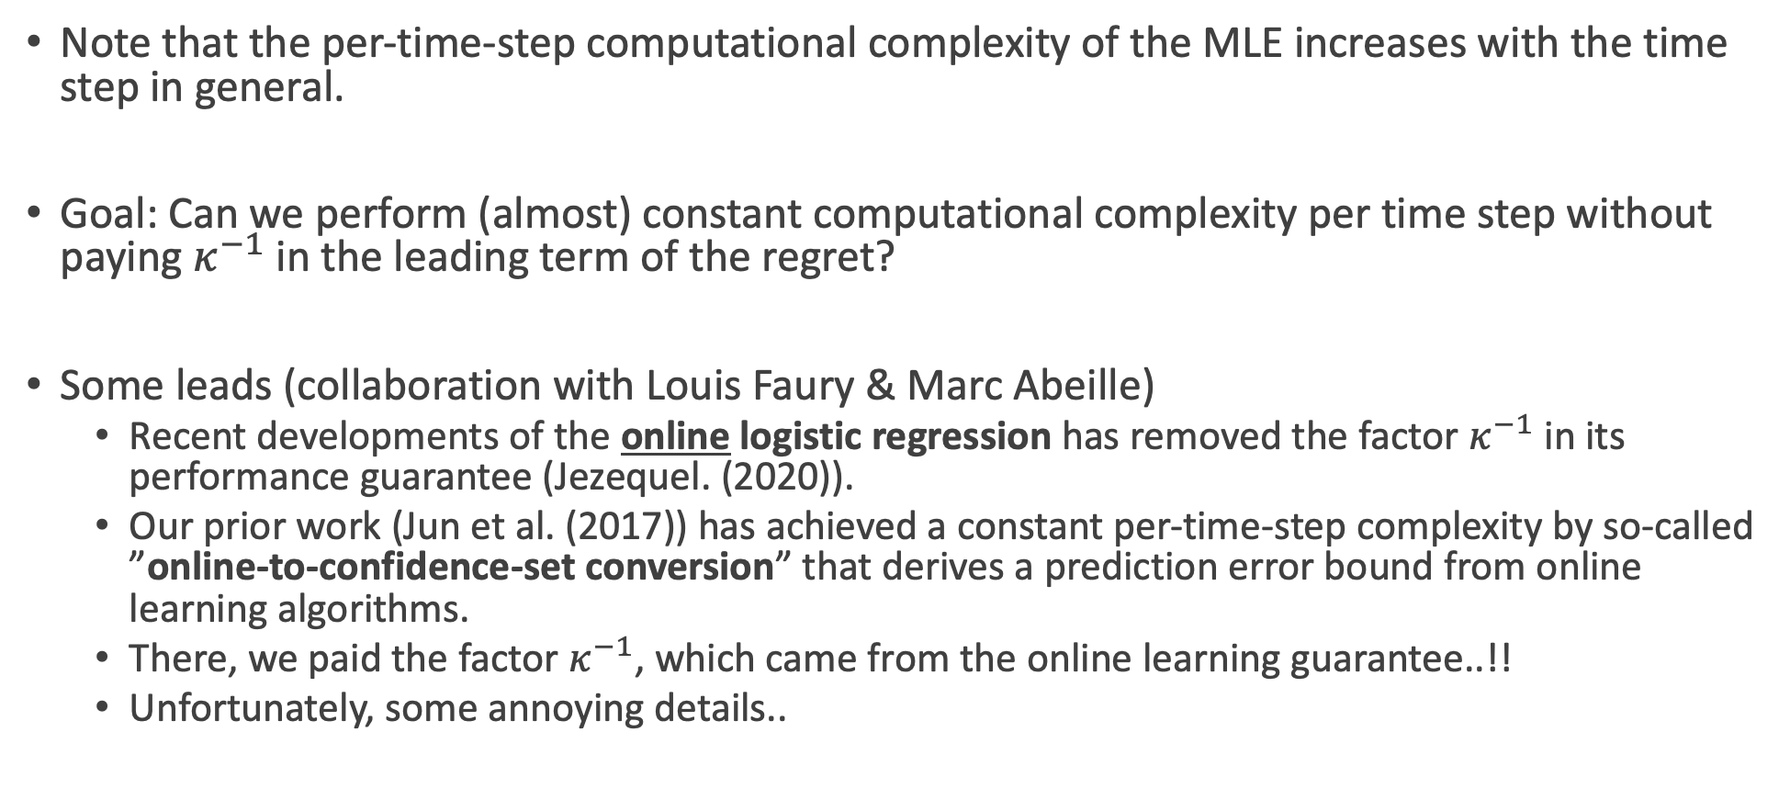
Open problem 3
Note that the per-time-step computational complexity of the MLE increases with the time step in general.
Goal: Can we perform (almost) constant computational complexity per time step without paying $κ^{−1}$ in the leading term of the regret?
Some leads (collaboration with Louis Faury & Marc Abeille)
  Recent developments of the online logistic regression has removed the factor $κ^{−1}$ in its performance guarantee (Jezequel. (2020)).
  Our prior work (Jun et al. (2017)) has achieved a constant per-time-step complexity by so-called ”online-to-confidence-set conversion” that derives a prediction error bound from online learning algorithms.
  There, we paid the factor $κ^{−1}$, which came from the online learning guarantee..!!
  Unfortunately, some annoying details..

Slide 30
BACKUP

Slide 31
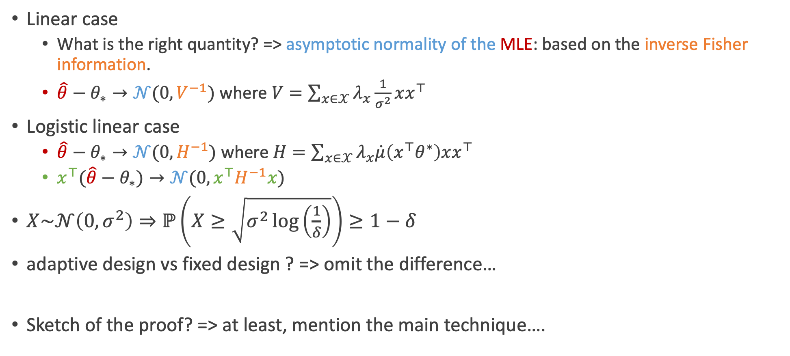
Improved confidence bound
Linear case
  What is the right quantity? => asymptotic normality of the MLE: based on the inverse Fisher information.
  $\hat{θ}−θ_{∗}→𝒩(0,V^{−1})$ where $V=\sum_{x∈𝒳}{λ_{x}\frac{1}{σ^{2}}xx^{⊤}}$
Logistic linear case
  $\hat{θ}−θ_{∗}→𝒩(0,H^{−1})$ where $H=\sum_{x∈𝒳}{λ_{x}\dot{μ}\left(x^{⊤}θ^{∗}\right)xx^{⊤}}$
  $x^{⊤}(\hat{θ}−θ_{∗})→𝒩(0,x^{⊤}H^{−1}x)$
$X\sim 𝒩\left(0,σ^{2}\right)⇒ℙ\left(X≥\sqrt{σ^{2}\log\left(\frac{1}{δ}\right)}\right)≥1−δ$
adaptive design vs fixed design ? => omit the difference…
Sketch of the proof? => at least, mention the main technique….

Slide 32

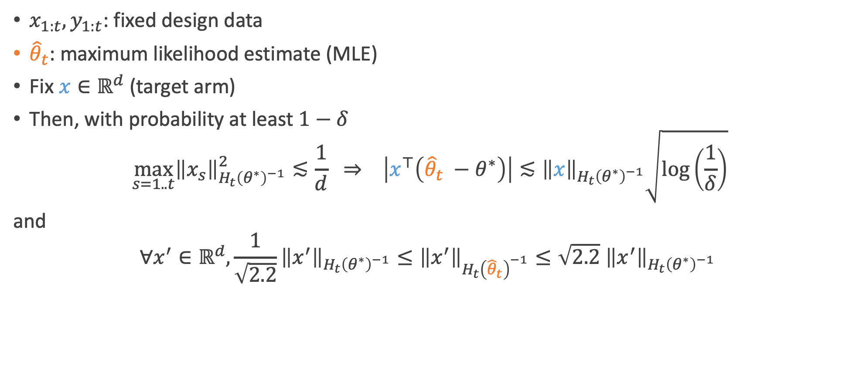
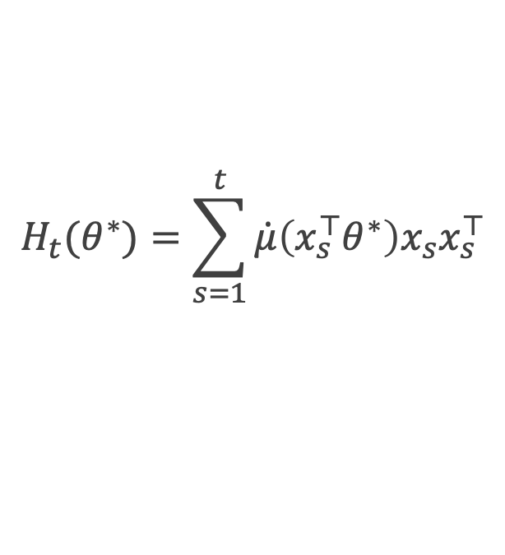

Our fixed design confidence bound
$x_{1:t}, y_{1:t}$: fixed design data
${\hat{θ}}_{t}$: maximum likelihood estimate (MLE)
Fix $x∈ℝ^{d}$ (target arm)
Then, with probability at least $1−δ$
$$\max_{s=1..t}{\left\|x_{s}\right\|}_{H_{t}{\left(θ^{∗}\right)}^{−1}}^{2}≲\frac{1}{d} ⇒ \left|x^{⊤}\left({\hat{θ}}_{t} −θ^{∗}\right)\right|≲{\left\|x\right\|}_{H_{t}{\left(θ^{∗}\right)}^{−1}}\sqrt{\log\left(\frac{1}{δ}\right)}$$
and
$$∀x^{′}∈ℝ^{d},\frac{1}{\sqrt{2.2}}{\left\|x^{′}\right\|}_{H_{t}{\left(θ^{∗}\right)}^{−1}}≤{\left\|x^{′}\right\|}_{H_{t}{\left({\hat{θ}}_{t}\right)}^{−1}}≤\sqrt{2.2} {\left\|x^{′}\right\|}_{H_{t}{\left(θ^{∗}\right)}^{−1}}$$
$y_{s}|x_{s}$ is independent of $x_{1},…,x_{s−1}, x_{s+1}, …, x_{t}$
$$H_{t}(θ^{∗})=\sum_{s=1}^{t}{\dot{μ}\left(x_{s}^{⊤}θ^{∗}\right)x_{s}x_{s}^{⊤}}$$
(fisher information matrix)
Required sample size: between $d^{2}\log{(κ^{−1} )}$ and $d^{2}κ^{−1}$.
(e.g., unit ball arm set -> polynomial dependence on $\log{(κ^{−1})}$ possible)

Slide 33

Our prediction error bound
$y_{s}|x_{s}$ is independent of $x_{1},…,x_{s−1}, x_{s+1}, …, x_{t}$
$x_{1:t}, y_{1:t}$: fixed design data
${\hat{θ}}_{t}$: maximum likelihood estimate (MLE)
$\dot{μ}\left(z\right)≔dμ/dz$
$\dot{μ}(x^{⊤}θ^{∗})$ : variance of the arm $x$.
$H_{t}\left(θ^{∗}\right)≔\sum_{s=1}^{t}{\dot{μ}\left(x_{s}^{⊤}θ^{∗}\right)x_{s}x_{s}^{⊤}}$ (fisher information matrix)
${\left\|x\right\|}_{A}≔\sqrt{x^{⊤}Ax}$
Fix $x∈ℝ^{d}$ (test point). Then, with probability at least $1−δ$
The key: $κ^{−1}=\frac{1}{\dot{μ}\left(\left\|θ^{∗}\right\|\right)}=Θ\left(\exp\left(\left\|θ^{∗}\right\|\right)\right)$ does not appear at all.
$$\max_{s=1..t}{\left\|x_{s}\right\|}_{H_{t}{\left(θ^{∗}\right)}^{−1}}^{2}≲\frac{1}{d} ⟹ \left|x^{⊤}\left({\hat{θ}}_{t} −θ^{∗}\right)\right|≲{\left\|x\right\|}_{H_{t}{\left(θ^{∗}\right)}^{−1}}\sqrt{\log\left(1/δ\right)}$$
and $∀x^{′}∈ℝ^{d}, {\left\|x^{′}\right\|}_{H_{t}{\left({\hat{θ}}_{t}\right)}^{−1}}=Θ\left( {\left\|x^{′}\right\|}_{H_{t}{\left(θ^{∗}\right)}^{−1}}\right)$

Slide 34


Algorithm (sketch)
$$\max_{s=1..t}{\left\|x_{s}\right\|}_{H_{t}{\left(θ^{∗}\right)}^{−1}}^{2}≲\frac{1}{d} ⇒ \left|x^{⊤}\left({\hat{θ}}_{t} −θ^{∗}\right)\right|≲{\left\|x\right\|}_{H_{t}{\left(θ^{∗}\right)}^{−1}}\sqrt{\log\left(\frac{1}{δ}\right)}$$
Perform initial sampling to compute ${\hat{θ}}_{0}$ satisfying the warmup condition
While $\left|𝒳_{k}\right|>1$
  $λ_{k}←\arg{\min_{λ∈Δ_{𝒵}}{[f\left(λ\right)≔4^{k}\max_{z,z^{′}∈𝒳_{k}}{{\left\|z −z^{′}\right\|}_{H{\left(λ, θ^{∗}\right)}^{−1} }^{2}} ]}}$
  $n_{k}←\left\lceil f\left(λ_{k}\right)\log\left(\frac{1}{δ}\right) \right\rceil$
  $x_{1},…,x_{n_{k}}←Round(n_{k},λ)$
  Pull $x_{1},…,x_{n_{k}}$ and receive rewards $y_{1},…, y_{n_{k}}∈\{0,1\}$
  Compute the MLE ${\hat{θ}}_{k}$ with ${\left\{\left(x_{i},y_{i}\right)\right\}}_{i=1}^{n_{k}}$
  $𝒳_{k+1}←𝒳_{k}∖\{x∈𝒳_{k}:{x^{⊤}\hat{θ}}_{k}<\max_{x^{′}∈𝒳_{k}}{{x^{′⊤}\hat{θ}}_{k}} −2^{−k}\}$
  $k←k+1$
$$f\left(λ\right)≔\max\left\{4^{k}\max_{x,x^{′}∈𝒳_{k}}{{\left\|x −x^{′}\right\|}_{H{\left(λ, {\hat{θ}}_{k−1}\right)}^{−1} }^{2}}, d⋅\max_{z∈𝒵}{\left\|z\right\|}_{H{\left(λ,{\hat{θ}}_{k−1}\right)}^{−1}}^{2}\right\}$$
Warmup condition

Slide 35


Open problem 2
Tightness of our warmup condition w.r.t. $κ^{−1}$?
Should be unavoidable in the worst case..
Q: can we avoid it whenever possible (i.e., instance-wise guarantees)?
In 1d, yes, it is possible (ongoing work)
  Turns out, pulling the arm $1/|θ^{∗}|$ is optimal

