Slide 1
High-quality Video Denoising for Motion-based Exposure Control
IWMV 2011
Travis Portz, Li Zhang, and Hongrui Jiang
University of Wisconsin–Madison
Presented by Brandon M. Smith

Slide 2
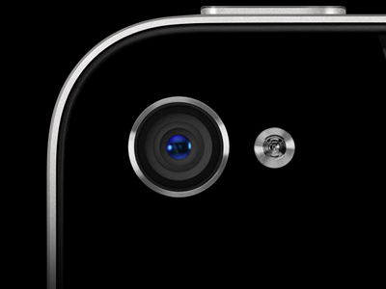
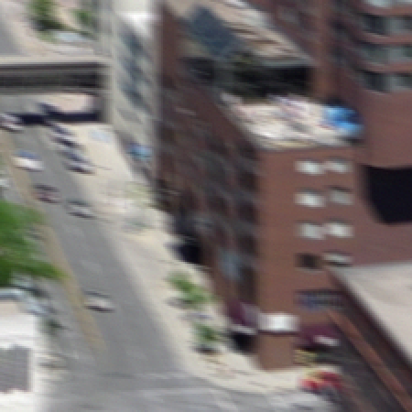
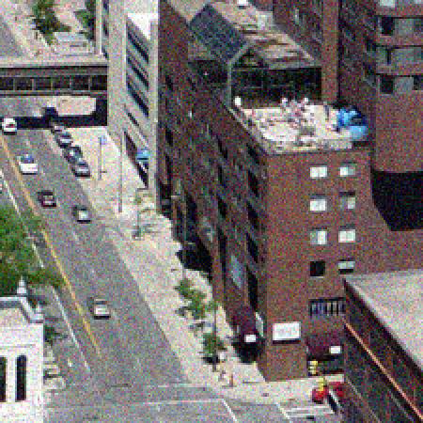
Motivation
Motion blur from dynamic scenes or handheld cameras
Example: mobile phone camera
Small and light → easy to introduce handshake blur
Small aperture →
Long Exposure
Low Gain
Motion Blur
Short Exposure
High Gain
Noise
Notes:
When capturing video of dynamic scenes or with handheld cameras, some motion blur is inevitable under normal camera settings.
A video taken with a mobile phone, for example, is likely to contain handshake blur. Furthermore, the small aperture requires either a longer exposure time or a higher gain to achieve good brightness levels. This means you will either get a blurry video or a noisy video. In both cases, some sort of enhancement is necessary to obtain a high-quality video.

Slide 3
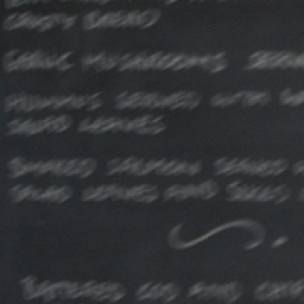
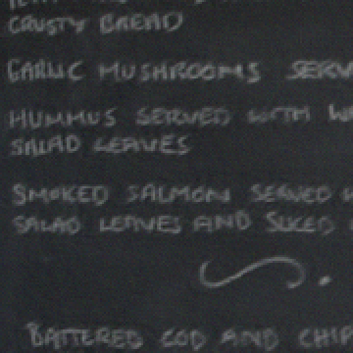
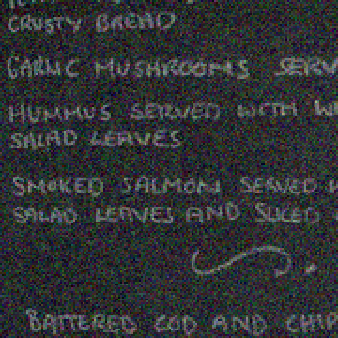
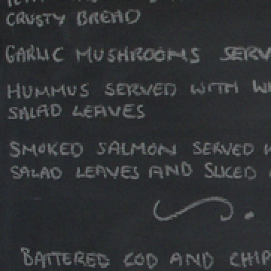
Deblurring vs. Denoising
Blind image deconvolution is ill-posed
L. Zhang, A. Deshpande, X. Chen, Denoising versus Deblurring: HDR Techniques Using Moving Cameras, CVPR 2010
? ⊗ ? ⁼
Blurry
Deblurred
Noisy
Denoised
Notes:
We have the choice of keeping a longer exposure time and deblurring the captured video, or using a shorter exposure time and denoising the video.
If we choose to keep the longer exposure time, blind image deconvolution is required to enhance the blurred frames. This requires estimation of the blur kernel in addition to the underlying sharp image. Small errors in the estimated kernel can produce significant ringing artifacts in the result, making deblurring a very ill-posed problem.
While still a difficult problem, denoising is not as prone to artifacts as deblurring.
The Denoising versus Deblurring work by co-author Li Zhang compares single image deblurring to multiple image denoising where the multiple noisy images are captured over the same time period as the single blurry image. Denoising produces higher quality results than deblurring in this context.

Slide 4
Motion-based Auto Exposure
Not all frames need shorter exposure time
Estimate motion in previous frames to set exposure for next frame
Some patents on this idea, not many academic papers
Single-shot versions in Canon Powershot, Nikon Coolpix
Notes:
Not all frames require the same exposure time and gain to avoid motion blur. Some frames will naturally have less motion; using a longer exposure time and lower gain for these frames will produce a higher-quality video, and therefore a higher quality denoising result as will be shown later in the presentation.
This can be accomplished using motion-based AE, where motion is estimated from previous frames and a new exposure setting is chosen to avoid blur while maintaining a constant brightness level.
Some patents exist on this idea, but there is little mention of it in academia. A few commercial cameras have motion-based AE features for single-shot mode, but none to our knowledge support it in video mode.

Slide 5
Motion-based Auto Exposure
Constant exposure time
(Canon EOS 7D)
Motion-based exposure
(Point Grey Grasshopper)
Notes:
This video shows motion-based Auto Exposure in action. You can see that the noise level ramps up in the motion-based AE video as the motion gets faster, whereas the constant exposure time video gets blurrier.

Slide 6
Motion-based Auto Exposure
Constant exposure time
(Canon EOS 7D)
Motion-based exposure
(Point Grey Grasshopper)
Notes:
This is a frame with large motion. The constant exposure time image is blurry, and the motion-based exposure image is sharp (but noisy).

Slide 7
Motivation
Denoise videos captured using motion-based auto exposure
Exploit varying noise levels to obtain higher quality results
Notes:
Since the captured video is noisy during fast motions, we need to perform denoising to obtain a high-quality video. Our main contribution is a denoising algorithm which exploits the varying noise levels under motion-base AE to outperform state-of-the-art algorithms.

Slide 8
Inspiration: Spatial Image Denoising
BM3D
Dabov, et al., Image denoising by sparse 3D transform-domain collaborative filtering. TIP August 2007
Stack of similar blocks
Stack of block estimates
Denoised block
3D Filter
Weighted Average
Notes:
Our algorithm draws inspiration from (and makes use of) the single-image denoising algorithm known as BM3D.
This algorithm uses block matching and 3D filtering to exploit self-similarity within an image.
Repetitive texture and uniform color regions have a lot of self-similarity and thus plenty of good block matches. BM3D is very effective on these image regions.
On the other hand, unique features do not have any good matches, so they are filtered with blocks that are not good matches, which tends to blur the features.

Slide 9
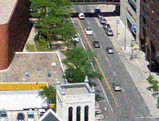
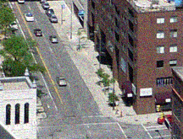
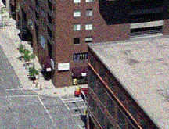
Inspiration: Spatiotemporal Video Denoising
Liu and Freeman, A High-Quality Video Denoising Algorithm based on Reliable Motion Estimation. ECCV 2010
Non-local means using approximate K-nearest neighbors and optical flow
Notes:
We also draw inspiration from the video denoising algorithm developed by Liu and Freeman.
This algorithm denoises in a non-local means fashion using patches found with an approximate K-nearest neighbors algorithm. The K-nearest neighbors algorithm is used to find matches within the current frame, and optical flow is used to find corresponding patches in nearby frames. These and their neighbors are aggregated with the current patch and its neighbors using a weighted average.
The use of optical flow provides temporal coherence between frames by ensuring that similar sets of patches are used to denoise corresponding pixels.
Similarly to the BM3D, this method can over-smooth features for which the K-nearest neighbors algorithm could not find good matches.
Inaccuracies in the optical flow will also degrade the results by providing bad matches.
The algorithm does not consider noise level differences between frames when aggregating the patches, which is necessary to obtain optimal results in the context of motion-based AE. (It does use a different noise level parameter for denoising each frame, but that parameter is constant when aggregating neighboring frame patches.)

Slide 10
Our Approach
Spatial Methods
Motion-compensated Filtering
+ Abundant locally similar structure
− Unique local patches
+ Unique local patches
Reliable motion estimation
− Abundant locally similar structure
Unreliable motion estimation
Combine spatial and motion-compensated (temporal) denoising based on reliability of flow
Notes:
As I have discussed, spatial denoising method perform well when there is abundant locally similar structure but poorly when local patches are unique.
On the other hand, motion-compensated filtering (where we only filter temporally along the optical flow) performs well on unique local patches where the motion can be estimated reliably but poorly on locally similar structure where the motion cannot be estimated reliably due to the aperture problem.
To gain the benefits of both methods, our algorithm combines spatial and temporal denoising based on the reliability of the optical flow.

Slide 11
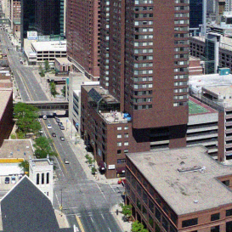
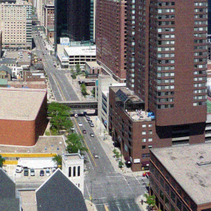
Temporal Denoising
Filter along optical flow
Temporal window of ±H frames
Hierarchical block matching to handle large displacements
Not all flows are reliable
Pixels from unreliable flows will degrade results
Solution: detect unreliable flows and exclude them from filter
u
v
Notes:
Temporal denoising (or motion-compensated filtering), as mentioned, filters along the optical flow. We compute the flow over a window of +/- H frames. (We used H = 5.)
Our video captured with motion-based AE had a limited frame rate, so they contained large displacements (often 70 pixels or more). Traditional gradient-based flow algorithms get stuck in local minima for such large motion, so we instead used a hierarchical block matching technique to estimate the flow.
Optical flow computed in such a manner will not always be reliable, as can be seen in the flow field on the right. The motion is uniform, so the field should be all one color (we visualize flows using the standard method where hue is the angle and saturation is the magnitude).
Temporal filtering along a bad flow trajectory will degrade the results, so we wish to detect unreliable flows and use spatial denoising rather than temporal.
Our flow method is unreliable in regions with repetitive texture or uniform color since there may be many reasonable block matches. Spatial denoising can handle these regions well, so reliable flow is not absolutely necessary.
Unique features can easily be matched from one frame to the next, so they can be denoised temporally without over-smoothing as in the spatial method.

Slide 12
Flow Reliability Estimation
Forward/backward consistency
Consistent
Inconsistent
v_{ij} = -v_{ji}
v_{ij} ≠ -v_{ji}
Reliable if:
Notes:
We use a forward/backward consistency check to estimate the flow reliability.
The flow is consistent if the flow from a pixel in frame i to a pixel in frame j is opposite the flow from that pixel in frame j back to frame i, and inconsistent if the flow from j to i does not go back to the same point.
We consider the flow to be reliable if the consistency error is below some threshold. Thresholding works well for our flow method, which usually has a very small consistency error when the flow is accurate, and a large error when it is inaccurate.

Slide 13
Temporal Denoising
Set of frames with consistent flow:
Filter along flow:
Weight function:
Threshold:
Notes:
We denote the set of frames with consistent flow by H_c.
The temporal filter is given by this weighted average over H_c.
z_t is the position of a pixel in the current frame t and z_i is the position of the corresponding pixel (along the flow) in frame i. Big Z is just a normalization factor.
Our weight function is similar to the one used by Liu and Freeman. The patch distance in the exponent is computed as a Gaussian weighted sum-of-squared-distances.
We include factors for the noise levels in the neighboring frames in addition to the current frame.
beta_i is proportional to the noise level in frame i and beta_t is proportional to the noise level in the current frame. The result is that more weight is assigned to pixels from clean images, so noisy frames can be denoised very effectively when there is reliable flow to a nearby clean frame.
We also use a threshold to completely reject pixels with large patch distances. If the patch distance is greater than tau_t, the patch is excluded from the filter.
The threshold is a function of the current frame’s noise level. Clean frames have a lower threshold to protect them from being degraded by nearby noisy frames.
Noisy frames have a higher threshold to maintain denoising power.
The parameter tau_0 is slightly negative so that very high quality frames have thresholds close to or even at zero.

Slide 14
Combining Spatial/Temporal Denoising
Quality of temporal result is based on number of samples used in filter
Interpolate between spatial and temporal results:
Notes:
The quality of the temporal denoising result is based on the number of samples used in the filter. More frames of reliable flow means more samples which gives a lower output variance.
Based on this observation, we use the number of consistent flows, |H_c|, to interpolate between the temporal denoising result and the spatial denoising result computed using the CBM3D method. (The C just stands for the color version of the algorithm.)
If the flow is reliable for the entire temporal window, we get pure temporal denoising.

Slide 15
Combining Spatial/Temporal Denoising
Optical Flow (forward/backward)
i - H
Consistency
⋮
i-2
Temporal Weights
i-1
i+1
⋮
i+H
Notes:
The spatial/temporal combination process can be summarized as the following:
Forward and backward optical flows are computed over the temporal window -H to +H.
The flows are used to compute a forward/backward consistency map for each frame in the window.
The consistency maps are combined to create the weight map used for interpolation between the spatial and temporal results.

Slide 16
Combining Spatial/Temporal Denoising
Example weight map
Notes:
Most of the low temporal weights come from regions of the image with uniform color such as the roof in the bottom-left corner of this frame.
The horizontal camera motion in this sequence produces vertical bands in the weight map as the sides of the image move out of the frame.

Slide 17
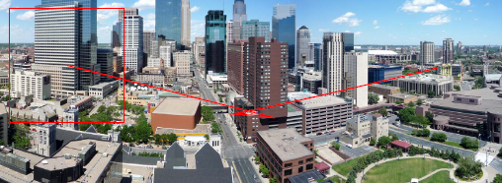
Simulation
Sliding window over panoramic image
Temporally-varying motion
AWGN with noise level proportional to window displacement
Notes:
We tested our algorithm on synthetic sequences that simulate motion-based auto exposure. Each sequence was generated by moving a window over a large panoramic image with temporally-varying motion. The displacement of the window was used to determine the ideal exposure time and gain. Additive white Gaussian noise was added to each frame with noise level proportional to the gain.

Slide 18
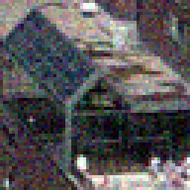
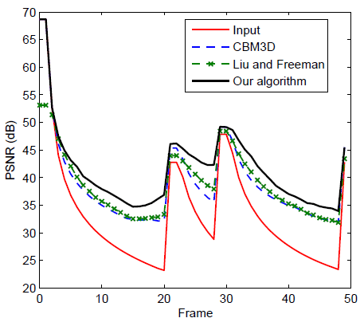
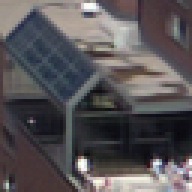
Results on Synthetic Videos
Constant Exposure
Time
Noisy Input
CBM3D
Liu and Freeman
Our Method
Ground Truth
Notes:
Here we show close-up results from a synthetic video of a city scene.
The BM3D and Liu and Freeman results are over-smoothed. Our result is significantly closer to the ground truth.
The Peak-Signal-to-Noise-Ratio plot for the full video shows that our algorithm produces better results for any frames with significant noise. The red line is the input video. Peaks in the PSNR correspond to frames with slower motion.

Slide 19
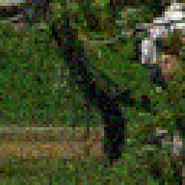
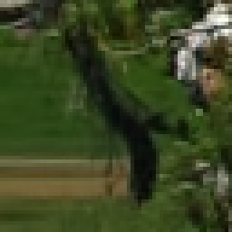
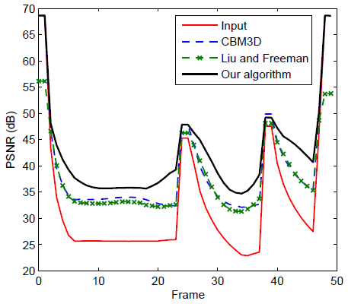
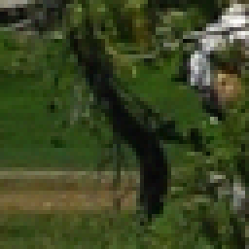
Results on Synthetic Videos
Constant Exposure
Time
Noisy Input
CBM3D
Liu and Freeman
Our Method
Ground Truth
Notes:
This synthetic example is from an outdoor scene.
Again, the BM3D and Liu and Freeman results are over-smoothed, whereas our results retain detail in the tree branches and grass.
The PSNR plot shows results similar to the previous video.

Slide 20
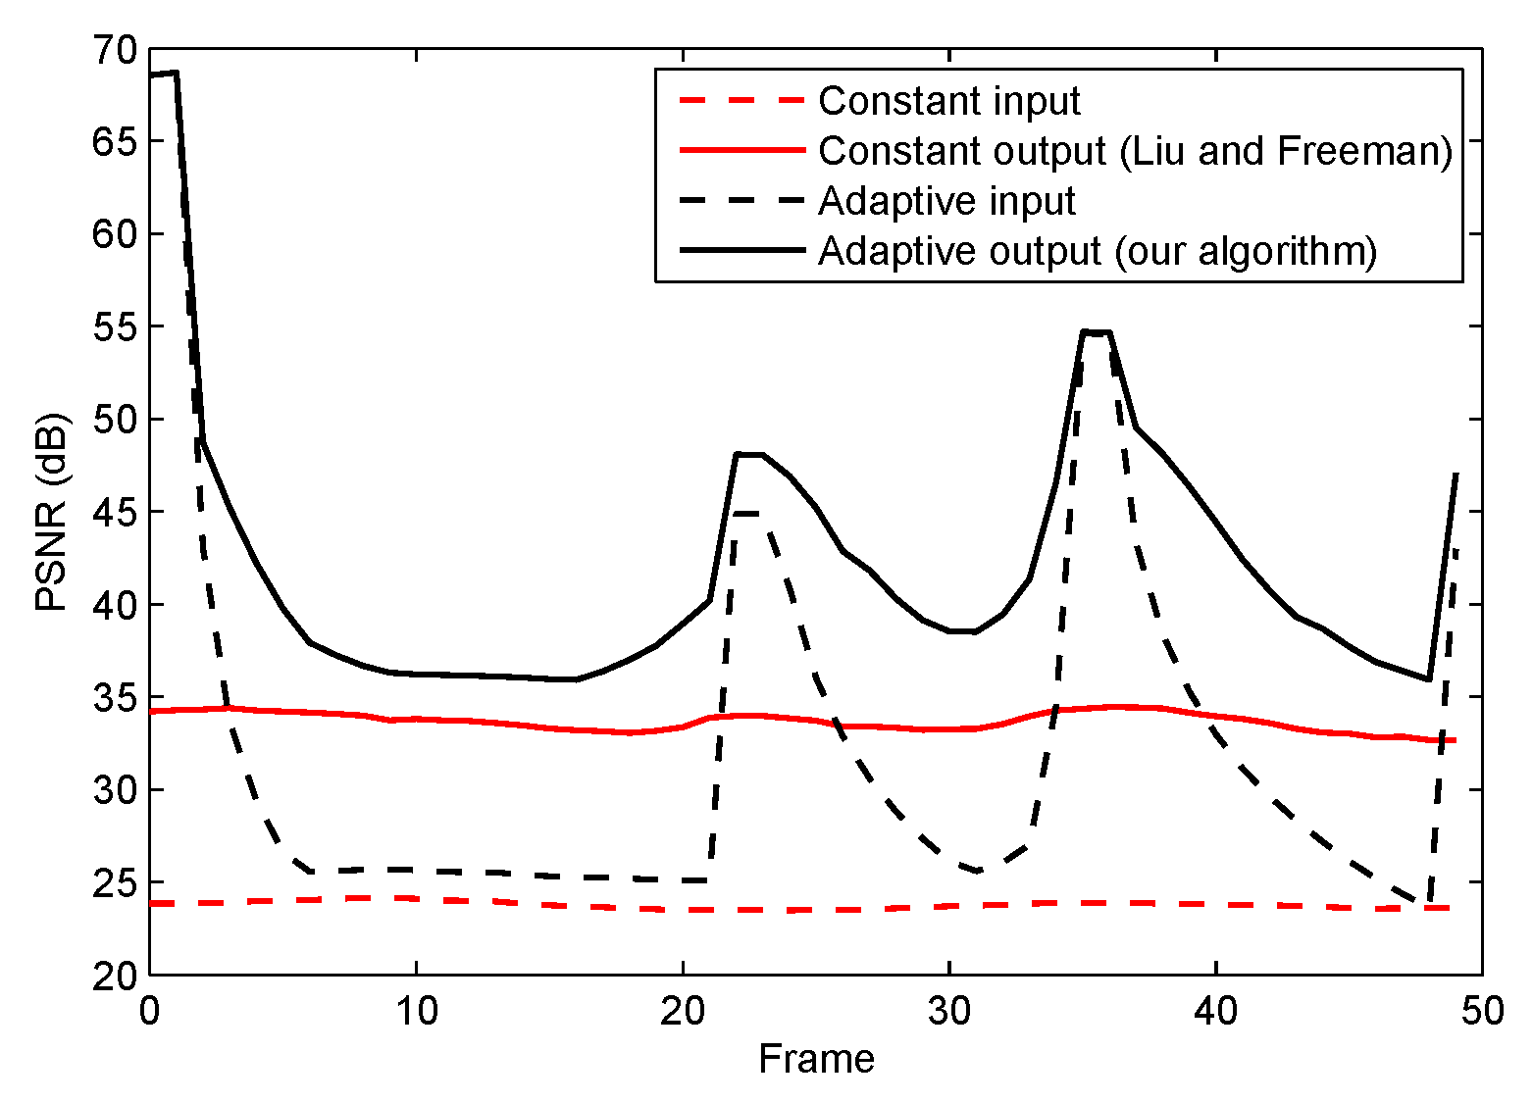
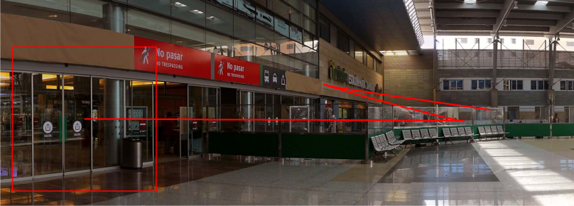
Results on Synthetic Videos
Constant short exposure vs. motion-based exposure
Notes:
We also compared results for denoising a synthetic video with constant short exposure time to denoising the same video captured instead with motion-based Auto Exposure.
The constant exposure time video uses an exposure time that avoids motion blur in any frame.
The results show that we get a significantly higher quality denoised video when using motion-based auto exposure, which is expected.

Slide 21
Real Video
Motion-base AE
Global, hierarchical image registration between previous two frames
Scenes with approximately planar motion
Notes:
We implemented motion-based AE using global coarse-to-fine image registration for motion estimation. This is performed on the previous two frames to determine the exposure time for the next frame.
We cannot completely eliminate motion blur since the motion is estimated between previous frames and there is a one frame delay in the new exposure time taking effect. Nevertheless, blur is significantly reduced in the captured video.
Since we are using global image registration, our videos are limited to scenes with mostly global translational motion.

Slide 22
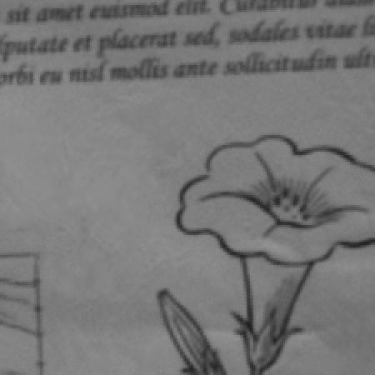
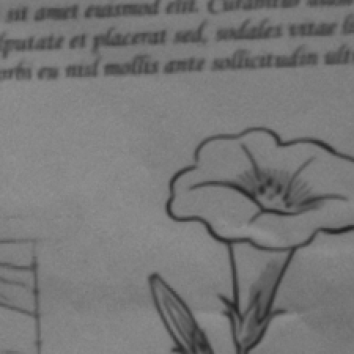
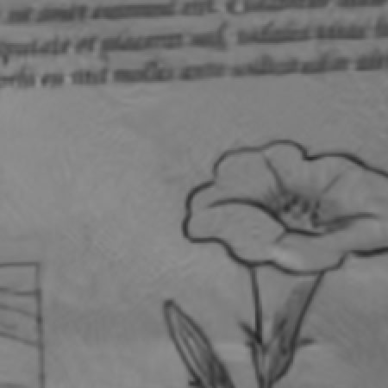
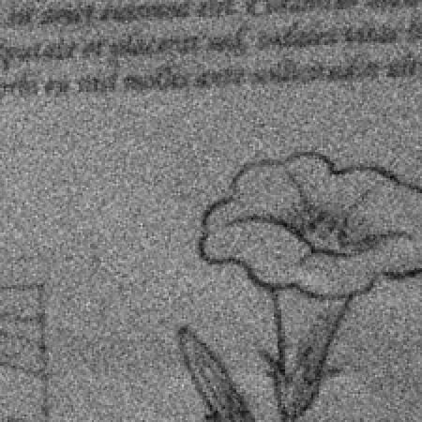
Results on Real Video
Input
BM3D
Liu and Freeman
Our Method
Notes:
This is an example from a video that has a sheet of text and line art moving in front of the camera.
BM3D does poorly, distorting the text and line art. Our method is comparable to Liu and Freeman. Their results are slightly smoother in the uniform color region. Our results have slightly sharper text and line art.

Slide 23
Results on Real Video
Constant exposure time
(Canon EOS 7D)
Motion-based exposure
(Point Grey Grasshopper)
Our denoising result
Notes:
This video shows the full results of our denoising method on the text sequence. The variations in the noise levels are no longer noticeable in the denoised video, which also lacks the motion blur of the constant exposure time video.

Slide 24
Future Work
Different weighting schemes
Temporal coherence
Dynamic scenes, spatially varying motion
Higher frame rates → more accurate flow
More AE latency → blurred frames
Use noisy/high-quality frames to enhance blurred frames
Notes:
We currently resort to spatial denoising when there are no frames with reliable motion; in this case, we don’t get temporal coherence. This is not very noticeable since the noisier frames have large motion, but if we applied video stabilization to the results, it could become a problem.
We would also like to be able to apply this method to dynamic scenes with spatially varying motion. This requires an AE implementation that can track multiple motions, which is more computationally expensive and likely cannot be done every frame.
Decoupling the frame rate from the AE would allow for higher frame rates (meaning more accurate optical flow), but the latency in the AE would result in more frames with motion-blur. It is desirable to use the noisy and/or high-quality frames to help enhance the blurred frames.

