Slide 1
0sim: Preparing the System Software for a World with Terabyte-scale Memories
Mark Mansi Michael M Swift
University of Wisconsin - Madison

Slide 2
Can System Software Scale? Ubuntu
Doesn’t support >=1TB RAM
Not documented anywhere
Failure mode: hanging boot

Slide 3
Can System Software Scale? memcached
4TB memcached instance
Out-of-Memory with “only” 2TB used, still 2TB free

Slide 4
Can System Software Scale? Linux kernel
10GB
1% dirty = 100MB = ~500ms to flush
1TB
1% dirty = 10GB = ~50s to flush

Slide 5
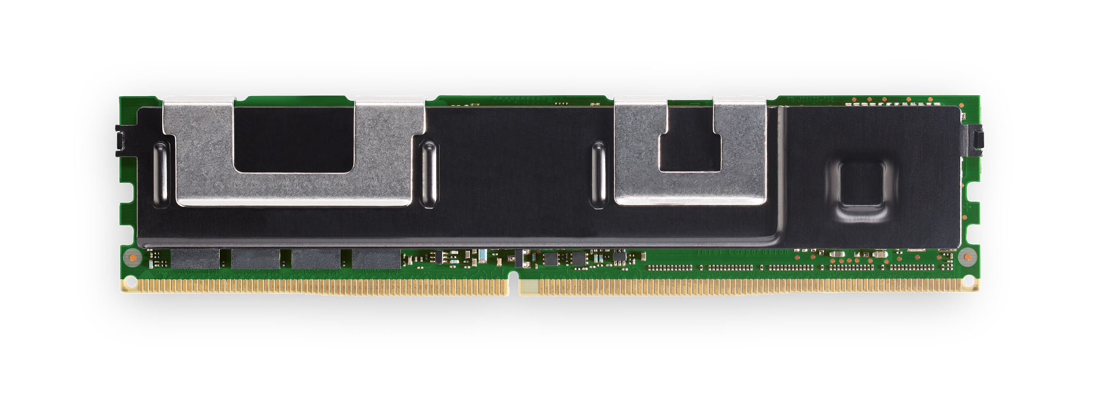
Can System Software Scale? Linux kernel
10GB
1% dirty = 100MB = ~500ms to flush
6TB on 2-socket machine
1TB
1% dirty = 10GB = ~50s to flush

Slide 6
The Capacity-Scaling Problem
System software should scale with memory capacity
O(memory size) overheads problematic
Prototyping/testing and research/exploration expensive

Slide 7
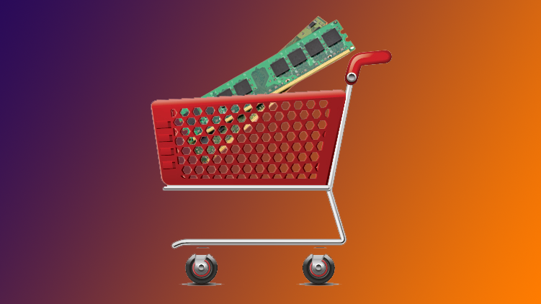
What are my options?
Google Cloud
16TB = 128x 128GB
4-5TB on-demand instances at $25/hr
12-24TB by contract at $200-300K/year

Slide 8
Addressing The Capacity Scaling Problem
0sim Simulator
TB-scale simulations
of unmodified system software
on readily available hardware
Data-oblivious workloads + Memory Compression
Fast and accurate enough
Case Studies
Interactively debugging 4TB memcached
Irreversible fragmentation despite 300GB free
github.com/multifacet/0sim-workspace

Slide 9
0sim Design: Challenges and Solutions
Simulation
Hardware Limitations
Virtualization
(Virtual Machine)
bar
XXXXXXXXXXXX
Workload
baz
XXXXXXXXXXXX
Preserve Behavior and Timing
Virtualize Timestamp Counters
Unmodified System Software
01010010010100101011
Speed and Scale
0sim
??
KVM

Slide 10
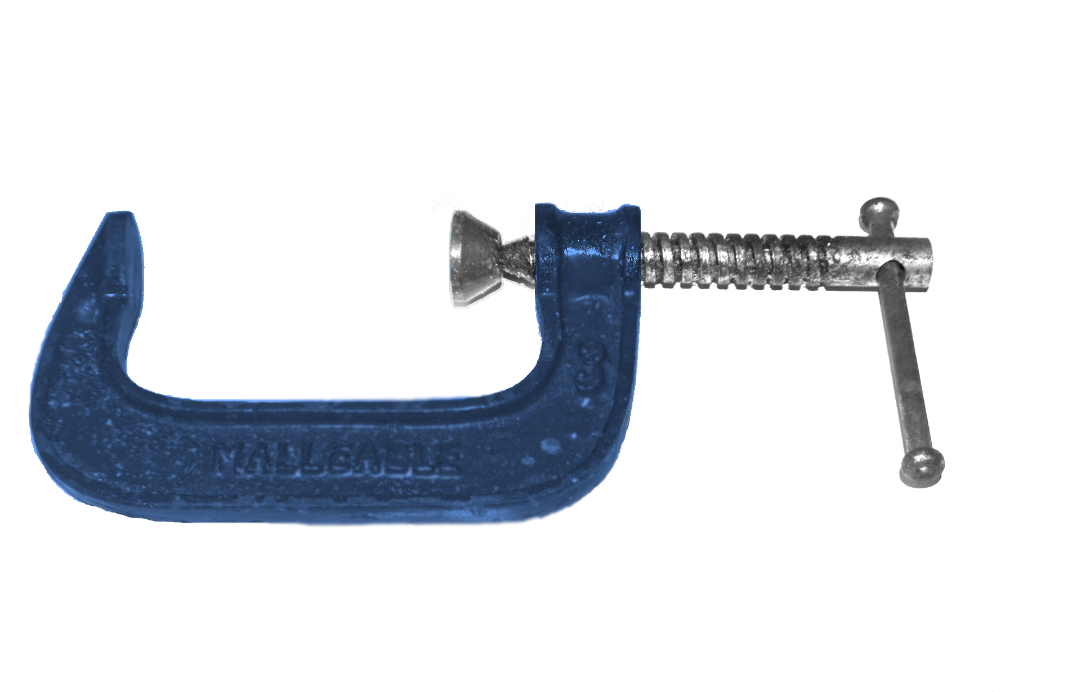
0sim Design: Scaling Simulation
Option 1: Store on disk
Too slow
Option 2: Memory compression
Not compressible enough?
Simulation
bar
XXXXXXXXXXXX
baz
Workload
XXXXXXXXXXXX
01010010010100101011
Unmodified System Software
0sim
010101101010101010100010010
101010
KVM

Slide 11
0sim Design: Scaling Simulation
Observation: the actual bytes often don’t matter…
KV Store
Matrix Multiplication
1 | 0 | 0 | 0
0 | 1 | 0 | 0
0 | 0 | 1 | 0
0 | 0 | 0 | 1
1 | 0 | 0 | 0
0 | 1 | 0 | 0
0 | 0 | 1 | 0
0 | 0 | 0 | 1
bar
XXXXXXXXXXXXXXXXXXXXXXXX
baz
XXXXXXXXXXXXXXXXXXXXXXXX
Data Oblivious
Different data,
Same control flow

Slide 12
Data-Oblivious Workloads
Simulation
Low-entropy dataset,
Highly compressible!
1 zeroed page => 1 bit
Fallback to aggressive compression
Client
KV Store
HashMap
K = foo
000000000000000000000000000000
K = bar
000000000000000000000000000000
K = baz
...
000000000000000000000000000000
0sim
11

Slide 13
0sim Design: Challenges and Solutions
Simulation
Hardware Limitations
Virtualization
(Virtual Machine)
bar
XYZXYZXYZXYZ
Workload
baz
MNOMNOMNOM
Preserve Behavior and Timing
Virtualize Timestamp Counters
Unmodified System Software
01010010010100101011
Speed and Scale
Data-Oblivious Workloads + Memory Compression
0sim
101010
KVM

Slide 14
Data-Obliviousness in Practice
Workload | Host Memory | Simulated Memory | Average Compressibility Ratio of Swapped Pages
Memcached (KV Store) | 62GB | 1TB | 215:1
Redis (KV Store) | 160GB | 1TB | 231:1
Metis (Matrix Mult) | 160GB | 4TB | 327:1
NAS CG | 31GB | 500GB | 16:1
~95% zero pages
Notes:
~2000-era machine

Slide 15
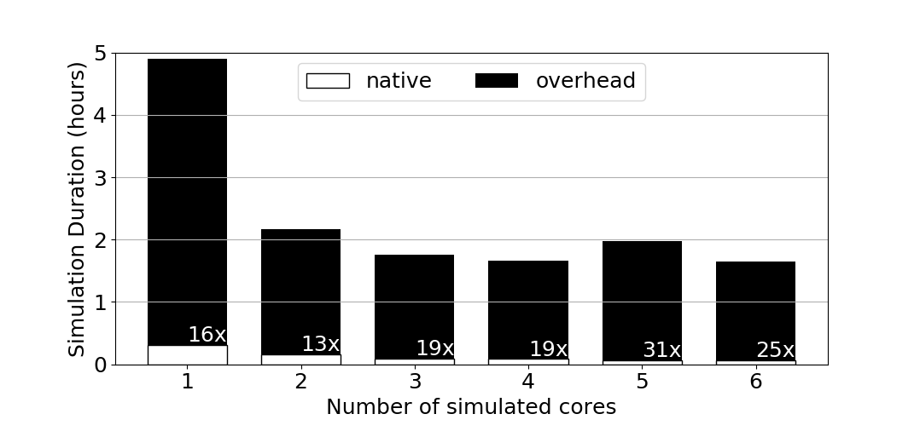
Simulation Speed – 1TB memcached, Old workstation

Slide 16
Case Studies with 0sim

Slide 17
Case Study 0: Debugging 4TB memcached
Interactive debugging: gdb inside simulator!

Slide 18
Case Study 1: Irreversible Fragmentation
Mix workload:
Memory pinning and unpinning (simulate driver)
Redis
Matrix multiplication
Look at distribution of pages in kernel allocator free lists

Slide 19
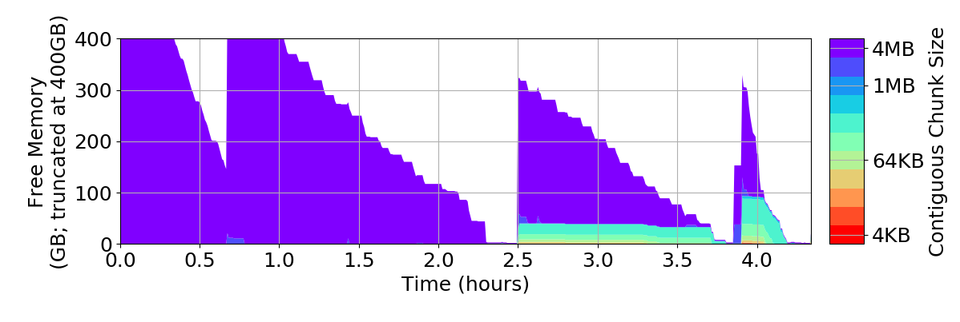
Case Study 1: Irreversible Fragmentation
Fragmentations persists,
worsens despite freeing 320GB

Slide 20
Conclusions
Questions?
Mark Mansi
markm@cs.wisc.edu
The Capacity-Scaling Problem
System software should scale with memory capacity; often doesn’t
0sim Simulator
Simulate TB-scale machines on readily available hardware
Accurate enough for many use cases
Case Studies
Used to interactively debug memcached OOM on >= 2TB systems
Early exploration: irreversible fragmentation with 100s of GBs free
github.com/multifacet/0sim-workspace

