Slide 1
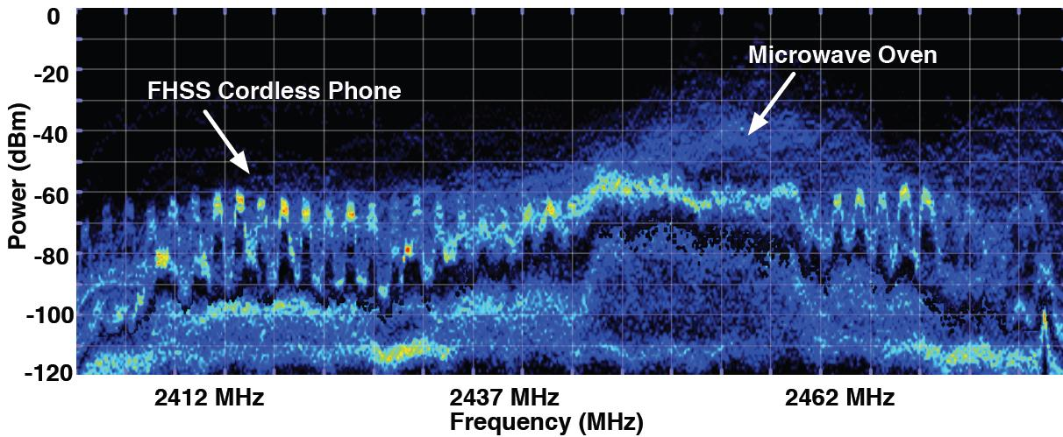
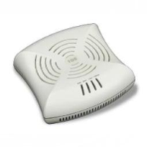
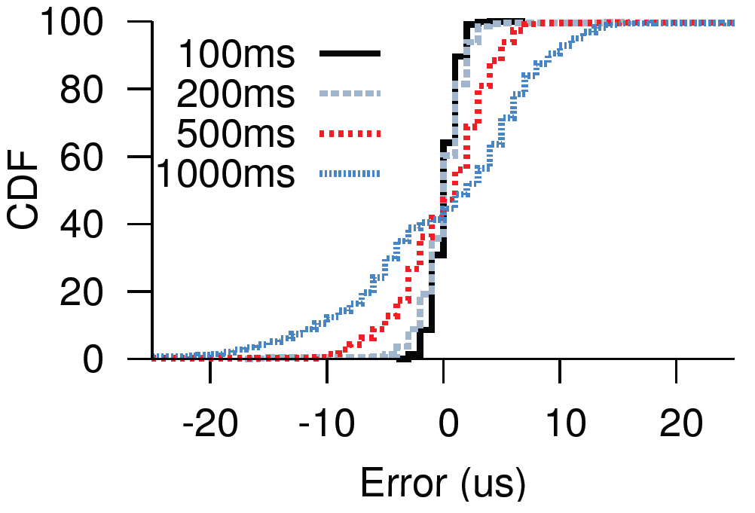
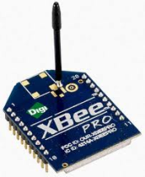
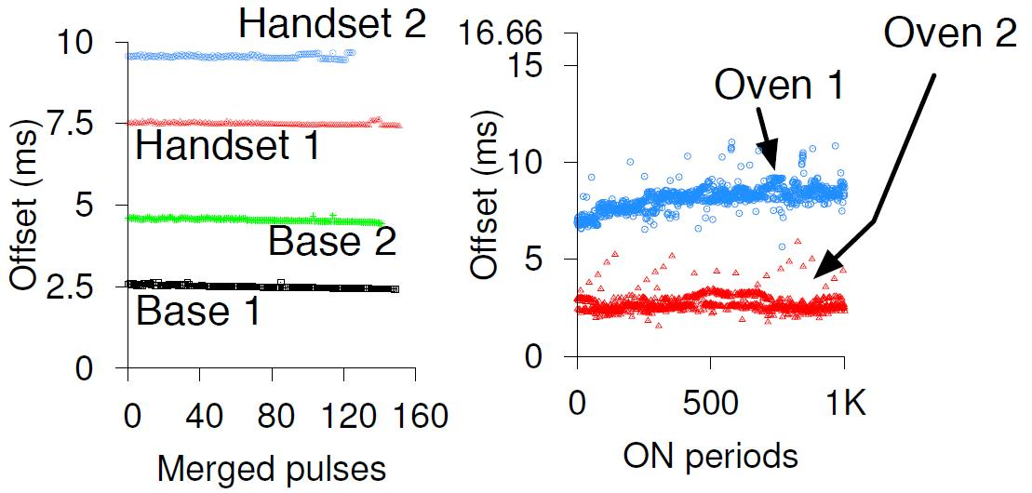
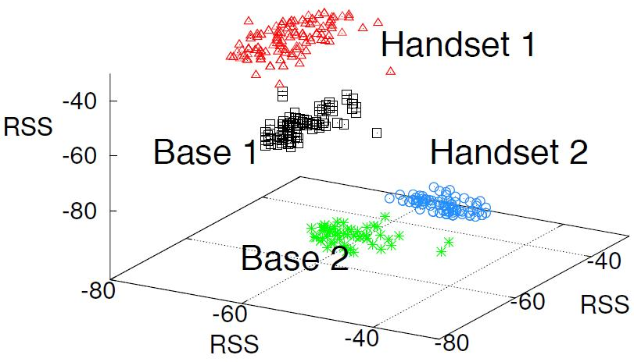
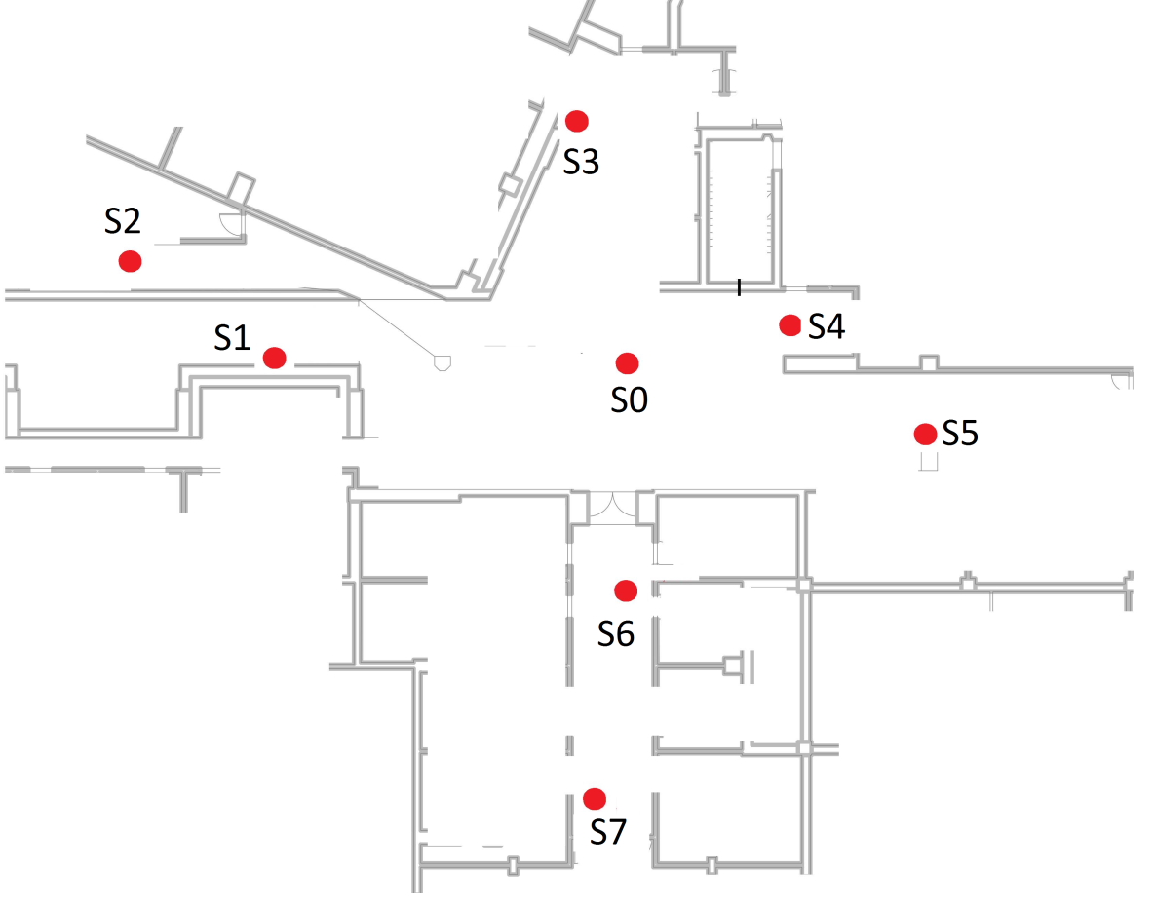
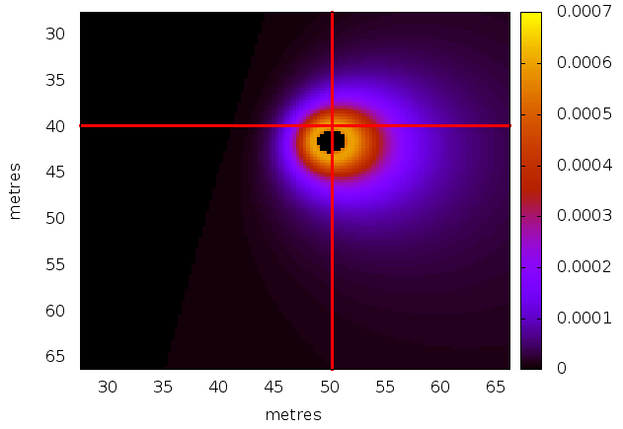
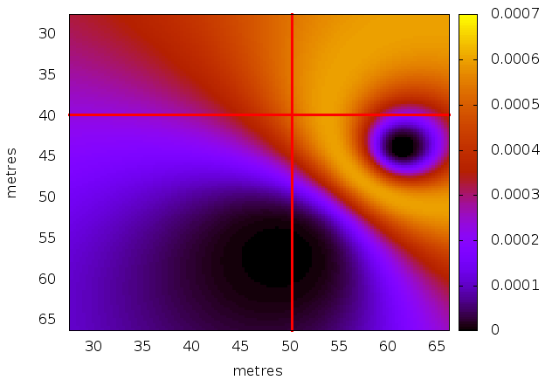
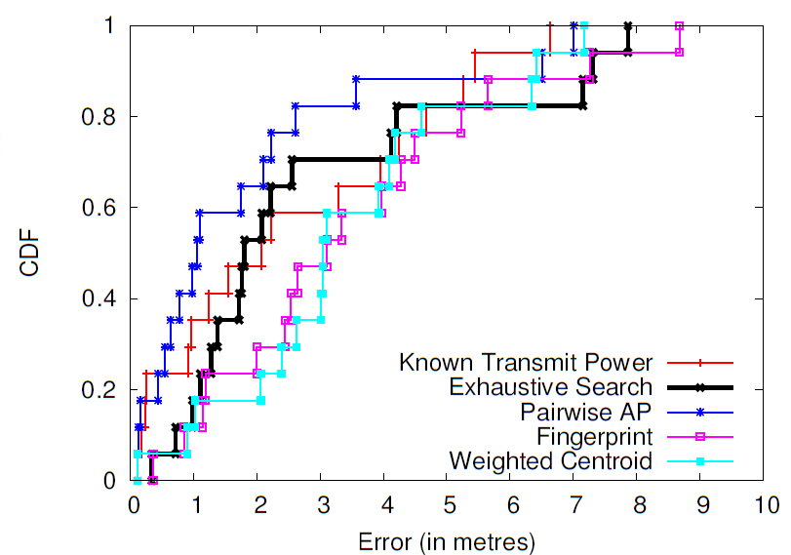
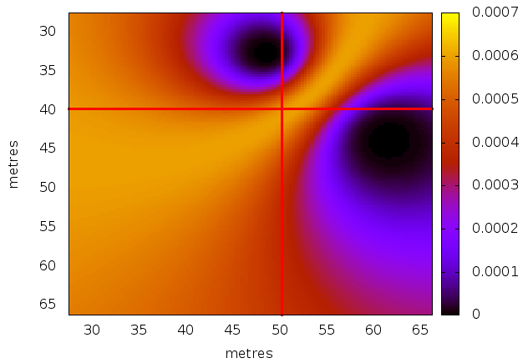
AirTrack: Locating Non-WiFi Interferers using Commodity WiFi Hardware
Ashish Patro, Shravan Rayanchu, Suman Banerjee
Wisconsin Wireless and NetworkinG Systems (WiNGS) Laboratory, UW-Madison
PROBLEM STATEMENT
AirTrack ARCHITECTURE
RESULTS
Non WiFi devices
affect WiFi performance
Synchronization results
Access Point (with Airshark sniffer)
AirTrack controller
For time interval <= 500 µs, Synchronization Error < 10 µs
How do we locate the multiple non-WiFi devices (even of the same type) ?
Clustering results
QUESTIONS?
How do we locate these non-WiFi devices?
How do we this in real time on a WiFi card, without additional hardware?
How to synchronize access points?
STAGE 1: Synchronization
Reference AP
Need to synchronize tagged pulses from multiple nodes
Find common packets received by multiple sniffers
BFS from the reference access point to get per-node skew
CHALLENGES?
Identify non-WiFi device transmissions
Identify unique non-WiFi device instances (e.g., 2 FHSS devices)
Localize devices with unknown transmit power
+5 µs
+6 µs
-8 µs
FHSS Phones
Microwave Oven
FHSS Phones
-5 µs
Time domain clustering
RSS domain clustering
How to merge common pulses from the same non-WiFi device?
STAGE 2 : Merge pulses
Each cluster is a unique active device
AirTrack can differentiate between multiple devices
SOLUTION FRAMEWORK
Time
FHSS
Pulses
Waterfall Merging Approach: Merge common pulses seen by multiple access points
- Matching Start/End time
- Matching center frequency
- Matching bandwidth
Localization results
Airshark
Sniffers that detect presence of non-WiFi devices
0 - 56
Pairwise AP: S0,S2
0 - 56
0 - 56
Frequency (FFT bins)
Capture FFT samples
Identify ``Pulses”
Extract ``Features’’
Binary Decision
Tree classifier
Synchronization
Airshark
Airshark
Airshark
Power
Duration
S1
S2
S3
Bandwidth
How many devices are active simultaneously?
STAGE 3 : Cluster pulses
Pairwise AP: S5,S7
Frequency
Timing
Properties
“Tagged
Pulses”
Cluster pulses to identify unique devices
- Temporal properties
- RSSI properties
Each cluster is a unique device
Localization error CDF for FHSS phone
AirTrack
Locate non-WiFi devices using multiple Airshark sniffers
STAGE 4 : Localization
Pairwise AP: S3,S5
How to find device’s physical location?
“Tagged
Pulses”
AP locations are known
Device transmit power is unknown
Create RF propagation model
For each cluster, find location
- RSS per sniffer
Synchronize access points
Merge + Cluster pulses
Localize each device
(Pulse Cluster)
S1
S1: -40db
S2: -70db
S3: -75db
S2
Access Point (with Airshark sniffer)
S1: -70db
S2: -60db
S3: -45db
Localization error < 6 metres for 80% of the locations
S3

