Slide 1
MMUs for GPGPUs
Supporting x86-64 Address Translation for 100s of GPU Lanes
Jason Power, Mark Hill, David Wood

Slide 2
Executive Summary
CPUs & GPUs: physically integrated, logically separate
Near Future: Cache coherence, Shared virtual address space
3 data-driven GPU MMU designs
D1: Post-coalescer MMU
coalescer and shared memory filter 85% of requests
D2: +Highly-threaded page table walker
TLB misses bursty with up to 140 concurrent
D3: +Page walk cache
high TLB miss rate (29% avg), need low-latency misses
Full x86-64 support with modest performance decrease (2% avg over an ideal MMU)
Notes:
1:50

Slide 3
Motivation
Closer physical integration of GPGPUs
Programming model still decoupled
Separate address spaces
Unified virtual address (NVIDIA) simplifies code
Want: Shared virtual address space (hUMA)

Slide 4
Example: Vector Copy

Slide 5
Host code
(separate address spaces)
Kernel code
void main() {
int *d_in, *d_out;
int *h_in, *h_out;
h_in = new int[1024]; // allocate input array on host
h_in = ... // Initial host array
h_out = new int[1024]; // allocate output array on host
d_in = cudaMalloc(sizeof(int)*1024); // allocate input array on device
d_out = cudaMalloc(sizeof(int)*1024); // allocate output array on device
cudaMemcpy(d_in, h_in, sizeof(int)*4, HtD); // copy input array from host to device
vectoryCopy<<<1,1024>>>(d_in, d_out);
cudaMemcpy(h_out, d_out, sizeof(int)*4, DtH); // copy the output array from device to host
... h_out // continue host computation with result
cudaFree(d_in); cudaFree(d_out); // Free memory on device
delete[] h_in; delete[] h_out; // Free memory on host
}
__device__ void vectorCopy(int *in, int *out) {
out[threadId.idx] = in[threadId.idx];
}

Slide 6
Host code
(separate address spaces)
Kernel code
void main() {
int *d_in, *d_out;
int *h_in, *h_out;
h_in = new int[1024]; // allocate input array on host
h_in = ... // Initial host array
h_out = new int[1024]; // allocate output array on host
d_in = cudaMalloc(sizeof(int)*1024); // allocate input array on device
d_out = cudaMalloc(sizeof(int)*1024); // allocate output array on device
cudaMemcpy(d_in, h_in, sizeof(int)*4, HtD); // copy input array from host to device
vectoryCopy<<<1,1024>>>(d_in, d_out);
cudaMemcpy(h_out, d_out, sizeof(int)*4, DtH); // copy the output array from device to host
... h_out // continue host computation with result
cudaFree(d_in); cudaFree(d_out); // Free memory on device
delete[] h_in; delete[] h_out; // Free memory on host
}
__device__ void vectorCopy(int *in, int *out) {
out[threadId.idx] = in[threadId.idx];
}

Slide 7
Host code
(Universal virtual addressing)
Kernel code
void main() {
int *d_in, *d_out;
int *h_in, *h_out;
h_in = new int[1024]; // allocate input array on host
h_in = ... // Initial host array
h_out = new int[1024]; // allocate output array on host
d_in = cudaMalloc(sizeof(int)*1024); // allocate input array on device
d_out = cudaMalloc(sizeof(int)*1024); // allocate output array on device
cudaMemcpy(d_in, h_in, sizeof(int)*4, HtD); // copy input array from host to device
vectoryCopy<<<1,1024>>>(d_in, d_out);
cudaMemcpy(h_out, d_out, sizeof(int)*4, DtH); // copy the output array from device to host
... h_out // continue host computation with result
cudaFree(d_in); cudaFree(d_out); // Free memory on device
delete[] h_in; delete[] h_out; // Free memory on host
}
__device__ void vectorCopy(int *in, int *out) {
out[threadId.idx] = in[threadId.idx];
}
cudaHostMalloc(sizeof(int)*1024);
cudaHostMalloc(sizeof(int)*1024);
h_in, h_out
cudaHostFree(h_in);
cudaHostFree(h_out);

Slide 8
Host code
(Universal virtual addressing)
Kernel code
__device__ void vectorCopy(int *in, int *out) {
out[threadId.idx] = in[threadId.idx];
}
void main() {
int *h_in, *h_out;
h_in = cudaHostMalloc(sizeof(int)*1024); // allocate input array on host
h_in = ... // Initial host array
h_out = cudaHostMalloc(sizeof(int)*1024); // allocate output array on host
vectoryCopy<<<1,1024>>>(h_in, h_out);
... h_out // continue host computation with result
cudaHostFree(h_in); // Free memory on host
cudaHostFree(h_out);
}
Notes:
Still have d_in and d_out in kernel launch

Slide 9
Host code
(Shared address space)
Kernel code
__device__ void vectorCopy(int *in, int *out) {
out[threadId.idx] = in[threadId.idx];
}
void main() {
int *h_in, *h_out;
h_in = new int[1024]; // allocate input array on host
h_in = ... // Initial host array
h_out = new int[1024]; // allocate output array on host
vectoryCopy<<<1,1024>>>(h_in, h_out);
... h_out // continue host computation with result
delete[] h_in; delete[] h_out; // Free memory on host
}

Slide 10
Host code
(Shared address space)
Kernel code
__device__ void vectorCopy(int *in, int *out) {
out[threadId.idx] = in[threadId.idx];
}
void main() {
int *h_in, *h_out;
h_in = new int[1024]; // allocate input array on host
h_in = ... // Initial host array
h_out = new int[1024]; // allocate output array on host
vectoryCopy<<<1,1024>>>(h_in, h_out);
... h_out // continue host computation with result
delete[] h_in; delete[] h_out; // Free memory on host
}
GPU kernel now a drop-in replacement

Slide 11
Shared virtual address space
Simplifies code
Easier to understand
Enables rich pointer-based datastructures
Trees, linked lists, etc.
Need: MMU (memory management unit) for the GPU
Low overhead
Support for CPU page tables (x86-64)
4 KB pages
Page faults, TLB flushes, TLB shootdown, etc
Notes:
6:16

Slide 12
Outline
Motivation
Data-driven GPU MMU design
D1: Post-coalescer MMU
D2: +Highly-threaded page table walker
D3: +Shared page walk cache
Alternative designs
Conclusions

Slide 13
System Overview

Slide 14
GPU Overview
Notes:
Need to add system parameters (128 entry TLB, etc)
Need to add workloads too

Slide 15
Methodology
Target System
Heterogeneous CPU-GPU system
Linux OS
Simulation
gem5-gpu – full system mode
Rodinia benchmarks & database sort
Ideal MMU
Infinite caches
Minimal latency

Slide 16
D0

Slide 17
D1
Per-CU MMUs:
Reducing the translation request rate

Slide 18
Lane
Lane
Lane
Lane
Lane
Lane
Lane
Lane
Lane
Lane
Lane
Lane
Lane
Lane
Lane
Lane
Notes:
Somehow say 1 compute unit

Slide 19
Lane
Lane
Lane
Lane
Lane
Lane
Lane
Lane
Lane
Lane
Lane
Lane
Lane
Lane
Lane
Lane
1x B/W
Shared Memory
0.45x B/W

Slide 20
Lane
Lane
Lane
Lane
Lane
Lane
Lane
Lane
Lane
Lane
Lane
Lane
Lane
Lane
Lane
Lane
1x B/W
Shared Memory
Coalescer
0.45x B/W
0.06x B/W

Slide 21
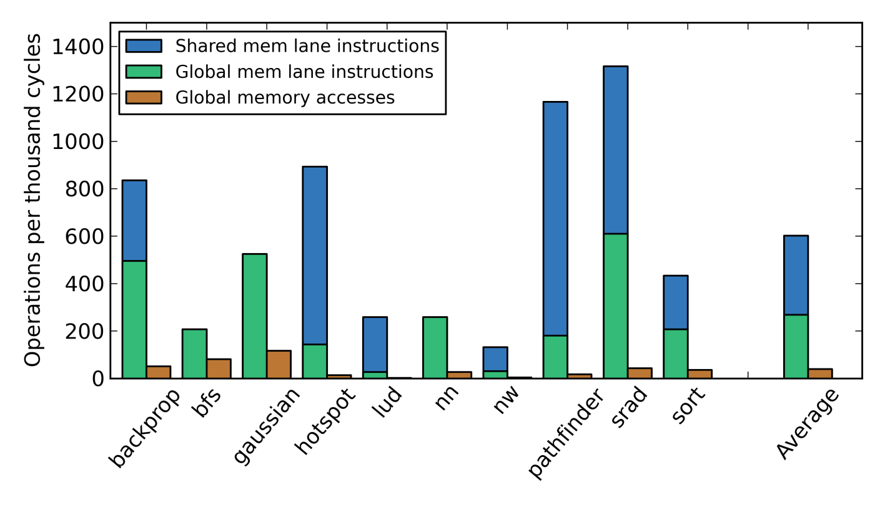
Reducing translation request rate
Breakdown of memory operations
Shared memory and coalescer effectively filter global memory accesses
Average 39 TLB requests per 1000 cycles
Notes:
3 slides, one for each bar
Stacked bar graph would be better

Slide 22
D1

Slide 23
Performance

Slide 24
D2
Highly-threaded page table walker:
Increasing TLB miss bandwidth

Slide 25
Lane
Lane
Lane
Lane
Lane
Lane
Lane
Lane
Lane
Lane
Lane
Lane
Lane
Lane
Lane
Lane
Shared Memory
Coalescer
Outstanding TLB Misses

Slide 26
Lane
Lane
Lane
Lane
Lane
Lane
Lane
Lane
Lane
Lane
Lane
Lane
Lane
Lane
Lane
Lane
Shared Memory
Coalescer
Outstanding TLB Misses

Slide 27
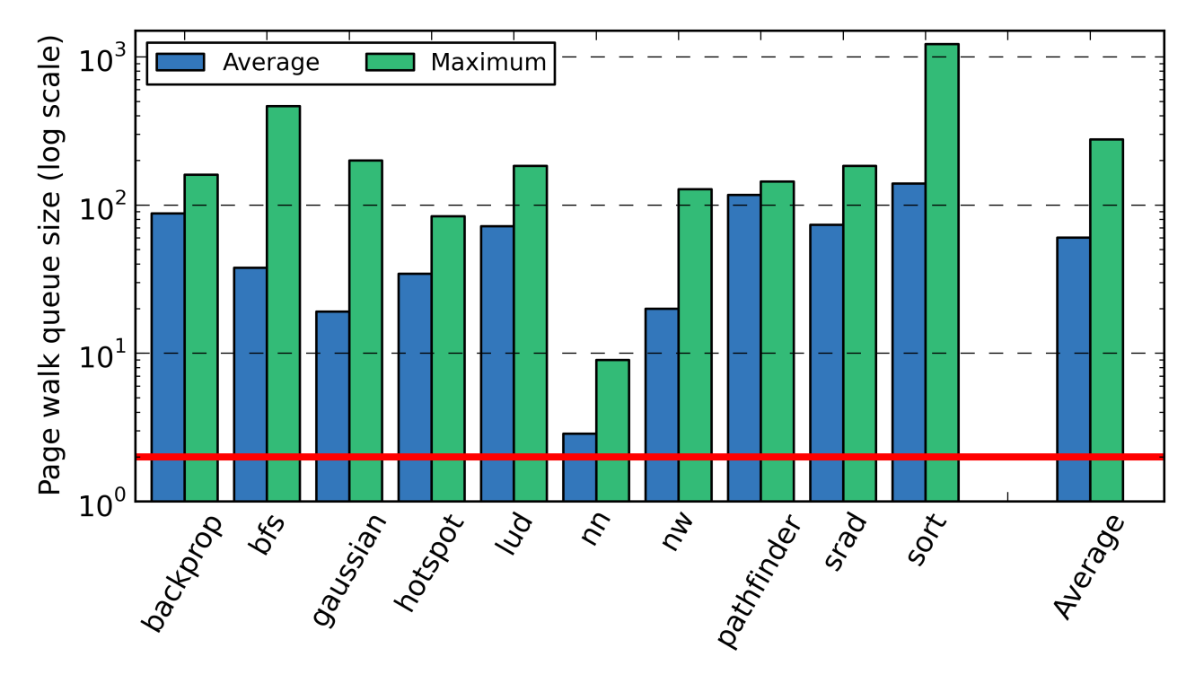
Multiple outstanding page walks
Concurrent page walks when non-zero (log scale)
2
Many workloads are bursty
Miss latency skyrockets due to queuing delays if blocking page walker

Slide 28
D2

Slide 29
Performance

Slide 30
D3
Page walk cache:
Overcoming high TLB miss rate

Slide 31
High L1 TLB miss rate
Per-access Rate with 128 entry L1 TLB
Average miss rate: 29%!
Notes:
Title for per reference add 128 entry

Slide 32
High TLB miss rate
Requests from coalescer spread out
Multiple warps issuing unique streams
Mostly 64 and 128 byte requests
Often streaming access patterns
Each entry not reused many times
Many demand misses

Slide 33
D3

Slide 34
Performance
Worst case: 12% slowdown
Average: Less than 2% slowdown

Slide 35
Correctness Issues
Page faults
Stall GPU as if TLB miss
Raise interrupt on CPU core
Allow OS to handle in normal way
Minor page faults: OK, Major page faults harder
One change to CPU microcode, no OS changes
TLB flush and shootdown
Leverage CPU core, again
Flush GPU TLBs whenever CPU core TLB is flushed
Notes:
Define major/minor page faults

Slide 36
Page faults
 | Number of page faults | Average page fault latency
Lud | 1 | 1698 cycles
Pathfinder | 15 | 5449 cycles
Cell | 31 | 5228 cycles
Hotspot | 256 | 5277 cycles
Backprop | 256 | 5354 cycles
Minor Page faults handled correctly
5000 cycles = 3.5 µsec: too fast for GPU context switch

Slide 37
Summary
 | Per-CU L1 TLB entries | Highly-threaded page table walker | Page walk cache size | Shared L2 TLB entries
Ideal MMU | Infinite | Infinite | Infinite | None
Design 0 | N/A: Per-lane MMUs |  | None | None
Design 1 | 128 | Per-CU walkers | None | None
Design 2 | 128 | Yes (32-way) | None | None
Design 3 | 64 | Yes (32-way) | 8 KB | None
D3: proof of concept
Non-exotic design
Low overhead
Fully compatible
Correctness issues

Slide 38
Outline
Motivation
Data-driven GPU MMU design
Alternative designs
Shared L2 TLB
Alternative page walk cache
Other sensitivity analysis
Energy and area
Conclusions
Notes:
18:38

Slide 39
Shared L2 TLB

Slide 40
Shared L2 TLB
Sharing pattern
Many benchmarks share translations between CUs

Slide 41
Shared L2 TLB
Performance relative to D3
A shared L2 TLB can work as well as a page walk cache
Some workloads need low latency TLB misses

Slide 42
Shared L2 TLB and PWC

Slide 43
Shared L2 TLB and PWC
Benefits of both page walk cache and shared L2 TLB
Can reduce the size of L1 TLB without performance penalty

Slide 44
Ideal Page Walk Cache
D3 uses AMD-like physically-addressed page walk cache
Ideal PWC performs slightly better (1% avg, up to 10%)

Slide 45
Other Sensitivity Analysis
TLB prefetching:
Simple 1-ahead prefetcher does not affect performance
Large pages:
Effective at reducing TLB misses
Requiring places burden on programmer
Must have compatibility

Slide 46
Alternative Designs
 | Per-CU L1 TLB entries | Highly-threaded page table walker | Page walk cache size | Shared L2 TLB entries
Design 3 | 64 | Yes (32-way) | 8 KB | None
Shared L2 | 64 | Yes (32-way) | None | 1024
Shared L2 & PWC | 32 | Yes (32-way) | 8 KB | 512
Ideal PWC | 64 | Yes (32-way) | Infinite | None
Each design has 16 KB extra SRAM for all 16 CUs
PWC needed for some workloads
Ideal PWC can increase performance slightly

Slide 47
Conclusions
Shared virtual memory is important
Non-exotic MMU design
Post-coalescer L1 TLBs
Highly-threaded page table walker
Page walk cache
Full compatibility with minimal overhead
Notes:
23:48

Slide 48
Questions?

Slide 49
Future Work
Add something?

Slide 50
Energy and Area of Unified MMU
These configurations provide a huge performance improvement
over D2 AND reduce area and (maybe) energy
*data produced using McPAT and CACTI 6.5
Notes:
Methods. Put down cacti and McPAT

Slide 51
Executive Summary (1/2)
Today: GPGPUs and CPUs closer physical integration
CPU/GPU on same die, sharing DRAM, L3 cache
AMD Fusion, Intel Sandy/Ivy Bridge, Qualcomm, …
Tomorrow: Closer logical integration
Share data simply
Cache coherence
Shared address space

Slide 52
Executive Summary (2/2)
MMU usage analysis findings:
F1: GPU per-CU TLB translation request rate is low (vs. CPU core)
F2: GPU applications have a high TLB miss rate (15%)
F3: Large pages (if applicable) are effective in reducing MMU overheads
F4: Multiple outstanding page walks are common (up to 350)
Non-exotic design sufficient
Per-CU L1 TLB
Shared L2 TLB
Multi-threaded page table walker
Page walk cache
Even with 4KB pages, within 3% performance of magic translation
Notes:
Subfont too small?

Slide 53
Low TLB translation request rate
Memory operations per thousand instruction instances
Memory operations per thousand cycles

Slide 54
F3
Large pages (if appropriate) are effective

Slide 55
128 entry TLB
With 4 kB pages
512 kB reach
128 entry TLB
With 2 MB pages
256 MB reach
4 kB page
2 MB page
*to scale

Slide 56
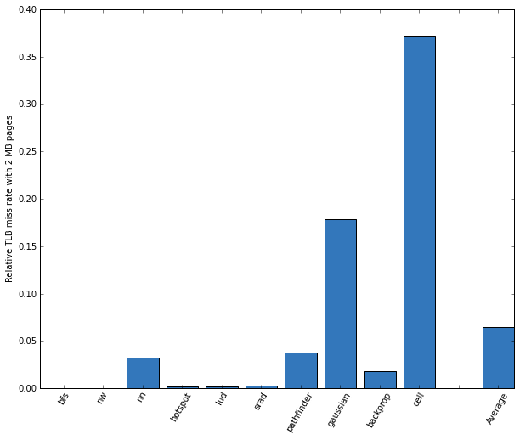
Large pages are effective
Relative miss rate with 2MB pages
2 MB pages significantly reduce miss rate
But can they be used?
slow adoption on CPUs
Special allocation API
Notes:
Cell and gaussian are pretty small and have relatively few TLB misses with 4 kB pages
Absolute numbers?

Slide 57
Implications
F1: GPU TLB translation request rate is low
By placing the TLB after coalescing, no exotic architecture needed to support multiple requests per cycle
F2: GPU applications have a high TLB miss rate
Page walk latency must be reduced to prevent queuing delays
F3: Large pages are effective in reducing MMU overheads
Large pages perform well, just like on CPU, but need compatibility
F4: Many outstanding page walks with blocking MMU
Need to support TLB misses while a page walk is outstanding: non-blocking page walker
Notes:
Last point is without the L2 TLB, probably should say something about that here.
Put the (vs…) on each finding slide?

Slide 58
Unified MMU Design
Memory request
(virtual addr)
Memory request
(physical addr)
Page walk request & response

Slide 59
Host code
(separate address spaces)
Kernel code
void main() {
int *d_in, *d_out;
int *h_in, *h_out;
h_in = new int[1024]; // allocate input array on host
h_in = ... // Initial host array
h_out = new int[1024]; // allocate output array on host
d_in = cudaMalloc(sizeof(int)*1024); // allocate input array on device
d_out = cudaMalloc(sizeof(int)*1024); // allocate output array on device
cudaMemcpy(d_in, h_in, sizeof(int)*4, HtD); // copy input array from host to device
vectoryCopy<<<1,1024>>>(d_in, d_out);
cudaMemcpy(h_out, d_out, sizeof(int)*4, DtH); // copy the output array from device to host
... h_out // continue host computation with result
cudaFree(d_in); cudaFree(d_out); // Free memory on device
delete[] h_in; delete[] h_out; // Free memory on host
}
__device__ void vectorCopy(int *in, int *out) {
out[threadId.idx] = in[threadId.idx];
}

Slide 60
Host code
(separate address spaces)
Kernel code
void main() {
int *d_in, *d_out;
int *h_in, *h_out;
h_in = new int[1024]; // allocate input array on host
h_in = ... // Initial host array
h_out = new int[1024]; // allocate output array on host
d_in = cudaMalloc(sizeof(int)*1024); // allocate input array on device
d_out = cudaMalloc(sizeof(int)*1024); // allocate output array on device
cudaMemcpy(d_in, h_in, sizeof(int)*4, HtD); // copy input array from host to device
vectoryCopy<<<1,1024>>>(d_in, d_out);
cudaMemcpy(h_out, d_out, sizeof(int)*4, DtH); // copy the output array from device to host
... h_out // continue host computation with result
cudaFree(d_in); cudaFree(d_out); // Free memory on device
delete[] h_in; delete[] h_out; // Free memory on host
}
__device__ void vectorCopy(int *in, int *out) {
out[threadId.idx] = in[threadId.idx];
}

Slide 61
Host code
(separate address spaces)
Kernel code
void main() {
int *d_in, *d_out;
int *h_in, *h_out;
h_in = new int[1024]; // allocate input array on host
h_in = ... // Initial host array
h_out = new int[1024]; // allocate output array on host
d_in = cudaMalloc(sizeof(int)*1024); // allocate input array on device
d_out = cudaMalloc(sizeof(int)*1024); // allocate output array on device
cudaMemcpy(d_in, h_in, sizeof(int)*4, HtD); // copy input array from host to device
vectoryCopy<<<1,1024>>>(d_in, d_out);
cudaMemcpy(h_out, d_out, sizeof(int)*4, DtH); // copy the output array from device to host
... h_out // continue host computation with result
cudaFree(d_in); cudaFree(d_out); // Free memory on device
delete[] h_in; delete[] h_out; // Free memory on host
}
__device__ void vectorCopy(int *in, int *out) {
out[threadId.idx] = in[threadId.idx];
}

Slide 62
Host code
(separate address spaces)
Kernel code
void main() {
int *d_in, *d_out;
int *h_in, *h_out;
h_in = new int[1024]; // allocate input array on host
h_in = ... // Initial host array
h_out = new int[1024]; // allocate output array on host
d_in = cudaMalloc(sizeof(int)*1024); // allocate input array on device
d_out = cudaMalloc(sizeof(int)*1024); // allocate output array on device
cudaMemcpy(d_in, h_in, sizeof(int)*4, HtD); // copy input array from host to device
vectoryCopy<<<1,1024>>>(d_in, d_out);
cudaMemcpy(h_out, d_out, sizeof(int)*4, DtH); // copy the output array from device to host
... h_out // continue host computation with result
cudaFree(d_in); cudaFree(d_out); // Free memory on device
delete[] h_in; delete[] h_out; // Free memory on host
}
__device__ void vectorCopy(int *in, int *out) {
out[threadId.idx] = in[threadId.idx];
}

Slide 63
Host code
(separate address spaces)
Kernel code
void main() {
int *d_in, *d_out;
int *h_in, *h_out;
h_in = new int[1024]; // allocate input array on host
h_in = ... // Initial host array
h_out = new int[1024]; // allocate output array on host
d_in = cudaMalloc(sizeof(int)*1024); // allocate input array on device
d_out = cudaMalloc(sizeof(int)*1024); // allocate output array on device
cudaMemcpy(d_in, h_in, sizeof(int)*4, HtD); // copy input array from host to device
vectoryCopy<<<1,1024>>>(d_in, d_out);
cudaMemcpy(h_out, d_out, sizeof(int)*4, DtH); // copy the output array from device to host
... h_out // continue host computation with result
cudaFree(d_in); cudaFree(d_out); // Free memory on device
delete[] h_in; delete[] h_out; // Free memory on host
}
__device__ void vectorCopy(int *in, int *out) {
out[threadId.idx] = in[threadId.idx];
}

