Slide 1


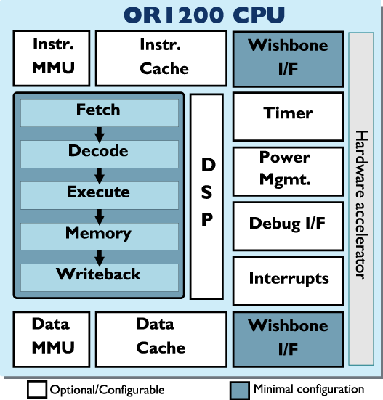
WOOF : The World’s First Opensource Out-of-order Processor
Raghu Balasubramanian, Jaikrishnan Menon, Karu Sankaralingam
The OpenRISC platform
What’s new?
A 32-bit RISC load store architecture^{[1]}
A full system software simulator
Toolchains
GNU^{[2]}
LLVM
Operating system support
Linux kernel 3.0
eCos, RTEMS, uCOS-II and FreeRTOS
Bootloaders like U-Boot
System on Chip reference platforms : ORPSoC
Xilinx^{[3]}, Altera ports
Support for a number of peripherals including
a debug I/F, Ethernet, VGA, UART, AC97 audio etc.,
On the core is the or1200 : A 5 stage commercially proven RTL implementation
An Out-of-Order Processor
A super-scalar processor implementation
Synthesizable
Able to run a full system standalone
Easy to add instructions, customize on micro-architectural parameters
Support for statistics gathering
LLVM Compiler support
Advantages : easier extendibility, faster compile times, target independent optimizations, diagnostics.
or32 Target support : skeleton backend ➔ or1k assembly generator ➔ binutils ➔ or32 binary
Status : compiles micro-benchmarks and SPEC2000 benchmarks
Why build a processor?
A Research tool
Fast and more accurate measurements.
Building a new branch predictor ? in addition to miss-prediction rates, get the area, power and timing hit.
Technology constrains of unreliable hardware and energy efficiency becoming more significant today!
A Teaching tool
Create real hardware
We used a version of this processor in CS 758. Student teams had 2 weeks to improve processor performance. Student teams designed branch predictors, played with the caching schemes etc.,
It’s cool
We will have the worlds first free and open-source out of order superscalar processor capable of running Linux standalone.
Our Out of Order Implementation
Dual issue out of order design pin compatible with ORPSoC
Configurable micro-architectural parameters include
Number of physical registers
Number of functional units
Instruction queue depths
Register write back ports
Activelist depth
The Design
9 man month effort
Functional units and decode logic reused from single issue in-order core
Modular: Easy to add functional units, instructions, stat counters
Current status : Runs binaries that do not require MMU support
Case studies
Idempotent Processing
Exception handling takes up significant resources in-terms of chip area and energy efficiency (check-pointing logic, recovery logic etc.,).
Also complicates design and verification efforts.
Idempotence: Regions of code that may be executed multiple times producing the same result.
Exception? restarting execution from the start of this region would suffice^{[5]}.
Area, power and design effort reduction.
Sampling-DMR
A fault detection mechanism that guarantees 100% detection of permanent faults^{[6]}
< 1% performance overhead
Need controllable fault injection models
Applications + full system required
Initial Results
Speedups compared to In-Order processor
Performance limiters (as seen from the issue side)
Evaluation methodology
Micro-benchmarks compiled on gcc (linked with newlibc)
Single issue as golden model
VCS for simulation
Perfect branch predictor
Offline memory disambiguation
Results
20% increase in performance on average
JAL and JR instructions : performance killers, they are single stepped to avoid data hazards
Next steps
Statistics ➔ Analysis ➔ Balanced design
Better exception handling support
Synthesize and run linux
Opensource code:
Available in Spring 2013
Links and References
[1] OpenRISC official website http://opencores.org/or1k
[2] GNU toolchain http://openrisc.net/toolchain-build.html
[3] Xilinx FPGA port http://chokladfabriken.org/projects/orpsoc-atlys
[4] Julius Baxter, “Open Source Hardware Development and the OpenRISC Project” Master’s Thesis at IMIT
[5] M. de Kruijf, and K. Sankaralingam, “Idempotent Processor Architecture”
MICRO '11: International Symposium on Microarchitecture, 2011.
[6] S. Nomura, M. Sinclair, C. Ho, V. Govindaraju, M. de Kruijf, and K. Sankaralingam ”Sampling + DMR: Practical and Low-overhead Permanent Fault Detection.” ISCA '11

