Slide 1
License Plate Recognition
Ben Farley,
Carter Steffen,
Chan Hyeok Yun

Slide 2
Outline
Introduction
Why is this technology relevant?
Our Approach
Edge Finding
Text Recognition
Results
Notes:
Our outline goes like this. First, importance of plate recognition, our approach, and result.

Slide 3
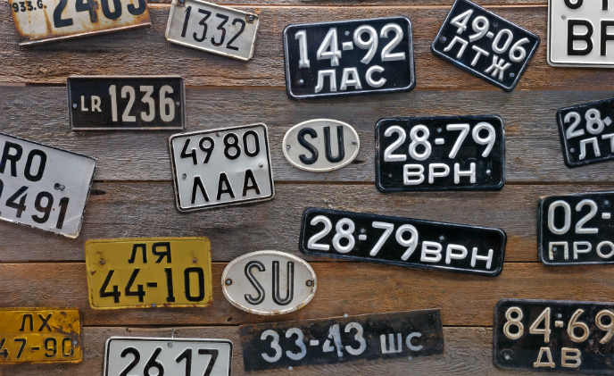
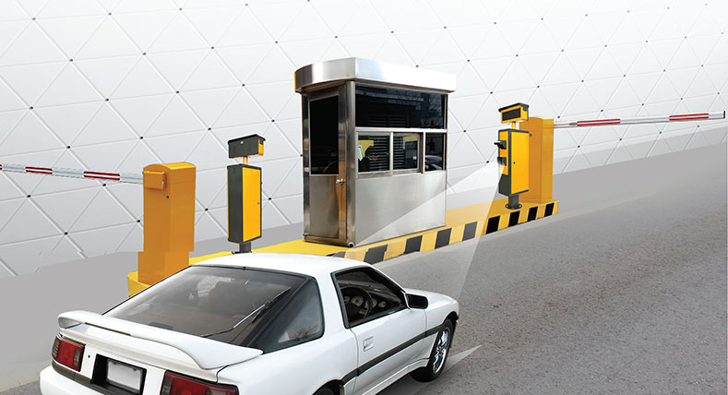
Introduction
Why is license plate recognition important?
Notes:
In introduction, I am going to talk about why is license plate recognition important. It would allow for the data associated with the plate to be accessed instantaneously. This could give the receiver the ability to identify the owner of the car, check if it was stolen, or determine if it is allowed to be in its current spot. Also, in parking lot, there will be no need to pay with actual ticket because scanner will tell drivers how much they need to pay. I never have had a car before, but I am sure it is going to be useful.

Slide 4
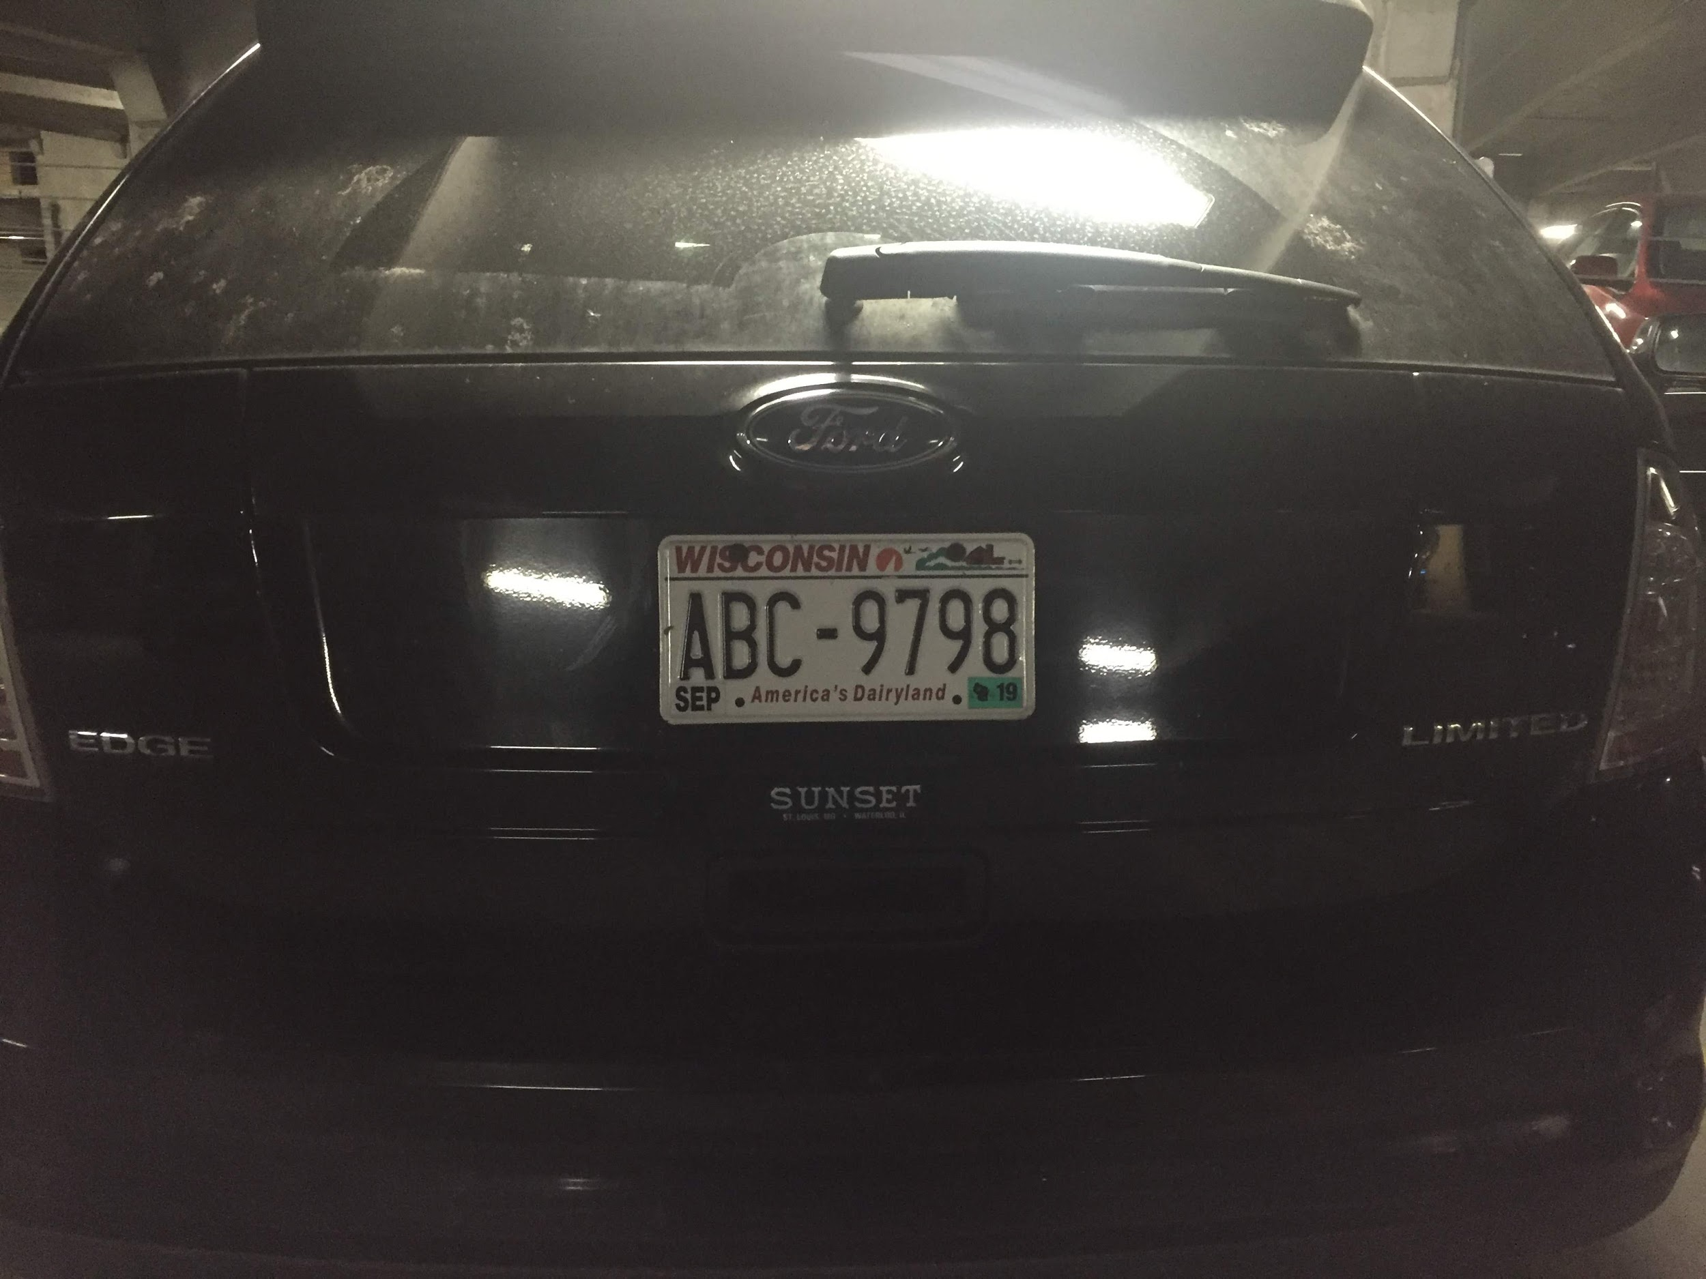
Our Approach
Edge Finding
Text Recognition
START
END

Slide 5
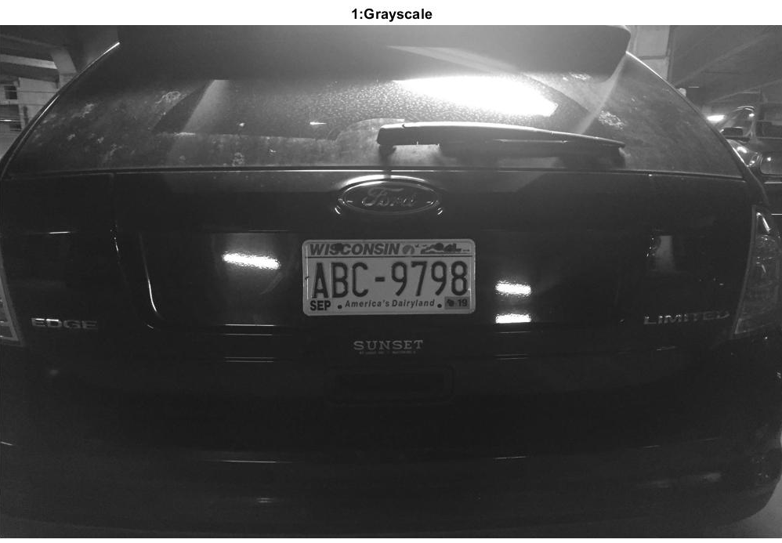
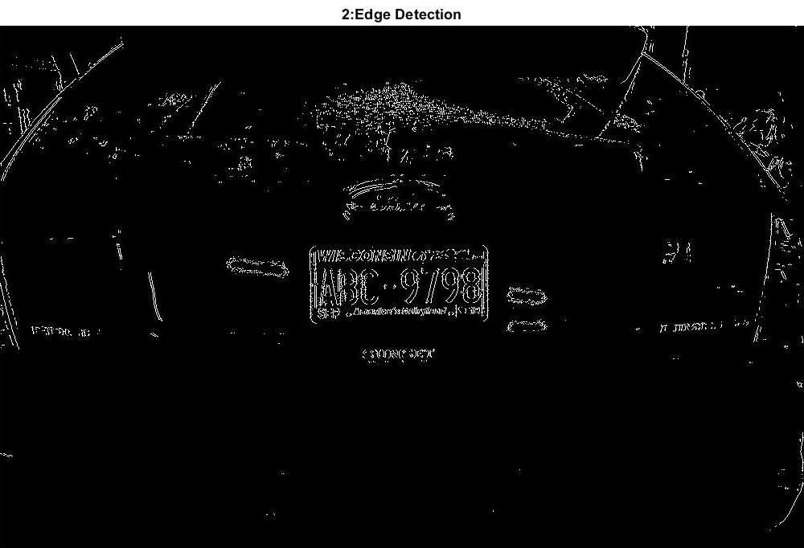
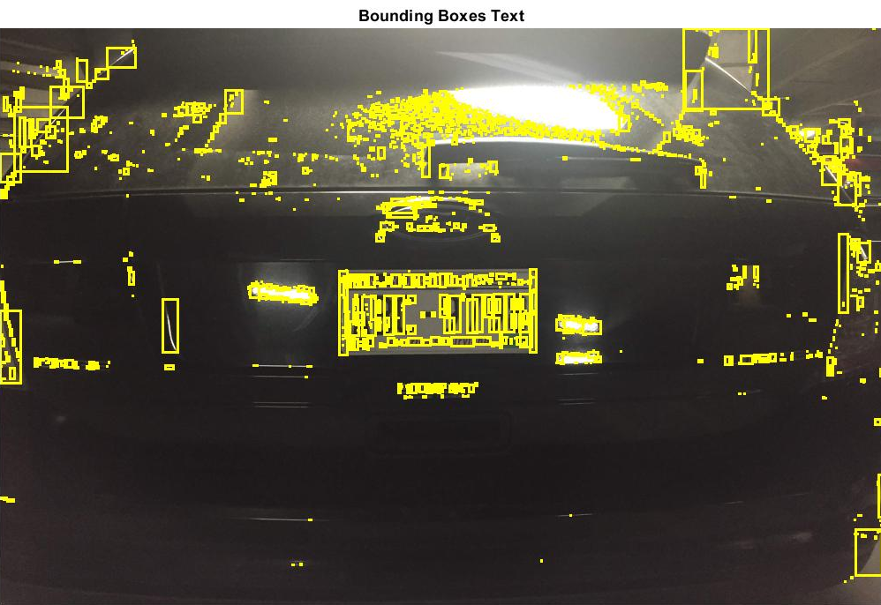
License Plate Location Detection
First convert the image to grayscale
Used sobel edge filter to filter for outline of the license plate
Used bwconncomp to find connected components passed that into regionprops.
Filter for a rectangle based on eccentricity, filledArea, Extent, and Orientation
1.
2.
3.

Slide 6
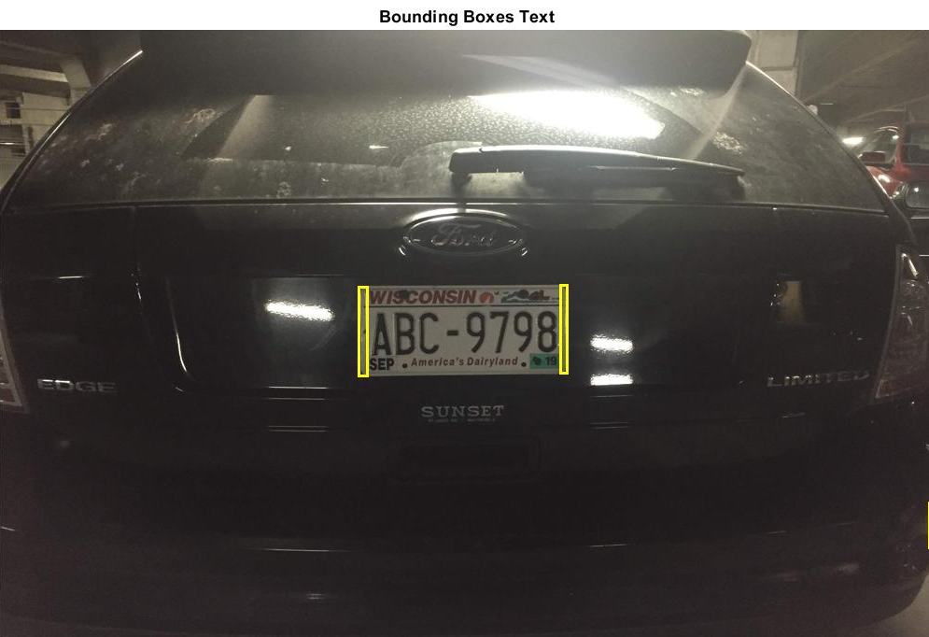
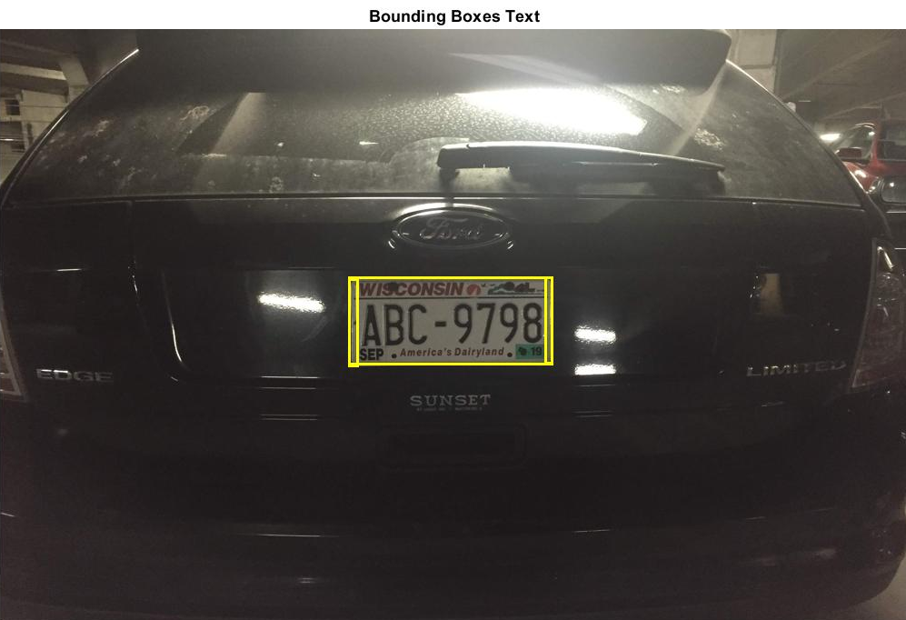
License Plate Extraction
Iterate through all pairs of bounding boxes, filter pairs of bounding boxes based on height differential, width Differential, and aspectRatio
Create new bounding box around both bounding boxes
Use imcrop to create new image of just the license plate
4.
5.
6.

Slide 7
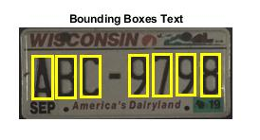
Text Recognition
1.
Incoming Image
Convert to Binary
Find properties of connected Components
Filter out undesired bounding boxes
Orientation of area
Location (should be in middle 50% of image height)
Compare Binary picture of letter to alphanumeric database
Output best comparison values
3.
4.
6.

Slide 8
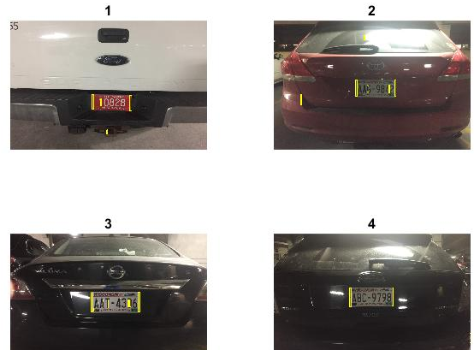
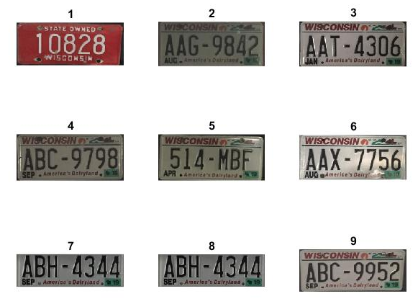
More Examples

Slide 9
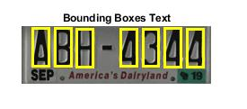
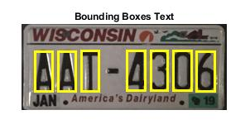
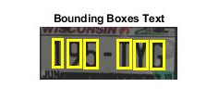
More Examples

Slide 10
References
How to classify shapes of this image as square, rectangle, triangle and circle? - MATLAB Answers - MATLAB Central
https://www.mathworks.com/matlabcentral/answers/116793-how-to-classify-shapes-of-this-image-as-square-rectangle-triangle-and-circle
Circle Finder - File Exchange - MATLAB Central
https://www.mathworks.com/matlabcentral/fileexchange/34365-circle-finder
Geometric shape detection with regionprops - MATLAB Answers - MATLAB Central
https://www.mathworks.com/matlabcentral/answers/62754-geometric-shape-detection-with-regionprops
Recognize text using optical character recognition - MATLAB ocr
https://www.mathworks.com/help/vision/ref/ocr.html
Qadir, R. (2013). Vehicle number plate recognition.. https://www.mathworks.com/matlabcentral/fileexchange/40426-vehicle-number-plate-recognition

Slide 11
Thank You

Slide 12
Guideline
Following up on the previous email, following are the guidelines for the project presentations:
1) Each project presentation should be no more than 4.5 minutes, with 30 seconds for transition (5 minutes total). We have a *strict schedule* to follow given the limited time. Going over the 4.5 minute limit will likely result in a grade reduction.
2) Please send your slides to the instructors by *no later than noon* on your presentation day. Please use either .pptx, or .pdf format. We will put all the slides on a single laptop to minimize transition time. If we have to load your slides during class, it may take up your 4.5 minute time.
3) While there is no single structure that fits all, you can use the following rough outline for the presentations (feel free to adapt as necessary):
a) Briefly explain what problem you are trying to solve [1 minute]
b) What is your approach? Explain at an intuitive level, with just enough technical details needed to explain to a lay person [2 minutes]
c) Show results and comparisons that demonstrate your approach [1.5 minutes]
-Mohit

