Slide 1



Enhancing Vehicular Internet Connectivity using Whitespaces, Heterogeneity and
A Scouting Radio
Tan Zhang★, Sayandeep Sen†, Suman Banerjee★
★University of Wisconsin Madison, †IBM Research India

Slide 2
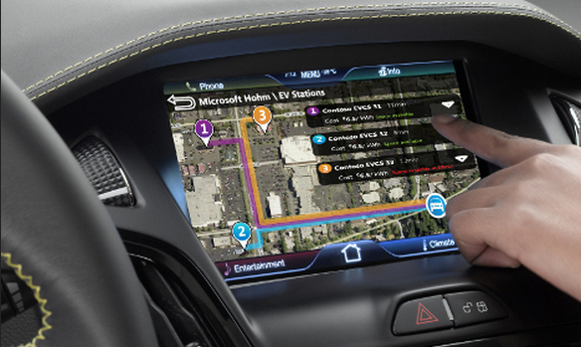
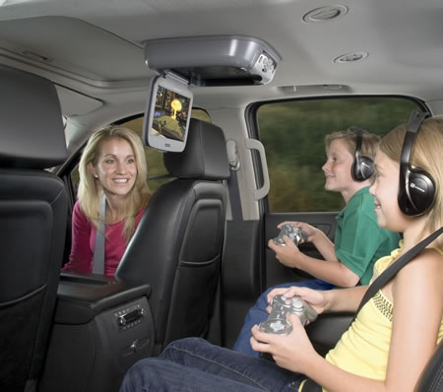
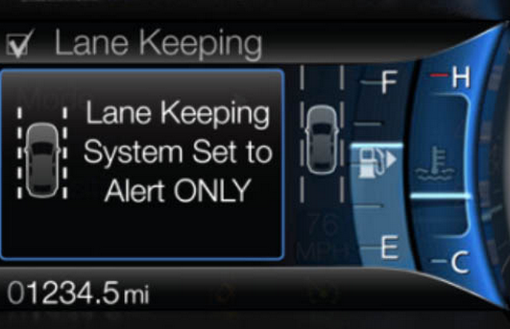
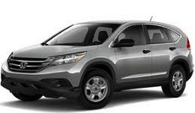
Motivation
Growing trend of vehicular Internet access
Infotainment
Entertainment
Road Safety

Slide 3
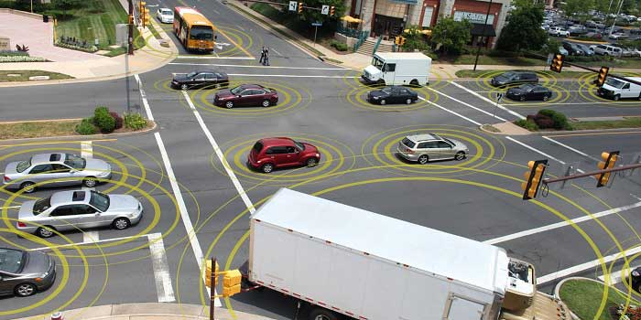
Motivation
300 million vehicles connected to Internet by 2020 [Cisco report]

Slide 4
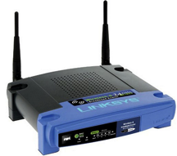
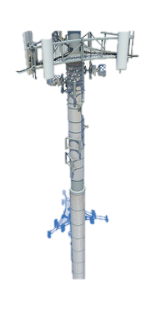
Motivation
Present-day approaches
WiFi
Cellular
Small (0.2km)
Congested
Large (10km)

Slide 5

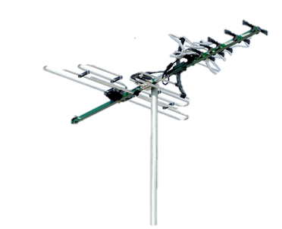
Motivation
New opportunity in TV whitespaces
  FCC released vacant TV channels for unlicensed use
Whitespace
Up to 180MHz spectrum
“This new unlicensed spectrum will be
a powerful platform for innovation…” - FCC Chairman
TV
Vacant
Long propagation range
Large
(2km)

Slide 6
Goal
Design robust communication protocols to use TV whitespaces for vehicular Internet access

Slide 7
Outline
Scout – TV whitespace network for vehicles
  Heterogeneous architecture
  Scouting radio based channel estimation
  Scouting based communication stack
Implementation
Evaluation
Conclusion

Slide 8
Outline
Scout – TV whitespace network for vehicles
  Heterogeneous architecture
  Scouting radio based channel estimation
  Scouting based communication stack
Implementation
Evaluation
Conclusion

Slide 9
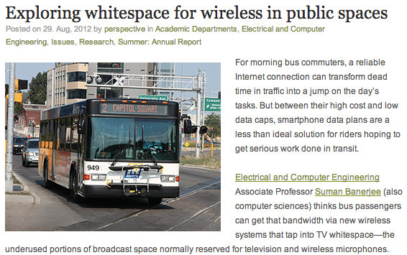
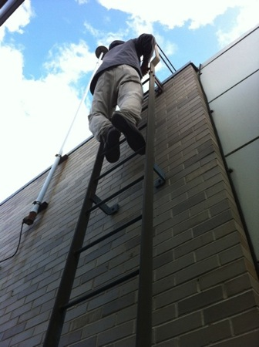
A Metro Hotspot
Super

Slide 10


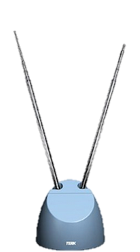
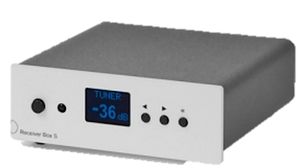
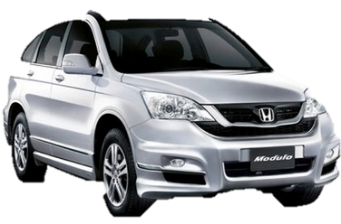


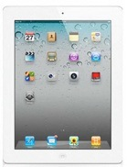

A Metro Hotspot
Super
Whitespaces
Gateway
Whitespaces
Base Station

Slide 11



Problem of Power Asymmetry
Asymmetric Power Limits (FCC 10-174)
Whitespaces
Gateway
Whitespaces
Base Station
0.5 km
2 km
Primary
Incumbents

Slide 12

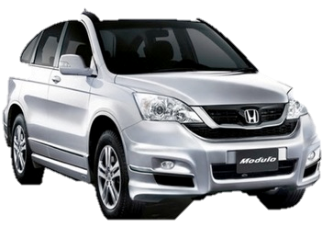
A Simple Symmetric Network Solution
16x base stations

Slide 13


Scout – A Heterogeneous Network
40 Kbps downlink TCP throughput
Cellular BS
Additional advantages:
Offloading the majority of traffic
Zero interference to primary incumbents
Whitespaces BS

Slide 14
Challenges in Heterogeneous Networks
Cellular path has high latency
Technology | One-way Latency
3G | 100 – 150ms
4G | 25 – 40ms
Whitespaces | < 5ms
Delayed Feedback
Poor Protocol Decisions
Fast Changing Environment

Slide 15






Problem of Delayed Feedback
Whitespaces BS
6Mbps
6Mbps
Cellular BS
Can the client foresee channel at a future location?
ACK
6Mbps

Slide 16
Outline
Scout: TV whitespace network for vehicles
  Heterogeneous architecture
  Scouting radio based channel estimation
  Scouting based communication stack
Implementation
Evaluation
Conclusion

Slide 17


Intuition behind Scouting Radio
Whitespaces BS
Cellular BS
Receiver
Scout
Rear
Front

Slide 18


Scouting Based Rate Adaptation
Candidate Rates
9Mbps
6Mbps
1Mbps
Whitespaces BS
1Mbps
6Mbps
6Mbps
Cellular BS
1Mbps
How does base station identify relevant feedback?
NACK
Front
6Mbps
Rear(receiving)
Front(scouting)
Current Reception Location
Future Reception Location

Slide 19


Time based Feedback Alignment
Calculate loss rates in a small window around aligned time
Base station stores scouted feedback according to its received time
Delay for rear radio to reach front location:
Time (s) | Feedback
1
2
3
4
5
6
Loss = 0.5
Now

Slide 20
Outline
Scout: TV whitespace network for vehicles
  Heterogeneous architecture
  Scouting radio based channel estimation
  Scouting based communication stack
Implementation
Evaluation
Conclusion

Slide 21
Scouting based Communication Stack
Packet Buffer
Base Station
Client
Packet
Loss
Over the Air

Slide 22
Scouting based Communication Stack
Packet Buffer
1
2
3
4
5
1
2
3
Rate | Loss | Throughput
1Mbps | 0.1 | 0.9Mbps
6Mbps | 0.4 | 3.6Mbps
9Mbps | 0.8 | 1.8Mbps
Packet Batch
Base Station
Client
Assign PHY rate
6
6
6
k redundant packets to
tolerate <= k lost packets
6
6
Over the Air

Slide 23
Scouting based Communication Stack
Packet Buffer
1
2
3
4
5
Rate | Loss | Throughput
1Mbps | 0.1 | 0.9Mbps
6Mbps | 0.4 | 3.6Mbps
9Mbps | 0.8 | 1.8Mbps
Base Station
Client
6
6
6
6
6
TV Whitespaces
Over the Air
Cellular
If Loss >= 0.75

Slide 24
Successful Error Correction
Packet Buffer
1
2
3
4
5
1
2
3
Base Station
Client
1
2
3
Loss <= k Packets
1
3
TV Whitespaces
Cellular

Slide 25
Error Correction Failure
Feedback
Packet Buffer
Link-layer Retransmission
1
2
3
4
5
3
Missing Packets
Base Station
Client
3
Loss > k Packets
3
TV Whitespaces
Cellular

Slide 26
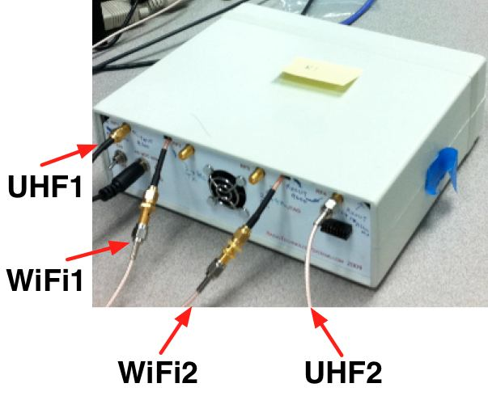
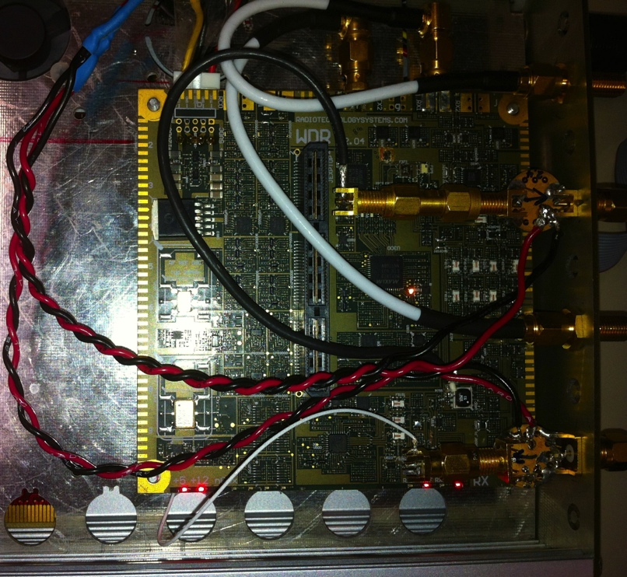
System Implementation
Downlink: translate WiFi to TV whitespaces
  Wide Band Digital Radio (WDR)
Uplink: use a 3G link
RF chain 1
RF chain 2

Slide 27
Outline
Scout: TV whitespace network for vehicles
  Heterogeneous architecture
  Scouting radio based channel estimation
  Scouting based communication stack
Implementation
Evaluation
Conclusion

Slide 28
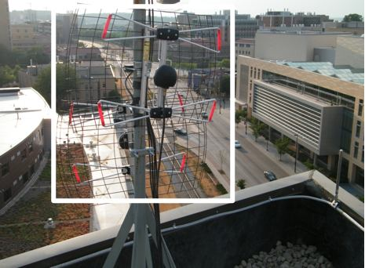
Evaluation
Experiment setup
  Mount a base station on top of a 8-floor building
  Drive about 500 miles along multiple routes

Slide 29


Advantage of Scouting Radio
Approach: measure how accurate a previous observation to the current channel condition
Metric: packet loss rates
Traffic: 200 byte UDP packets at 12Mbps
Single Static
Single 10mph and 25mph
Scout 25mph
29

Slide 30
Advantage of Scouting Radio
Single has 27% - 34% estimation error
Single has high variation under mobility
Typical 3G Delay
Scout has 5x lower estimation error
Lag (ms)
Low variation in static scenarios

Slide 31
Overall Performance
Approach: measure downlink performance during 5 drives for each system
Metric: TCP throughput averaged over 1 second bins
8x and 3x gain over A-3 and A-4
System | Rate Adaptation | Dual-radio Combine
A-1 | RRAA | No
A-2 | Minstrel | No
A-3 | RRAA | Yes
A-4 | Minstrel | Yes
2.5x

Slide 32
Conclusion
Explored the opportunity in using TV whitespaces to
provide vehicular network connectivity.
Designed a heterogeneous network to extend network coverage under asymmetric power limits.
Designed a scouting radio to improve channel estimation under feedback delay.
Designed a scouting based communication stack to
enhance link robustness.

Slide 33
Thanks a lot!
Contact: tzhang@cs.wisc.edu
Video demo: http://youtu.be/_rnzH7owtBw

