Slide 1


Enabling GPGPU Low-Level Hardware Explorations with MIAOW: An Open-Source RTL Implementation of a GPGPU
www.miaowgpu.org
Raghuraman Balasubramanian, Vinay Gangadhar, Ziliang Guo, Chen-Han Ho, Cherin Joseph, Jaikrishnan Menon, Mario Paulo Drumond*, Robin Paul, Sharath Prasad, Pradip Valathol, and Karthikeyan Sankaralingam
Vertical Research Group
University of Wisconsin – Madison, US
*École polytechnique fédérale de Lausanne, Switzerland
Notes:
I am excited to present our open source GPGPU hardware design called MIAOW that we have built in my research group. I’ll cover the technical design and some broader implications of open source hardware. <pause>
Here is a summary of what is MIAOW.

Slide 2
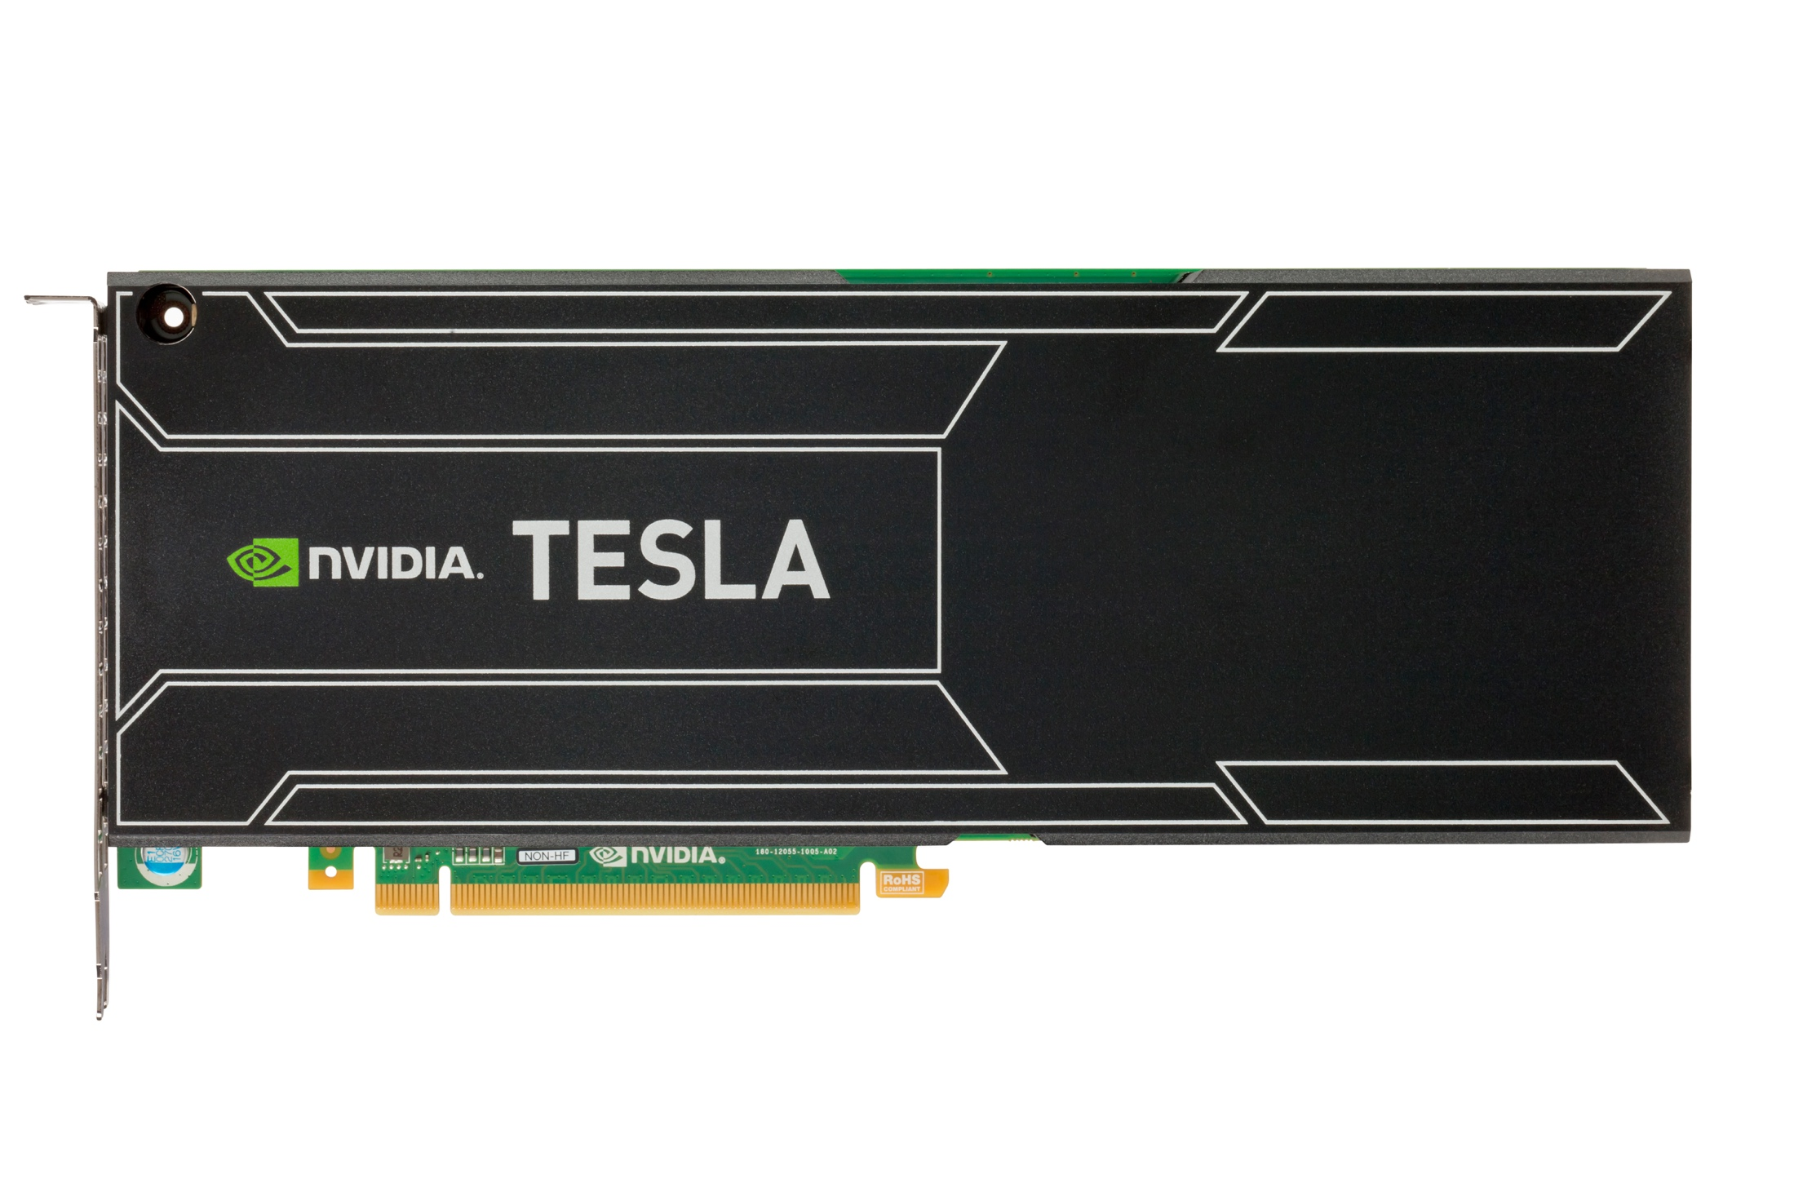
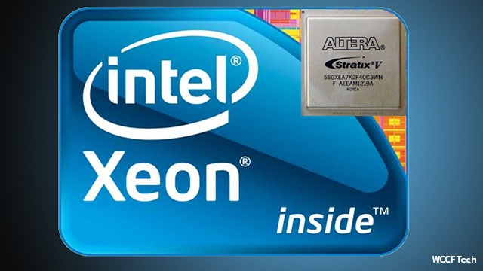
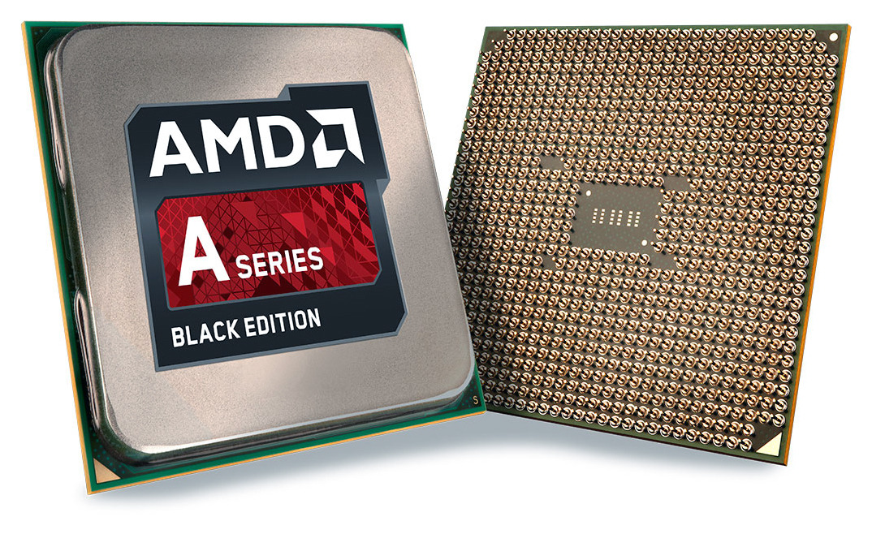
The Heterogeneous Computing Era
Explosion in data + end of Dennard scaling
= heterogeneous computing
GPUs are the most successful accelerator to date

Slide 3
GPU research
Its exciting to do research on GPUs right now
  Many new applications
But how do we model GPUs?
  Today: mainly on software simulators
What can simulators tell us?
  Where is the critical path?
  Area? Power?
  Can we relax circuit constraints?
Need more detailed models moving forward

Slide 4


Open Source Hardware
Game changing in computer architecture education
  At least in my education
Useful for researchers
  Better, more detailed models
Slowly becoming mainstream
Still, no Open Source GPUs… until now

Slide 5
MIAOW – An open source GPGPU
MIAOW is a credible GPGPU implementation
  Compatible with AMD Southern Islands ISA
  Similar design and performance to industry state-of-art
  Flexible and Extendable
MIAOW is useful as a research tool
MIOAW’s hardware design is Open Source
  Contributes to changing hardware landscape
* Frequency, Physical Design, Area goals relaxed

Slide 6
Overview
Introduction
MIAOW Technical Overview
Is MIAOW realistic?
Is MIAOW useful?
Development and Lessons Learned

Slide 7
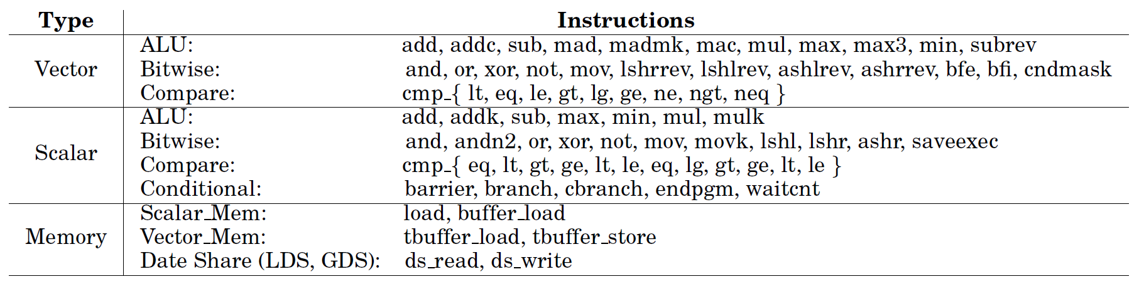
ISA Summary
95 instructions
Single-precision support only
No graphics support (yet)
Notes:
The instruction selected are based on application profiling , operations in datapath and practically implementable by a small design team
Program control – predication and branch instructions
32 bit data support
95 instructions
support only
No Graphics support

Slide 8
MIAOW Overview
Notes:
Avoid warp explanations

Slide 9
Front-end

Slide 10
Execution units
Load-store-unit (LSU)
  Handles all memory instr.
  In active development
Vector ALU
  16-wide vector ALUs
  Integer and floating point
  4 cycles per instruction
Scalar ALU
  Handles scalar instr.

Slide 11
MIAOW Implementations
Notes:
Spectrum of Implementation strategizes and tradeoffs MIAOW follows
Shaded portion indicates Register file and SRAM storage
FPGA has resource constraints

Slide 12
Overview
Introduction
MIAOW Technical Overview
Is MIAOW realistic?
Is MIAOW useful?
Development and Lessons Learned

Slide 13
A word on realism
Area, Frequency, Performance, Power goals are relaxed
  We are not trying to compete with AMD or NVIDIA
MIAOW should represent trade-offs faced by GPUs
  Ideally, researchers would observe similar trends in both

Slide 14
Methodology
Area and Power from Synopsis synthesis
  Using single-ported SRAM register file
  All synthesis using 32nm low-power models
Performance from Multi2sim OpenCL benchmarks
  Compared number of execution cycles

Slide 15
Performance Comparison
Notes:
MatrixTranspose: we don’t have coalescing; so bandwidth limited
ScanLargeArrays: compiler putting stuff in global memory instead of LDS
Other cases, we are close.
Methodology: measure exact cycle counts on both designs.

Slide 16
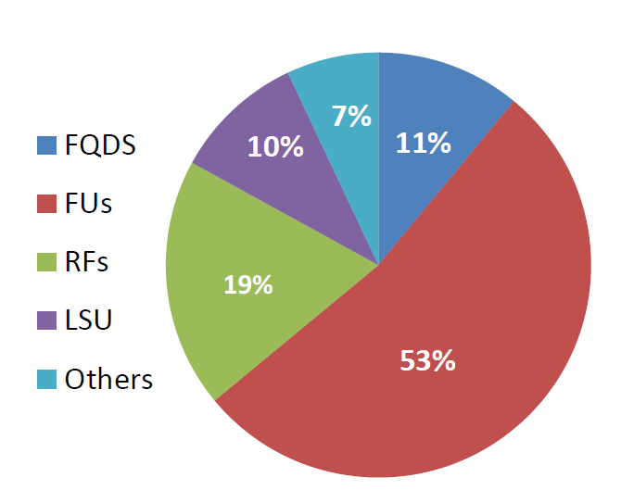
Power
Tahiti CU power*: 0.52 W
MIAOW CU Power: 1.1 W
* Ballpark estimate from TDP and occupancy
Notes:
I will say the power number in words approx 1 watt. I am reluctant to put on slide as this is an estimate and not measured or from any documentation.

Slide 17
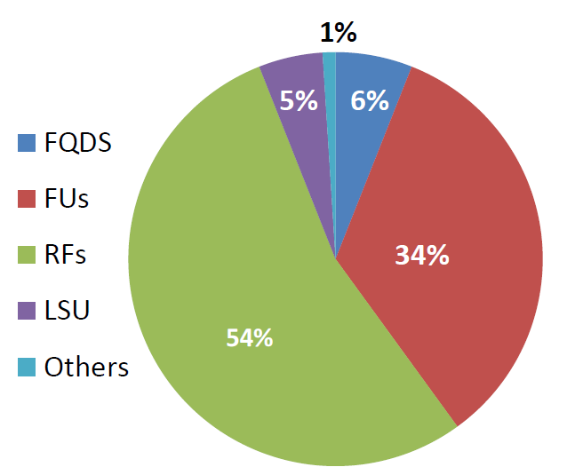
Area Comparison
Tahiti CU area*: 5.02 mm² @ 28nm
MIAOW CU area: 9.1 mm² @ 32nm
*Estimate from die-photo analysis and block diagrams from wccftech.com

Slide 18
Overview
Introduction
MIAOW Technical Overview
Is MIAOW realistic?
Is MIAOW useful?
Development and Lessons Learned

Slide 19

Software Compatibility
Runs unmodified OpenCL programs
All OpenCL benchmarks
Many Rodinia benchmarks
Easily extendable to add additional instructions

Slide 20
MIAOW as a Research tool
Physical Design Perspective of traditional research:
  Thread block compaction
  iGPU
New research:
  Sampling DMR on GPUs
  Timing Speculation
Timing Speculation today, more on the paper

Slide 21
Timing speculation
Run circuits at lower-than-nominal voltage levels
  Achieve power reductions
  Requires errors tolerance
Measured the error rate in MIAOW
  Delay-aware gate level simulation at different clocks
  SPICE model maps relationship between V_{dd} and logic delay

Slide 22
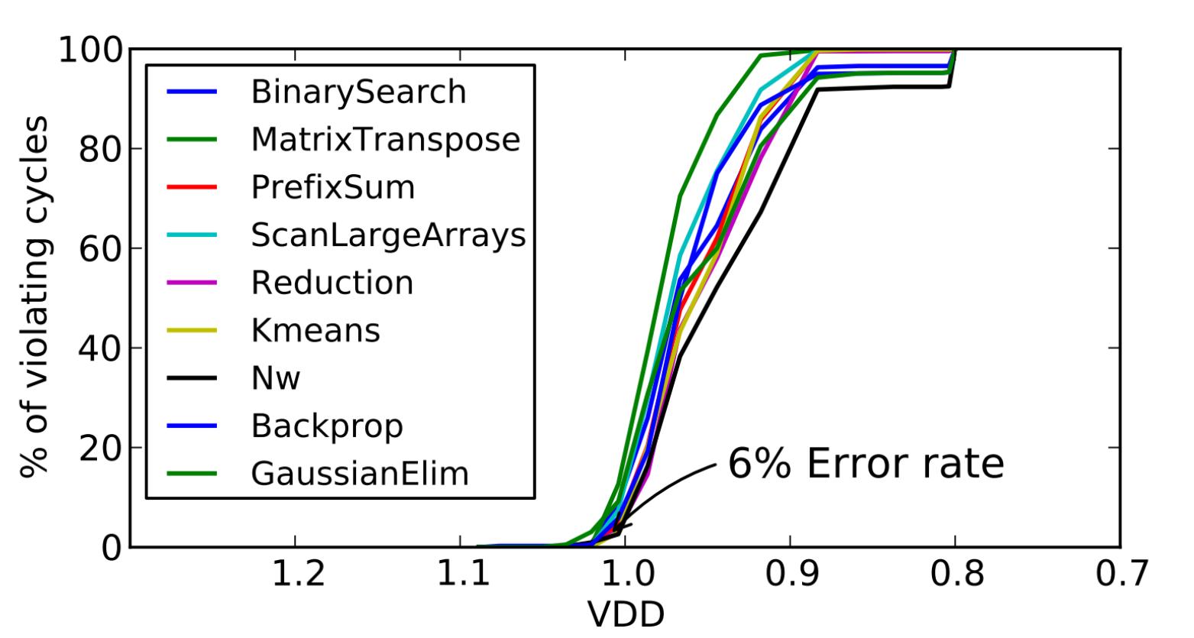
Timing speculation results
6% error rate @ 115 mV reduction

Slide 23
Overview
Introduction
MIAOW Technical Overview
Is MIAOW realistic?
Is MIAOW useful?
Development and Lessons Learned

Slide 24
Design Team
First phase: small initial design team (12 months)
  5-person HDL team
  1-person software team
  1-person physical design team
Second phase:
  Added FPGA expert
  3 undergrads extended the design
36 months total development

Slide 25
Lessons Learned
It was surprising this was doable!
  Microarchitecture design, HDL, verification not tedious
  Less tedious than working with simulators
The devil is in the details
  The more you verify, the harder it is to debug
  Late design changes are very painful to implement
Software toolchain being available was great
FPGA tools are still quite tedious to use

Slide 26
MIAOW is open source!
We want the community to come help us
  Help build critical mass on OSH
Many ways to make MIAOW better
  Physical design
  End-to-end open source software stack
  Many things to optimize

Slide 27
Conclusion
MIAOW is transformative for GPU research
  Detailed model for GPGPU microarchitecture
MIAOW is a big step for Open Source hardware
  Towards first Open Source silicon GPU chip
Notes:
MIAOW is tranformative for GPU research and development
It has intereesting promise as part of a brodaer open source hardware push
With more community support, we look forward to building a silicon gpu chip in next few years.

Slide 28


www.miaowgpu.org
3.9 FPS on FPGA @ 50 MHz
23 FPS in simulation @ 222 MHz
Notes:
Let me wrap up with a visual demo. Here is Sobel filter running on our MIAOW prototype – detecting some cats at about 4 FPS ☺ Thanks for listening – I’ll be happy to take any questions.

Slide 29
Back Up Slides
Notes:
-- It should be flexible enough to accommodate research studies of various types

Slide 30
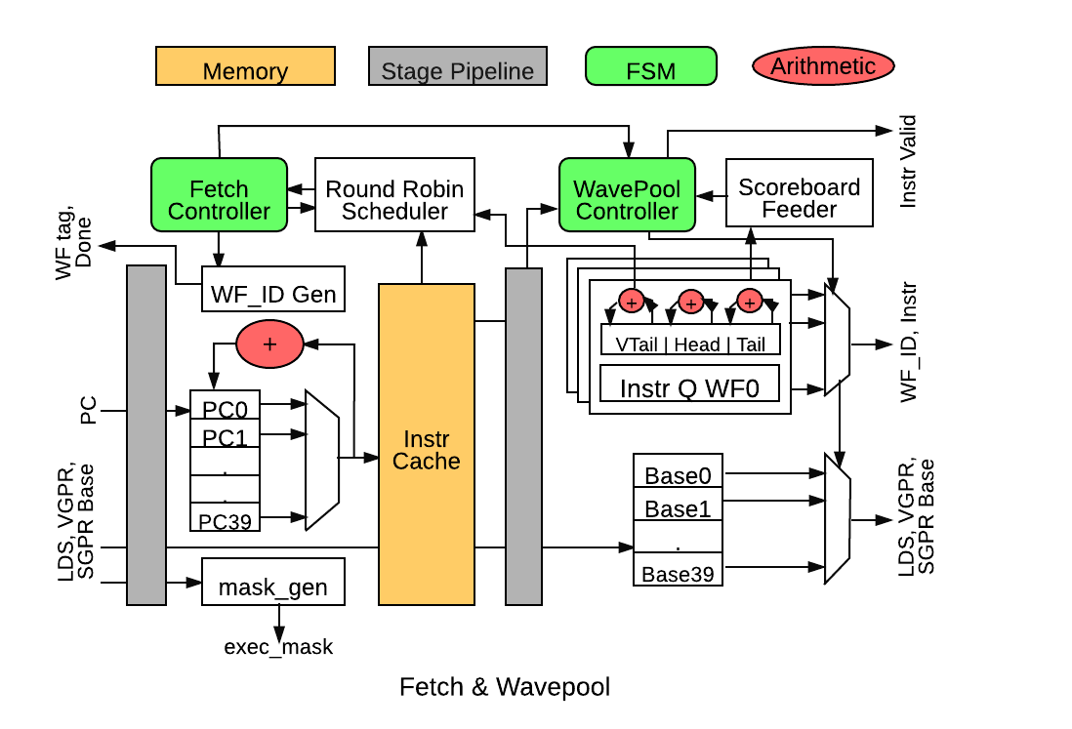
Fetch & Wavepool
Notes:
Mainly to fetch instructions from instruction cache and feed into wavepool unit. UTD provides PC values and corresponding base addresses for LDS, VGPR and SGPR. Has storage for 40 PC addresses belonging to 40 wavefronts each tracking a thread of instructions.
Fetch controller is responsible for assigning a free wavefront ID for the incoming wavefront PC. Wavefront ID generator keeps track of finished wavefronts by receiving the Done signal from Issue unit and frees up corresponding ID slot. It also informs UTD about that wavefront completion.
Round robin scheduler is responsible for scheduling a PC for instruction fetch from I-Cache. Fetch unit provides the buffer address where the PC is stored.
PC buffers: 40 entries x 32b PC value
Intermediate buffer (b/w Fetch and Wavepool): 40 entries x 32b instruction
I-Cache is a behavioral model and the instruction fetched is buffered in a flop before feeding it further to Wavepool unit.
Wavepool controller gets the control signal (WF ID) every time a PC is sent for I-Fetch. The buffered instructions from I-Cache are stored in a per-wavefront queue. This queue has six slots -- a head and a tail pointer monitors the filling of the queue and sending the instructions to Decode stage. The base addresses and register ranges are stored in per-wavefront base register slot.
Base Regs: 40 entries x 35b base regs -- 1 read, 1 write port
WF queue: 40 entries x 6 slots x 64b -- 1 read, 1 write port
Scoreboard feeder: This unit is a simple logic unit, which keeps track of issued wavefronts and ones that have finished. It decodes the incoming finish siganl and maps it to corresponding wavefront slot among the 40, so that the pipeline keeps pushing the instructions to next stage.
Design decisions:
Fetch BW was designed to be 1 mainly to optimize the instruction cache hits and single instruction pipeline. I-Cache module is a behavioral module (non-blocking) and thus it helped to not worry about always fetching 16 or 32 instructions per cycles to match a cache line like in AMD’s GCN 1.0. It also had a lower area impact because of less storage for wider machine without impacting too much of performance as there are always enough instructions from other wavefronts to feed the execution units. However, since all the interfaces are modularized, it is easy to make MIAOW a superscalar machine.
Wavepool queue slots are designed to hold 6 instructions from each wavefront. Design evaluations showed that all 6 slots are filled 50% of the time for AMD APP benchmarks and was a balanced design decision. However, the slots can be increased if the benchmarks have more locality thus filling all the slots most of the time. This is parametrized -- Hence, this is a small change to change the register number to required slots and pointing the tail pointer to tail of the queue.

Slide 31
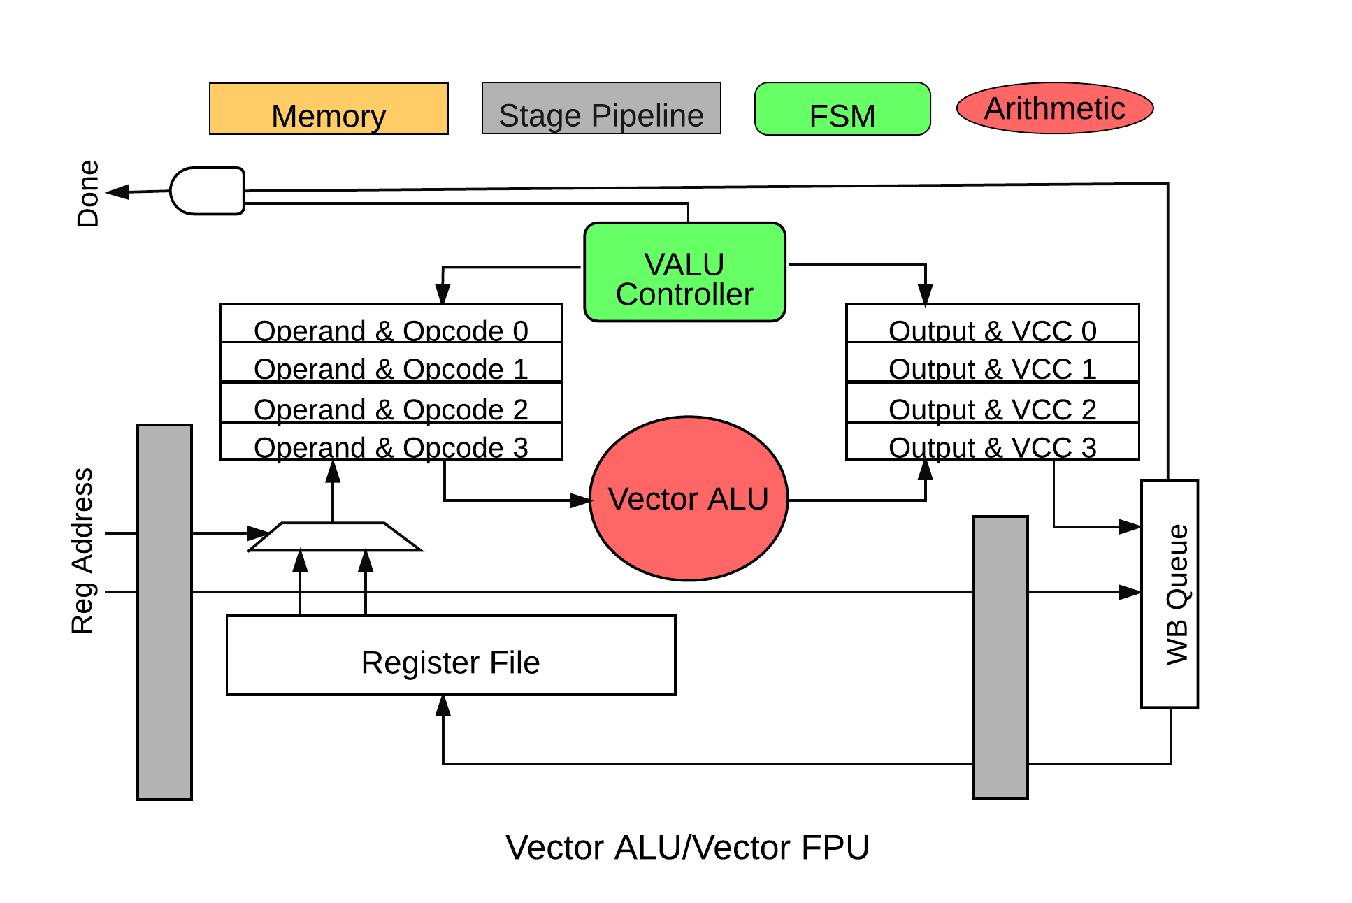
Vector ALU/FPU
Notes:
All SIMD and SIMF units have a vector alu as part of their execution modules. SIMD has an integer unit and SIMF a floating point unit.
Each execution unit gets an instruction and related information (including the register and memory addresses to operate on) which is flopped. Vector ALU (VALU) controller is a state machine which monitors the VALU which is 16 wide [16 parallel ALUs taking inputs and operating on an opcode]. VALU controller also requests access to corresponding vector and scalar registers for source operands. This request is done for all 16 ALUs.
Once the data arrives, there are source muxes and correct data is delivered to ALU based on the opcode type. The data could be data from SGPR or VGPR or literal value or immediate value. And then this data is fed into shift registers to shift the data and feed it into 16 ALUs. Similar operation is done once the results are produced --it is fed into a destination shift register and further into a Writeback queue which
WB queue -- 1 entry x 2kb [For all VGPR dest data to be written back] -- 1 r, 1 w port
However, a wavefront takes 4 cycles to execute all 64 threads in a wavefront [16 x 4].
Design Decision:
Number of SIMD and SIMF units was designed to be 4 similar to the GCN uArch. This was designed keeping in mind that apart from simple benchmarks, computationally complex benchmarks could utilize all 4 execution units all time and thus still have enough computation throughput.
The WB slot was chosen to be 1 to reflect the straightforward 1 instruction issue per cycle. Adding more slots could be overkill on the design and impacts area power. Since, all execution units only execute 1 instruction per cycle, and there is a back-pressure signal to issue unit [to make sure not issue dependent instruction until the results are produced], there is no point in holding back (pipelining) the result to avoid register file write congestion [RFA takes care of that]. However, again this is parameterized and it is a small modification to the queue module of the WB queue.

Slide 32
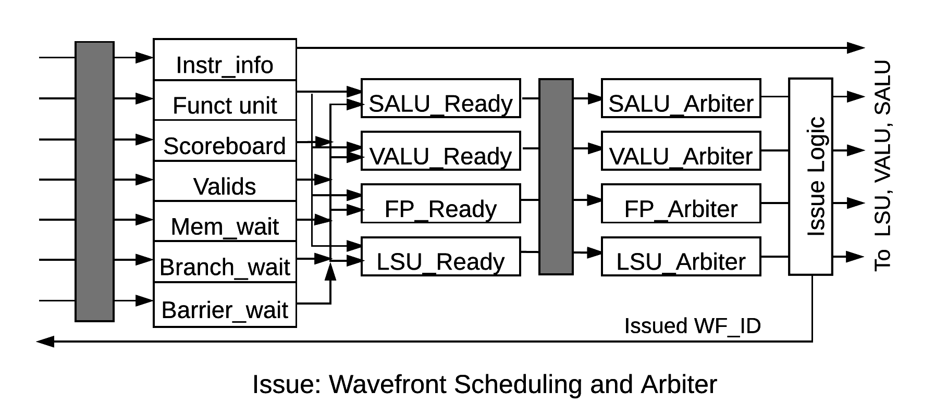
Issue
Notes:
The issue unit is the complex unit of all as it needs to keep track of all in-flight instructions and resolve the data dependencies among the instructions.
The decode unit tags a functional unit type with each instruction, opcode and all SGPR/VGPR/LDS access related information. This information is used by the scoreboard to keep track of which registers/memory locations are used by each instruction every cycle.
Valid entry is the unit which keeps track of special control signals like valid, barrier, branch taken, halt etc. which is fed to SALU for control and divergence related decisions.
Scoreboard is the main control piece, which takes in the information of all register addresses, current execution units busy signals, condition control signals and schedules the wavefront to corresponding execution unit or LSU when all the operands or source register data becomes availble.
Each execution unit type and LSU has an arbiter -- This arbiter arbitrates among the ready wavefronts and shifts them in a circular barrel shifter. The instruction info is sent for issue based on the select signal provided by the arbiter.
Design Decision: Issue BW is 1 and it is less flexible and hard to change as increasing the issue ports would also complexify the arbiter logic to keep track of multiple open issue slots of all execution units. Also, to facilitate the multi-instructions issued, the read ports of SGPR/VGPR has to be increased which incurs lot of power/area overhead (muxing and priority encoder/decoder stuff). Scoreboard logic also becomes more complex now to resolve the dependencies among multiple in-flight instructions. The back pressure of 1 fetch/decode instruction every cycles keeps the issue unit busy and enough to feed in all the SIMD/SIMFs.

Slide 33
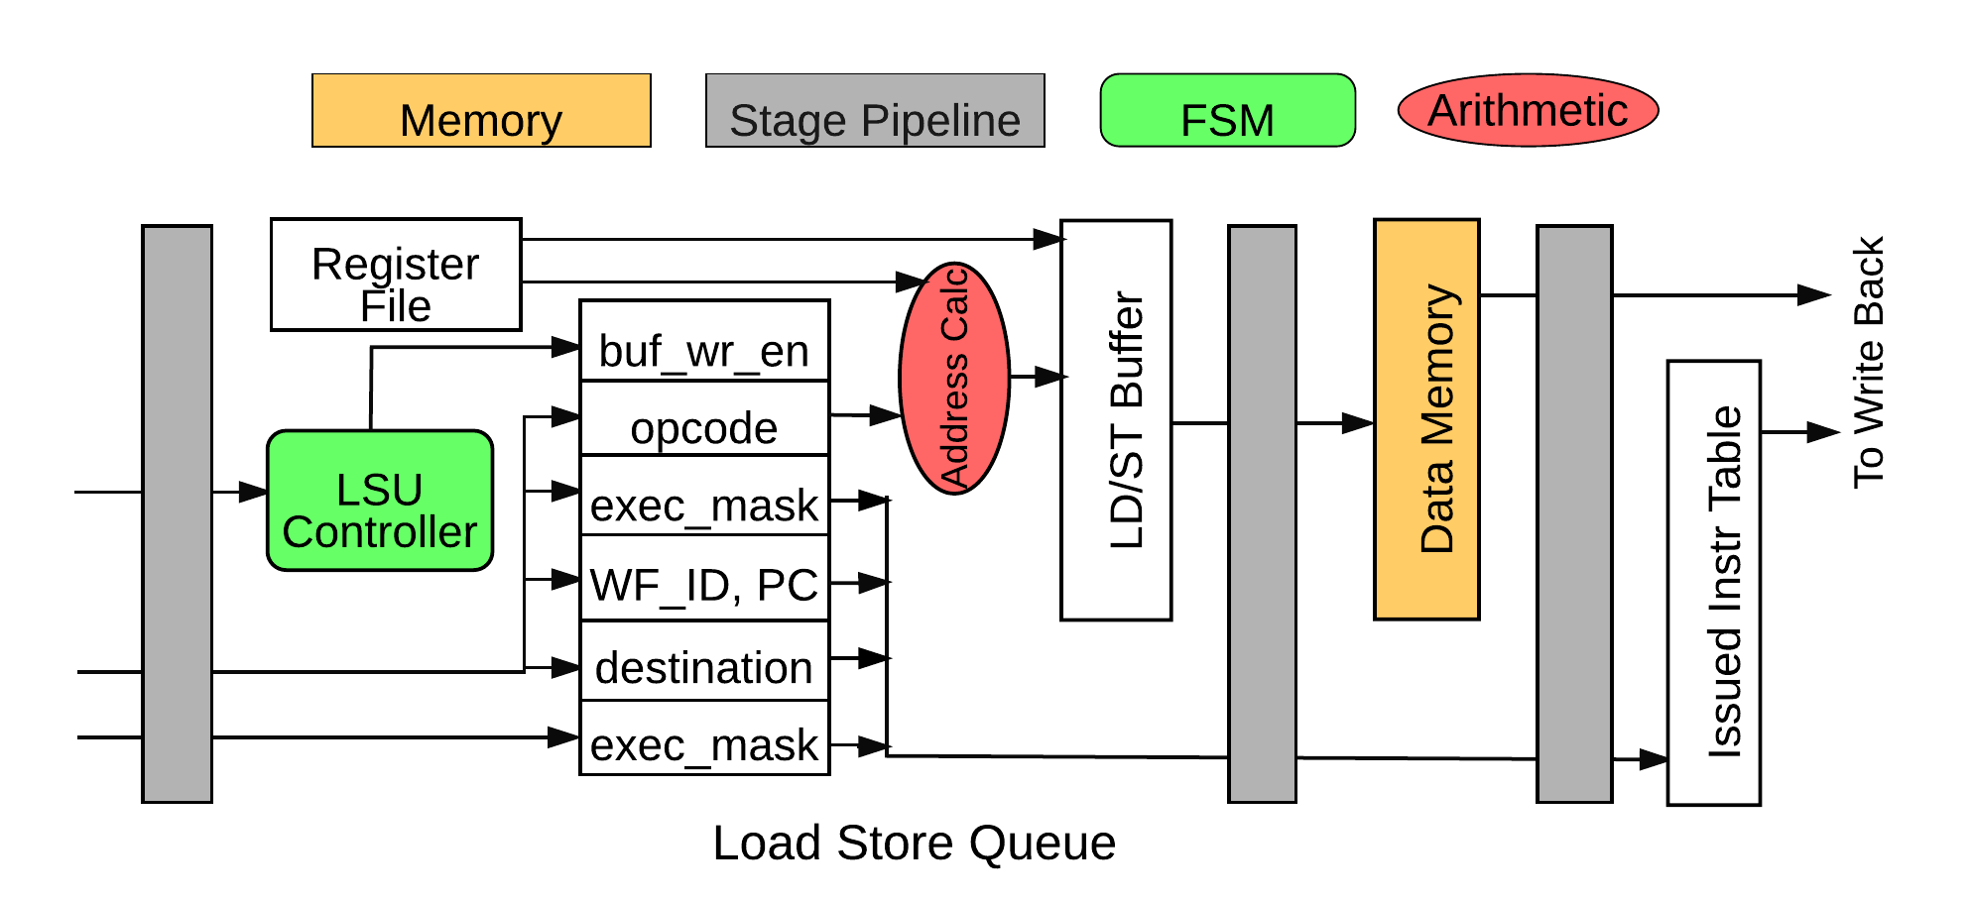
Load/Store Unit
Notes:
Responsible for all memory related instructions (vector and scalar) and interfaces with the local and global memory.
It has interface to VGPR and SGPR as well which uses the register data to calculate the address. The memory operation opcode, WF-ID, 54b execution mask and destination register addresses are all flopped and is used by Address calculation unit. The memory addresses are calculated based on the instruction encoding and LSU controller enables the write enable signals as well as monitors the register reads/writes.
The ld/st buffer holds the memory address (32b now), and any register indirect address and corresponding store data [8kb or 2kb based on type of encoding].
Once the memory request is sent, it is updated in the issue instruction table (part of scoreboard mechanism) to keep track of in-flight memory instructions.

Slide 34
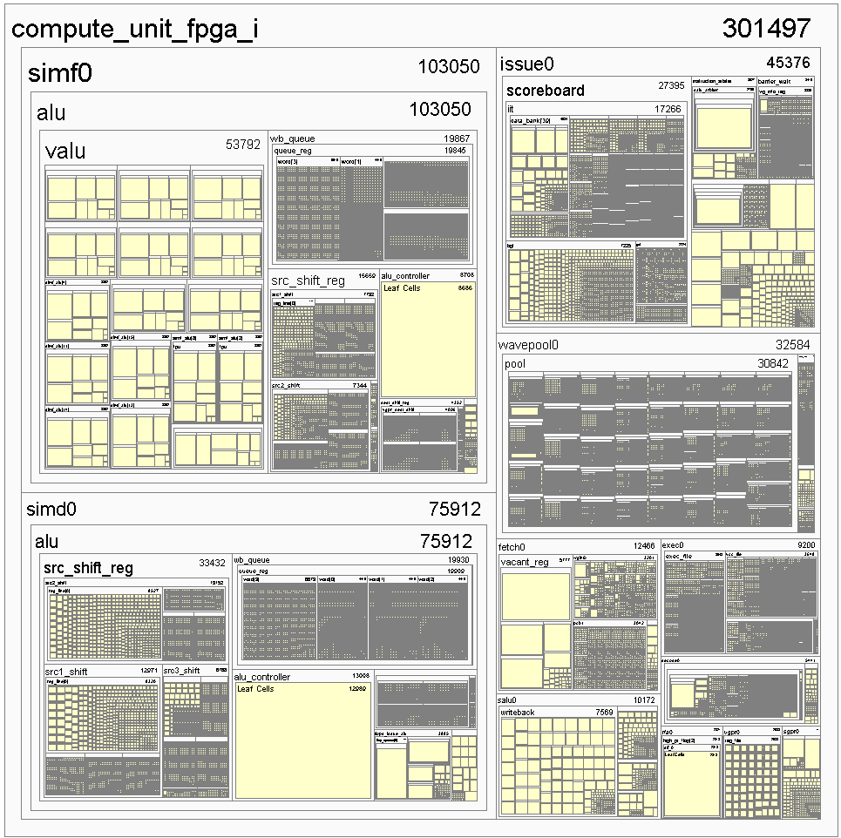
Virtex7-based FPGA – Neko
1 CU design
50 MHz
Utilization:
  LUTs 133K Registers: 100K

Slide 35
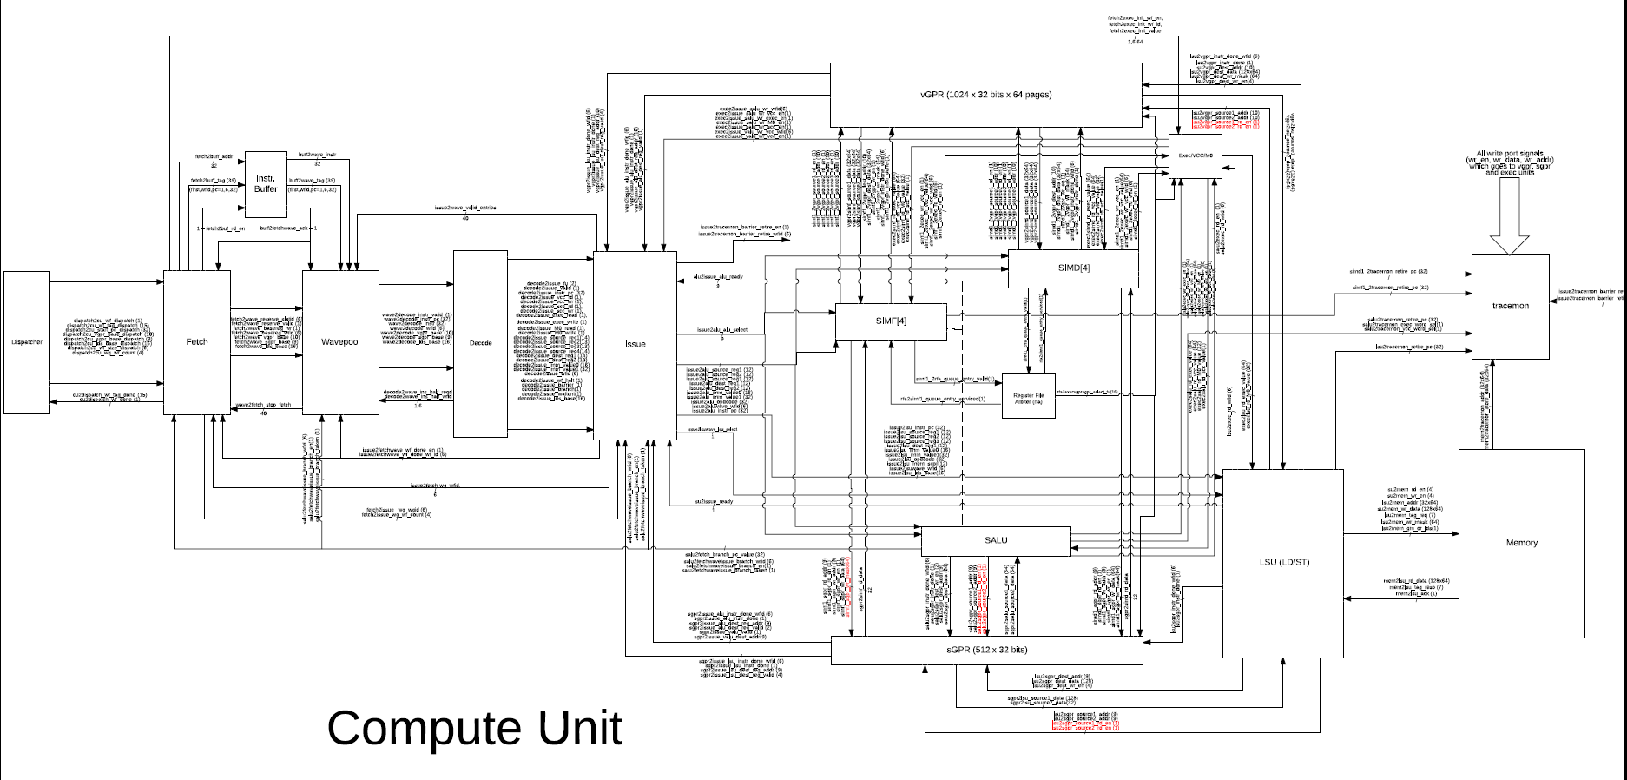

Slide 36
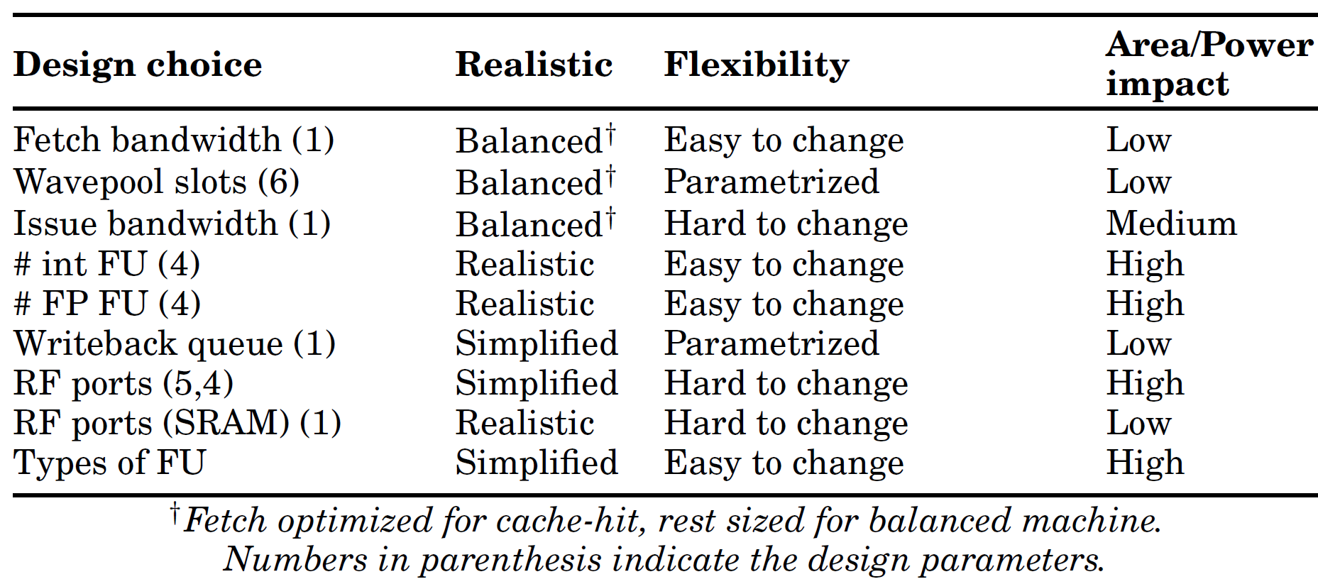
Flexibility

Slide 37
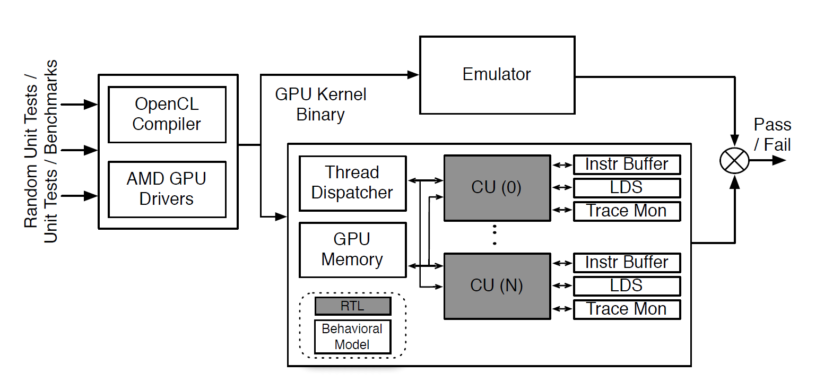
Verification

Slide 38
As a Research Tool
Direction | Research Idea | MIAOW enabled findings
Traditional µarch | Thread-block compaction (TBC) | Implemented TBC in RTL Significant design complexity Increase in Critical Path length
New Directions | Circuit-Failure Prediction (Aged SDMR) | Implemented entirely in µarch Works elegantly in GPUs Small area, power overheads
 | Timing Speculation (TS) | Quantifies error-rate on GPU TS framework for future studies
Validation of Simulator studies | Transient Fault Injection | RTL Level Fault Injection More Gray area than CPUs Silent data corruption seen
Notes:
Physical design perspective to traditional uarch
It should be flexible enough to accommodate research studies of various types
Compare the implementation to simulator studies

