Slide 1
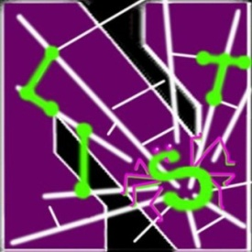
DroidChameleon: Evaluating Android Anti-malware against Transformation Attacks
Vaibhav Rastogi, Yan Chen, and Xuxian Jiang
Lab for Internet and Security Technology, Northwestern University
†North Carolina State University

Slide 2
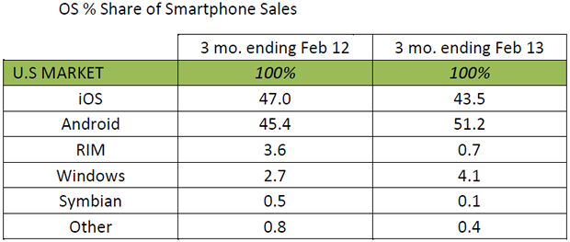
Android Dominance
Smartphone sales already exceed PC sales
Android world-wide market share ~ 70%
Android market share in US ~50%
(Credit: Kantar Worldpanel ComTech)

Slide 3
Introduction
Android malware – a real concern
Many Anti-malware offerings for Android
Many are very popular
Source: http://play.google.com/ | retrieved: 4/29/2013

Slide 4
Objective
What is the resistance of Android anti-malware against malware obfuscations?
Smartphone malware is evolving
Encrypted exploits, encrypted C&C information, obfuscated class names, …
Polymorphic attacks already seen in the wild
Technique: transform known malware

Slide 5
Transformations: Three Types
Trivial
No code-level changes or changes to AndroidManifest
Detectable by Static Analysis - DSA
Do not thwart detection by static analysis completely
Not detectable by Static Analysis – NSA
Capable of thwarting all static analysis based detection

Slide 6
Trivial Transformations
Repacking
Unzip, rezip, re-sign
Changes signing key, checksum of whole app package
Reassembling
Disassemble bytecode, AndroidManifest, and resources and reassemble again
Changes individual files

Slide 7
DSA Transformations
Changing package name
Identifier renaming
Data encryption
Encrypting payloads and native exploits
Call indirections
…

Slide 8
Evaluation
10 Anti-malware products evaluated
AVG, Symantec, Lookout, ESET, Dr. Web, Kaspersky, Trend Micro, ESTSoft (ALYac), Zoner, Webroot
Mostly million-figure installs; > 10M for three
All fully functional
6 Malware samples used
DroidDream, Geinimi, FakePlayer, BgServ, BaseBridge, Plankton
Last done in February 2013.

Slide 9
DroidDream Example
 | AVG | Symantec | Lookout | ESET | Dr. Web
Repack |  |  | x
Reassemble |  |  | x
Rename package | x |  | x
Encrypt Exploit (EE) |  |  | x
Rename identifiers (RI) |  | x | x
Encrypt Data (ED) |  |  | x
Call Indirection (CI) |  |  | x
RI+EE |  | x | x | x
EE+ED |  |  | x
EE+Rename Files |  |  | x
EE+CI |  |  | x |  | x

Slide 10
DroidDream Example
 | Kasp. | Trend M. | ESTSoft | Zoner | Webroot
Repack
Reassemble |  |  |  | x
Rename package |  |  | x | x
Encrypt Exploit (EE) |  |  |  | x
Rename identifiers (RI) |  |  |  | x | x
Encrypt Data (ED) |  |  |  | x
Call Indirection (CI) |  |  |  | x
RI+EE |  |  |  | x | x
EE+ED | x |  |  | x
EE+Rename Files |  | x |  | x
EE+CI |  |  |  | x

Slide 11
Findings
All the studied tools found vulnerable to common transformations
At least 43% signatures are not based on code-level artifacts
90% signatures do not require static analysis of Bytecode. Only one tool (Dr. Web) found to be using static analysis

Slide 12
Signature Evolution
Study over one year (Feb 2012 – Feb 2013)
Key finding: Anti-malware tools have evolved towards content-based signatures
Last year 45% of signatures were evaded by trivial transformations compared to 16% this year
Content-based signatures are still not sufficient

Slide 13
Takeaways
Need to have semantics-based detection
Need to provide better platform support for anti-malware
Google and device manufacturers
Anti-malware vendors

Slide 14
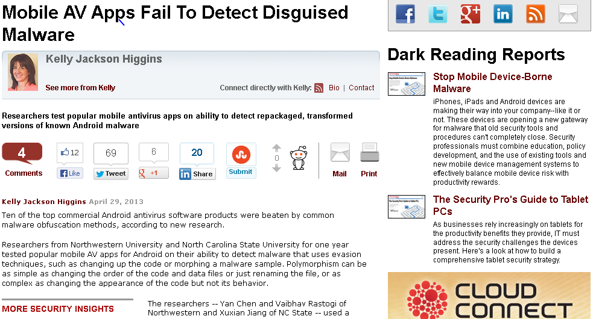
Impact
The focus of a Dark Reading article on April 29
Contacted by Lookout Director of Security Engineering regarding transformation samples and tools on May 2nd
Contacted by McAfee Lab and TechNewsDaily this week …

Slide 16
Conclusion
Developed a systematic framework for transforming malware
Evaluated latest popular Android anti-malware products
All products vulnerable to malware transformations

Slide 17
Thank You!
http://list.cs.northwestern.edu/mobile

Slide 18
Backup

Slide 19
Solutions
Content-based Signatures are not sufficient
Analyze semantics of malware
Dynamic behavioral monitoring can help
Need platform support for that

Slide 20
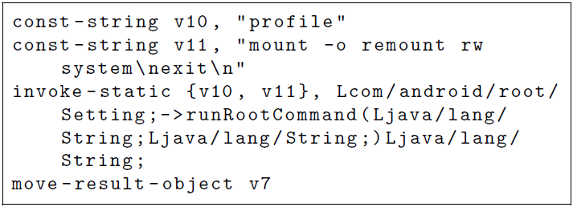
Example: String Encryption

Slide 21
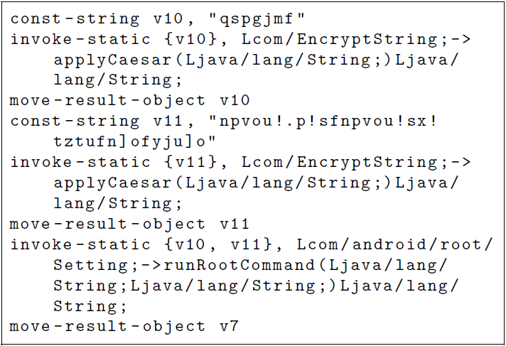
Example: String Encryption

Slide 22
NSA Transformations
Reflection
Obfuscate method calls
Subsequent encryption of method names can defeat all kinds of static analysis
Bytecode encryption
Encrypt the malicious bytecode
load at runtime using user-defined class loader

Slide 23
Product Details

