Slide 1
Symbiosis: The Art of Application and Kernel Cache Cooperation
Yifan Dai, Jing Liu,
Andrea Arpaci-Dusseau and Remzi Arpaci-Dusseau
Notes:
(3) Hello everyone, I am Yifan Dai.
Today, I will present Symbiosis, a framework for application and kernel cache coordination.
This is a joint work with my colleague Jing and my advisors Andrea and Remzi.

Slide 2
Database Systems and Storage Engines
Large scale database systems
MongoDB / MySQL / CockroachDB
Notes:
(1) Today, large scale database systems like CockroachDB, MongoDB, and MySQL are widely used.

Slide 3
Database Systems and Storage Engines
Large scale database systems
MongoDB / MySQL / CockroachDB
Storage engines within DB to interact with filesystems
RocksDB / WiredTiger / InnoDB
Notes:
(1) They are embedded with storage engines like RocksDB and WiredTiger to interact with the underlying filesystems.

Slide 4
Caching in Storage Engine
Cache within the application
An implicit layer of kernel caching
App
Kernel
Device
Cache
Page Cache
Data
Notes:
(2) For performance purposes, storage engine applications use data caching.
Implicitly, there is another layer of kernel caching, that is the page cache.

Slide 5
Caching in Storage Engine
Cache within the application
An implicit layer of kernel caching
Stores compressed data
App
Kernel
Device
Cache
(Uncompressed)
Cache
(Compressed)
Data
(Compressed)
Notes:
(1) Many storage engines utilize data compression to save device I/O, so that the kernel caches compressed data from the device and the application caches uncompressed data.

Slide 6
Caching in Storage Engine
Forms a special two-layer cache structure
Sharing of memory quota
Optimal cache partitioning is important and not trivial
Yields great benefit
Depends on various factors
Memory Quota
App
Kernel
Device
Cache
(Uncompressed)
Cache
(Compressed)
Data
(Compressed)
Notes:
(5) This forms a unique application-kernel two-layer cache structure.
The two cache layers share the same memory quota.
- Here, we highlight the memory partitioning problem between the two caches.
It can yield great benefit if we do it right.
But doing it right is not trivial because it depends on various factors such as working set size and access pattern.

Slide 7
Optimal Cache Partitioning is Hard
App Cache
Kernel Cache
#1: All to app cache
#2: All to kernel cache
Memory Quota
Memory Quota
Configuration
Performance with
small working set size
Performance with
large working set size
Notes:
(2) For example, let’s consider one varying factor, the working set size, and two simple cache size configurations, one is giving all the memory to the application cache and the other is giving all the memory to the kernel cache.
Accessing the application cache is faster than accessing the kernel cache, but the kernel cache essentially holds more data in memory because of compression.

Slide 8
Optimal Cache Partitioning is Hard
App Cache
Kernel Cache
#1: All to app cache
#2: All to kernel cache
Memory Quota
Memory Quota
Configuration
Performance with
small working set size
2
1
Performance with
large working set size
Notes:
(1) When the working set is small, giving all the memory to the application cache could be 2x faster than giving all the memory to the kernel cache because the application cache holds all the data.

Slide 9
Optimal Cache Partitioning is Hard
The best partition could be arbitrary percentage in the middle
App Cache
Kernel Cache
#1: All to app cache
#2: All to kernel cache
Memory Quota
Memory Quota
Configuration
Performance with
small working set size
2
1
Performance with
large working set size
1
5
Notes:
(3) But with a larger working set, giving all the memory to the kernel cache could be 5x faster instead because the kernel cache can still hold all the data in the compressed form.
Therefore, it incurs far less device access than the other configuration.
- According to our study, the best cache partition could vary a lot depending on workloads and environments.

Slide 10
Symbiosis - Adapt Cache Sizes by Simulation
Symbiosis
App
Kernel
Cache
Cache
Device
Notes:
(1) In this work, we build Symbiosis to solve the cache partitioning problem.

Slide 11
Symbiosis - Adapt Cache Sizes by Simulation
Symbiosis
Embedded in the storage engine
App
Kernel
Symbiosis
Cache
Cache
Device
Notes:
(2) Symbiosis is a framework for key-value storage systems that configures cache sizes to improve performance.
It embeds a module in the application,

Slide 12
Symbiosis - Adapt Cache Sizes by Simulation
Symbiosis
Embedded in the storage engine
Optimizes cache partitioning automatically
App
Kernel
Symbiosis
<- Cache ->
Cache
Device
Notes:
(1) that automatically optimizes cache sizing by online simulation.

Slide 13
Symbiosis - Adapt Cache Sizes by Simulation
Symbiosis
Embedded in the storage engine
Optimizes cache partitioning automatically
Adapts cache sizes to dynamic workloads
App
Kernel
Working set grows ->
Decrease app cache!
Symbiosis
-> Cache <-
Cache
Device
Notes:
(1) Further, to deal with dynamic workloads, Symbiosis detects workload change and adapts cache sizes accordingly.

Slide 14
Symbiosis - Adapt Cache Sizes by Simulation
Integrated into production systems with <1000 LoC
LevelDB, RocksDB, WiredTiger
Performance improvements
1.5x on average for read-heavy workloads
Online cache simulation with high accuracy and negligible overhead
~0.1% space overhead and ~1% time overhead
App
Kernel
Symbiosis
Cache
Cache
Device
Notes:
(3) Symbiosis is integrated into three production systems, each within 1000 lines of code change.
It improves performance by 1.5x on average for read-heavy workloads.
- Symbiosis applies several optimization techniques to achieve high accuracy in online cache simulation with negligible space and time overhead.

Slide 15
Outline
Overview of Symbiosis
Key Challenge
Simulate accurately with low overhead
Optimization Techniques
Incremental reuse of a single ghost cache
Misalignment-aware sampling
Guard against unmodeled
Evaluation
Static workloads
Dynamic (changing) workloads
Notes:
(4) In this talk, I will first give an overview of Symbiosis,
then talk about the key challenge, that is how to simulate accurately with low overhead.
Then we will dive into several optimization techniques to solve the problem.
Finally, I will show the evaluation on various static and dynamic workloads.

Slide 16
Symbiosis - Overview
Detects workload change
Notes:
(2) Symbiosis works in the following steps.
First, it detects workload change by monitoring cache performance.

Slide 17
Symbiosis - Overview
Detects workload change
Simulates multiple candidate cache size configurations
App Cache
Kernel Cache
Candidate Configuration 1
Candidate Configuration 2
Candidate Configuration 3
Candidate Configuration 4
Notes:
(1) Upon workload change, Symbiosis starts to simulate a set of candidate cache size configurations.

Slide 18
Symbiosis - Overview
Detects workload change
Simulates multiple candidate cache size configurations
Finds the configuration with the best expected performance
App Cache
Kernel Cache
Candidate Configuration 1
Exp. Performance: 4
Candidate Configuration 2
Exp. Performance: 3
Candidate Configuration 3
Exp. Performance: 5
Candidate Configuration 4
Exp. Performance: 6
Notes:
(1) Then the expected performance of each candidate is predicted and the best configuration is selected.

Slide 19
Symbiosis - Overview
Detects workload change
Simulates multiple candidate cache size configurations
Finds the configuration with the best expected performance
Applies the best configuration if it yields enough benefit
App Cache
Kernel Cache
Candidate Configuration 1
Exp. Performance: 4
Candidate Configuration 2
Exp. Performance: 3
Candidate Configuration 3
Exp. Performance: 5
Candidate Configuration 4
Exp. Performance: 6
Notes:
(1) Finally, the best configuration is applied if it yields enough benefit.

Slide 20
Key Challenge
How to simulate accurately?
How to simulate with negligible overhead?
Notes:
(2) To get robust performance improvements, we must accurately predict the performance of the candidates.
On the other hand, we want to incur negligible overhead during simulation.

Slide 21
Key Challenge
How to simulate accurately?
How to simulate with negligible overhead?
Tension!
Notes:
(2) There is a tension between the two objectives.
A naïve full simulation with the highest accuracy would incur unacceptable overhead.

Slide 22
Key Challenge
How to simulate accurately?
How to simulate with negligible overhead?
Optimization Techniques
Incremental reuse of a single ghost cache
Misalignment-aware sampling
Guard against unmodeled
Tension!
Notes:
(1) Therefore, we propose several optimization techniques to achieve both high accuracy and low overhead.

Slide 23
Classical Solution - Ghost Cache Simulation
Ghost cache - maintain only cache access metadata
Useful for cache statistics analysis
Cache
Metadata
Data
Ghost cache
Metadata
Notes:
(3) A classical solution for cache simulation is to use ghost cache.
Unlike a real cache, ghost cache leaves out data and maintains only cache access metadata such as keys.
- It is useful for cache stats analysis when only hit/miss results matter.

Slide 24
Ghost Cache Simulation - Single Layer
Use a single ghost cache instance
Largely reduces space and time overhead
Simulate caches of multiple sizes simultaneously
When the eviction policy has stack property
Ghost cache
1
2
3
4
(tail)
< size=2 >
< size=4 >
Notes:
(6) We want to use a single ghost cache instance to simulate all candidate configurations to reduce memory consumption.
In the case of a single-layer cache, when the eviction policy has stack property, such as LRU, this is easy.
One can simulate caches of multiple sizes simultaneously by recording the positions of hits.
- In this example, we have one ghost cache instance and two caches with size 2 and 4.
An access to cache entry 1 is counted as a hit for both caches.
An access to entry 4 is counted as a hit for the larger cache but a miss for the smaller cache because the hit position is beyond the latter’s size.

Slide 25
Ghost Cache Simulation - Two Layers
Simultaneous simulation of caches with different sizes is not feasible
The second layer sees different access patterns
Notes:
(2) But in the case of a two-layer cache structure, the previous technique no longer works.
The reason is that the second layer sees different access patterns if the first layer is sized differently.

Slide 26
Ghost Cache Simulation - Two Layers
Simultaneous simulation of caches with different sizes is not feasible
The second layer sees different access patterns
size = 1
2 1 3 2 3 1 3 1 2 4
2 1 3 2 3 1 2 1 3 4
2 1 3 2 1 3 1 3 2 4
1st-layer access trace:
1st-layer Ghost cache
1
Notes:
(2) Let’s look at an example.
We have a trace with skewed access to entries 1 through 3 and occasional access to entry 4.

Slide 27
Ghost Cache Simulation - Two Layers
Simultaneous simulation of caches with different sizes is not feasible
The second layer sees different access patterns
size = 1
2 1 3 2 3 1 3 1 2 4
2 1 3 2 3 1 2 1 3 4
2 1 3 2 1 3 1 3 2 4
1st-layer access trace:
1st-layer Ghost cache
1
2 1 3 2 3 1 3 1 2 4
2 1 3 2 3 1 2 1 3 4
2 1 3 2 1 3 1 3 2 4
2nd-layer access trace:
Notes:
(2) Accesses that are missed in the first layer go to the second layer.
If the first layer’s size is only 1, it misses all the accesses and the second layer sees the same skewed access pattern to entries 1 through 3.

Slide 28
Ghost Cache Simulation - Two Layers
Simultaneous simulation of caches with different sizes is not feasible
The second layer sees different access patterns
size = 3
2 1 3 2 3 1 3 1 2 4
2 1 3 2 3 1 2 1 3 4
2 1 3 2 1 3 1 3 2 4
1st-layer access trace:
1st-layer Ghost cache
1
2
3
2nd-layer access trace:
4 3 4 2 4
Notes:
(3) With the same trace, if the first layer’s size is 3, most of the accesses to entries 1 through 3 hit in the first layer, but all accesses to entry 4 miss and go to the second layer.
Then the second layer sees a different access pattern that is skewed to entry 4.
Thus, it’s not possible to simulate these two configurations simultaneously.

Slide 29
Incremental reuse of a single ghost cache
Use a single ghost cache instance
Largely reduces space and time overhead
Notes:
(1) In Symbiosis, we achieve the goal of using only one ghost cache instance by incremental reuse of the instance.

Slide 30
Incremental reuse of a single ghost cache
Use a single ghost cache instance
Largely reduces space and time overhead
Simulate candidates one at a time
App Cache
Kernel Cache
Full app cache
(for reuse)
Candidate Configuration 1
Candidate Configuration 2
Candidate Configuration 3
Notes:
(1) With only one instance, we need to simulate multiple candidate configurations one by one.

Slide 31
Incremental reuse of a single ghost cache
Use a single ghost cache instance
Largely reduces space and time overhead
Simulate candidates one at a time
App Cache
Kernel Cache
Full app cache
(for reuse)
Candidate Configuration 1
Candidate Configuration 2
Candidate Configuration 3
Notes:
(1) We can always reuse the contents of the first-layer application cache because of the stack property.

Slide 32
Incremental reuse of a single ghost cache
Use a single ghost cache instance
Largely reduces space and time overhead
Simulate candidates one at a time
Minimize warm-up before each simulation
Utilize the stack property for the first layer
Simulate in the order of increasing application cache size
App Cache
Kernel Cache
Candidate Configuration 1
warm up
Candidate Configuration 2
warm up
Candidate Configuration 3
Notes:
(2) The question is how to deal with the second-layer kernel cache.
Before each simulation, we insert a short warm-up period to let the contents of the ghost cache approach the next configuration.

Slide 33
Incremental reuse of a single ghost cache
Use a single ghost cache instance
Largely reduces space and time overhead
Simulate candidates one at a time
Minimize warm-up before each simulation
Utilize the stack property for the first layer
Simulate in the order of increasing application cache size
App Cache
Kernel Cache
Candidate Configuration 1
Candidate Configuration 2
Simulation Order
Candidate Configuration 3
Notes:
(1) We then design a simulation order of increasing application cache size, so that we minimize the difference between neighboring configurations to minimize the warm-up period.

Slide 34
Misalignment-aware Sampling
Key-space sampling
Sample targets in key space and all accesses to the targets
Key Space
Waldspurger et al. Efficient MRC Construction with SHARDS. 2015 (original key space sampling)
Notes:
(4) Even with one ghost cache instance, its memory consumption is still too large.
- Thus, we incorporate key-space sampling to further reduce the overhead.
Key-space sampling is widely used in cache analysis, which uniformly samples targets in the key space and all accesses to the sampled targets.
In this example, three targets marked in gray are sampled.

Slide 35
Misalignment-aware Sampling
Key-space sampling
Samples targets in key space and all accesses to the targets
Works in normal multi-layer caching
Key Space
Waldspurger et al. Efficient MRC Construction with SHARDS. 2015 (original key space sampling)
Notes:
(2) Then only the accesses to the sampled targets are kept.
This sampling method also works in normal multi-layer caching.

Slide 36
Misalignment-aware Sampling
Misalignment - different caching units
The unit of app cache: app-defined blocks
The unit of kernel cache: pages
One unit in the 1st layer corresponds to multiple units in the 2nd layer
App Cache Key Space
(uncompressed data)
Kernel Cache Key Space
(compressed data)
Notes:
(6) But there is another property in our application-kernel cache structure, that is misalignment.
The original sampling method doesn’t work well with misalignment.
So, what is misalignment?
- The application caches in the unit of blocks of uncompressed data, while the kernel caches in fixed-sized pages of compressed data.
They may be in different sizes and misalign with each other.
In this example, the gray block in the application cache key space corresponds to two gray pages in the kernel cache key space.

Slide 37
Misalignment-aware Sampling
Key-space sampling with misalignment
App Cache Key Space
Kernel Cache Key Space
Notes:
(2) To understand why the original key-space sampling doesn’t work with misalignment, consider this more complicated example.
The two gray blocks in the first layer have been accessed, and they corresponds to 4 pages in the second layer.

Slide 38
Misalignment-aware Sampling
Key-space sampling with misalignment
Hits in the 2nd layer due to accessed neighboring blocks in the 1st layer
App Cache Key Space
Kernel Cache Key Space
Notes:
(3) Now we access the blue block.
Note that the corresponding pages in the second layer have already been touched by previous accesses to the neighboring blocks,
so this would be a hit in the kernel cache.

Slide 39
Misalignment-aware Sampling
Key-space sampling with misalignment
Hits in the 2nd layer due to accessed neighboring blocks in the 1st layer
Contiguous targets not all sampled so hits are not counted
Loses the effects of accessing contiguous pages
App Cache Key Space
Kernel Cache Key Space
Notes:
(3) But since key-space sampling uniformly samples the key space, it is unlikely to sample contiguous targets.
So the blue block is not sampled, and the additional hit in the kernel cache is not counted.
- Essentially, misalignment affects accesses to contiguous pages more, but key space sampling loses such effects.

Slide 40
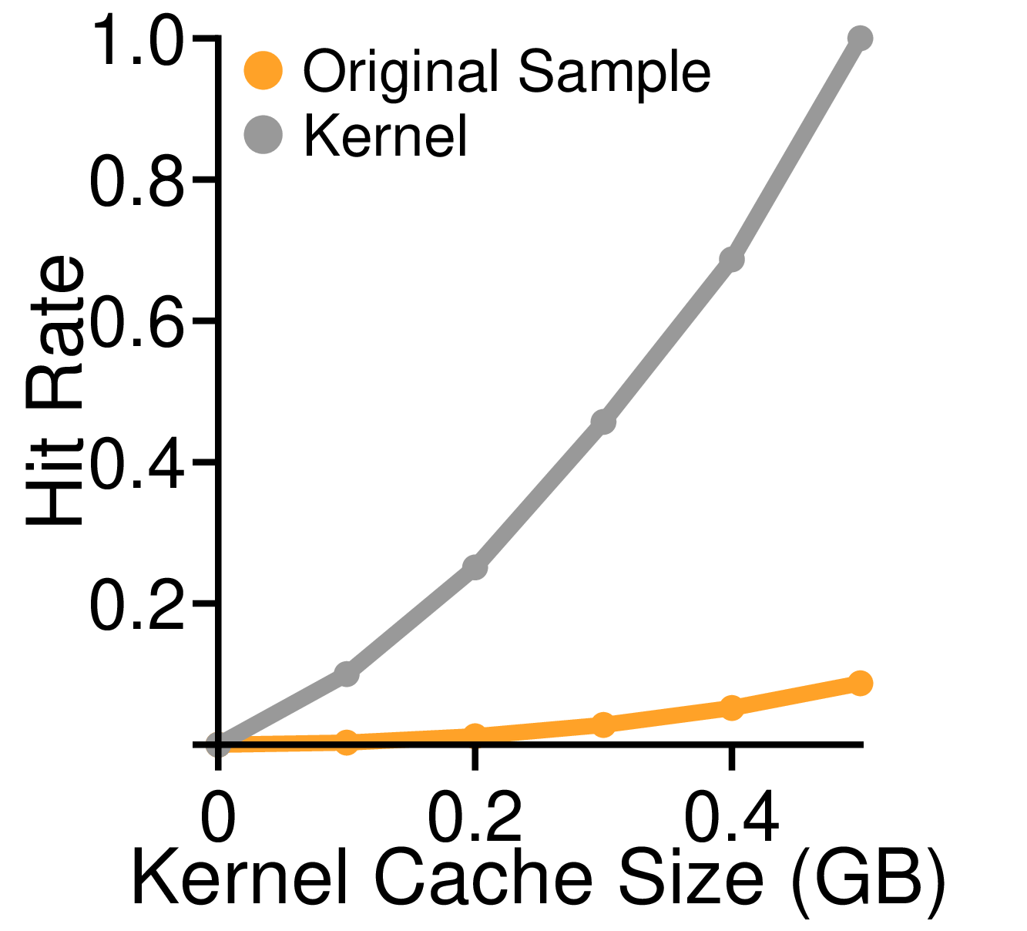
Misalignment-aware Sampling
Key-space sampling with misalignment
Much lower kernel cache hit rate
Waldspurger et al. Efficient MRC Construction with SHARDS. 2015 (original key-space sampling)
Notes:
(5) Thus, it could result in a very inaccurate simulation.
- The graph shows the hit rate of the kernel cache of difference sizes with and without sampling.
The y-axis is the hit rate and the x-axis is the cache size.
- The gray line does not use sampling and the orange line uses the original key-space sampling.
We can see that their hit rates differ a lot.

Slide 41
Misalignment-aware Sampling
Misalignment-aware Sampling
Sample contiguous targets together to keep the effect of misalignment
App Cache Key Space
Kernel Cache Key Space
Notes:
(2) Since the effects of misalignment are significant when contiguous targets are accessed, we propose misalignment-aware sampling that always samples contiguous targets together.
In this example, we sample three contiguous blocks in the first layer as a group.

Slide 42
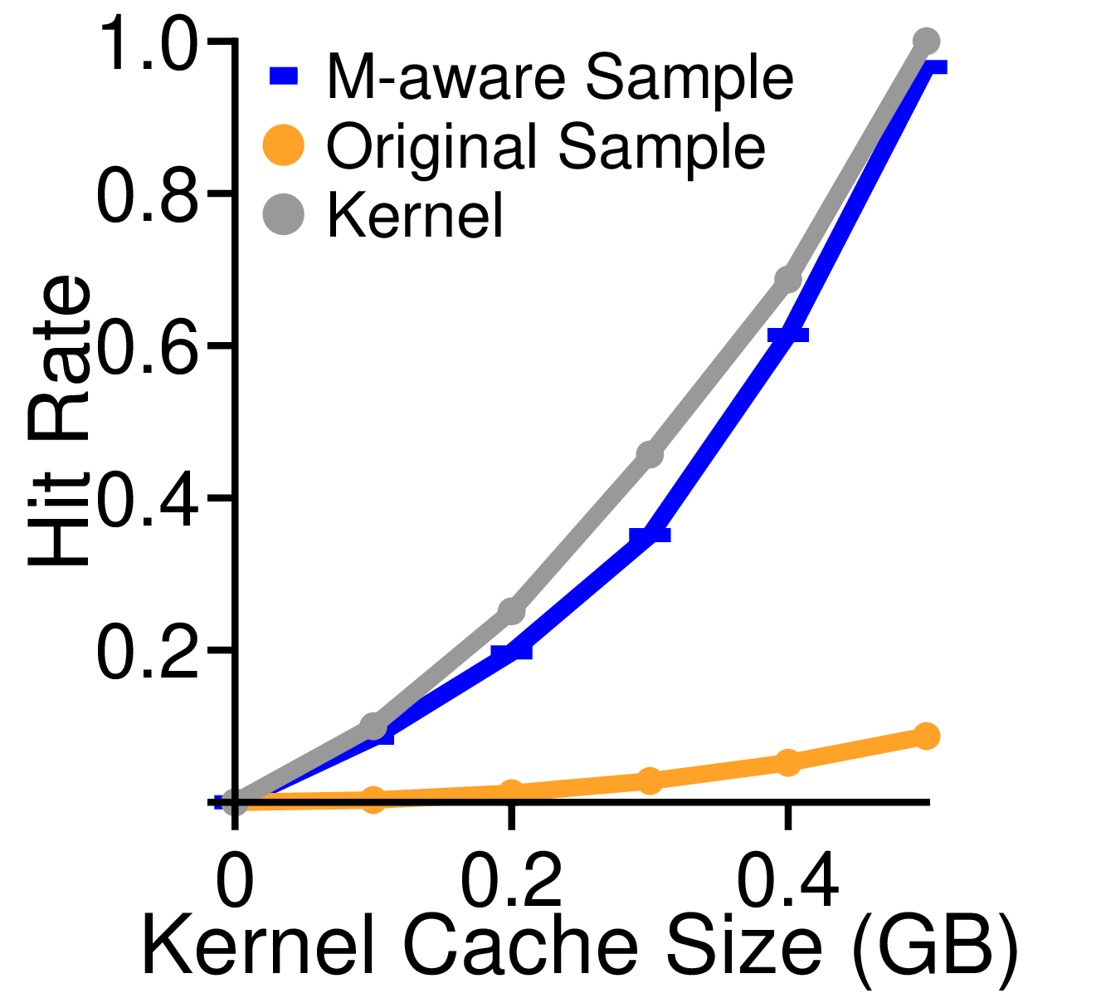
Misalignment-aware Sampling
Misalignment-aware Sampling
Sample contiguous targets together to keep the effect of misalignment
In Symbiosis, we samples in groups of 32 and the sampling rate is 1/64
Misalignment-aware sampling is much more accurate
approximate no sampling better
Notes:
(2) Misalignment-aware sampling gives us a much more accurate result.
In this graph, it is the blue line and it approaches the hit rate of no sampling much better.

Slide 43
Guard Against Unmodeled Cases
Some kernel features not modeled (e.g., read-ahead)
Notes:
(4) Besides misalignment, there are many other properties and optimizations in the kernel that may also influence the kernel cache hit rate, for example, read-ahead.
To reduce overhead, we choose not to precisely model all the features.
Then there would be a few corner-case workloads where our simulation is not accurate.

Slide 44
Guard Against Unmodeled Cases
Some kernel features not modeled (e.g., read-ahead)
When simulation is accurate
Adapt!
Simulated Performance
Current Performance
Performance
Application Cache Size
Notes:
(4) The graph shows an example in the normal case where simulation is accurate.
The y-axis is the performance where higher is better, and the x-axis is the application cache size of different configurations.
The dashed line is the current performance, while the solid curve is the simulated performance of different configurations. Each point represents a configuration.
- The best performance takes place at the right most point and its better than the current performance, so we adapts to that configuration.

Slide 45
Guard Against Unmodeled Cases
Some kernel features not modeled (e.g., read-ahead)
When simulation is not accurate
Observation: omitting such features usually results in a worse perf.
Current Performance
Performance
Simulated Performance
Application Cache Size
Notes:
(3) Now, what happens if simulation is not accurate?
We have an observation that omitting kernel features in simulation tends to make the simulated performance worse.
- As shown in the graph, all the simulated performance are worse than the current performance.

Slide 46
Guard Against Unmodeled Cases
Some kernel features not modeled (e.g., read-ahead)
Observation: omitting such features usually results in a worse perf.
Policy: only adapts when predicted perf. is better than current perf.
Current Performance
Performance
Simulated Performance
Reject all configurations
Application Cache Size
Notes:
(3) Thus, we have a policy that only adapts to a new configuration if the simulated performance is better than the current performance by a threshold amount.
This way, we not only rule out inaccurate simulations in unmodeled cases, but also generally avoid adapting to a worse configuration.
- In this example, we simply reject all the simulated configurations and keep the cache size as-is.

Slide 47
Evaluation - Static Workloads
Experiments
Performance with various workloads and environments
Results
Improves performance in 98% of 190+ workloads by 1.5x on average
Factors |  | Presented Space | # of parameters
Workloads | Data Set Size | 5, 2.5, 1.67, 1.24, 1 | 4
 | Access Pattern | uniform, zipfian, hotspot{30,20,10} | 5
Software | Compression Lib. | snappy (default), zstd | 2
 | Storage Engine | LevelDB, RocksDB, WiredTiger | 3
Hardware | CPU Frequency | CPU1: 2.9GHz, CPU2: 2.0GHz | 2
 | Device Latency | SSD1: ~10us, SSD2: ~70us | 2
Notes:
(4) We evaluate Symbiosis with various static and dynamic workloads.
- With static workloads, we evaluate Symbiosis’s ability to find a better cache size configuration in various workloads and environments and its generalizability to different storage engines.
We integrate Symbiosis in three production systems and run over 190 workloads with different data set sizes, access patterns, compression algorithms, and hardware.
- Symbiosis performs better or equal to the best static configuration in 98 percent of the workloads, with an average gain of 1.5x over each static configuration.

Slide 48
Evaluation - Dynamic Workloads
Experiments
Performance with abrupt and gradual workload changes
Performance with real world workloads
Overhead and tail latency analysis
Results
Symbiosis properly reacts to all of 38 workloads
Symbiosis incurs 0.1% space overhead and 1% time overhead
Notes:
(4) In dynamic workloads, we evaluate Symbiosis’s ability to detect and adapt to workload changes and analyze its overhead and tail latency.
Symbiosis properly reacts to workload changes in all of the 38 dynamic workloads.
- Its online simulation incurs only 0.1 percent space overhead and around 1 percent time overhead.
I will show how Symbiosis works with an example dynamic workload.

Slide 49
Dynamic Workloads - Example
Consists of 2 static workloads
Workload 1 is very skewed, while workload 2 is less skewed
Data set fits in memory when compressed, but not when uncompressed
Workload 1
(Skewed)
Workload
Change
↓
Workload 2
20
Latency (us)
15
10
Workload Progress
5
0
Notes:
(4) The example contains 2 static workloads and the workload change takes place in the middle.
Workload 1 is very skewed while workload 2 is not.
Both data sets fit in memory when compress but not when uncompressed.
- In the graph below, the x-axis is the progress of the workload, and the y-axis is the latency per operation, where lower is better.

Slide 50
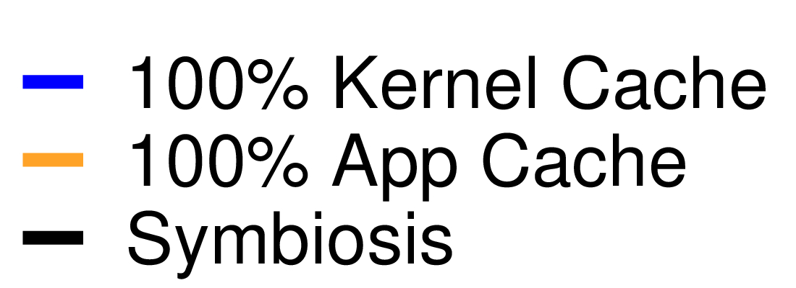
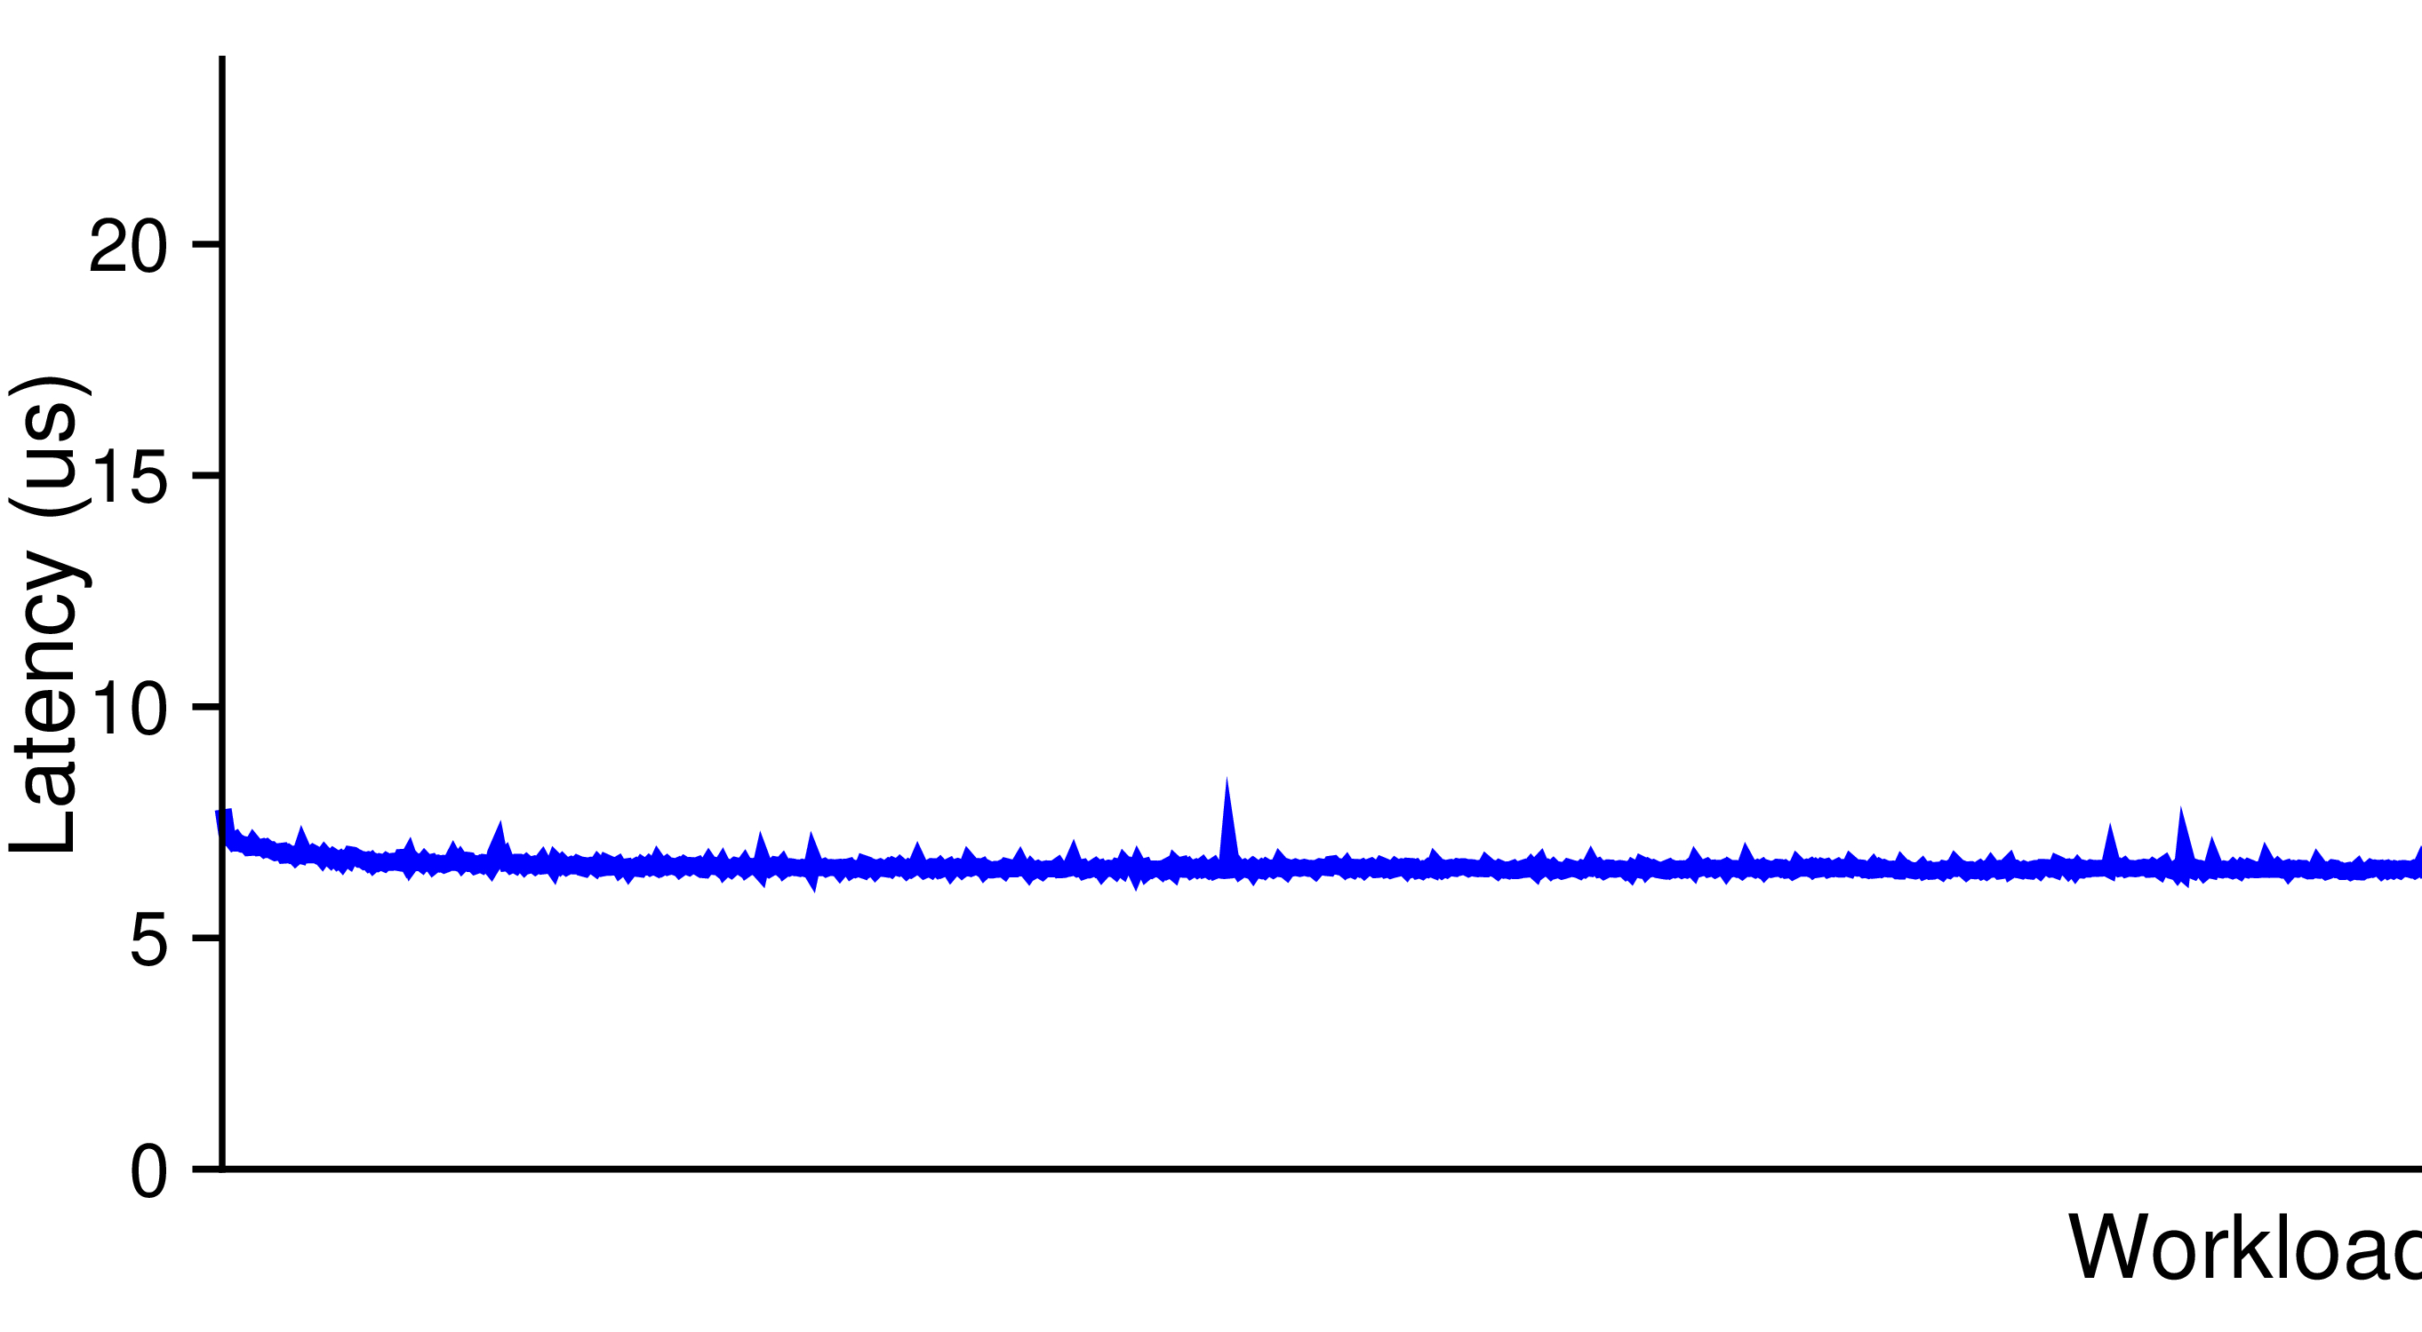
Dynamic Workloads - Example
Workload 1
Workload 1
Workload 2
20
Latency (us)
15
10
Workload Progress
5
0
Notes:
(1) During workload 1, if we give all the memory to the kernel cache, it has a steady performance of around 6 microseconds per op as shown in the blue line.

Slide 51
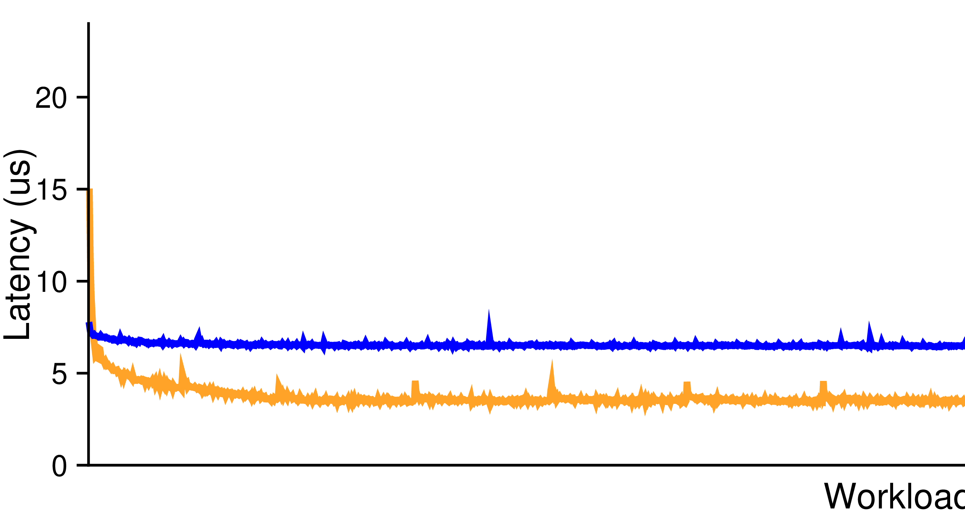
Dynamic Workloads - Example
Workload 1
100% app cache performs better due to high skewedness
Workload 1
Workload 2
20
Latency (us)
15
10
Workload Progress
5
0
Notes:
(2) If we give all the memory to the application cache, it performs better because the workload is very skewed and the application cache holds the entire hotspot.
This is shown in the orange line.

Slide 52
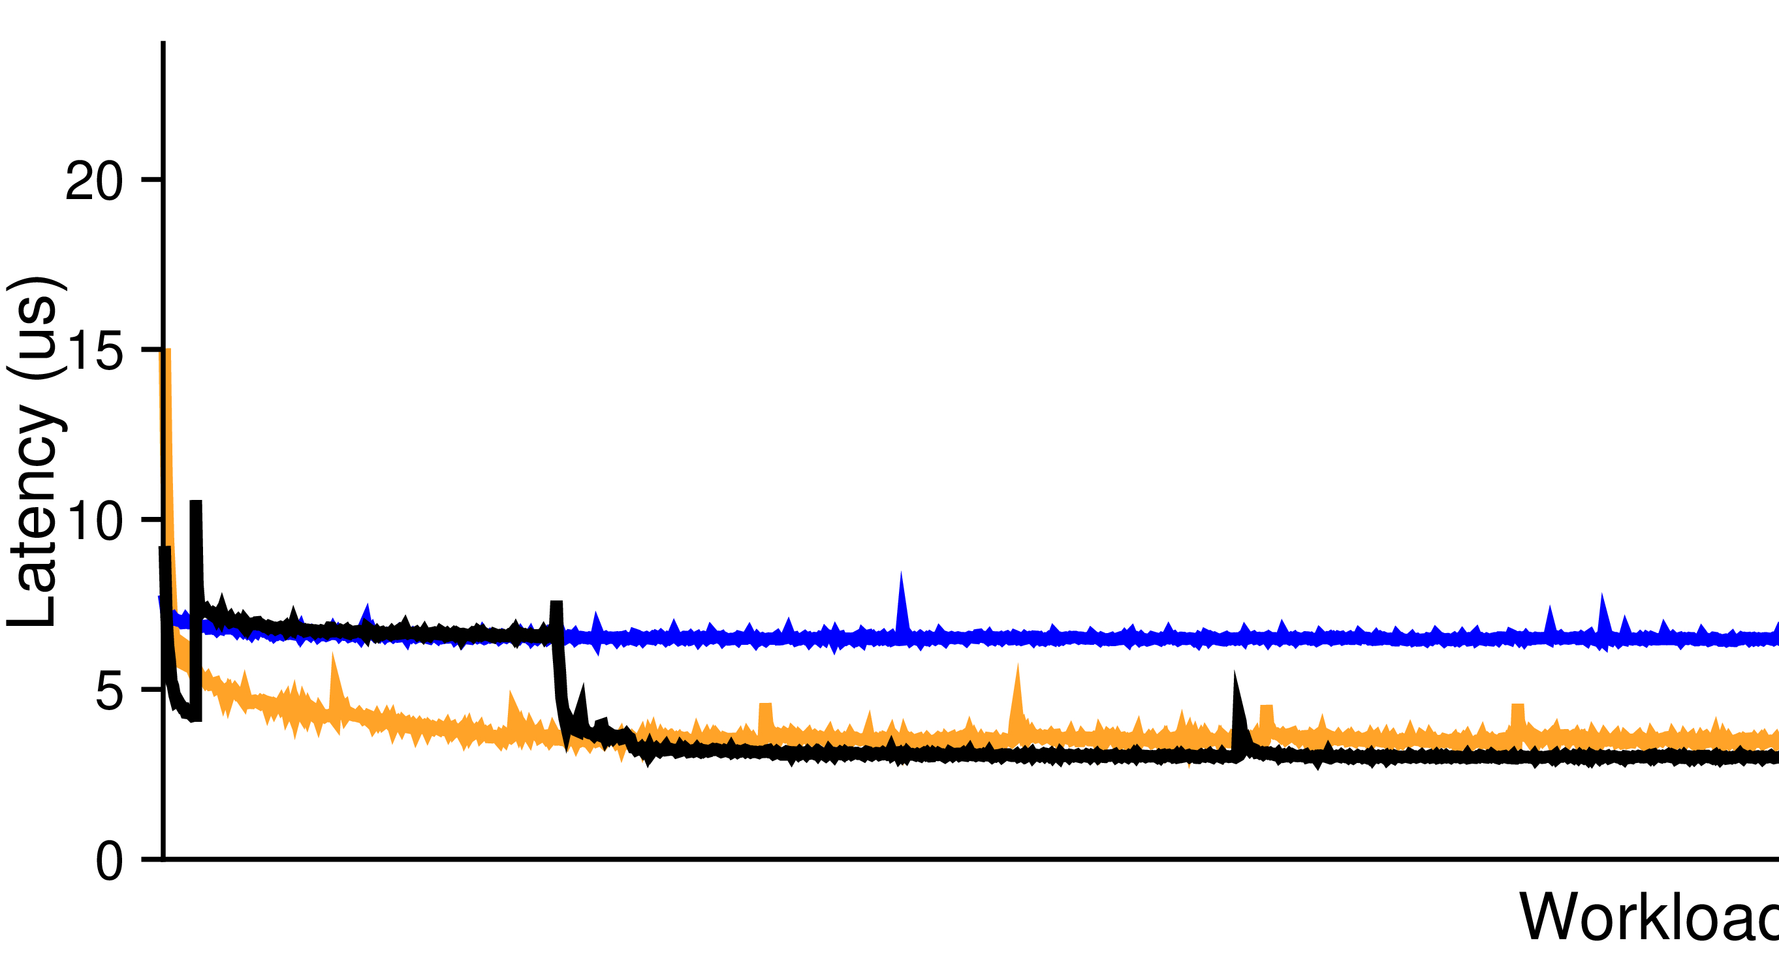
Dynamic Workloads - Example
Workload 1
Symbiosis performs best after simulation
Workload 1
Workload 2
Simulation
20
Latency (us)
15
10
Workload Progress
5
0
Notes:
(2) Symbiosis is the black line.
- It performs a round of simulation at the start of the workload, then adapts to a better cache size with a lower latency than both static configurations.

Slide 53
Dynamic Workloads - Example
Workload 1
Symbiosis incurs negligible overhead during simulation
Workload 1
Workload 2
Simulation
20
Latency (us)
15
negligible overhead
10
Workload Progress
5
0
Notes:
(2) During simulation, Symbiosis has the same cache size configuration as the blue line.
Its latency is also the same as the blue line during simulation, showing that Symbiosis incurs negligible overhead.

Slide 54
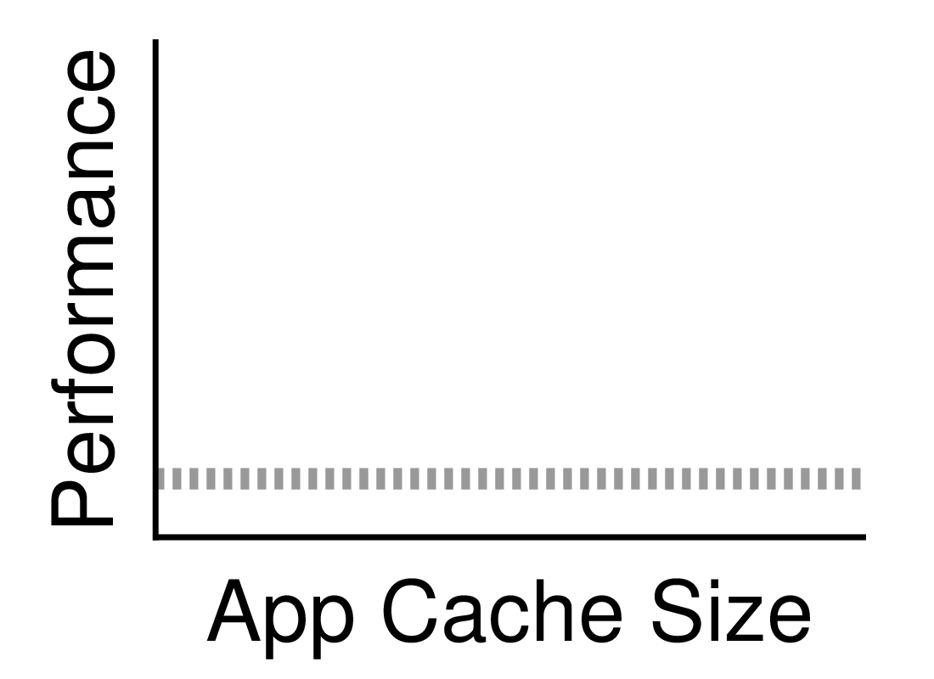
Dynamic Workloads - Example
Workload 1
Workload 1
Workload 2
Simulation
20
Latency (us)
15
10
Workload Progress
5
0
Notes:
(3) The line plot shows how simulation works.
The y-axis is the performance where higher is better, and the x-axis is the application cache sizes.
The dashed line is the current performance.

Slide 55
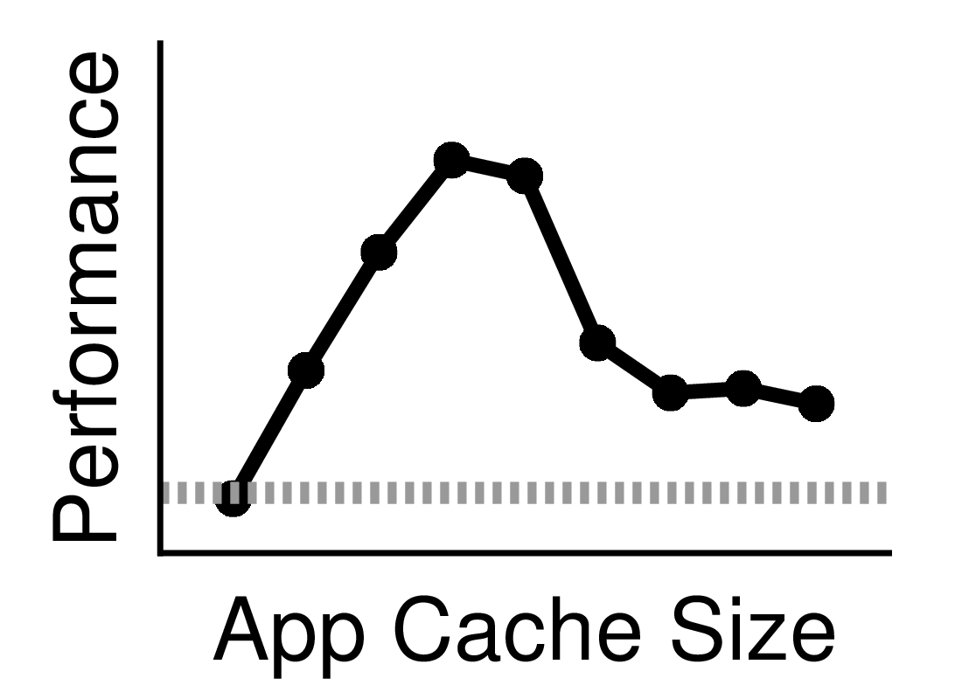
Dynamic Workloads - Example
Workload 1
Workload 1
Workload 2
Simulation
20
Latency (us)
15
10
Workload Progress
5
0
Notes:
(2) Each configuration is simulated one by one in the order of increasing application cache size.
The solid curve is the simulated performance.

Slide 56
Dynamic Workloads - Example
Workload 1
Simulation result: giving ~40% of memory to app cache is the best
Workload 1
Workload 2
Adapt!
Simulation
20
Latency (us)
15
10
Workload Progress
5
0
Notes:
(2) Symbiosis finds that giving about 40% of the memory to the application cache performs the best.
The expected performance is better than the current performance, so we adapt to that configuration.

Slide 57
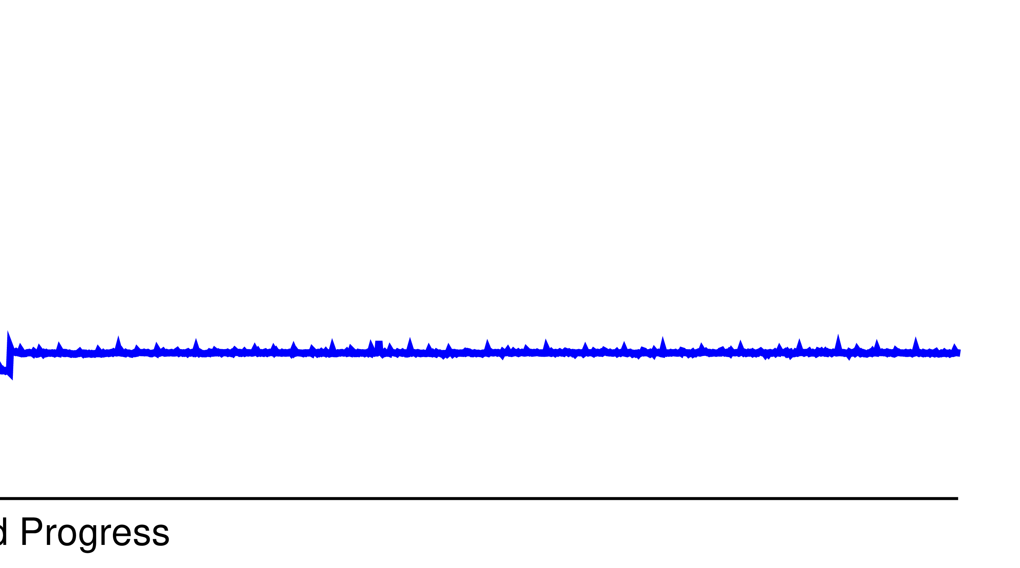
Dynamic Workloads - Example
Workload 2
100% kernel cache performs similarly
Workload 1
Workload
Change
↓
Workload 2
20
Latency (us)
15
10
Workload Progress
5
0
Notes:
(2) Now let’s proceed to workload 2.
- The blue line, giving all the memory to the kernel cache, performs similarly because the kernel cache still holds all the compressed data.

Slide 58
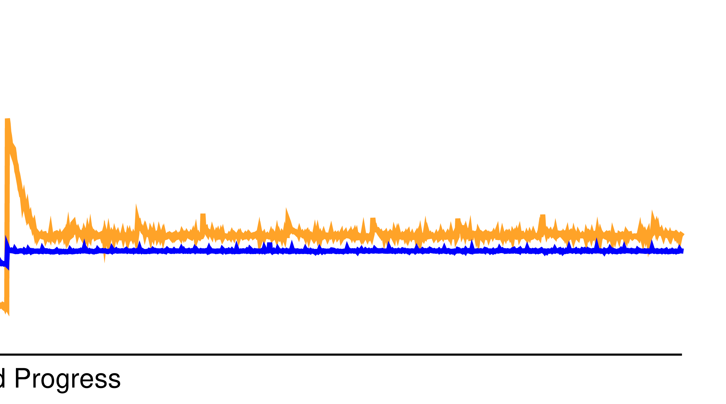
Dynamic Workloads - Example
Workload 2
100% app cache performs worse due to less skewedness
Workload 1
Workload 2
20
Latency (us)
15
10
Workload Progress
5
0
Notes:
(1) The orange line, giving all the memory to the application cache, performs worse because the workload is less skewed and the application cache no longer holds the hotspot.

Slide 59
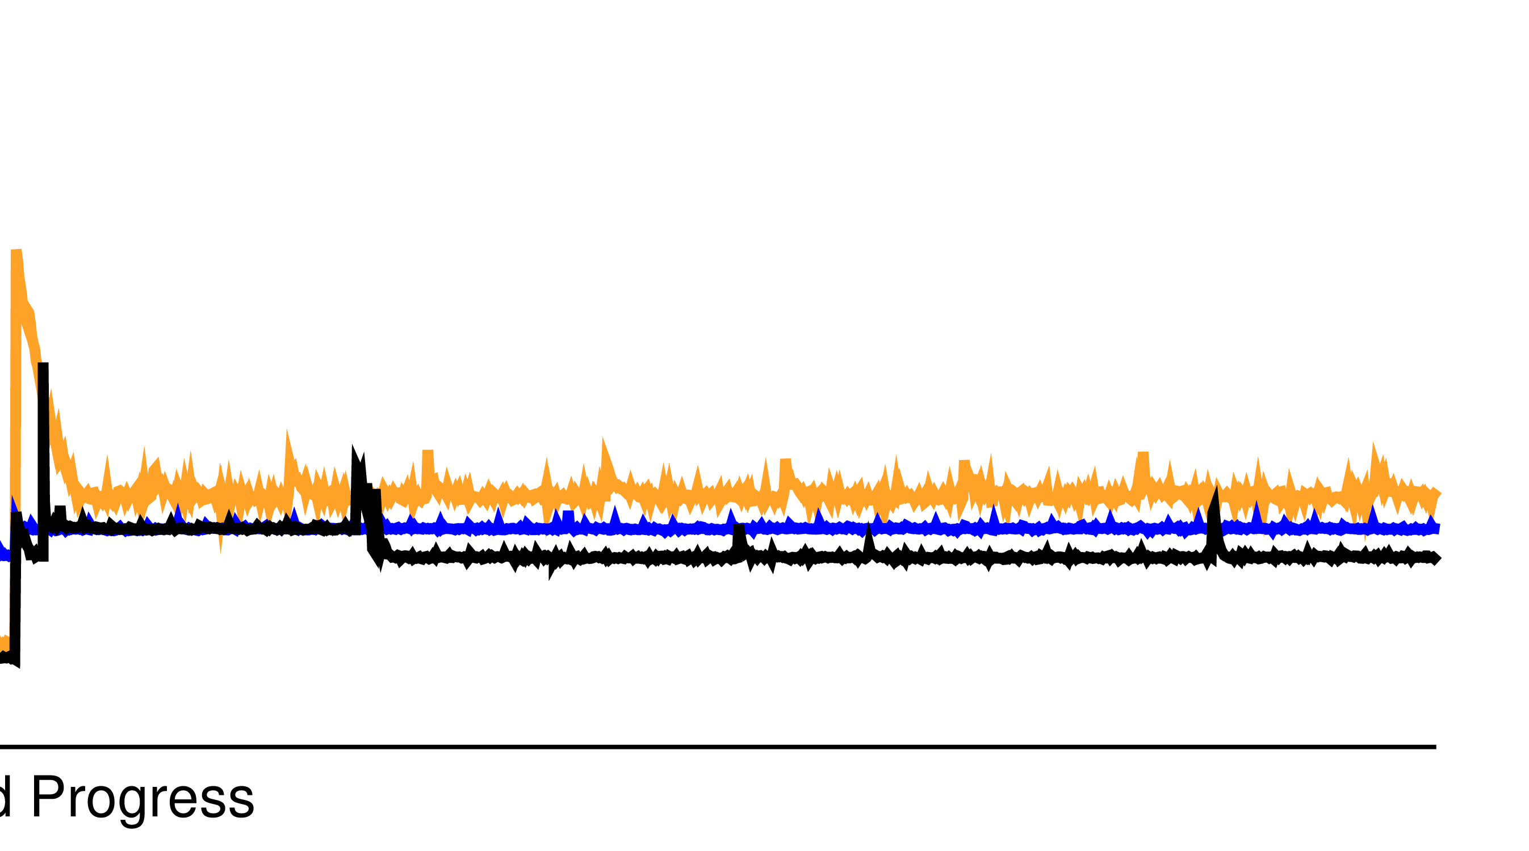
Dynamic Workloads - Example
Workload 2
Symbiosis maintains the best performance after simulation
Workload 1
Workload 2
Simulation
20
Latency (us)
15
10
Workload Progress
5
0
Notes:
(1) The black line, Symbiosis, detects the workload change, starts another round of simulation, adapts to a new configuration, and performs better.

Slide 60
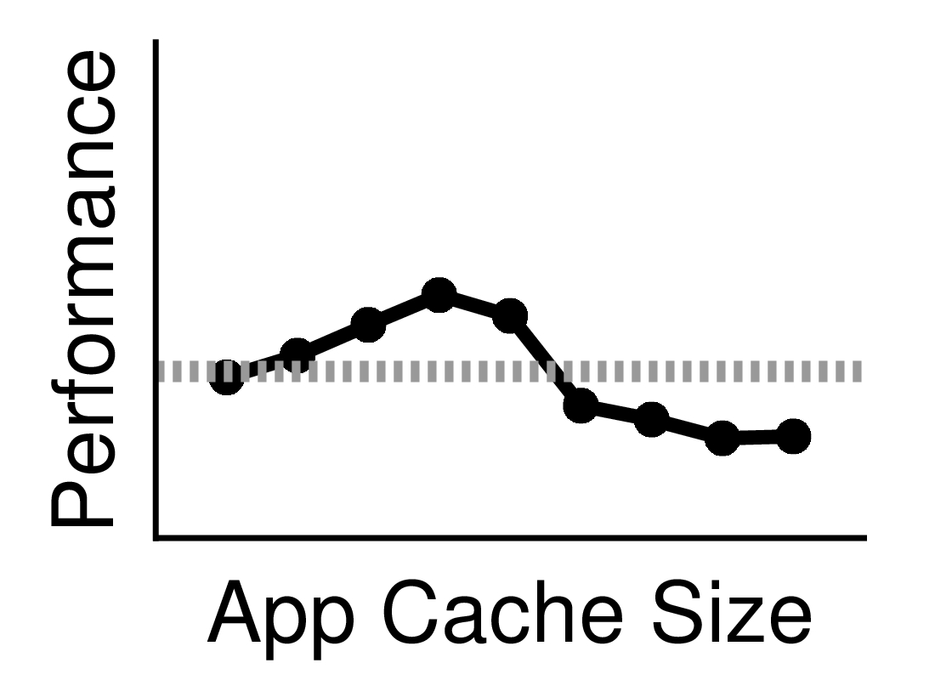
Dynamic Workloads - Example
Workload 2
Symbiosis maintains the best performance after simulation
Workload 1
Workload 2
Simulation
Adapt!
20
Latency (us)
15
10
Workload Progress
5
0
Notes:
(3) The line plot shows the simulation result.
Again, the best performance takes place when we give 40% of the memory to the application cache.
- In general, Symbiosis takes some time for simulation and find a better configuration.

Slide 61
Dynamic Workloads - Example
Workload 2
Symbiosis maintains the best performance after simulation
Workload 1
Workload 2
Simulation
Adapt!
20
Latency (us)
15
10
Workload Progress
5
cache size change
0
Notes:
(1) Then, it changes the cache sizes which may incur a small latency peak, and achieves performance gain after that.

Slide 62
Conclusion
Symbiosis: dynamic cache size adjustment via online simulation
Integrated into production systems within 1000 LoC
LevelDB, RocksDB, WiredTiger
Adapts to various workloads and reacts to workload changes
Performs well on 190+ static workloads and 38 dynamic workloads
Delivers excellent performance with negligible overhead
1.5x gain on average for read-heavy workloads
0.1% space overhead and 1% time overhead
Notes:
(4) In conclusion, Symbiosis is a framework that adjusts cache sizes dynamically by online simulation.
It is integrated into three production systems, each within 1000 lines of code change.
- It adapts to various workloads and environments and properly reacts to workload changes.
It delivers an average gain of 1.5x for read-heavy workloads, with only about 0.1 percent space overhead and 1 percent time overhead by carefully-designed optimizations to online cache simulation.

Slide 63
Conclusion
Simulation-based online performance tuning
A tuning approach that does not rely on machine learning
Deep understanding and careful optimizations are necessary
Potential parameter tuning beyond cache sizes
Notes:
(4) From a broader view, we advocate the approach of simulation-based online performance tuning, especially when dealing with the dynamic nature of modern workloads.
Unlike machine-learning-based tuning where high-quality dataset is important, simulation-based approach is generic and relies on deep understanding of the underlying system and the performance space.
For example, as shown in our work, system behaviors such as misalignment are important to cache simulation.
- By making proper tradeoff and optimization, there is a high potential of simulation-based parameter tuning of other knobs beyond cache sizes.

Slide 64
Thank You for Listening!
See the paper for:
Offline simulation study
Detailed implementation and evaluation
Symbiosis source code
https://github.com/daiyifandanny/Symbiosis
Notes:
(3) Please refer to our paper for offline simulation study and detailed implementation and evaluation.
We have open-sourced our framework and workload traces to help further investigation.
Thank you for listening!

