Slide 1
Neural Network Part 1: Multiple Layer Neural Networks Yingyu Liang Computer Sciences 760 Fall 2017
http://pages.cs.wisc.edu/~yliang/cs760/
Some of the slides in these lectures have been adapted/borrowed from materials developed by Mark Craven, David Page, Jude Shavlik, Tom Mitchell, Nina Balcan, Matt Gormley, Elad Hazan, Tom Dietterich, and Pedro Domingos.

Slide 2
Goals for the lecture
you should understand the following concepts
perceptrons
the perceptron training rule
linear separability
multilayer neural networks
stochastic gradient descent
backpropagation

Slide 3
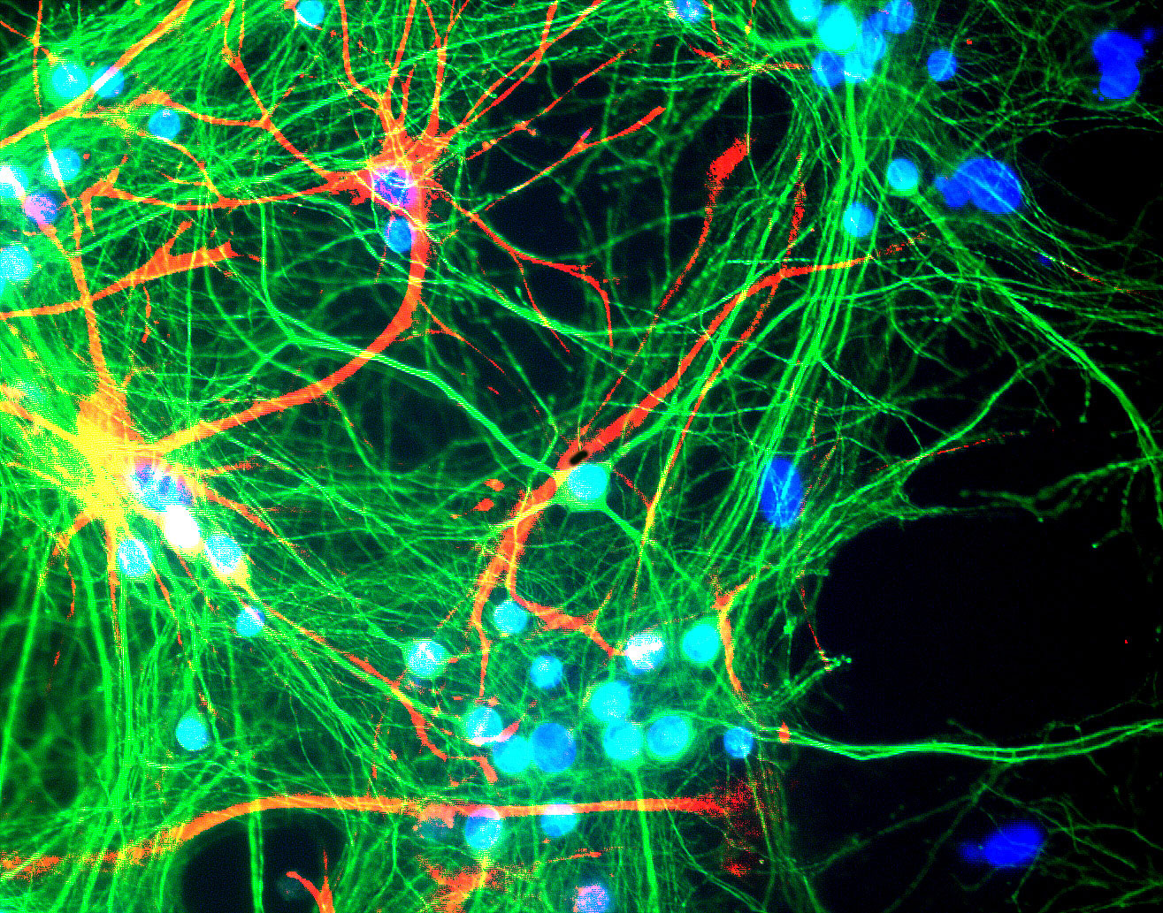
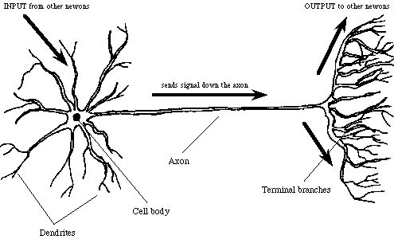
Neural networks
a.k.a. artificial neural networks, connectionist models
inspired by interconnected neurons in biological systems
simple processing units
each unit receives a number of real-valued inputs
each unit produces a single real-valued output

Slide 4
Perceptrons
[McCulloch & Pitts, 1943; Rosenblatt, 1959; Widrow & Hoff, 1960]
input units:
represent given x
output unit:
represents binary classification

Slide 5
Learning a perceptron: the perceptron training rule
randomly initialize weights
iterate through training instances until convergence
2a. calculate the output for the given instance
2b. update each weight
η is learning rate;
set to value << 1

Slide 6
Representational power of perceptrons
perceptrons can represent only linearly separable concepts
decision boundary given by:
x₂
+ +
+ + +
+ -
+ - -
+ +
+ + -
+ + - -
-
+ + -
-
+ - - -
- -
also write as: wx > 0
x₁

Slide 7
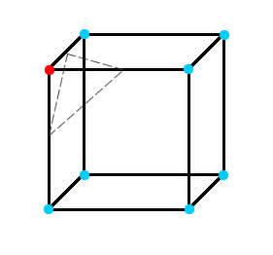
Representational power of perceptrons
in previous example, feature space was 2D so decision boundary was a line
in higher dimensions, decision boundary is a hyperplane

Slide 8
Some linearly separable functions
AND
a
b
c
d
x₁ x₂
0 0
0 1
1 0
1 1
y
0
0
0
1
x₁
1
b
d
a
c
0
1
x₂
OR
a
b
c
d
x₁ x₂
0 0
0 1
1 0
1 1
y
0
1
1
1
x₁
1
b
d
a
c
0
1
x₂

Slide 9
XOR is not linearly separable
a
b
c
d
x₁ x₂
0 0
0 1
1 0
1 1
y
0
1
1
0
x₁
1
b
d
a
c
0
1
x₂
1
1
-1
a multilayer perceptron
can represent XOR
-1
1
1
assume w₀ = 0 for all nodes

Slide 10
Example multilayer neural network
output units
hidden units
input units
figure from Huang & Lippmann, NIPS 1988
input: two features from spectral analysis of a spoken sound
output: vowel sound occurring in the context “h__d”

Slide 11
Decision regions of a multilayer neural network
figure from Huang & Lippmann, NIPS 1988
input: two features from spectral analysis of a spoken sound
output: vowel sound occurring in the context “h__d”

Slide 12
Components
Representations:
Input
Hidden variables
Layers/weights:
Hidden layers
Output layer

Slide 13
Components
First layer
Output layer
…
…
… …
$$y$$
…
…
Input $x$
Hidden variables $h^{1}$
$h^{2}$
$h^{L}$

Slide 14
Input
Represented as a vector
Sometimes require some
preprocessing, e.g.,
Subtract mean
Normalize to [-1,1]
Expand

Slide 15
Input (feature) encoding for neural networks
nominal features are usually represented using a 1-of-k encoding
ordinal features can be represented using a thermometer encoding
real-valued features can be represented using individual input units (we may want to scale/normalize them first though)

Slide 16
Output layers
Regression: $y=w^{T}h+b$
Linear units: no nonlinearity
Output layer
$$y$$
$h$

Slide 17
Output layers
Multi-dimensional regression: $y=W^{T}h+b$
Linear units: no nonlinearity
Output layer
$$y$$
$h$

Slide 18
Output layers
Binary classification: $y={σ(w}^{T}h+b)$
Corresponds to using logistic regression on $h$
Output layer
$$y$$
$h$

Slide 19
Output layers
Multi-class classification:
$y=softmax\left(z\right)$where $z=W^{T}h+b$
Corresponds to using multi-class
logistic regression on $h$
Output layer
$$z$$
$$y$$
$h$

Slide 20
Hidden layers
Neuron take weighted linear combination of the previous layer
So can think of outputting one value for the next layer
…
…
$h^{i}$
$h^{i+1}$

Slide 21
Hidden layers
$y=r(w^{T}x+b)$
Typical activation function $r$
Threshold $t\left(z\right)=𝕀[z≥0]$
Sigmoid $σ\left(z\right)=1/\left(1+exp(−z)\right)$
Tanh $tanh\left(z\right)=2σ\left(2z\right)−1$
$$r(⋅)$$
$$x$$
$$y$$

Slide 22
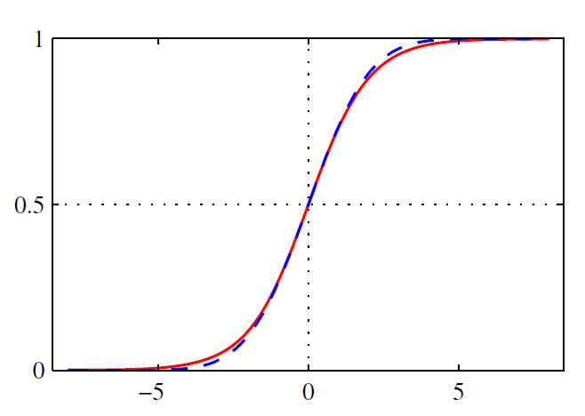
Hidden layers
Problem: saturation
$$r(⋅)$$
$$x$$
$$y$$
Too small gradient
Figure borrowed from Pattern Recognition and Machine Learning, Bishop

Slide 23
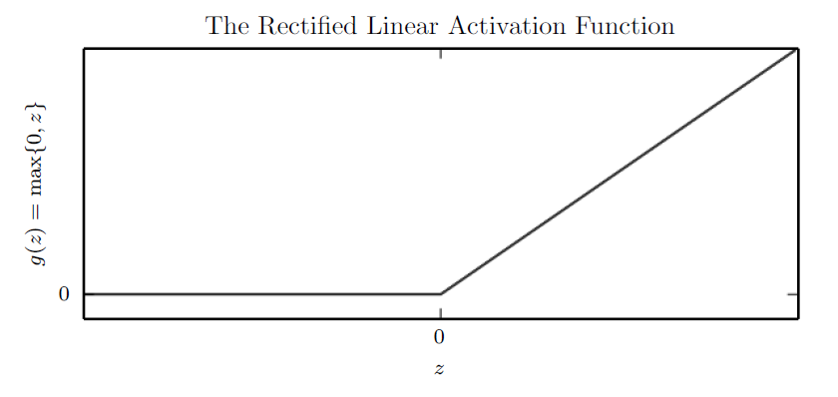
Hidden layers
Activation function ReLU (rectified linear unit)
$ReLU\left(z\right)=max\{z,0\}$
Figure from Deep learning, by
Goodfellow, Bengio, Courville.

Slide 24
Hidden layers
Activation function ReLU (rectified linear unit)
$ReLU\left(z\right)=max\{z,0\}$
Gradient 1
Gradient 0

Slide 25
Hidden layers
Generalizations of ReLU $gReLU\left(z\right)=max\left\{z,0\right\}+α\min{\{z,0\}}$
Leaky-$ReLU\left(z\right)=max\{z,0\}+0.01\min{\{z,0\}}$
Parametric-$ReLU\left(z\right):α$ learnable
$$gReLU\left(z\right)$$
$$z$$

Slide 26
Learning in multilayer networks
work on neural nets fizzled in the 1960’s
single layer networks had representational limitations (linear separability)
no effective methods for training multilayer networks
how to determine
error signal for
hidden units?
revived again with the invention of backpropagation method [Rumelhart & McClelland, 1986; also Werbos, 1975]
key insight: require neural network to be differentiable; use gradient descent

Slide 27
Learning in multilayer networks
learning techniques nowadays
random initialization of the weights
stochastic gradient descent (can add momentum)
regularization techniques
norm constraint
dropout
batch normalization
data augmentation
early stopping
pretraining
…

Slide 28
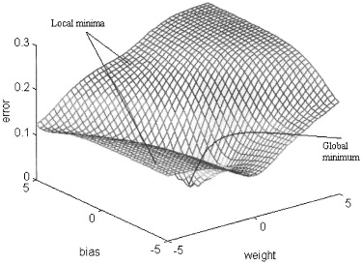
Gradient descent in weight space
Given a training set we can specify an error measure that is a function of our weight vector w
figure from Cho & Chow, Neurocomputing 1999
w₂
w₁
This error measure defines a surface over the hypothesis (i.e. weight) space

Slide 29
Gradient descent in weight space
gradient descent is an iterative process aimed at finding a minimum in the error surface
on each iteration
current weights define a point in this space
find direction in which error surface descends most steeply
take a step (i.e. update weights) in that direction
Error
w₁
w₂

Slide 30
Gradient descent in weight space
calculate the gradient of E:
take a step in the opposite direction
Error
w₁
w₂

Slide 31
Batch neural network training
given: network structure and a training set
initialize all weights in w to small random numbers
until stopping criteria met do
initialize the error
for each (x^{(d)}, y^{(d)}) in the training set
input x^{(d)} to the network and compute output o^{(d)}
increment the error
calculate the gradient
update the weights

Slide 32
Online vs. batch training
Standard gradient descent (batch training): calculates error gradient for the entire training set, before taking a step in weight space
Stochastic gradient descent (online training): calculates error gradient for a single instance, then takes a step in weight space
much faster convergence
less susceptible to local minima

Slide 33
Online neural network training (stochastic gradient descent)
given: network structure and a training set
initialize all weights in w to small random numbers
until stopping criteria met do
for each (x^{(d)}, y^{(d)}) in the training set
input x^{(d)} to the network and compute output o^{(d)}
calculate the error
calculate the gradient
update the weights

Slide 34
Taking derivatives in neural nets
recall the chain rule from calculus
we’ll make use of this as follows

Slide 35
Gradient descent: simple case
Consider a simple case of a network with one linear output unit and no hidden units:
let’s learn w_{i}’s that minimize squared error
batch case
online case

Slide 36
Stochastic gradient descent: simple case
let’s focus on the online case (stochastic gradient descent):

Slide 37
Gradient descent with a sigmoid
Now let’s consider the case in which we have a sigmoid output unit and no hidden units:
useful property:

Slide 38
Stochastic GD with sigmoid output unit

Slide 39
Backpropagation
now we’ve covered how to do gradient descent for single-layer networks with
linear output units
sigmoid output units
how can we calculate for every weight in a multilayer network?
➔ backpropagate errors from the output units to the hidden units

Slide 40
Backpropagation notation
let’s consider the online case, but drop the ^{(d)} superscripts for simplicity
we’ll use
subscripts on y, o, net to indicate which unit they refer to
subscripts to indicate the unit a weight emanates from and goes to
i
j

Slide 41
Backpropagation
each weight is changed by
where
x_{i} if i is an input unit

Slide 42
Backpropagation
each weight is changed by
where
same as
single-layer net
with sigmoid
output
if j is an output unit
if j is a hidden unit
sum of backpropagated
contributions to error

Slide 43
Backpropagation illustrated
calculate error of output units
determine updates for weights going to output units
j

Slide 44
Backpropagation illustrated
calculate error for hidden units
determine updates for weights to hidden units using hidden-unit errors
j
j

