Slide 1
SDN
Aditya Akella
(Based on slides from Aaron Gember and Nick McKeown)

Slide 2
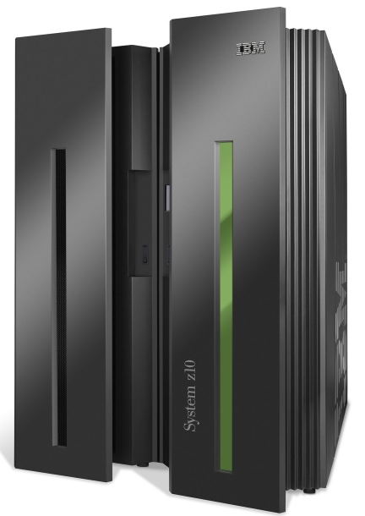
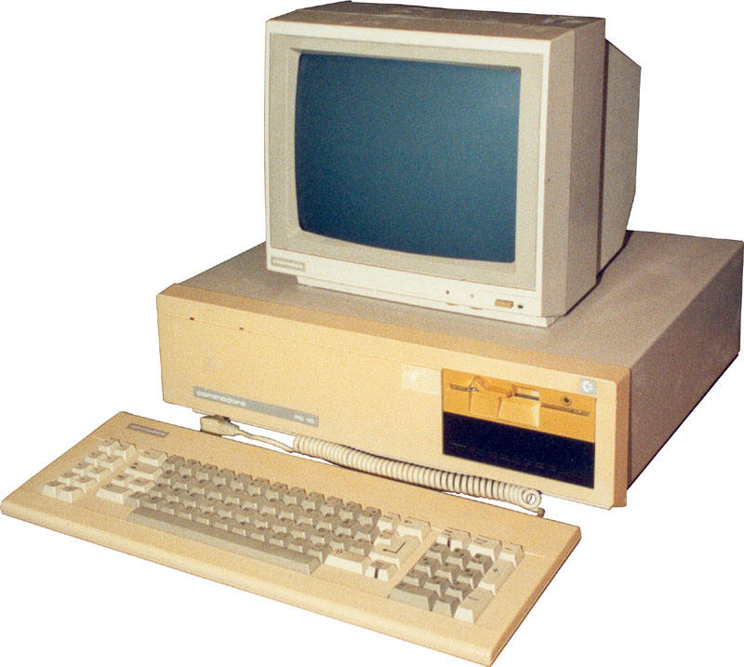
App
App
App
App
App
App
App
App
App
App
App
Specialized
Applications
Open Interface
Windows
(OS)
Linux
Mac
OS
Specialized
Operating
System
or
or
Open Interface
Specialized
Hardware
Microprocessor
Vertically integrated
Closed, proprietary
Slow innovation
Small industry
Horizontal
Open interfaces
Rapid innovation
Huge industry

Slide 3
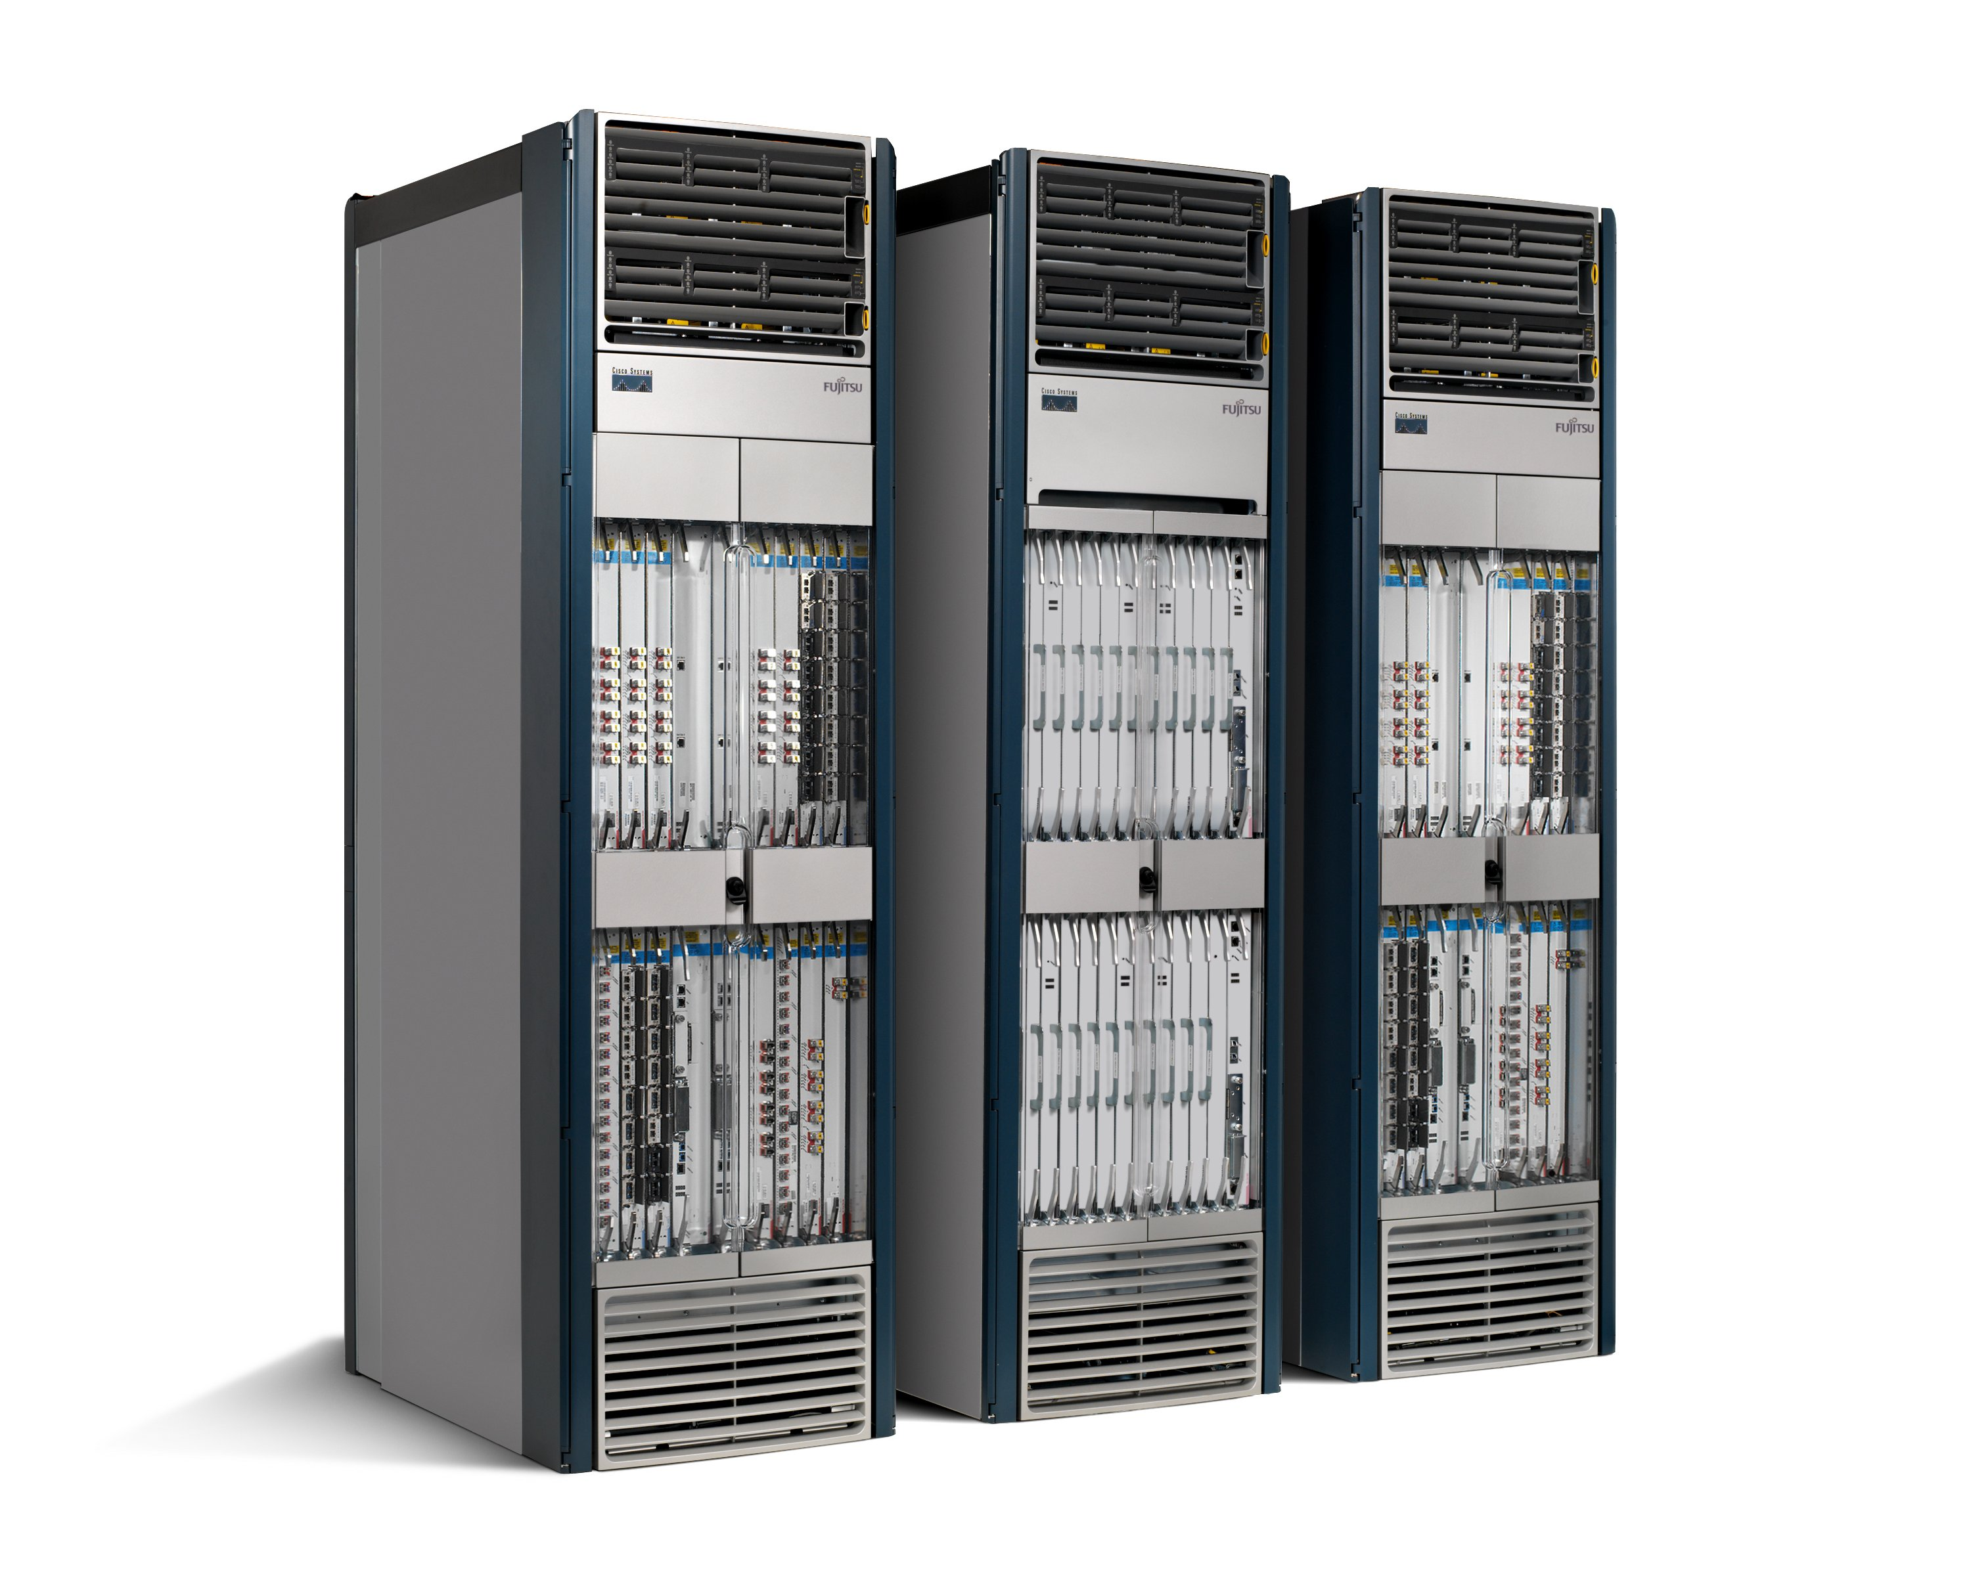
App
App
App
App
App
App
App
App
App
App
App
Specialized
Features
Open Interface
Control
Plane
Control
Plane
Control
Plane
or
or
Specialized
Control
Plane
Open Interface
Specialized
Hardware
Merchant
Switching Chips
Vertically integrated
Closed, proprietary
Slow innovation
Horizontal
Open interfaces
Rapid innovation

Slide 4
Today
Closed Boxes, Fully Distributed Protocols
Closed
App
App
App
Operating
System
Specialized Packet Forwarding Hardware
App
App
App
Operating
System
App
App
App
Specialized Packet Forwarding Hardware
Operating
System
App
App
App
Specialized Packet Forwarding Hardware
Operating
System
Specialized Packet Forwarding Hardware
App
App
App
Operating
System
Specialized Packet Forwarding Hardware
4
Notes:
Historical artifact that forwarding boxes host the code too. Leads to a specific design point for networks. Great for the internet, not so much for the networks the internet connects.
Note each piece.

Slide 5
Software Defined Network (SDN)
2. At least one Network OS probably many. Open- and closed-source
Control Program
Control Program
Global Network View
Network OS
1. Open interface to packet forwarding
Packet
Forwarding
Packet
Forwarding
Packet
Forwarding
Packet
Forwarding
Packet
Forwarding

Slide 6
Software Defined Network (SDN)
Control
Programs
Control
Programs
Control
Programs
Control logics
Abstract Network View
Network Virtualization
Global Network View
Control platform
Network OS
Packet
Forwarding
Packet
Forwarding
Packet
Forwarding
Packet
Forwarding
Packet
Forwarding

Slide 7
Software Defined Network (SDN)
firewall.c
…
if( pkt->tcp->dport == 22)
dropPacket(pkt);
…
Control
Programs
Control
Programs
Control
Programs
Control logics
Abstract Network View
Network Virtualization
Global Network View
Control platform
Network OS
<Match, Action>
<Match, Action>
<Match, Action>
<Match, Action>
<Match, Action>
…
…
<Match, Action>
<Match, Action>
<Match, Action>
<Match, Action>
<Match, Action>
…
…
Packet
Forwarding
<Match, Action>
<Match, Action>
<Match, Action>
<Match, Action>
<Match, Action>
…
…
<Match, Action>
<Match, Action>
<Match, Action>
<Match, Action>
<Match, Action>
…
…
Packet
Forwarding
<Match, Action>
<Match, Action>
<Match, Action>
<Match, Action>
<Match, Action>
…
…
Packet
Forwarding
Packet
Forwarding
Packet
Forwarding

Slide 8
Isolated “slices”
Many operating systems, or
Many versions
App
App
App
App
App
App
App
App
Network Operating System 1
Network Operating System 2
Network Operating System 3
Network Operating System 4
Open interface to hardware
“Slicing” Layer
Open interface to hardware
Simple Packet Forwarding Hardware
Simple Packet Forwarding Hardware
Simple Packet Forwarding Hardware
Simple Packet Forwarding Hardware
Simple Packet Forwarding Hardware

Slide 9
Control Logic
Runs on one or more controllers
Manages computation of forwarding state and perhaps coordination among instances
Control platform provides basic services to ease the latter (See Onix paper)
State distribution mechanisms
Logic still must decide how to partition computation, dealing with failover and the underlying consistency model

Slide 10
Control Platform
Scheduling computations over the network graph
Storing network state and support for different consistency models
Today: most control platforms can run a single control application
Not yet sure how to resolve interference (e.g., policy routing vs traffic engineering)

Slide 11
State Distribution Abstraction
Control program should not have to handle all distributed-state details
Proposed abstraction: global network view
Control program operates on network view
Input: global network view (graph)
Output: configuration of each network device
Network OS provides network view
Notes:
Note difference between being asked to build OSPF vs implementing Dijskstra’s algorithm.

Slide 12
Specification Abstraction
Give control program abstract view of network
Provide enough detail to specify goals, but not to implement them

Slide 13
Forwarding Abstraction
Forwarding behavior specified by a control program.
Possibilities: x86, MPLS, OpenFlow

Slide 14
Example
OSPF
(Dijkstra)
IS-IS
New!
OSPF
IS-IS
Network OS
Distributed System
Distributed
System
Distributed
System
OS
Packet
Forwarding
Custom Hardware
Packet
Forwarding
Packet
Forwarding
Packet
Forwarding

Slide 15
OpenFlow Forwarding Abstraction
Control Program A
Control Program B
Network OS
“If header = p, send to port 4”
Packet
Forwarding
“If header = q, overwrite header with r, add header s, and send to ports 5,6”
“If header = ?, send to me”
Flow
Table(s)
Packet
Forwarding
Packet
Forwarding

Slide 16
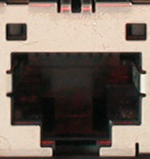
How does OpenFlow work?
Ethernet Switch

Slide 17
Control Path
Control Path (Software)
Data Path (Hardware)

Slide 18
OpenFlow Controller
OpenFlow Protocol (SSL/TCP)
Control Path
OpenFlow
Data Path (Hardware)

Slide 19
OpenFlow Forwarding Abstraction <Match, Action>
Match
Match on any header, or new header
Allows any flow granularity
Action
Forward to port(s), drop, send to controller
Overwrite header with mask, push or pop
Forward at specific bit-rate
Header
Data
Match: 1000x01xx0101001x

Slide 20
OpenFlow Example
Controller
OpenFlow Client
PC
Software
Layer
Flow Table
MAC
src
MAC
dst
IP
Src
IP
Dst
TCP
sport
TCP
dport
Action
Hardware
Layer
*
*
*
5.6.7.8
*
*
port 1
port 1
port 2
port 3
port 4
5.6.7.8
1.2.3.4

Slide 21
OpenFlow Basics Flow Table Entries
Rule
Action
Stats
Packet + byte counters
Forward packet to zero or more ports
Encapsulate and forward to controller
Send to normal processing pipeline
Modify Fields
Any extensions you add!
Switch
Port
VLAN
ID
VLAN
pcp
MAC
src
MAC
dst
Eth
type
IP
Src
IP
Dst
IP
ToS
IP
Prot
L4
sport
L4
dport
+ mask what fields to match
Notes:
Now I’ll describe the API that tries to meet these goals.

Slide 22
Examples
Switching
Switch
Port
MAC
src
MAC
dst
Eth
type
VLAN
ID
IP
Src
IP
Dst
IP
Prot
TCP
sport
TCP
dport
Action
*
*
00:1f:..
*
*
*
*
*
*
*
port6
Flow Switching
Switch
Port
MAC
src
MAC
dst
Eth
type
VLAN
ID
IP
Src
IP
Dst
IP
Prot
TCP
sport
TCP
dport
Action
port3
00:20..
00:1f..
0800
vlan1
1.2.3.4
5.6.7.8
4
17264
80
port6
Firewall
Switch
Port
MAC
src
MAC
dst
Eth
type
VLAN
ID
IP
Src
IP
Dst
IP
Prot
TCP
sport
TCP
dport
Action
*
*
*
*
*
*
*
*
*
22
drop

Slide 23
OpenFlow Forwarding Abstraction
Protocol Independent
Construct Ethernet, IPv4, VLAN, MPLS, …
Construct new forwarding methods
Backward Compatible
Run in existing networks
Technology Independent
Switches, routers, WiFi APs
Cellular basestations
WDM/TDM circuits

Slide 24
Things to Note about Forwarding
Common OpenFlow model is to use first packets of flows to compute and push state
Flows vs state: SDN allows more general models of forwarding state management independent of traffic
Events trigger changes, e.g., failures, control traffic
Managing inconsistencies is critical
Fabrics vs switches: Control logics don’t have to deal with switches
They essentially program a fabric that looks like one large switch and supports end-to-end connectivity by default
Complex logic pushed to the edge

Slide 25
Virtual Data Paths
Thinking in terms of fabrics essentially means control logics have to deal with simpler topologies
Topology captured by “virtual data paths”
Depending on control logic, can be very simple: for access controls it is just data path through a single switch
Every virtual element uses familiar forwarding abstractions, e.g., L2, L3 and ACLs
Control platform responsible for mapping virtual data path to the physical network

Slide 26
SDN in development
Domains
Data centers
Public clouds
Enterprise/campus
Cellular backhaul
Enterprise WiFi
WANs
Home networks
Products
Switches, routers: About 15 vendors
Software: 8-10 vendors and startups
New startups. Lots of hiring in networking.

Slide 27
The SDN Stack
Simple Switch
CloudNaaS
Stratos
…
Applications
NOX
Beacon
Trema
Maestro
…
Controller
Slicing
Software
FlowVisor
Console
FlowVisor
Commercial Switches
Software
Ref. Switch
NetFPGA
Broadcom
Ref. Switch
HP, NEC, Pronto, Juniper.. and many more
OpenFlow
Switches
OpenWRT
PCEngine WiFi AP
Open vSwitch
27
Notes:
There are components at different levels that work together in making it work
The commercial switch details will follow in next slide
There are a plethora of applications possible. I only list those available at Stanford

Slide 28
The SDN Stack
Controller
OpenFlow
Switches
28
Notes:
There are components at different levels that work together in making it work
The commercial switch details will follow in next slide
There are a plethora of applications possible. I only list those available at Stanford

Slide 29
OpenFlow Progression
OF v1.0: released end of 2009: “Into the Campus”
OF v1.1: released March 1 2011: “Into the WAN”
multiple tables: leverage additional tables
tags and tunnels: MPLS, VLAN, virtual ports
multipath forwarding: ECMP, groups
OF v1.2: approved Dec 8 2011: “Extensible Protocol”
extensible match
extensible actions
IPv6
multiple controllers

Slide 30
The SDN Stack
Controller
Commercial Switches
Software
Ref. Switch
NetFPGA
Broadcom
Ref. Switch
HP, NEC, Pronto, Juniper.. and many more
OpenFlow
Switches
OpenWRT
PCEngine WiFi AP
Open vSwitch
30
Notes:
There are components at different levels that work together in making it work
The commercial switch details will follow in next slide
There are a plethora of applications possible. I only list those available at Stanford

Slide 31
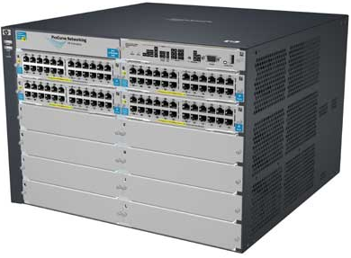
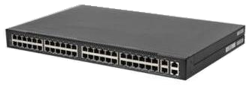
Switches
Vendor | Models | Virtualize? | Notes | Image
HP ProCurve | 5400zl, 6600, + | 1 OF instance per VLAN | LACP, VLAN and STP processing before OF Wildcard rules or non-IP pkts processed in s/w Header rewriting in s/w CPU protects mgmt during loop
Pronto/ Pica8 | 3290, 3780, 3920, + | 1 OF instance per switch | No legacy protocols (like VLAN and STP) Most actions processed in hardware MAC header rewriting in h/w
Name | Lang | Platform(s) | Original Author | Notes
OpenFlow Reference | C | Linux | Stanford/Nicira | not designed for extensibility
Open vSwitch | C/ Python | Linux/BSD? | Ben Pfaff/Nicira | In Linux kernel 3.3+
Indigo | C/Lua | Linux-based Hardware Switches | Dan Talayco/BigSwitch | Bare OpenFlow switch
Notes:
Language open-source Performance cross-platform runtime modular

Slide 32
The SDN Stack
NOX
Beacon
Trema
Maestro
…
Controller
Commercial Switches
Software
Ref. Switch
NetFPGA
Broadcom
Ref. Switch
HP, NEC, Pronto, Juniper.. and many more
OpenFlow
Switches
OpenWRT
PCEngine WiFi AP
Open vSwitch
32
Notes:
There are components at different levels that work together in making it work
The commercial switch details will follow in next slide
There are a plethora of applications possible. I only list those available at Stanford

Slide 33
Controllers
Name | Lang | Original Author | Notes
OpenFlow Reference | C | Stanford/Nicira | not designed for extensibility
NOX | Python, C++ | Nicira | actively developed
Beacon | Java | David Erickson (Stanford) | runtime modular, web UI framework, regression test framework
Maestro | Java | Zheng Cai (Rice)
Trema | Ruby, C | NEC | includes emulator, regression test framework
RouteFlow | ? | CPqD (Brazil) | virtual IP routing as a service
POX | Python
Floodlight | Java | BigSwitch, based on Beacon
Too many to easily keep track of…
http://yuba.stanford.edu/~casado/of-sw.html
Notes:
Language open-source Performance cross-platform runtime modular

Slide 34
The SDN Stack
NOX
Beacon
Trema
Maestro
…
Controller
Slicing
Software
FlowVisor
Console
FlowVisor
Commercial Switches
Software
Ref. Switch
NetFPGA
Broadcom
Ref. Switch
HP, NEC, Pronto, Juniper.. and many more
OpenFlow
Switches
OpenWRT
PCEngine WiFi AP
Open vSwitch
34
Notes:
There are components at different levels that work together in making it work
The commercial switch details will follow in next slide
There are a plethora of applications possible. I only list those available at Stanford

Slide 35
FlowVisor Creates Virtual Networks
Simple switch
CloudNaaS
Stratos
Each application runs in an isolated slice of the network.
OpenFlow
Protocol
OpenFlow
Protocol
OpenFlow
Switch
FlowVisor
Reservations
FlowVisor slices OpenFlow networks, creating multiple isolated and programmable logical networks on the same physical topology.
OpenFlow
Switch
OpenFlow
Switch

Slide 36
The SDN Stack
Simple Switch
CloudNaaS
Stratos
…
Applications
NOX
Beacon
Trema
Maestro
…
Controller
Slicing
Software
FlowVisor
Console
FlowVisor
Commercial Switches
Software
Ref. Switch
NetFPGA
Broadcom
Ref. Switch
HP, NEC, Pronto, Juniper.. and many more
OpenFlow
Switches
OpenWRT
PCEngine WiFi AP
Open vSwitch
36
Notes:
There are components at different levels that work together in making it work
The commercial switch details will follow in next slide
There are a plethora of applications possible. I only list those available at Stanford

Slide 37
How SDN will shape networking
Empower network owners and operators
Customize networks to local needs
Eliminate unneeded features
Creation of virtual, isolated networks
Increase the pace of innovation
Innovation at software speed
Standards (if any) will follow software deployment
Technology exchange with partners
Technology transfer from universities

Slide 38
Summary
Networks becoming
More programmatic
Defined by owners and operators, not vendors
Faster changing, to meet operator needs
Lower opex, capex and power
Abstractions
Will shield programmers from complexity
Make behavior more provable
Will take us places we can’t yet imagine

